Slide 1
How’s My Network? Predicting Performance From Within a Web Browser Sandbox
Murad Kaplan
University of Colorado, Boulder, MA
Mihajlo Zeljkovic
Mark Claypool
Craig Wills
Worcester Polytechnic Institute, Worcester, MA

Slide 2
Network measurement platforms and testbeds
Why we need them
Where measurements occur
Challenging and problems of current platforms
Speedtest [3]
Limited incentives for typical users (download, upload, ping)
Not designed to inform network researchers
Netalyzer [3,4]
A broad range of network measurements
Output not meaningful for typical users
Required software to be installed

Slide 3
How is My Network (HMN)
Overcome the impediments in existing measurement platforms
Increase incentives for users/research experts
New techniques using JavaScript and Flash from within Browser sandbox environment
Applied to real world Web applications (Web browsing, VoIP, Video streaming etc)

Slide 4
HMN Approach
Choose Web applications (Web browsing, VoIP, Video streaming, etc.)
Characterize chosen Web applications
Design prediction models
Set up environment
Implement models and evaluate results

Slide 5
Web Applications
Web browsing
Reading news online, social networking, shopping, etc.
VoIP and Video chatting
Skype, Yahoo! Messenger, MSN, etc
Video streaming
Youtube, Hulu, Netflex, etc

Slide 6
Online News
Increasingly important Internet activity.
Korea, more than half of population reads news online [The OECD Report. 2009]
62% of US Internet users aged12-17 go online for news [The guardian. 10]
73% of Internet users read news online [The guardian. 10]
“Mobile access to Internet is on the rise, and the reading of news on the platform is likely to follow this development” [Pew Internet Project. 10]
Web sites must display a significant amount of content on the home page. [E. Jorden. 2010]
Notes:
Korea [1] The Organisation for Economic Co-operation and Development (OECD)
The OECD reports "The future of news and the Internet “, Organization for Economic Cooperation and Development, June 2009. http://www.oecd.org/document/48/0,3343,en_2649_34223_45449136_1_1_1_1,00.html
[2]
E. Jorden. Newspaper Website Design http://www.ejordanweb.com/index.php?option=com_content&view=article&id=62:newspaper-website-design&catid=19:news&Itemid=176 , 2010.

Slide 7
Approach for Online News
Predict performance for online news sites by:
Select characteristics of news sites to be measured
Select suitable methods of measuring
Analyze collected data
Build models based on analysis
Evaluate models
Provide performance from user prospective
Choosing a specific news site
Provide meaningful results (excellent, very good, good, bad, etc.)
Without the need to install any special software
Predict performance with small costs
Little time (< 3 seconds)
Few downloads (Max 7 objects)
Apply to other sites
Implement in HMN

Slide 8
Characterization and Analysis
Characterization for News sites
Choose most popular News sites [The EbizMbA. 2011]: :CNN, New York Times, LA Times, and MSN
Collect:
Number of objects per page
Sizes of objects
Number of domains and number of objects come from (using pagestats)*
Web Browsers Behaviors
Choose most popular Web browsers [Browserscope. 2011]: Chrome v14, Firefox v3.6, and Internet Explorer v8.
Analyze:
Mechanism for retrieving Web pages
Number of connections per hostname
Number of connections for all hostnames
Notes:
*Pagestats, a plugin by WPI http://web.cs.wpi.edu/~weizhang/docs/pagestats.xpi
“BrowserScope,” http://www.browserscope.org.

Slide 9
Characterization Summary
Similarity but there is some variance
Notes:
LAT has big number of objects and 78% of its objects come from one domain.
While MSN and NYT the biggest percentage of object number is only 24% and 31% respectively.

Slide 10
Domains
Notes:
Different distribution of objects among the domains

Slide 11
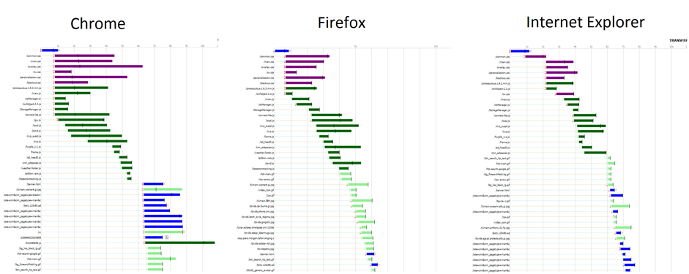
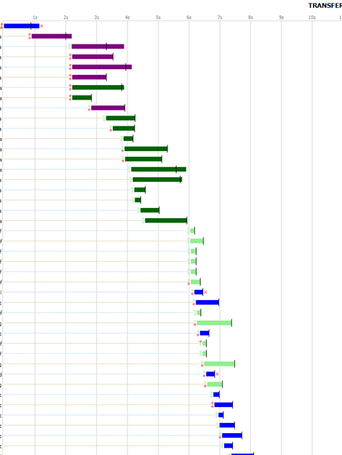
Browsers Behaviors
IE, CNN home page
Fiddler [fiddler Web debugger]
Notes:
Explain the different behaviors for different Web browsers
[12] Fiddler Web Debugger - A free web debugging tool www.fiddler2.com/

Slide 12
Prediction Methods
Characterization Observation
Container loading.
Domains that browsers retrieves its objects from.
Serial vs. Parallel downloads.
Model 3. Parallel Total PT
Download Container
Download Average Object Size six times in parallel
Use Total number of objects in the page (from all domains)
Model 1. Serial Total ST
Download Container
Download Average Object Size one time
Use Total number of objects in the page (from all domains)
Model 4. Parallel Dominant PD
Download Container
Download Average Object Size six times in parallel
Use Total number of objects in the dominant domain only
Model 2. Serial Dominant SD
Download Container
Download Average Object Size one time
Use Total number of objects in the dominant domain only

Slide 13
Prediction Methods
Tc : time to download container
To : time to download an average-size object
Nt : number of total objects,
Nd : number of objects in the dominant domain
P : number of downloads in parallel

Slide 14
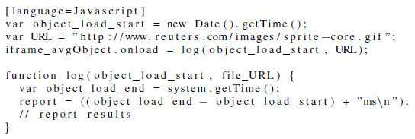
Use of JavaScript in Web Browsers

Slide 15
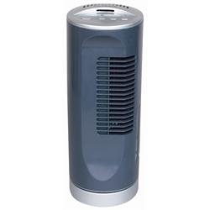
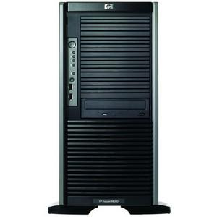
Experiment Setup
UST
ABC
RUE
WPT
1Mbit/0.256Mbit 50 msec
HPT
eth1
eth0
New DELL, Win 7
Bridge, UNIX
BBC
Extend to 10 Most popular News
5 Times
3 Browsers
4 Models
LAT
CNN
MSN
NYT

Slide 16
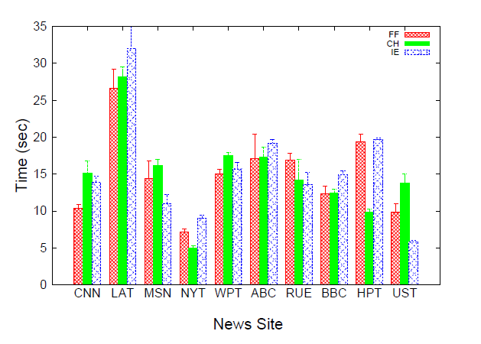
Evaluation
A glance of News sites download times
Difference in DL time across news sites
Difference DL time for one site across browsers (object types)

Slide 17
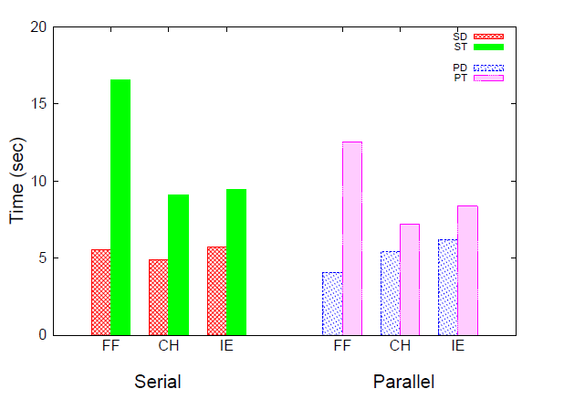
Serial vs. Parallel
Domain methods always win
Notes:
Time difference between actual page download time and the four models.

Slide 18
Predicting User Experience
Measured time differences may be of interest for network researchers
Typical user may not notice impact of a few seconds of page load time
Provide performance predictions intended to have more relevance than time alone [Net Forecasts et al. 02] [S. Souder. High Performance Web sites 09]

Slide 19
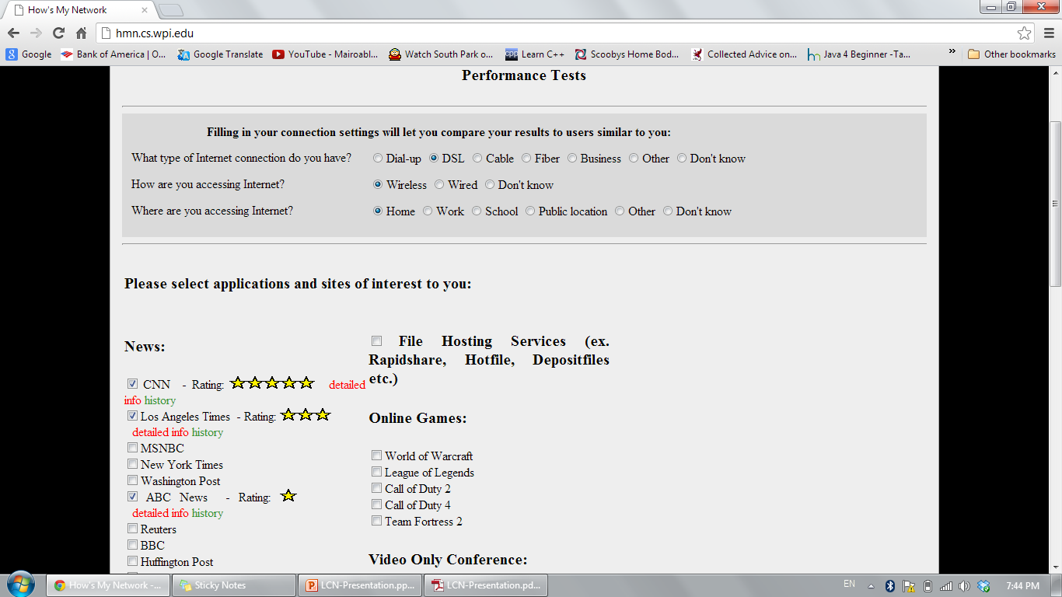
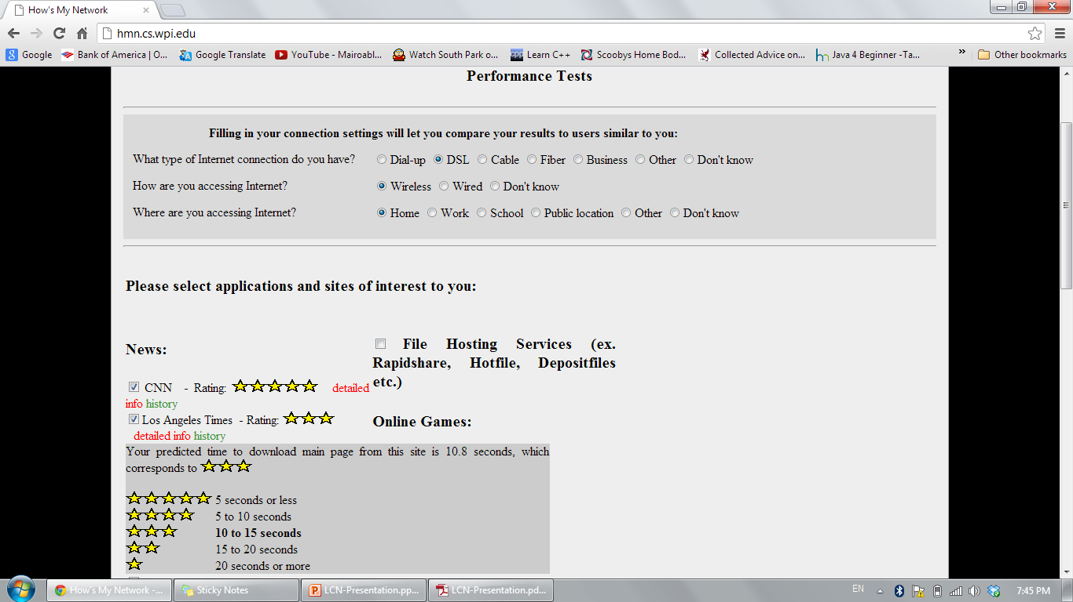
HMW hmn.cs.wpi.edu
Notes:
To give the aoudiance a better understanding of HMN method

Slide 20
Prediction Error for News Sites Across Browsers
PD wins

Slide 21
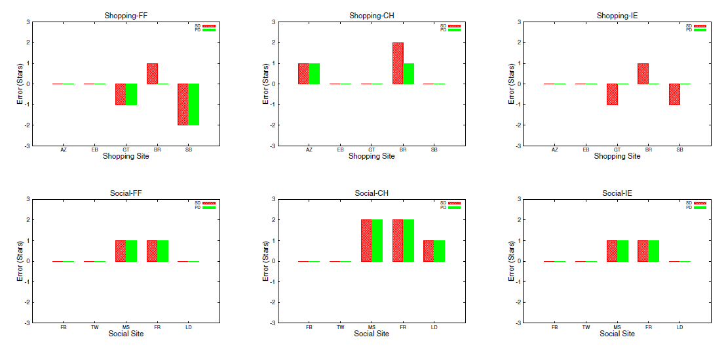
Prediction Error for Other Types of Sites
Notes:
“Social Networking Websites Review,” http://social-networkingwebsites-review.toptenreviews.com.
“Top 15 Most Popular Comparison Shopping Websites,”http://www.ebizmba.com/articles/shopping-websites.

Slide 22
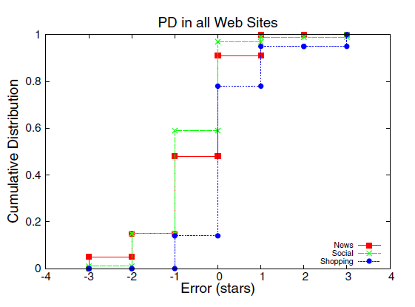
PD provides predictions with effectively 0 stars of error 80% of the time for shopping and 60% of the time for social networking.
Notes:
PD provides predictions with effectively 0 stars of error 80% of the time for shopping and 60% of the time for social networking.

Slide 23
Conclusion
Online news prediction techniques in HMN provide:
low impediment
high incentive
for researchers and typical users
Using number of objects from dominant domain better than using total number of objects
15% to 60% better
Assuming objects download in parallel rather than serially provides generally better predictions
15% “perfect” predictions for online news
Our methods can be used for other Web sites
80% zero stars of error for shopping sites
60% zero stars of error for social networks

Slide 24
Future Work
Extend Web characterization to different Web sites.
Other activities
HMN site development - an interface for all HMN activities, testing site, entertainment activities (e.g. games), performance data presentation.
Mobile devices - providing HMN client services (network performance)

Slide 25
References
[1] The OECD reports "The future of news and the Internet “, Organization for Economic Cooperation and Development, June 2009. http://www.oecd.org/document/48/0,3343,en_2649_34223_45449136_1_1_1_1,00.html
[2] E. Jorden. Newspaper Website Design http://www.ejordanweb.com/index.php?option=com_content&view=article&id=62:newspaper-website-design&catid=19:news&Itemid=176 , 2010.
[3] SpeedTest http://www.speedtest.net/
[4] Planetlab http://www.planet-lab.org/
[5] F. Papadopoulos and K. Psounis. Predicting the performance of Internet-like networks using scaled-down replicas. In ACM SIGMETRICS Performance Evaluation Review, Volume 35 Issue 3, December 2007
[6] C. Xing, M. Chen, and L. Yang. Predicting Available Bandwidth of Internet Path with Ultra Metric Space
[7] kc claffy, Mark Crovella, Timur Friedman, Colleen Shannon, and Neil Spring. Communityoriented network measurement infrastructure (CONMI) workshop report. SIGCOMM Comput. Commun. Rev., 36(2):41–48, 2006.
[8] J. Pitkow. Summary of WWW Characterizations. In Computer Networks and ISDN Systems, Volume 30 Issue 1-7, April 1, 1998.
[9] E. O’Neill. OCLC, Online Computer Library Center, Web Characterization Project. Wcp.oclc.org, 2002
[10] http://web.cs.wpi.edu/~weizhang/docs/pagestats.xpi
[11]http://www.ebizmba.com/articles/news-websites
Fiddler Web Debugger - A free web debugging tool www.fiddler2.com/

