Slide 1
IMGD 3000: Basic Computer Graphics
William DiSanto
Computer Science Dept.
Worcester Polytechnic Institute (WPI)

Slide 2
Overview
Extremely over-simplified view of graphics (60 min)
Purpose of Computer Graphics in a Game Engine
Representations of Data
Geometry
Light
Maps
Rendering
Courses

Slide 3
Purpose
A first look at:
Some kinds of graphical information games require
Discussion on why some simplifications are made
Free engines
Where to find out more
Some examples in games if we have time

Slide 4
Rendering Equation
Games/Real Time rendering:
Find ways to simplify the rendering equation
Target ~30+ frames per second
We will glance at a small portion of the devices used in making game images realistic or at least appealing.

Slide 5
Rendering Equation
Integrate over the hemisphere surrounding the point x.
Find the amount of light in some direction w to some point x on a surface.
Incoming light for a direction w’
Lambert’s Law
The point x may itself emit light.
Consider, the material at point x may alter the reflected light in some way for different pairs of input and output directions.
Integrate with small solid angles.

Slide 6
Some Representations of Data
Following slides present objects that have the following attributes:
All are used in modern games/engines
Relatively quick and easy to compute
Can be fitted to real world data within some measure of accuracy
Cannot necessarily represent real world data exactly
For now consider the data to represent some solid object

Slide 7
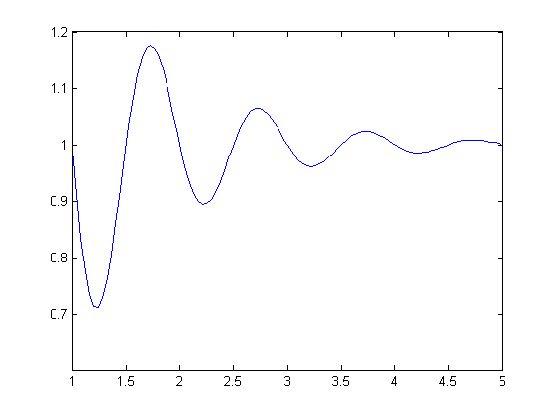
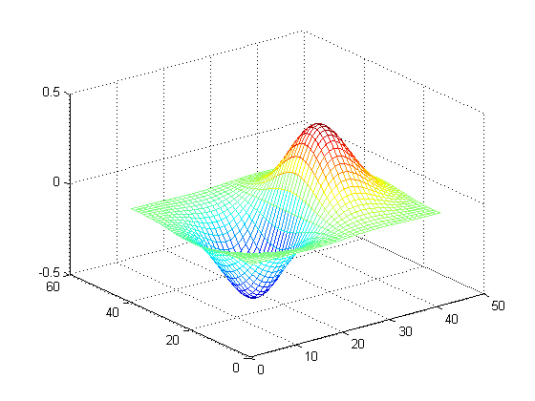
Exact
Use equations, parametric functions, etc.
Can be evaluated at arbitrary degree of accuracy
Remember that your graphics card has limited accuracy

Slide 8
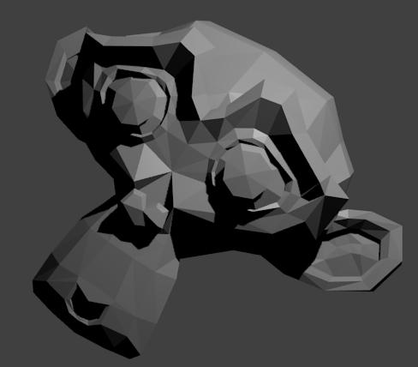
Mesh
Mesh: connected set of vertices
Maintained as lists of connections and vertex locations
Compact and malleable
Used to establish boundaries in the game world

Slide 9
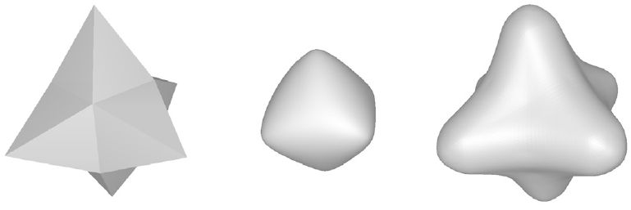
Subdivision Surface
Insert new vertices and smooth

Slide 10
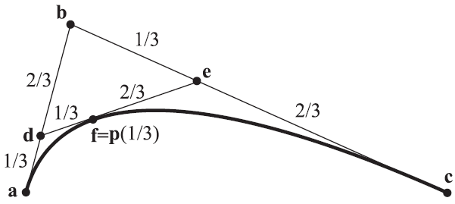
Spline
Splines: interpolate around a set of control points
Defined parametrically

Slide 11
NURBS / B-Spline
NURBS/B-Splines
Local Editing
Transform Invariant
Control over continuity
Well defined derivatives, normals, position
Some editing techniques are expensive
Can represent conics
The NURBS Book

Slide 12
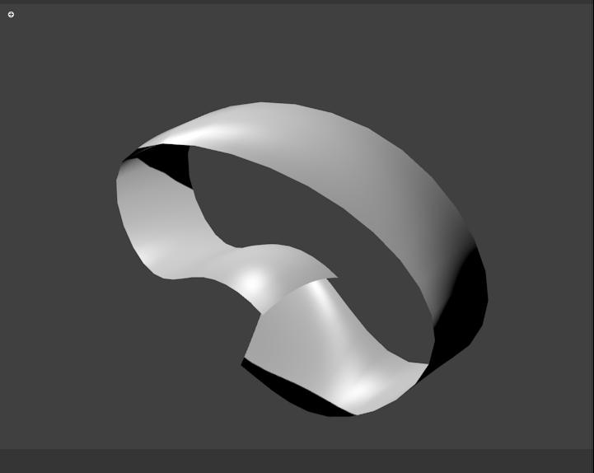
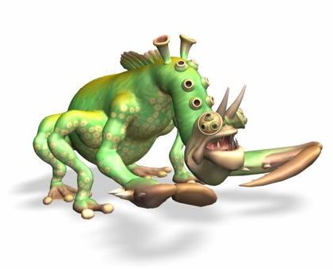
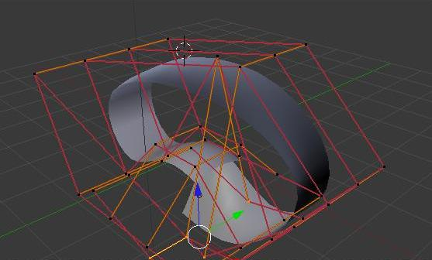
NURBS / B-Spline

Slide 13
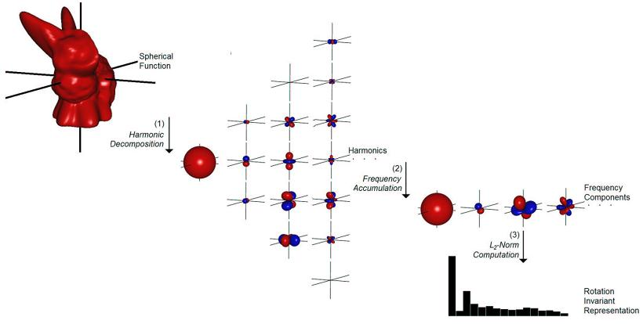
Frequency
Decompose data into collection of equivalent scaled/modified basis functions
Performance gain for certain operations
Expensive to represent high detail objects

Slide 14
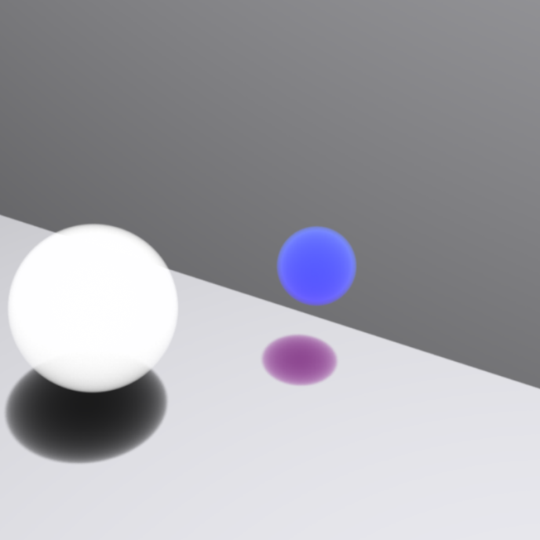
Probabilistic Basis Function
Decompose data into collection of equivalent probability density functions
Inexpensive
Can model solid objects, dense objects, nebulous media

Slide 15
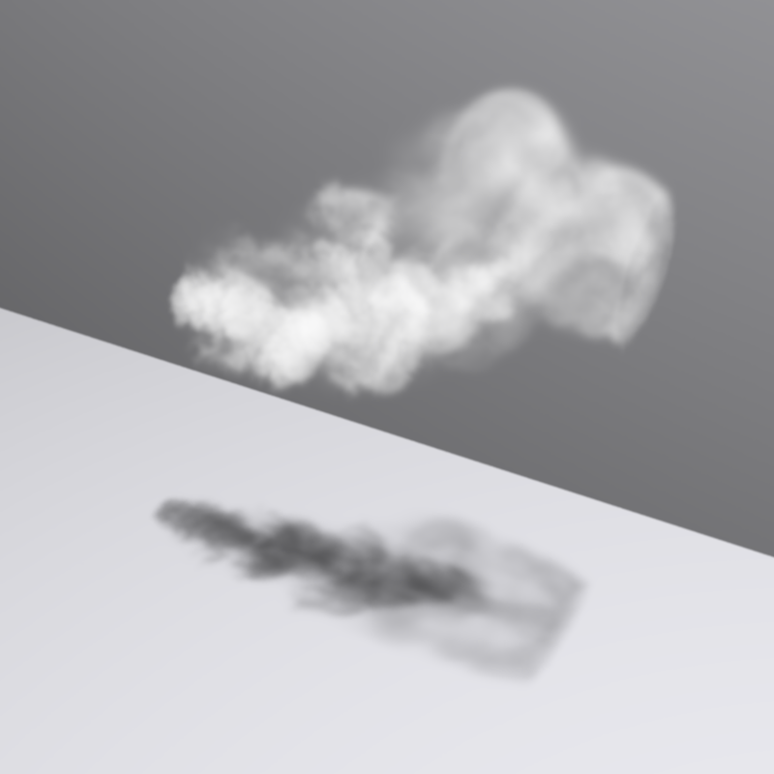
Density Grid
Density data contained in a 3D grid
Many ways to render
Rendered with PBRT

Slide 16
Light Models
Different ways of representing light sources of different shape and distance from rendering area.
Shape can be defined with previously mentioned representations
Simplified model of light used to allow faster rendering

Slide 17
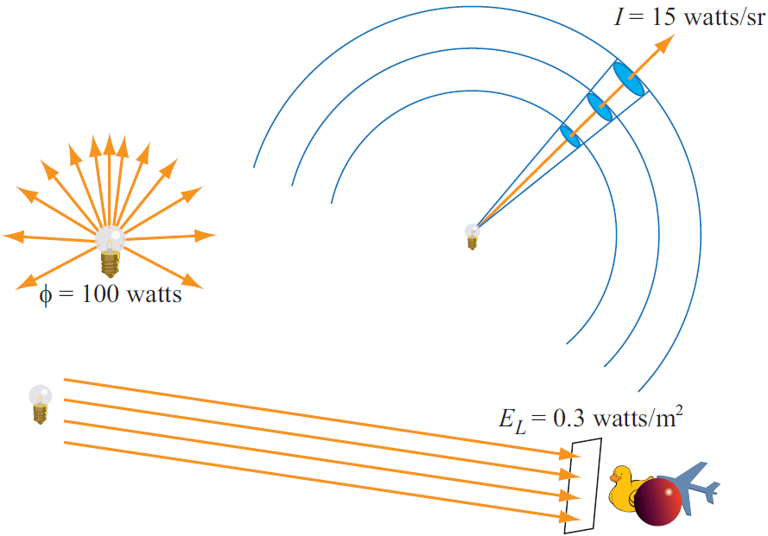
Measure of Energy

Slide 18
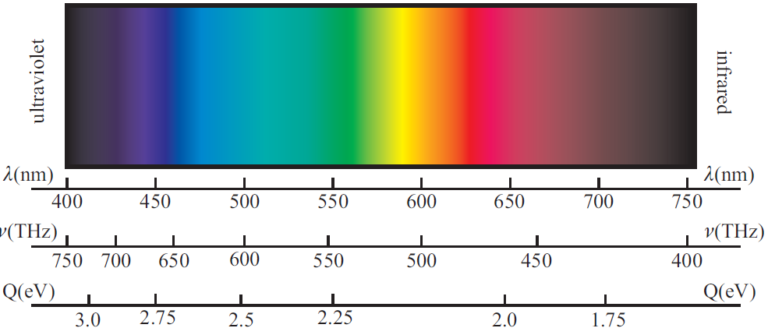
Light
Typical Simplifying Assumptions:
Unpolorized
Sample few wavelengths
Speed is not considered (considered with refraction)
Other assumptions where appropriate

Slide 19
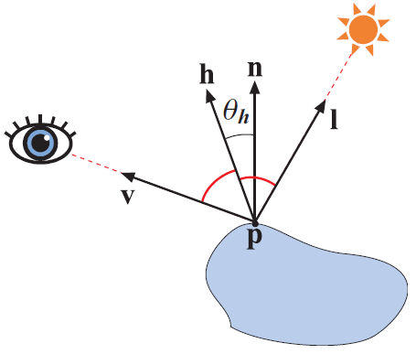
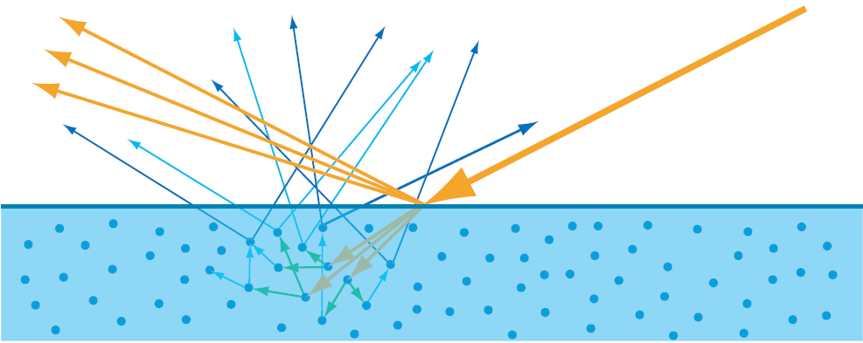
Propagation of Light
Rays of light will reflect and refract depending on the nature of the object they hit
More rays produced, each go on to reflect and refract off other surfaces
Too expensive: reduce number of bounces

Slide 20
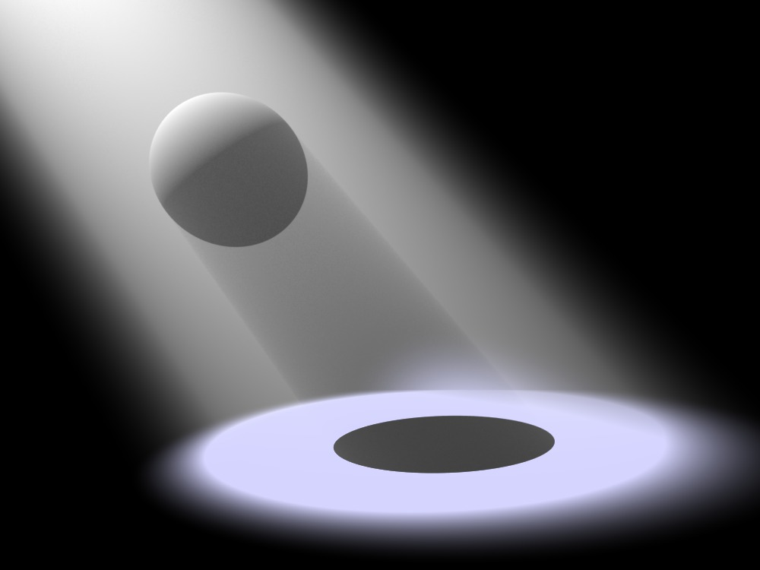
Spot + Directional
Light originates at a point or a infinite plane and moves in a direction (all rays in directional case are parallel)
Spot Lighting PBRT: Not Real Time

Slide 21
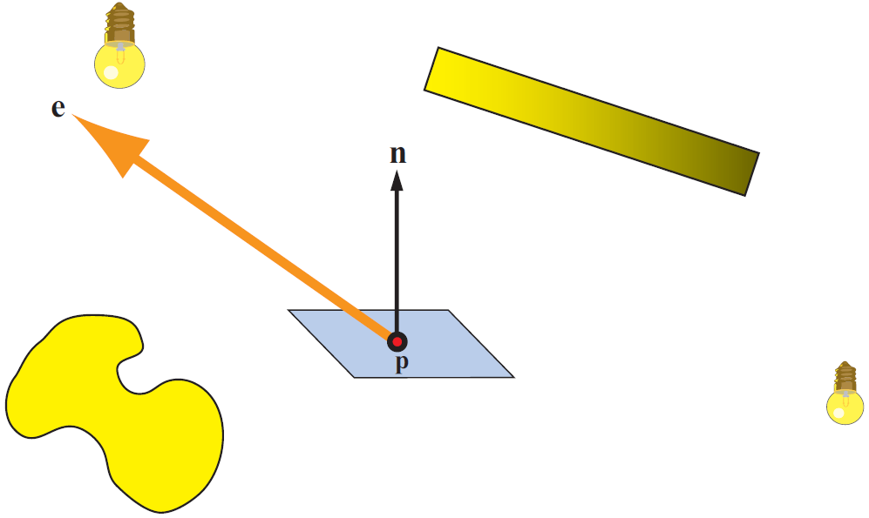
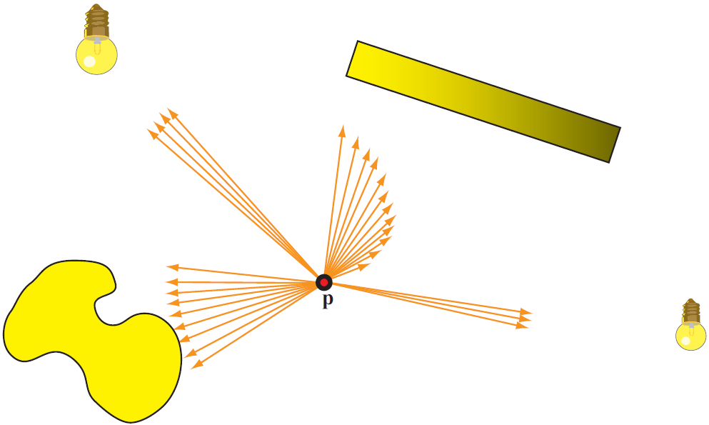
Area Lighting
Light originates from many locations on a surface
Many surfaces too complicated to integrate directly
Sample or average to increase frame rate

Slide 22
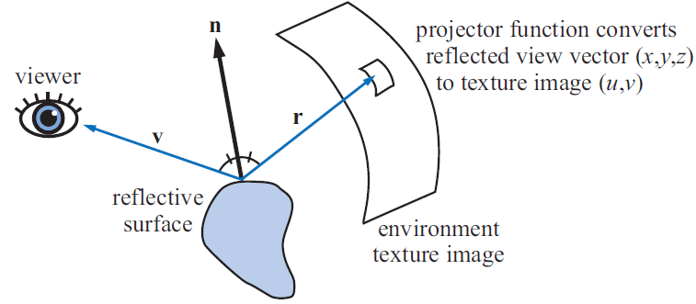
Environment Lighting
Light originates from many locations on a surface
Many surfaces too complicated to integrate directly
Sample or average to increase frame rate

Slide 23
Mappings
OpenGL DirectX support 2D + 3D textures
Textures can be used to map information to other objects in ways that can improve rendering efficiency.
Require the mapped-to object to store map coordinates
They can be viewed as objects themselves:
Vertex/index data can be written to texture
Can be used as flat sprites
3D textures as voxel grids (density/opacity)
Can model any part of the rendering function

Slide 24
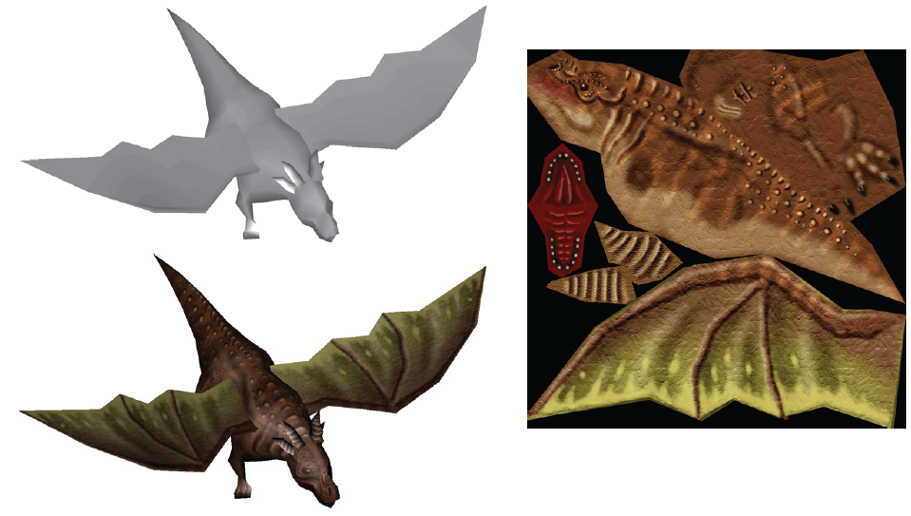
Albedo Texturing
Set or modify the color of an object
Map pixels in texture to surface of triangles

Slide 25
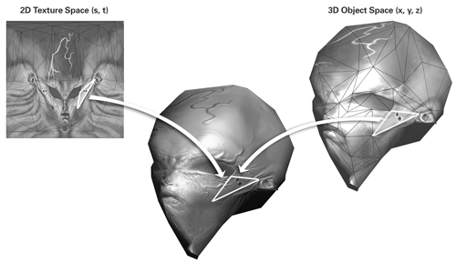
Bump/Normal Mapping
Set or modify the normal of an object

Slide 26
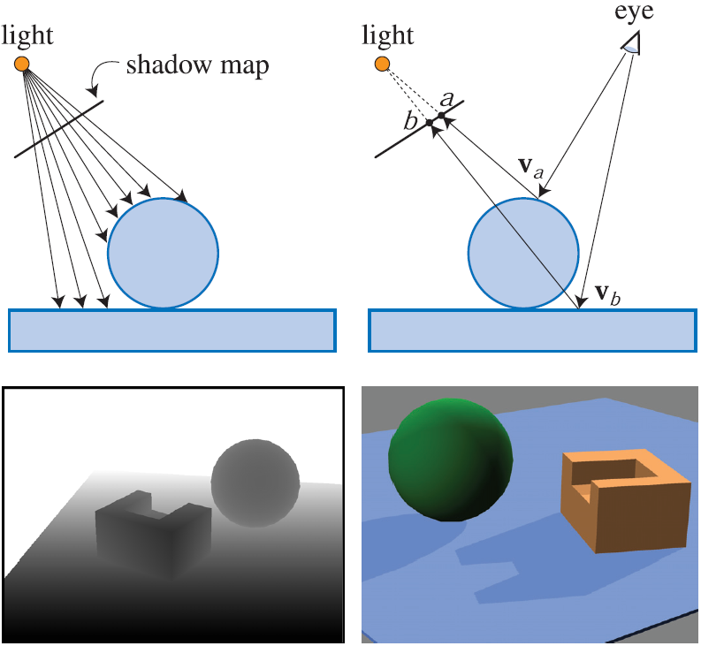
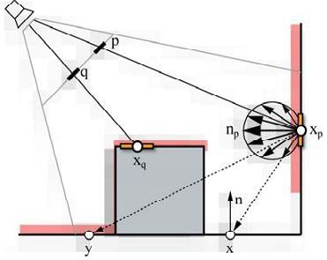
Shadow/RSM
Render scene from perspective of light source
Use pixels to indicate regions that receive light or generate indirect illumination

Slide 27
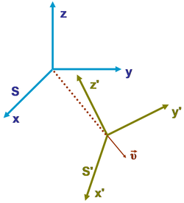
Transformations
Matrix transformation of:
Control Points
Vertices, Normals, directions
Centers
Other matrix transforms
Rotate, Scale, Translate,
Project, …
Performed on the GPU

Slide 28
Animation
An area of study in its own right.
Important to CG since animation transformations may take place on the graphics hardware
We will ignore that animations:
Can collide
Have mass and acceleration
Limited degrees of translational and rotational freedom
Etc.

Slide 29
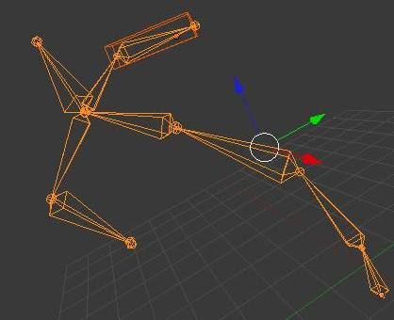
Forward Kinematic
Compute orientations of the armature
from the root of the chain to the effector.
http://demonstrations.wolfram.com/ForwardKinematics/

Slide 30
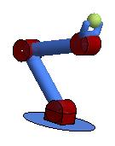
Inverse Kinematic
Compute orientations of the armature
from the effector to the root
Many solutions
http://demonstrations.wolfram.com/InverseKinematics/

Slide 31
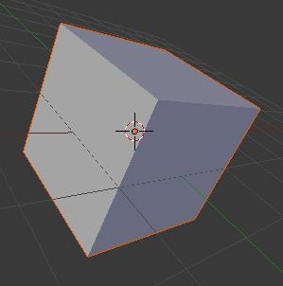
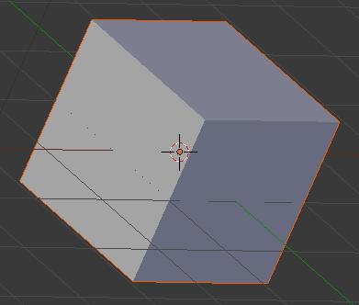
Projection: Perspective/Ortho
Sample the world with rays from the camera
Rays from camera originate at a point
Rays from camera originate at a plane
Perspective
Ortho

Slide 32
Rendering
Sample the world over a given interval
Select w rays along which light energy is integrated
Combine observations together with other effects
Camera lenses distortion
Focus/blur
Pretty much anything from image processing

Slide 33
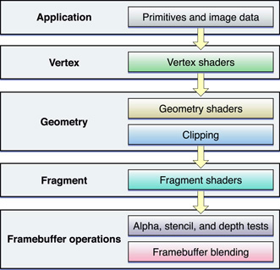
Graphics Pipeline
Broken into stages: some controlled by shader programs

Slide 34
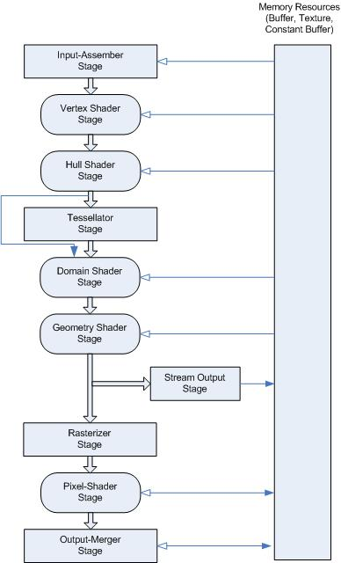
DX11

Slide 35
Free Engines
Ogre
Unity (to some degree)
Blender
Lux

Slide 36
Miscellaneous
Real time graphics is becoming increasingly influenced by physical models
Most convincing renders are computed with information taken from experiment
Graphics hardware has progressed to the point were some ray-trace scenes are realizable with at least interactive frame rates

Slide 37
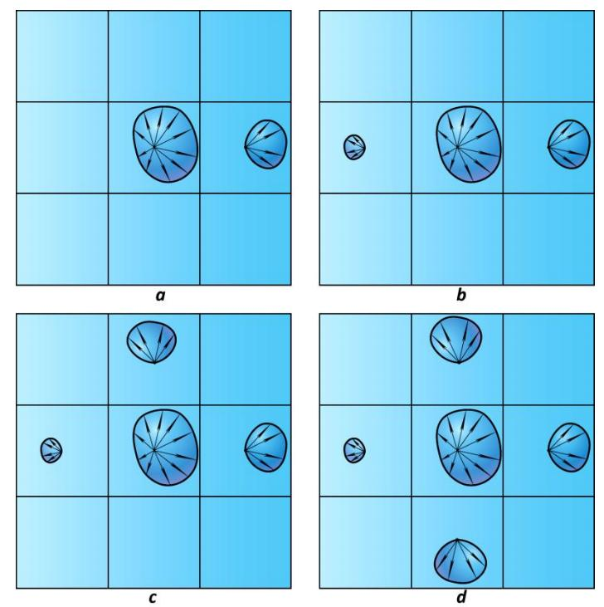
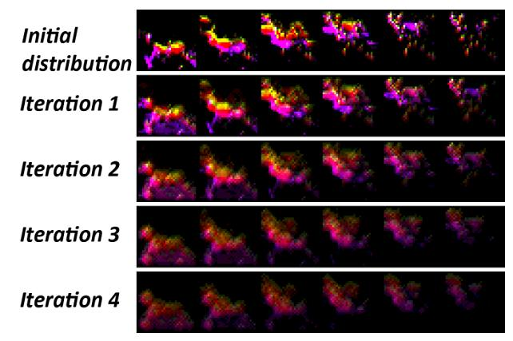
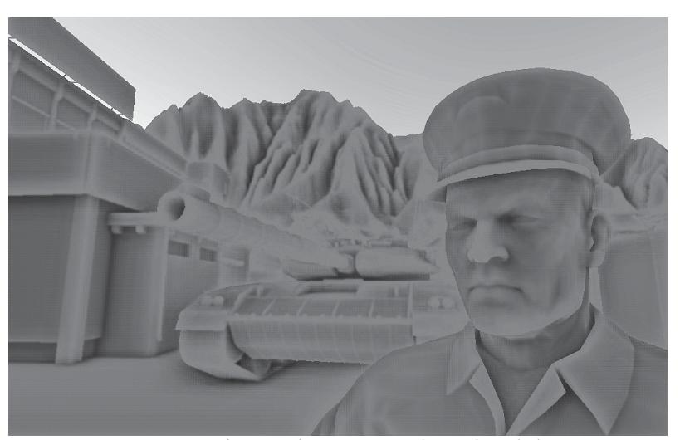
CryENGINE: LPV, SSAO

Slide 38
What was Missed?
How to do any of these things
How to do them in an efficient manner
How to program with OpenGL or DirectX
How to program shaders
Photorealistic techniques
A whole lot more…

Slide 39
Graphics Oriented Classes
CS 4731 Computer Graphics
CS 545 Digital Image Processing
CS 549 Computer Vision
CS 563 Advanced Computer Graphics
Courses will generally focus on aspects graphics itself rather than graphics as it applies to games in particular.
Signals/Systems + Applied Math Classes may help

Slide 40
References
Wan, L., Wong, T.‐T., and Leung, C.‐S. (2007). Isocube: Exploiting the Cubemap Hardware. IEEE Transactions on Visualization and Computer Graphics, 13(4):720–731.
Michael Kazhdan , Thomas Funkhouser , Szymon Rusinkiewicz, Rotation invariant spherical harmonic representation of 3D shape descriptors, Proceedings of the 2003 Eurographics/ACM SIGGRAPH symposium on Geometry processing, June 23-25, 2003, Aachen, Germany

Slide 41
References
Carsten Dachsbacher , Jan Kautz, Real-time global illumination for dynamic scenes, ACM SIGGRAPH 2009 Courses, p.1-217, August 03-07, 2009, New Orleans, Louisiana
http://en.wikipedia.org/wiki/Inertial_frame_of_reference (figure of reference frames)
https://developer.apple.com/library/mac/#documentation/graphicsimaging/conceptual/OpenGL-MacProgGuide/opengl_shaders/opengl_shaders.html
(shader pipeline image)

Slide 42
References
Kaplanyan, A. (2009). Light propagation volumes in cryengine 3.
The CG Tutorial
by Randima Fernando and Mark J. Kilgard
Physically Based Ray Tracing
by Matt Pharr and Greg Humphreys
Real Time Rendering
by Tomas Akenine-Möller, Eric Haines and Naty Hoffman
http://msdn.microsoft.com/en-us/library/windows/desktop/ff476882%28v=vs.85%29.aspx

