Slide 1
Performance Tuning

Slide 2
The Need for Tuning (1 of 2)
You don’t need to tune your code!
Most important → Code that works
Most important → Code that is clear, readable
It will be re-factored
It will be modified by others (even you!)
Less important → Code that is efficient, fast
Is performance really the issue?
Can a hardware upgrade fix performance problems?
Can game design fix performance problems?
Ok, so you do really need to improve performance
All good game programmers should know how to …

Slide 3
The Need for Tuning (2 of 2)
In most large games, typically small amount of code uses most CPU time (or memory)
Good programmer knows how to identify such code
Good programmer knows techniques to improve performance
Questions you (as a good programmer) may want answered:
How slow is my game?
Where is my game slow?
Why is my game slow?
How can I make my game run faster?

Slide 4
Steps for Tuning Performance
Measure performance
Timing and profiling
Identify “hot spots”
Where code spends the most time/resources
Apply techniques to improve performance
Tune
Re-evaluate

Slide 5
Outline
Introduction (done)
Timing (next)
Benchmarks
Profiling
Tuning
Summary

Slide 6
Time Your Game
/usr/bin/time (Windows has timeit.exe)
Elapsed: Wall-clock time from start to finish
User: CPU time spent executing game
System: CPU time spent within OS game’s behalf
CPU: Percent time processing vs blocked for I/O
Useful, since provides a guideline for user-code (that can be optimized) and general processing/waiting
However, I/O accounting isn’t always accurate
But … which parts are most time consuming?
claypool 54 fulham% /usr/bin/time saucer-shoot
2:24.04 elapsed (minutes:seconds)
13.26 user (seconds)
2.74 system (seconds)
11% CPU

Slide 7
Time Parts of Your Game
Call before and after
start = getTime()
// do stuff
stop = getTime()
elapsed = stop - start
(Where did we do this before?)
Use Dragonfly Clock
Remember, this is not a singleton
E.g.
clock.delta() // start timer
Pathfind() // do stuff
elapsed = clock.delta() // compute elapsed

Slide 8
Outline
Introduction (done)
Timing (done)
Benchmarks (next)
Profiling
Tuning
Summary

Slide 9
Benchmark
Benchmark – a program to assess relative performance
e.g. Compare ATI and NVIDIA video cards
e.g. Compare Google Chrome to Mozilla Firefox
A “good” benchmark will assess performance using typical workload
Getting “typical” workload often difficult part
Use benchmark to compare performance before and after performance. e.g.
Run benchmark on Dragonfly → old
Tune performance
Run benchmark on Dragonfly → new
Is new better than old?
What is a good benchmark for Dragonfly? What should it do?

Slide 10
Bounce – What is it?
o
o
o
o
A benchmark designed to estimate Dragonfly performance
Primarily dependent upon number of objects can support at target frame rate
Assumes “standard” game creates many objects that move and interact
Bounce stresses Dragonfly by creating many objects that move and collide
When Dragonfly can’t keep up, has reached limit
Record value – provides basis for comparison
Compare other systems (e.g. faster processor), engine improvements (e.g. scene graph)

Slide 11
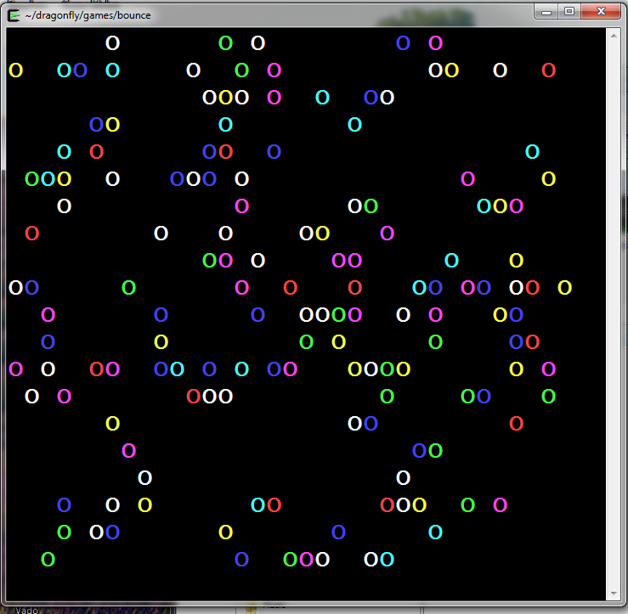
Screenshot/Demo
o
o
o
o
Steps to use
Download from Web page
Compile
(Modify Makefile to point to Dragonfly)
Run
http://www.youtube.com/watch?v=82GGLjyz3lY&feature=youtu.be

Slide 12
Bounce Details
o
o
o
o
Balls random speed (0.1 to 1 spaces/step) and direction
Balls solid, so collide with other objects and screen edge
Start → 0 Balls
Each step → Create one ball
So, about 30/second
Record frame time for latest 30 steps
So, about 1 second of time
Compute median
If median 10% over target frame time (33 ms) , stop iteration
Record number of Balls created
After three iterations → average Balls/iteration is max objects (bounce-mark)
(Show code: Ball, Bouncer, bounce)

Slide 13
Bounce Data (1 of 2)
o
o
o
o
Bounce - a Dragonfly Benchmark (v1.0)
** Average maximum number of objects (bounce-mark): 1803 **
grep BOUNCE dragonfly.log
05:29:36 BOUNCE: Frame 1 - 33 of 33 msec ( median is 0 )
05:29:36 BOUNCE: Frame 2 - 33 of 33 msec ( median is 0 )
05:29:36 BOUNCE: Frame 3 - 33 of 33 msec ( median is 0 )
…
05:30:30 BOUNCE: Frame 1634 - 34 of 33 msec ( median is 33 )
05:30:30 BOUNCE: Frame 1635 - 34 of 33 msec ( median is 34 )
05:30:30 BOUNCE: Frame 1636 - 37 of 33 msec ( median is 34 )
05:30:30 BOUNCE: Frame 1637 - 33 of 33 msec ( median is 33 )
…
05:32:34 BOUNCE: Frame 1772 - 38 of 33 msec ( median is 36 )
05:32:34 BOUNCE: Frame 1773 - 39 of 33 msec ( median is 37 )
05:32:34 BOUNCE: Iteration 3 - max objects: 1773
05:32:34 BOUNCE: Done. Average max objects: 1780

Slide 14
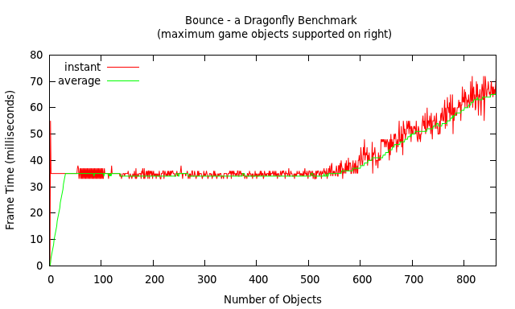
Bounce Data (2 of 2)
o
o
o
o
System
Intel I5-2500, 3.30 GHz
8GB RAM
Windows 7 64-bit, Service Pack 1
Cygwin

Slide 15
Bounce Results
o
o
o
o
61x20 squares. Dependent upon resolution?
2400x1250 pixels → 360 objects
500x300 pixels →353 objects
290x100 squares. Dependent upon squares?
~2400x1250 pixels →331
~500x300 pixels →350
May want to take minimum bounce-mark. Or, may want take “typical” setup. Or, may want your setup.
Will definitely want setup that meets target specifications!

Slide 16
Bounce – What Does it Mean?
o
o
o
o
Provides target maximum number of moving objects Engine can support
Note, game-code computations “cost”, too, so will decrease max
Note, if single moving object, can support about n² as many objects (e.g. Walls)
In general:
B = estimated maximum reported by Bounce
M = number of moving objects
S = number of static (non-moving) objects
Need → M * (M + S) <= B²
Note, this could be refined with “velocity” for more accuracy (and more complications)

Slide 17
How to Use for Planning
o
o
o
o
Say Bounce reports 500 objects for target setup (B = 500)
Making game, say a maze runner
100x100 walls
Hero and up to 10 bad guys
Can Dragonfly support?
M = 11, S = 10000
→ 11 * (11 + 10000) <= 500*500 ?
→ 110,121 <= 250,000 (yes)
Say 10x bigger world. And bullets, up to 50 “in flight” during firefight
Can Dragonfly support?
M = 61, S = 100000
→ 61 * (61 + 100000) <= 250000
→ 6,103,721 <= 250,000 (no)
What to do?
Tune code (more later)
Design differently
Don’t spawn bad guys until Hero can see them
Make levels smaller (but have more of them)
Make sections of walls combined → multiple objects to one
Reduce movement speed / fire rate
M * (M + S) <= B²

Slide 18
Outline
Introduction (done)
Timing (done)
Benchmarks (done)
Profiling (next)
Tuning
Summary

Slide 19
Profiling
Why?
Learn where program spent time executing
Which functions called
Can help understand where complex program spends its time
Can help find bugs
How?
Re-compile so every function call records some info
After running, profiler figures out what called, how many times
Also, takes samples to see where program is (about 100/sec)
Keeps histogram

Slide 20
gprof
GNU profiler
Linux, and can install with cygwin, too
Works for any language GNU compiler supports: C, C++, Objective-C, Java, Ada, Fortran, Pascal …
For us → g++
Broadly, after profiling, outputs: flat profile and call graph
Flat profile provides overall “burn” perspective
How much time program spent in each function
How many times function was called
Call graph shows individual execution profile for each function
Which functions called it
Which other functions it called
How many times
Estimate how much time in subroutines of each function
http://docs.freebsd.org/44doc/psd/18.gprof/paper.pdf

Slide 21
Running gprof
1) Compile with –pg flag
Need for creating all .o files
And need when linking!
2) Run program normally
Produces file “gmon.out” (overwritten if there)
Note, program must exit normally! (e.g. via exit() or return from main())
3) Run gprof on program
Uses data from gmon.out
Often, redirect to file via ‘>’
4) Analyze output

Slide 22
Example - Bounce
Compile
Run
Profile
Analyze
g++ -c –pg -I../../dragonfly Ball.cpp -o Ball.o
g++ -c –pg -I../../dragonfly Bouncer.cpp -o Bouncer.o
g++ bounce.cpp Ball.o Bouncer.o libdragonfly.a –pg -o bounce -lncurses -lrt
./bounce
gprof bounce > out
(emacs or vi or pico or less) out

Slide 23
Gprof – Flat Profile (e.g. QuickSort)
Explanations
Each line describes one function
name: name of function
%time: percentage of time spent exececuting
cumulative seconds: total time spent
self seconds: time spent executing
calls: number of times function called (excluding recursive)
self s/call: avg time per exec (excluding descendents)
total s/call: avg time per exec (including descendents)
Observations
swap() called many times, but each fast
consumes only 9% of overall time
partition() called many times, fast
consumes 85% of overall time
Conclusions
Improve performance →make partition() faster
Don’t try to make fillArray() or quicksort() faster

Slide 24
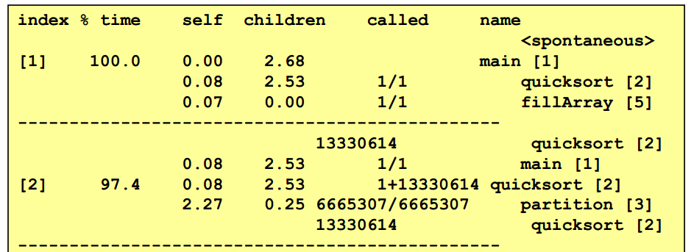
Gprof – Call Graph Profile
Each section describes one function
Which functions called it, and how much time was consumed
Which functions it calls, how many times, and for how long
Usually overkill → we won’t look at it in too much detail

Slide 25
Example - Bounce
% cumulative self
time seconds seconds calls name
29.89 0.52 0.52 15986054 boxIntersectsBox(Box, Box)
16.09 0.80 0.28 303902763 Position::~Position()
12.07 1.01 0.21 206448124 Box::getCorner()
6.90 1.13 0.12 15986054 getWorldBox(GameObject*)
6.32 1.24 0.11 73253 WorldManager::isCollision(GameObject *, Pos)
5.17 1.33 0.09 127780828 Position::getY()
4.02 1.40 0.07 31676507 Box::getVertical()
2.87 1.45 0.05 16176361 ObjectListIterator::next()
2.87 1.50 0.05 79953 ObjectList::ObjectList()
1.72 1.53 0.03 127781828 Position::getX()
1.72 1.56 0.03 48402042 Box::~Box()
1.72 1.59 0.03 16059309 Box::setCorner(Position)
1.72 1.62 0.03 16059307 Object::getBox()
1.15 1.64 0.02 32122197 Object::getPosition()
1.15 1.66 0.02 31674366 Box::getHorizontal()
1.15 1.68 0.02 16064131 Position::setX(int)
1.15 1.70 0.02 16060277 Position::setY(int)
0.57 1.71 0.01 16266646 ObjectListIterator::isDone()
0.57 1.72 0.01 16176361 ObjectListIterator:currentObject()
0.57 1.73 0.01 186921 WorldManager::getInstance()
0.57 1.74 0.01 73253 SceneGraph::solidGameObjects()
0.00 1.74 0.00 361538 WorldManager::getView()
0.00 1.74 0.00 312676 getVelocityStep(float&, float&)
0.00 1.74 0.00 280748 Position::Position(int, int)
0.00 1.74 0.00 179804 worldToView(Position)
0.00 1.74 0.00 179804 GraphicsManager::drawCh()
Each is a sample taken every 0.01 seconds → 1319 samples (more later)

Slide 26
Example – Saucer Shoot
% cumulative self
time seconds seconds calls name _
20.00 0.06 0.06 29179995 Position::~Position()
20.00 0.12 0.06 1265573 boxIntersectsBox(Box, Box)
16.67 0.17 0.05 29255 ObjectList::ObjectList()
10.00 0.20 0.03 1275432 getWorldBox(GameObject*)
6.67 0.22 0.02 16743168 Box::getCorner()
3.33 0.23 0.01 12840584 Position::getX()
3.33 0.24 0.01 2247840 Box::getVertical()
3.33 0.25 0.01 1297989 Object::getBox()
3.33 0.26 0.01 755020 worldToView(Position)
3.33 0.27 0.01 58662 ObjectListIterator::~ObjectListIterator()
3.33 0.28 0.01 27206 WorldManager::moveGameObject()
3.33 0.29 0.01 22555 WorldManager::isCollision()
3.33 0.30 0.01 2025 WorldManager::draw()
0.00 0.30 0.00 12376988 Position::getY()

Slide 27
Example – Bounce (call graph)
Total time in function or children (percent)
Total time in function or children (percent)
[1] 100.0 0.00 2.12 main [1]
0.00 2.12 1/1 GameManager::run() [3]
0.00 0.00 1/1 GameManager::startUp() [40]
0.00 0.00 1/1 Bouncer::Bouncer() [41]
0.00 0.00 1/1 GameManager::shutDown() [46]
0.00 0.00 1/2 GameManager::getInstance() [107]
-----------------------------------------------
0.00 2.12 1/1 GameManager::run() [3]
[2] 100.0 0.00 2.12 1 GameManager::run(int) [2]
0.00 2.08 975/975 WorldManager::update() [4]
0.01 0.03 976/976 WorldManager::draw() [18]
0.00 0.00 1/162708 WorldManager::getInstance() [42]
0.00 0.00 1950/2925 Clock::delta() [74]
0.00 0.00 976/976 GraphicsManager::swapBuffers() [88]
0.00 0.00 975/975 InputManager::getInput() [91]
0.00 0.00 138/1132 LogManager::writeLog(char const*, ...) [80]
0.00 0.00 1/159811 GraphicsManager::getInstance() [56]
0.00 0.00 1/3 InputManager::getInstance() [106]
0.00 0.00 1/1610 LogManager::getInstance() [76]
0.00 0.00 1/2 Clock::Clock() [110]
Time in function
Function name
Number of times called

Slide 28
Additional Options
‘-A’ to annotate code
‘-l’ to profile by lines, not functions
366 -> int Sprite::getHeight() {
return height;
}
6 -> void Sprite::setHeight(int new_height) {
height = new_height;
}
5300 -> int Sprite::getFrameCount() {
return frame_count;
}

Slide 29
Using Profiling (1 of 2)
Determine where to optimize
Pick the bottleneck and make more efficient
This provides most “bang for the buck” (buck = time, often!)
E.g.
Program takes 10 seconds to execute
Function A() takes 10% of the time
Make A() 90% more efficient!
How long does program take? → 9.1 seconds
Function B() takes 90% of the time
Instead of working on A(), make B() 50% more efficient!
How long does program take? → 5.5 seconds
Bottleneck will then move → this is ok and expected
Repeat, as needed

Slide 30
Using Profiling (2 of 2)
Warning! Just because bottleneck moves does not mean performance is improving!
E.g. Say boxIntersectsBox() is bottleneck
Could alleviate by checking distance between objects before doing boxesIntersect()
Then boxIntersectsBox() called less often would be small
But, distanceObjects() now huge!
Is this better? Could be → but only if distance test “cheaper” than intersection test
Can’t make code more efficient (e.g. library)? → may be able to redesign game
Q: Consider Mario-type platformer that “can’t keep up”. How to redesign to improve performance?
A: make levels smaller
A: spawn/move objects only when Hero is near
A: perhaps new type of object – “platform” for movement?

Slide 31
Statistical Inaccuracies (1 of 3)
Count of function calls is accurate
Time/percent for function calls may not be → they sampled
Samples only during run-time
So, if game waiting on I/O (say, file or input) won’t show up even if it caused big I/O
Beware that periodic samples may exactly miss some routines
Observer effect – by observing behavior of program, we change it
This is true for almost any measurements
Certainly true for profiling

Slide 32
Statistical Inaccuracies (2 of 3)
Actual error larger than one sampling period
The more samples, the larger the cumulative error
Guideline: value n times sampling period →expected error is square-root of n sampling periods
Say, 0.5 seconds for GameObjectListItrtr::isDone()
Sample period is 0.01 seconds, so 50 times as large
So, average error is sqrt(50) = ~7 sample periods → 0.07 seconds (maybe more)
Note, small run-time (less than sample period) could still be useful
E.g. Program's total run-time large, then small run-time for one function says that function used little of whole → not worth optimizing

Slide 33
Statistical Inaccuracies (3 of 3)
To get more accuracy, run program longer
Or, combine data from several runs
Run program once (e.g. a.out)
Move “gmon.out” to “gmon.sum”
Run program again
Merge:
gprof -s a.out gmon.out gmon.sum
Repeat steps 3 and 4, as needed
Combine the cumulative data then analyze:
gprof a.out gmon.sum > output-file

Slide 34
Outline
Introduction (done)
Timing (done)
Benchmarks (done)
Profiling (done)
Tuning (next)
Summary

Slide 35
Tuning (1 of 4)
Can choose better algorithms or data structures
Mergesort instead of Quicksort?
Linked List instead of Array?
Compiler optimizations
gcc –Ox
X from 1 to 3, with some to more optimizations
man gcc, for details
Unroll loops (compiler optimizations sometimes do this automatically)
Re-write in assembly (but many compilers excellent)
Inline function calls

Slide 36
Tuning (2 of 4)
Better memory efficiency
Memory is cheap, so not reduce memory for cost
Rather, reduce use for performance → less access often means keeping CPU busier
Keep locality of reference to improve performance
Pointers tend to scatter locality
Arrays preserve locality
Use smaller data structures if possible
E.g. short instead of int
E.g. smaller max size on arrays
Compiler option -Os (for size optimization)

Slide 37
Tuning (3 of 4) – Multi-threading
Many modern CPU’s have multiple cores
Can think of each as a separate CPU
Great if doing 2 independent tasks at once
E.g. surfing web while playing music
Potential speedup is enormous (e.g. 4 core CPU may run up to 4 times faster or support 4 times as many objects)
How to take advantage of for single application (e.g. game)?
Concurrency through multi-threading
How to this?
Easy on the surface (see right)
So, what’s the problem?
Need to share data
Thread execution order not deterministic
Threads need to synchronize
int a[max];
void DoStuff() {
for (int i=0; i<max; i++)
a[i] = i;
}
main() {
beginThread(DoStuff);
for (int i=0; i<max; i++)
a[i] = max - i;
}

Slide 38
Tuning (4 of 4) – Multi-threading
Could partition tasks
e.g. Half of array for each thread
Could “lock” data when using
But wastes CPU time when other thread waiting
Threading best speedup for independent tasks that minimize thread synchronization
In Dragonfly, would multithreading help? How would you implement it?

Slide 39
Final Notes
Improving performance is not the first task of a programmer. Nor the second. Nor the third. In fact, it might never be a task!
Correctly working code is more important than performance
Code clarity is more important the performance
Don’t improve performance unless you have to!
Improving performance is not the last task of a programmer
You must test thoroughly after tuning → may introduce bugs!
However, when performance becomes the last obstacle between a working, playable, fun game -→ you better know how
Requires “deep” technical knowledge

Slide 40
Summary
Tune performance when necessary
(Are there easier solutions to the problem?)
Need measures of performance to gauge potential improvements
Timing
Benchmarks
Profile sections of code
Identify bottlenecks where most time spent
That is where improvements should be targeted
Apply techniques to improve performance
Data structures, algorithms, compiler optimizations, multithreading …
Pick the right tool for the job!
Re-test when done

