Slide 1
Operating Systems
Inter-Process Communication
ENCE 360

Slide 2
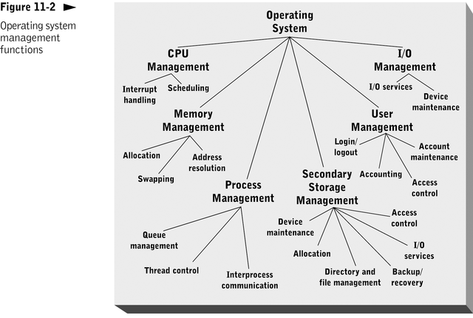
Outline
Introduction
Examples
Shared Memory
Files
Pipes
Signals
Pages 43-45, 733-734
MODERN OPERATING SYSTEMS (MOS)
By Andrew Tanenbaum

Slide 3
Interprocess Communication (IPC)
Independent process cannot affect or be affected by execution of another process
Cooperating process can affect or be affected by execution of another process
Advantages of process cooperation:
Information sharing
Computation speed-up
Modularity
Convenience
Examples?

Slide 4
Cooperating Processes - Examples
Communication example – Unix shell
Sharing example – print spooler
Processes (A, B) enter file name in spooler queue
Printer daemon checks queue and prints
cat file.jpg | jpegtopnm | pnmscale 0.1 | ssh claypool@host.com “cat > file.pnm”
free
9
A
B
print
daemon
...
...
letter
hw1
(empty)
6
7
8

Slide 5
Interprocess Communication (IPC)
Independent process cannot affect or be affected by execution of another process
Cooperating process can affect or be affected by execution of another process
Advantages of process cooperation:
Information sharing
Computation speed-up
Modularity
Convenience
THE CRUX OF THE PROBLEM:
HOW TO EFFICIENTLY ENABLE PROCCESS COMMUNICATION/COORDINATION?
How do processes share data?
How do processes communicate data?
How to avoid problems/issues when sharing data?

Slide 6
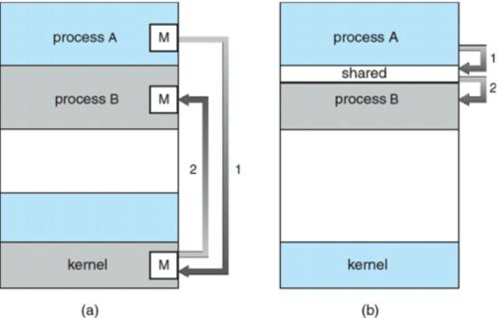
IPC Paradigms
Message passing
Why good? All sharing is explicit less chance for error
Why bad? Overhead. Data copying, cross protection domains
Shared Memory
Why good? Performance. Set up shared memory once, then access w/o crossing protection domains
Why bad? Can change without process knowing, error prone

Slide 7
Outline
Introduction (done)
Examples
Shared Memory (next)
Files
Pipes
Signals

Slide 8
What Are Some IPC Mechanisms?

Slide 9
Some IPC Mechanisms
Shared memory
Through shared variables
File system
By reading and writing to file(s)
Message passing
By passing data through pipe
Also: remote procedure call, sockets
Signal
By indicating event occurred
A
B
?
C

Slide 10
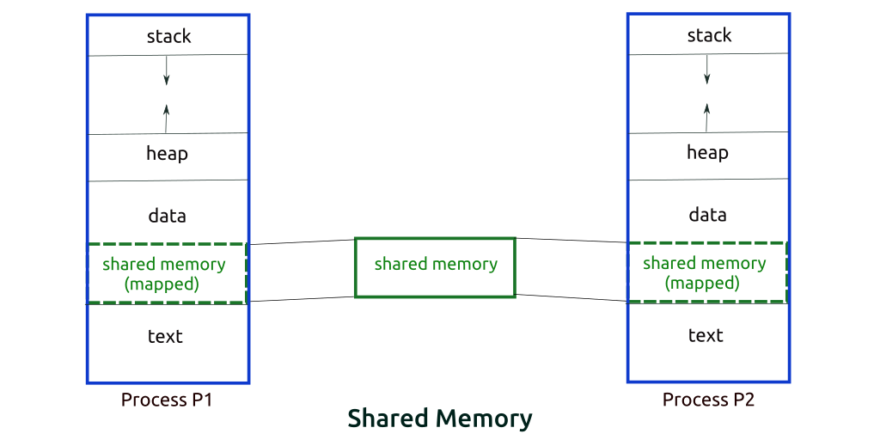
IPC Using Shared Memory
System call to create shared memory segment
Once created, access as “normal” memory

Slide 11
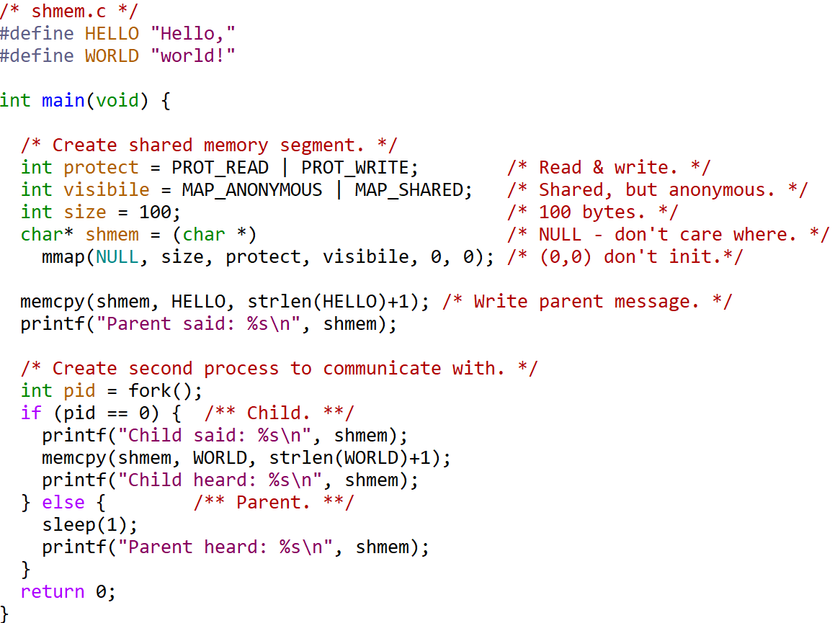
Shared Memory - Example
See: “shmem.c”

Slide 12
Outline
Introduction (done)
Examples
Shared Memory (done)
Files (next)
Pipes
Signals

Slide 13
IPC Using Files
Process writes to file, another reads from same file
Note, if both writing, requires locking to share file safely
File – locks the whole file (e.g., flock(), fcntl())
Record – locks portion of file (e.g., databases)
A
B
file system
Note! Windows and Linux do not lock by default

Slide 14
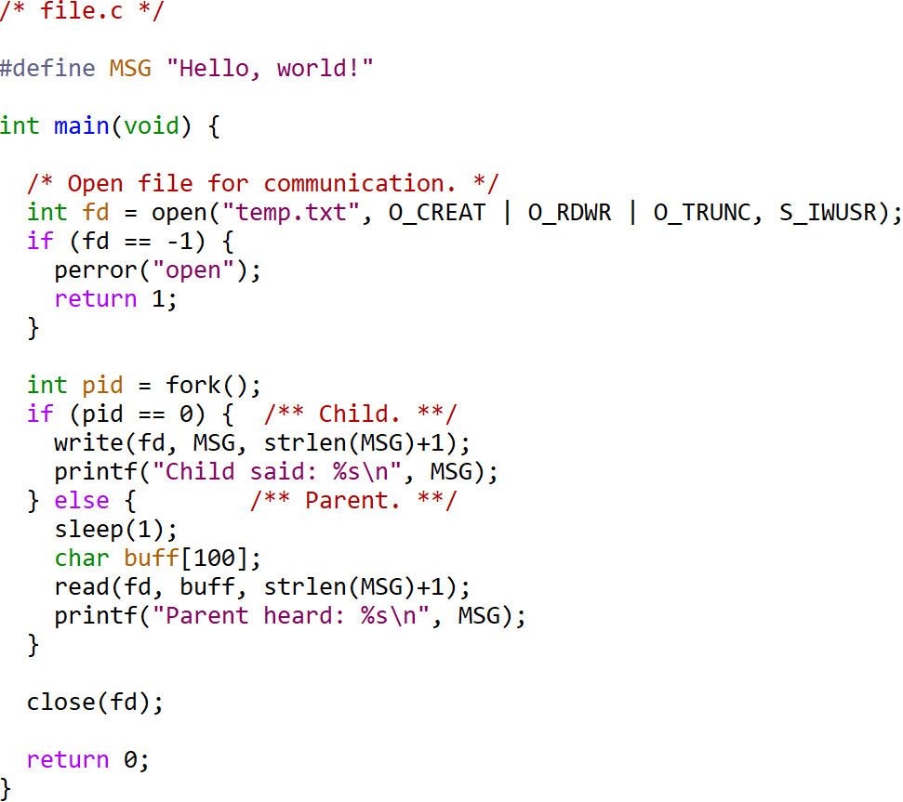
File - Example
See: “file.c”

Slide 15
Outline
Introduction (done)
Examples
Shared Memory (done)
Files (done)
Pipes (next)
Signals

Slide 16
IPC Using Pipes
b
l
a
h
.
c
\0
read fd
write fd
A bounded buffer, provided by OS
Shared buffer
Block writes to full pipe
Block reads to empty pipe
System calls to create/destroy
e.g., pipe()
System calls to read/write
e.g., read(), write()

Slide 17
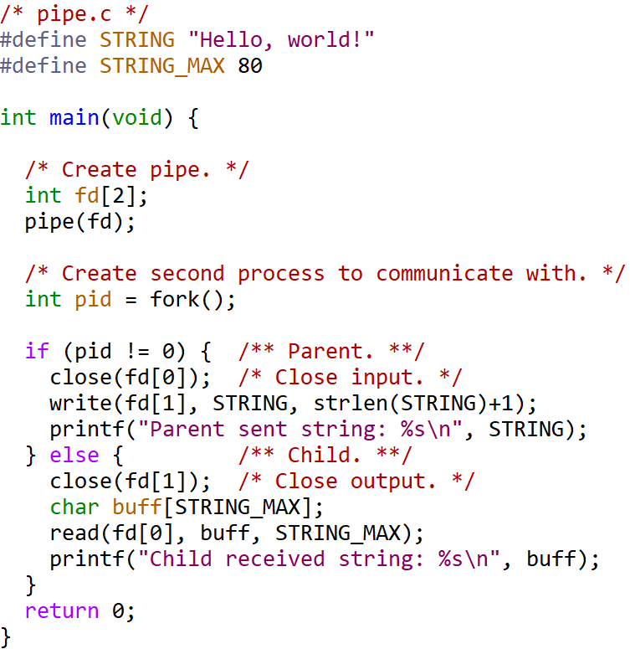
Pipe - Example
See: “pipe.c”

Slide 18
Named versus Unnamed Pipes
Unnamed pipe
int pid[2];
pipe(pid);
write(pid[1], buffer, strlen(buffer)+1);
read(pid[0], buffer, BUFSIZE);
Named pipe
int pid0, pid1;
mknod("named_pipe_filename", S_IFIFO | 0666, 0);
pid1 = open("named_pipe_filename", O_WRONLY);
pid0 = open("named_pipe_filename", O_RDONLY);
write(pid1, buffer, strlen(buffer)+1);
read(pid0, buffer, BUFSIZE);
Persistent (after processes exit)
Can be shared by any process)
Can be treated like FIFO file

Slide 19
The Shell Using a Pipe
One process writes, 2nd process reads
% ls | more
1
Shell
3
2
ls
more
stdout
stdin
Shell:
Create unnamed pipe
Create process for ls, setting stdout to write side
Create process for more, setting stdin to read side
Ok, but how to “set” stdout and stdin?

Slide 20
File Descriptors
int fd = open(“blah”, flags);
read(fd, …);
0-2 standard for each process
Used for files, pipes, sockets …
Can be changed
Openend
Closed
Copied (dup2())
User Space
System Space
0
1
2
3
stdin
stdout
stderr
...
(index)
(Per process)

Slide 21
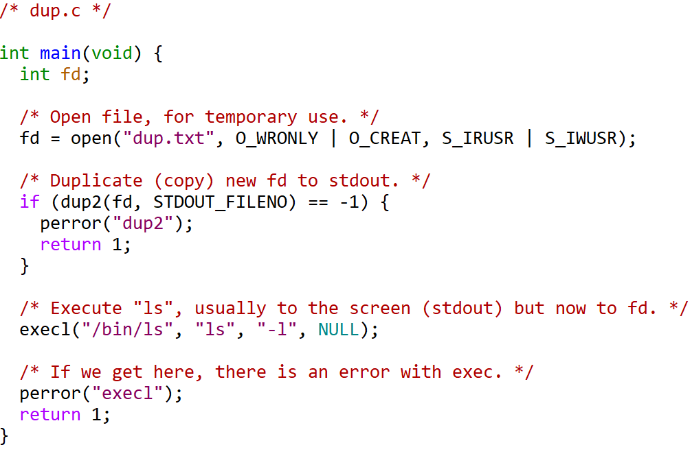
Example – dup2
See: “dup.c”

Slide 22
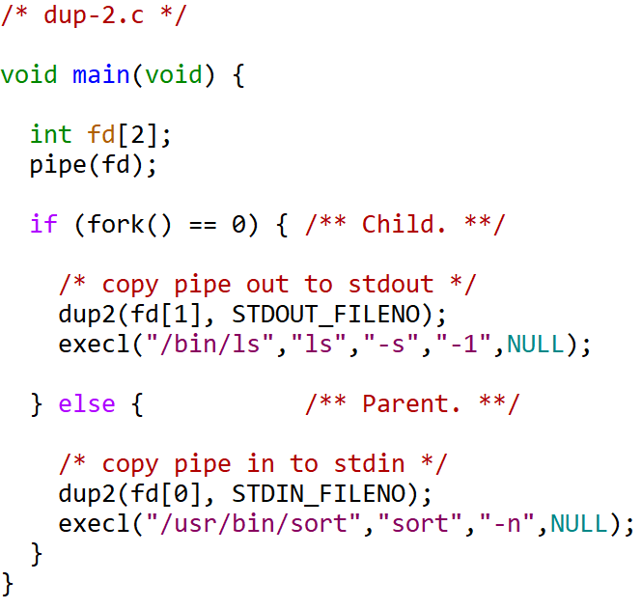
Example – dup2 w/pipe
before
0 stdin
1 stdout
2 stderror
3 pipe read
4 pipe write
File Descriptor
Table (FDT)
after fork
parent
0
1
2
parent
3
4
pipe
0 stdin
1 stdout
2 stderror
3 pipe read
4 pipe write
FDT
after fork
child
3
4
child
0
1
2
after
0 pipe read
1 stdout
2 stderror
3 pipe read
4 pipe write
FDT
after dup2
parent
1
2
parent
0
pipe
1
0 stdin
1 pipe write
2 stderror
3 pipe read
4 pipe write
FDT
after dup2
child
child
2
0
0 pipe read
1 stdout
2 stderror
0 stdin
1 pipe write
2 stderror
FDTs
after execl

Slide 23
Outline
Introduction (done)
Examples
Shared Memory (done)
Files (done)
Pipes (done)
Signals (next)

Slide 24
IPC using Signals
Signal corresponds to an event
Raised (or “sent”) by one process (or hardware)
Handled by another
E.g., ctrl-c → sends signal (SIGINT) to process
Originate from various sources
Hardware. e.g., divide by zero
Operating System. e.g., file size limit exceeded
User (shell)
Keyboard. e.g., ctrl-Z (SIGTSTP), ctrl-C (SIGINT)
Kill command
Other processes. e.g., child
Handling varies by processes
default – most terminate process
catch – catch and do appropriate action
ignore – do not take any action, but do not terminate
B
“child process exiting”
“stop”
C
kernel
“illegal instruction”
“timer expired”
D
A

Slide 25
Generating & Handling Signals
Generate
Handle
kill()- send signal to specified process
kill(int pid, int sig);
signal: 0-31
pid == 0 → goes to all user’s processes
alarm()- send SIGALRM to itself after specified time
raise()- send signal to itself
kill(getpid(), sig);
sigaction() - change behaviour for when signal arrives
See: “man 7 signal”

Slide 26
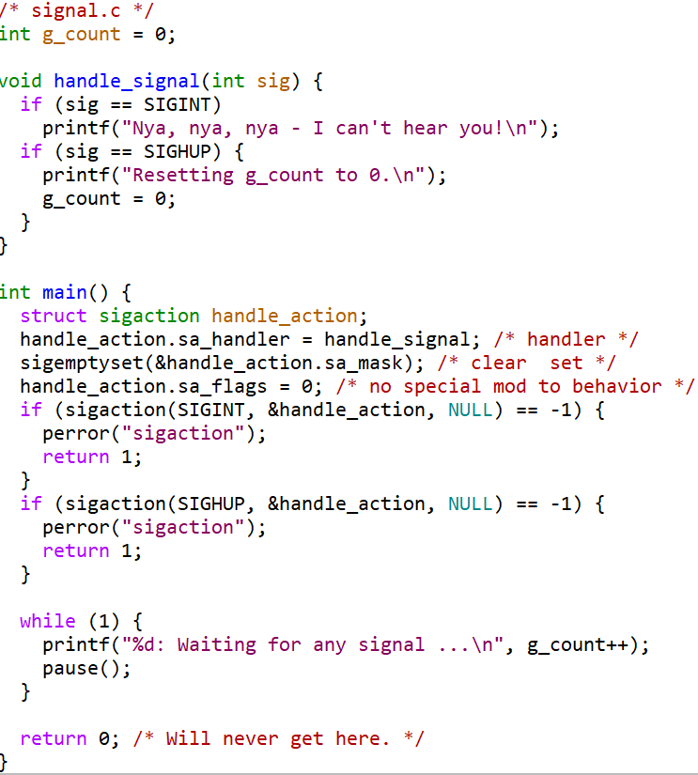
Example - Signal
See: “signal.c”
Note, handling is like interrupt
Store state/location where process was (stack)
Move to handler
When handler done, return to previous location

Slide 27
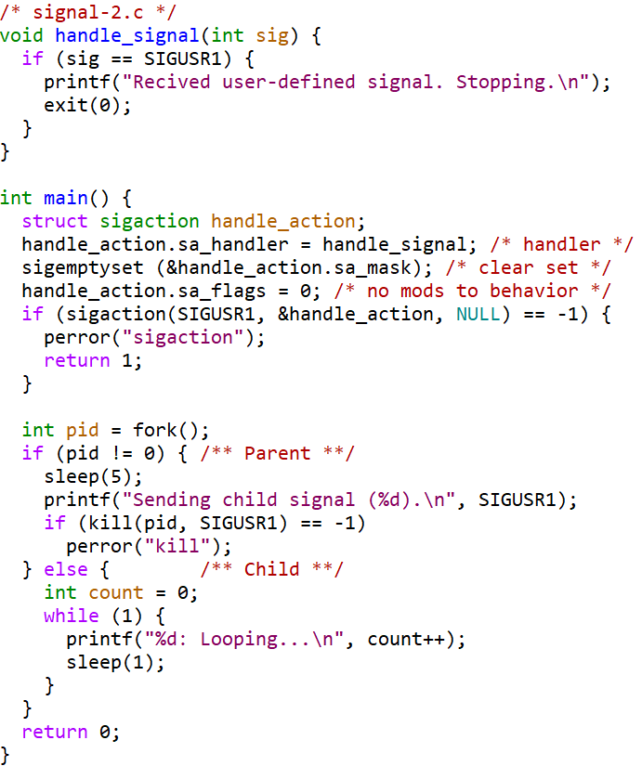
Example – Signal-2
See: “signal-2.c”

Slide 28
Defined Signals
SIGABRT Process abort signal.
SIGALRM Alarm clock.
SIGFPE Erroneous arithmetic operation.
SIGHUP Hangup.
SIGILL Illegal instruction.
SIGINT Terminal interrupt signal.
SIGKILL Kill (cannot be caught or ignored).
SIGPIPE Write on pipe no one to read it.
SIGQUIT Terminal quit signal.
SIGSEGV Invalid memory reference.
SIGTERM Termination signal.
SIGUSR1 User-defined signal 1.
SIGUSR2 User-defined signal 2.
SIGCHLD Child process terminated
SIGCONT Continue executing, if stopped.
SIGSTOP Stop (cannot be ignored).
SIGTSTP Terminal stop signal.
SIGTTIN Background attempt read.
SIGTTOU Background attempting write.
SIGBUS Bus error.
SIGPOLL Pollable event.
SIGPROF Profiling timer expired.
SIGSYS Bad system call.
SIGTRAP Trace/breakpoint trap.
SIGURG High bandwidth data at socket.
SIGVTALRM Virtual timer expired.
SIGXCPU CPU time limit exceeded.
SIGXFSZ File size limit exceeded.
See man pages for details

Slide 29
Outline
Introduction (done)
Examples (done)
Shared Memory (done)
Files (done)
Pipes (done)
Signals (done)

