Slide 1
Operating Systems
Sockets
ENCE 360

Slide 2
Outline
Introduction
Details
Example code
Socket options+

Slide 3
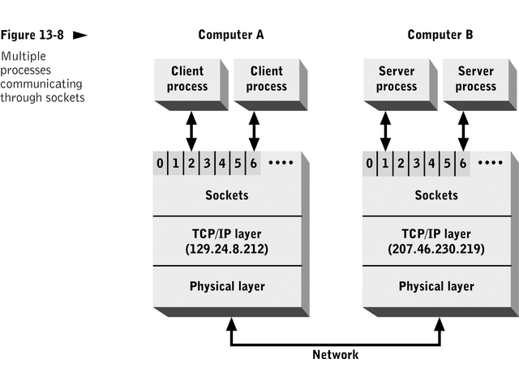
Socket Overview
Socket - An end-point for connection to another process (remote or local)
What application layer “plugs into”
User sees descriptor - integer index/handle
Like: file index from open()
Returned by socket() call (more later)
Programmer cares about Application Programming Interface (API) → similar to file I/O
Application
Sockets
Protocol A
Protocol B
Protocol C
Network
(TCP=Transport Control Protocol, IP=Internet Protocol)

Slide 4
Connection Endpoints
End point determined by two things:
Host address: e.g., IP address
Port number
Two end-points determine connection → socket pair
Sever
Port
Port
Client
Connection
any port
agreed port
socket
socket
message
client
server
other ports
Internet address = 138.37.94.248
Internet address = 138.37.88.249

Slide 5
Ports
port 0
port 1
Each host has 65,536 ports
16-bit integer
Some ports are reserved for specific apps (/etc/services)
FTP 20,21
Telnet 23
HTTP 80
Ports below 1024 are reserved
User level 1024+
Ports 1024-5000 ephemeral
Assigned in outgoing connection
Ports 5001+ services
port 65535
server
port
client
app
app
app
app
data
port
port
port
port
Network Packet
port
data
Packet

Slide 6
Two Main Network Transport Protocols Today
UDP: User Datagram Protocol
no acknowledgements
no retransmissions
out of order, duplicates possible
Connectionless
SOCK_DGRAM
TCP: Transmission Control Protocol
reliable (in order, all arrive, no duplicates)
flow control
connection-based
SOCK_STREAM
Application
(http,ftp,telnet,…)
Transport
(TCP, UDP,..)
Network
(IP,..)
Link
(device driver,..)
TCP ~95% of all flows and packets on Internet
(What applications may use UDP?)
More in a networks course!

Slide 7
Socket Descriptor Data Structure
Descriptor Table
Socket Data Structure
0
Family: PF_INET
Service: SOCK_STREAM
Local IP: 111.22.3.4
Remote IP: 123.45.6.78
Local Port: 2249
Remote Port: 3726
1
2
3
received queue
sent queue
4
Service is the Transport Protocol
IP (Internet Protocol) - address of computer
Port - specifies which process on computer

Slide 8
Outline
Introduction (done)
Details (next)
Example code
Socket options+
Unix Network Programming, W. Richard Stevens, 2nd edition, ©1998, Prentice Hall
Beej’s Guide to Network Programming, Brian Hall, ©2015, self-published,
http://beej.us/guide/bgnet/

Slide 9
Addresses and Sockets
Structure to hold address information
Functions pass info (e.g., address) from user to OS
bind()
connect()
sendto()
Functions pass info (e.g., address) from OS to user
accept()
recvfrom()

Slide 10
Socket Address Structure
struct in_addr {
in_addr_t s_addr; /* 32-bit IPv4 addresses */
};
struct sockaddr_in {
unit8_t sin_len; /* length of structure */
sa_family_t sin_family; /* AF_INET */
in_port_t sin_port; /* TCP/UDP port number */
struct in_addr sin_addr; /* IPv4 address (above) */
char sin_zero[8];/* unused */
};
Also “generic” and “IPv6” socket structures
Notes:
Length field makes it easier for OS to handle

Slide 11
TCP Client-Server
Server
_{socket()}
_{“well-known”}
_{port}
_{bind()}
_{listen()}
_{Client}
_{accept()}
_{socket()}
_{(Block until connection)}
_{“Handshake”}
_{connect()}
_{Data (request)}
_{send()}
_{recv()}
_{Data (reply)}
_{send()}
_{recv()}
_{End-of-File}
_{close()}
_{recv()}
_{close()}

Slide 12
socket()
int socket(int family, int type, int protocol);
Create socket, giving access to transport layer service
family is one of
AF_INET (IPv4), AF_INET6 (IPv6), AF_LOCAL (local Unix),
AF_ROUTE (access to routing tables), AF_KEY (for encryption)
type is one of
SOCK_STREAM (TCP), SOCK_DGRAM (UDP)
SOCK_RAW (for special IP packets, PING, etc. Must be root)
setuid bit (-rwsr-xr-x root 2014 /sbin/ping*)
protocol is 0 (used for some raw socket options)
upon success returns socket descriptor
Integer, like file descriptor → index used internally
Return -1 if failure

Slide 13
bind()
int bind(int sockfd, const struct sockaddr *myaddr,
socklen_t addrlen);
Assign local protocol address (“name”) to socket
sockfd is socket descriptor from socket()
myaddr is pointer to address struct with:
port number and IP address
if port is 0, then host will pick ephemeral port
not usually for server (exception RPC port-map)
IP address == INADDR_ANY (unless multiple nics)
addrlen is length of structure
returns 0 if ok, -1 on error
EADDRINUSE (“Address already in use”)

Slide 14
listen()
int listen(int sockfd, int backlog);
Change socket state (to passive) for TCP server
sockfd is socket descriptor from socket()
backlog is maximum number of incomplete connections
historically 5
rarely above 15 even on moderately busy Web server!
sockets default to active (for client)
change to passive so OS will accept connection

Slide 15
accept()
int accept(int sockfd, struct sockaddr * cliaddr, socklen_t *addrlen);
Return next completed connection
blocking call (by default)
sockfd is socket descriptor from socket()
cliaddr and addrlen return protocol address from client
returns brand new descriptor, created by OS
note, if create new process or thread, can create concurrent server

Slide 16
close()
_{int close(int sockfd);}
_{Close socket for use}
sockfd is socket descriptor from socket()
closes socket for reading/writing
returns (doesn’t block)
attempts to send any unsent data
socket option SO_LINGER
block until data sent
or discard any remaining data
returns -1 if error

Slide 17
TCP Client-Server
Server
_{socket()}
_{“well-known”}
_{port}
_{bind()}
_{listen()}
_{Client}
_{accept()}
_{socket()}
_{(Block until connection)}
_{“Handshake”}
_{connect()}
_{Data (request)}
_{send()}
_{recv()}
_{Data (reply)}
_{send()}
_{recv()}
_{End-of-File}
_{close()}
_{recv()}
_{close()}

Slide 18
connect()
int connect(int sockfd, const struct sockaddr *servaddr, socklen_t addrlen);
_{Connect to server}
sockfd is socket descriptor from socket()
servaddr is pointer to structure with:
port number and IP address
must be specified (unlike bind())
addrlen is length of structure
client doesn’t need bind()
OS will pick ephemeral port
returns socket descriptor if ok, -1 on error

Slide 19
Sending and Receiving
int recv(int sockfd, void *buff, size_t mbytes, int flags);
int send(int sockfd, void *buff, size_t mbytes, int flags);
Same as read() and write() but with flags
MSG_DONTWAIT (this send non-blocking)
MSG_OOB (out of band data, 1 byte sent ahead)
MSG_PEEK (look, but don’t remove)
MSG_WAITALL (don’t return less than mbytes)
MSG_DONTROUTE (bypass routing table)

Slide 20
UDP Client-Server
_{Server}
_{socket()}
_{bind()}
_{“well-known”}
_{port}
_{Client}
_{recvfrom()}
_{socket()}
_{(Block until receive datagram)}
_{Data (request)}
_{sendto()}
_{sendto()}
_{recvfrom()}
_{Data (reply)}
_{close()}
- No “connection”, no “handshake”
- No simultaneous close

Slide 21
Sending and Receiving
int recvfrom(int sockfd, void *buff, size_t mbytes, int flags, struct sockaddr *from, socklen_t *addrlen);
int sendto(int sockfd, void *buff, size_t mbytes, int flags, const struct sockaddr *to, socklen_t addrlen);
Same as recv() and send() but with addr
recvfrom fills in address of where packet came from
sendto requires address of where sending packet to

Slide 22
Can connect() with UDP
Record address and port of peer
Datagrams to/from others are not allowed
Does not do three way handshake, or connection
So, “connect” a misnomer, here. Should be setpeername()
Use send() instead of sendto()
Use recv() instead of recvfrom()
Can change connect or unconnect by repeating connect() call
(Can do similar with bind() on receiver)

Slide 23
Outline
Introduction (done)
Details (done)
Example code (next)
Socket options+

Slide 24
Example Code
Server
Client
1
3
% listen-tcp
listen-tcp - server to accept TCP connections
usage: listen-tcp <port>
<port> - port to listen on
% listen-tcp 7500
Listen activating.
Trying to create socket at port 7500...
Socket ready to go! Accepting connections....
received: 'Hello, world!'
received: 'Networking is awesome!'
server exiting
% talk-tcp
talk-tcp - client to try TCP connection to server
usage: talk-tcp <host> <port>
<host> - Internet name of server host
<port> - port
% talk-tcp localhost 7500
Talk activated.
Trying to connect to server localhost at port 7500...
Looking up localhost...
Found it. Setting port connection to 7500...
Done. Creating socket...
Created. Trying connection to server...
Connection established!
Type in messages to send to server.
Hello, world!
sending: 'Hello, world!'
Networking is awesome!
sending: 'Networking is awesome!'
2
4
See:
“listen-tcp.c”
“talk-tcp.c”

Slide 25
Outline
Introduction (done)
Details (done)
Example code (done)
Socket options+ (next)

Slide 26
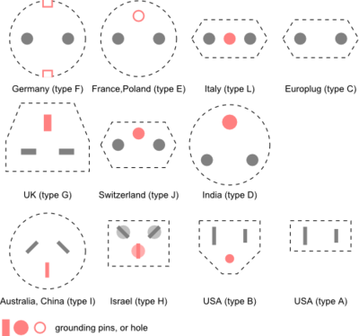
Socket Options (General)
setsockopt(), getsockopt()
SO_LINGER
Upon close, discard data or block until sent
SO_RCVBUF, SO_SNDBUF
Change buffer sizes
For TCP is “pipeline”, for UDP is “discard”
SO_RCVLOWAT, SO_SNDLOWAT
How much data before “readable” via select()
SO_RCVTIMEO, SO_SNDTIMEO
Timeouts

Slide 27
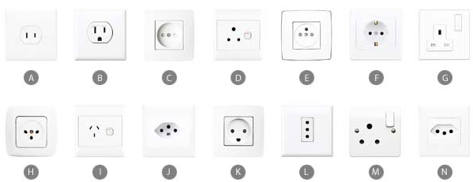
Socket Options (TCP)
TCP_KEEPALIVE
Idle time before close (2 hours, default)
TCP_MAXRT
Set timeout value
TCP_NODELAY
Disable Nagle’s Algorithm
Won’t buffer data for larger chunk, but sends immediately

Slide 28
fcntl()
‘File control’ - manipulate file descriptor
So, used for sockets, too
Get/Set socket owner
Get/Set socket lock
Set socket non-blocking
flags = fcntl(sockfd, F_GETFL, 0);
flags |= O_NONBLOCK;
fcntl(sockfd, F_SETFL, flags);
Beware not getting flags before setting!

Slide 29
Connecting to the Internet
If one computer, connect to server?

Slide 30
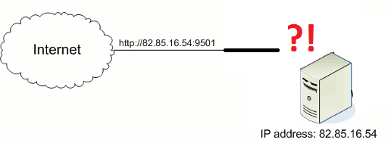
Internet Connecting to You
If one computer, connect to server?
Server connect to your computer?

Slide 31
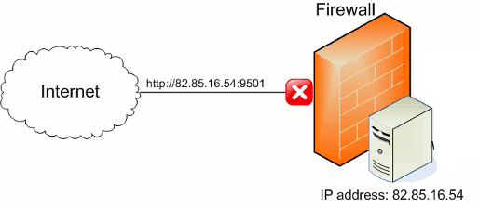
Firewall to the Rescue!
Close all ports!
Note: even if no services (processes), OS response still gives information to hackers! (“fingerprint”)

Slide 32
Firewall Too Restrictive
Close all ports!
Note: even if no services (processes), OS response still gives information to hackers! (“fingerprint”)
What if want connection? (Examples?)

Slide 33
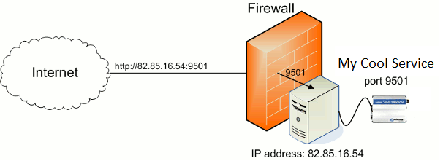
Firewall – Port Forwarding
Close all ports!
Note: even if no services (processes), OS response still gives information to hackers! (“fingerprint”)
What if want connection? (Examples?)
Open port.
Aka:
port forwarding

Slide 34
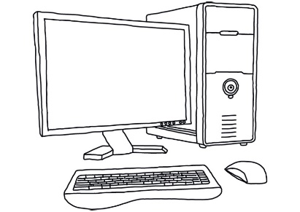
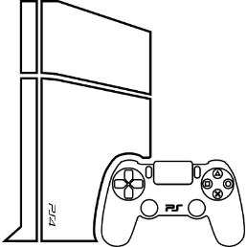
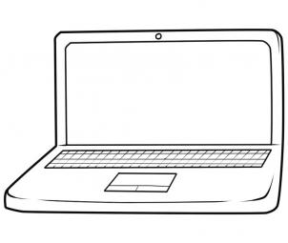
Connecting to the Internet, Take 2
Single address, multiple computers?
104.45.147.81
(World)
202.36.179.10
?
(Home)

Slide 35
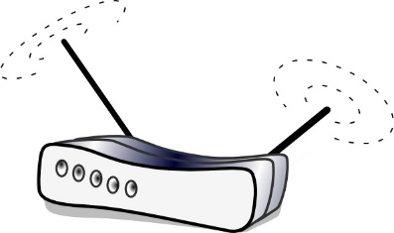
Connecting to the Internet, Take 2
Single address, multiple computers?
Assign one box to route packets to all
But how to differentiate incoming?
104.45.147.81
(World)
202.36.179.10
202.36.179.10
192.168.1.1
?
(Home)
192.168.1.2
192.168.1.4
192.168.1.3

Slide 36
Network Address Translation (NAT)
Single address, multiple computers?
Assign one box to route packets to all
But how to differentiate incoming?
Based on port
Setup when connecting
104.45.147.81
(World)
80
202.36.179.10
202.36.179.10
192.168.1.1
9991
192.168.1.2
(Home)
192.168.1.2
Network Address Translation
192.168.1.4
192.168.1.3

Slide 37
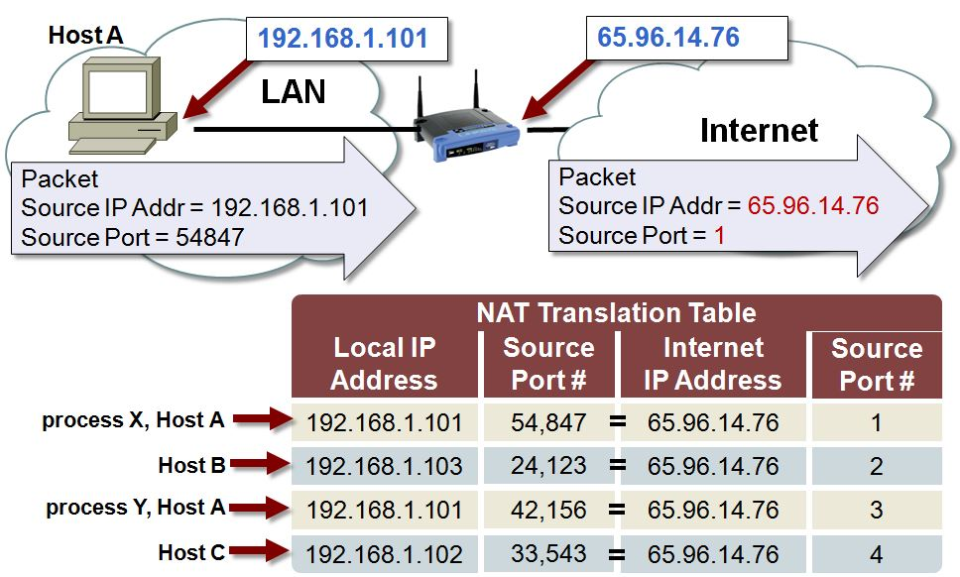
NAT Tables
https://microchip.wdfiles.com/local--files/tcpip:nat-translation-table/nat_table.JPG
Table maps local IP + port to Internet IP + port
Setup when connected by client (punch out)
Pre-setup by administrator when connecting in (local service/server)

Slide 38
Outline
Introduction (done)
Details (done)
Example code (done)
Socket options+ (done)

