Slide 1
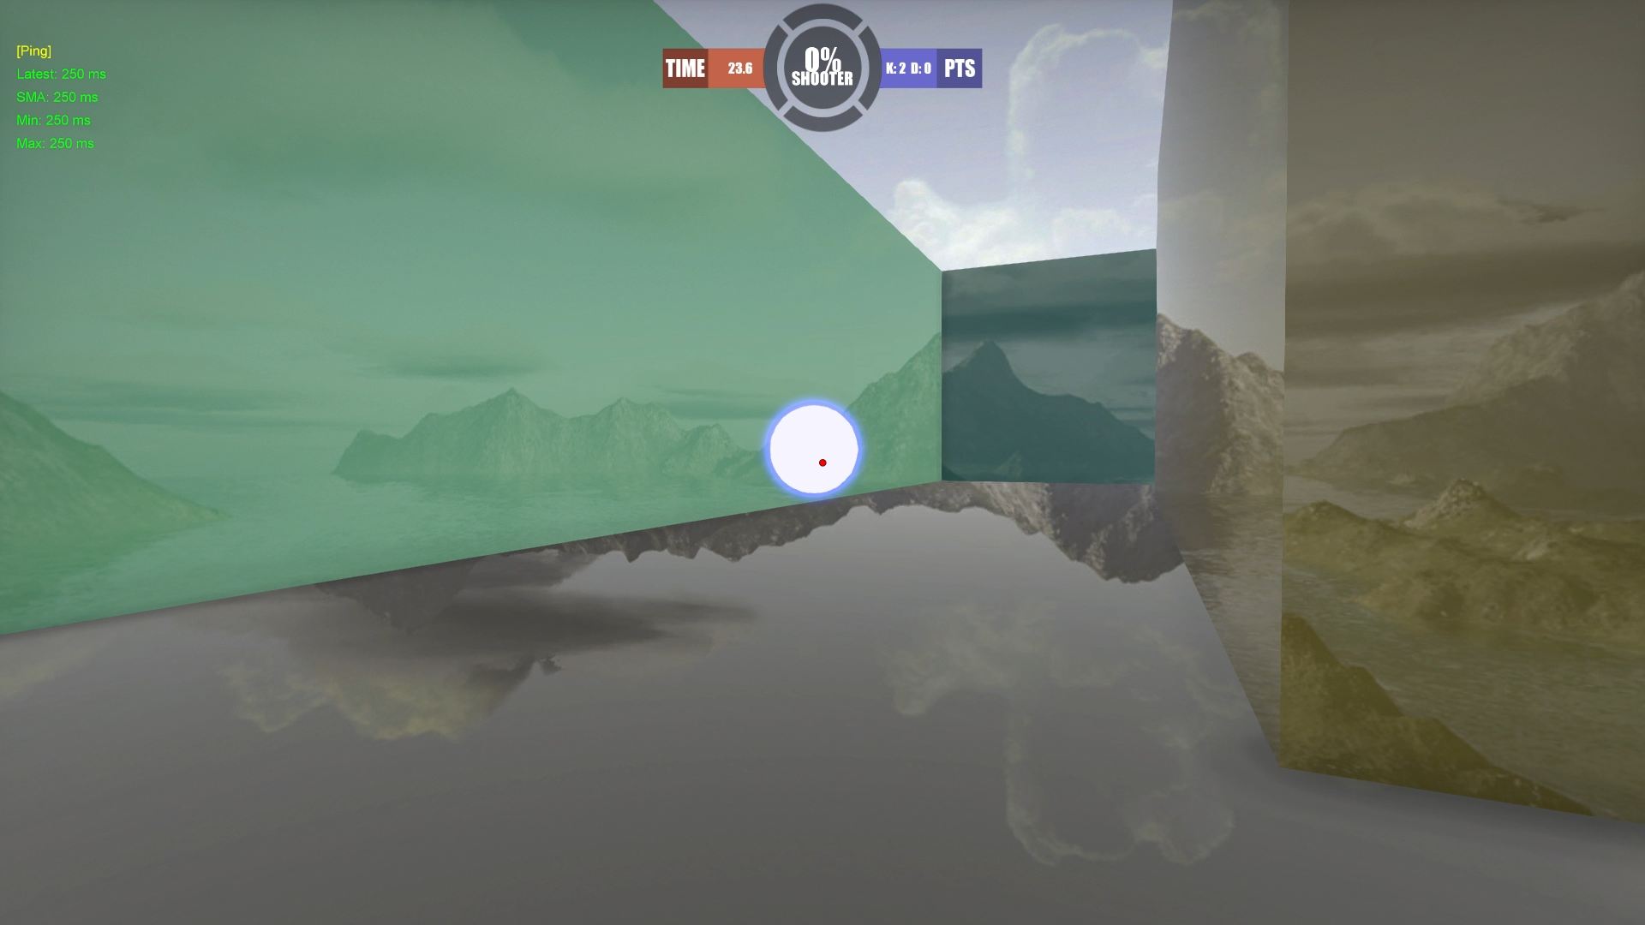
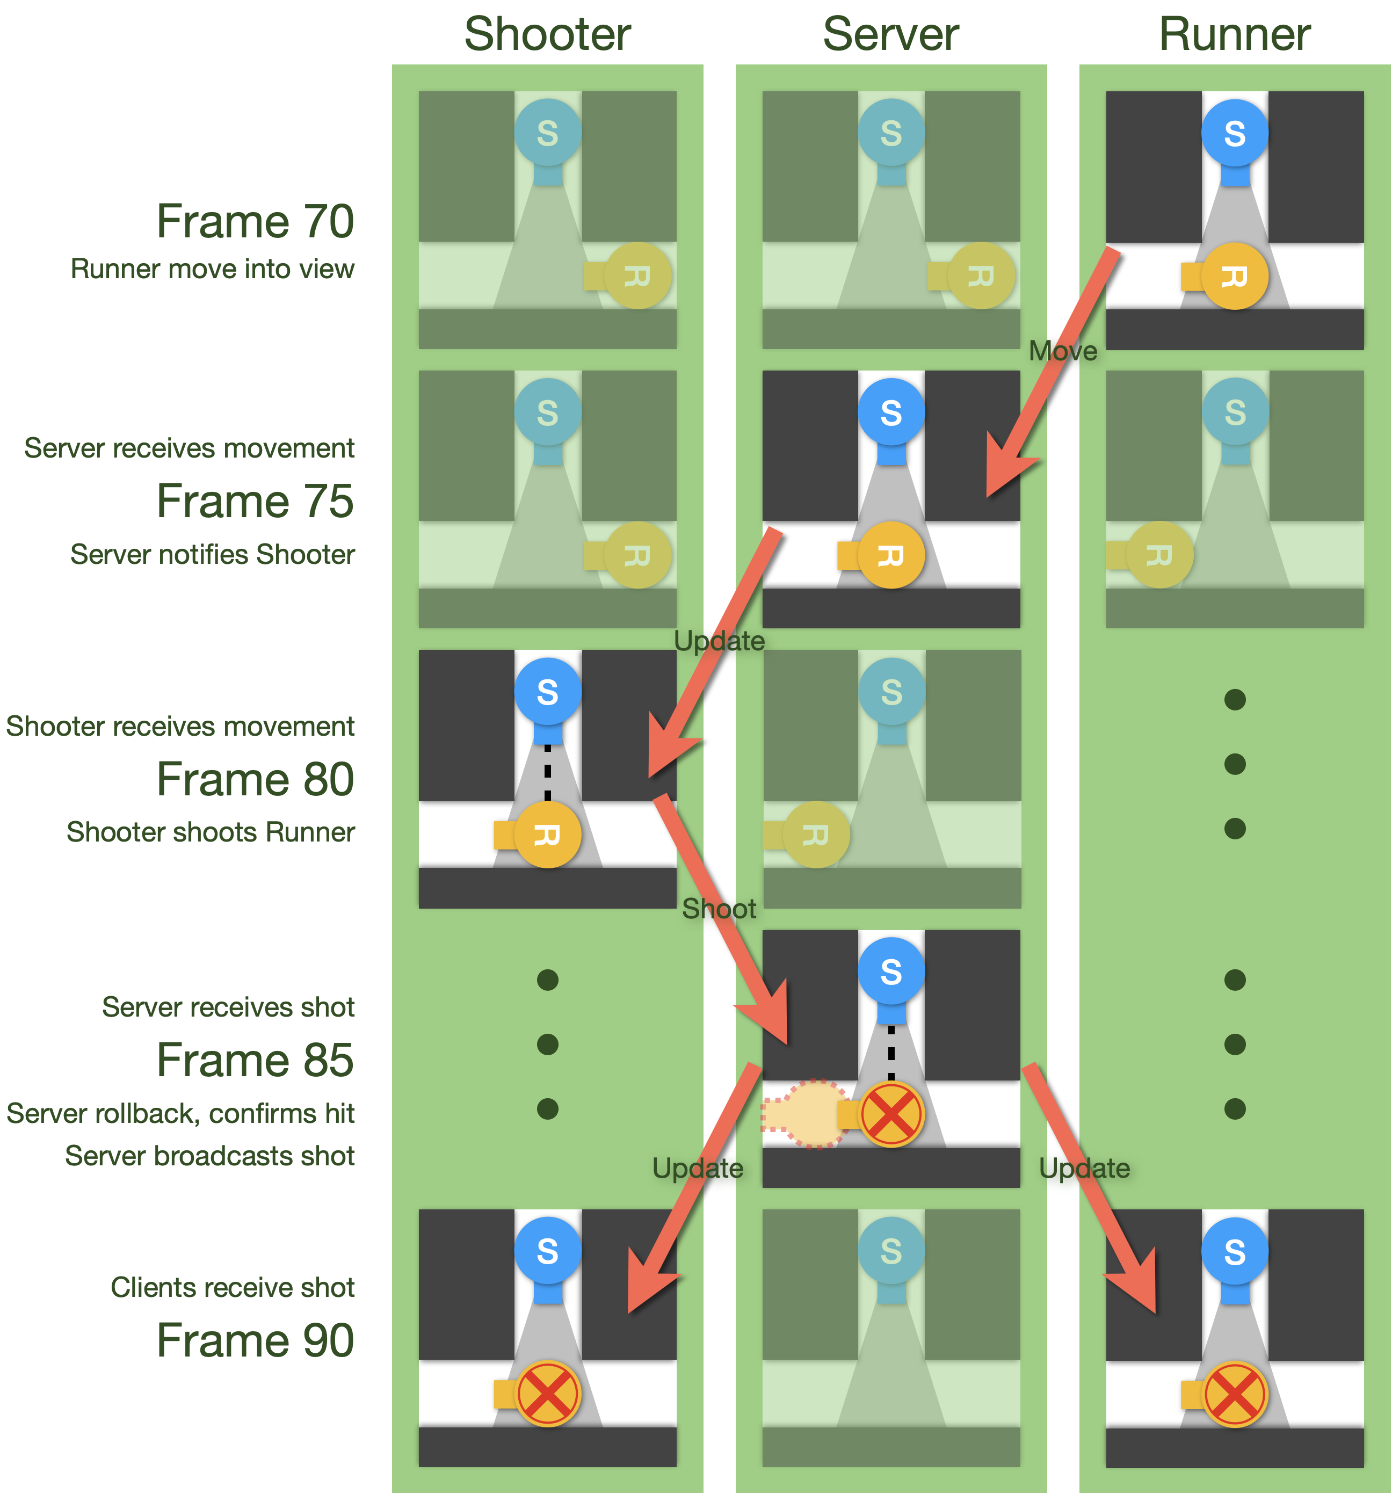
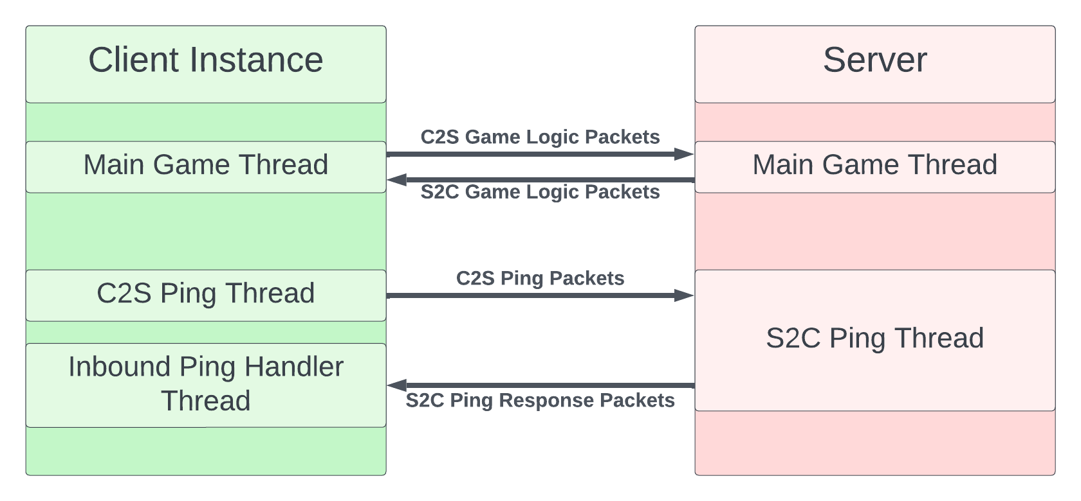
Exploring the Effects of Latency Compensation Techniques
on Player Performance and Experience in FPS Games
Ivan Klevanski (CS), Alexander Mitchell (CS), Yihong Xu (CS/IMGD), Sitsanok Young (CS)
Advisor: Professor Mark Claypool (CS/IMGD)
Introduction
Latency Compensation Techniques
Game Screenshot
Online FPS games are affected by network latency or delay
Latency can affect user experience
Several latency compensation techniques were developed to mitigate the unwanted effects of network latency
This study explores the impact of latency compensation techniques, in particular time warp and latency exposure, on player performance and quality of experience
Techniques used in online gaming to help players with latency issues.
Time Warp
Compensates for delays by processing a player's shots as if they had taken place in the player's world timeline, rather than the server's world
Allows the player to successfully hit other players, even if they have moved on the server
Essentially "warps" the server's time to match the player's time during the shot
Without time warp, players may need to lead their shots to compensate for the delay and hit others
Latency Exposure
Provides the player with a form of visual feedback on the current network latency present in the game
Can incentivize the behavior of players based on the feedback (e.g. whether to lead shots in very latent game sessions)
Latency Concealment
Improves immersion by allowing the player to hear a hit sound as soon as the local prediction determines that they hit, instead of hearing after the server has determined a hit was made
With concealment on a player may hear a hit sound when the server later determines that the shot missed
Extrapolation
Predicts the movement of objects in the game world based on their past trajectory and velocity
Typically, mutually exclusive with time warp
User Study
Background
1v1, 50s of close-quarter combat
Two client PCs, one server PC
Participants answer questions before the game, after each round, and after the game
20 rounds form 2 groups of 10 rounds
Each round has a different latency out of a selection of 0, 250, 500ms. Some latencies are less than shown: 0, 175, 375ms
The 2 groups have different Time Warp Settings (on/off)
First round in each group is discarded
First-Person Shooter (FPS) Games
Video games that simulate the experience of shooting enemies / other players from a 3D first-person perspective
First-Person Science (FPSci)
Open-source, experiment-centric Single Player FPS game developed by NVIDIA for research purposes
Designed to study a broad set of user interactions at low local latency
Network Latency
Also known as "ping" or "lag"
A measure of the delay in communication between a client and a network server
High network latency can result in several impacts on the user's experience, breaking player immersion
Examples: missed shots, delayed interactions, and more
Client-Server Structure
Authoritative Server
Allows more advanced optimizations compared to P2P networked games
Resolves/mitigates issues that come with enabling multiplayer games:
Conflicting actions from clients
Desyncing between clients
Cheating
Stores the “true values” of the entire game world, along with the history of all information for Time Warp
Movement
Server provides authoritative location
Client provides movement calculation
Client handles world collision
Server handles player collision
Shooting
Client sends shoot signal to server
Server performs physical simulation for authoritative results and broadcasts
Future Work
Local player to player collision detection
Perform more user studies with various setting configurations
Analyze data to its fullest
Add more game features to observe time warps effectiveness as more and complex features are introduced
Current implementation is one variation of time warp. Other varieties exist that could be more effective, fun, and fair

