Slide 1
Predicting the Perceived Quality of a First Person Shooter Game
The Team Fortress 2 T-Model
David Dwyer
Eric Finn
Advisor: Mark Claypool

Slide 2
Motivation
Lag hurts online gameplay
Models needed to aid research into lag compensation
Previous work has good models for VoIP, but only one model for a game
Notes:
Lack of quantitative data, except Quake IV

Slide 3
Goals
Create model to predict gameplay quality based on network conditions for Team Fortress 2
Network Conditions: delay, jitter, packet loss
Reproduce another study (Quake IV G-Model) for a different game
Notes:
Packet loss has negligible effect on gameplay quality according to initial testing and other studies

Slide 4
Team Fortress 2
Networked multiplayer first-person shooter
Uses a lag compensation method called “Time Warp”

Slide 5
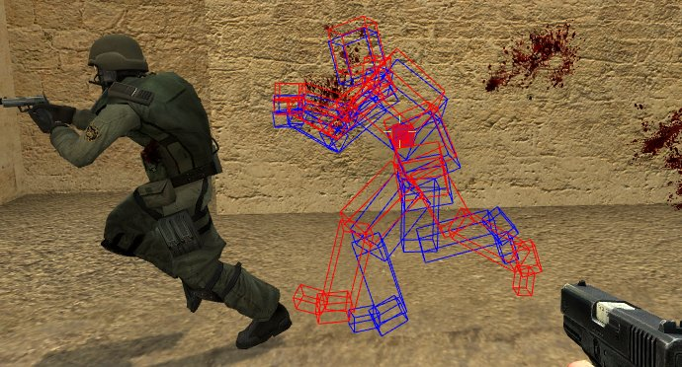
Time Warp
Server “turns back time” to estimate where clients saw other clients’ avatars
https://developer.valvesoftware.com/wiki/File:Lag_compensation.jpg
Notes:
Red is actual position on attacker’s client at time of attack, blue is server’s estimate of position, model is victim’s position on server at time attack message is received

Slide 6
Methodology
Volunteers played TF2 for 1-hour sessions
Up to 8 players against server-controlled bots
Multiple 3-6 minute rounds, with different network conditions each round
Introduced server-to-client latency with netem
Volunteers provided feedback every round
Notes:
Feedback included Opinion Score for round

Slide 7
Results
Collected opinion scores (1-5) for each set of network conditions for each participant
Created Mean Opinion Score (MOS) for each set of network conditions

Slide 8
Mean Opinion Score vs Mean Delay (How did they like it?)
Notes:
X-axis is delay in ms, Y-axis is mean opinion score.
Trendlines are based on how much jitter there is (proportional to delay). Error bars are 95% confidence intervals.
As delay and jitter increase, average opinions get worse.

Slide 9
The Model
Best fit (lowest mean absolute error) for score proportional to delay and jitter:
score = 4.15 – 0.0012 delay – 0.013 jitter
Notes:
Talk about what the variables are:
Delay is mean delay in ms
Jitter is standard deviation in delay in ms
Score is predicted MOS

Slide 10
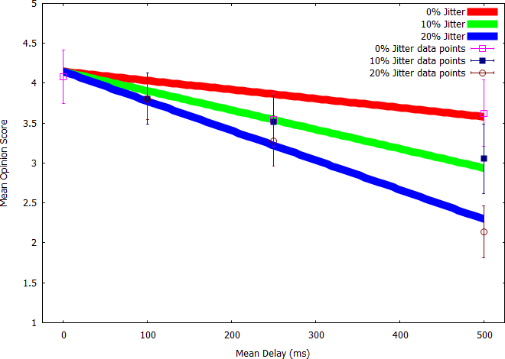
Notes:
X-axis is delay in ms, Y-axis is mean opinion score.
Trendlines are based on how much jitter there is (proportional to delay). Error bars are 95% confidence intervals.
Model is good fit to data.

Slide 11
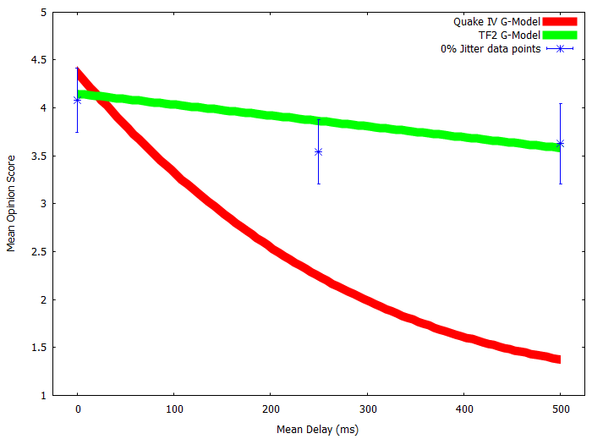
Notes:
Comparison of our model with the Quake 4 G-Model at 0% Jitter
X-axis is delay in ms, Y-axis is mean opinion score.
Quake 4 opinion scores decrease much more quickly than TF2 opinion scores

Slide 12
Conclusion
Modern lag compensation helps improve perceived gameplay quality
For our setup, 800ms of delay or 80ms of jitter worsened MOS by about 1 point
Model can be used in simulations to assess and predict effects of network conditions
Notes:
Modern lag compensation – TF2 more recent than Quake 4 and more regularly updated

Slide 13
Future Works
Test more subjects, different demographics
Test different game modes and maps
Create more general model for TF2

Slide 14
Questions?
Full report and data available at:
http://www.wpi.edu/Pubs/E-project/Available/E-project-031213-141112/

