Slide 1
Predictive Shipping
Matthew Beaulieu, Tiffany Leung,
& Derek McMaster
Notes:
<< 30 sec
Speaker: Matthew
Welcome, Thank everyone for coming, Thank Endicia Employees for hosting us

Slide 2
Brief Context & Overall Project Goal
Notes:
<< 30 sec
Speaker: Tiffany
Here we start a story about an Endicia business customer
They are a small company, limited resources

Slide 3
Who is endicia ?

Slide 4
( First Class )
( Priority )
( Express )
2-3 business days (excluding Alaska and Hawaii)
Up to $4.30
(up to 16 ounces)
1-3 business days (including Alaska and Hawaii)
Up to $200
0-1 business days (including Alaska and Hawaii)
Up to $470
Notes:
<< 1 min
Speaker: Tiffany
http://pe.usps.com/text/dmm300/Notice123.htm#2517977
Youre a company spending a lot of money on shipping with priority because it has guarantees 1-3 business days
You want to cut shipping costs without sacrificing delivery time
If you had a service that could confidently say when first class will arrive in the same time as priority, you can save on your shipping margins

Slide 5
The goal of our project was to
produce a validated prototype
that forecasts
delivery time distributions
to optimize shipping costs.
Notes:
<< 30 sec
Speaker: Matthew
Problem Statement
Probability distributions

Slide 6
Objectives
Notes:
<< 30 sec
Speaker: Derek
To complete this goal, we divided the problem into three steps.

Slide 7
( 1 )
Design and implement a Predictive Shipping Prototype
( 2 )
Update and optimize the Prototype
( 3 )
Validate the mathematical approach used to predict shipping distributions
Notes:
<< 1 min
Speaker: Derek
Reword

Slide 8
How?
(1) Billion rows of scan events
(2) Process and load rows into another database
(3) Query database for shipping information
Notes:
Speaker: Matthew
Millions rows of Scan Events
Process and load it into another database
Query database for shipping paths

Slide 9
Technology
Notes:
Speaker: Tiffany
With those difficulties in mind...
“Now we are going to explain how we achieved objectives (1) and (2)”

Slide 10
Data processing tool
Big Data
10-100x faster
Batch processing
Hadoop distributed file system
Graph database
Performs well with relationships
Does not require JOINs
Queries are 1000x faster
Notes:
Speaker: Tiffany and Matthew
https://neo4j.com/blog/3-advantages-neo4j-alongside-oracle-rdbms/
RDMS have JOIN operations, which are compute- and memory-intensive, and the performance impact increases as data volumes grow. A graph database can analyze complex, connected data much faster and persist that analysis for future reference.
Using Neo4j, a shortest path query on data with tens of billions of nodes and relationships might take one or two milliseconds to run. The equivalent SQL query would run many thousands of times slower if an application was solely using an RDBMS such as Oracle.

Slide 11
Design &
Implementation
Notes:
Speaker: Derek
“Now we are going to explain how we achieved objectives (1) and (2)”

Slide 12
Scan Event Data
JDBC Connection
Front End (jQuery, Mapbox, D3js)
Spark Engine
Scan Event Updates from USPS
VPO1
Neo4j Relationships
NEO Fast Import Tool
HTTP
Server
Neo4j
Neo4j
Calculator and Business Layer
Prototype System Architecture
Notes:
Speaker: Derek
Here is our prototype’s new system architecture and we are going to now explain each component

Slide 13
Scan Event Data
JDBC Connection
Example of a Scan Event
Tracking Id | 2540002306
Timestamp | 2014-12-31 17:32:00
Facility Zip Code | 29201
Mail Class | First Class
End Destination | 29212
Event Code | 1078
Scan Event Updates from USPS
VPO1
Prototype System Architecture
Notes:
Speaker: Tiffany
Explain how data gets imported into VPO SQL Server
Scan Events come from USPS workers in the field
Every 15 minutes VPO1 gets updated with a batch of new, real-time scan events
Explain CSV header with first scan event row

Slide 14
From Facility (5 digits) | 29201
To Facility (5 digits) | 29210
End Destinations (3 digits) | [292, 313]
End Destination Occurrences | [1,11]
Time Distributions per Arrival Hour | {}:{}:{35=1}:{40=5|42=5}:{}:{}:{}:{}:{}:{}: {}:{}:{}:{}:{}:{}:{}:{}:{}:{}:{}:{}:{}:{}:
2AM
29201
Scan Event Data
Spark Engine
35hr
29210
Neo4j Relationships
NEO Fast Import Tool
1x
11x
Neo4j
292
313
Prototype System Architecture
Notes:
Speaker: Matthew
Explain final rows produced by Spark
For reference, the final row is from the first row in the previous slide
Finally, say that these rows are readily importable by Neo4j
Start Id, End Id, From Facility, To Facility, End Destinations, Occurrences, List of Transit Times Occurrences
29201;29210;29201;
29210;[292,313];[1,11];{}:{}:{35=1}:{40=5|42=5}:{}:{}:{}:{}:{}:{}:{}:{}:{}:{}:{}:{}:{}:{}:
{}:{}:{}:{}:{}:{}:;ShipsTo

Slide 15
Neo4j
Demonstration
Notes:
Speaker: Matt
“match (f:Facility)-[r]->(d:Facility) with f,count(d) as cnt where cnt > 500 return f limit 15”
“MATCH p=(d:Facility{fiveZip:'07032'})-[r:ShipsTo*3]->(f:Facility{fiveZip:'02780'}) where all (r1 in relationships(p) where '027' in r1.endDestZipThrees) return p;”
Front end demo
Orig: 97527, dest: 94040, hour: 8
Orig 55121,dest 11747, hour 8, then 13

Slide 16
Input
Output
{
"originZipFive":"27701",
"destZipFive":"61701",
"dropOffDay":"Monday",
"dropOffHour":"8",
"mailClass":"FCPS"
}
{
"31":"0.27230046948356806",
"32":"0.04929577464788732",
…
…
"41":"0.004694835680751174",
"56":"0.002347417840375587",
"-1":"0.0"
}
Front End (jQuery, Mapbox, D3js)
HTTP
Server
Neo4j
Calculator and Business Layer
Prototype System Architecture
Notes:
Speaker: Derek
POST request examples; Mention users can also send a GET request with query parameters in the URL
Explain how the calculator pulls the data stored in Neo4j and calculates the distributions
Explain response
For reference, this one in particular had transit hours 31-38 (every hour), 41, and 56.

Slide 17
Results &
Testing
Notes:
Speaker: Matthew
Results from Spark and Neo4j and System testing

Slide 18
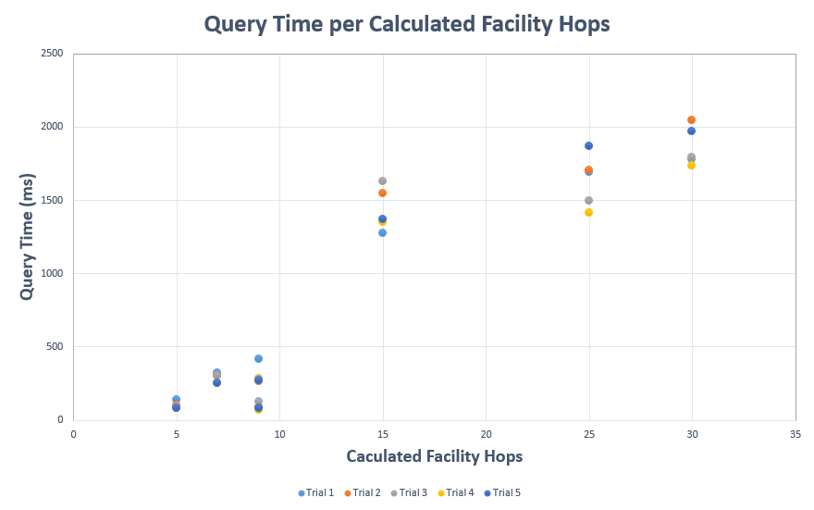
Notes:
Speaker: Matt
One goal of our system was fast response

Slide 19
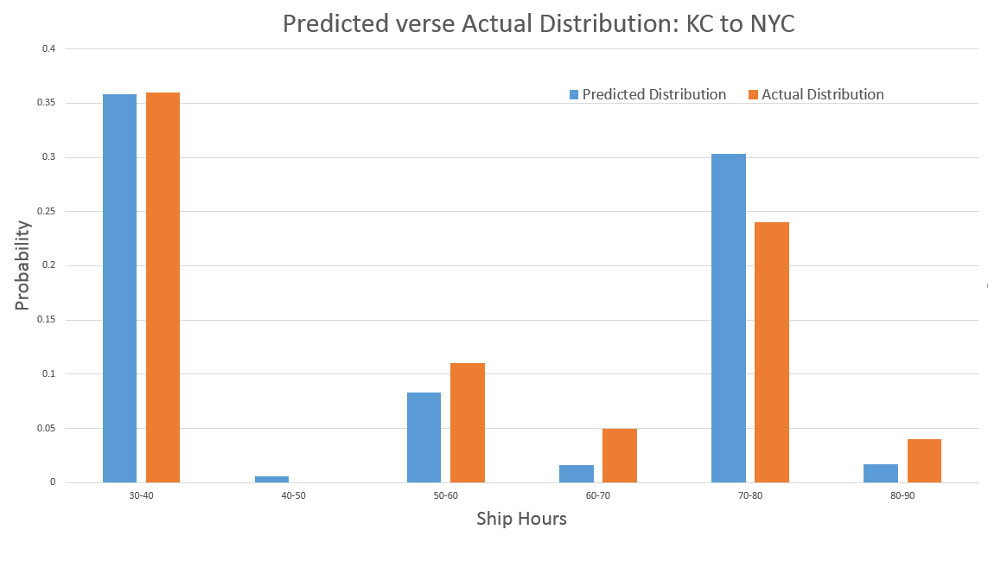
Notes:
Speaker: Matt

Slide 20
Spark Engine
(1) 36.6 minutes to process
62 million VPO rows
(2) 7 months
of scan events = 1.2 billion rows
(3) Estimated 11.8 hours
to process
Notes:
Speaker: Tiffany
50% faster on a local machine. Can be easily parallelized to be 100x faster
One of our goals was to process data quickly.
It takes less than 12 hours to process 7 months of data, which is 50% faster than the previous prototype.

Slide 21
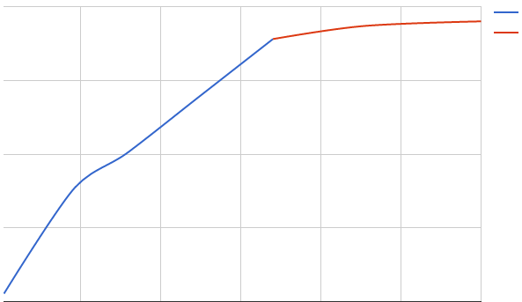
Unique ShipsTo Relationships in Neo4j
Actual
Y
Extrapolated
2.25
Number of unique
relationships (in millions)
1.25
0.75
0
X
200
400
600
Number of VPO rows (in millions)
Notes:
Speaker: Derek
Explain how this is a line graph of number of VPO rows (in millions) to the number of unique (fromFacility, toFacility) relationships (in millions)
Grows linearly but it should eventually stop growing as the dataset gets larger and only will grow because of obscure fromFacility to Facility combos

Slide 22
Demonstration
Notes:
Speaker: Matt
“match (f:Facility)-[r]->(d:Facility) with f,count(d) as cnt where cnt > 500 return f limit 15”
“MATCH p=(d:Facility{fiveZip:'07032'})-[r:ShipsTo*3]->(f:Facility{fiveZip:'02780'}) where all (r1 in relationships(p) where '027' in r1.endDestZipThrees) return p;”
Front end demo
Orig: 97527, dest: 94040, hour: 8
Orig 55121,dest 11747, hour 8, then 13

Slide 23
Conclusions
Notes:
Speaker: Derek

Slide 24
Full working prototype on local machine
Use Spark to efficiently process data
Model USPS network in Neo4j
Produce accurate predictions on an average <2 seconds
Notes:
Speaker: Derek
Conclusions and recommendations for Endicia
We were able to get a fully working prototype on our local machines but we believe that the prototype could be much more powerful and accurate
More resources to store data and compute
We can model USPS network in the Neo4j
Use Spark to efficiently process the data
Produce realistic predictions

Slide 25
Next Steps
Notes:
Speaker: Tiffany
Quick acknowledgements before we get to Q&A

Slide 26
Cloud Services
Live Updates
Add Complexity
Notes:
Speaker: Tiffany
Our results are based off of our local machines
Moving this to the cloud with more resources would drastically improve the performance
another improvement to our system is live updates.
VPO is updated every 15 minutes constantly.
Spark has a feature that can stream these updates to Neo4j
In that way, you will always have an up to date system
Finally, adding other factors such as seasonality, drop off day, and different mail classes could improve predictions

Slide 27
Acknowledgements
Notes:
Speaker: Matt
Quick acknowledgements before we get to Q&A

Slide 28
Patrick Farry
Amine Khechfé
Sanjay Nepak
Subhasis Saha
Varun Sood
All of Endicia
Mark Claypool
Craig Wills
WPI Computer Science Department
Notes:
Speaker: Matt

Slide 29
Questions?

