Slide 1
Read Eval Print Loop and User Interface for the DEX Security Policy Configuration Language
Marcus Chalmers, Felix Chen, and Timothy Goon
Notes:
Hello everyone, we are the Shape Security / F5 Group and we are here to present our REPL and User Interface for the DEX security policy configuration language.
<Introduce ourselves> M F T

Slide 2
Shape and F5
Shape Security is based in Santa Clara, CA
Shape focuses on online fraud and abuse prevention
Shape was acquired by F5 in 2020
Notes:
For our MQP, we worked with Shape Security, a cybersecurity company that focuses on online fraud and abuse prevention. Which, In 2020, was acquired by F5, a company that specializes in services to grow and improve all aspects of web applications like application delivery, availability, performance, and obviously security.

Slide 3
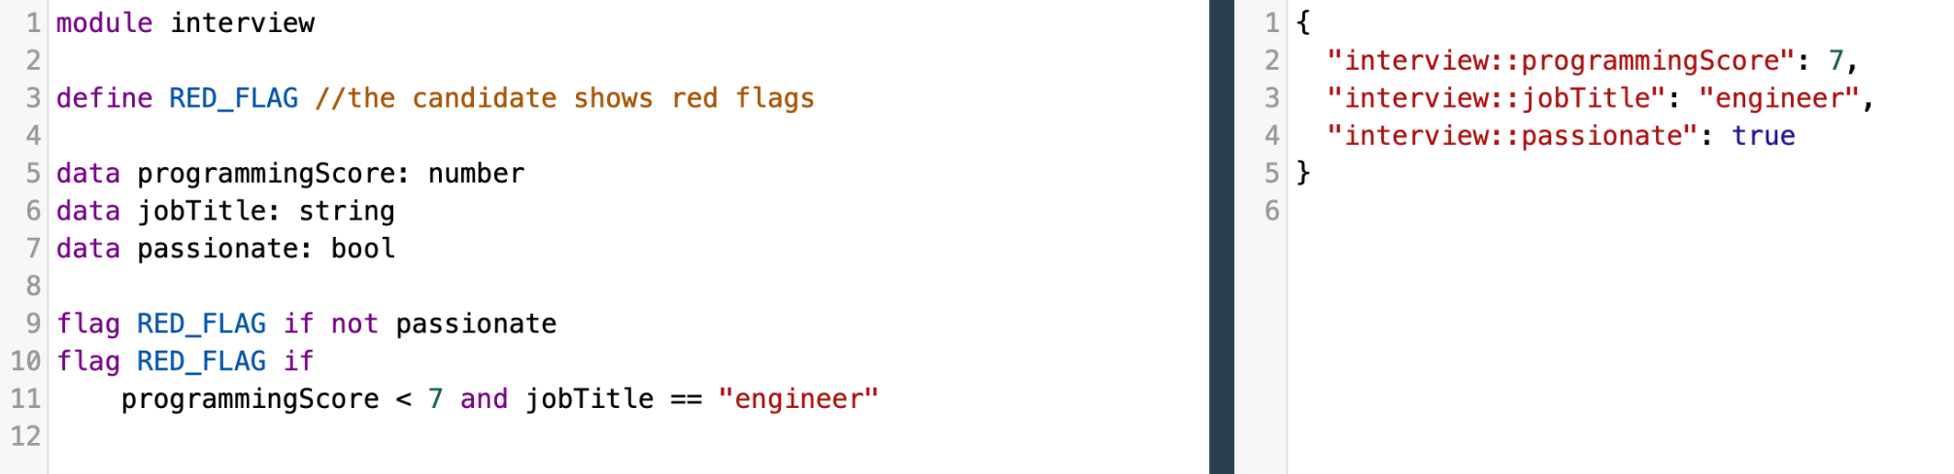
DEX
Used to configure security policies
Supports Foreign Function Interface (FFI)
Has a module system
Notes:
Our project was based around Shapes own language called DEX, which they used to configure security policies. DEX is a purely functional language that is restricted in such a way as to prevent infinite loops. While this may seem like a dowside, the simplified abilities of DEX allow security policies to be written with the upmost faith in their ability to work every time. In this small example we can see a FLAG is defined, This red flag will only be raised when one of the checks fails, given the JSON data on the right.
For our project, it’s important to mention that DEX also supports a Java FFI, or foreign function interfaces where users can write functions in Java and then import those into DEX to be used in the code. So while normally DEX is entirely functional, should the need arise any Java function can be implemented.
DEX also has a module system. That means that DEX developers create a series of modules when programing which contains all of their definitions. Then then allows them to import from each other.

Slide 4
The Problem
Development with DEX is slow
No way to do live development
https://newsinfo.inquirer.net/files/2021/02/20210212-slow-internet.png
Notes:
So what problem were we tasked with? Currently, development with DEX is slow. due to the fact that there is no way to do live development with DEX. If you were trying to test out the example on the previous slide you would have to create the whole security policy before even knowing if one of your flag rules was correct. The obvious solution to this, and the solution that can be found in many many other languages from python to C is a REPL. Which allows the user to input DEX code strings and then see what they return in real time. So you don’t have to compile a whole program just to see if your Flag is raised properly.
https://newsinfo.inquirer.net/files/2021/02/20210212-slow-internet.png

Slide 5
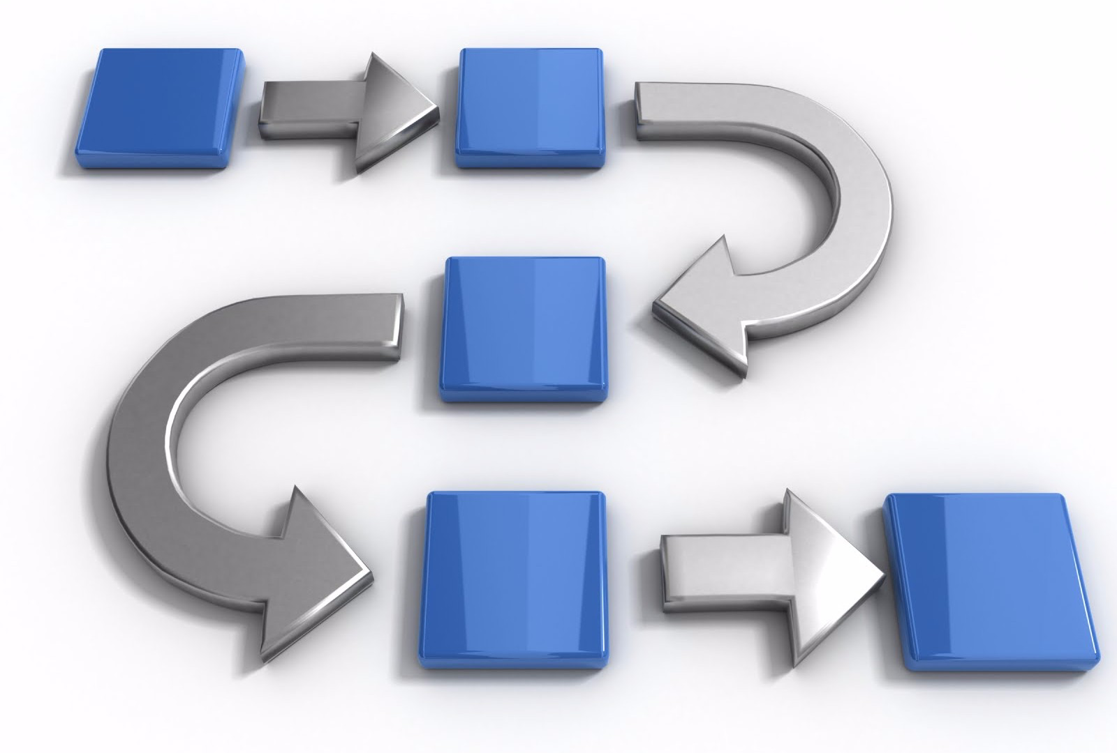
Methodology
Investigate existing tools
Develop a CLI REPL
Migrate CLI REPL to a Web UI
https://masterofproject.com/blog/3457/what-is-methodology
Notes:
After background research, our process for solving this problem started with investigating any existing tools that shape might have that would assist us. Once we found a starting point, the Athena CLI which acts as a middle man to interact with the DEX compiler, we were able to move onto developing a command line interface for our REPL which would allow the user to test DEX code line by line in the command line. Then finally we were able to migrate that CLI version of the REPL to a proper Web UI
https://masterofproject.com/blog/3457/what-is-methodology

Slide 6
CLI REPL
Notes:
We will now talk about our first implementation of the REPL, which was a Command Line Interface

Slide 7
Overview
Receive Input
Print Output
Edit REPL State
Compile and Run
Notes:
While running, our REPL loops through four states which are shown here. To keep track of data, our REPL has a REPL State which maintains important data like DEX code, JSON data, and Java FFI data.
The REPL’s initial state is waiting for input from the user. After receiving input, it then edits the REPL state depending on what the input was. Once the REPL state is updated, the DEX and JSON data is passed into the compiler and run. Finally, the output report is printed to the user and the REPL waits for additional input.

Slide 8
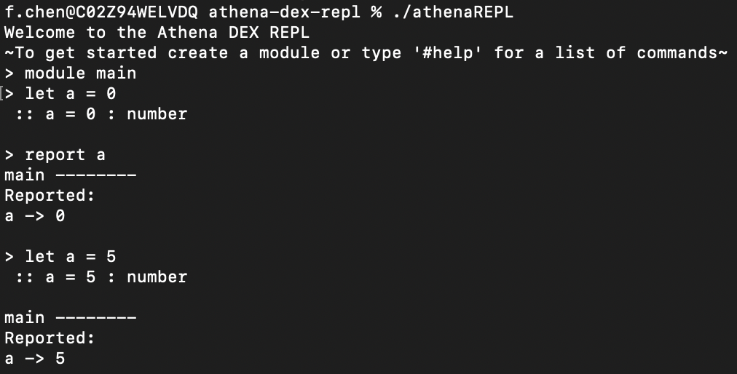
CLI Features
Notes:
This is what the user sees when they first open our CLI REPL looks with a few example lines already run. As you can see, the user can type in lines of DEX and the REPL reports the output. Anytime the REPL detects a variable being bound, it prints the type of the variable that was just bound. You can see here in this highlighted portion, when ‘A’ is set to zero, the REPL reports that ‘A’ is of the type ‘number’. The REPL also supports redeclarations of every DEX type. In this bottom portion, you can see that we have now redeclared ‘A’ to be five, and this is reflected in the fact that ‘A’ is now reported as being five. Before our project, no such tool existed where you could write individual lines of DEX and get constant results as you added more lines

Slide 9
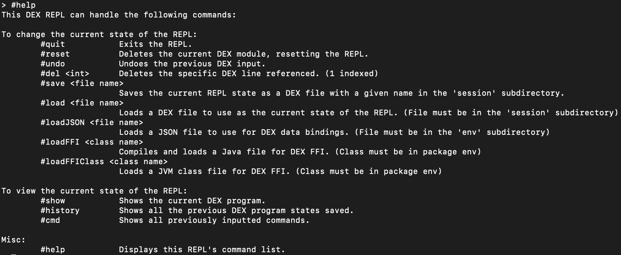
REPL Commands
Notes:
In addition to supporting DEX code, we also added many REPL commands to enhance the user experience. We have some quality of life commands such as ‘undo’ and ‘delete’ which allow the user to correct any mistakes they may have made while coding. We also added a save and load feature where the user can save and load DEX code. Finally, we have the load JSON and FFI commands which allow the user to load JSON and FFI data.

Slide 10
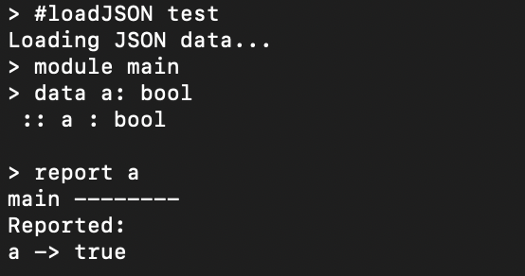
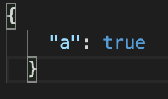
Loading JSON Data
Notes:
Here is an example of loading JSON data. On the right, we have a simple JSON file where we set ‘A’ to true. on the left, we bind the variable ‘A’ to the type boolean and when external JSON is loaded, ‘A’ is reported as true

Slide 11
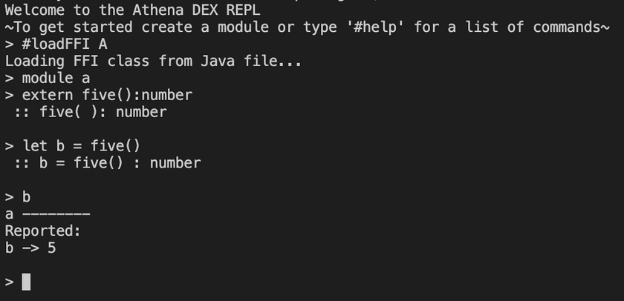
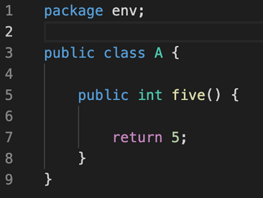
Loading Java for FFI
Notes:
Here is an example of loading external Java functions. On the right, we have a java file with a function ‘five’ that returns five. On the left, once we import the java class and bind the variable ‘B’ to the function, when we report the value of ‘B’, we get that ‘B’ is the value five.

Slide 12
Web REPL
Notes:
As an addition to the CLI REPL we created, we incorporated it into a full-stack web app to give it a UI and improve the user experience.

Slide 13
Architecture
Users
Websocket Connection
React Frontend
Spring Boot Backend
CLI REPL Code
REPL State
REPL State
Notes:
The backend server uses the REPL code we created for the CLI and also servers the frontend of the app.
The frontend will connect to the server through a websocket connection and through that have access to the REPL logic.
Web sockets are used here because the nature of a REPL means that there is going to be a lot of interaction between the front and backends and therefore it’s more efficient than using HTTP.
Also, each client will be responsible for its own REPL state to send to the backend. This allows for much simpler REPL session handling and reduces complexity in the backend.

Slide 14
Demo
Notes:
Now we’ll go into a demo of both the CLI and web REPLs.

Slide 15
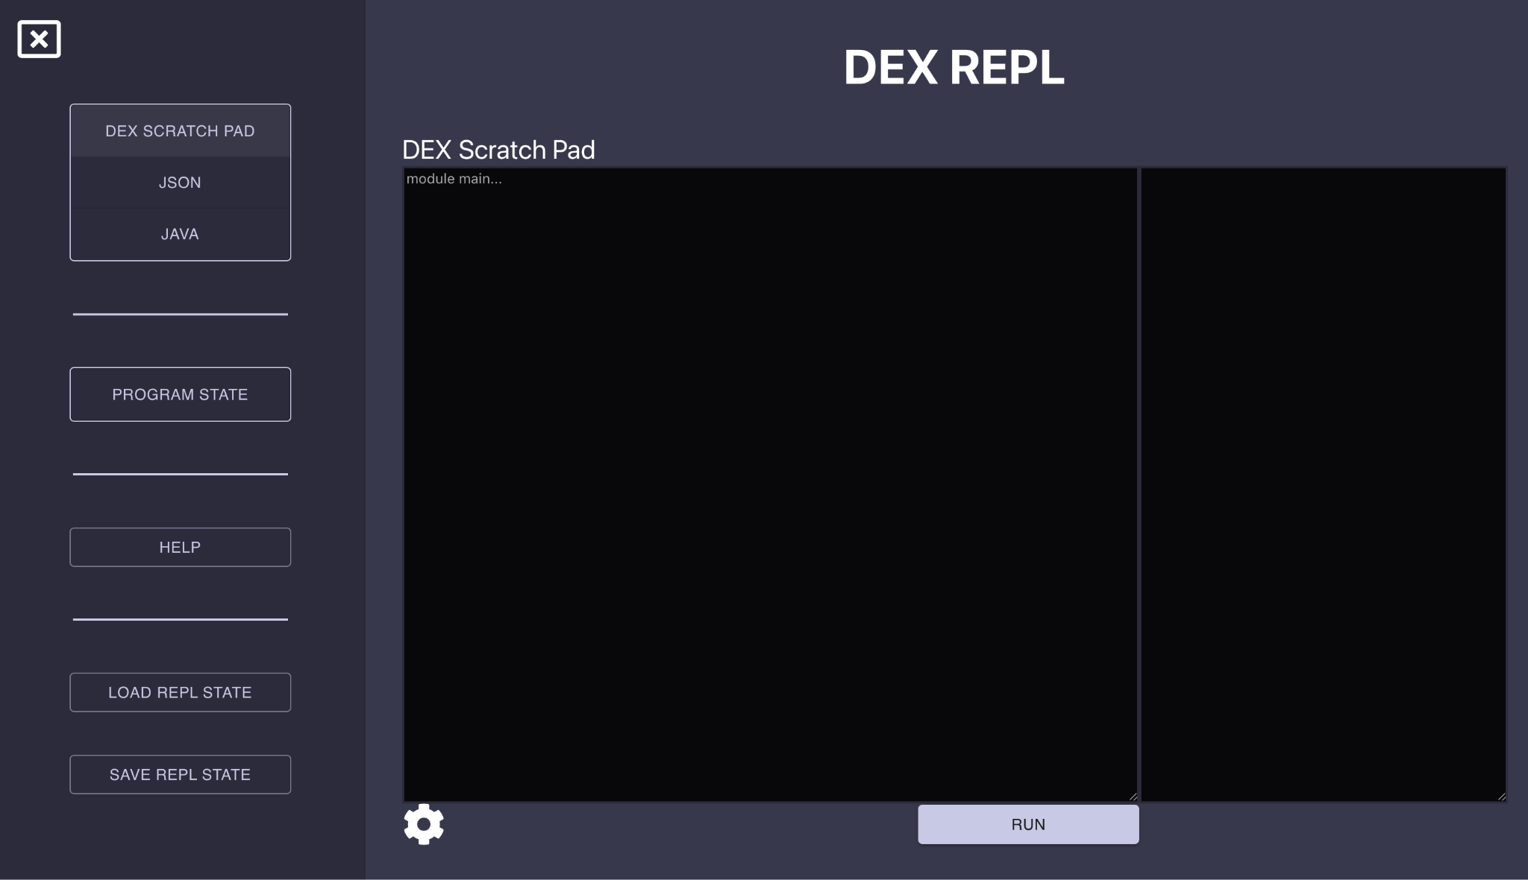
Recap and Conclusion
We investigated existing tools
We made both a CLI REPL and a Web REPL
Presented our project to engineers at F5
Notes:
Felix:
To quickly recap our project, we started by first investigating existing DEX development tools. Then, we made a CLI REPL which we ported over to a web UI. Finally, we presented our project to engineers at F5 and they loved it. In fact, a few of them seemed really excited to get their hands on it as soon as possible to start playing around with the REPL we created.

Slide 16
Future Work
Improve styling and user experience
Add more user customization
Add database for saving and loading files
Add login system
Add debugging features
https://www.forbes.com/sites/deborahlovich/2021/03/03/the-many-benefits-of-employees-designing-the-future-of-work/?sh=fbc699d6341c
Notes:
Felix:
We have some ideas about future work which could be done on this project. FIrst, there can always be improvements made to the styling of the UI and the user experience. There could also be more user customization so that things like color scheme and fonts or font sizes could be changed. A database could be added so that users could save and load data without having to save and load things from their computer. Along with this, linking the F5 authentication system to our REPL would allow each user to have their own profile that data could be stored on, such as the previously mentioned UI customizations or save files. Lastly, we could add some debugging functionality to the REPL
https://www.forbes.com/sites/deborahlovich/2021/03/03/the-many-benefits-of-employees-designing-the-future-of-work/?sh=fbc699d6341c

Slide 17
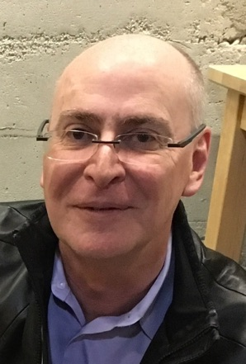
Acknowledgments
Mark Claypool
Gilad Bracha
Michael Ficarra
Daniel Szmulewicz
Notes:
Finally, we would like to thank the people who made this project possible including,
Our WPI Project Advisor: Professor Mark Claypool
And from F5,
Technical Fellow: Gilad Bracha,
Distinguished Engineer: Michael Ficarra
And Sr Software Engineer: Daniel Szmulewicz

Slide 18
Thank You!
Read Eval Print Loop and User Interface for DEX Security Policy Language
Marcus Chalmers, Felix Chen, and Timothy Goon
Notes:
Thank you!
At this time we would like to answer any questions

