Slide 1
Impact of Acknowledgements on Application Performance in 4G LTE Networks
Master’s Thesis Presentation
Brett Levasseur
Advisors
Mark Claypool, Robert Kinicki
Reader
Emanuel Agu

Slide 2
Network Growth
Worldwide Mobile networks in 2013
½ billion mobile devices added
77% of this growth from smartphones
Mobile data traffic grew 81%
Mobile video traffic 51% of all mobile data
4G in 2013
2.9% of all connections
Account for 30% of all mobile traffic
Predicted to be ½ of all connections in 2018
[Cisco 13]

Slide 3
4G Long Term Evolution (LTE)
Long Term Evolution (LTE) – Standard created by the 3rd Generation Partnership Project
Deployed globally
All packet switched network
High throughput and QoS considerations
Provides wireless retransmissions of lost data

Slide 4
Wireless Loss and LTE
LTE responds to poor signal quality by decreasing throughput
Retransmissions
LTE has multiple configuration parameters for wireless retransmissions
E.g. 1 or 2 layers of retransmissions
Network providers may not choose optimum settings
Application developers have no knowledge on LTE retransmissions

Slide 5
General Problem Statement
How do LTE retransmissions impact application performance?
What LTE retransmissions settings impact application performance?
Which LTE retransmission policies are preferred in different wireless loss conditions?

Slide 6
Outline
Introduction
Background
LTE
ns-3
Related Work
Approach
Results
Conclusion

Slide 7
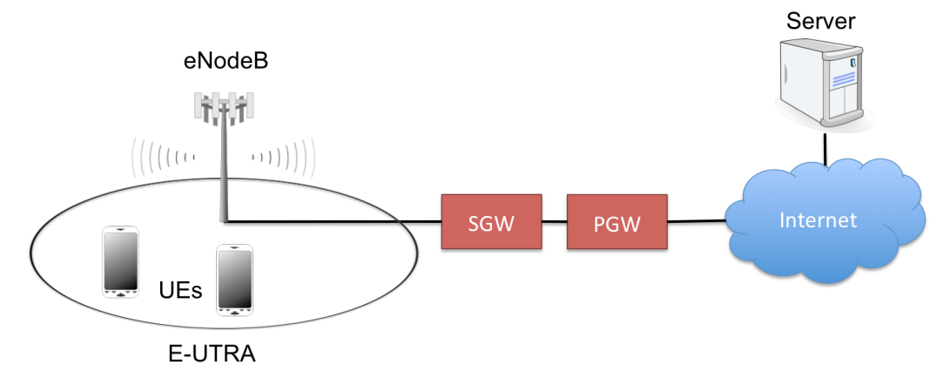
LTE Network
Packet Delivery Network Gateway (PGW)
Connects LTE network to IP networks
Serving Gateway (SGW)
Route packets to and from wireless access points
Enhanced Node B (eNodeB)
Wireless access point
User Equipment (UE)
End user devices

Slide 8
LTE Network Layers
Application
LTE wireless network has 6 layers (not all shown)
PHY – RLC layers carry user and network control data
LTE transmits collections of Physical Resource Blocks (PRB)s in transport blocks
TCP
UDP
IP
RLC
MAC
PHY

Slide 9
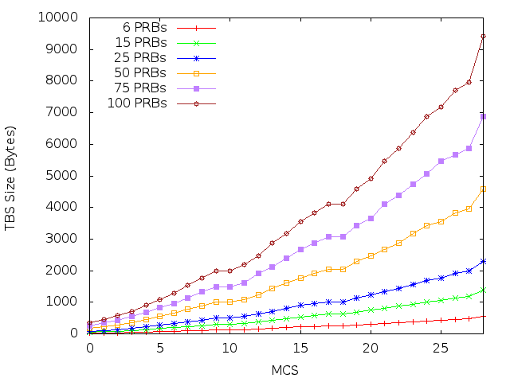
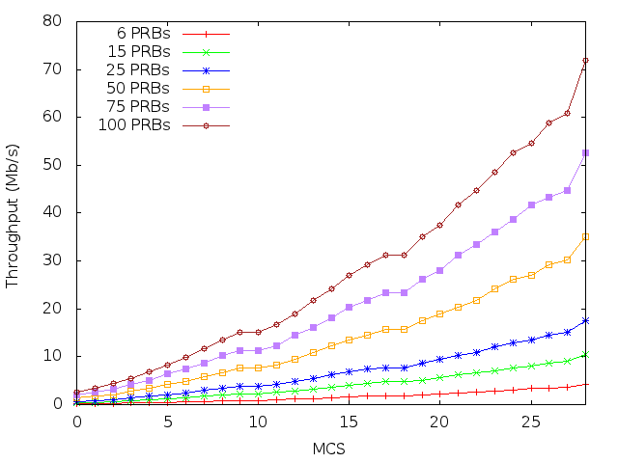
Channel Quality Indictor (CQI)
UEs send CQI to notify received signal quality
Maps to modulation and encoding schemes (MCS)
MCS and PRBs determine transport block size

Slide 10
LTE Retransmissions: MAC
1ms TTI
[Dahlman 11]
Hybrid Automatic Request Reply (HARQ)
Data sent at time n, arrives at time n
3ms taken to check if data arrived with errors
n+4 ACK/NACK sent back
n+8 if NACK, data can be retransmitted
Up to 3 retransmissions for downlink traffic

Slide 11
LTE Retransmissions: RLC
Unacknowledged Mode (UM) receive window
VR(UR) – Lower bound
VR(UH) – Highest received SN + 1
VR(UX) – Reordering SN
Acknowledged Mode (AM) receive window
VR(R) – Lower bound
VR(H) – Highest received SN + 1
VR(X) – Reordering SN
VR(MS) – Highest SN to ACK
VR(MR) – Upper bound

Slide 12
RLC UM
0
1
2
3
4
5
6
VR(UR),VR(UH)
Receiving window used for reordering PDUs
Out of order PDU trigger timer t-Reordering
0
1
2
3
4
5
6
VR(UR)
VR(UX),VR(UH)

Slide 13
Timer t-Reordering UM
0
1
2
3
4
5
6
Timer runs when PDUs arrive out of order
Gives MAC layer chance to recover lost data
Expiration moves VR(UR) up to first SN >= VR(UX) that is not received
Tradeoffs
Small timer, MAC retransmissions lost
Large timer, keeps lower bound of window stalled
VR(UR)
VR(UX),VR(UH)
0
1
2
3
4
5
6
VR(UR),VR(UH)
Recovered
0
1
2
3
4
5
6
VR(UR),VR(UH)
LOST

Slide 14
RLC AM
0
1
2
3
4
5
6
VR(R),VR(H),VR(MS)
Receiving window used for reordering and ACK/NACK messaging
0
1
2
3
4
5
6
VR(R),VR(MS)
VR(X),VR(H)

Slide 15
Timer t-Reordering AM
0
1
2
3
4
5
6
Gives MAC layer time before NACKing
t-Reordering starts when SN 5 arrives
ACK = 3
While running SN 4 arrives
ACK = 3
When timer expires VR(MS) is updated
ACK = 6, NACK = 3
Tradeoffs
Small timer, NACK data that MAC can recover
Large timer, stalls NACKs
VR(R),VR(MS)
VR(X),VR(H)
0
1
2
3
4
5
6
VR(R),VR(MS)
VR(X),VR(H)
0
1
2
3
4
5
6
VR(R)
VR(H),VR(MS)

Slide 16
RLC AM STATUS
Control message for sending ACKs/NACKs between UEs and eNodeBs
Sender polls for STATUS messages
[LTE RLC]

Slide 17
Timer t-StatusProhibit
Receiver side timer
Stops receiver from sending STATUS messages
Timer started when STATUS message sent
All poll requests collapsed to one STATUS sent when timer expires
Trade off
Small timer could send many STATUS messages
Large timer delays sending ACKs and NACKs

Slide 18
Outline
Introduction
Background
LTE
ns-3
Related Work
Approach
Results
Conclusion

Slide 19
ns-3
Open source packet level network simulator
Successor to ns-2
Funded by National Science Foundation and the Planete group at INRIA Sophia Antipolis
2009 - 2012 ns-3 downloaded 50,792 times
As of version 3.16 there were 113 listed authors and 25 maintainers
[ns-3]
[ns-3 stats]

Slide 20
LTE-EPC Network Simulator Module
LTE/EPC Network Simulator (LENA)
Developed Centre Tecnologic de Telecomunicacions de Catalunya
Allows simulations with LTE networks in ns-3
Part of the main ns-3 branch
Still under active development
[Baldo 11]

Slide 21
Outline
Introduction
Background
LTE
ns-3
Related Work
Approach
Results
Conclusion

Slide 22
Related Work
Applications Used
Böhmer et al. – Mobile apps mostly used for communication
Huang et al. – Majority of data over LTE uses TCP
HARQ
Kawser et al. – Limit MAC retransmissions to 3 or less
RLC AM
Makidis – Examined TCP with RLC AM
[Böhmer 11]
[Huang 13]
[Kawser 12]
[Makidis 07]

Slide 23
Outline
Introduction
Background
LTE
ns-3
Related Work
Approach
Results
Conclusion

Slide 24
Specific Problem Statement
How do MAC and RLC layer retransmission impact VoIP, FTP, Video
Delay/Loss/Throughput sensitive
How does adjusting RLC timer settings impact retransmissions and application performance
When is it better to use RLC AM or UM with varying loss rates at physical layer

Slide 25
ns-3 LTE Modifications
LTE module for ns-3 did not support NACKs in AM STATUS message
Joined discussion forum to implement NACKs
Worked with LTE module developers and others
Provided code for (de-)serializing NACKs to developers
Discussed specifics of AM receive window for NACKs with developers
Helped LTE model developers test changes
[ns-3 Forum]

Slide 26
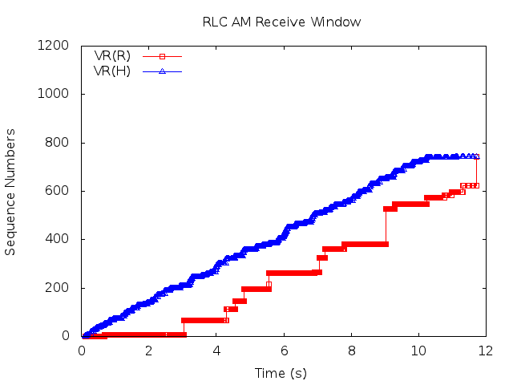
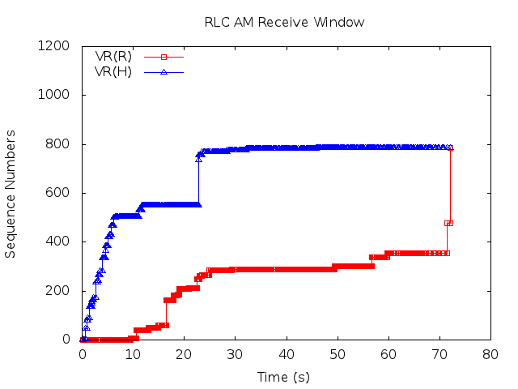
Simulator Additions
Confirmed NACK read/write works
Modified how NACKs are selected
Found and corrected errors on when AM window variables were updated
Tests show AM recovers all lost PDUs

Slide 27
Simulating VoIP
ns-3 example code for application that sends data at a specified rate
Use G.711 encoding format to define size of packets and sending rate
160 bytes data, 12 bytes RTP header, 8 bytes UDP header, 20 bytes IP header
Sending rate 64Kbps or about 1 packet every 20ms
Mean Opinion Score (MOS) used as performance metric
1 – 5 point scale, 1 worst, 5 best
Calculated from delay and loss using E-Model
[ITU G.711]
[E-Model]

Slide 28
Simulating FTP
ns-3 bulk send application
Transmits as much data as possible over TCP
Default ns-3 congestion control algorithm is NewReno
Throughput used as performance metric

Slide 29
Simulating MPEG
ns-3 MPEG trace file application
Reads a file of MPEG frame sizes and times to transmit
Sends frames in UDP packets
Compatible video trace files from the Telecommunication Network Group at Technische Universität Berlin
Selected video of soccer match
Frame rate used as performance metric
[MPEG Trace]

Slide 30
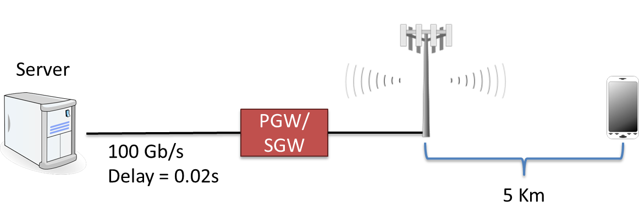
Simulation Network
Server sends data to UE
Wireless link bottleneck
UE stationary
No obstructions or noise sources
UE positioned so it would request CQI 8

Slide 31
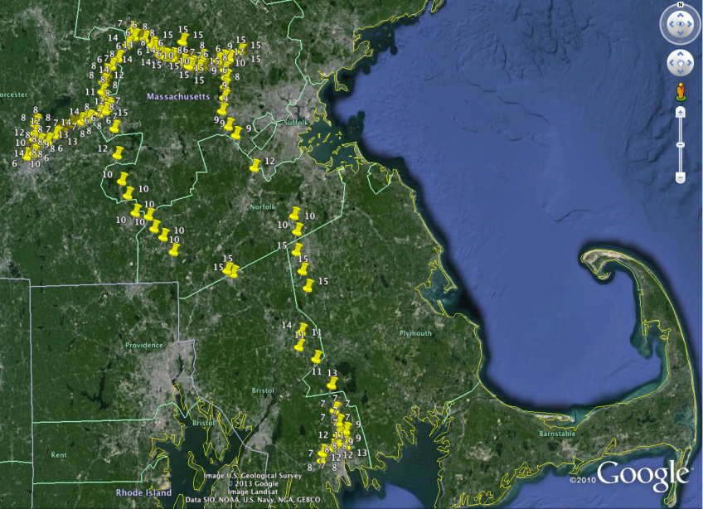
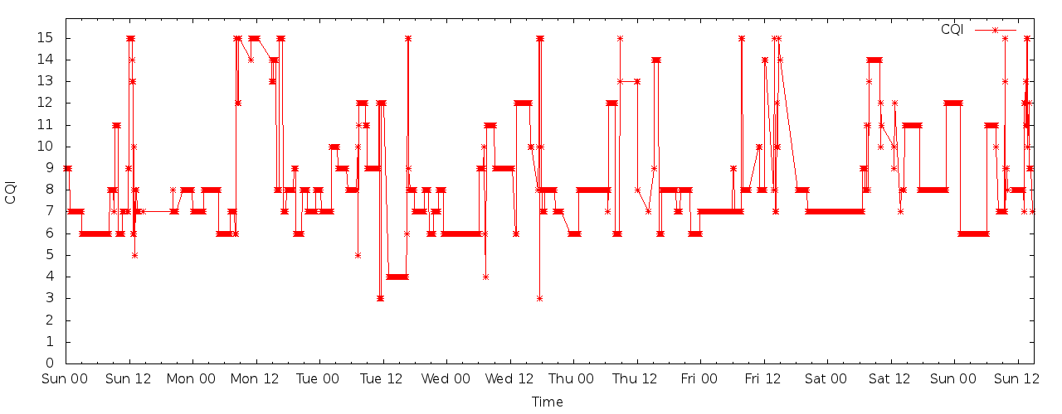
CQI Choice
Wrote Android application to log requested CQI value on LTE networks
Collected data over 1 week from Feb – March 2014
Average CQI requested was 8

Slide 32
Wireless Loss
LTE simulator allows fading trace files to impose SINR
File is a matrix of TTI, PRB number and SINR
If fading trace SINR is too high any data in that PRB sent in that TTI is lost
Gilbert-Elliot model used to set which TTIs have loss
Bursty Loss

Slide 33
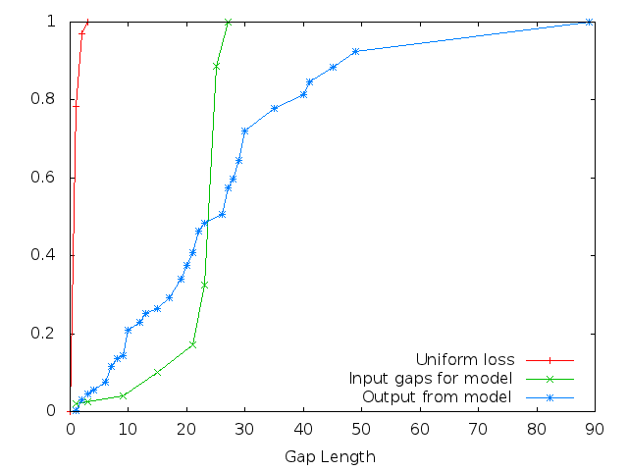
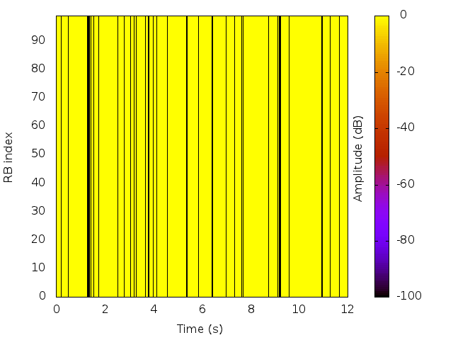
Wireless Loss Cont
Creating fading loss file
Run previous equations for state transitions
Run Gilbert model

Slide 34
RLC Settings
Test adjusting t-Reordering and t-StatusProhibit timers
Settings suggested in LTE specification
Subset of these suggested values are used for testing
t-Reordering | 0 ms, 5, 10, 15, 20, 25, 30, 35, 40, 45, 50, 55, 60, 65, 70, 75, 80, 85, 90, 95, 100, 110, 120, 130, 140, 150, 160, 170, 180, 190, 200
t-StatusProhibit | 0 ms, 5, 10, 15, 20, 25, 30, 35, 40, 45, 50, 55, 60, 65, 70, 75, 80, 85, 90, 95 100, 105, 110, 115, 120, 125, 130, 135, 140, 145, 150, 155, 160, 165, 170, 175, 180, 185, 190, 195, 200, 205, 210, 215, 220, 225, 230, 235, 240, 245, 250, 300, 350, 400, 450, 500
[LTE RRC]

Slide 35
Outline
Introduction
Background
LTE
ns-3
Related Work
Approach
Results
Conclusion

Slide 36
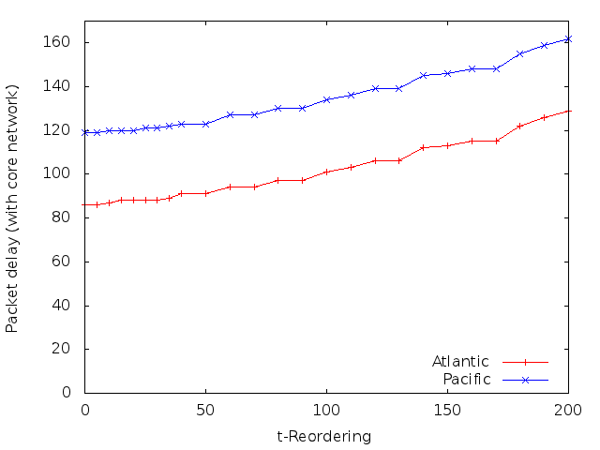
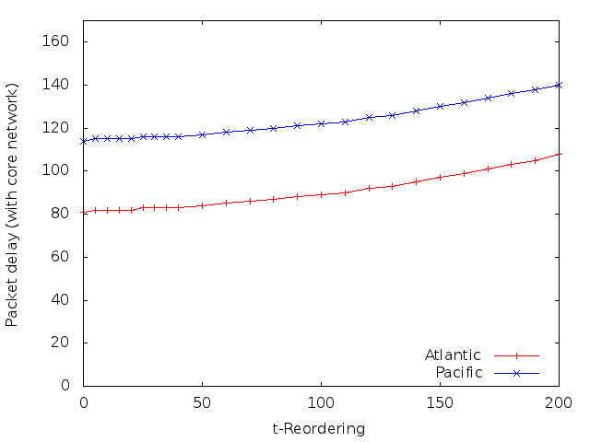
VoIP t-Reordering
AM
UM
Adjusting t-Reordering has little impact on delay
AM experiences more delay but not by much

Slide 37
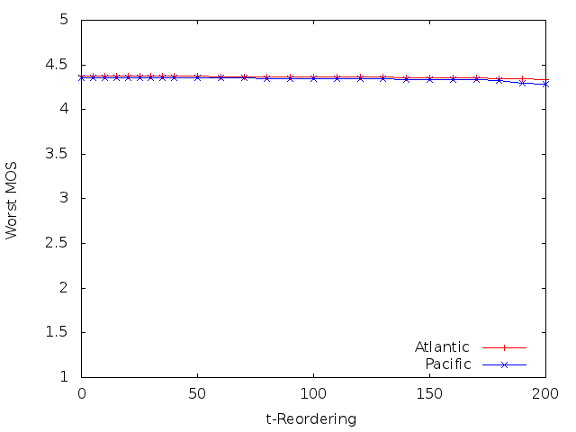
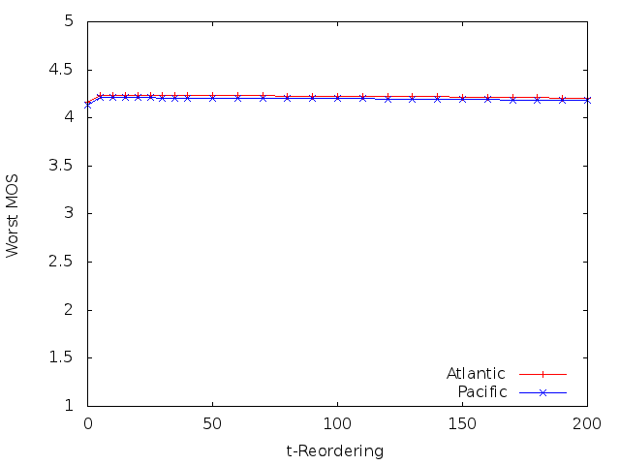
VoIP t-Reordering
AM
UM
Adjusting t-Reordering has little impact on MOS
Worst MOS is still good across all settings
Fix t-Reordering = 30ms

Slide 38
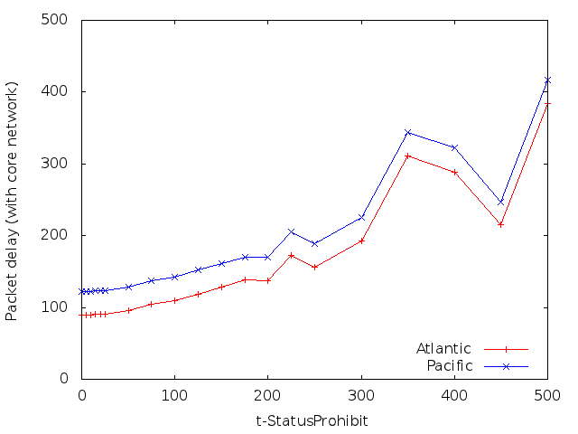
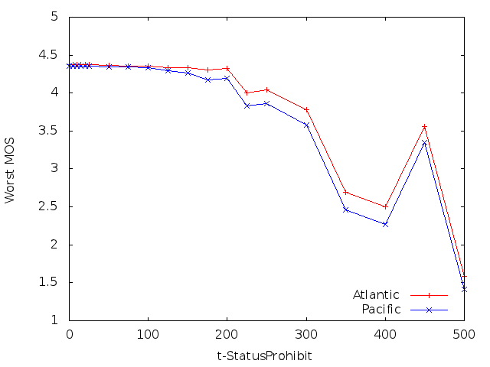
VoIP t-StatusProhibit
Adjusting t-StatusProhibit has greater impact
Lower values for timer better than higher in general
Fix t-StatusProhibit = 50ms

Slide 39
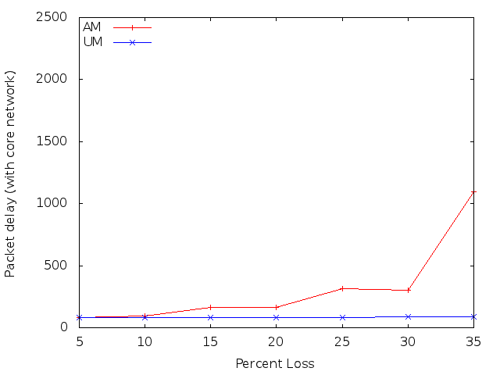
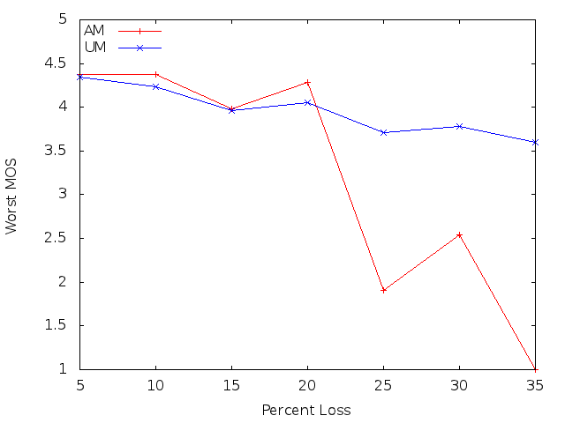
VoIP AM vs UM
Adjusted loss percent
VoIP over AM outperforms VoIP over UM until 20% loss
Same for both Atlantic and Pacific test

Slide 40
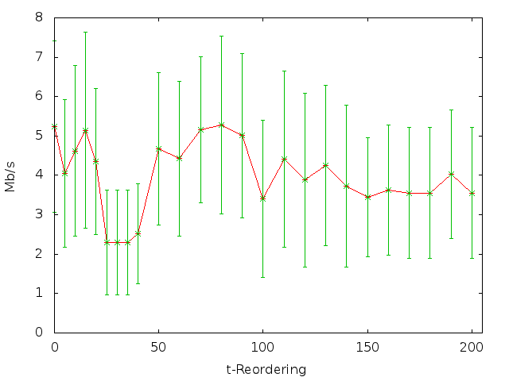
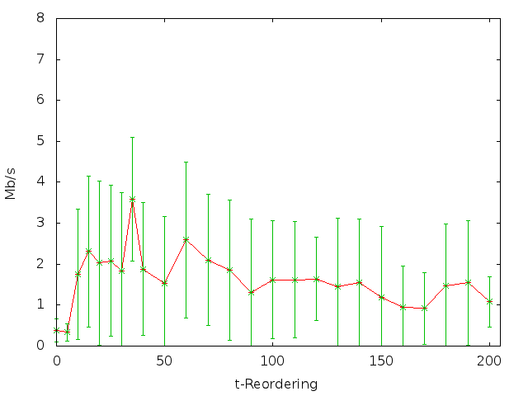
FTP t-Reordering
AM
UM
AM outperforms UM across t-Reordering
Large error ranges due to TCP RTO
Fix t-Reordering = 50ms

Slide 41
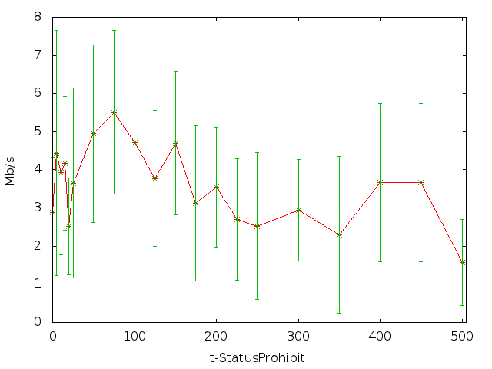
FTP t-StatusProhibit
Lower values for t-StatusProhibit are better
Large error ranges from TCP RTOs
Fix t-StatusProhibit = 75ms

Slide 42
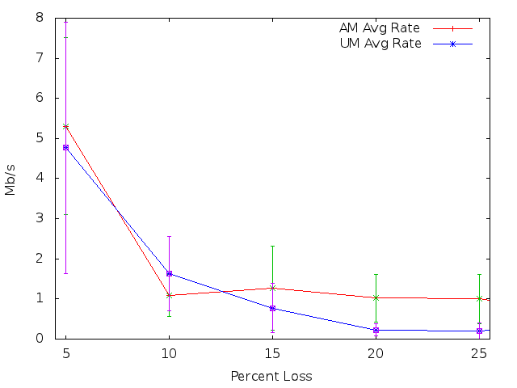
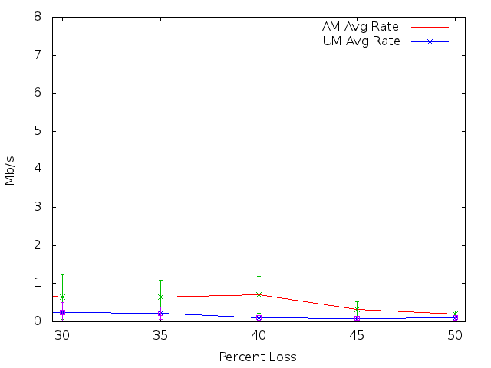
FTP AM vs UM
FTP over AM has higher average throughput than FTP over UM
UM briefly better at 10% loss but has higher error range
Input gap lengths up to 30 for 5 – 25% and up to 100 for 30 – 50%

Slide 43
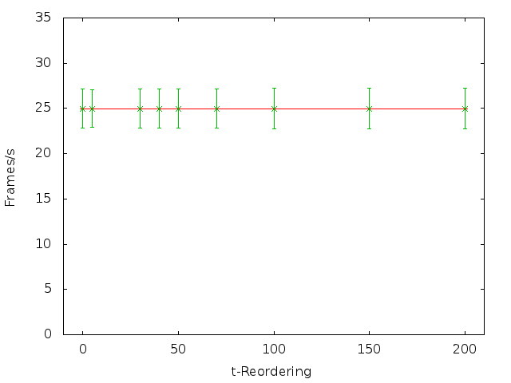
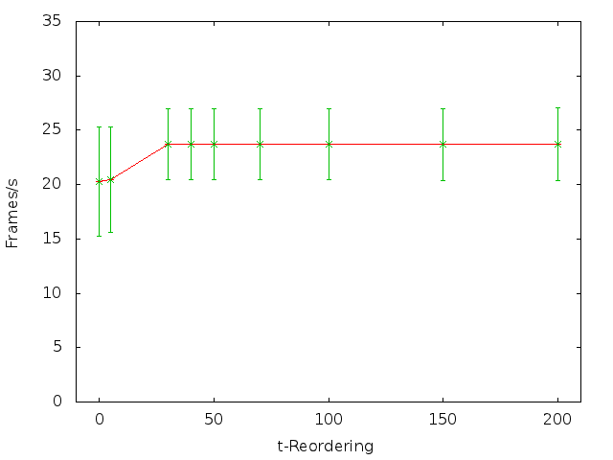
MPEG t-Reordering
AM
UM
Adjusting t-Reordering has little impact on frame rate
Exception is additional frames recovered in UM
Fix t-Reordering = 30ms

Slide 44
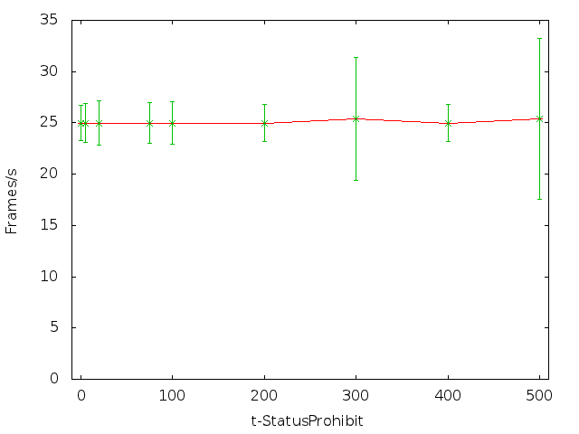
MPEG t-StatusProhibit
Lower values for t-StatusProhibit produce less variation
Large error ranges from RLC retransmissions
Fix t-StatusProhibit = 75ms

Slide 45
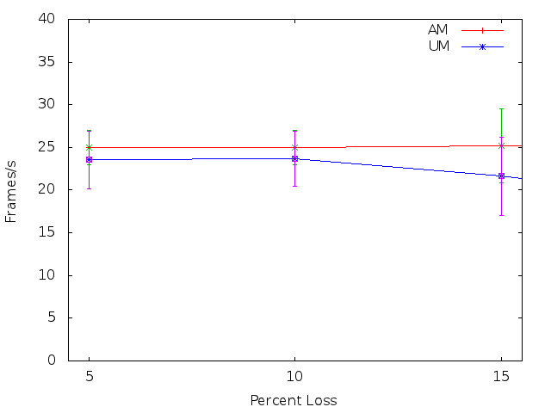
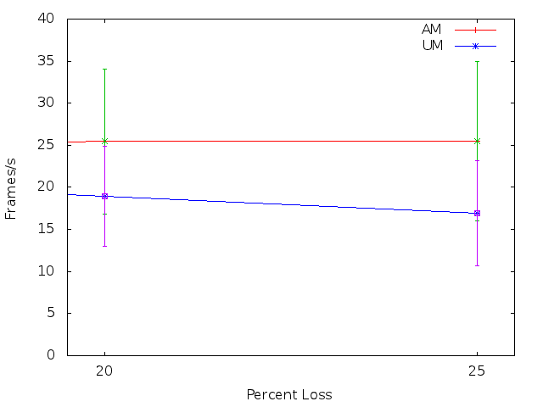
MPEG AM vs UM
AM – Higher average frame rate
UM – Lower average frame rate

Slide 46
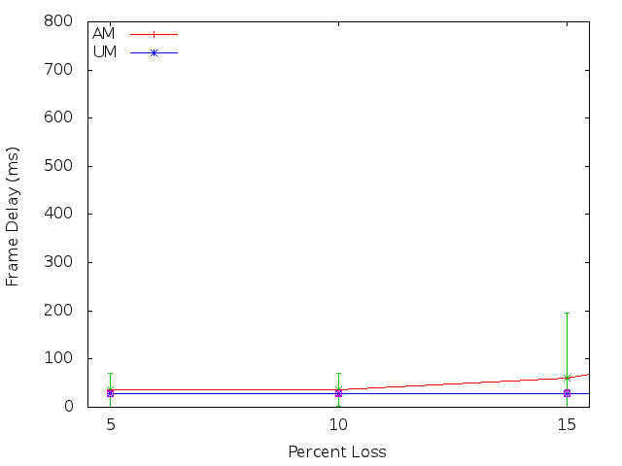
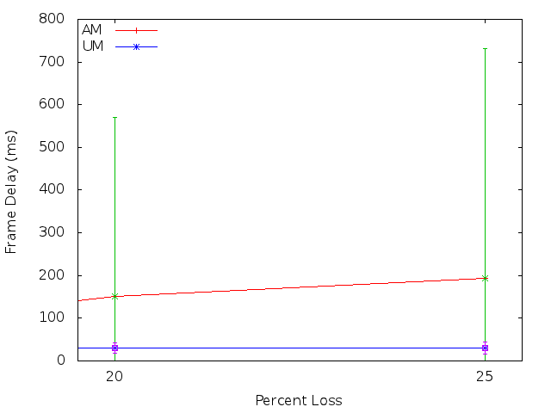
MPEG AM vs UM
AM – Out of order frames delayed by retransmissions
UM – Lower average delay but more frames lost

Slide 47
Conclusion
Added RLC AM NACKs to ns-3 LTE simulator
VoIP over AM has higher MOS until 20% loss
5 – 20% loss rate AM avg 4.26, UM avg 4.15
25 – 35% loss rate AM avg 1.82, UM avg 3.7
FTP over AM has higher average throughput
AM average throughput 1.21Mb/s, UM 0.83 Mb/s
Video over AM has higher delay, UM lower average frame rate
AM avg 25 frames per sec, UM avg 21
UM frame delay avg 29 ms, AM avg 95 ms

Slide 48
Future Work
Video simulations with TCP
Test with other RLC layer settings
t-PollRetransmit timer
PollPDU and pollByte
Add support for RLC AM maximum retransmission radio link layer failure

Slide 49
Questions
Impact of Acknowledgements on Application Performance in 4G LTE Networks
Master’s Thesis Presentation
Brett Levasseur
Advisors
Mark Claypool, Robert Kinicki
Reader
Emanuel Agu

Slide 50
References
[LTE RLC] 3GPP. 3rd Generation Partnership Project; Technical Specification Group Radio Access Network; Evolved Universal Terrestrial Radio Access (E-UTRA); Radio Link Control (RLC) protocol specification (Release 8). Technical Specification 36.322v8.0.0, 3GPP, December 2007. http://www.3gpp.org/ftp/Specs/html-info/36322.htm.
[LTE RRC] 3GPP. 3rd Generation Partnership Project; Technical Specification Group Radio Access Network; Evolved Universal Terrestrial Radio Access (E-UTRA); Radio Resource Control (RRC) Protocol specication (Release 8). Technical Specication 36.331v8.10.0, 3GPP, march 2008. http://www.3gpp.org/ftp/Specs/html-info/36331.htm.
[Cisco 13] Cisco. Cisco Visual Networking Index: Global Mobile Data Traffic Forecast Update, 2013-2018. Technical report, Cisco, 2014. http://www.cisco.com/en/US/solutions/collateral/ns341/ns525/ns537/ns705/ns827/white paper c11-520862.pdf
[Dahlman 11] Erik Dahlman, Stefan Parkvall, and Johan Skold. 4G LTE/LTE-Advanced for Mobile Broadband. Academic Press, Oxford, 2011.
[Zyren 07] Jim Zyren. Overveiw of the 3GPP Long Term Evolution Physical Layer. Technical report, Freescale Semiconductor, 07 2007.
[ns-3] https://www.nsnam.org/
[ns-3 stats] https://www.nsnam.org/overview/statistics/
[Baldo 11] Nicola Baldo, Marco Miozzo, Manuel Requena-Esteso, and Jaume Nin-Guerrero. An open source product-oriented lte network simulator based on ns-3. In Proceedings of the 14th ACM International Conference on Modeling, Analysis and Simulation of Wireless and Mobile Systems, MSWiM '11, pages 293{298, New York, NY, USA, 2011. ACM.
[ITU G.711] International Telecommunication Union. Pulse Code Movulation (PCM) of Vlice Frequencies. Technical Specification G.711, ITU-T, November 1988. https://www.itu.int/rec/dologin pub.asp?lang=e&id=T-REC-G.711-198811-I!!PDFE& type=items.
[MPEG Trace] http://www-tkn.ee.tu-berlin.de/research/trace/trace.html
[Gordo 10] N Gordo and A Daniel. Evaluating video quality degradation from data packet losses in an lte environment, 2010.
[Verizon] Verizon. IP Lagency Sstatistics, April 2014. http://www.verizonenterprise.com/about/network/latency/.

Slide 51
References Cont
[ns-3 Forum] https://groups.google.com/forum/#!topic/ns-3-users/CEfmMX3IRBw
[E-Model] Leandro Carvalho, Edjair Mota, Regeane Aguiar, Ana F Lima, Jose Neuman de Souza, and Anderson Barreto. An E-model implementation for speech quality evaluation in VoIP systems. In Proceedings of the 10th IEEE Symposium on Computers and Communications, volume 154. IEEE Computer Society, 2005.
[Böhmer 11] Matthias Böhmer, Brent Hecht, Johannes Schoning, Antonio Kruger, and Gernot Bauer. Falling asleep with angry birds, facebook and kindle: a large scale study on mobile application usage. In Proceedings of the 13th International Conference on Human Computer Interaction with Mobile Devices and Services, pages 47{56. ACM, 2011.
[Huang 13] Junxian Huang, Feng Qian, Yihua Guo, Yuanyuan Zhou, Qiang Xu, Z. Morley Mao, Subhabrata Sen, and Oliver Spatscheck. An In-depth Study of LTE: Eect of Network Protocol and Application Behavior on Performance. In Proceedings of the ACM SIG-COMM 2013 Conference on SIGCOMM, SIGCOMM '13, pages 363{374, New York, NY, USA, 2013. ACM.
[Makidis 07] Michael Makidis. Implementing and evaluating the RLC/AM protocol of the 3GPP specification. Master's thesis, Athens University of Economics and Business, 2007.
[Kawser 12] T. Mohammad Kawser, Nax Imtiaz Bin Hamid, Nayeemul Hasan, M. Shah Alam, and M. Musqur Rahman. Limiting HARQ Retransmissions in Downlink for Poor Radio Link in LTE. International Journal of Information and Electronics Engineering, 2012.

Slide 52
Backup Slides

Slide 53
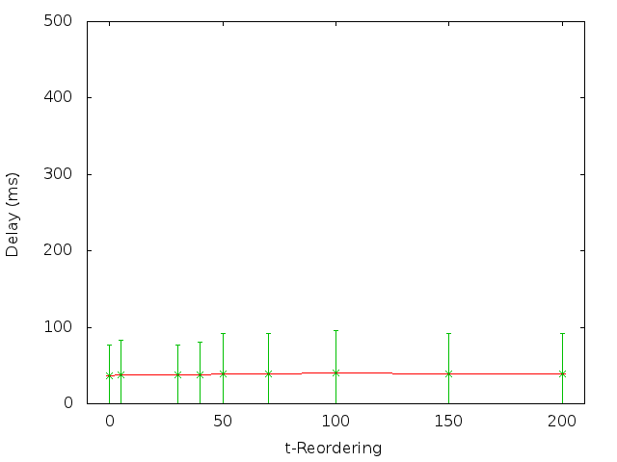
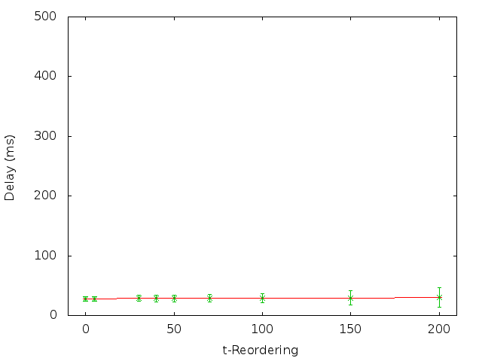
MPEG t-Reordering
AM
UM
Video over UM outperforms video over AM across t-Reordering
Fix t-Reordering = 30ms

Slide 54
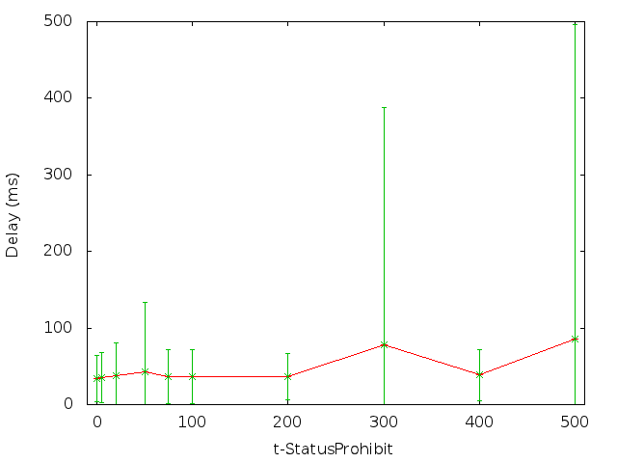
MPEG t-StatusProhibit
Lower values for t-StatusProhibit are better
Large error ranges from RLC retransmissions
Fix t-StatusProhibit = 75ms

Slide 55
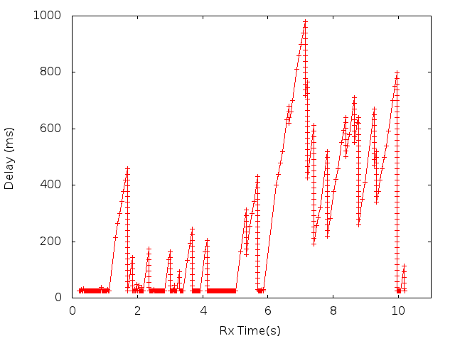
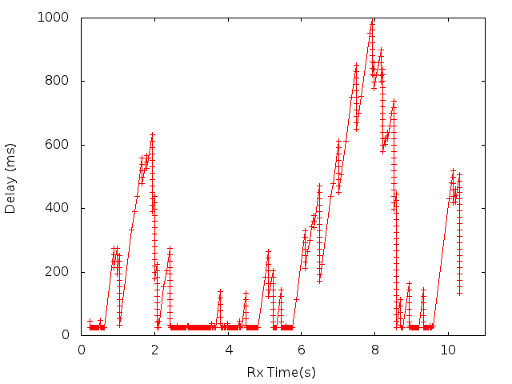
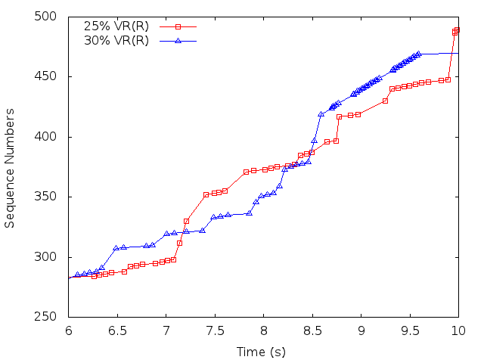
Loss Shape
30% loss performs better for AM than 25%

Slide 56
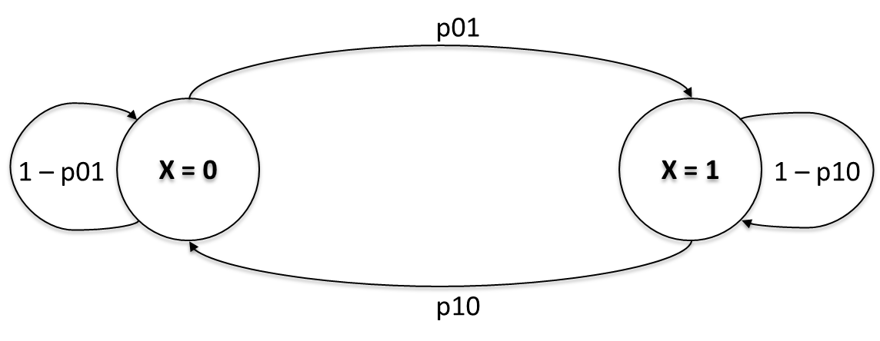
Gilbert-Elliot Model
Two state machine for loss
X = 0 no loss
X = 1 loss
Transition probabilities define when to change states

Slide 57
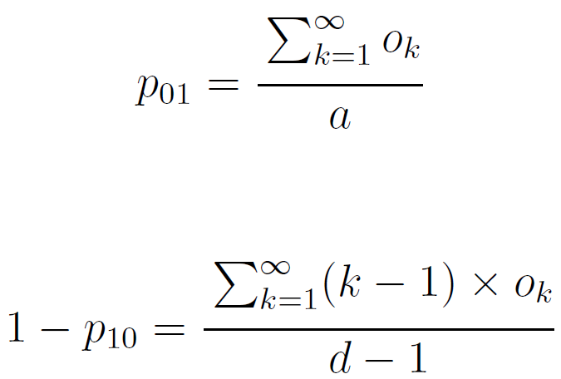
Transitions
Gordo et al. shows how to take input of loss gaps and determine state transitions
O_{k} – # of burst losses of length k
a - # of TTIs
d - # of lost TTIs
[Gordo 10]

Slide 58
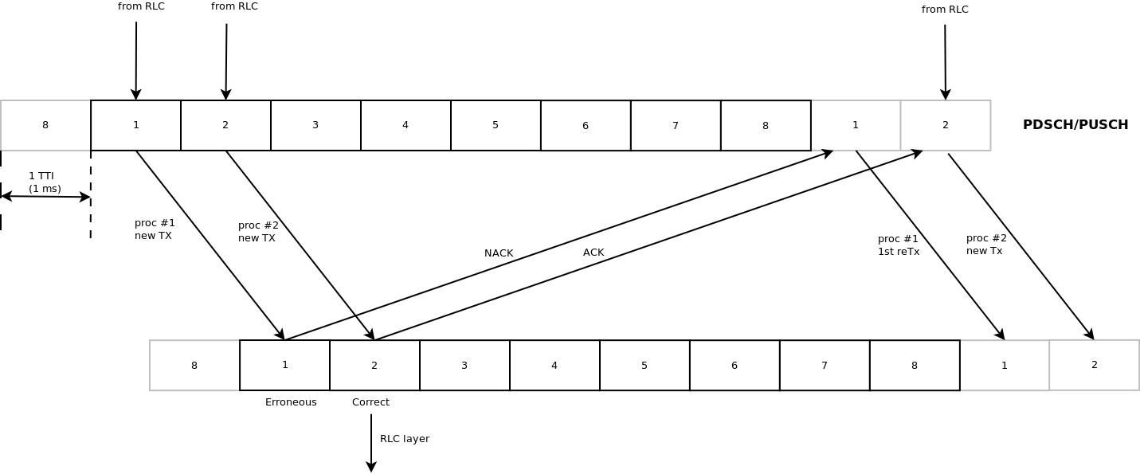
HARQ
MAC layer fixes blocks with known errors

Slide 59
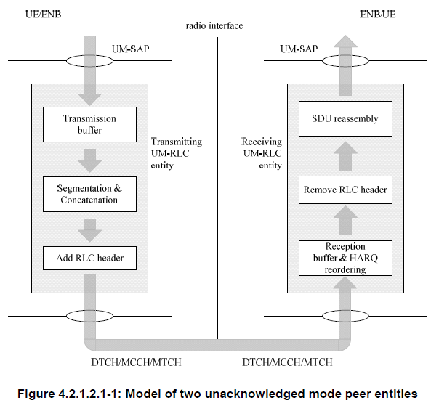
RLC UM
Maintains transmission & reception buffers
Segmentation & concatenation of RLC SDUs
Reorder of PDUs
Retransmissions still occur in MAC layer

Slide 60
RLC AM
Maintains transmission, retransmission & reception buffers
Segmentation & concatenation of RLC SDUs
Reorder of PDUs
Sliding window for PDUs sent/received
Max retransmission threshold

Slide 61
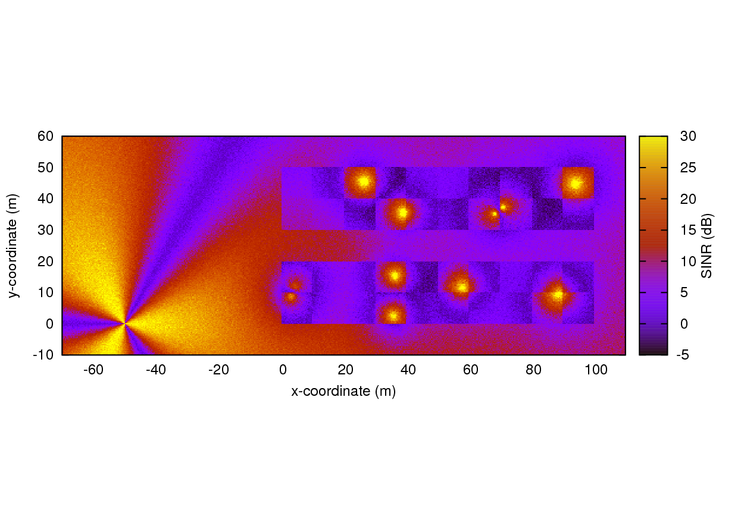
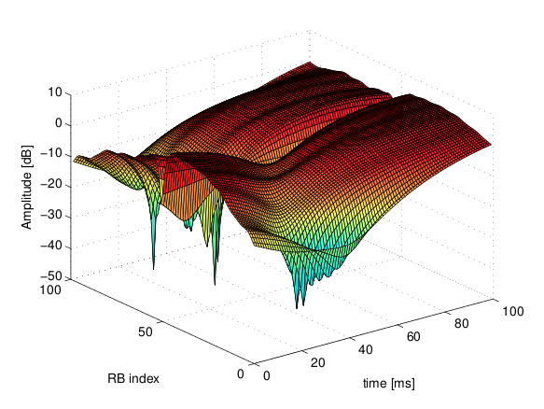
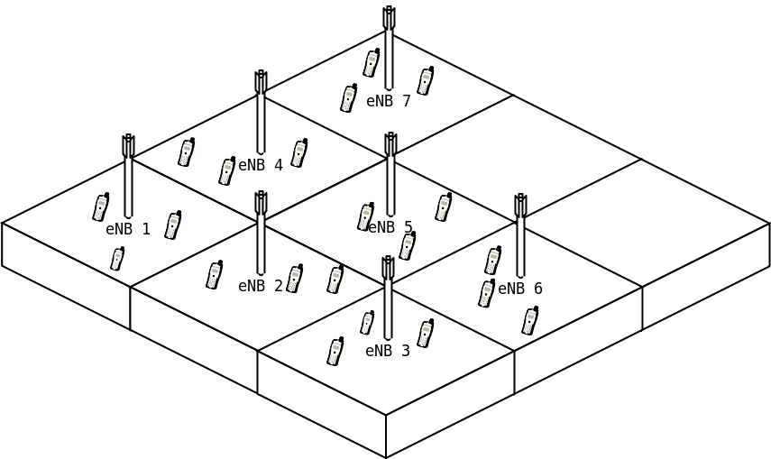
Simulation Settings
Physical
Tx Power
Noise
Mobility
RLC
AM
UM
Applications
Protocols
App types

Slide 62
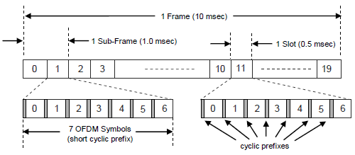
Traffic Separation & Frame Structure
Time Division Duplexing (TDD)
Frequency Division Duplexing (FDD)
Generic Frame Structure for FDD
Notes:
LTE Frames are 10 msec in duration. They are divided into 10 sub-frames, each of 1 msec. Each sub-frame is divided into two slots of 0.5 msec. Slots have either 6 or 7 OFDM symbols, depending on the cycle prefix used.
Symbol = waveform so symbol rate is waveform changes per unit of time.
A symbol can have 1 or more bits.

Slide 63
Downlink Multiplexing
Orthogonal Frequency Division Multiple Access (OFDMA)
User allocated Physical Resource Blocks (PRBs) or subcarriers for predetermined time
Total subcarriers depends on bandwidth
Bandwidth (MHz) | 1.4 | 3.0 | 5.0 |  | 10.0 | 15.0 | 20.0
Subcarrier bandwidth (kHz) | 15
PRB bandwidth (kHz) | 180
# of available PRBs | 6 | 15 |  | 25 | 50 | 75 | 100
Notes:
Orthogonal Frequency Division Multiple Access (OFDMA) downlink
PRB allocation is handled by scheduling function at eNodeB
LTE frame is 10 msec in duration, divided into 10 subframes of 1 msec and each subframe is divided into 2 slots of 0.5 msec. Slots have 6 to 7 OFDM symbols
OFDM supports
QPSK (4QAM) = 2 bits per symbol
16QAM = 4 bits per symbol
64QAM = 6 bits per symbol

Slide 64
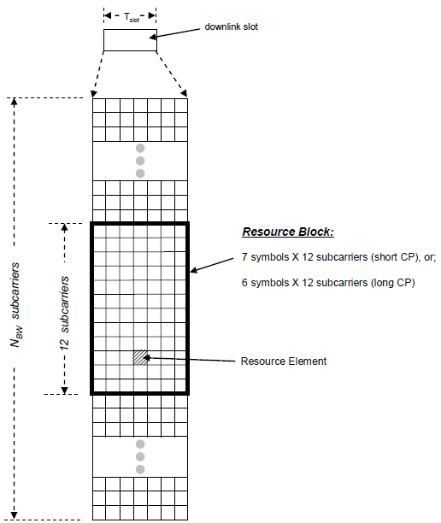
Downlink Resource Grid
PRB X
PRB X
Frequency
PRB 1
PRB 1
12 sub
carriers
PRB 0
PRB 0
Slot 1
0.5 ms
Slot 2
1 ms
Time
Notes:
Instead of PHY preamble special reference symbols are embedded in the PRB (physical resource block)
Each box is one OFDM symbol on one subcarrier
PRB uses 12 consecutive subcarriers per slot (0.5 msec)
MIMO apps have one resource grid per transmitting antenna

Slide 65
Transport Block Size
1 Frame (10 msec)
TB
TB
TB
TB
TB
TB
TB
TB
TB
TB
1 Transport Block (1 msec)
PRB
PRB
1 – 100 possible PRBs per slot depending on available frequencies
…
…
Depending on modulation and number of PRBs the total size of 1 Transport Block can be from:
16 – 75,376 bits
PRB
PRB
Slot (0.5msec)

Slide 66
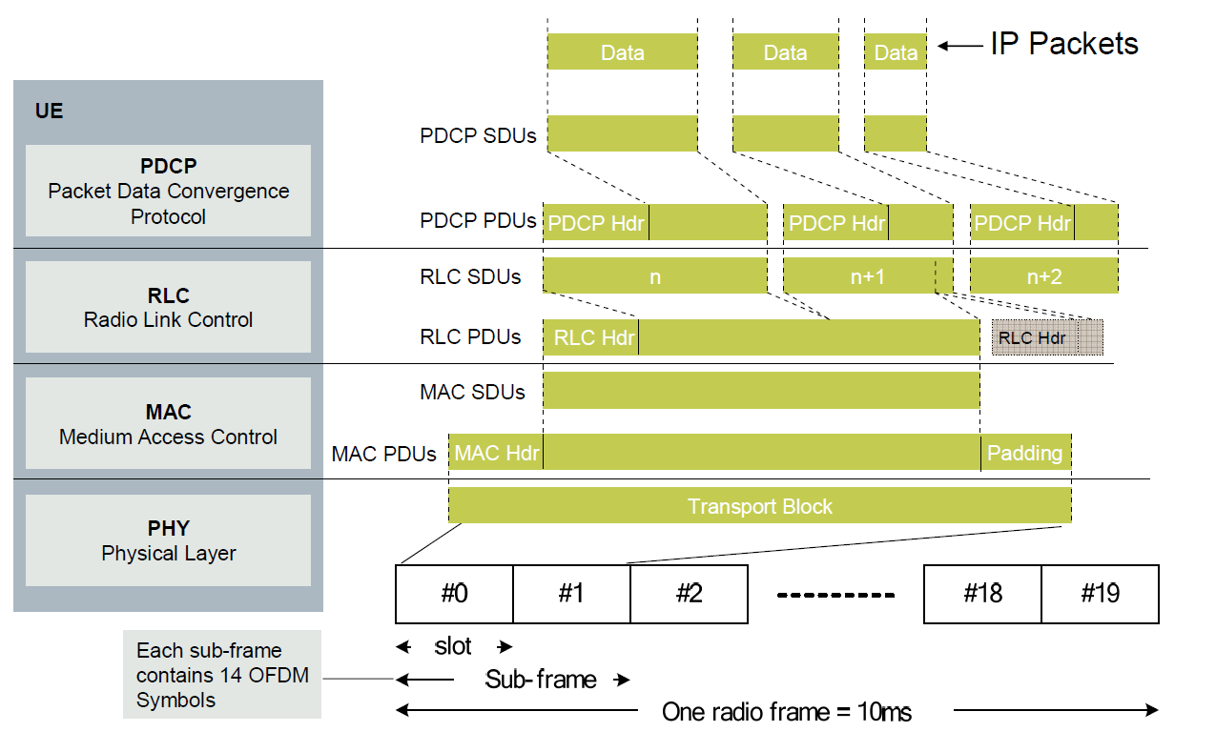
SDUs & PDUs
Notes:
Service Data Units (SDUs)
Protocol Data Units (PDUs)
These terms can be misleading if you do not realize that the MAC, RLC and PDCP layers have their own PDUs and SDUs. One layers SDU is the higher layers PDU and one layers PDU is the lower layers SDU.
PDCP – One to one mapping of SDUs to PDUs
RLC – SUDs are stuffed into PDUs or PDUs are padded for single SDUs depending on SDU and Transport Block size
MAC – One to one mapping of SDUs to PDUs

Slide 67
LTE
Long Term Evolution – Standard of wireless communication of high-speed data for mobile equipment
ITU lowered original 4G criteria for LTE and WIMAX
Standard Organization | 3GPP
Uplink Speed (theoretical) | 50 Mbit/s
Downlink Speed (theoretical) | 100 Mbit/s
Bandwidth Range | 1.4 MHz – 20 MHz
Based On | GSM/EDGE and UMTS/HSPA
Notes:
ITU = International Telecommunication Union
3GPP = 3rd Generation Partnership Project

Slide 68
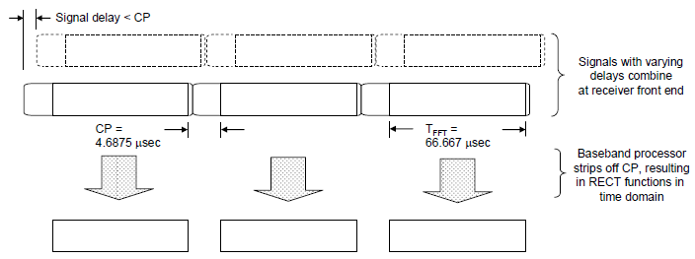
Multipath Handling
Orthogonal Frequency Division Multiplexing (OFDM)
Transmits data in parallel streams
Symbol preceded by cyclic prefix (CP)
Overlap of multiple paths occur in the CP
Notes:
Orthogonal Frequency Division Multiplexing (OFDM)
OFDM systems break the available bandwidth into many narrower sub-carriers and transmit the data in parallel streams. Each subcarrier is modulated using varying levels of QAM modulation, e.g. QPSK, QAM, 64QAM or possibly higher orders depending on signal quality. Each OFDM symbol is therefore a linear combination of the instantaneous signals on each of the subcarriers in the channel.

