Slide 1
CStream: Neighborhood Bandwidth Aggregation For Better Video Streaming
Thangam Vedagiri Seenivasan
Advisor: Mark Claypool
Reader: Robert Kinicki
M.S. Thesis Presentation

Slide 2

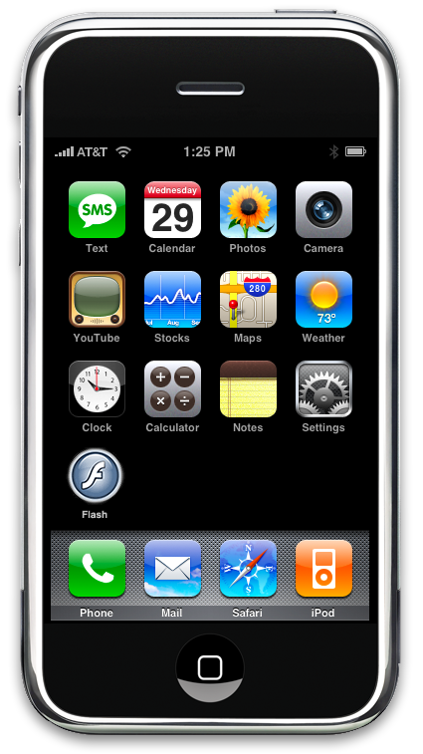
Motivation
Increasing popularity of video streaming
[Cisco survey 09’]
Video traffic
Video traffic
2009
2012
[Internet traffic]
Other traffic
[Internet traffic]
Other traffic
High definition videos
Encoding rate: 8 Mbps to 20 Mbps
Clients still have limited Internet bandwidth
Dialup, DSL
3G
128 Kbps to 3 Mbps
384 Kbps to 2 Mbps
Video streaming still a challenge

Slide 3
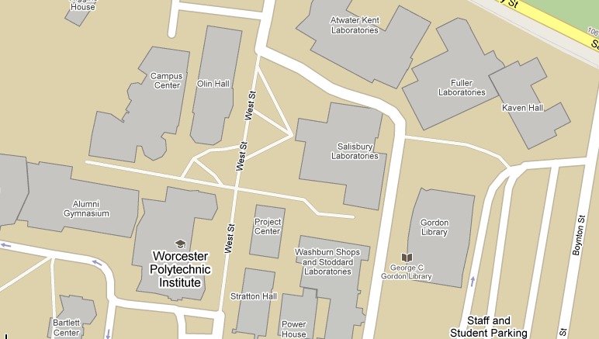
Motivation
High density of Internet connections
even in this room!!
Idle users = spare bandwidth
Potential unused bandwidth most of the time

Slide 4




Motivation
Devices have multiple network interfaces
Can form ad-hoc networks
Device can connect to nearby nodes
at the same time it is connected to Internet

Slide 5




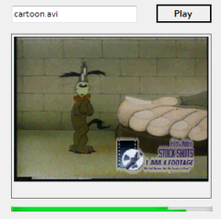
CStream – Collaborative Streaming
Aggregates bandwidth from multiple clients in a neighborhood for video streaming
Internet
Frame 2
Frame 3
CStream Video Server
Frame 1
CStream Video Player

Slide 6
Related Work
Download Accelerators [Rodriguez et al. 00’]
  Multiple connections to mirrored servers
Multi-homing [Chebrolu et al. 06’]
  Multi-homed devices, with multiple interfaces
  Aggregate bandwidth from multiple interfaces
COMBINE [Ananthanarayanan et al. 07’]
  Aggregate bandwidth in phones for HTTP download of large files
Link Alike [Jakubczak et al. 08’]
  Improve client upload capacity for file transfer

Slide 7
Outline
Motivation
Challenges
Design
Implementation
Evaluation
Future Work
Conclusion

Slide 8
Challenges
Neighbor discovery and maintenance
  Find and connect to neighbors
  Updated knowledge of neighbor status
Multi-path streaming
  Stream through multiple nodes
  Frame distribution across links
  Effectively utilize available bandwidth

Slide 9
Challenges
Handle dynamically changing neighborhood
  Adapt to neighbors joining and leaving
  Use the bandwidth of new neighbors joining
  Tolerant to neighbors leaving abruptly
Buffering and Playing
  Buffering mechanism
  Discard late frames (I-policy) or Wait for late frames (E-policy)

Slide 10
Outline
Motivation
Challenges
Design
Implementation
Evaluation
Future Work
Conclusion

Slide 11
Design
Video
Server
Video Database
Video
Plan Handler
Plan
Frame Distributor
Video
query
Request
Plan
Frames
Frames
Neighbor
Meta data
Video Player
Buffer Manager
Video Plan Manager
Proxy
Helper Manager
Frames
Update
Neighbor Manager
Frames
I-CAN-HELP
Client
Wireless ad-hoc network

Slide 12
Client
Video Player
Buffer Manager
Video Plan Manager
Video Plan Manager
Frames
Update
Neighbor Manager
Neighbor Manager
Neighbor manager
  Keeps updated knowledge of active neighbors
  Informs the Video Plan Manager about change in neighborhood
  Receives frames from the neighbor and forwards to the Buffer Manager
Video Plan Manager
  Informs the server about the active neighbors (IP Address, Port to stream) - streaming plan
  Dynamically updates streaming plan based on input from Neighbor Manager

Slide 13
Client
Video Player
Video Player
Buffer Manager
Buffer Manager
Video Plan Manager
Video Plan Manager
Frames
Update
Neighbor Manager
Neighbor Manager
Buffer Manager
  Receives frames from the server
  Receives frames from the neighbor through the Neighbor Manager
  Maintains playout buffer
Video Player
  Extracts frames from the Buffer Manager and plays it
  Implements E-policy (wait for late frames)

Slide 14
Design
Video
Server
Video Database
Video
Plan Handler
Plan
Frame Distributor
Video
query
Plan
Frames
Frames
Neighbor
Video Player
Buffer Manager
Video Plan Manager
Proxy
Helper Manager
Frames
Update
Neighbor Manager
Frames
I-CAN-HELP
Client
Wireless ad-hoc network

Slide 15
Neighbor
Proxy
Proxy
Helper Manager
Helper Manager
Proxy
  Receives frames from the server
  Sends to the client
Helper Manager
  Sends periodic I-CAN-HELP messages that it is willing to collaborate
  Stops when there is user and network activity

Slide 16
Design
Video
Server
Video Database
Video
Plan Handler
Plan
Frame Distributor
Video
query
Plan
Frames
Frames
Neighbor
Video Player
Buffer Manager
Video Plan Manager
Proxy
Helper Manager
Frames
Update
Neighbor Manager
Frames
I-CAN-HELP
Client
Wireless ad-hoc network

Slide 17
Video Server
Video Database
Video
Plan Handler
Plan Handler
Plan
Frame Distributor
Frame Distributor
Frame Distributor
  Runs a frame assignment module
  Sends assigned frames to client and neighbors
  Assignment adapts to the bandwidth of each client
Plan Handler
  Receives dynamic plan about active neighbors from the client
  Updates the Frame Distributor to adapt streaming to the changing neighborhood

Slide 18
Outline
Motivation
Challenges
Design
Implementation
Evaluation
Future Work
Conclusion

Slide 19
Implementation
Neighbor Management
Frame Distribution
Adapting to changing neighborhood
  Neighbor joining
  Neighbor leaving
Buffering and Playing

Slide 20

Neighbor Management
Video Server
Frames
Frames
I-CAN-HELP
Plan
Frames
I-CAN-HELP
REQUEST
SSID: CStream
Ad-hoc network
Ad-hoc network
Client

Slide 21
Frame Distribution
Frames
1
2
3
4
5
6
7
8
9
10
11
12
13
14
Neighbors N1 and N2
Thread - N1
Thread - C
Thread - N2
1
6
2
4
5
3
TCP
1
6
2
4
5
3
1
1
2
4
5

Slide 22
Neighbor Joining

Slide 23
Neighbor Joining
Frames
7
8
9
10
11
12
13
14
New neighbor N3
Thread - N1
Thread - C
Thread - N2
Thread – N3
7
TCP
1
6
2
4
5
3
7
1
2
4
5

Slide 24
Neighbor Leaving

Slide 25
Neighbor Leaving
Frames
6
8
9
10
11
12
13
14
Neighbor N1 left
Last Frame Received - 1
Thread - N1
Thread - C
Thread - N2
Thread – N3
CStream is fault-tolerant
6
TCP
6
5
6
3
7
1
2
4
5

Slide 26
Buffering Policy (E-policy)
Initial Buffering before first frame played
  Playout buffer: n seconds (2 sec in our implementation)
  Wait till (n * encodedFrameRate) frames buffered
Stop and Rebuffering
  frame to be played, not arrived
Resume video after rebuffering
  2 seconds of frames from the current frame to be played received

Slide 27
Outline
Motivation
Challenges
Design
Implementation
Evaluation
Future Work
Conclusion

Slide 28
CStream
Built the complete system
  Video Server, Neighbor, Client Video Player
C# .NET
  3000 lines of code
AVI Video Library
  Extract frame by frame from avi files
[C. John, CodeProject]

Slide 29
Experimental Setup
SERVER
Netem, CBQ
BRIDGE
WPI LAN
Ethernet
Ad-hoc network
Ad-hoc network
NEIGHBOR
CLIENT
NEIGHBOR

Slide 30
Experiment Parameters
Bandwidth from the video server
  Class based queuing discipline, Netem
  250 Kbps, 500 Kbps, 1 Mbps, 2 Mbps, 3 Mbps, 5 Mbps
  Equal bandwidth, Unequal bandwidth for nodes
Number of neighbor nodes
  0, 1, 2
Location of neighbor nodes
  Signal Strength: Excellent, Good, Weak
Video Content
  Short Video
  Long Video

Slide 31
Video Content
 | Short Video cartoon_dog.avi | Long Video foreman.avi
Length | 8 seconds | 33 seconds
Size | 10 MB | 26 MB
Encoded bitrate | 10Mbps | 6.3Mbps
Frames per second | 15 | 12
Average Frame Size | 85 KB | 68 KB
Total Frames | 120 | 400
Resolution | 320×240 | 176×144

Slide 32
Performance Metrics
Aggregate Throughput (Kbps)
  Application throughput at the client node
Playout Time
  Total time to play the entire video
Startup Delay
  Time taken to play the first frame
Rebuffer Events
  Number of stop and buffer events
Frame Distribution
  Contribution of each node vs. ratio of bandwidth

Slide 33
Throughput (Short Video)
Per Host Capacity Constraint
Almost 2x improvement with 1 neighbor
Almost 3x improvement with 2 neighbors
Client and Neighbors have same bandwidth
Neighbors had excellent signal strength to the client

Slide 34
Throughput (Long Video)
Per Host Capacity Constraint
Client and Neighbors have same bandwidth
Neighbors had excellent signal strength to the client

Slide 35
Playout Time

Slide 36
Startup Delay

Slide 37
Rebuffer Events
Maximum Rebuffer Events - 15
Bandwidth | Neighbors
 | 0 | 1 | 2
250 Kbps | 15 | 14.3 | 14
500 Kbps | 15 | 13 | 12
1 Mbps | 13 | 11 | 9
2 Mbps | 11 | 6.6 | 2
3 Mbps | 9 | 2.6 | 0
5 Mbps | 6 | 0 | 0
Need three 3 Mbps links or two 5Mbps links
to stream without rebuffering

Slide 38
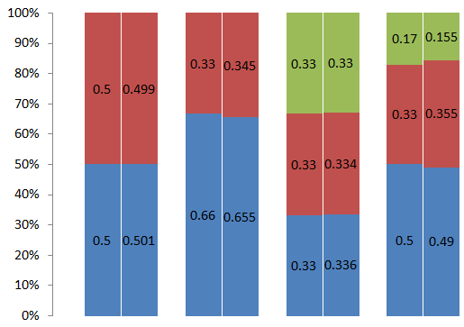
Frame Distribution
Expected
Actual
Expected
Actual
Expected
Actual
Expected
Actual
Client – 2 Mbps
Neighbor– 2 Mbps
Client– 2 Mbps
Neighbor– 1 Mbps
Client– 2 Mbps
Neighbor1 – 2 Mbps
Neighbor2– 2 Mbps
Client – 3 Mbps
Neighbor1– 2 Mbps
Neighbor2 – 1 Mbps

Slide 39
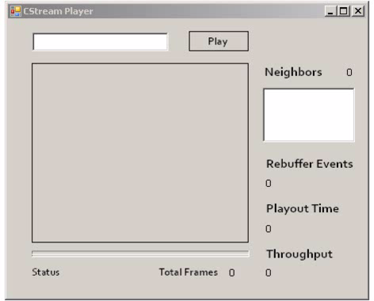
Short Video – 0 Neighbors
Experiment
Client – 2 Mbps

Slide 40
Short Video – 1 Neighbor
Experiment
Client – 2 Mbps
Neighbor1 – 2 Mbps

Slide 41
Short Video – 2 Neighbors
Experiment
Client – 2 Mbps
Neighbor1 – 2 Mbps
Neighbor2 – 2Mbps

Slide 42
Neighbors Joining
5747 kbps
1st Neighbor joined
3576 kbps
1787 kbps
2nd Neighbor joined
Experiment: Long Video, Client – 2 Mbps, Neighbor1 – 2 Mbps, Neighbor2 – 2 Mbps

Slide 43
Neighbor Leaving
1st Neighbor left
5653 kbps
2nd Neighbor left
3773 kbps
1781kbps
Experiment: Long Video, Client – 2 Mbps, Neighbor1 – 2 Mbps, Neighbor2 – 2 Mbps

Slide 44
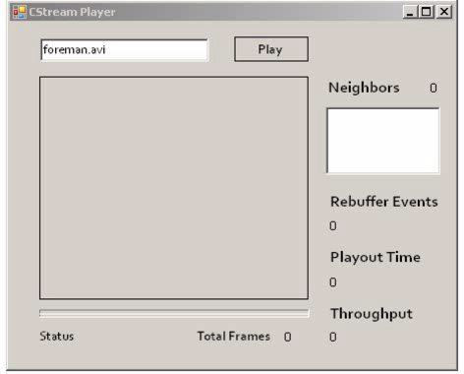
Neighbor Joining and Leaving
Experiment
Client – 3 Mbps
Neighbor1 – 3 Mbps

Slide 45
Impact of Wireless
Experiment
Client – 2 Mbps
Neighbor1 – 2 Mbps
Excellent
Iperf – 13 Mbps
Good
Iperf – 980 Kbps
Poor
Iperf – 520 Kbps
Wireless Signal Strength
Bandwidth contributed
by Neighbor
=
Min (Internet Bandwidth, Wireless Bandwidth)

Slide 46
Future Work
Better frame distribution algorithm
  Solve out of order frame reception
Other video types (MPEG)
Include audio stream
Extend CStream to support video scaling
CStream system for smart phones
  Aggregate the 3G internet bandwidth

Slide 47
Conclusion
Designed and built CStream
  Aggregate bandwidth from neighbors for better video streaming
Effectively utilizes available bandwidth
Dynamically handles changes in neighborhood
Detailed evaluation
  Throughput, Playout Time, Startup Delay, Rebuffer Events, Frame Distribution

Slide 48
Thank You
Questions?

Slide 49
Backup

Slide 50
Short Video

Slide 51
Throughput
Per Host Capacity Constraint

Slide 52
Playout Time

Slide 53
Startup Delay

Slide 54
Rebuffer Events
Bandwidth | Neighbors
 | 0 | 1 | 2
250 Kbps | 3 | 3 | 3
500 Kbps | 3 | 3 | 3
1 Mbps | 3 | 3 | 2
2 Mbps | 3 | 2 | 1
3 Mbps | 2 | 1.3 | 1
5 Mbps | 2 | 1 | 0
Maximum Rebuffer Events - 3

Slide 55
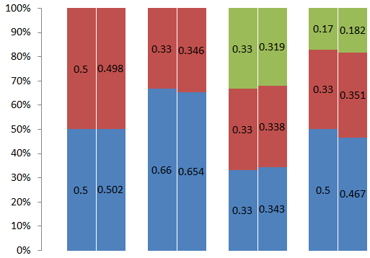
Frame Distribution
Expected
Actual
Expected
Actual
Expected
Actual
Expected
Actual
Client – 2 Mbps
Neighbor– 2 Mbps
Client– 2 Mbps
Neighbor– 1 Mbps
Client– 2 Mbps
Neighbor1 – 2 Mbps
Neighbor2– 2 Mbps
Client – 3 Mbps
Neighbor1– 2 Mbps
Neighbor2 – 1 Mbps

