Slide 1
Fresh Analysis of Streaming Media Stored on the Web
Rabin Karki
M.S. Thesis Presentation
Advisor: Mark Claypool
Reader: Emmanuel Agu
10 Jan, 2011

Slide 2
Outline
Introduction
Related work
Methodology and design
Analysis
Conclusion
Future work

Slide 3
Introduction
Internet access for population growing rapidly
Multimedia content on the Web more accessible
Sites sharing user generated content and serving from single administration contributing to the overall multimedia content

Slide 4
Introduction
Streaming media present new challenges to system designers
Require higher data rates and consume more bandwidth
Traffic is bursty [1] and more sensitive to delay
Require more storage, affecting media servers and proxy caches
Playing takes longer than downloading traditional Web objects
[1] Mena et al., IEEE ‘03

Slide 5
Introduction
Information on characteristics of stored media helps:
Capacity planning of content delivery infrastructures and prepare for the next generation of Web users
Selecting representative streaming media clips for empirical Internet measurements studies
Longitudinal comparison of trend across time

Slide 6
Introduction
Previous data gathered in ‘97 and ’03 is dated
Hypotheses
Compared to 29% in ‘03, today fewer videos targeted for modem bitrates
Today, video resolutions larger
Today, newer media encoding types have emerged to dominate

Slide 7
Outline
Introduction
Related work
Methodology and design
Analysis
Conclusion
Future work

Slide 8
Related work
Data from 1997
QuickTime most common
Internet bandwidth order of magnitude too slow to support real-time video playback
Today, broadband access to homes common

Slide 9
Related work
Data from 2003
Volume of streaming media had increased by 600% in previous 6 years
Streaming media dominated by Real Media and Windows Media
Today, 24 hours of video is uploaded every minute to YouTube alone

Slide 10
Related work
Studies on video content of YouTube
Cha et al. 2007 – popularity distribution, evolution and content duplication
Duarte et al. 2007 – correlation between geography and social network
Chesire et al. 2001 – comparison of streaming media workloads with traditional Web object workloads
Did not compare to Internet at large

Slide 11
Outline
Introduction
Related work
Methodology and design
Analysis
Conclusion
Future work

Slide 12
Methodology and design – Starting points
Make data gathered representative of media stored on the Web
Popular – using Nielsen and About.com rankings
Geographically diverse – from six different countries
Different content types – video, podcasts, news, sports

Slide 13
Methodology and design – Crawling and gathering data
Crawling done using Larbin
Open source
Parallel (we used 5) connections
Easily customizable
URLs unique for one crawling instance
Changed Larbin to log the URLs that begin with prefix other than HTTP (default behavior)

Slide 14
Methodology and design – Extraction of media characteristics
Go through the URLs gathered
Identify if they are links to streaming media or if they contain streaming media

Slide 15
Methodology and design – Challenges
Size of the Web today, multimedia content dynamically generated, paid or private
URLs not always the direct link to actual media files
Embedded in video players (e.g. YouTube video player)

Slide 16
Methodology and design – Tools
MediaTracker for Windows Media
RealTracer for Real Media
For media objects streamed over HTTP, MediaProbe was built using FFprobe

Slide 17
Methodology and design – MediaProbe
URLs containing streaming media are added to a linked list
Web page is downloaded
Page text is parsed and direct link to the streaming media is extracted, if available
Header of the streaming media is downloaded and stored in a temporary file
FFprobe is executed on that temporary file

Slide 18
Outline
Introduction
Related work
Methodology and design
Analysis
Conclusion
Future work

Slide 19
Analysis – Summary
16 starting points
1.25 million URLs each
Between 10 Dec, 2009 and 24 Jan, 2010

Slide 20
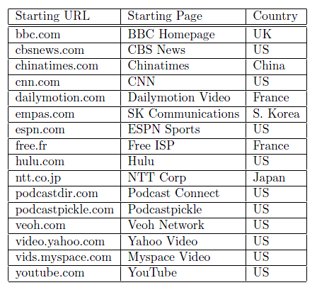
Analysis – Summary Starting points

Slide 21
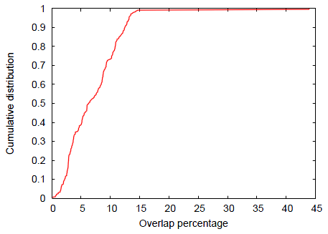
Analysis – Summary URLs overlap percentage
Overlap between any two starting points is <15%
Except between bbc.com and veoh.com (43.9%)
15.32 million unique URLs

Slide 22
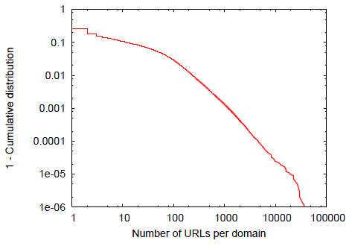
Analysis – Summary URLs per domain name
1,070,591 different Web servers
55% of the domains contribute only one URL

Slide 23
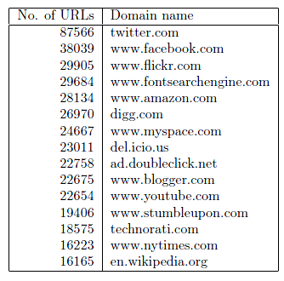
Analysis – Summary Top 15 domains

Slide 24
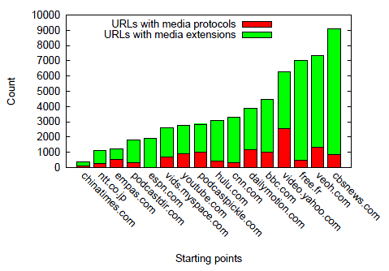
Analysis – Summary Media URL counts per starting point

Slide 25
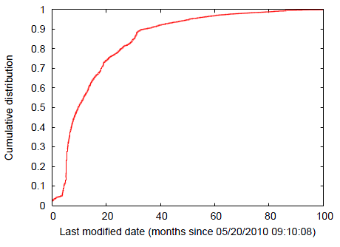
Analysis – Summary Last modified date
Half of the content is <10 months old
Oldest streaming media clip we encountered was 170 months old

Slide 26
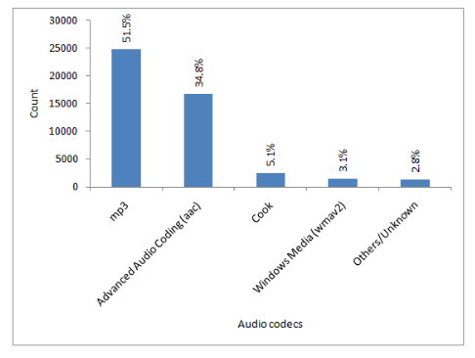
Analysis – Audio Audio codecs
23 different types of audio codecs found in total

Slide 27
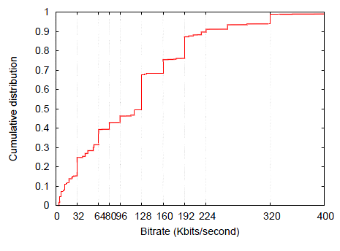
Analysis – Audio Encoded bitrates
Median bitrate is 128 Kbits/sec
Quality of the audio stored on the Web has significantly increased since the study in 2003

Slide 28
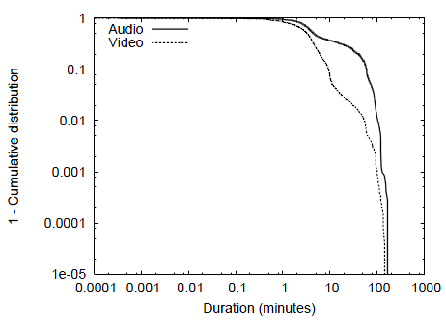
Analysis – Audio/Video Length
Median audio clip length is 4.5 mins
10% audio is 60 mins or longer
Longest audio clip – 251 mins
Median video clip length 3.2 mins
0.5% video is 60 mins or longer
Longest video clip – 165 mins
More videos have lengths between 1 to 10 mins

Slide 29
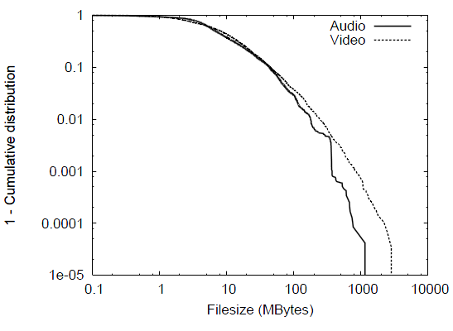
Analysis – Audio/Video Filesize
Median audio clip size is 6.5 MB
Max – 1 GB, 1 hr 43 mins long ogg
Median video clip size is 8 MB
Max – about 3 GB, 2 hr 4 mins long wmv

Slide 30
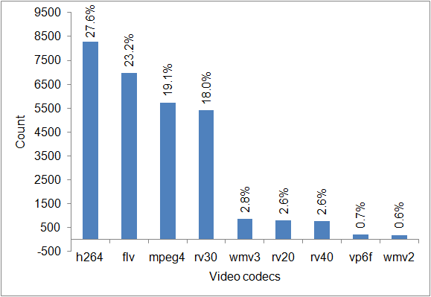
Analysis – Video Codecs
36 different types of video codecs found in total

Slide 31
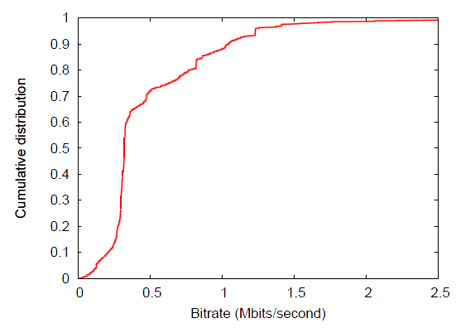
Analysis – Video Encoded bitrate
Median – 0.3 Mbps
Encoded rates still significantly lower than studio quality videos (3-6 Mbps) and HDTV quality videos (35-34 Mbps)

Slide 32
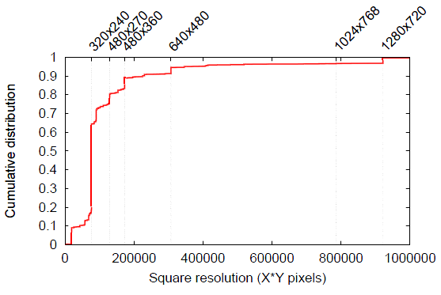
Analysis – Video Resolution
Significant amount of videos are 320x240
There are videos with High Definition resolution (720p, 1080p)

Slide 33
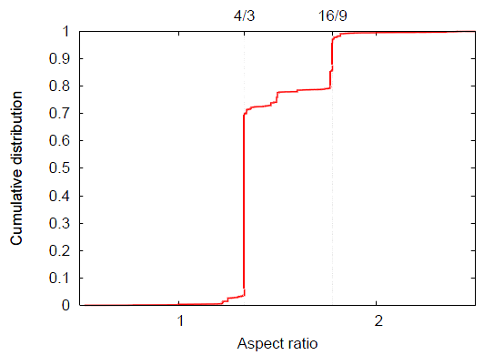
Analysis – Video Aspect ratio
4/3 most prevalent aspect ratio

Slide 34
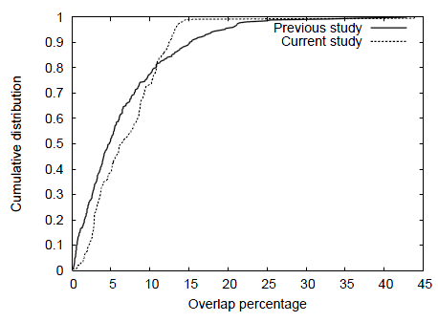
Analysis – Comparison with previous study in 2003
Overlap percentages

Slide 35
Analysis – Comparison with previous study
 | Study in 2003 | Our study in 2010
Median audio clips duration | 2 minutes | 3.2 minutes
Median video clips duration | 4 minutes | 4.5 minutes
Audio clips encoded at less than 40 Kbps | 90% | About 20%
Videos targeted for broadband (768 Kbps) or higher | 1% | More than 20%
Videos with resolutions greater than or equal to 640x480 | Less than 1% | More than 10%

Slide 36
Outline
Introduction
Related work
Methodology and design
Analysis
Conclusion
Future work

Slide 37
Conclusion
Fresh analysis and current snapshot of streaming media stored on the Web
80% of the audio clips mp3 and AAC
50% of the video clips H.264 and FLV
Audio/video clips are longer and larger
Encoding rates targeted for faster broadband connections
High Definition (720p, 1080p) videos present

Slide 38
Future work
Create tools to crawl peer-to-peer file sharing systems and analyze the multimedia content found
Determine multiple bitrate levels for stored multimedia clips, if available
Find effective methods to gather information about freely inaccessible media content

Slide 39
Thank You!
Questions?

