Slide 1
PREDICTING PERFORMANCE FOR READING NEWS ONLINE FROM WITHIN A BROWSER SANDBOX
Murad Kaplan
Advisor: Mark Claypool
Reader: Craig Wills
M.S. Thesis Presentation

Slide 2
Online News
Increasingly important Internet activity.
Korea, more than half of population reads news online [The OECD Report. 2009]
62% of US Internet users aged12-17 go online for news [The guardian. 10]
73% of Internet users read news online [The guardian. 10]
“Mobile access to Internet is on the rise, and the reading of news on the platform is likely to follow this development” [Pew Internet Project. 10]
Web sites must display a significant amount of content on the home page. [E. Jorden. 2010]
Notes:
Korea [1] The Organisation for Economic Co-operation and Development (OECD)
The OECD reports "The future of news and the Internet “, Organization for Economic Cooperation and Development, June 2009. http://www.oecd.org/document/48/0,3343,en_2649_34223_45449136_1_1_1_1,00.html
[2]
E. Jorden. Newspaper Website Design http://www.ejordanweb.com/index.php?option=com_content&view=article&id=62:newspaper-website-design&catid=19:news&Itemid=176 , 2010.

Slide 3
Current Limitations to Measuring Performance for Online News
Available platforms provide low-level network data, but not necessarily understandable to average users
Web site performance measurement tools focus on server side, with measurements not readily mapping to user experience
No research in performance measurements targeted online news before.
Notes:
[7] kc claffy, Mark Crovella, Timur Friedman, Colleen Shannon, and Neil Spring. Communityoriented network measurement infrastructure (CONMI) workshop report. SIGCOMM Comput. Commun. Rev., 36(2):41–48, 2006.

Slide 4
Goal
Predict performance for online news sites by:
Select characteristics of news sites to be measured
Select suitable methods of measuring
Analyze collected data
Build models based on analysis
Evaluate models
Provide performance from user prospective
Choosing a specific news site
Provide meaningful results (very good, good, bad, etc.)
Predict performance with small costs
Little time (< 3 seconds)
Few downloads (Max 7 objects)
Apply to other sites
Implement in HMN

Slide 5
Outline
Introduction
Background
Approach
Evaluation
Conclusion
Future Work

Slide 6
Network Measurement Platforms
Speedtest
Limited incentives for typical users (download, upload, ping)
Not designed to inform network researchers
Netalyzer [3,4]
A broad range of network measurements
Output not meaningful for typical users
Gomez
Offers monetary incentive
Needs software
Notes:
Performance Predictions
[3] SpeedTest http://www.speedtest.net/
[4] Planetlab http://www.planet-lab.org/
[5] F. Papadopoulos and K. Psounis. Predicting the performance of Internet-like networks using scaled-down replicas. In ACM SIGMETRICS Performance Evaluation Review, Volume 35 Issue 3, December 2007
[6] C. Xing, M. Chen, and L. Yang. Predicting Available Bandwidth of Internet Path with Ultra Metric Space

Slide 7
Web Characterization
Has been done since almost the beginning of the World Wide Web [J. Pitkow 98]
Better understand of objects types/sizes on the Web for network performance and measurement.
Provide Web designers with their Web sites performance to the end users [Web Characterization Project. 02]
No Characterization for specific Web type such as News, shopping, etc.
Notes:
[8] J. Pitkow. Summary of WWW Characterizations. In Computer Networks and ISDN Systems, Volume 30 Issue 1-7, April 1, 1998.
[9] E. O’Neill. OCLC, Online Computer Library Center, Web Characterization Project. Wcp.oclc.org, 2002

Slide 8
Background - HMN
Overcome the impediments in the existing measurement platforms
Increase the incentives for users/research experts
New techniques using JavaScript and Flash from within Browser sandbox environment
Applied to real world Web Applications

Slide 9
Outline
Introduction
Background
Approach
Evaluation
Conclusion
Future Work

Slide 10
Approach
Characterize news sites and analyze Web browsers behaviors
Design prediction models
Set up environment
Implement models and evaluate results.

Slide 11
Characterization and Analysis
Characterization for News sites
Choose most popular News sites [The EbizMbA. 2011]: :CNN, New York Times, LA Times, and MSN
Collect:
Number of objects per page
Sizes of objects
Number of domains objects come from
Web Browsers Behaviors
Choose most popular Web browsers [Browserscope. 2011]: Chrome 14, Firefox 3.6, and Internet Explorer 8.
Analyze:
Mechanism for retrieving Web pages
Number of connections per hostname
Number of connections for all hostnames

Slide 12
Characterization for News sites
Three levels for characterization (home page, sections (sport, world, health, etc.), and articles)
Use Pagestats [10], to crawl news page
Home Page
World
Health
Politics
Travel
Sport
Article
Notes:
[10] http://web.cs.wpi.edu/~weizhang/docs/pagestats.xpi
[11] http://www.ebizmba.com/articles/news-websites

Slide 13
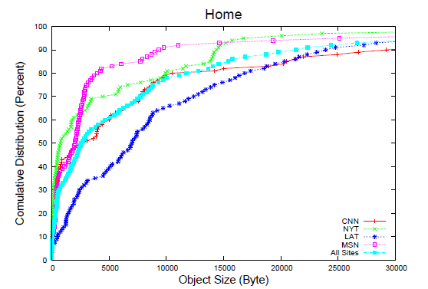
Characterization Results
Distribution of objects differ across sites
Object Sizes Distribution for Home page of the Four News Sites
Notes:
Describe the axis LAT has larger objects compared to the other three. MSN has the smallest sizes.

Slide 14
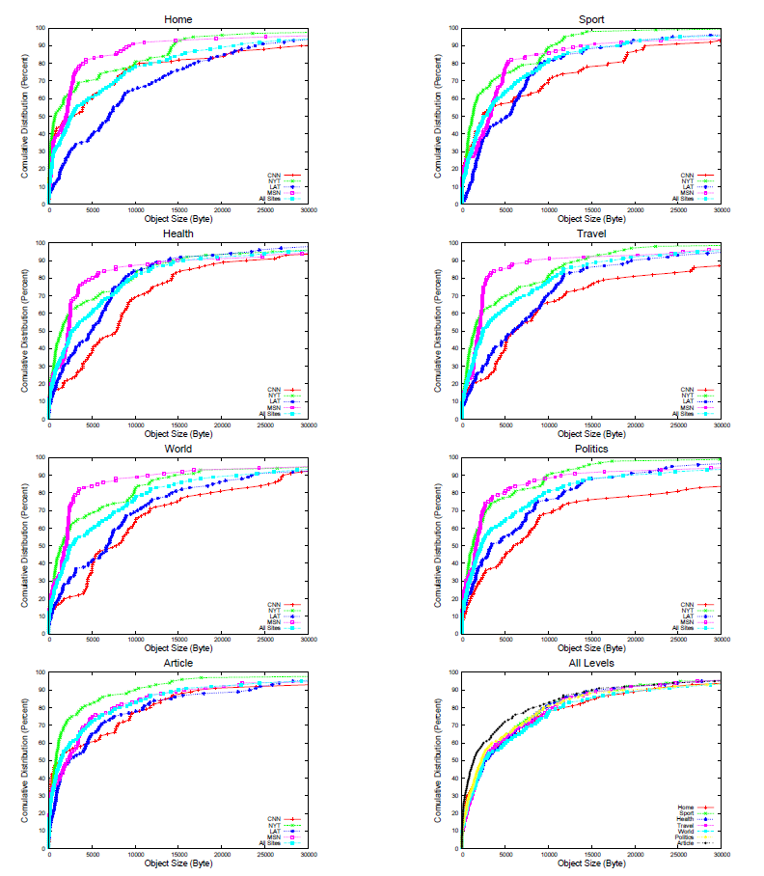
- MSN, usually 80% of objects < 5KByte - LAT and CNN, larger objects - Sections, except Sport are similar to Home
Notes:
Repeating the charecterization to all levels, NYT and LAT usually have larger objects, MSN has the smallest.

Slide 15
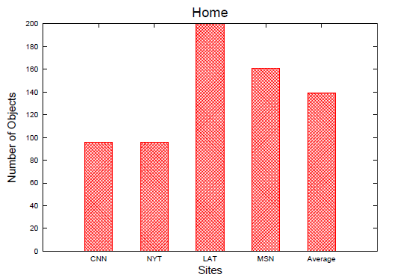
Number of Objects in Home Page in News Sites
Similarity in number of objects in CNN and NYT

Slide 16
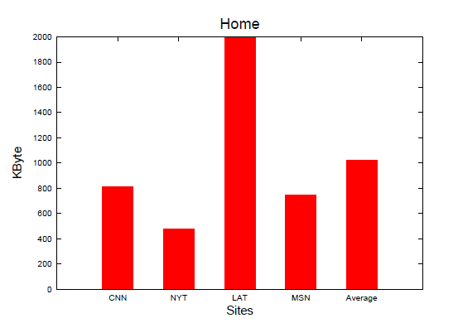
Page Size in for Home Page in News Sites
Similar page sizes except LAT

Slide 17
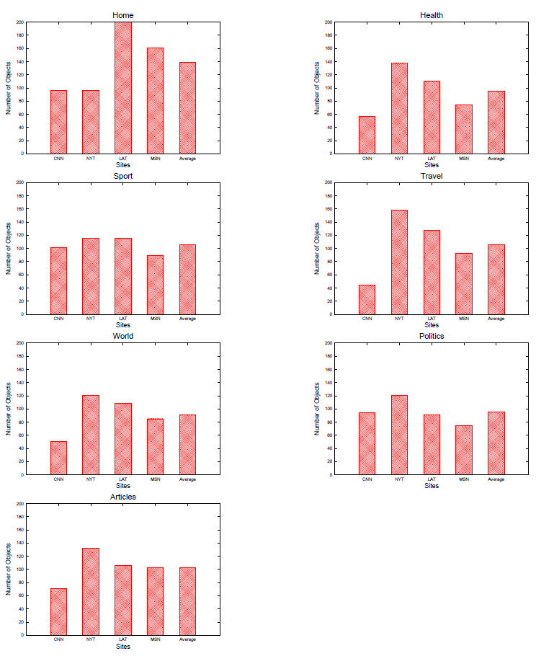
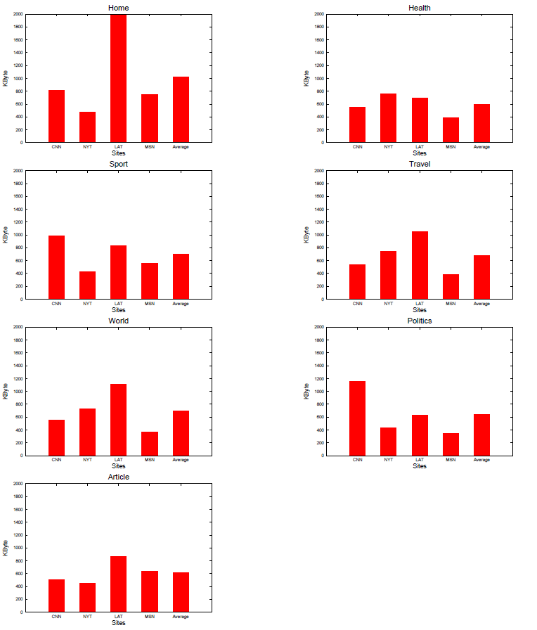
Number of Objects among the levels in News Sites
Page Size in all levels in News Sites
High number of objects doesn’t mean large page size
Notes:
To show that it sometimes we have a trend between object numbers and page size as we see in LA home page. But in many situations it is not the same case, so we cant rely on only the object numbers or total page size.

Slide 18
Domains
Notes:
Different distribution of objects among the domains

Slide 19
Characterization Summary
Similarity but there is some variance
Notes:
LAT has big number of objects and 78% of its objects come from one domain.
While MSN and NYT the biggest percentage of object number is only 24% and 31% respectively.

Slide 20
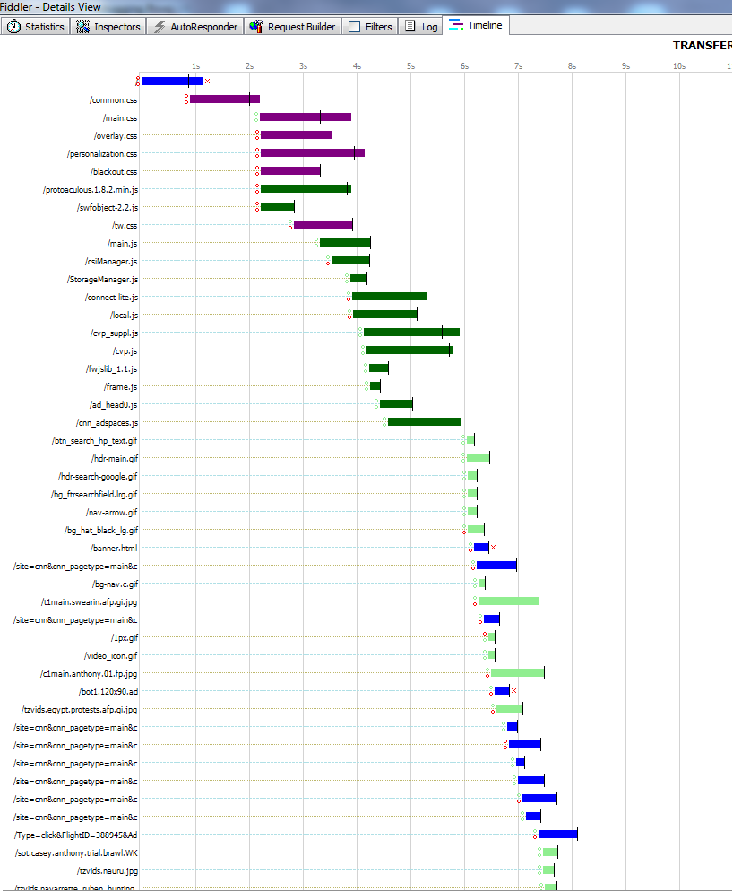
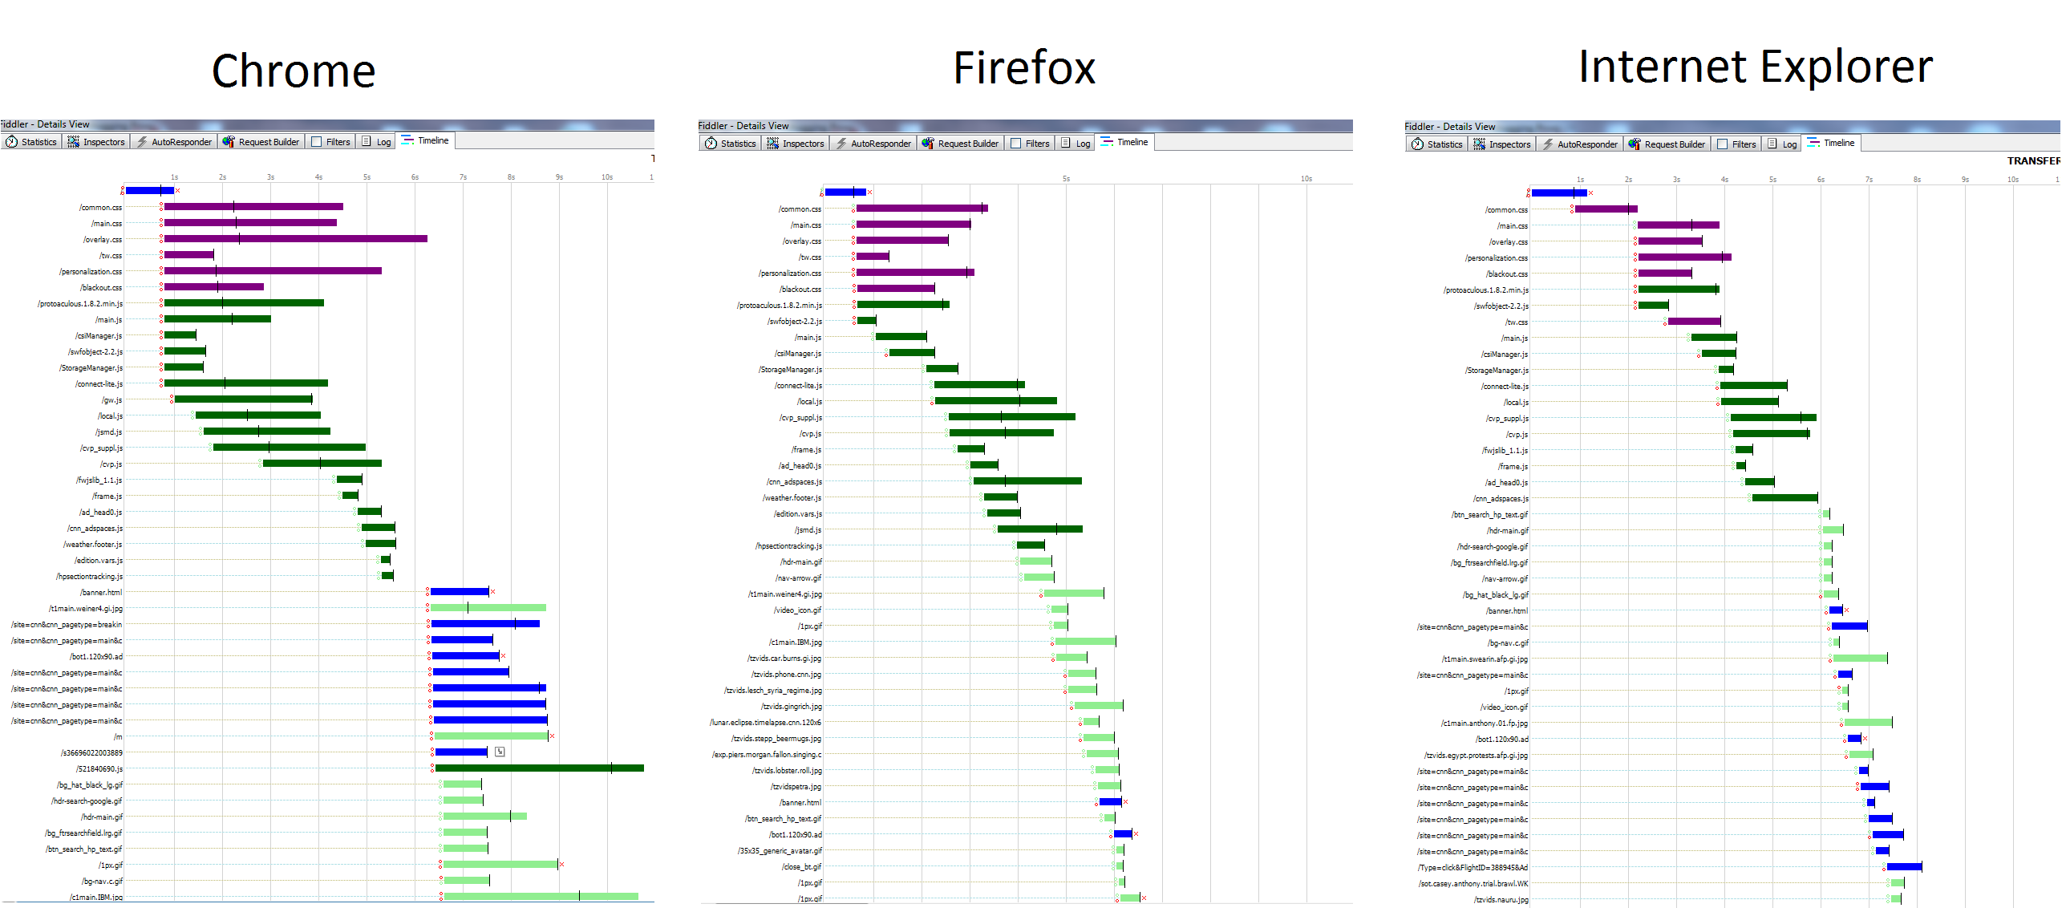
Browsers Behaviors
IE, CNN home page
Fiddler [fiddler Web debugger]
Notes:
Explain the different behaviors for different Web browsers
[12] Fiddler Web Debugger - A free web debugging tool www.fiddler2.com/

Slide 21
Prediction Methods
Characterization Observation
Container loading.
Domains that browsers retrieves its objects from.
Serial vs. Parallel downloads.
Model 3. Parallel Total PT
Download Container
Download Average Object Size six times in parallel
Use Total number of objects in the page (from all domains)
Model 1. Serial Total ST
Download Container
Download Average Object Size one time
Use Total number of objects in the page (from all domains)
Model 4. Parallel Dominant PD
Download Container
Download Average Object Size six times in parallel
Use Total number of objects in the dominant domain only
Model 2. Serial Dominant SD
Download Container
Download Average Object Size one time
Use Total number of objects in the dominant domain only

Slide 22
Prediction Methods
Tc : time to download container
To : time to download an average-size object
Nt : number of total objects,
Nd : number of objects in the dominant domain
P : number of downloads in parallel

Slide 23
Experiment Setup
UST
ABC
RUE
WPT
1Mbit/0.256Mbit 50 msec
HPT
eth1
eth0
New DELL, Win 7
Bridge, UNIX
BBC
Extend to 10 Most popular News
5 Times
3 Browsers
4 Models
LAT
CNN
MSN
NYT

Slide 24
Outline
Introduction
Background
Approach
Evaluation
Conclusion
Future Work

Slide 25
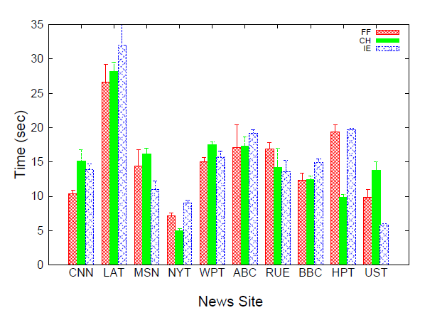
Evaluation
A glance of News sites download times
Difference in DL time across news sites
Difference DL time for one site across browsers (object types)

Slide 26
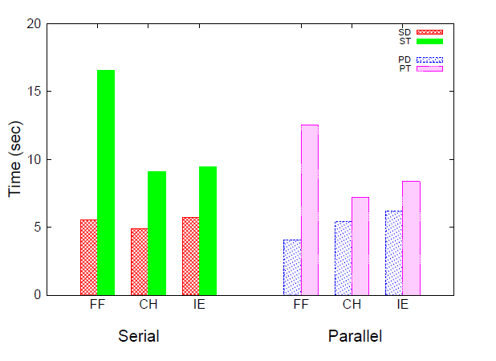
Serial vs. Parallel
Domain always wins
Notes:
Time difference between actual page download time and the four models.

Slide 27
Predicting User Experience
Measured time differences may be of interest for network researchers
Typical user may not notice the impact of an additional few seconds of page load time
Provide performance predictions intended to have more relevance than time alone [Net Forecasts et al. 02] [S. Souder. High Performance Web sites 09]

Slide 28
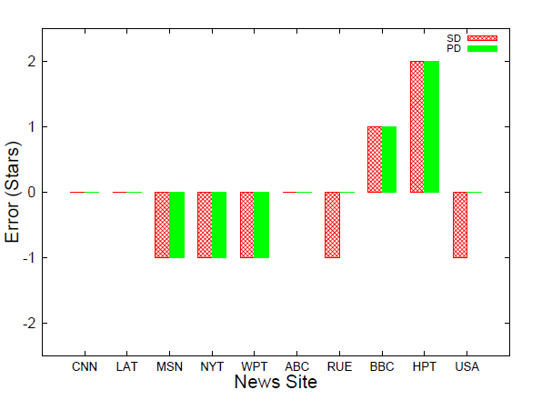
Prediction Error for News in Firefox
Some predictions "perfect", others under, others over
Parallel slightly better than Serial

Slide 29
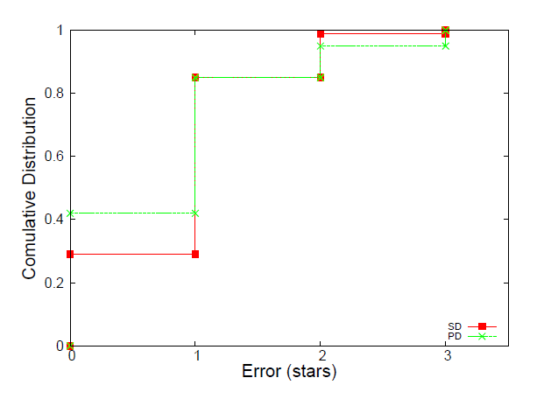
- PD, “perfect” predictions > 40% of the time
- SD, worse, < 30%
- For about 3% of the predictions, PD is nearly 3 stars in error, compared to only 0.5% for SD
Cumulative Distribution of Prediction Errors for all News Sites and Browsers

Slide 30
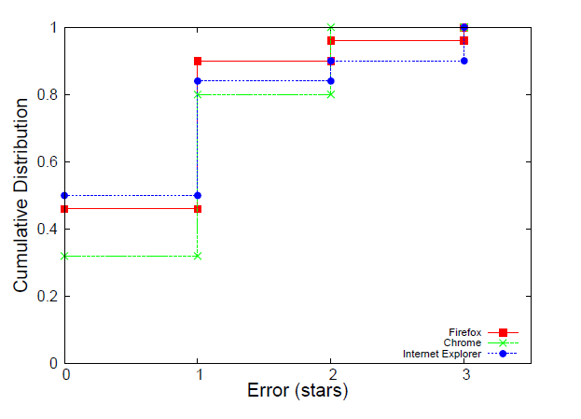
- IE, about 50% of predictions are “perfect” and about 85% have 1 star error
- Firefox has 45% of predictions “perfect” and about 90% with 1 star error
- Chrome has 30% of predictions “perfect” and about 90% with 1 star error
Cumulative Distribution of Prediction Errors for PD for all News Sites across Browsers

Slide 31
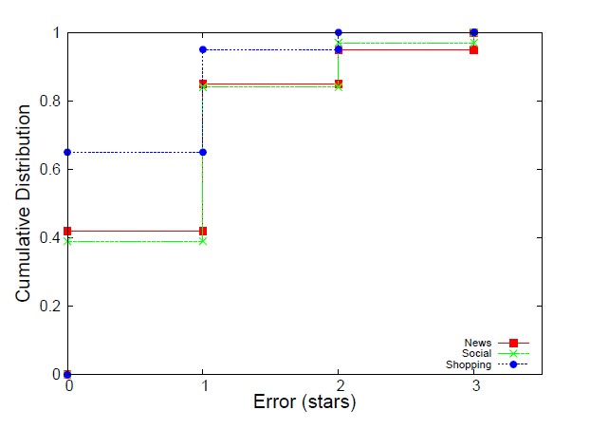
Using our methods to different type of Web sites
For online shopping, about 65% of the predictions are “perfect” and no predictions are worse than 2 stars in error.

Slide 32
Outline
Introduction
Background
Approach
Evaluation
Conclusion
Future Work

Slide 33
Conclusion
Online news prediction techniques in HMN can provide low impediment and high incentive for researchers and typical users.
Using number of objects from dominant domain is always better than using total number of objects
15% to 60% better
Assuming objects download in parallel rather than serially provides generally better predictions
15% “perfect” predictions for online news.
Our methods can be used for other Web sites
65% “perfect” predictions for shopping sites
39% “perfect” predictions for social networks

Slide 34
Future Work
Extend Web characterization to different Web sites.
Develop our models to include other factors such as object types.
Extend to target Multimedia in online news.

Slide 35
References
[1] The OECD reports "The future of news and the Internet “, Organization for Economic Cooperation and Development, June 2009. http://www.oecd.org/document/48/0,3343,en_2649_34223_45449136_1_1_1_1,00.html
[2] E. Jorden. Newspaper Website Design http://www.ejordanweb.com/index.php?option=com_content&view=article&id=62:newspaper-website-design&catid=19:news&Itemid=176 , 2010.
[3] SpeedTest http://www.speedtest.net/
[4] Planetlab http://www.planet-lab.org/
[5] F. Papadopoulos and K. Psounis. Predicting the performance of Internet-like networks using scaled-down replicas. In ACM SIGMETRICS Performance Evaluation Review, Volume 35 Issue 3, December 2007
[6] C. Xing, M. Chen, and L. Yang. Predicting Available Bandwidth of Internet Path with Ultra Metric Space
[7] kc claffy, Mark Crovella, Timur Friedman, Colleen Shannon, and Neil Spring. Communityoriented network measurement infrastructure (CONMI) workshop report. SIGCOMM Comput. Commun. Rev., 36(2):41–48, 2006.
[8] J. Pitkow. Summary of WWW Characterizations. In Computer Networks and ISDN Systems, Volume 30 Issue 1-7, April 1, 1998.
[9] E. O’Neill. OCLC, Online Computer Library Center, Web Characterization Project. Wcp.oclc.org, 2002
[10] http://web.cs.wpi.edu/~weizhang/docs/pagestats.xpi
[11]http://www.ebizmba.com/articles/news-websites
Fiddler Web Debugger - A free web debugging tool www.fiddler2.com/

