Slide 1
Uniquitous: Implementation and Evaluation of a Cloud-based Game System in Unity3d
IMGD M.S. Thesis Presentation
Meng Luo
Advisor: Professor Mark Claypool
Committee: Professor David Finkel
Professor Robert W. Lindeman

Slide 2
Background (1/2)
What is Cloud Gaming?
New service based on cloud computing technology
Why Cloud Games?
Convenience for players
Efficiency for developers
Reduce piracy for publishers

Slide 3
Background (2/2)
Existing Cloud Gaming Systems
OnLive, Gaikai, StreamMyGame, GamingAnywhere etc.
Cloud Games Are Growing Fast
Estimated to grow from $1 billion in 2010 to $9 billion in 2017 [1]
In 2012, Sony bought Gaikai service for $380 million and integrated the service into PlayStation in Jan. 2014 [2]

Slide 4
Motivation (1/2)
Major Challenges for Cloud Gaming Providers
Network latency
Higher bandwidth required, e.g. 2 Mbps min for OnLive [3]
System processing delay
Need Effective Cloud Gaming Testbed for Research and Development
Commercial cloud gaming systems (e.g. OnLive)
Proprietary
Academic cloud gaming systems (e.g. GamingAnywhere)
No access to and not integrated with the source code of games

Slide 5
Motivation (2/2)
Uniquitous
More flexible and easily accessed cloud gaming system implemented with Unity3d
Convenient for Unity developers (1 million, 2012 to 2.5 million, 2014, 0.6 million monthly [4])
Allows modifications to internal structures, configurations on system parameters
Allows game content adjustments
Different game scene complexities
Different camera views
Evaluation of Uniquitous
Micro evaluation
Macro evaluation

Slide 6
Outline
Introduction
Related Work
Implementation
Micro Evaluation
Macro Evaluation
Conclusion and Future Work

Slide 7
Related Work (1/2)
Cloud Systems
Cloud system architecture
Foster et al. [5] defined a four-layer model for cloud system architecture (fabric layer, Unified resource layer, Platform layer and Application layer)
Cloud services
Foster et al. [5] listed the services at three different levels: Infrastructure as a Service (IaaS), Platform as a Service (PaaS), Software as a Service (SaaS)
Cloud Gaming Frameworks
Three approaches classified by Huang et al. [6]
Video streaming approach
3D graphics streaming approach
Video streaming with post-rendering operations approach

Slide 8
Related Work (2/2)
System Measurement
Measuring system delays
Huang et al. [6] -- Measuring the delay of each system subcomponent of GamingAnywhere
Three system parameters affecting players’ experience: frame rate, game quality and game resolution
Chang et al. [7] -- Frame rate and game quality degradation are both critical to gaming performance. Frame rate has a greater impact
Claypool et al. [8] -- Frame rate has a greater influence on gaming performance than game resolution

Slide 9
Outline
Introduction
Related Work
Implementation
Micro Evaluation
Macro Evaluation
Conclusion and Future Work

Slide 10
Implementation (1/4)

Slide 11
Implementation (2/4)
Image Data Flow: carry data for the game frames
Image Encoding : JPEG encoder
Image Transmission : unreliable remote procedural call (RPC)

Slide 12
Implementation (3/4)
Audio data flow: carry data for the game audio
Audio Source : Audio listener
Audio Capture : OnAudioFilterRead, TCP socket
Audio Encoding & Transmission : FFMPEG
Audio Reception & Decoding : FFPLAY
Notes:
Simple DirectMedia Layer is a cross-platform development library designed to provide low level access to audio, keyboard, mouse, joystick, and graphics hardware via OpenGL and Direct3D. It is used by video playback software, emulators, and popular games including Valve's award winning catalog and many Humble Bundle games.

Slide 13
Implementation (4/4)
Input data flow: carry data for user input
Input Transmission : unreliable remote procedural call (RPC)
Unity Game : game scripts affected by user input

Slide 14
Outline
Introduction
Related Work
Implementation
Micro Evaluation
Macro Evaluation
Conclusion and Future Work

Slide 15
Micro Evaluation (1/6)
Goal
Measure processing times of subcomponents of Uniquitous
Understand the performance bottlenecks in cloud game systems
Experiment Setup
Hardware
12 GB RAM, Intel 3.4GHz i7-3770, AMD Radeon HD 7700 series
Operating System
64-bit Windows 7 Enterprise edition

Slide 16
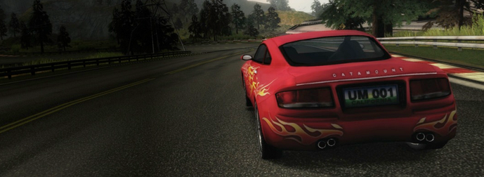
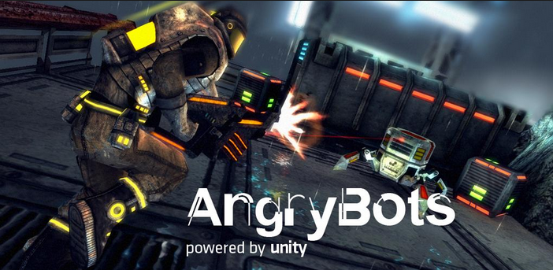
System Parameters (2/6)
Two Game Genres
Eight Game Qualities
Nine Game Resolutions
Car Tutorial
AngryBots
Quality Factor(Q) | 1 | 5 | 10 | 20 | 40 | 60 | 80 | 100
Game Resolution (R) | 210 by 114 | 420 by 240 | 640 by 480 | 800 by 600 | 960 by 680 | 1280 by 720 | 1366 by 768 | 1680 by 860 | 1906 by 986

Slide 17
Methodologies (3/6)
Use Unity Pro Profiler to observe the CPU time of the component
Unity Project
Game Window
Put time stamps in different places in the source code to measure time differences
Screen Capture
Image Encoding
Image Transmission
Use Unix command “time” to get timing statistics for running the component
Audio Encoding & Transmission
Experimental Results

Slide 18
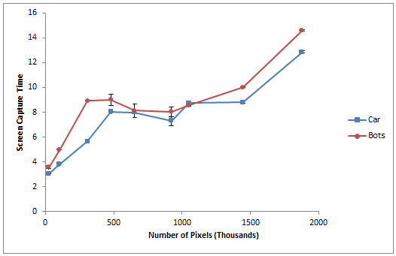
Screen Capture (4/6)
Screen Capture Time at Nine Different Resolutions

Slide 19
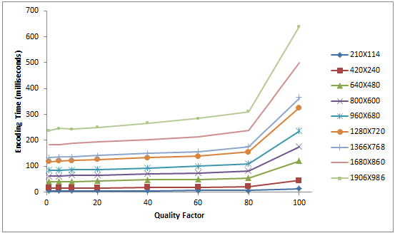
JPEG Encoding (5/6)
Increase game image quality increases per frame encoding time
Increase game resolution increases per frame encoding time
Per frame encoding time versus the JPEG Quality Factor at different Resolutions (Car Tutorial)

Slide 20
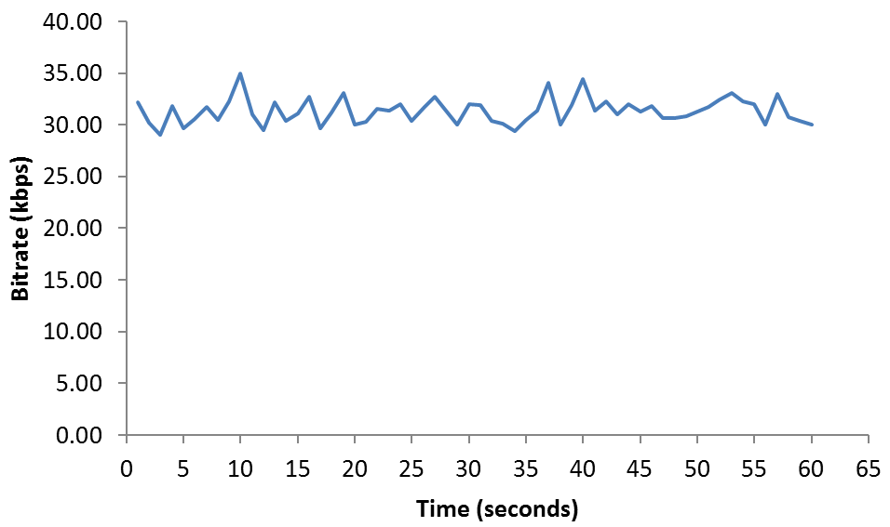
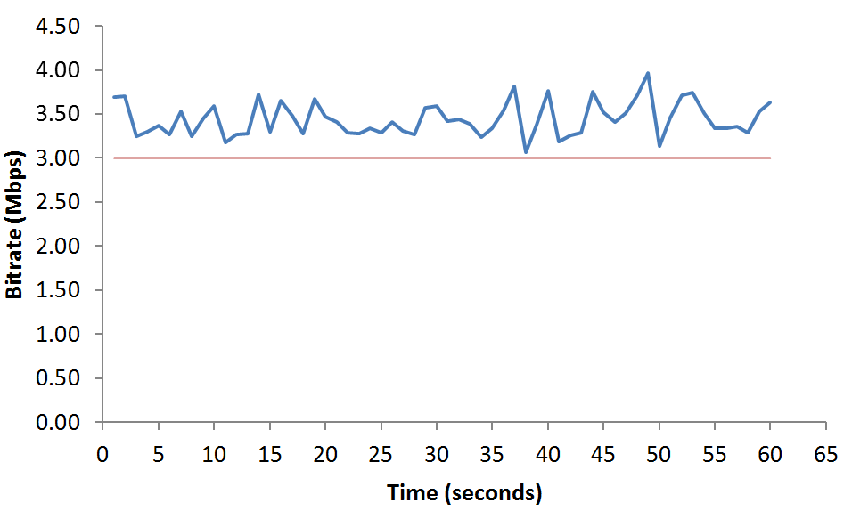
Network Estimate (6/6)
R: 640×480, Q: 20, AngryBots
Uplink bitrate is fluctuating around 32 kbps
Downlink bitrate is fluctuating around 3.5 Mbps
Uplink traffic is much smaller than the downlink traffic
Similar to network traffic of OnLive [9]
Uplink network bitrate versus time
Downlink network bitrate versus time

Slide 21
Outline
Introduction
Related Work
Implementation
Micro Evaluation
Macro Evaluation
Conclusion and Future Work

Slide 22
Macro Evaluation - Goal
Analysis and Evaluation of performance of Uniquitous
Game Image Quality
Frame rate
Predict Uniquitous performance under alternate configurations

Slide 23
Game Image Quality
Compressed Image Samples
Original Image: game image from Car Tutorial
200 images with 20 compression ratios and 10 resolution levels
Objective Visual Quality Measurement
Peak Signal Noise Ratio (PSNR)
Structural Similarity Index (SSIM)
Experiment Setup
Same as the Micro Evaluation

Slide 24
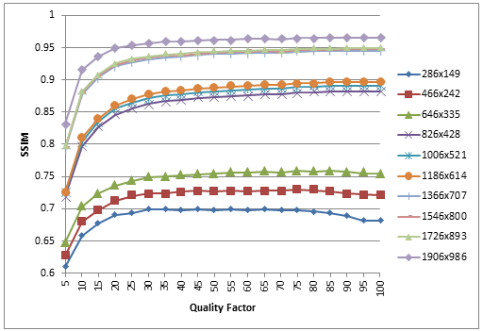
Experimental Results
Marked increase from 1 to 15
Modest increase from 15 to 35
Recommended quality factor: 15 to 35
SSIM values versus the JPEG quality factor among
different game resolutions

Slide 25
Frame Rate
Data Samples Selection
Each data sample contains a different setting of JPEG encoding quality factor and resolution
44 data samples for the Car Tutorial
37 data samples for the AngryBots
Frame Rate Computation
Use time stamps to measure frame intervals
Calculate the inverse of the average interval value
Experiment Setup
Same as the Micro Evaluation

Slide 26
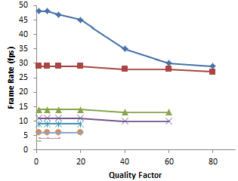
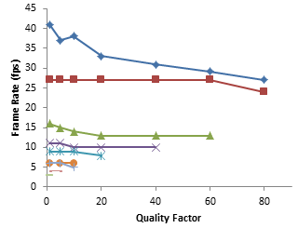
Experimental Results
Car Tutorial
AngryBots
Increase the image quality or the resolution degrades the frame rate
Recommended min frame rate: 15 fps [8]
Recommended resolution: 640x480

Slide 27
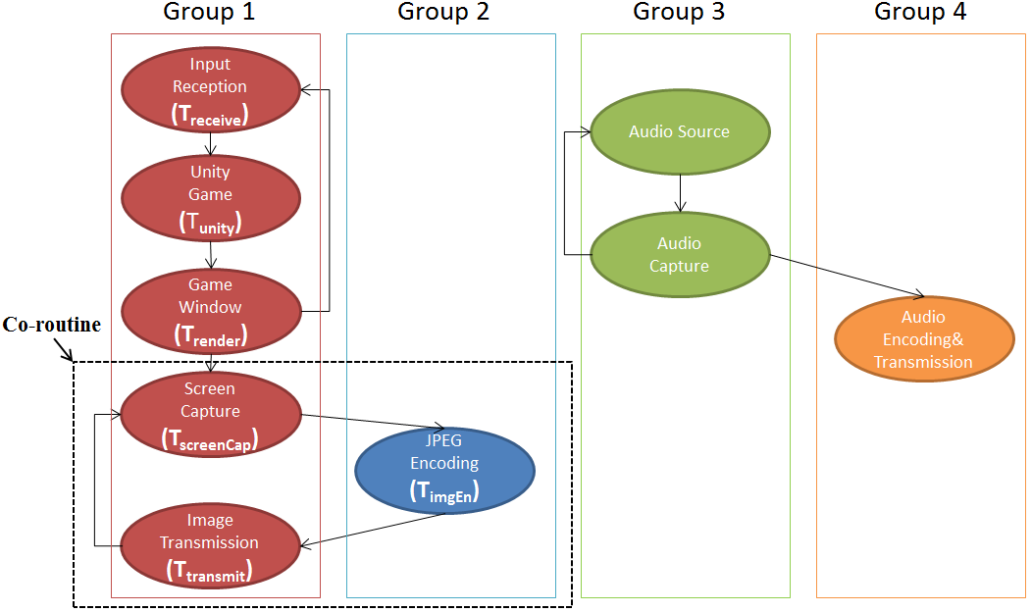
Predicting Frame Rate (1/3)
Parallel working structure of Uniquitous Server

Slide 28
Predicting Frame Rate (2/3)
Derive the Model Predicting the Frame Rate on the Server
F = 1/T
T= Max (T_{1’},T₂) + T_{screenCap} + T_{transmit}
T_{1’} = T_{unity} + T_{render}
T₂ = T_{imgEn}
If T₂ = Max (T_{1’},T₂),
Then T = Max (T_{1’},T₂) + T_{screenCap} + T_{transmit}+T_{error}
(T_{error} ϵ [0, 20])
T_{1’} : processing time of the first three components of Group 1
T₂ : processing time of Group 2
T: frame interval
F: predicted frame rate
T_{error} : error term

Slide 29
Predicting Frame Rate (3/3)
Build the model to predict the client frame rate
Based on game Resolution (R), JPEG encoding quality factor (Q)
Weka Linear regression classifier (10-fold cross validation)
Car Tutorial: F_{predict} = 1 / (0.1348×R + 0.118×Q + 21.0)
AngryBots : F_{predict} = 1/ (0.1361×R + 0.1224×Q + 22.5)
Validation results

Slide 30
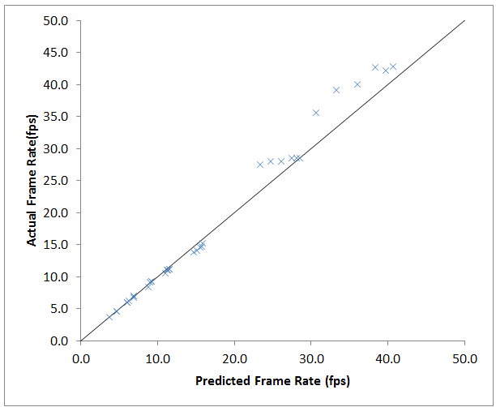
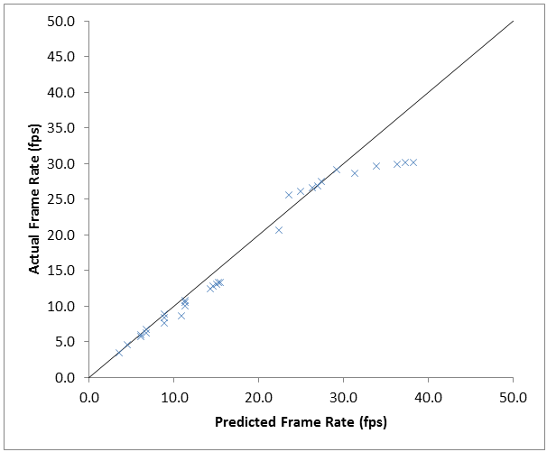
Validation Results
Both models predict well
Car: correlation coefficient is 0.995, average error percentage is 4.79%.
Bots: correlation coefficient is 0.981, average error percentage is 9.47%.
Car Tutorial
AngryBots

Slide 31
Outline
Introduction
Related Work
Implementation
Micro Evaluation
Macro Evaluation
Conclusion and Future Work

Slide 32
Conclusions
Uniquitous is a system for cloud game research or cloud game development.
Uniquitous architecture: three entities and three data flows.
The image encoding process is the processing bottleneck – processing time increases with game image quality and resolution.
Frame rate is inversely proportional to both the game quality and the resolution.
Recommended quality factor range for Uniquitous: 15-35 , to maintain a good frame rate.
Recommended resolution for Uniquitous: no larger than 640x480, to achieve a frame rate of 15 fps or higher.
Models can be used by developers to choose settings for good gameplay performance

Slide 33
Future Work
Performance improvement
Increase the achieved frame rate
Support the transmission of frames of higher game quality and higher resolution
Areas recommended for exploring with Uniquitous
Test with more games to include three general game genres [10]
Extend and deploy Uniquitous on mobile devices to evaluate its performance

Slide 34
Thank You!
Questions?

Slide 35
References
[1] Distribution and monetization strategies to increase revenues from Cloud Gaming: http://www.cgconfusa.com/report/documents/Content-5minCloudGamingReportHighlights.pdf, Date accessed: 05/01/2014
[2] Sony buys Gaikai cloud gaming service for $380 million http://www.engadget.com/2012/07/02/sony-buys-gaikai/, by Sharif Sakr on July 2nd 2012, at 2:55:00 am ET
CES 2014: Gaikai becomes PlayStation Now, streaming games to just about everything
http://www.extremetech.com/gaming/174236-ces-2014-gaikai-becomes-playstation-now-streaming-games-to-just-about-everything ,by James Plafke on January 7, 2014 at 3:09 pm
[3] Minimum system requirement for OnLive: https://support.onlive.com/hc/en-us/articles/201229050-Computer-and-Internet-Requirements-for-PC-Mac-, Date accessed: 11/06/2014
[4] Unity Fast Facts: http://unity3d.com/company/public-relations, Date accessed: 05/01/2014
[5] I. Foster, Y. Zhao, I. Raicu, and S. Lu, “Cloud Computing and Grid Computing 360-Degree Compared,” In Proceedings of Workshop on Grid Computing Environments (GCE), pp. 1, January 2009.
[6] C. Huang, C. Hsu, Y. Chang, and K. Chen. “Gaminganywhere: An open cloud gaming System,” in Proceedings of the ACM Multimedia Systems Conference (MMSys’13), Oslo, Norway, February 2013.
[7] Yu-Chun Chang, Po-Han Tseng, Kuan-Ta Chen, and Chin-Laung Lei.” Understanding the Performance of Thin-Client Gaming”, in Proceedings of IEEE CQR, May 2011.
[8] Mark Claypool and Kajal Claypool. “Perspectives, Frame Rates and Resolutions: It’s all in the Game”, in Proceedings of the 4th ACM International Conference on the Foundations of Digital Games (FDG), Florida, USA, April 2009.
[9 M. Claypool, D. Finkel, A. Grant and M. Solano, “On the performance of OnLive Thin Client Games”, in Multimedia System Journal (MMSJ) – Network and Systems Suppport for Games, Denver, Colorado, USA, Octorber 2013.]
[10] M. Claypool and K. Claypool, “Latency can kill: precision and deadline in online games,” in Multimedia Systems Conference (MMSys), Phoenix, Arizona, USA, February 2010.
[11] What is cloud computing: http://searchcloudcomputing.techtarget.com/definition/cloud-computing Date accessed: 11/06/2014

Slide 36
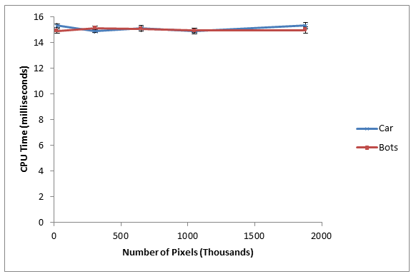
Unity Project (4/6)
Average per frame CPU time of Unity Project (except Uniquitous code) at five different resolutions

Slide 37
The talk from CEO of Ubitus, Wesley Kuo

Slide 38
The talk from CEO of Ubitus, Wesley Kuo

