Slide 1
Impact of Acknowledgements on Application Performance in 4G LTE Networks
Brett Levasseur
Mark Claypool, Robert Kinicki
ICNC 2015
2/16/2015

Slide 2
Network Growth
Worldwide Mobile networks in 2013
½ billion mobile devices added
77% of this growth from smartphones
Mobile data traffic grew 81%
Mobile video traffic 51% of all mobile data
4G in 2013
2.9% of all connections
Account for 30% of all mobile traffic
Predicted to be ½ of all connections in 2018
[Cisco 13]

Slide 3
General Problem Statement
LTE responds to poor signal quality by decreasing throughput
LTE has multiple configuration parameters for wireless retransmissions
How do LTE retransmissions impact application performance?
What LTE retransmissions settings impact application performance?
Which LTE retransmission policies are preferred in different wireless loss conditions?

Slide 4
Outline
Introduction
Background
Approach
Results
Conclusion

Slide 5
LTE Retransmissions: MAC
1ms TTI
[Dahlman 11]
Hybrid Automatic Request Reply (HARQ)
Data sent at time n, arrives at time n
3ms taken to check if data arrived with errors
n+4 ACK/NACK sent back
n+8 if NACK, data can be retransmitted
Up to 3 retransmissions for downlink traffic

Slide 6
LTE Retransmissions: RLC
Unacknowledged Mode
No retransmissions
Timer t-Reordering – wait before handing data up a layer for MAC layer to try recovery
Acknowledged Mode
Retransmissions
Timer t-Reordering – wait before requesting retransmission
Timer t-StatusProhibit – wait before sending RLC ACK/NACK message

Slide 7
ns-3
[ns-3]
Open source packet level network simulator
Successor to ns-2
Funded by National Science Foundation and the Planete group at INRIA Sophia Antipolis
2009 - 2012 ns-3 downloaded 50,792 times
LTE/EPC Network Simulator (LENA)
Developed Centre Tecnologic de Telecomunicacions de Catalunya
[ns-3 stats]
[Baldo 11]

Slide 8
Related Work
Applications used in mobile networks
Böhmer et al. – Mobile apps mostly used for communication
Huang et al. – Majority of data over LTE uses TCP
HARQ
Kawser et al. – Found that MAC retransmissions could be limited to 3 or less as allowing more in poor signal quality conditions did not improve reception
RLC AM
Makidis – Examined TCP with RLC AM for VoIP and FTP but did not examine UM or MAC layer retransmissions

Slide 9
Outline
Introduction
Background
Approach
Results
Conclusion

Slide 10
Specific Problem Statement
How do MAC and RLC layer retransmission impact VoIP, FTP, Video
Delay/Loss/Throughput sensitive
How does adjusting RLC timer settings impact retransmissions and application performance
When is it better to use RLC AM or UM with varying loss rates at physical layer

Slide 11
ns-3 LTE Modifications
LTE module for ns-3 did not support NACKs in AM STATUS message
Joined discussion forum to implement NACKs
Worked with LTE module developers and others
Provided code for (de-)serializing NACKs to developers
Discussed specifics of AM receive window for NACKs with developers
Helped LTE model developers test changes
[ns-3 Forum]

Slide 12
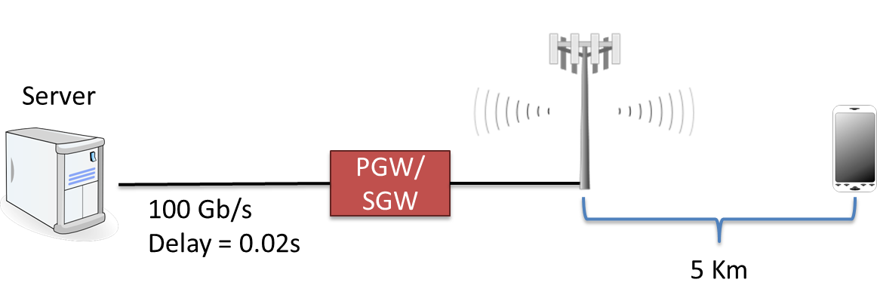
Simulation Network
Server sends data to UE
Wireless link bottleneck
UE stationary
No obstructions or noise sources
UE positioned so it would request CQI 8

Slide 13
Outline
Introduction
Background
LTE
ns-3
Related Work
Approach
Results
Conclusion

Slide 14
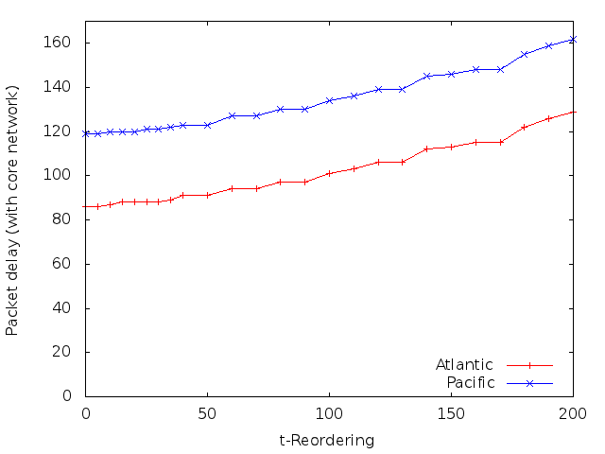
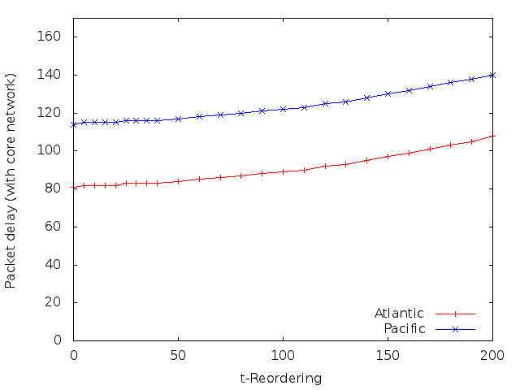
VoIP t-Reordering
AM
UM
Adjusting t-Reordering has little impact on delay
AM experiences more delay but not by much

Slide 15
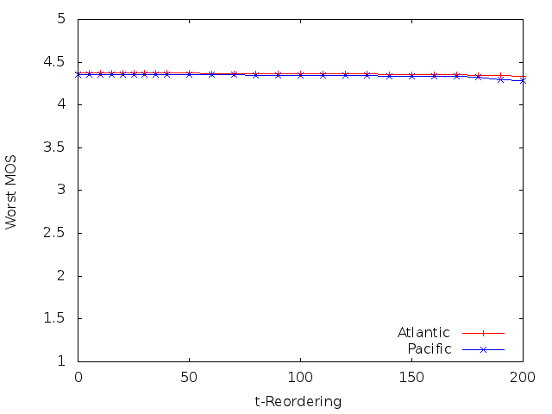
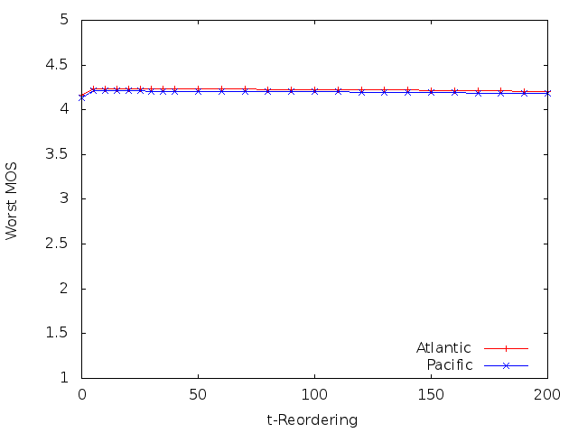
VoIP t-Reordering
AM
UM
Adjusting t-Reordering has little impact on MOS
Worst MOS is still good across all settings
Fix t-Reordering = 30ms

Slide 16
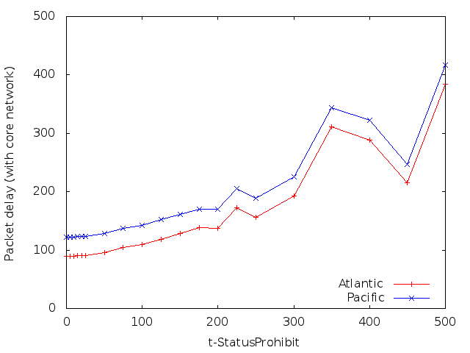
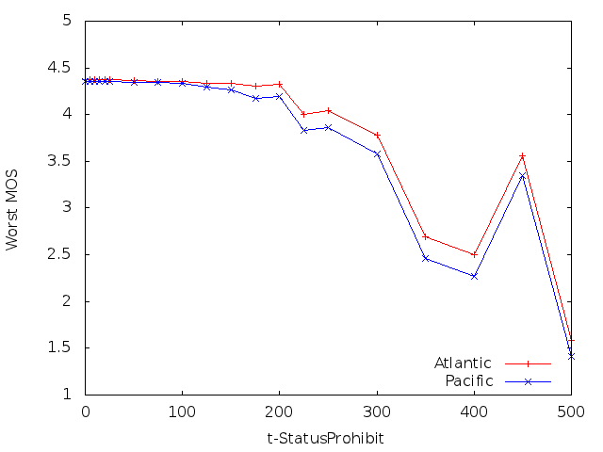
VoIP t-StatusProhibit
AM
AM
Adjusting t-StatusProhibit has greater impact
Lower values for timer better than higher in general
Fix t-StatusProhibit = 50ms

Slide 17
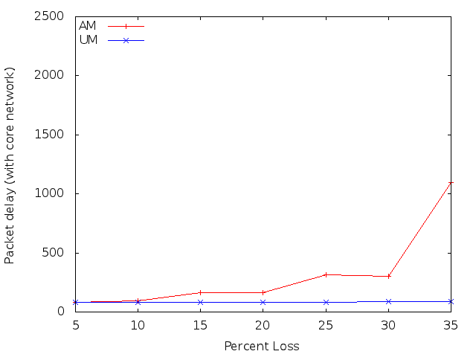
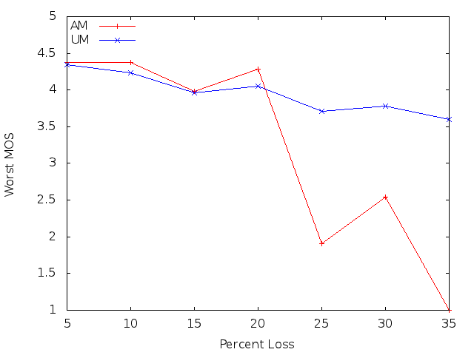
VoIP AM vs UM
Adjusted loss percent
VoIP over AM outperforms VoIP over UM until 20% loss
Same for both Atlantic and Pacific test

Slide 18
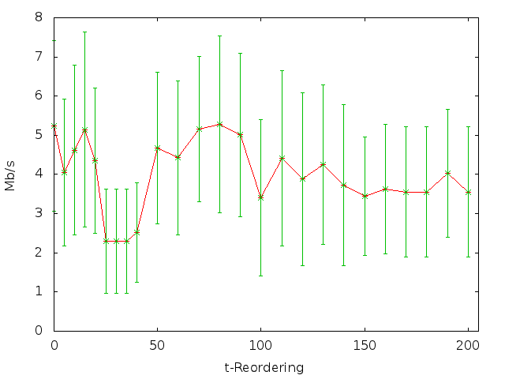
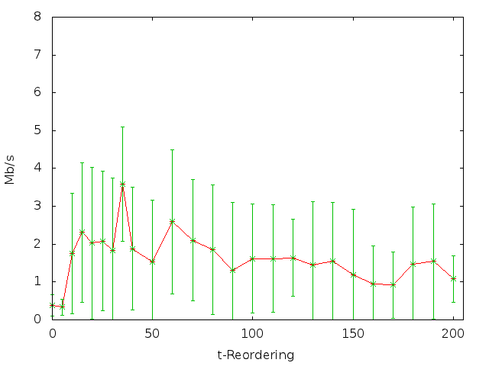
FTP t-Reordering
AM
UM
AM outperforms UM across t-Reordering
Large error ranges due to TCP RTO
Fix t-Reordering = 50ms

Slide 19
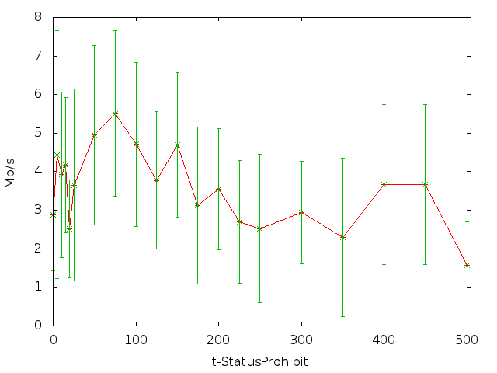
FTP t-StatusProhibit
AM
Lower values for t-StatusProhibit are better
Large error ranges from TCP RTOs
Fix t-StatusProhibit = 75ms

Slide 20
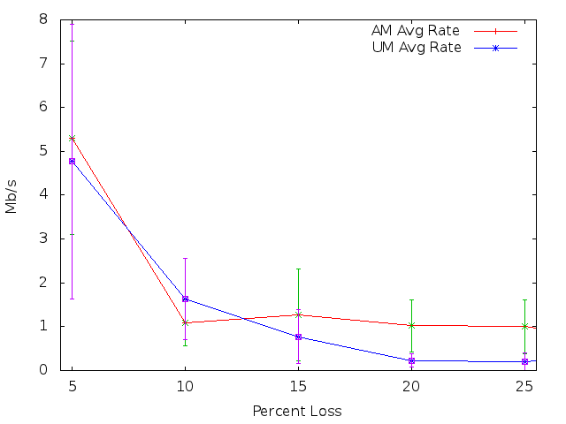
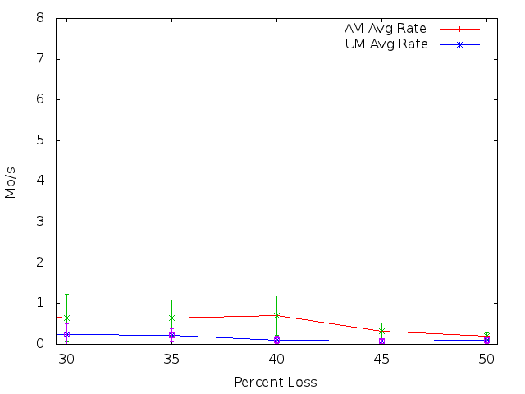
FTP AM vs UM
FTP over AM has higher average throughput than FTP over UM
UM briefly better at 10% loss but has higher error range
Input gap lengths up to 30 for 5 – 25% and up to 100 for 30 – 50%

Slide 21
Conclusion
Added RLC AM NACKs to ns-3 LTE simulator
VoIP over AM has higher MOS until 20% loss
5 – 20% loss rate AM avg 4.26, UM avg 4.15
25 – 35% loss rate AM avg 1.82, UM avg 3.7
FTP over AM has higher average throughput
AM average throughput 1.21Mb/s, UM 0.83 Mb/s

Slide 22
Future Work
Video simulations with TCP
Test with other RLC layer settings
t-PollRetransmit timer
PollPDU and pollByte
Add support for RLC AM maximum retransmission radio link layer failure

Slide 23
Questions
Impact of Acknowledgements on Application Performance in 4G LTE Networks
Brett Levasseur
Mark Claypool, Robert Kinicki
ICNC 2015

Slide 24
References
[Baldo 11] Nicola Baldo, Marco Miozzo, Manuel Requena-Esteso, and Jaume Nin-Guerrero. An open source product-oriented lte network simulator based on ns-3. In Proceedings of the 14th ACM International Conference on Modeling, Analysis and Simulation of Wireless and Mobile Systems, MSWiM '11, pages 293{298, New York, NY, USA, 2011. ACM.
[Böhmer 11] Matthias Böhmer, Brent Hecht, Johannes Schöning, Antonio Krüger, and Gernot Bauer. Falling asleep with angry birds, facebook and kindle: a large scale study on mobile application usage. In Proceedings of the 13th International Conference on Human Computer Interaction with Mobile Devices and Services, pages 47-56. ACM, 2011.
[Cisco 13] Cisco. Cisco Visual Networking Index: Global Mobile Data Traffic Forecast Update, 2013-2018. Technical report, Cisco, 2014. http://www.cisco.com/en/US/solutions/collateral/ns341/ns525/ns537/ns705/ns827/white paper c11-520862.pdf
[Dahlman 11] Erik Dahlman, Stefan Parkvall, and Johan Sköld. 4G LTE/LTE-Advanced for Mobile Broadband. Academic Press, Oxford, 2011.
[E-Model] Leandro Carvalho, Edjair Mota, Regeane Aguiar, Ana F Lima, Jose Neuman de Souza, and Anderson Barreto. An E-model implementation for speech quality evaluation in VoIP systems. In Proceedings of the 10th IEEE Symposium on Computers and Communications, volume 154. IEEE Computer Society, 2005.
[Huang 13] Junxian Huang, Feng Qian, Yihua Guo, Yuanyuan Zhou, Qiang Xu, Z. Morley Mao, Subhabrata Sen, and Oliver Spatscheck. An In-depth Study of LTE: Eect of Network Protocol and Application Behavior on Performance. In Proceedings of the ACM SIG-COMM 2013 Conference on SIGCOMM, SIGCOMM '13, pages 363{374, New York, NY, USA, 2013. ACM.
[ITU G.711] International Telecommunication Union. Pulse Code Modulation (PCM) of Vlice Frequencies. Technical Specification G.711, ITU-T, November 1988. https://www.itu.int/rec/dologin pub.asp?lang=e&id=T-REC-G.711-198811-I!!PDFE& type=items.
[Kawser 12] T. Mohammad Kawser, Nax Imtiaz Bin Hamid, Nayeemul Hasan, M. Shah Alam, and M. Musqur Rahman. Limiting HARQ Retransmissions in Downlink for Poor Radio Link in LTE. International Journal of Information and Electronics Engineering, 2012.

Slide 25
References Cont
[LTE RLC] 3GPP. 3rd Generation Partnership Project; Technical Specification Group Radio Access Network; Evolved Universal Terrestrial Radio Access (E-UTRA); Radio Link Control (RLC) protocol specification (Release 8). Technical Specification 36.322v8.0.0, 3GPP, December 2007. http://www.3gpp.org/ftp/Specs/html-info/36322.htm.
[LTE RRC] 3GPP. 3rd Generation Partnership Project; Technical Specification Group Radio Access Network; Evolved Universal Terrestrial Radio Access (E-UTRA); Radio Resource Control (RRC) Protocol specification (Release 8). Technical Specification 36.331v8.10.0, 3GPP, march 2008. http://www.3gpp.org/ftp/Specs/html-info/36331.htm.
[Makidis 07] Michael Makidis. Implementing and evaluating the RLC/AM protocol of the 3GPP specification. Master's thesis, Athens University of Economics and Business, 2007.
[ns-3] https://www.nsnam.org/
[ns-3 Forum] https://groups.google.com/forum/#!topic/ns-3-users/CEfmMX3IRBw
[ns-3 stats] https://www.nsnam.org/overview/statistics/
[Verizon] Verizon. IP Latency Statistics, April 2014. http://www.verizonenterprise.com/about/network/latency/.
[Zyren 07] Jim Zyren. Overveiw of the 3GPP Long Term Evolution Physical Layer. Technical report, Freescale Semiconductor, 07 2007.

Slide 26
Backup Slides

Slide 27
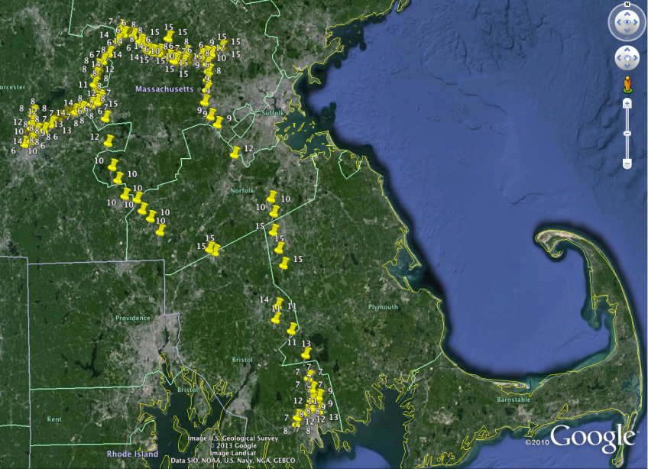
CQI Choice
Wrote Android application to log requested CQI value on LTE networks
Collected data over 1 week from Feb – March 2014
Collected in multiple locations

Slide 28
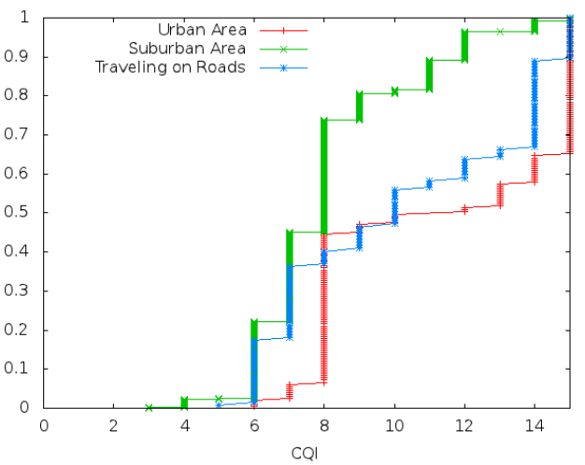
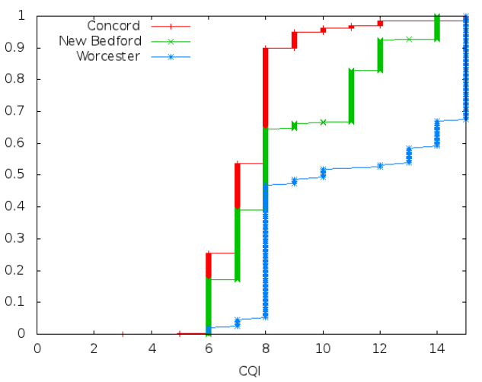
CQI Choice Cont.
Cumulative distribution of data
Collected 5,070 data points
Average CQI requested was 8

Slide 29
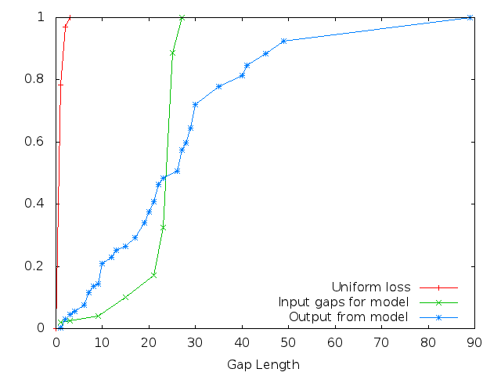
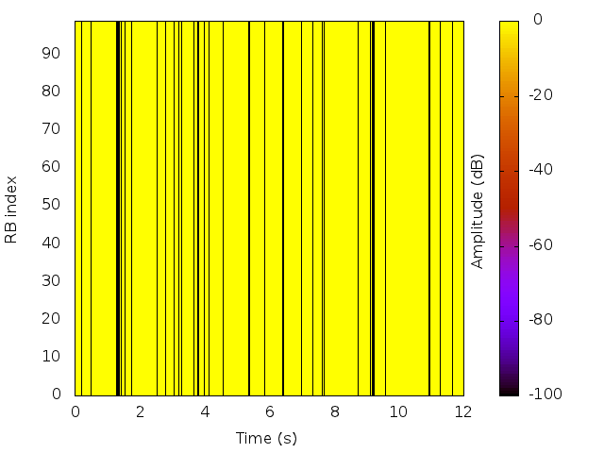
Wireless Loss Cont
Creating fading loss file
Use goal % loss and set of input gap lengths to find state transition probabilities
Run Gilbert model

Slide 30
Simulating VoIP
ns-3 example code for application that sends data at a specified rate
Use G.711 encoding format to define size of packets and sending rate
160 bytes data, 12 bytes RTP header, 8 bytes UDP header, 20 bytes IP header
Sending rate 64Kbps or about 1 packet every 20ms
Mean Opinion Score (MOS) used as performance metric
1 – 5 point scale, 1 worst, 5 best
Calculated from delay and loss using E-Model
[ITU G.711]
[E-Model]

Slide 31
Simulating FTP
ns-3 bulk send application
Transmits as much data as possible over TCP
Default ns-3 congestion control algorithm is NewReno
Throughput used as performance metric

Slide 32
RLC UM
0
1
2
3
4
5
6
VR(UR),VR(UH)
Receiving window used for reordering PDUs
Out of order PDU trigger timer t-Reordering
0
1
2
3
4
5
6
VR(UR)
VR(UX),VR(UH)

Slide 33
Timer t-Reordering UM
0
1
2
3
4
5
6
Timer runs when PDUs arrive out of order
Gives MAC layer chance to recover lost data
Expiration moves VR(UR) up to first SN >= VR(UX) that is not received
Tradeoffs
Small timer, MAC retransmissions lost
Large timer, keeps lower bound of window stalled
VR(UR)
VR(UX),VR(UH)
0
1
2
3
4
5
6
VR(UR),VR(UH)
Recovered
0
1
2
3
4
5
6
VR(UR),VR(UH)
LOST

Slide 34
RLC AM
0
1
2
3
4
5
6
VR(R),VR(H),VR(MS)
Receiving window used for reordering and ACK/NACK messaging
0
1
2
3
4
5
6
VR(R),VR(MS)
VR(X),VR(H)

Slide 35
Timer t-Reordering AM
0
1
2
3
4
5
6
Gives MAC layer time before NACKing
t-Reordering starts when SN 5 arrives
ACK = 3
While running SN 4 arrives
ACK = 3
When timer expires VR(MS) is updated
ACK = 6, NACK = 3
Tradeoffs
Small timer, NACK data that MAC can recover
Large timer, stalls NACKs
VR(R),VR(MS)
VR(X),VR(H)
0
1
2
3
4
5
6
VR(R),VR(MS)
VR(X),VR(H)
0
1
2
3
4
5
6
VR(R)
VR(H),VR(MS)

Slide 36
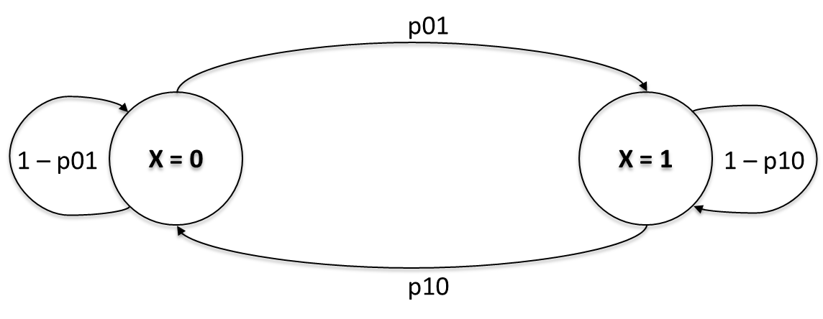
Gilbert-Elliot Model
Two state machine for loss
X = 0 no loss
X = 1 loss
Transition probabilities define when to change states

Slide 37
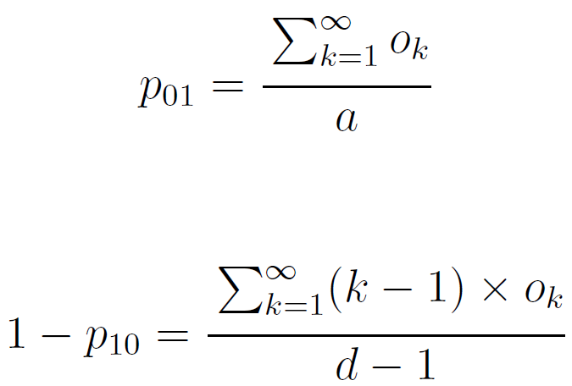
Transitions
Gordo et al. shows how to take input of loss gaps and determine state transitions
O_{k} – # of burst losses of length k
a - # of TTIs
d - # of lost TTIs
[Gordo 10]

Slide 38
LTE Network Layers
Application
LTE wireless network has 6 layers (not all shown)
PHY – RLC layers carry user and network control data
LTE transmits collections of Physical Resource Blocks (PRB)s in Transport Blocks (TB)
A TB is the packet sent through the PHY layer
One TB can have multiple PRBs
Each PRB takes up some radio spectrum and time frame
TCP
UDP
IP
RLC
MAC
PHY

