Slide 1
Measurements Comparing TCP Cubic and TCP BBR over a Satellite Network
Saahil Claypool, Mark Claypool
Jae Chung
Notes:
Saahil Claypool, Jae Chung, and Mark Claypool. Measurements Comparing TCP Cubic and TCP BBR over a Satellite Network, In Proceedings of the IEEE Consumer Communications & Networking Conference (CCNC), Virtual Conference, January 9-12, 2021.
Online at: http://www.cs.wpi.edu/~claypool/papers/bbr-cubic-sat/

Slide 2
Introduction (1 of 2)
Satellites provide global networking
“Always on” connectivity for remote locations, during disasters [SIA20]
Bitrates increasing (20x recently)
Challenge is latency → about 300 ms min. one-way for geosynchronous
300 ms

Slide 3
Introduction (2 of 2)
Latency impacts TCP bitrates
One window of packets each RTT
Window size depends upon congestion control algorithm
TCP Cubic – most Internet bytes, servers
TCP BBR – newcomer, Google servers
Few published studies of TCP over satellite network
Mostly simulation or emulation
This paper → TCP Cubic & TCP BBR over satellite network

Slide 4
Outline
Introduction (done)
Background (next)
Methodology
Results
Conclusions

Slide 5
TCP Inflight Data
x
x
x
Delivery Rate
BBR
Cubic
Inflight
x
x
x
RTT
BBR
Cubic
BDP
BDP + Queue

Slide 6
TCP over Time
Cubic
[HRX08]
Slow Start
inflight
Congestion
Avoidance
Time
Start-up
BBR
[CCGY17]
Probe BW
inflight
Probe RTT

Slide 7
Outline
Introduction (done)
Background (done)
Methodology (next)
Results
Conclusions

Slide 8
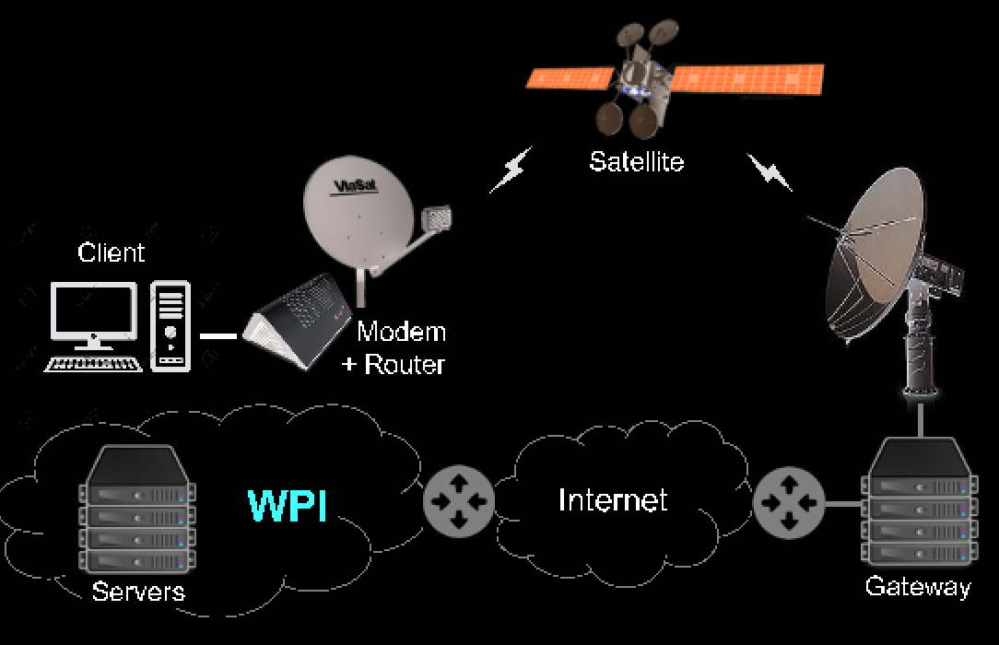
Methodology
Client
144 Mb/s
Servers
Baseline
UDP Ping
Bulk-download
iperf
[RFC 5166]
Throughput
Round-trip time
Retransmissions (loss)
Notes:
Client Intel i7-1065G7 CPU @ 1.30GHz and 32 GB RAM
Servers Intel Ken E312xx CPUs @ 2.5 GHz and 32 GB RAM
Servers and client run Ubuntu 18.04.4 LTS, Linux kernel v4.15.0
Servers connect to WPI LAN via Gb/s Ethernet.
WPI campus connected to Internet via several 10 Gb/s, throttled to 1 Gb/s.
Viasat terminal to Ka-band outdoor antenna (RF amplifier, up/down converter, reflector and feed) through Viasat 2 satellite to Ka-band gateways links
Service plan peak data rate of 144 Mb/s
Gateway does per-client queue management for traffic
Queue up to 36 MBytes (about 2 seconds)
Active Queue Management (AQM) randomly drops 25% when queue over 18 MBytes

Slide 9
Outline
Introduction (done)
Background (done)
Methodology (done)
Results (next)
Baseline
Steady State
Start-up
Conclusions

Slide 10
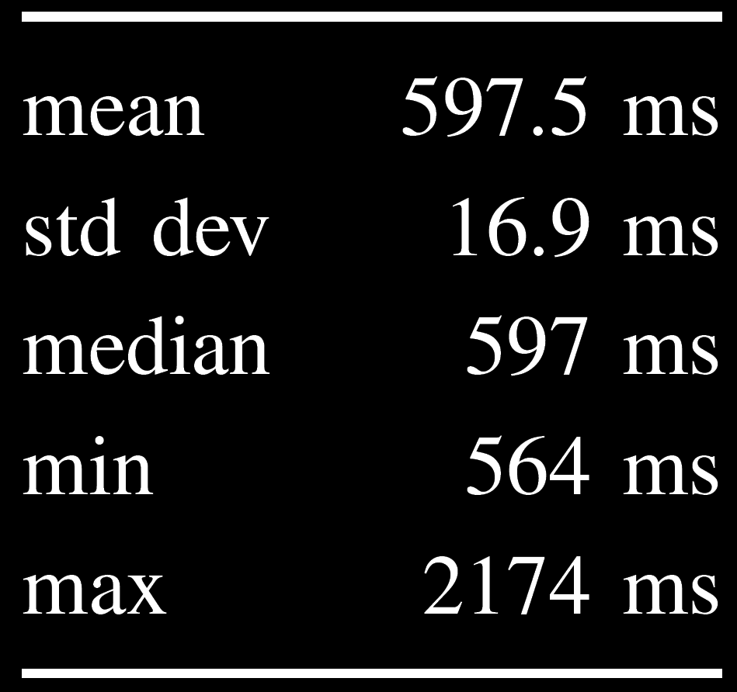
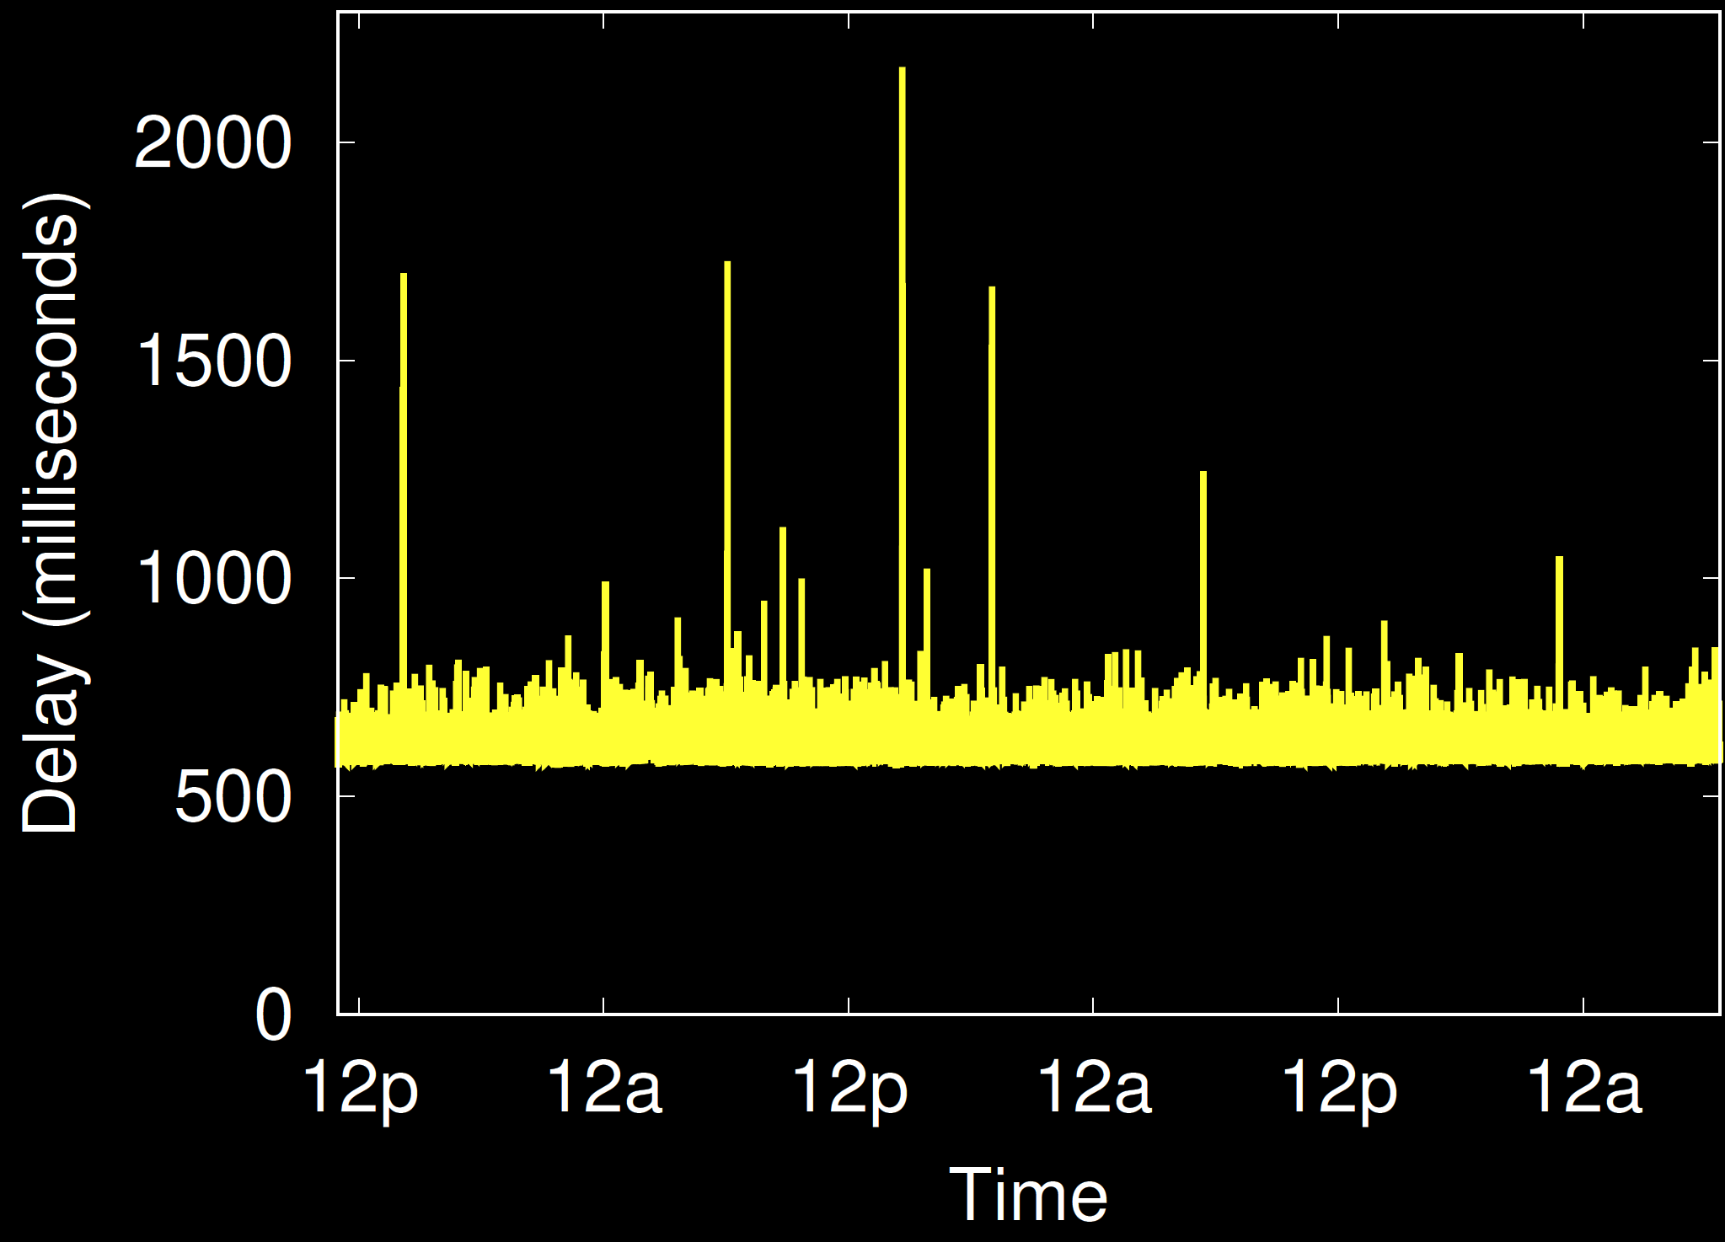
Baseline
Loss: 0.05%
77% are single packet
Largest 11 packets (2.2 seconds)

Slide 11
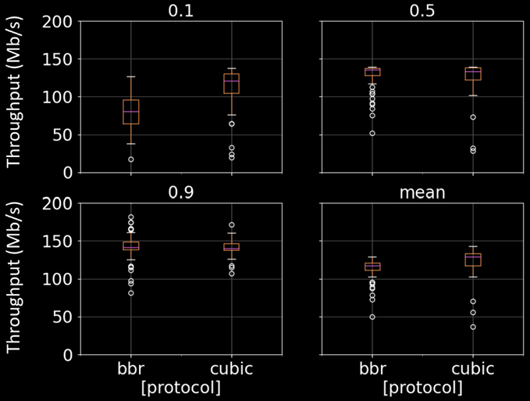
Steady State – Throughput
BBR
Cubic
BBR
Cubic

Slide 12
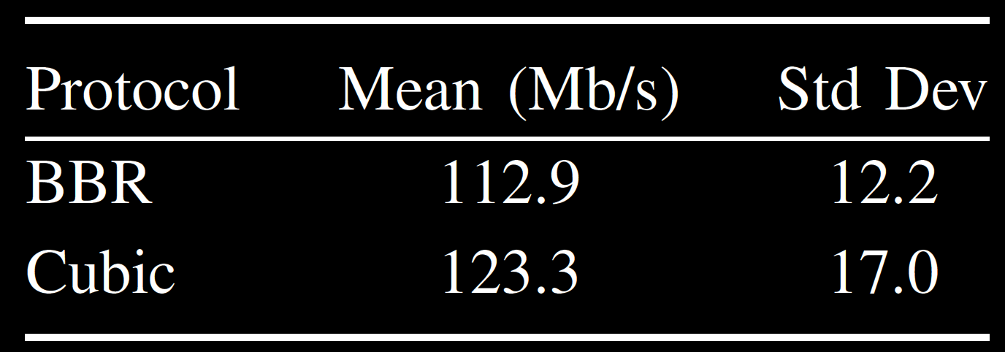
Steady State – Throughput
BBR
Cubic
Independent, 2-tailed t test (α = 0.5) → statistically significant
t(158) = 4.4
p < .0001
Large effect size (d = 0.7)

Slide 13
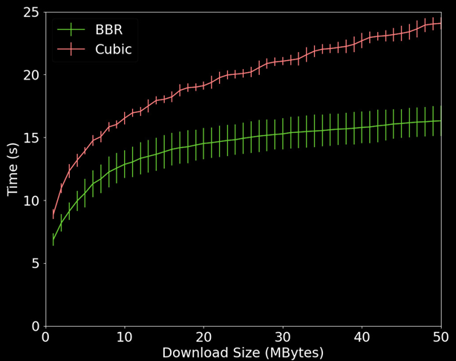
Start-up

Slide 14
Start-up
BBR
Cubic
Independent, 2-tailed t test (α = 0.5) for mean start-up throughput → statistically significant
t(158) = 31.9
p < .0001
Very large effect size (d = 5)

Slide 15
Conclusion
Baseline consistent RTT 600ms, low loss
Steady-state: BBR a bit lower throughput than Cubic
From BBR “probe RTT” state
Start-up: BBR 50% faster than Cubic

Slide 16
Future Work
Multiple Flows
e.g., BBR and Cubic together
Other Protocols
e.g., PCC, Hybla, QUIC
Performance Enhancing Proxy (PEP)
Other applications
e.g., Web browsing, streaming video

Slide 17
Measurements Comparing TCP Cubic and TCP BBR over a Satellite Network
Thank-you!
Saahil Claypool, Mark Claypool
Jae Chung
Notes:
Saahil Claypool, Jae Chung, and Mark Claypool. Measurements Comparing TCP Cubic and TCP BBR over a Satellite Network, In Proceedings of the IEEE Consumer Communications & Networking Conference (CCNC), Virtual Conference, January 9-12, 2021.
Online at: http://www.cs.wpi.edu/~claypool/papers/bbr-cubic-sat/

Slide 18
References
[BCDA99] C. Barakat, N. Chaher, W. Dabbous, and E. Altman, “Improving TCP/IP over Geostationary Satellite Links,” in Proceedings of GLOBECOM, Rio de Janeireo, Brazil, Dec. 1999.
[CCGY17] N. Cardwell and Y. Cheng and C. S. Gunn and S. H. Yeganeh and Van Jacobson, “BBR: Congestion-based Congestion Control,” Communications of the ACM, no. 2, pp. 58–66, Jan. 2017.
[HRX08] S. Ha, I. Rhee, and L. Xu, “CUBIC: A New TCP-Friendly High-Speed TCP Variant,” ACM SIGOPS OS Review, vol. 42, no. 5, 2008.
[OTI11] H. Obata, K. Tamehiro, and K. Ishida, “Experimental Evaluation of TCP-STAR for Satellite Internet over WINDS,” in Proceedings of Autonomous Decentralized Systems, Tokyo, Japan, Mar. 2011.
[RFC 5166] S. Floyd, “Metrics for the Evaluation of Congestion Control Mechanisms,” Internet Requests for Comments RFC 5166, March 2008.
[SIA20] S. I. Association, “Introduction to the Satellite Industry,” Online presentation: https://tinyurl.com/y5m7z77e, 2020.
[WZL+18] Y. Wang, K. Zhao, W. Li, J. Fraire, Z. Sun, and Y. Fang, “Performance Evaluation of QUIC with BBR in Satellite Internet,” in Proceedings of IEEE Wireless for Space and Extreme Environments (WiSEE), Huntsville, AL, USA, Dec. 2018.

Slide 19
Extra Slides

Slide 20
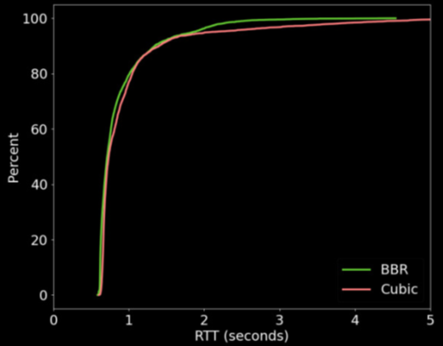
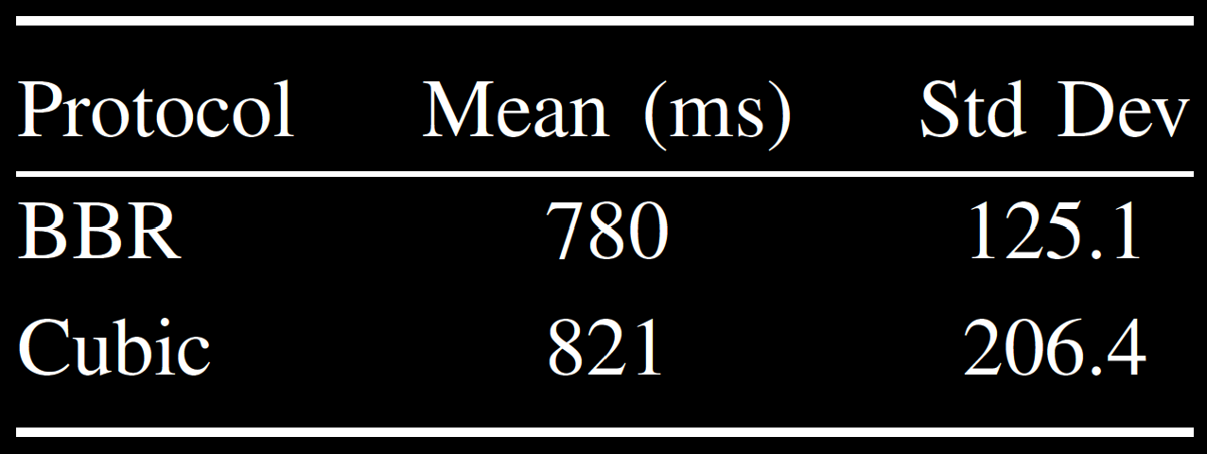
Steady State – RTT
BBR
Cubic

Slide 21
Steady State – Loss

