Slide 1
Sharing but not caring: Performance of BBR
and CUBIC at the network bottleneck
Saahil Claypool

Slide 2
Outline
Current state of congestion control
Approach
Results
Conclusion

Slide 3
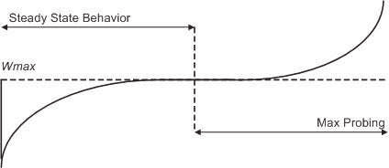
Loss-based Congestion Control (CC)
Loss-based congestion is the defacto standard (TCP CUBIC)
Treat loss as a congestion signal
Expands CWND until loss occurs
2008 Sangtae Ha et. al.
[Sangtae Ha, 2008]
Notes:
Sends window of packets each RTT
Y is window size
X is time

Slide 4
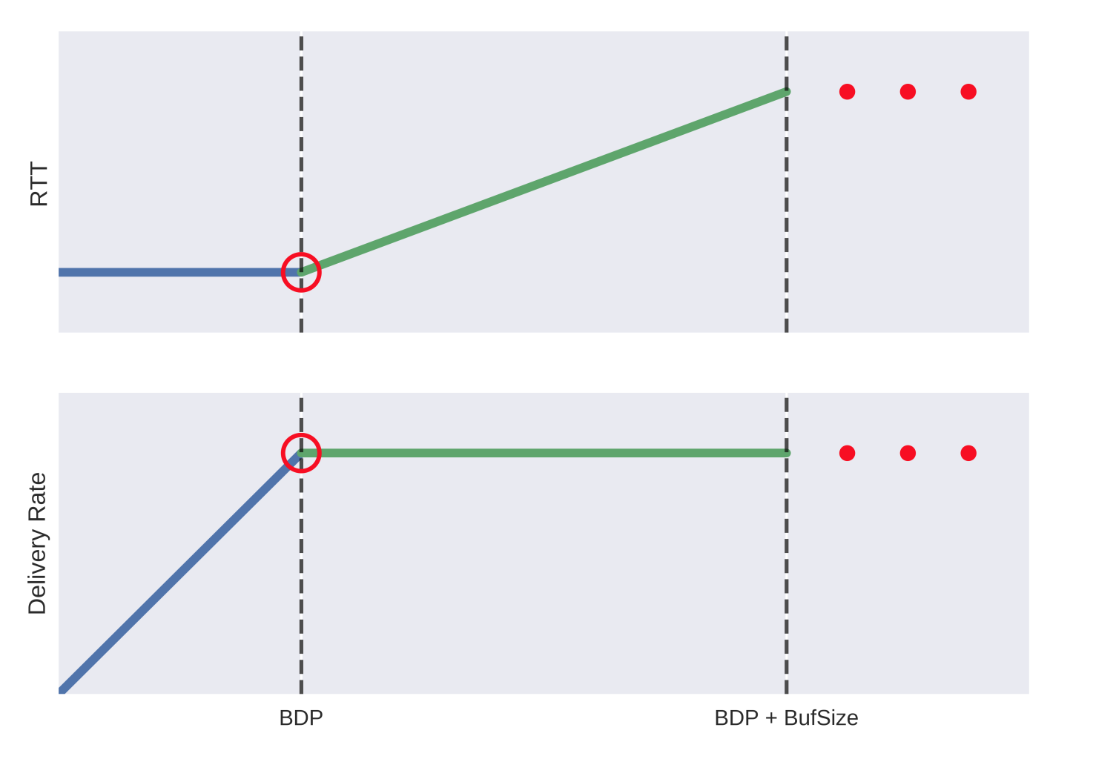
Loss-based CC is sub-optimal
Loss-based operates at right
CWND size

Slide 5
Loss-based CC is sub-optimal
Loss-based operates at right of optimal
Kleinrock’s Optimal: 1 BDP of packets inflight
BDP = Throughput * RTprop
Maximum throughput and minimum round trip time
Loss-based
CC
Optimal
[Kleinrock, 1978]
CWND size

Slide 6
Optimal operating point: intuition
Single throughput bottleneck
Waiting in line does not provide higher throughput
Boarding groups reduce queuing
Throughput is unchanged

Slide 7
Optimal operating point: intuition
Single throughput bottleneck
Waiting in line does not provide higher throughput
Boarding groups reduce queuing
Throughput is unchanged

Slide 8
BBR: bottleneck bandwidth and round-trip
propagation time
BDP = BtlBW * RTprop
Estimate BtlBw and RTprop
Set CWND to 2 BDP
Accommodates delayed & stretched ACKs
Pace packets at BtlBw
Often - ProbeBW
Increase inflight, check for larger BtlBW
Infrequent - ProbeRTT
Reduce inflight, check for lower RTT
ProbeBW
ProbeRTT
[Cardwell, 2017]

Slide 9
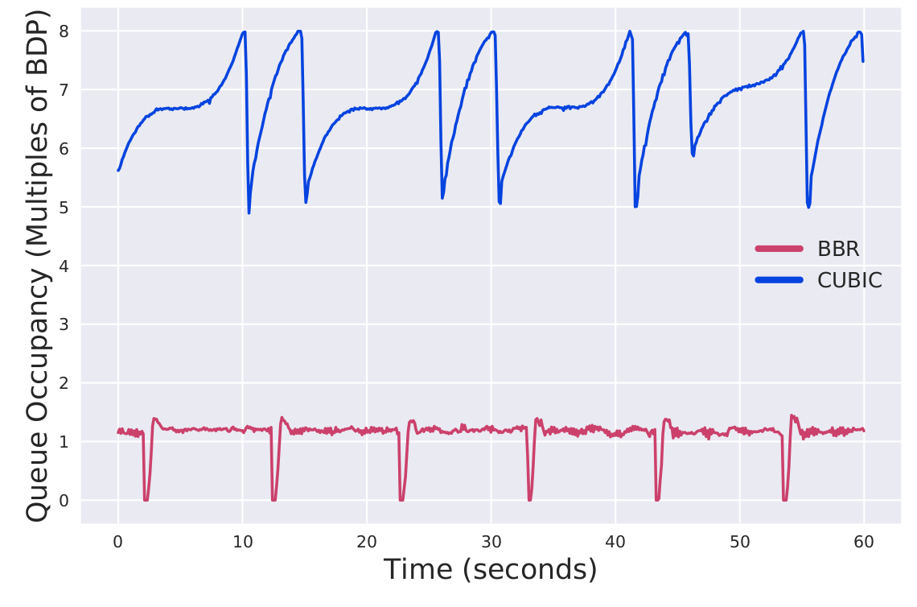
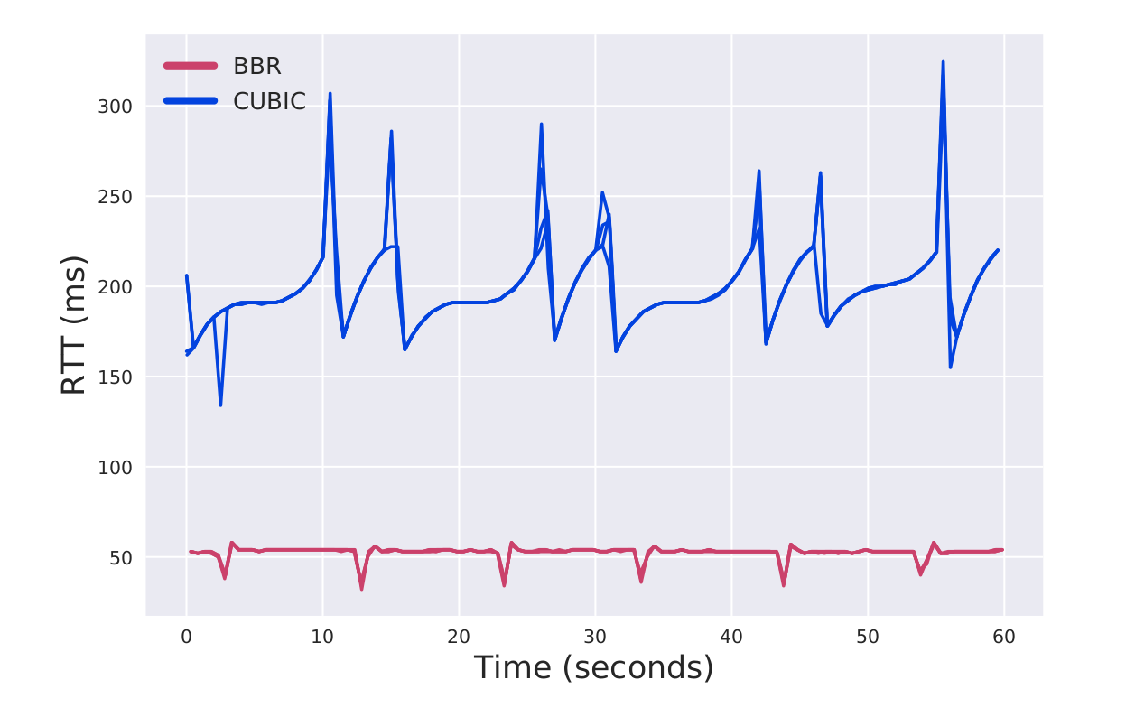
BBR’s Potential
CC | RTT (ms) | TP (mb/s)
BBR | 49.43 | 78.2
CUBIC | 198.3 | 78.8
Maximizes throughput with low RTT and router queues
BBR has been used by:
Youtube
Spotify
Dropbox
Potential problems:
Loss in shallow buffers
Poor fairness with CUBIC
[Cardwell, 2017; Carlsson, 2019; Ivanov, 2017; Sholz, 2018 ]
Results from 25 ms 80 mbps connection, 4 flows of each type. Not competing

Slide 10
Outline
Current state of congestion control
Approach
Results
Conclusion

Slide 11
Approach
Goal: improve BBR
Evaluate the BBR protocol over a range of network conditions
Setup an environment for TCP research
Possible test environments:
Simulation (NS3)
Doesn’t use kernel BBR
‘Web-scale’ deployment
Requires resources
Not reproducible
Cloud-based provider (gcompute)
Hard to reason about results

Slide 12
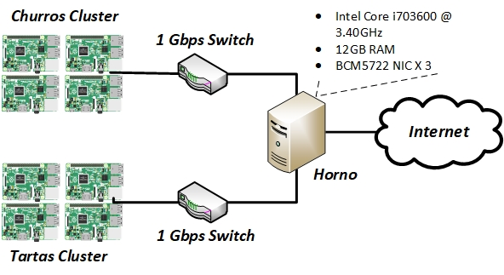
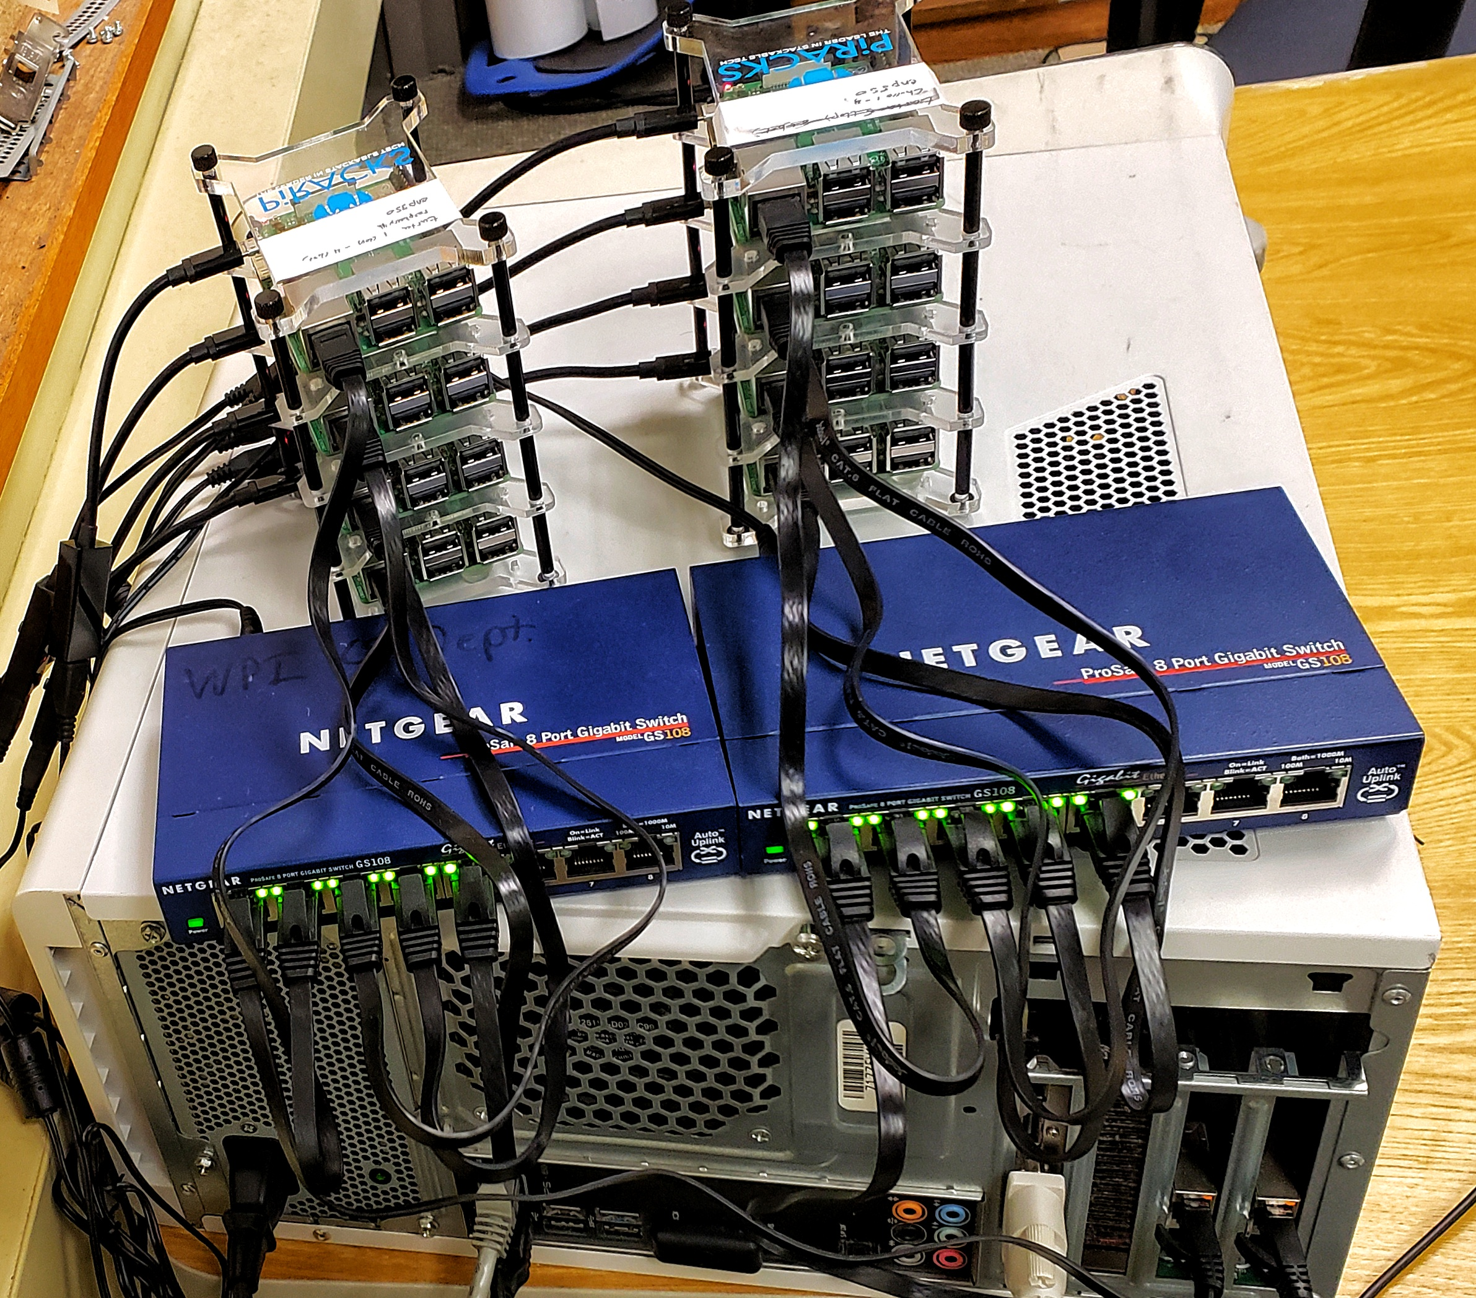
“The Panaderia”
Our choice - hardware testbed
Raspberry Pi 3B+
Cheap
Mainline kernel BBR and CUBIC
Controlled

Slide 13
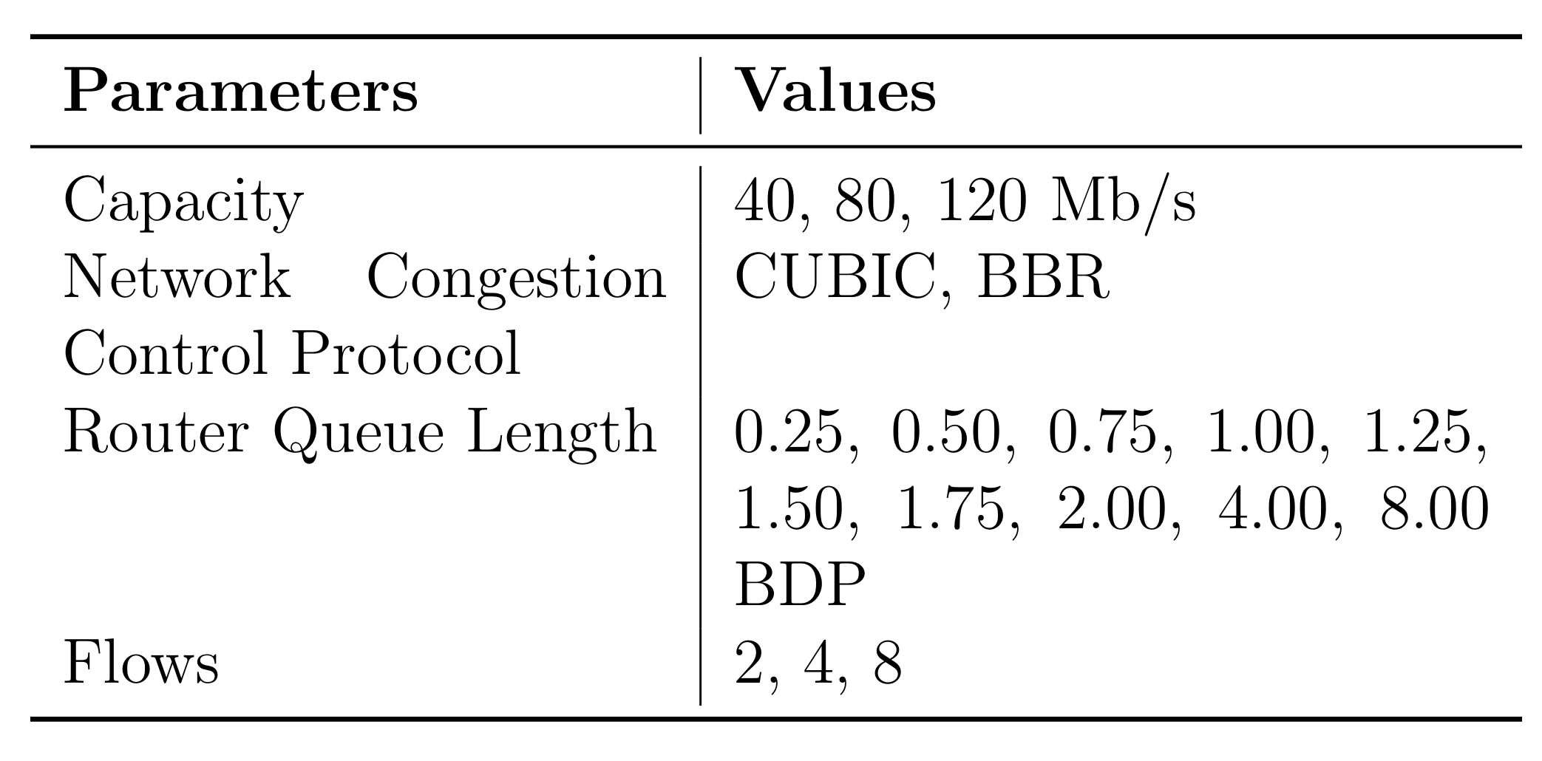
Evaluation
Measurements of interest:
Sender throughput
Receiver goodput
Sender RTT
Router queue length
Router loss rate
Future QoS measurements:
Perceived latency
Rebuffering events (video/audio)
Bitrate encoding changes (audio/video)
(We don’t gather these yet)

Slide 14
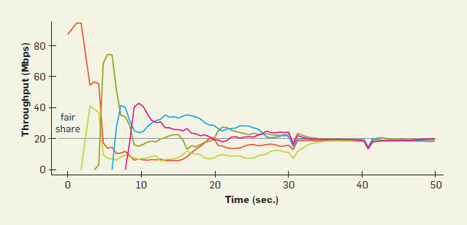
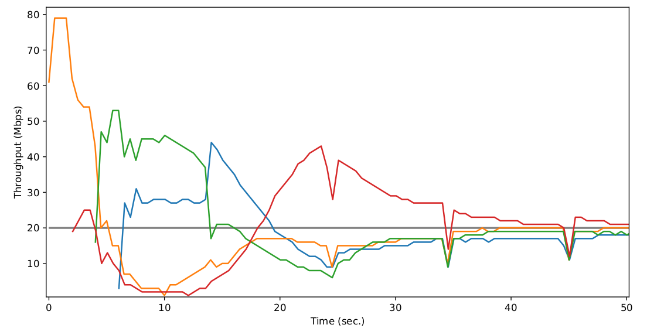
Validating the testbed
Convergence Test
Validate by comparing our results to Google’s
Early issues included:
Token bucket filters
Cause bursts in throughput
Fair queueing default in router
Kernel parameter tuning in PIs
Convergence test:
100 mbps / 5 flows, 25 ms RTT
Converge to fair share
Timers synchronize
Google’s
Panaderia

Slide 15
Outline
Current state of congestion control
Approach
Results
Conclusion

Slide 16
BBR’s 2 BDP CWND
BBR caps CWND at 2 BDP
1 BDP “on the wire”
1 BDP queued at the router
BBR ignores loss
So, what if router queue < 1 BDP?
“Shallow buffers”

Slide 17
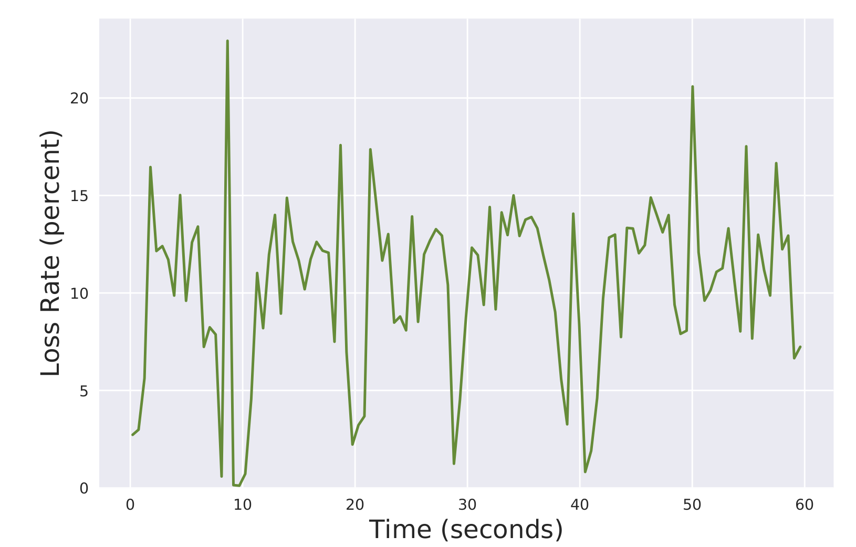
BBR in Shallow Buffers
Attempts to fill 1 BDP at the router
Ignores the resulting loss
Still maintains high throughput
Loss in a shallow buffer

Slide 18
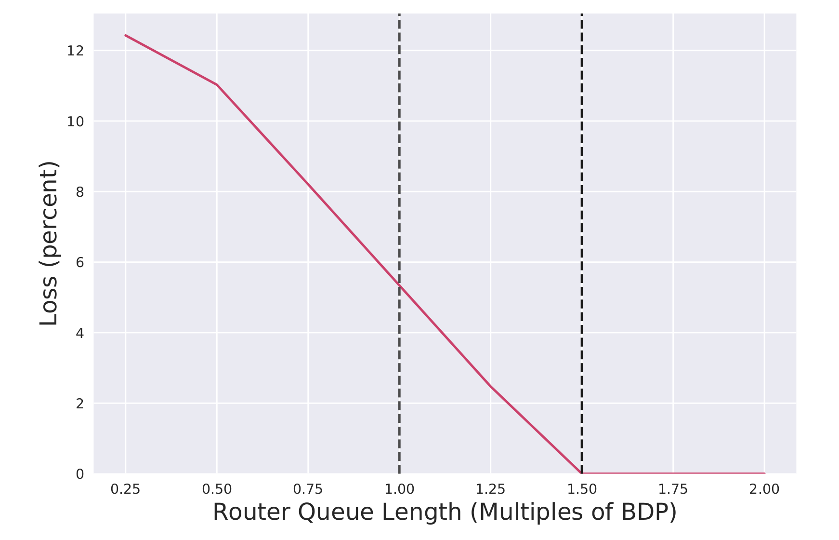
What is a shallow buffer?
1 BDP queued at router → Any router queue less than 1 BDP is shallow
* Actually, 1.5 BDP
Notes:
Axis
Experiments: each trial we measure the loss rate (percent)
So, this is the summary of ~100 trials

Slide 19
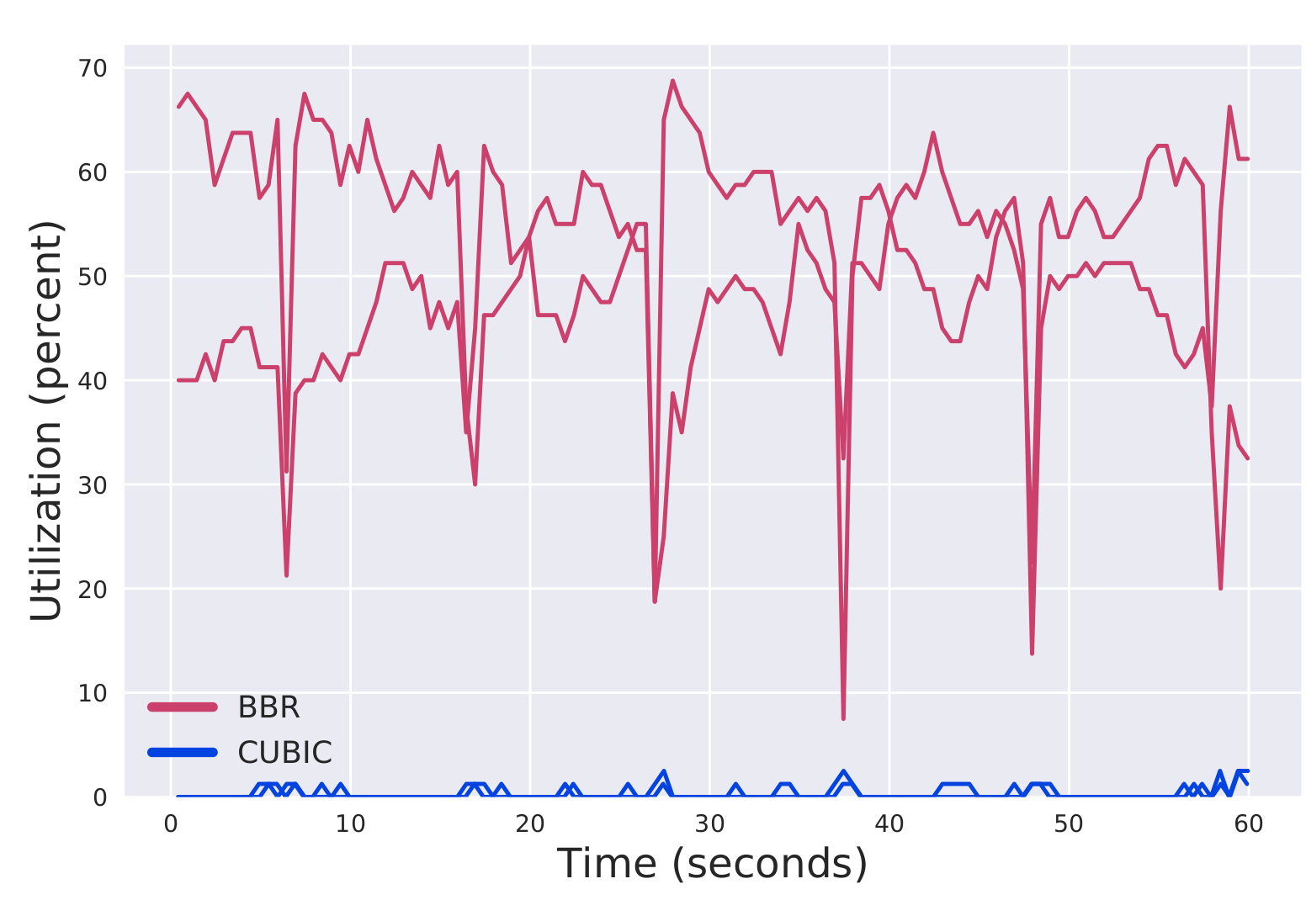
BBR vs CUBIC: shallow buffers (0.5 BDP)
BBR creates loss in shallow buffers
CUBIC treats loss as congestion and reduces inflight packets → BBR dominates

Slide 20
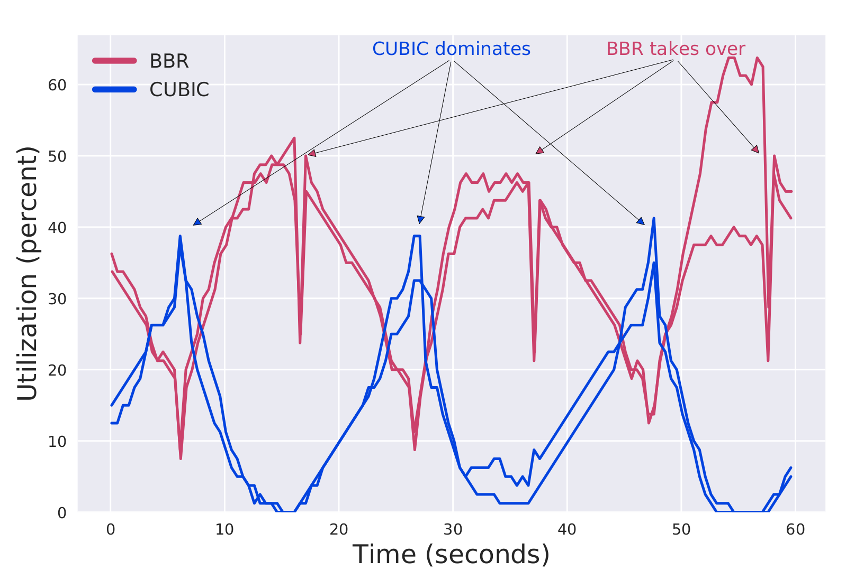
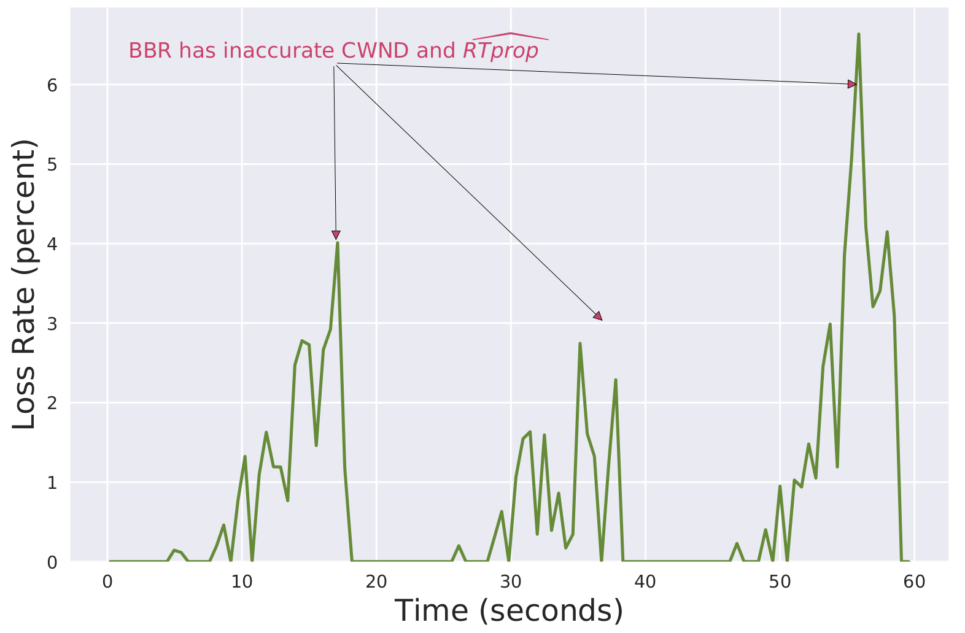
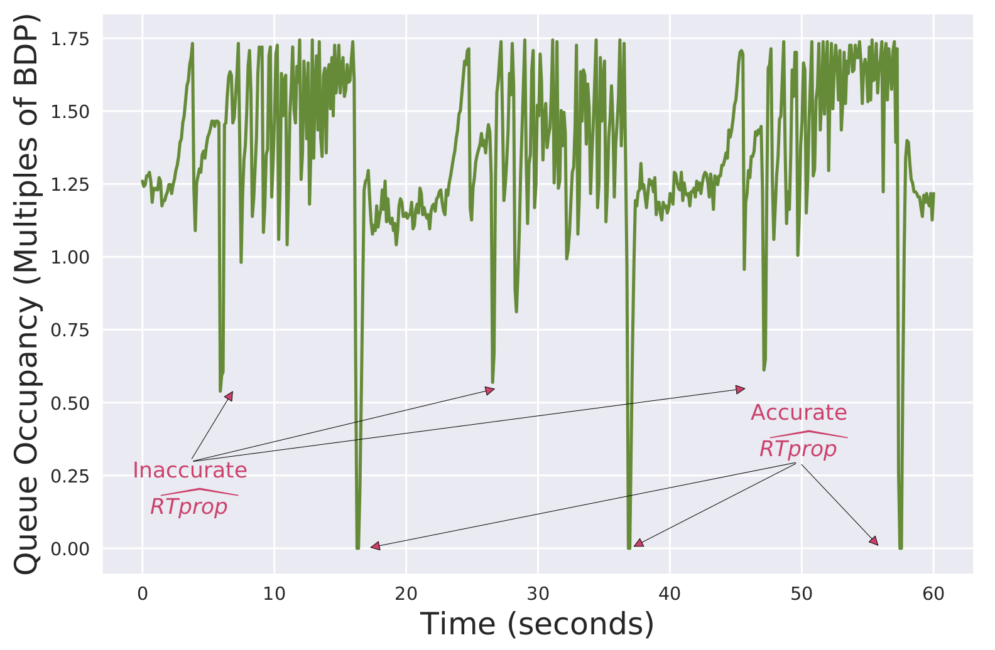
BBR vs CUBIC: medium buffers (1.75 BDP)
BBR and CUBIC exhibit cyclic performance
BBR’s static CWND limits it in steady state → CUBIC dominates
BBR mismeasures RTT when CUBIC dominates → creates loss

Slide 21
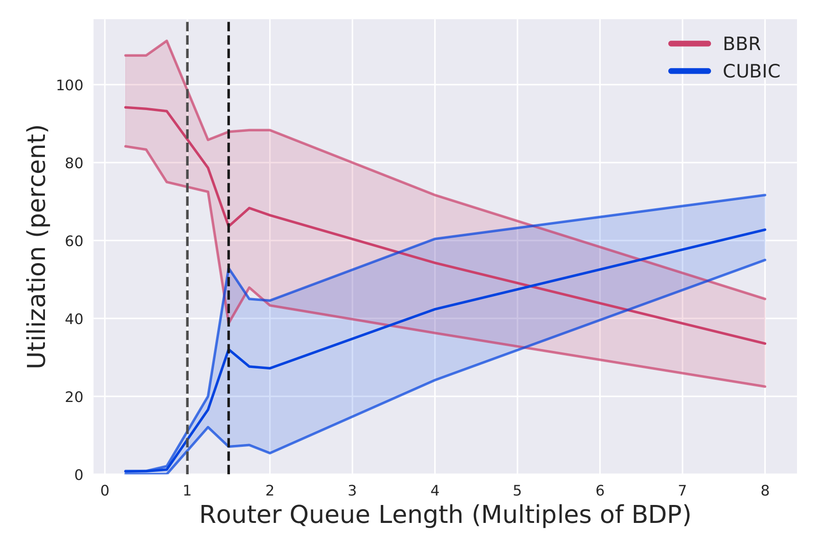
Measuring Fairness
Inter-protocol fairness depends on router queue size
In large queues, BBR’s 2 BDP CWND limits it

Slide 22
Improving BBR: areas for improvement
BBR’s static 2 BDP CWND is problematic
In shallow buffers, it is too large
In competition with CUBIC, it is too small
BBR over-estimates RTT when competing with CUBIC
Solution?:
Ignore increasing RTT estimates
dynamically change the CWND

Slide 23
Improving BBR: dynamic CWND adjustment
If BBR observes less throughput than the highest observed
Then: increase the CWND to compete with buffer filling protocols.
If BBR observes high, persistent loss or higher than minimum RTT
Then: decrease the CWND to minimize buffer saturation.

Slide 24
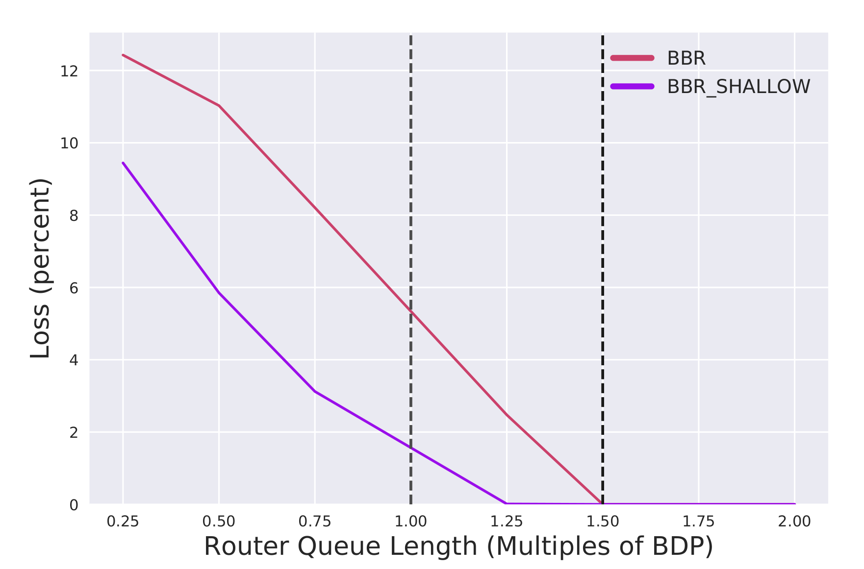
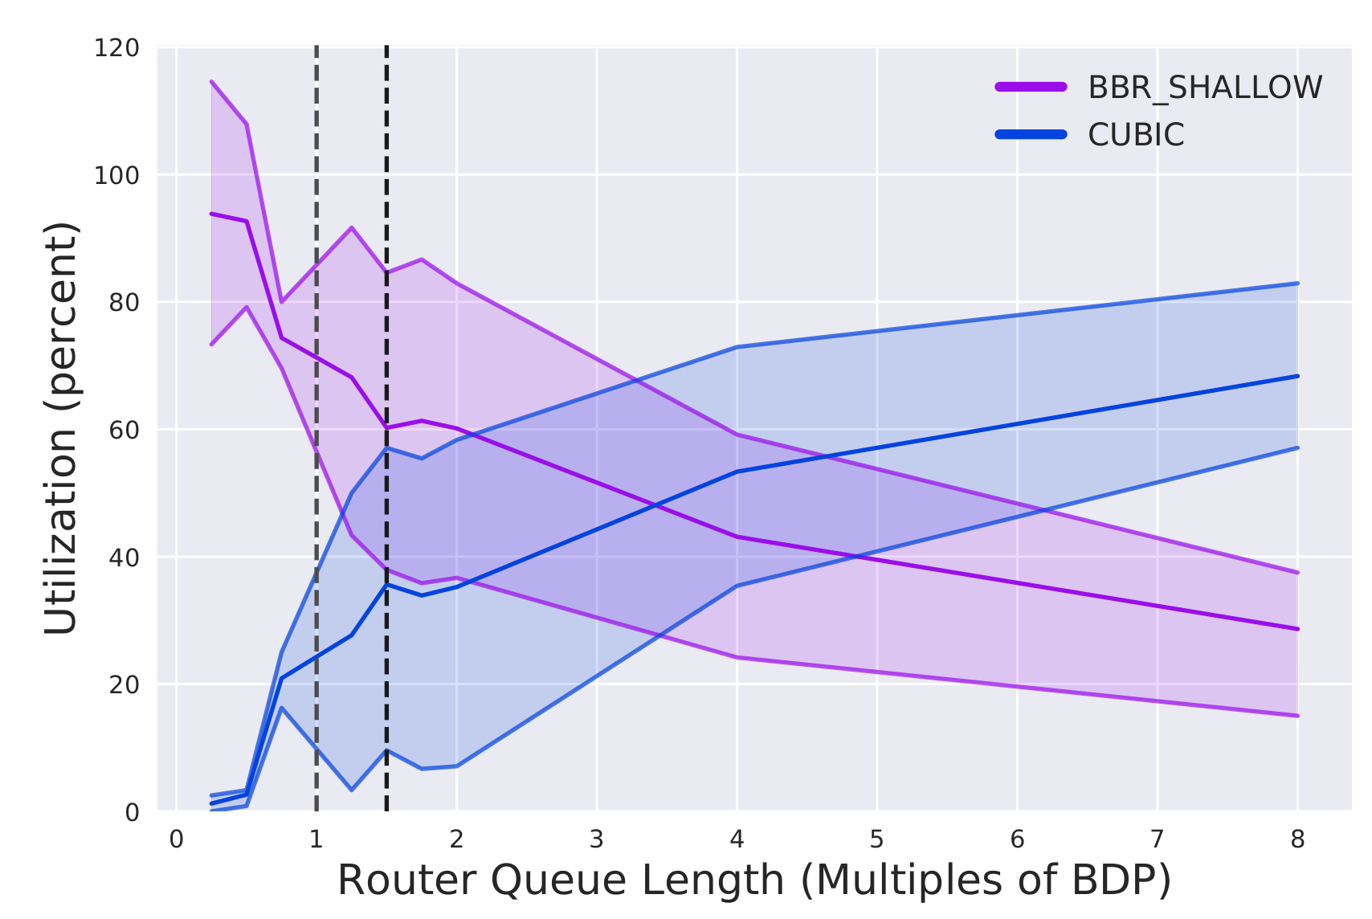
Improving BBR: proof of concept 1.5 BDP CWND
What if CWND was instead 1.5 BDP?
Less loss
Less Fairness
→ Fairness and loss are dictated by the CWND

Slide 25
Conclusions
BBR has large adoption and improves on loss-based bufferbloat
BBR still requires testing in different scenarios
We propose a hardware testbed to test BBR
Inaccurate RTprop and 2 BDP CWND at the root of unfairness and loss

Slide 26
Future work
Evaluate BBR over other conditions (esp. high BDP)
Satellite
4G/5G
Extend these results with QoS measures
Evaluate QUIC and its BBR implementation

Slide 27
References (Paper)
[11] M. Hock, R. Bless, and M. Zitterbart, “Experimental evaluation of BBR
congestion control,” in IEEE ICNP, Toronto, ON, Oct. 2017, pp. 1–10.
[12] L. Kleinrock, “Power and deterministic rules of thumb for probabilistic
problems in computer communications,” in ICC, Boston, MA, 1979.
[13] J. M. Jaffe, “Flow control power is nondecentralizable,” IEEE Transac-
tions on Communications, vol. 29, 10 1981, pp. 1301 – 1306.
[14] M. Dong, Q. Li, D. Zarchy, P. B. Godfrey, and M. Schapira, “PCC:
Re-architecting congestion control for consistent high performance,” in
USENIX NSDI, 2015, pp. 395–408.
[15] V. Arun and H. Balakrishnan, “Copa: Practical Delay-Based Congestion
Control for the Internet,” in Proceedings of the Applied Networking
Research Workshop. Montreal, QC: ACM Press, 2018, pp. 19–19.
[16] L. Brakmo and L. Peterson, “TCP Vegas: end to end congestion
avoidance on a global Internet,” IEEE Journal on Selected Areas in
Communications, vol. 13, no. 8, Oct. 1995, pp. 1465–1480.
[17] S. Claypool, “The Panaderia,” 2019. [Online]. Available: https:
//saahilclaypool.github.io/panaderia/
[18] S. Hemminger, “Network emulation with NetEm,” in Proceedings of
Linux Australia, Sydney NSW 2001, Australia, 2005, pp. 18–23.
[19] “tc-tbf (8): Token Bucket Filter - Linux man page,” accessed: February
24, 2019. [Online]. Available: https://linux.die.net/man/8/tc-tbf
[20] “Dual Token Bucket Algorithms - TechLibrary,” accessed: February
24, 2019. [Online]. Available: https://tinyurl.com/yy5owway
[21] S. Claypool, “Sharing but not caring - performance of TCP BBR
and TCP CUBIC at the network bottleneck,” WPI Major Qualifying
Project MQP-CEW-1904, March 2019, (Advisor C. Wills). [Online].
Available: https://digitalcommons.wpi.edu/mqp-all/6728/
[22] S. Claypool, “BBR Shallow,” 2019. [Online]. Available: https:
//tinyurl.com/bbrshallow-git
[1] Cisco, “VNI Global Fixed and Mobile Internet Traffic Forecasts,” 2017.
[2] B. Wang, J. Kurose, P. Shenoy, and D. Towsley, “Multimedia stream-
ing via TCP: An analytic performance study,” ACM Transactions on
Multimedia Computing (TOMM), vol. 4, no. 2, 2008, p. 16.
[3] S. Ha, I. Rhee, and L. Xu, “CUBIC: a new TCP-friendly high-speed
TCP variant,” ACM SIGOPS OS Review, vol. 42, no. 5, Jul. 2008.
[4] J. Gettys and K. Nichols, “Bufferbloat: dark buffers in the Internet,”
Communications of the ACM, vol. 55, no. 1, Jan. 2012, p. 57.
[5] N. Cardwell, Y. Cheng, C. S. Gunn, S. H. Yeganeh, and Van Jacobson,
“BBR: congestion-based congestion control,” Communications of the
ACM, vol. 60, no. 2, Jan. 2017, pp. 58–66.
[6] L. Kleinrock, “Internet congestion control using the power metric: Keep
the pipe just full, but no fuller,” Ad Hoc Networks, vol. 80, Nov. 2018.
[7] E. Carlsson and E. Kakogianni, “Smoother streaming with BBR,” Aug.
2018, Spotify Labs. Accessed: February 24, 2019. [Online]. Available:
https://tinyurl.com/yyt5tbhd
[8] A. Ivanov, “Optimizing Web servers for high throughput and low
latency,” Sep. 2019, Dropbox Blogs. Accessed: April 7, 2019. [Online].
Available: https://tinyurl.com/y9qtt2yf
[9] D. Scholz, B. Jaeger, L. Schwaighofer, D. Raumer, F. Geyer, and
G. Carle, “Towards a deeper understanding of TCP BBR congestion
control,” in Proceedings of IFIP Networking, Zurich, Switzerland, 2018.
[10] K. Miyazawa, K. Sasaki, N. Oda, and S. Yamaguchi, “Cycle and
divergence of performance on TCP BBR,” in IEEE 7th International
Conference on Cloud Networking (CloudNet), 2018.

Slide 28
References (Slides)
Neal Cardwell, Yuchung Cheng, C. Stephen Gunn, Soheil Hassas Yeganeh, and Van Jacobson.
BBR: congestion-based congestion control.
Communications of the ACM, 60(2):58–66, January 2017.
Erik Carlsson and Eirini Kakogianni.
Smoother streaming with BBR, August 2018.
Spotify Labs. Accessed: Feburuary 24, 2019.
Dropbox: https://blogs.dropbox.com/tech/2017/09/optimizing-web-servers-for-high-throughput-and-low-latency/
Cubic with Faster Convergence: An Improved Cubic Fast Convergence Mechanism
Dominik Scholz, Benedikt Jaeger, Lukas Schwaighofer, Daniel Raumer, Fabien Geyer,
and Georg Carle.
Towards a deeper understanding of TCP BBR congestion control.
In Proceedings of IFIP Networking, Zurich, Switzerland, 2018.
Boarding: https://thumb10.shutterstock.com/display_pic_with_logo/454414/296631647/stock-photo-gdansk-airport-poland-april-people-boarding-to-ryanair-plane-on-lech-walesa-airport-in-296631647.jpg

Slide 29
Extra slides

Slide 30
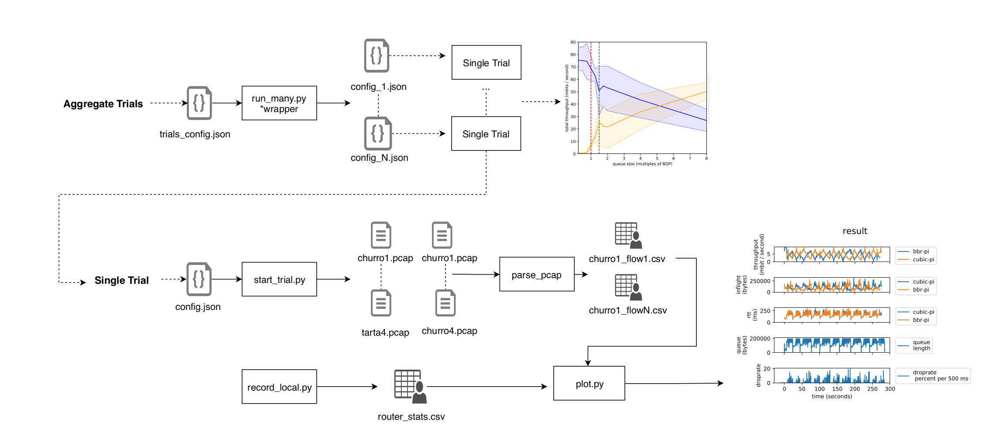
Dataflow
Notes:
We created a testing infrastructure to quickly let us test different network configurations in our hardware testbed, which was vital in allowing us to test all of the network conditions mentioned in the previous slide.

Slide 31
Dataflow
Notes:
We created a testing infrastructure to quickly let us test different network configurations in our hardware testbed, which was vital in allowing us to test all of the network conditions mentioned in the previous slide.

Slide 32
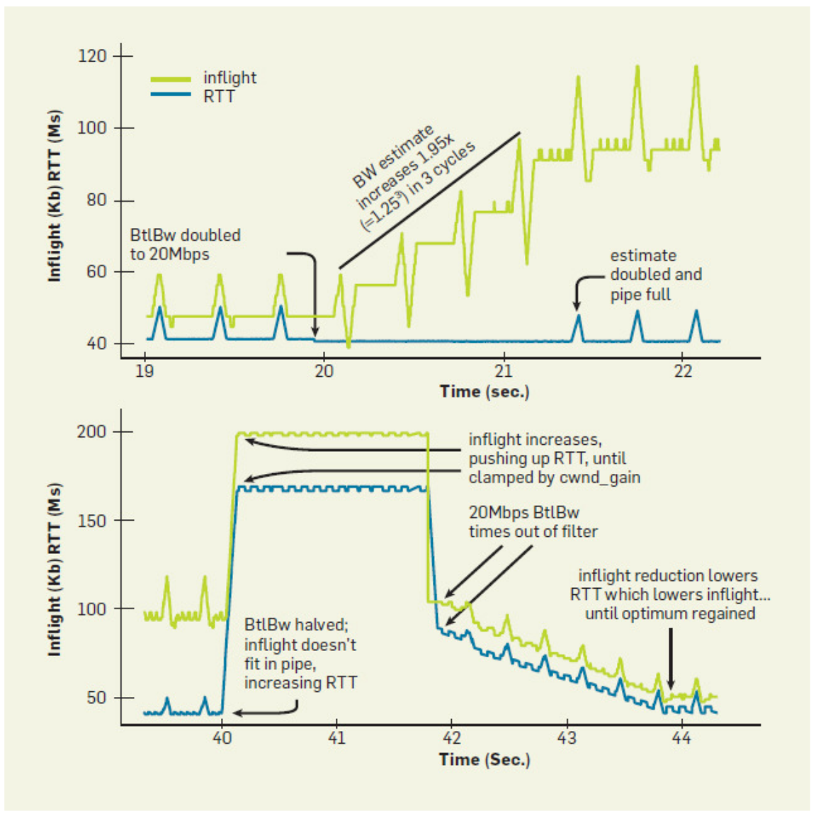
Validating the Raspberry Pi
CWND Expansion test:
Double throughout @ T20
Half throughput @ T40
Google’s

Slide 33
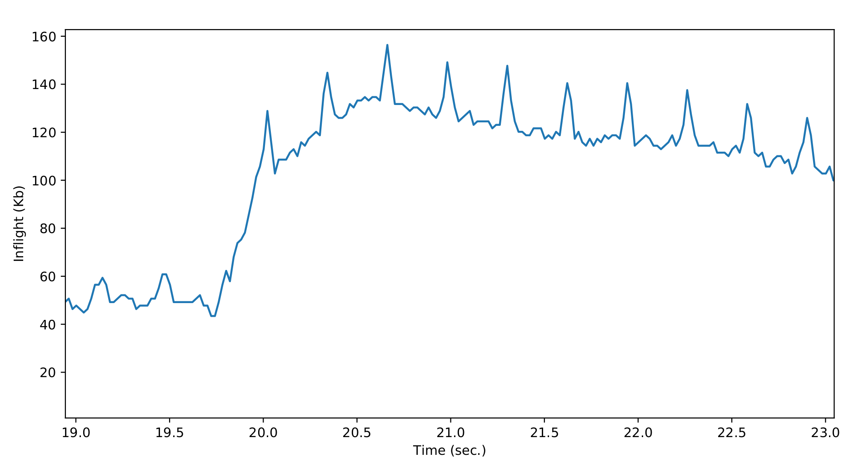
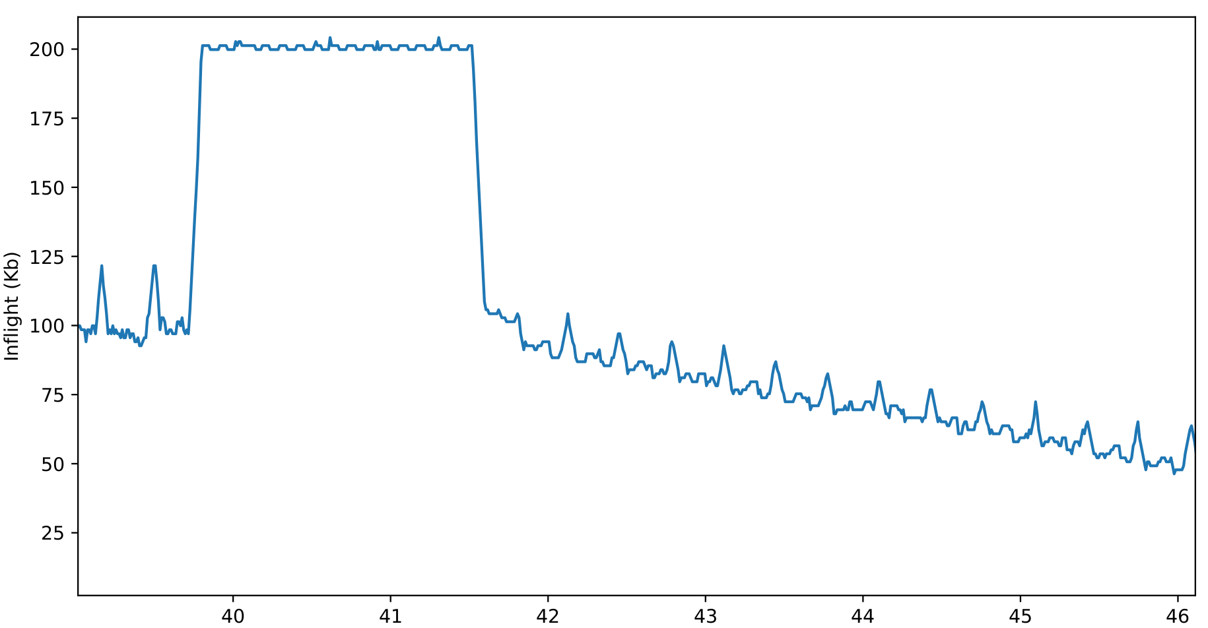
Validating the Raspberry Pi
CWND Expansion test:
Double throughout @ T20
Half throughput @ T40
Google’s
Panaderia

Slide 34
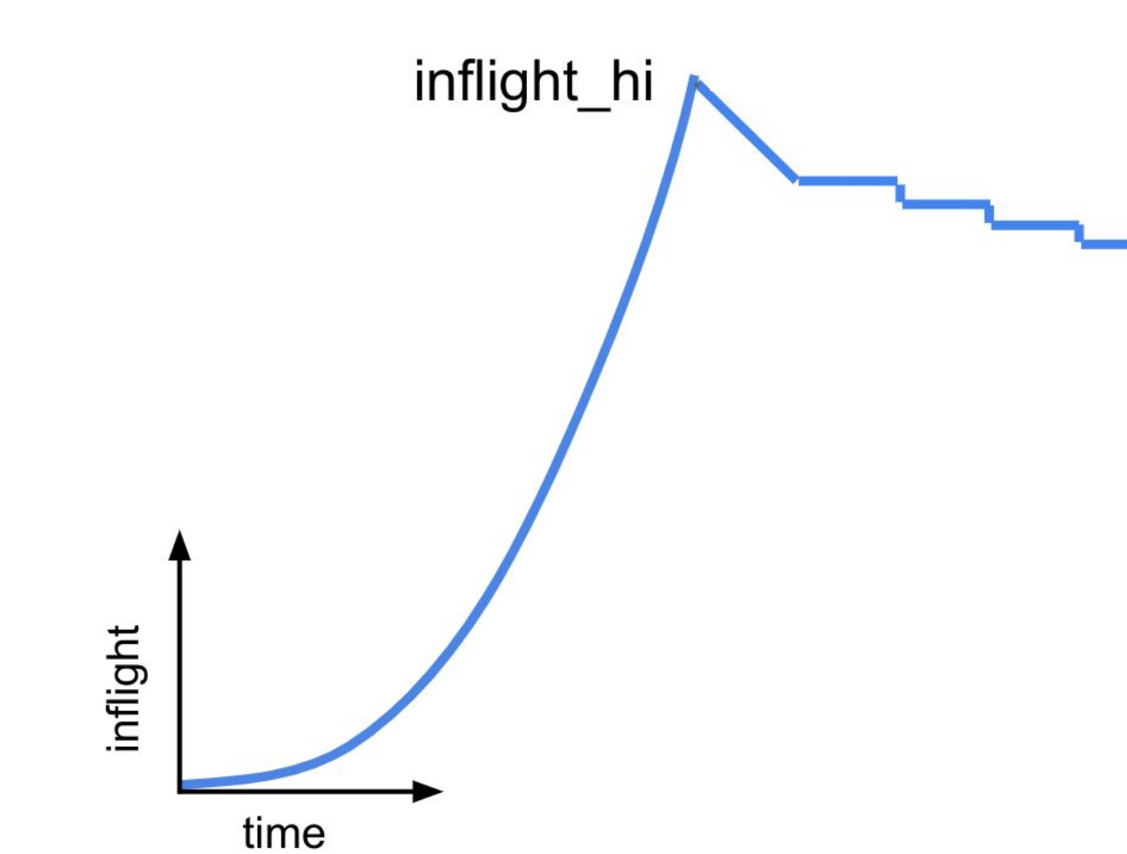
Validating the Raspberry Pi
CWND Expansion test:
Double throughout @ T20
Half throughput @ T40
* Our results fit better with BBR 2.0
We use more recent kernel version 4.17
Google’s
Panaderia

