Slide 1
Measuring and Modeling the Impact of Buffering and Interrupts on Streaming Video Quality of Experience
Josh Allard, Andrew Roskuski, Mark Claypool

Slide 2
Playout Buffering
Network
Client Computer
Rate
Time
Video Stream
Buffer
Video Playout
Pick buffer size. Larger:
Reduces interrupts
Increases start time
→ Tradeoff

Slide 3
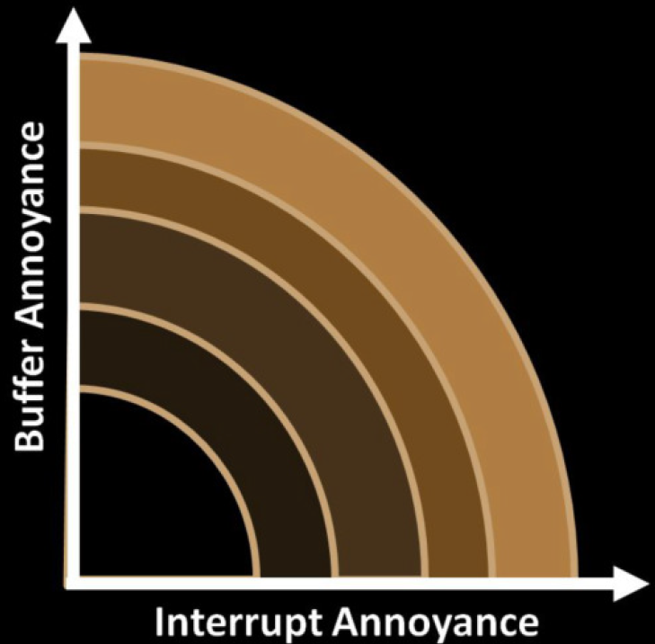
Buffering vs. Interrupts
Worse
Best
If knew “cost” for each,
could decide best buffer size

Slide 4
How Low Can You Go?
Know: how often interrupts, typical delays [7]
Tradeoffs for delay-interrupts, but not effects on QoE [10, 15]
Infer QoE from viewing, but not tradeoffs [2, 19]
Our paper: quantify QoE for initial playout buffer and interrupts
Can use to assess tradeoffs
Can use to pick buffer sizes

Slide 5
Outline
Introduction (done)
Related work (next)
Methodology
Analysis
Conclusion

Slide 6
Related Work (1 of 2)
Egger et al. [9] pycho-physics based model for QoE
Logarithmic relationship between QoE and buffering
We use for model fit
Modlovan and Hoßfeld [17] bitrate variance on QoE
Model QoE as exponential with interrupts and buffering
We show logarithmic
Mok et al. [16] network QoS & QoE
Interrupts main factor in QoE
Interrupts and initial buffer independent
Confirm, and we have 3x larger study

Slide 7
Related Work (2 of 2)
Dobrian et al. [8] total time waiting largest impact on user engagement
We break into interrupt time and waiting/buffer time
Li et al. [14] and Kim et al. [13] model video playout based on minimum buffer size
Ours provide QoE model useful in choices
Hoßfeld et al. [10] model of QoE for buffering
Ours model for interrupts
Ours confirms relationships, computes effect sizes

Slide 8
Outline
Introduction (done)
Related work (done)
Methodology (next)
Analysis
Conclusion

Slide 9
Methodology – User Study
Select and re-encode videos
Develop an interface for users to watch and evaluate videos
Install videos in dedicated user laboratory
Solicit users to watch and rate videos
Analysis and modeling

Slide 10
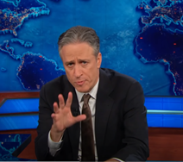
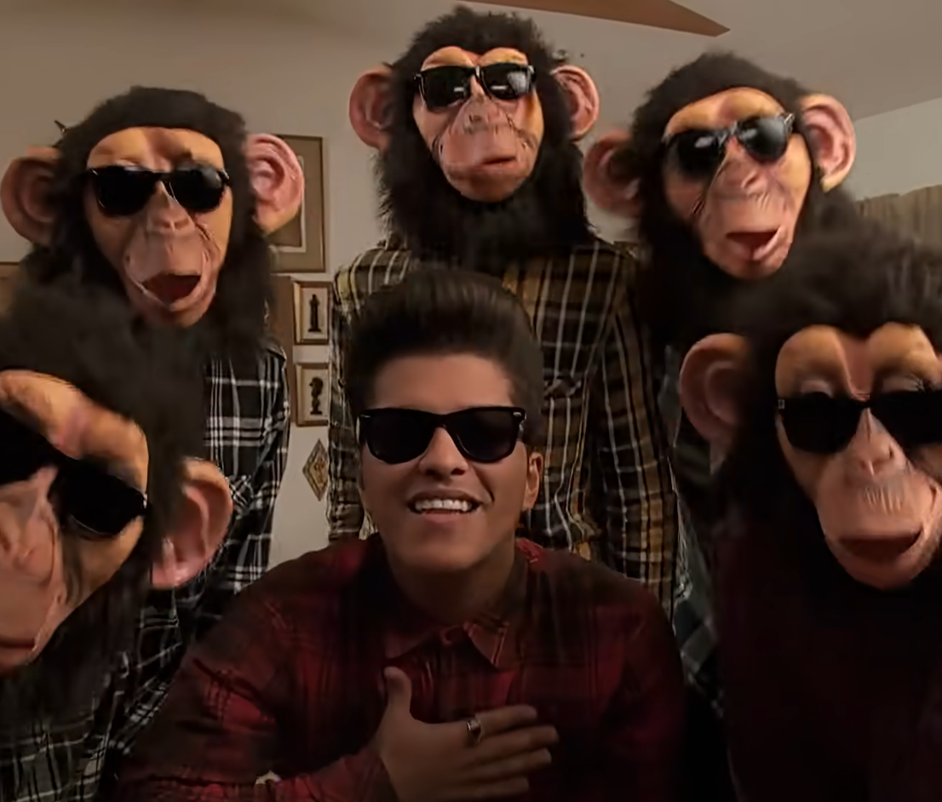
Methodology – Video Selection
17 videos (one per condition)
Range of content (link). Examples:
Encoding: 30 seconds (one scene), MPEG-4, 1280x720 @ 30 f/s
Comedy – The Daily Show
Music Video – Bruno Mars

Slide 11
Methodology – Video Preparation
Re-encode with Initial Buffer, Interrupts
Buffer: 2, 4, 8, 16 seconds
Interrupts: 2, 4, 8, 16 interrupts (each 1s)
Original
Initial
Buffering
Interrupts

Slide 12
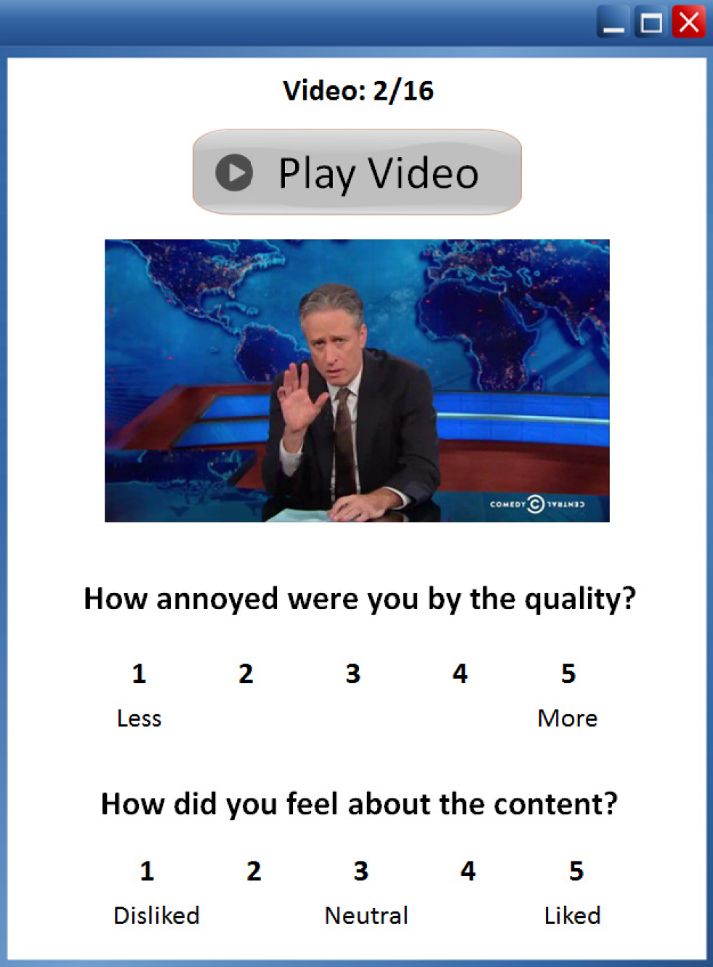
Methodology – Interface
Stored locally (not streamed)

Slide 13
Methodology – Procedure
Fill out consent form
Sit and get comfortable
Fill out demographics survey
Watch reference video with no buffering or interrupts
Watch videos with one of:
Buffering only
Interrupts only
After each, rate QoE and content
Total time → about 15 minutes

Slide 14
Methodology – User Demographics
Solicit: mailing list, psych pool
Participants 37 users
Gender 22 male, 15 fem.
Age 17-22 yrs
(mean/med 20)
Major 35% CS or IMGD
Streaming (1-5) 4.7 (std 0.9)

Slide 15
Outline
Introduction (done)
Related work (done)
Methodology (done)
Analysis (next)
Conclusion

Slide 16
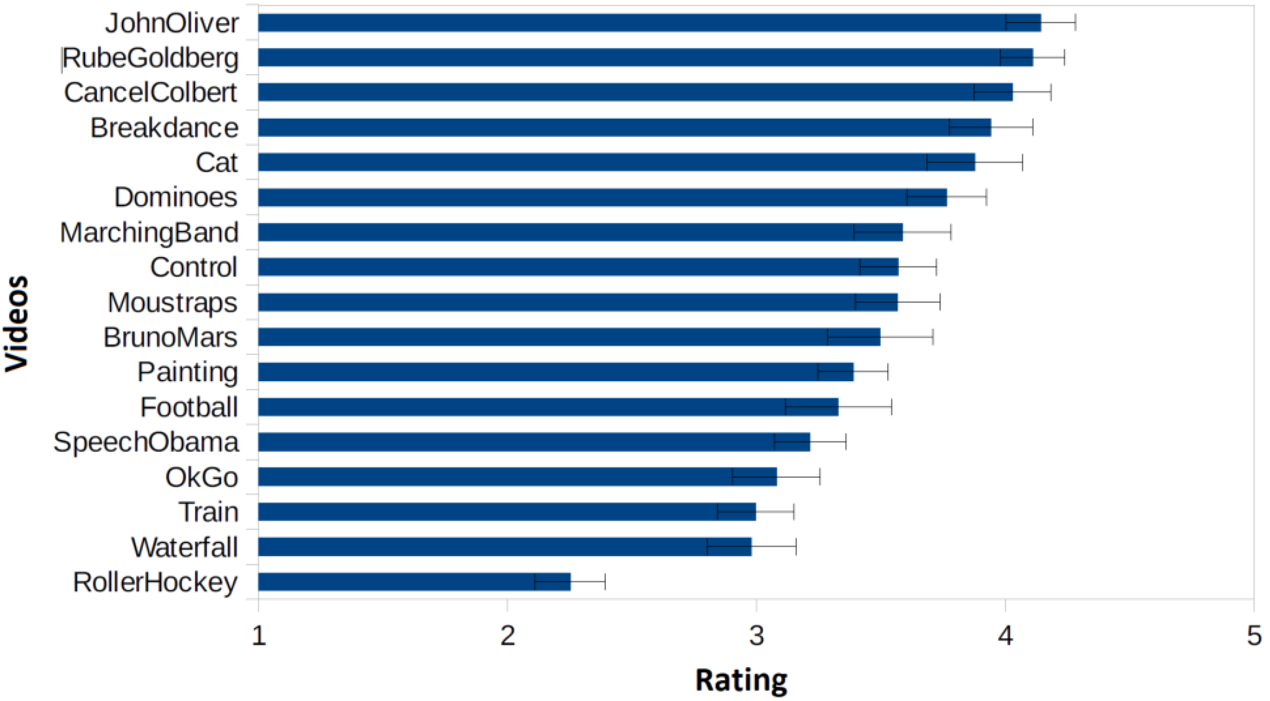
Analysis – Content Ratings
Mostly “liked”
No correlations: “like” and QoE, temporal/spatial features and QoE

Slide 17
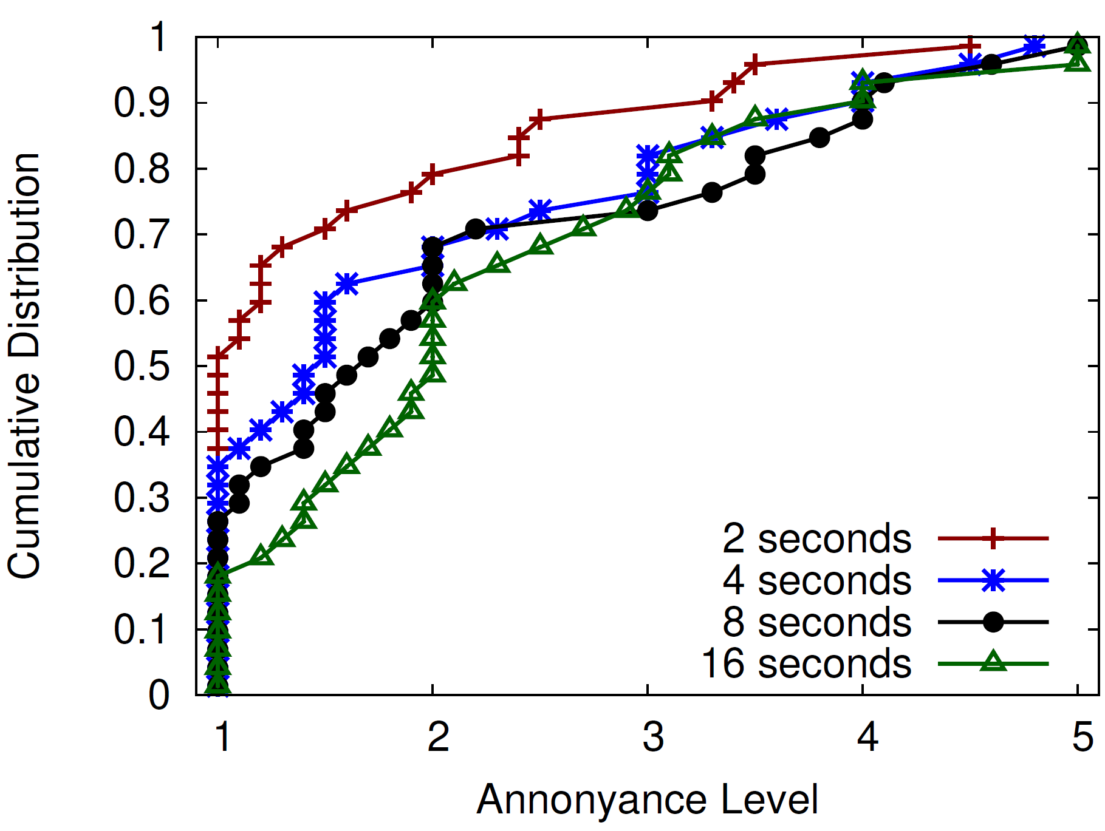
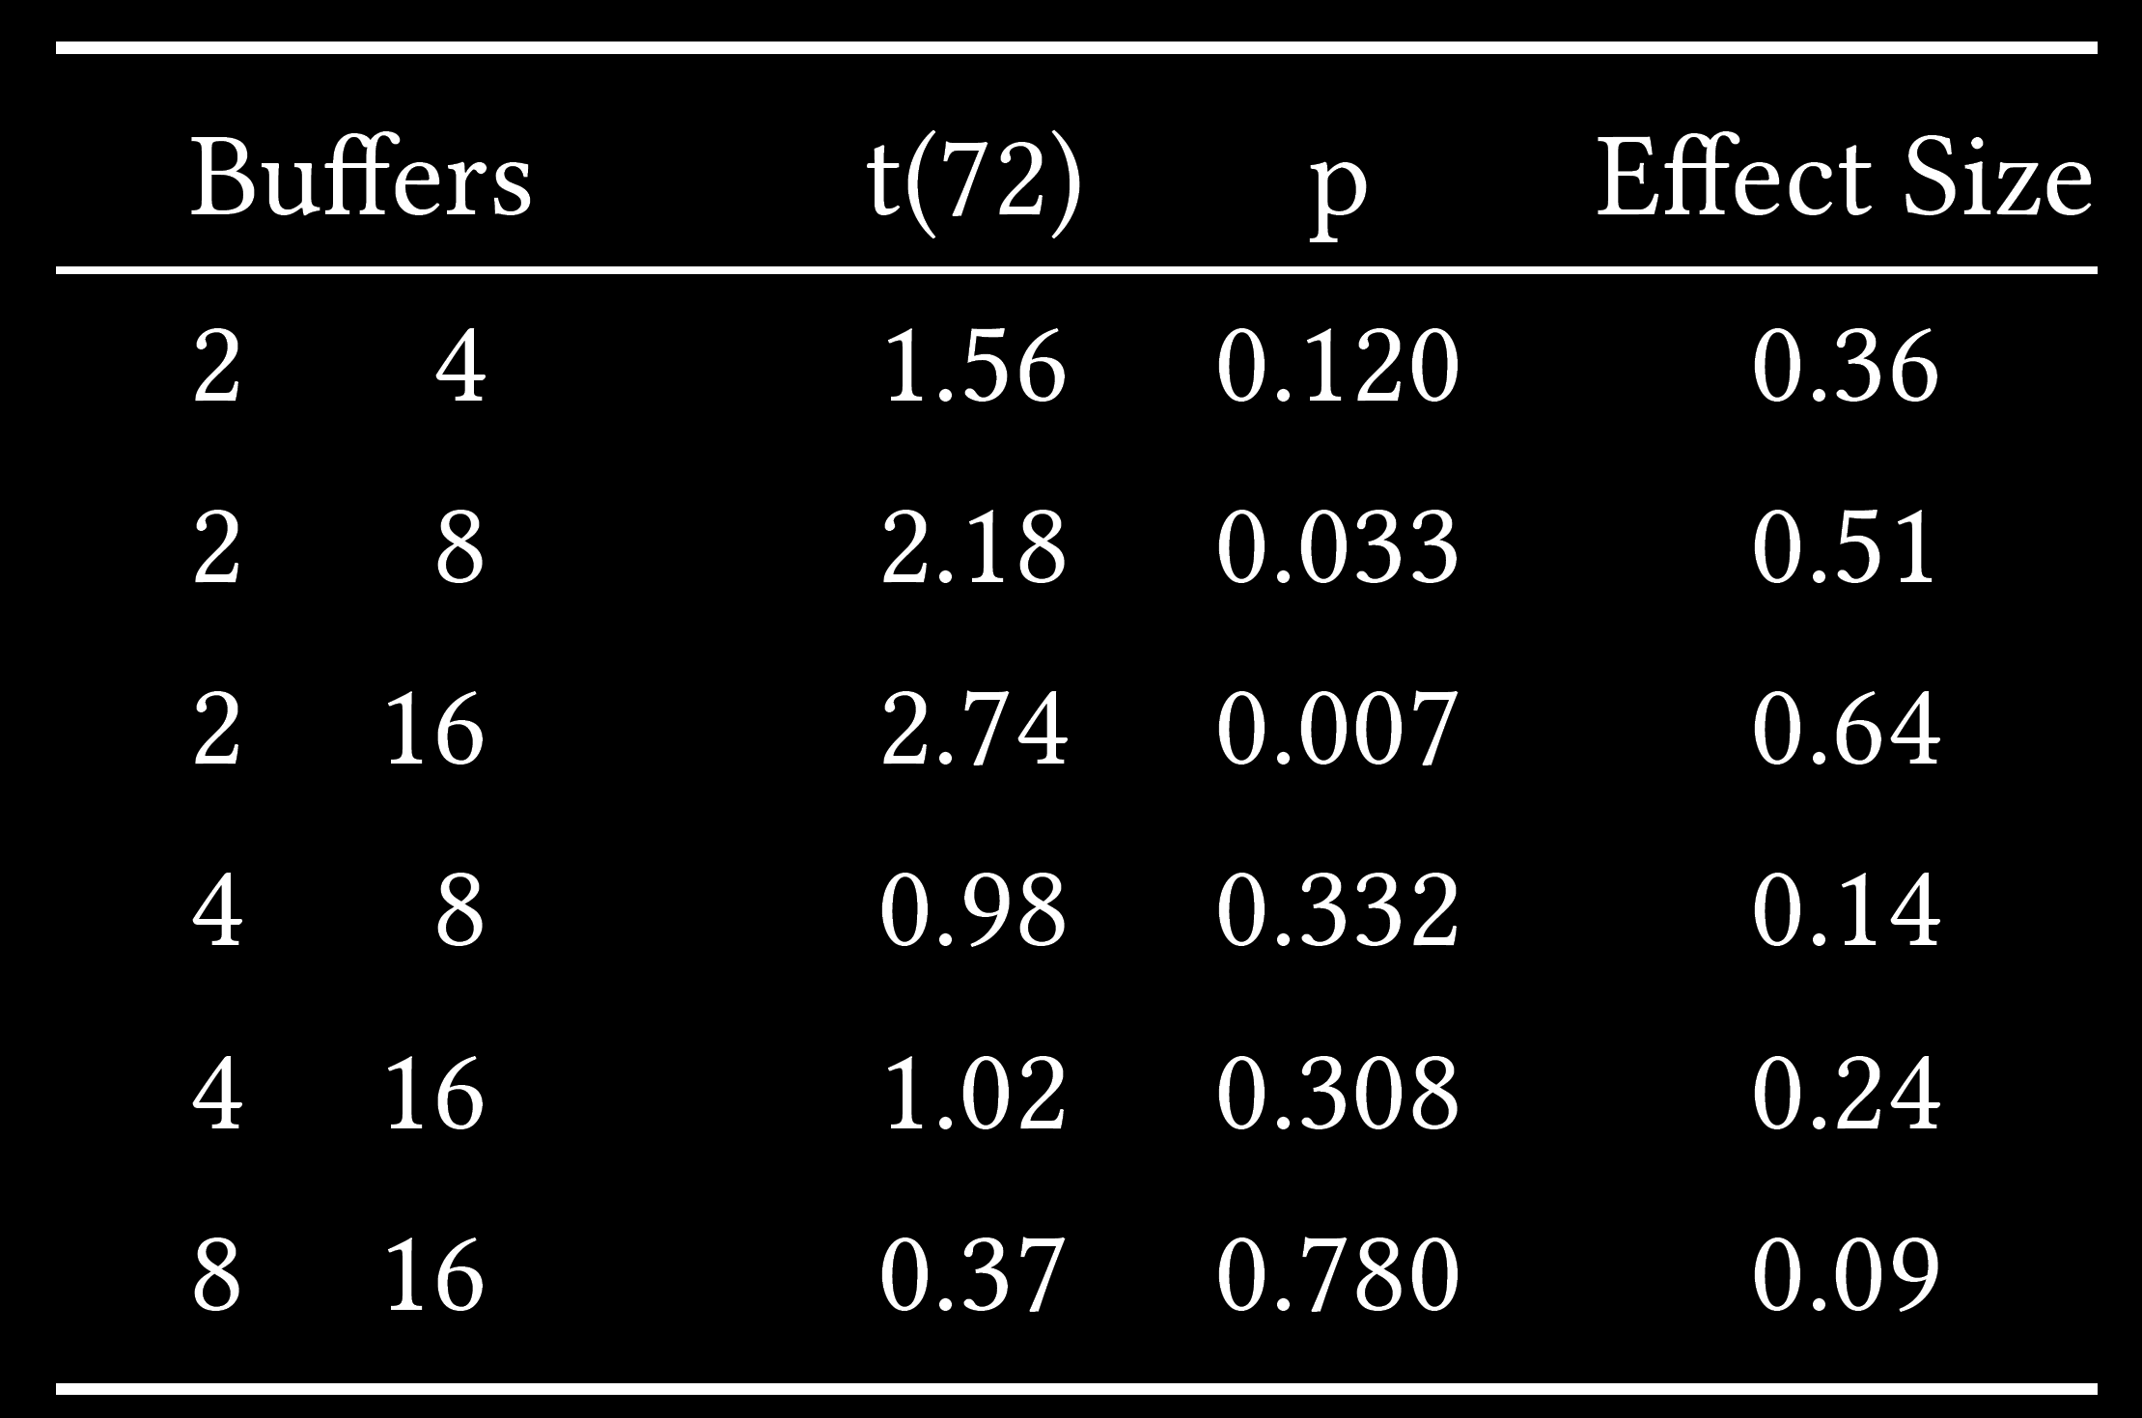
Analysis – Buffer Delay

Slide 18
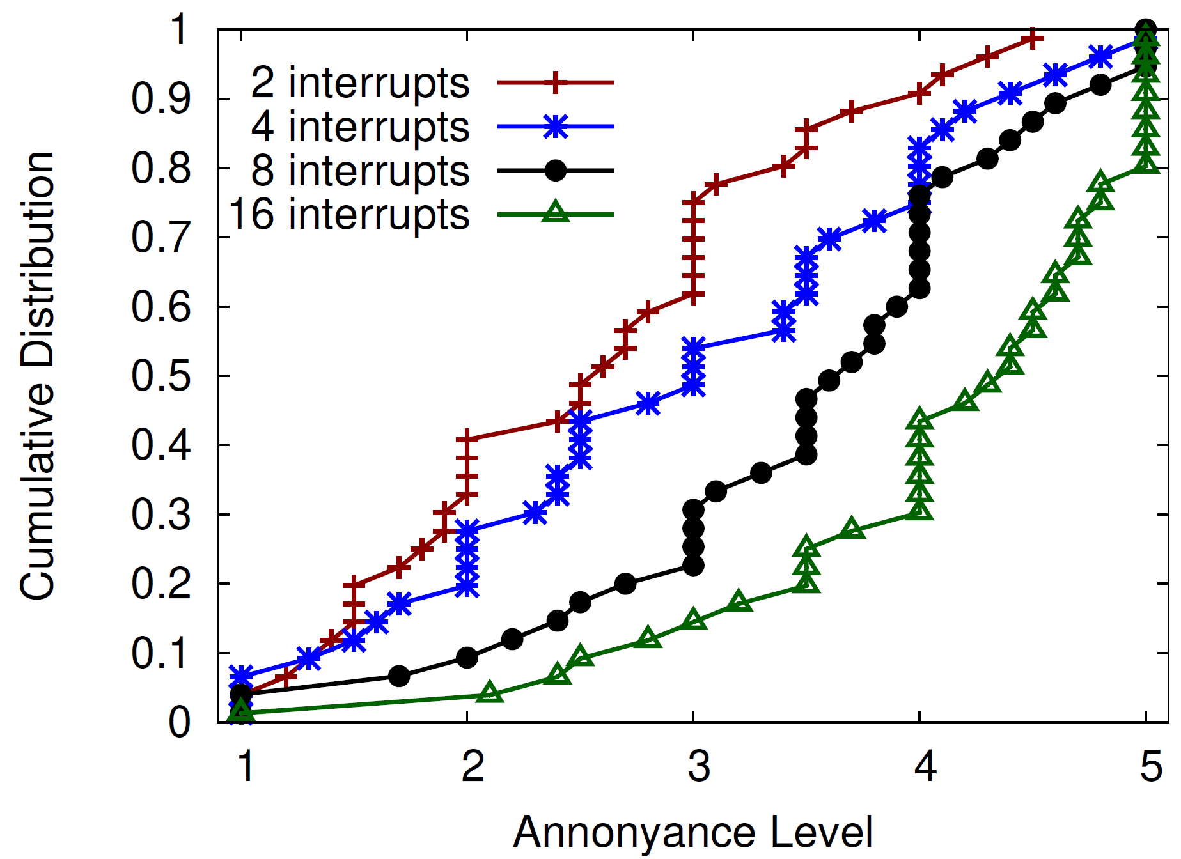
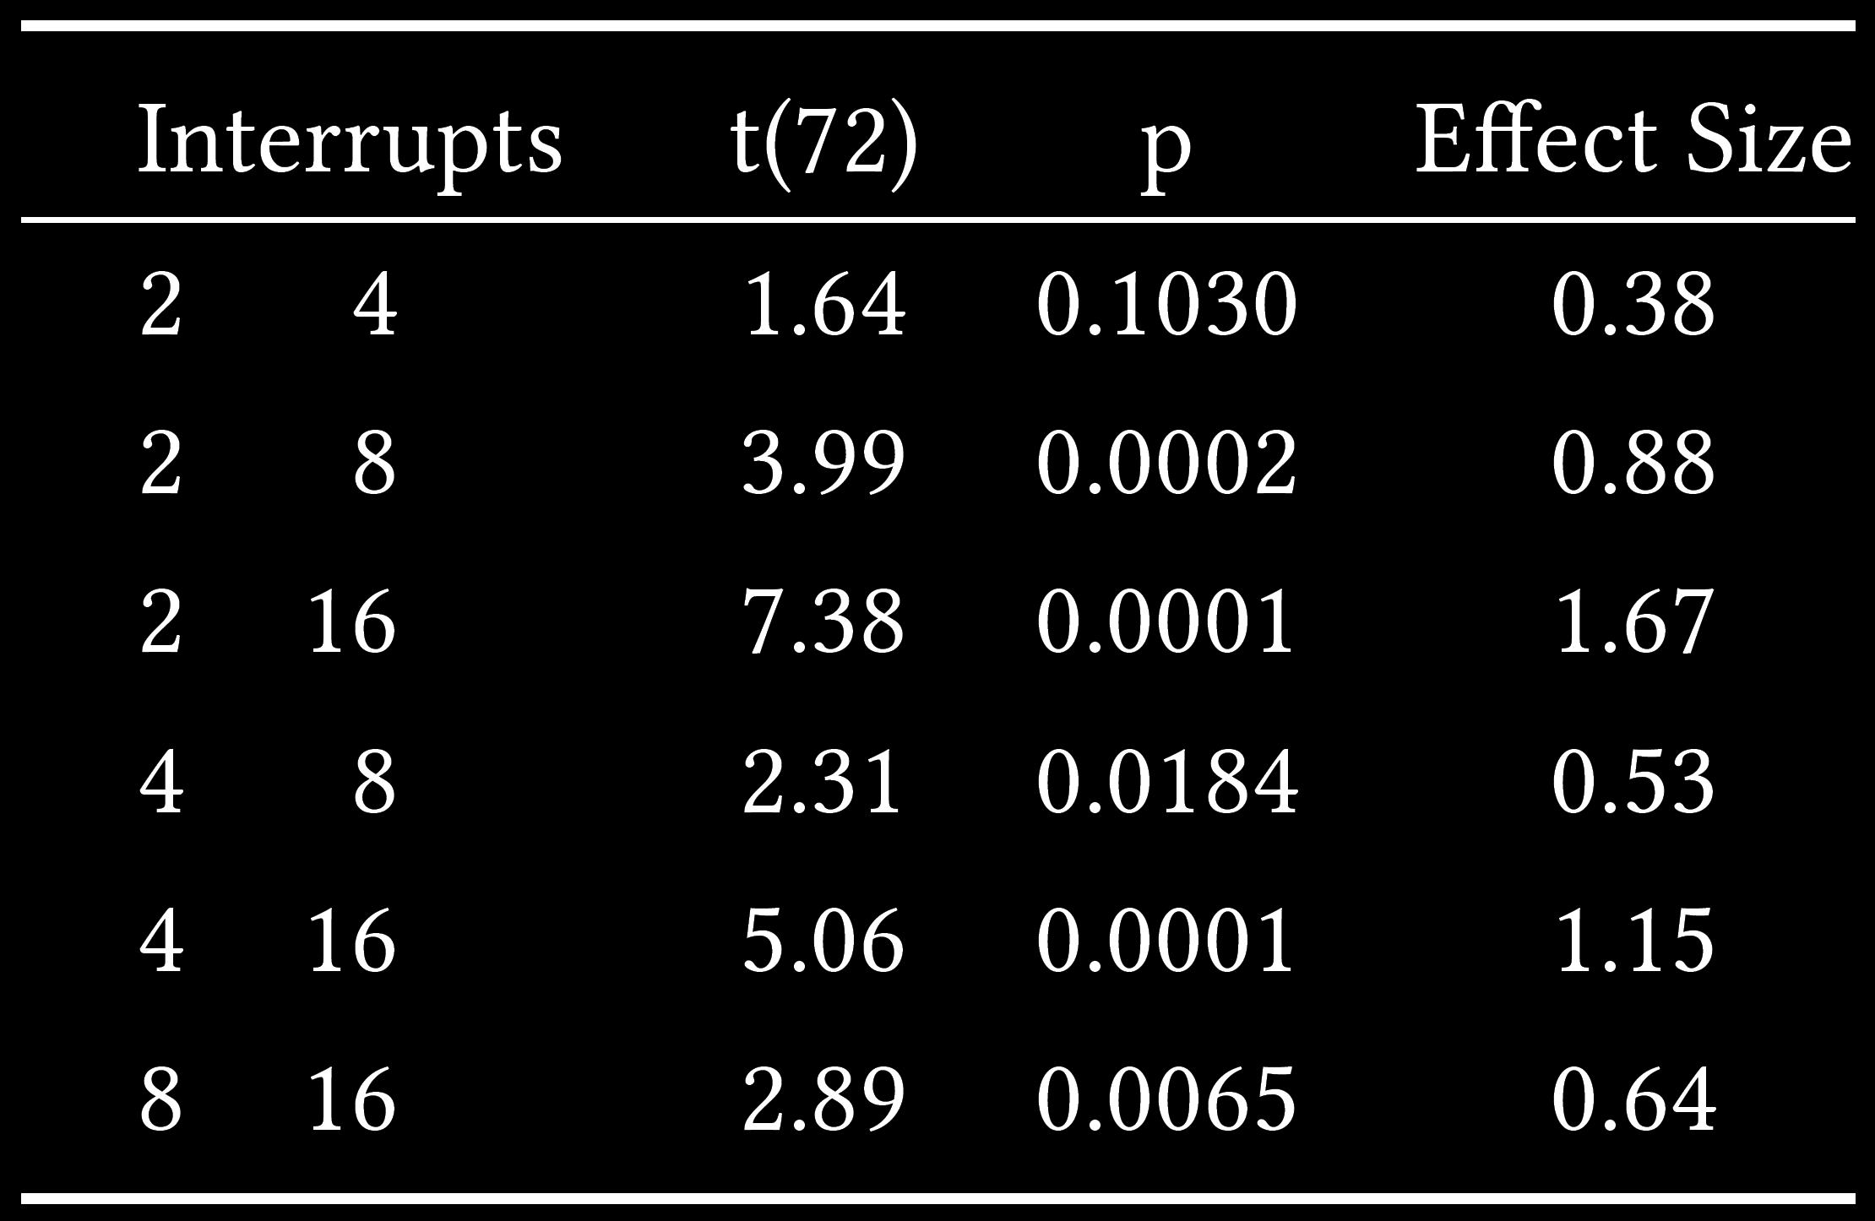
Analysis – Interrupts

Slide 19
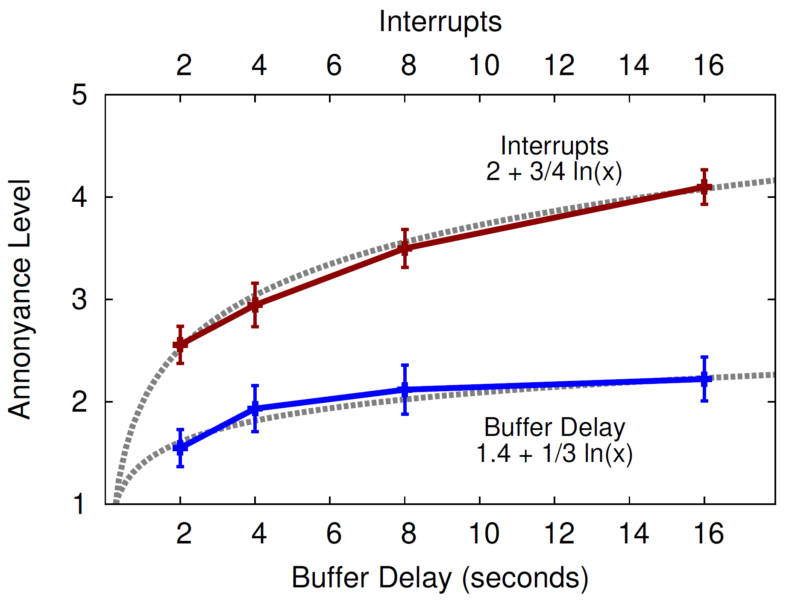
Analysis
Egger et al. [9] suggests logarithmic
1.25 avg for
no buffer, no interrupts

Slide 20
Model
Adjusted
R² 0.88
Adjusted
R² 0.99
Mok et al. [16] suggests no interaction

Slide 21
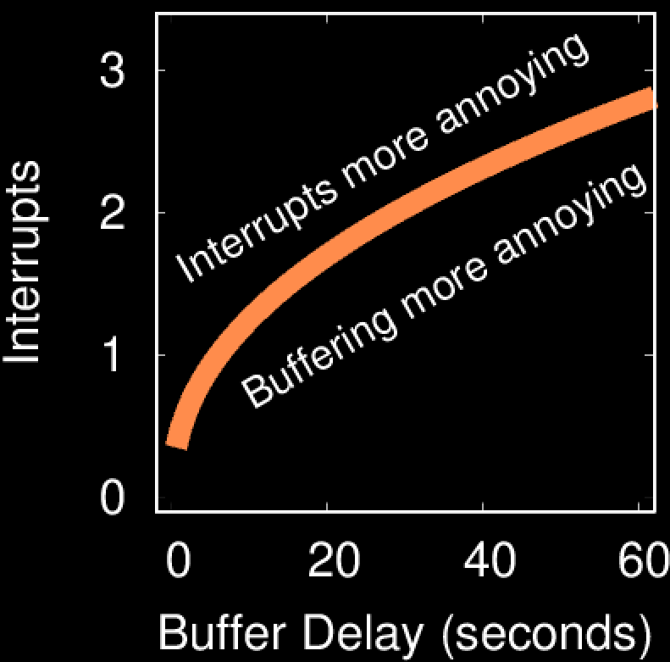
Equal QoE

Slide 22
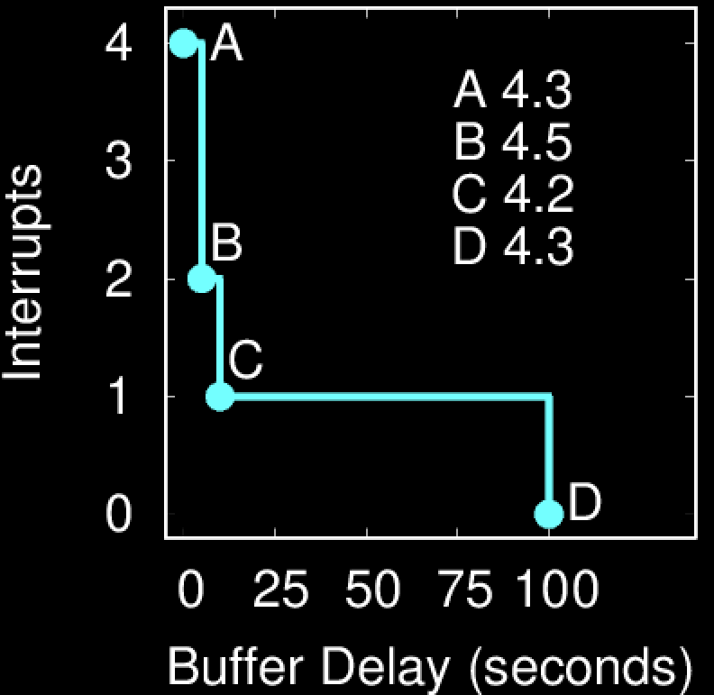
Example of Model Use

Slide 23
Conclusion
Short videos selected and encoded
4 buffer times: 2, 4, 8, 16
4 interrupts: 2, 4, 8, 16
User study
37 participants
Watch and rate videos
Analysis shows:
Interrupts 2x impact on QoE vs buffering
Buffer of 30 sec = 2 one-sec interrupts
Analytic model → QoE for video with given buffer delay and interrupts
Tool to assess and improve QoE

Slide 24
Future Work
Buffering and interrupts
Interaction term
Wider range of video lengths, network conditions, encoding
Video quality (quality scaling) and audio
Use of model in buffer size selection algorithms

Slide 25
Measuring and Modeling the Impact of Buffering and Interrupts on Streaming Video Quality of Experience
Thank-you!
Josh Allard, Andrew Roskuski,
Mark Claypool

Slide 26
References
[2] A. Balachandran, V. Sekar, A. Akella, S. Seshan, I. Stoica, and H. Zhang. 2012. A Quest for an Internet Video Quality-of-Experience Metric. In Proceedings of HotNets. Seattle, WA, USA.
[7] Conviva. 2012. Viewer Experience Report. http://www.conviva.com/vxr [Accessed 1-March-2014].
[8] F. Dobrian, V. Sekar, A. Awan, I. Stoica, D. Joseph, A. Ganjam, J. Zhan, and H. Zhang. 2011. Understanding the Impact of Video Quality on User Engagement. ACM SIGCOMM CCR
[9] S. Egger, P. Reichl, T. Hoßfeld, and R. Schatz. 2012. Time is Bandwidth? Narrowing the Gap between Subjective Time Perception and Quality of Experience. In IEEE ICC ICC CQRM. Ottawa, Canada.
[10] T. Hoßfeld, S. Egger, R. Schatz, M. Fiedler, K. Masuch, and C. Lorentzen. 2012. Initial Delay vs. Interruptions: Between the Devil and the Deep Blue Sea. In Proceedings of IEEE QoMEX.
[13] T. Kim, N. Avadhanam, and S. Subramanian. 2006. Dimensioning Receiver Buffer Requirement for Unidirectional VBR Video Streaming over TCP. In Proceedings of IEEE Image Processing.
[14] Mingzhe Li, Mark Claypool, and Robert Kinicki. 2009. Playout Buffer and Rate Optimization for Streaming over IEEE 802.11Wireless Networks. ACM TOMCCAP, 5, 3, (Aug. 2009).
[15] G. Liang and B. Liang. 2007. Balancing Interruption Frequency and Buffering Penalties in VBR Video Streaming. In Proceedings of IEEE Infocom.
[16] R. Mok, E. Chan, and R. Chang. 2011. Measuring the Quality of Experience of HTTP Video Streaming. In Proceedings of IFIP/IEEE IM. Dublin, Ireland.
[17] Christian Moldovan and Tobias Hoßfeld. 2016. Impact of Variances on the QoE in Video Streaming. In Proceedings of IEEE ITC.
[19] F. Qiu and Y. Cui. 2011. A Quantitative Study of User Satisfaction in Online Video Streaming. In Proceedings IEEE CCNC. Las Vegas, NV, USA.

