Slide 1
Treatment-Based Classification for Residential
Wireless Networks
Feng Li, Mark Claypool, and Robert Kinicki
{lif,claypool,rek}@cs.wpi.edu
Department of Computer Science,
Worcester Polytechnic Institute
Worcester, MA 01609
International Conference on Computing, Networking and Communication (ICNC2015)
Anaheim, USA, February 15, 2015

Slide 2
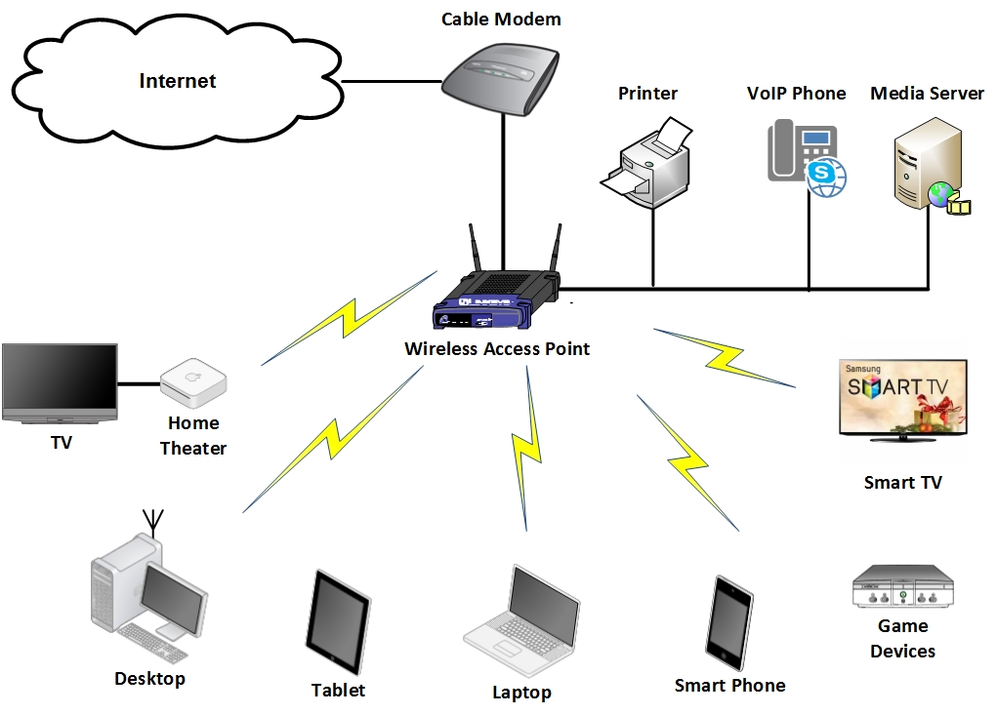
Access Point as Central Point in Home
Notes:
AP is the central communication point in Home.
It connects wired devices and wireless devices. In addition to internet traffic, AP also handles the intra-home traffic, for example, when you watch video on iPad from the media server inside your home.
In the past 10 years, people are arguing which device is the bottleneck in home.

Slide 3
IEEE 802.11 Wireless Network Review
Why not reach claimed speed?
3 non-overlapping 20 MHz channels.
  802.11n using 40 MHz channel.
  MIMO needs separate channels.
Crowded air space.
  Neighbor APs as hidden terminal.
  Interference from non-wifi devices.
Mixed wireless environment.
  802.11 b/g devices in use (cheaper!).
  Lower datarate larger range.
  802.11n performs bad in mixed environments.
5GHz has more troubles penetrating solid objects.
Throughput Comparison between 802.11 Standards [Singha, 2012]
Notes:
Here is a short review of IEEE 802.11 families. By this year, IEEE 802.11 wireless standard includes a,b,g, and n.
The figure on the left shows the measured throughput of each kind of AP. We can see even in lab environment, IEEE 801.11 protocol hardly reach their claimed speed.
IEEE 802.11g AP only yield 19 Mbps throughput which is less than half of its claimed datarate 54 Mbps.
Why this happens ?
First, on

Slide 4
Game, VoIP
(time sensitive)
Video, VoIP
(UDP-based, loss-tolerant)
Interactive
Non-response-based
Interactivity
Video
Streaming
Non-greedy
Bandwidth Eagerness
File
Transfer
Responsiveness
Greedy
Response-based
Non-interactive
File Transfer,
SSH
(TCP based, loss-sensitive)
File Transfer,
P2P File Sharing.
(time insensitive)
Notes:
In addition, hardware changes in home, let look at the software and applications.
Blue, response-based, TCP
Red, interactive, time-sensitive
Green. Greedy…

Slide 5
Problems in Current Home Wireless Networks
Residential APs do not guarantee low transmission delays required by time sensitive applications.
Residential APs do not automatically provide traffic classifications.
Current QoS methods may not fit home wireless APs.
By examples:
  5th Generation Apple AirPort Extreme (A1521) -- no QoS support.
  Cisco Wireless LAN Controller Configuration Guide. -- (1072 page long user manual.)

Slide 6
Outline
Introduction
Treatment-Based Classification
  CATNAP by an Example
Experiments and Results
Future Work
Conclusions

Slide 7
CATNAP
Limit Rate
Drop Packets
Bandwidth Eagerness
Non-Greedy
Streaming Video
Greedy
Delay
Packets
FTP
P2P, Email
NFS w/UDP
P2P w/UDP
Non-interactive
Web
Push
Packets
Interactivity
VoIP
Game
Interactive
Reserve Bandwidth
Telnet/SSH
DNS, IM
Response-based
Non-response-based
Responsiveness

Slide 8
Treatment Based Classification
Responsiveness.
  Response-based: loss sensitive applications.
    Dropping packets triggers retransmission.
    Modify advertised window size to slow down the sender.
  Non-response-based: loss tolerant applications.
    Dropping a small fraction of packets would NOT degrade their quality.
Interactivity.
  Interactive: delay sensitive applications.
    Push, cut-in-line.
  Non-Interactive: delay tolerant applications.
    Delay, lower its priority.
Bandwidth eagerness.
  Greedy: best-effort applications.
    Dropping or limited advertised window size.
  Non-greedy: bandwidth requirement limited by itself.
    Reserve bandwidth for them.
Notes:
Examples… interactive voip and non-interactive FTP

Slide 9
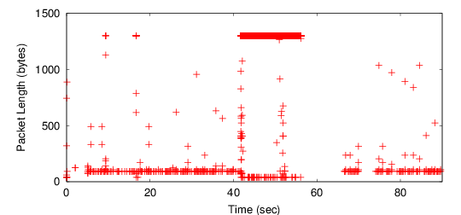
Example: A Remote Login Flow
Between 0 – 41th seconds, the user executed directory commands.
Between 41- 57th seconds, the user opened a 100 MB+ file.
Between 57th-65th seconds, no activity.
After 65th seconds, the user resumed directory operations.

Slide 10
Example: Interactive Classifier w/ a Remote Login Flow
Notes:
Here is a sample of a SSH flow with flow state changes. Before the time 40th seconds, the user executes several shell cmds on a remote host, at time 41th seconds, we can see the

Slide 11
CATNAP
Classification
CATNAP
Treatment

Slide 12
Outline
Introduction
Treatment-Based Classification
  CATNAP by an Example
Experiments and Results
Future Work
Conclusions

Slide 13
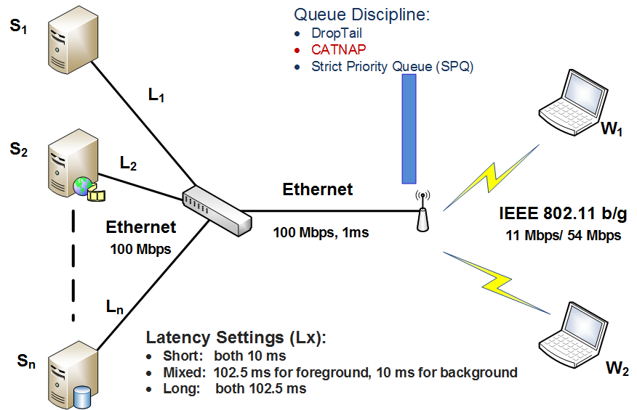
Simulation Setup
Notes:
1 show AP, AP queue controller, what is SPQ

Slide 14
Core Simulation Settings
Settings | Variables
Queue Controller | DropTail, Strict Priority Queue (SPQ), CATNAP.
Queue Capacity | CATNAP:1000 Packets. DropTail/SPQ: based on bandwidth delay products.
IEEE 802.11 standard | IEEE 802.11b, IEEE 802.11g
Latency Setting | Short (both 10 ms) Mixed (foreground: 102.5 ms, background: 10 ms) Long (both 102.5 ms)
QoS Metrics | Throughput, and queue size. Mean Opinion Score (MOS) for game, VoIP flows. Video frame rate for video streaming. ( > 15 fps as good). Response time for Web flows. Jain’s fairness index for the fairness of FTP flows.

Slide 15
Applications in Simulation
Background
Stress wireless link and build up the queue.
  FTP
  NFS w/ UDP
Foreground
Evaluate their QoS improvements.
  FTP
  NFS w/UDP
  Game w/UDP
  Game w/TCP
  VoIP w/UDP
  VoIP w/TCP
  Video w/TCP
  Video w/UDP
  Web
Verified all possible combinations in the cube.

Slide 16
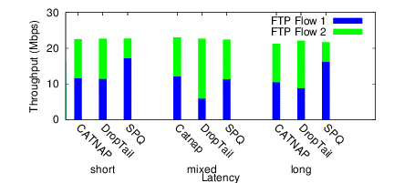
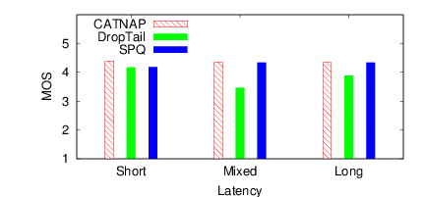
Fig. 9. Average Throughput for Two FTP flows (54Mbps Link)
Fig. 10. 10th percentile of MOS for UDP based VoIP (11Mbps Link)

Slide 17
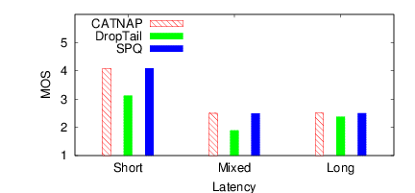
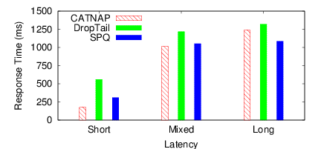
Fig. 11. 10th percentile of MOS for Game (54Mbps Link)
Fig. 12. Average Response Time for Web (54Mbps Link)

Slide 18
QoS Improvement for CATNAP over DropTail (54 Mbps)
Foreground | Quality | Latency Settings
 |  | short | mixed | long
Game w/UDP | MOS (10% tail) | 58.1% | 52.4% | 15.7%
Game w/TCP | MOS (10% tail) | 54.5% | 55.6% | 53.7%
VoIP w/UDP | MOS (10% tail) | 1.1% | 1.8% | 1.6%
VoIP w/TCP | MOS (10% tail) | 0.2% | 0.6% | 0.9%
Video w/UDP | Fr Rate (10% tail) | 0.0% | 0.0% | 0.0%
Video w/TCP | Fr Rate (10% tail) | 3.4% | 3.4% | 0.0%
Web | Response Time (sec) | 13.6% | 48.1% | 56.4%

Slide 19
Future Work
Implementation on a real AP.
  Open Source AP.
Resource consumption measurement.
  CPU utilization.
  Memory consumption.
Identify Paced Flows.
  Voice.
  Video (e.g 24 – 30 fps, I, P, B frames).

Slide 20
Conclusions
CATNAP lowers the queuing delay for time sensitive applications by effectively controlling queue length.
  Improve QoS for interactive applications, VoIP and game.
  Reducing the response time for Web traffic.
CATNAP provides a better QoS.
  Automatically classify flows for treatment purposes.
  Taming greedy high-bandwidth traffic, especially misbehaved UDP flows.
CATNAP can be implemented in a real AP router.
  Without modification on end-host, applications or network standards.
  Possible design guideline for future APs.

Slide 21
Questions ?
Treatment-Based Classification for Residential
Wireless Networks
Feng Li, Mark Claypool, and Robert Kinicki
{lif,claypool,rek}@cs.wpi.edu
Department of Computer Science,
Worcester Polytechnic InstituteWorcester,
MA 01609

Slide 22
Thank You !

Slide 23
References (1/3)
[Singha, 2012] A. Singh and B. Mishra, “Comparative Study on Wireless Local Area Network Standards”, International Journal of Applied Engineering and Technology 2012.
[Akamai, 2014] Akamai Inc, “ The State of the Internet: Q3, 2013 Report”, 2014.
[NetIndex, 2014] Ookla, http://www.netindex.com/, 2014.
[IANA, 2014] Internet Assigned Numbers Authority (IANA), http://www.iana.org/assignments/port-numbers, last updated on 2014-02-21.
[CORSARO, 2013] Corsaro. Online at http://www.caida.org/tools/measurement/corsaro/, Last Access on October 30th, 2013.
[Khalife, 2013] Jawad Khalife, et al. “Performance of OpenDPI in Identifying Sampled Network Trace”. Journal of Networks, 8(1), January 2013.
[Xie, 2013] Guowu Xie, et al., “ReSurf: Reconstructing web-surng activity from network tracffic”. In Proceedings of IFIP Networking Conference, 2013, May 2013.
[Nguyen, 2012] Thuy Nguyen, et al., “Timely and Continuous Machine-learning-based Classication for Interactive IP Traffic”. Journal of IEEE/ACM Transactions on Networking (TON), 20(6), December 2012.

Slide 24
References (2/3)
[Roughan, 2004] M. Roughan, et al., “Class-of-service Mapping for QoS: a Statistical Signature-based Approach to IP Traffic Classification”, the ACM SIGCOMM Internet Measurement Conference (IMC), 2004.
[Karagiannis, 2005] K. Papagiannaki and M. Faloutsos, “BLINC: Multilevel Traffic Classication in the Dark”, SIGCOMM, 2005.
[Zhang, 2013] Jun Zhang, et al., “Internet Traffic Classification by Aggregating Correlated Naive Bayes Predictions”. Journal of IEEE Transactions on Information Forensics and Security, 8(1), January 2013.
[Rawat, 2007] M. Rawat, “Interoperability of 802.11 with 802.11e”, MS Thesis, IIT India, 2007.
[Li, 2011] Maodong Li, et al., “Cross-layer optimization for SVC video delivery over the IEEE 802.11e wireless networks”. Journal of Visual Communication and Image Representation, Vol(22):3, 2011.
[Lee, 2013] Kang Yong Lee, et al., Traffic Aware QoS Scheduling for IEEE 802.11 e HCCA WLAN. IEICE Transactions on Communications, 96(2), 2013.
[Siemon, 2013] Dan Siemon. “Queueing in the Linux Network Stack”. Linux Journal., 2013, July 2013.
[Chung, 2005], J Chung, “Congestion Control for Streaming Media”, Ph.D. thesis, 2005.

Slide 25
References (3/3)
[Wu, 2005] H. Wu, “ARMOR - Adjusting Repair and Media Scaling with Operations Research for Streaming Video”, Ph.D. thesis, WPI, 2006.
[Pau, 2007] G. Pau, et al., “Wireless Home Entertainment Center: Reducing Last Hop Delays for Real-Time Applications”, ACM SIGCHI International Conference on Advances in Computer Enter-tainment Technology (ACE), 2006.
[Sharma, 2013] Vishal Sharma, et al., “Quality of Service (QoS) evaluation of IEEE 802.11 WLAN using different PHY-Layer Standards”. Optik-International Journal for Light and Electron Optics, 124(4):2013.
[Claypool, 2007] M. Claypool, et al., “Treatment-Based Trac Signatures”, IETF Internet Measurement Research Group Workshop on Application Classification and Identification, 2007.
[Patro, 2013] A. Patro, et al., “Observing Home Wireless Experience through WiFi APs”, MobiCom, 2013.
[Maier, 2009] G. Maier, et al., “On Dominant Characteristics of Residential Broadband Internet Traffic”, IMC,2009.

Slide 26
Traffic Classification Methods
Port-based approach [IANA, 2014], [Corsaro, 2013].
  Based on transport port.
  Pros: widely used, simple.
  Cons: low accuracy.
Payload-based approach [Moore, 2005], [Khalife, 2013].
  Based on payload content.
  Pros: nearly 100% accuracy.
  Cons: offline, need human invention, encryption.
Statistics-based approach [Nguyen, 2012], [Zhang, 2013].
  Based on flow level statistics information.
  Pros: reasonable accuracy.
  Cons: training dataset matters, unable to detect new apps.
Behavior-based approach [Karagiannis, 2005], [Xie, 2013].
  Based on users’ behavior.
  Pros: accurate.
  Cons: user behavior matters.

Slide 27
Improve Quality of Service (QoS)
IEEE 802.11e & Wi-Fi Multimedia (WMM) [Lee 2013][Li 2011].
  Prioritizes traffic according to four Access Categories (AC): Voice, Video, Best-effort, and background.
  Pros: Enhance Media Access Control (MAC) layer, wireless oriented.
  Cons: MAC layer changes, performance bad in mixed environment.
Linux Traffic Control [Siemon, 2013].
  Traffic Control (TC) supports FIFO, Token Bucket Filter (TBF), Credit based (CBQ) and Stochastic Fair Queue (SFQ), etc.
  Pros: more predictable usage of network when properly used.
  Cons: complexity, inappropriate used leading more divisive contention, and TOS bits needed.
Active Queue Management (AQM) [Chung, 2005], [Sharma, 2013].
  Drop or mark packets (ECN) before the queue is full.
  Pros: inform sender to slow down, maintain a short queue length.
  Cons: dropping may not be correct, ECN could not carry information such as available bandwidth.

Slide 28
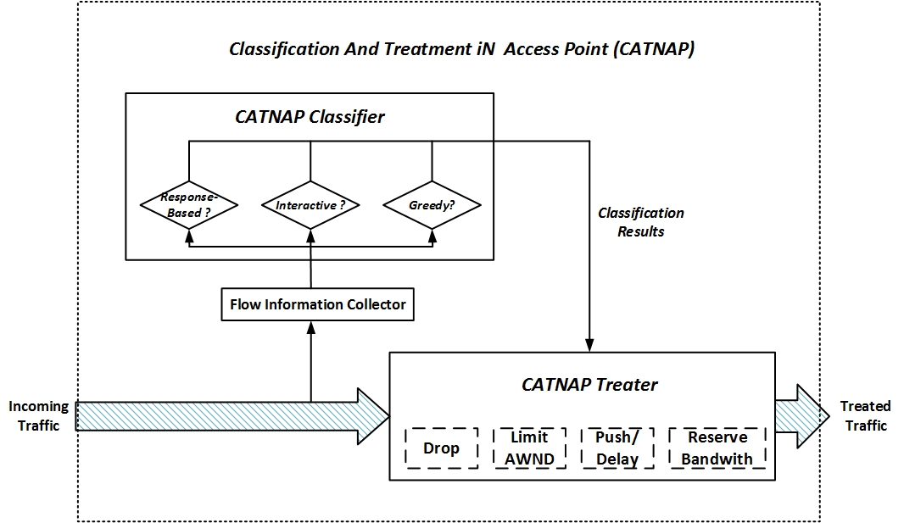
Classification And Treatment iN Access Point (CATNAP)

Slide 29
DropTail
CATNAP
Notes:
Green cycle shows CATNAP provides better QoS because the file transfer finishised 3 seconds earlier.

