Slide 1
A Credit-based Home Access Point (CHAP) to Improve Application Performance on IEEE 802.11 Networks
Choong-Soo Lee, Mark Claypool and Robert Kinicki
Worcester Polytechnic Institute
MMSys 2010
Feb. 22, 2010

Slide 2
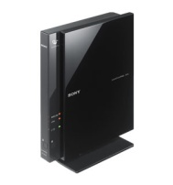
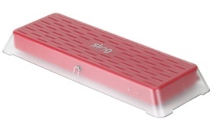
Introduction
Wide deployment of broadband access at home
Wireless Access Point to connect devices at home over the shared Internet connection
Diverse networked devices
Diverse applications and their needs

Slide 3
Challenge and Possible Approaches
How to manage throughput, delay and loss with a diversity of applications and their needs
Possible Approaches:
Applications can claim quality requirements.
Changes to the end-hosts, applications and protocols
Middle boxes can figure out quality requirements.
Port/signature-based classification
Both approaches require:
Pre-determined treatment for traffic classes
Careful configuration

Slide 4
Outline
Introduction (done)
Credit-based Home Access Point (CHAP)
Performance Evaluation
Conclusion

Slide 5
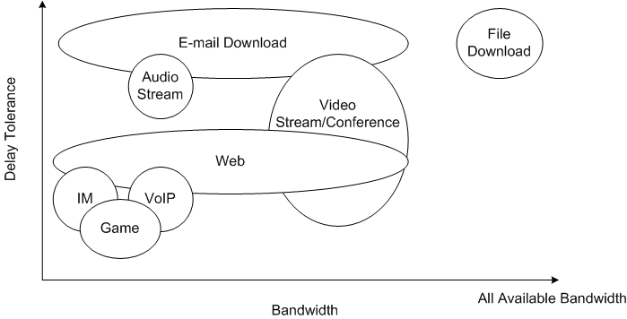
Summary of Network Traffic Characteristics
High
Medium
Low
Low
Medium
High

Slide 6
Credit-based Scheduling
Use of credit as priority
Map application traffic characteristics to credit
Delay Tolerance
Credit
Bandwidth

Slide 7
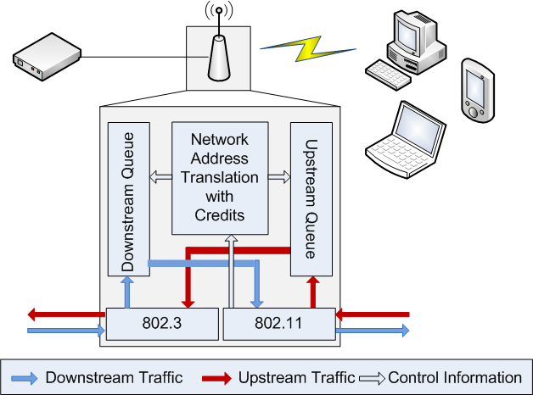
Credit-based Home Access Point (CHAP)
Credits in time
Wireless Transmission Time
P

Slide 8
Outline
Introduction (done)
Credit-based Home Access Point (CHAP) (done)
Performance Evaluation
Conclusion and Future Work

Slide 9
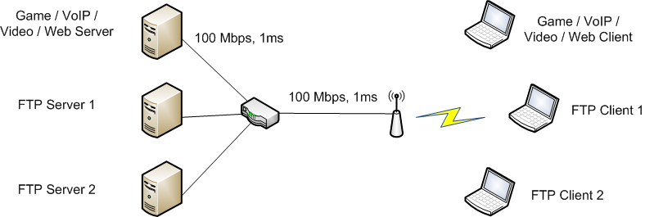
Simulation Setup
Network Simulator (NS-2)
Single channel, IEEE 802.11g Infrastructure Network
Shadowing propagation model
DropTail / CHAP / Strict Priority Queue (SPQ)

Slide 10
Simulation Flow Schedule
Application
under test
FTP 1
FTP 2
30
90
150
210
270
330
Time (s)

Slide 11
Game Scenario - Throughputs

Slide 12
Game Scenario – G-Model MOS

Slide 13
Summary of Performance
Scn. | App (Unit) | DropTail | CHAP | SPQ | % Impr.
Game | Game (MOS) | 3.67 | 4.27 | 4.27 | +16%
 | FTPs (Mbps) | 26.42 | 26.60 | 26.00 | +1%
VoIP | VoIP (MOS) | 4.37 | 4.42 | 4.42 | +1%
 | FTPs (Mbps) | 26.18 | 26.34 | 26.17 | +1%
Video | Video (fps) | 9.97 | 30.00 | 30.00 | +201%
 | FTPs (Mbps) | 23.03 | 23.12 | 22.95 | +0%
Web | Web (ms) | 109.52 | 39.70 | 33.96 | +64%
 | FTPs (Mbps) | 26.59 | 26.73 | 26.54 | +1%

Slide 14
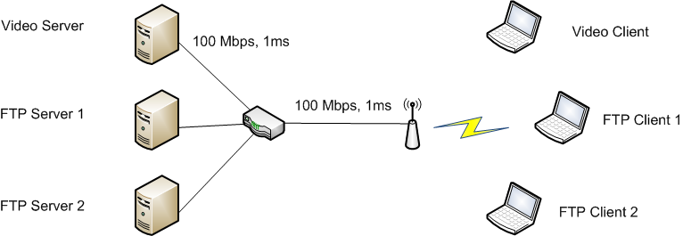
Distance Scenario
Simulation runs with varying distances
d = 1m ~ 30m
d

Slide 15
Distance Scenario – Video

Slide 16
Outline
Introduction (done)
Credit-based Home Access Point (CHAP) (done)
Performance Evaluation (done)
Conclusion and Future Work

Slide 17
Conclusion
Credit-based Home Access Point (CHAP) improves quality of delay sensitive applications.
FTP performance preservation
CHAP improves performance over DropTail and provides performance close to SPQ.
Minimal configuration
No explicit classification
No pre-determined treatment
CHAP adjusts to wireless network configuration automatically.
Overall performance improvement over DropTail and SPQ

Slide 18
Future Work
More evaluation of CHAP
Formal analysis of CHAP algorithm for setting the increment
Prototype implementation using a Linux-based access point

Slide 19
Questions and Comments
?

Slide 20
Scenario – Multiple Applications
App. (Unit) | DropTail | CHAP | SPQ | % Impr.
Game (MOS) | 3.57 | 4.27 | 4.25 | +20%
VoIP (MOS) | 4.31 | 4.42 | 4.42 | +3%
Video – No FEC (fps) | 15.58 | 30.00 | 30.00 | +93%
Video – Small FEC (fps) | 17.44 | 30.00 | 30.00 | +72%
Video – Large FEC (fps) | 23.16 | 30.00 | 30.00 | +30%
Web (ms) | 113.39 | 56.07 | 41.85 | +51%
FTP (Mbps) | 22.95 | 22.91 | 22.91 | 0%

