Slide 1
The Effects of Latency on Player Performance in Cloud-based Games
Mark Claypool and David Finkel
{claypool,dfinkel}@cs.wpi.edu
Computer Science and
Interactive Media & Game Development
Worcester Polytechnic Institute
Notes:
Mark Claypool and David Finkel. The Effects of Latency on Player Performance in Cloud-based Games,
In Proceedings of the 13th ACM Network and System Support for Games (NetGames),
Nagoya, Japan, December 4-5, 2014.
Online at:http://www.cs.wpi.edu/~claypool/papers/cloud-games/

Slide 2
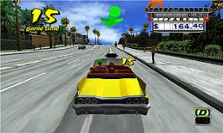
Cloud-based Games
Connectivity and capacity of networks growing
Opportunity for cloud-based games
Game processing on servers in cloud
Stream game video down to client
Client displays video, sends player input up to server
Game frames
Server
Server
Player input
Server
Thin Client
Cloud Servers

Slide 3
Motivation and Challenges
Cloud-based games
Server controls content, helps prevent piracy
Easy to distribute games to many players
Client “thin”, so inexpensive ($100 for OnLive console vs. $400 for Playstation 4 console)
Potentially less frequent client hardware upgrades
Challenges
Requires more downstream capacity than traditional network games (5000 Kb/s vs. 50 Kb/s [1])
Latency since player input requires round-trip to server before player sees effects

Slide 4
Latency and Interactive Applications
Numerous studies on latency and interactive applications (e.g., VoIP)
But interactions for games different
Numerous studies on latency and network games (e.g., car racing [2], role playing [3], first person shooter [4])
But cloud-based has only thin client so results may differ
Some studies on latency cloud-based games (e.g., [6], [7])
But do not measure impact on users
Few studies on latency cloud-based on users (e.g., [8])
Still need more data
But does not compare with traditional network games
Need to compare to traditional network games → inform developers of game and cloud systems

Slide 5
Our Research
Measure impact of latency on players in cloud-based games
Two separate user studies – two games, two systems
Users play games with controlled amounts of latency
Measure objective (performance) and subjective (quality)
Compare performance to traditional network games

Slide 6
Teasers
Player performance degrades directly with increase in latency
Every 100 ms latency means 25% decrease in performance
Degradation similar to traditional first person network games
Despite difference in genres!
E.g., third person game latency tolerance:
Traditional network game → 500 ms
Cloud-based game → only 100 ms

Slide 7
Outline
Introduction (done)
User Studies (next)
Results
Conclusion

Slide 8
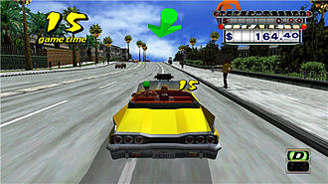
User Study 1
OnLive console
Connects to laptop configured as router
Dummynet on router
Control latency: 0-150ms
Router connects to Internet then OnLive servers
Users play Crazy Taxi
3rd person view
Deliver customers for points
About 12 minutes total
Users volunteers from campus

Slide 9
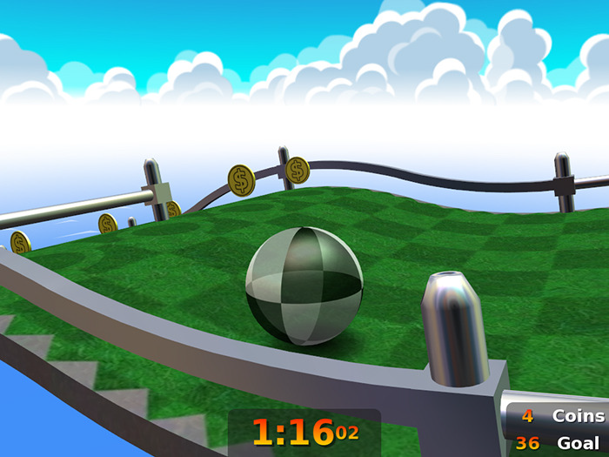
User Study 2
GamingAnywhere LAN
Client connects to PC configured as router
Dummynet on router
Control latency: 0-200ms
Router connects to server on LAN
Users play Neverball
3rd person view
“Roll” marble to goal as fast as possible
About 10 minutes total
Users volunteers from campus

Slide 10
User Study Summary

Slide 11
Outline
Introduction (done)
User Studies (done)
Results (next)
Demographics
Subjective
Objective
Traditional network games
Conclusion

Slide 12
Demographics
OnLive Crazy Taxi: 49 users
95% 18-22 years old
70% male
75% “average+” game playing experience
GamingAnywhere Neverball: 34 users
100% 18-22 years old
90% male
100% “average+” game playing experience

Slide 13
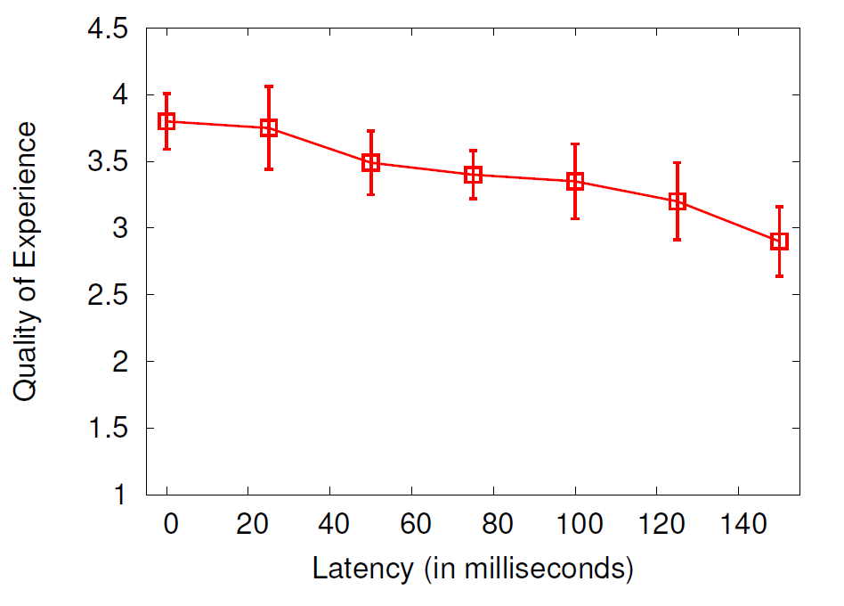
QoE for OnLive Crazy Taxi
Subjective opinions combined [12]
Mean with standard error
Linear regression R² 0.92
QoE drop of 30% over 150 ms

Slide 14
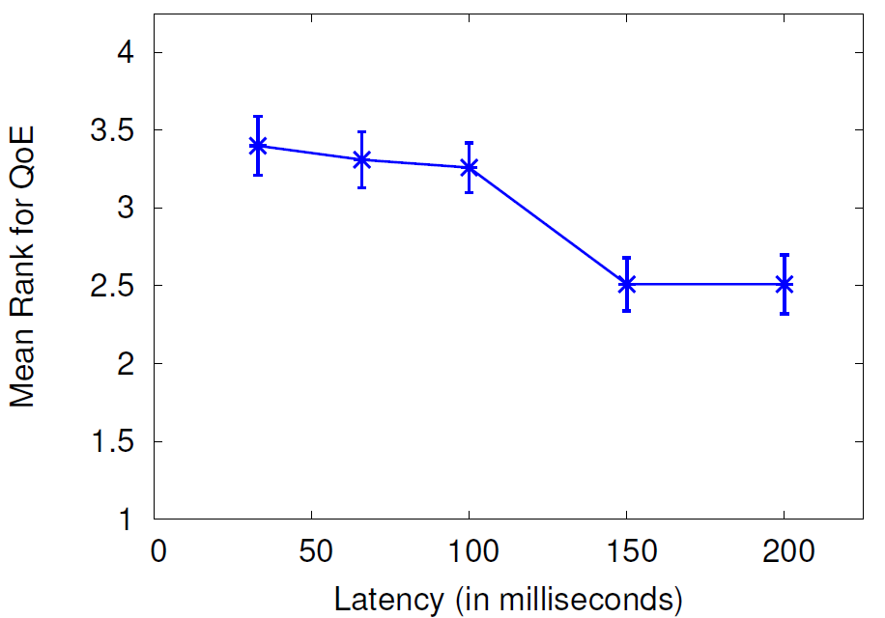
QoE for GamingAnywhere Neverball
QoE ranked for each test
Mean with standard error
Friedman test for correlation (p=0.002)
Linear regression R² 0.86
QoE drop of 40% over about 200 ms

Slide 15
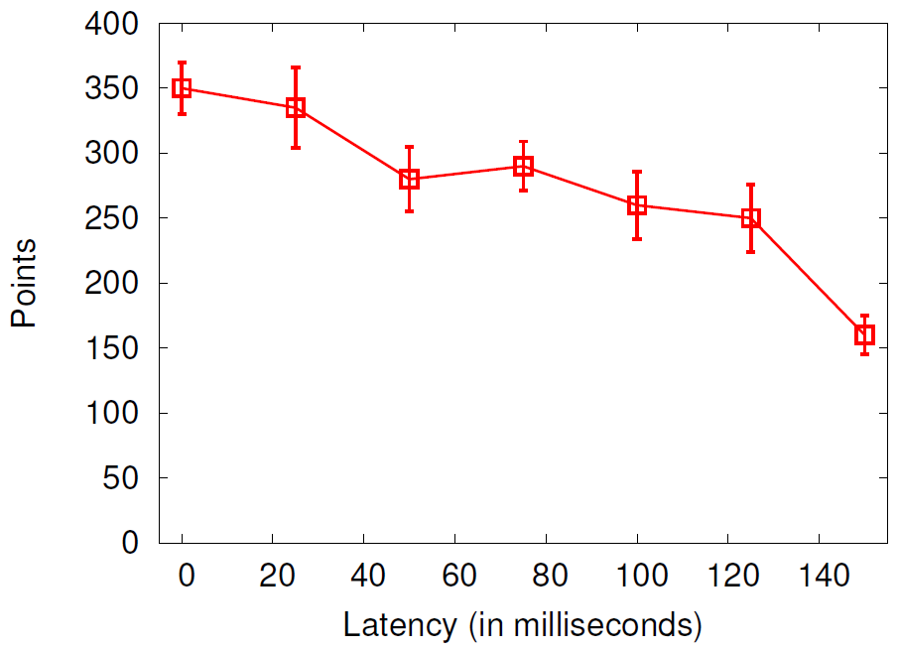
Points for OnLive Crazy Taxi
Points for delivering customers
Mean with standard error
Linear regression R² 0.87
Score drop of 35% over 150 ms

Slide 16
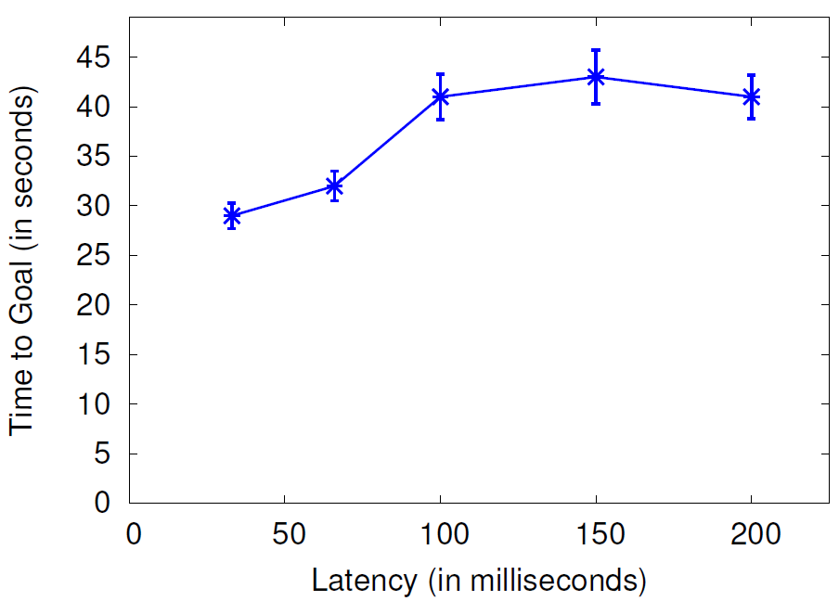
Times for GamingAnywhere Neverball
Time to get marble to goal
Mean with standard error
Linear regression R² 0.70
Time increase of 35% over about 200 ms

Slide 17
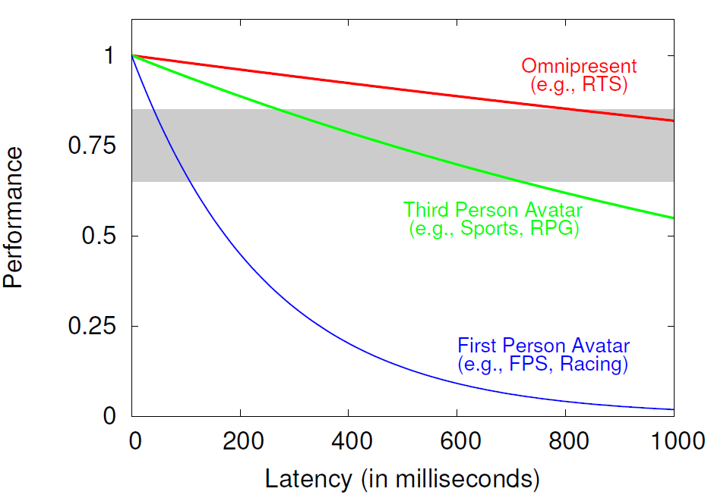
User Performance in Game Genres
Traditional games → Impact of latency depends upon perspective [5]
First Person most sensitive
Third Person less sensitive
Omnipresent least sensitive

Slide 18
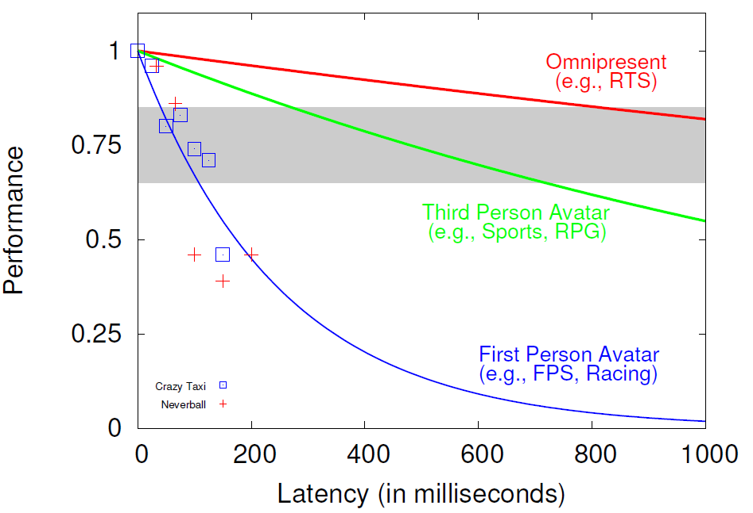
User Performance in Game Genres
Cloud-based games most closely follow first person avatar
… Despite being third person!
Convert objective measurements to performance degradation

Slide 19
Conclusion
Cloud-based games increasingly relevant
Effects of latency? Versus traditional network games?
Two user studies on cloud-based games and latency
Measure object (score) and subjective (QoE)
Comparison with traditional games
Cloud-based games sensitive to modest latencies
25% degradation for each 100 ms
Most similar to first person games
Even if genre more tolerant to latency in traditional games
Future work
Additional user studies, other genres
Latency compensation for cloud-based games
Effects of variation in latency (i.e., delay jitter)

Slide 20
Acknowledgements
GamingAnywhere Neverball
OnLive Crazy Taxi
James Anouna
Zachary Estep
Michael French
Robert Dabrowski
Chrisitan Manuel
Robert Smieja

Slide 21
The Effects of Latency on Player Performance in Cloud-based Games
Mark Claypool and David Finkel
{claypool,dfinkel}@cs.wpi.edu
Computer Science and
Interactive Media & Game Development
Worcester Polytechnic Institute

