Slide 1
The Effects of Latency on Player Performance in Cloud-based Games
Mark Claypool and David Finkel
In Proceedings of the 13th ACM Network and System Support for Games (NetGames),
Nagoya, Japan, December 4-5, 2014.
Worcester Polytechnic Institute
Notes:
Mark Claypool and David Finkel. The Effects of Latency on Player Performance in Cloud-based Games,
In Proceedings of the 13th ACM Network and System Support for Games (NetGames),
Nagoya, Japan, December 4-5, 2014.
Online at:http://www.cs.wpi.edu/~claypool/papers/cloud-games/

Slide 2
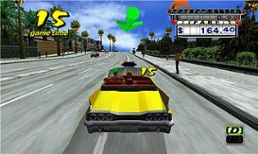
Cloud-based Games
Connectivity and capacity of networks growing
Opportunity for cloud-based games
Game processing on servers in cloud
Stream game video down to client
Client displays video, sends player input up to server
Game frames
Server
Server
Player input
Server
Thin Client
Cloud Servers

Slide 3
Why Cloud-based Games?
Potential elastic scalability
Overcome processing and storage limitations of clients
Avoid potential upfront costs for servers, while supporting demand
Ease of deployment
Client “thin”, so inexpensive ($100 for OnLive console vs. $400 for Playstation 4 console)
Potentially less frequent client hardware upgrades
Games for different platforms (e.g., Xbox and Playstation) on one device
Piracy prevention
Since game code is stored in cloud, server controls content and content cannot be copied
Unlike other solutions (e.g., DRM), still easy to distribute to players
Click-to-play
Game can be run without installation

Slide 4
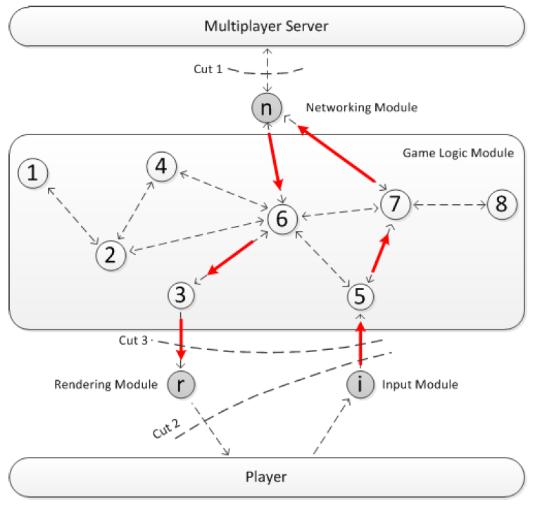
Cloud Game - Modules (1 of 2)
Input (i) – receives control messages from players
Game logic – manages game content
Networking (n) – exchanges data with server
Rendering (r) – renders game frames
How to put in cloud?
Notes:
W. Cai, M. Chen, and V. Leung. “Toward Gaming as a Service”, IEEE Internet Computing, May/June, 2014

Slide 5
Cloud Game - Modules (2 of 2)
“Cuts”
All game logic on player, cloud only relay information (traditional network game)
Player only gets input and displays frames (remote rendering)
Player gets input and renders frames (local rendering)
Notes:
W. Cai, M. Chen, and V. Leung. “Toward Gaming as a Service”, IEEE Internet Computing, May/June, 2014

Slide 6
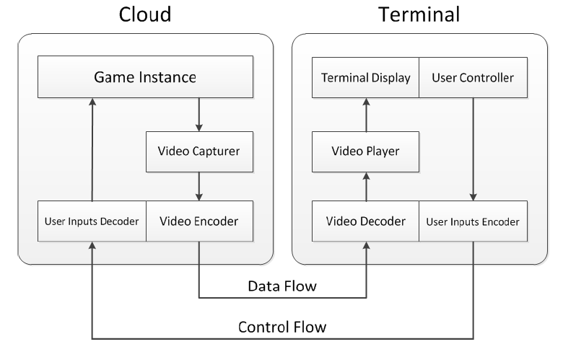
Cloud Game - Remote Rendering
Cloud runs full, traditional game
Captures video (“scrape” screen) and encode
Client only needs capability to decode and play
Relatively minor requirements
Bitrate requirements can be an issue
E.g.,
Onlive (commercial)
Gaming Anywhere (research)
Cloud Saucer Shoot (teaching)
Notes:
W. Cai, M. Chen, and V. Leung. “Toward Gaming as a Service”, IEEE Internet Computing, May/June, 2014

Slide 7
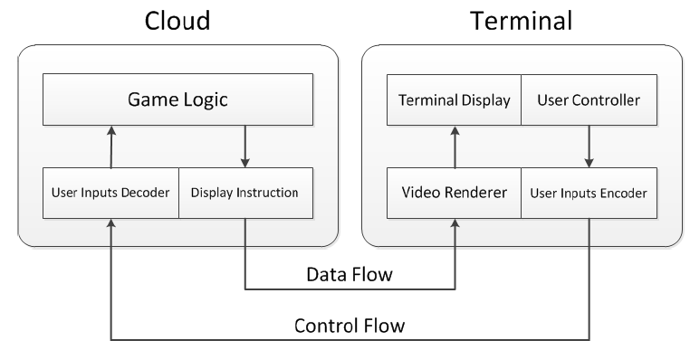
Cloud Game - Local Rendering
Instead of video frames, send display instructions
Potentially great bitrate savings
Challenge for instruction set: able to represent all images for all games
E.g., Browser-based games (via HTML5 and/or Javascript), [De Winter et al., NOSSDAV ‘06]
Notes:
W. Cai, M. Chen, and V. Leung. “Toward Gaming as a Service”, IEEE Internet Computing, May/June, 2014

Slide 8
Challenges for Cloud Based Games
Requires more downstream capacity than traditional network games (5000 Kb/s vs. 50 Kb/s [Claypool et al. ‘14])
Latency since player input requires round-trip to server before player sees effects

Slide 9
Latency and Interactive Applications
Many studies on latency and interactive applications (e.g., VoIP)
But interactions for games different
Numerous studies on latency and network games (e.g., car racing [Pantel and Wolf ‘02], role playing [Fritsch ‘05], first person shooter [Armitage ‘03])
But cloud-based has only thin client so results may differ
Some studies on latency cloud-based games (e.g., [Shea et al. ‘13], [Chen et al. ‘14])
But do not measure impact on players
Few studies on latency cloud-based on users (e.g., [Jarshel et al. ‘11])
Still need more data
And no comparison with traditional network games
→ inform developers of game and cloud systems

Slide 10
This Paper
Measure impact of latency on players in cloud-based games
Two separate user studies – two games, two systems
Users play games with controlled amounts of latency
Measure objective (performance) and subjective (quality)
Compare performance to traditional network games

Slide 11
Teasers
Player performance degrades directly with increase in latency
Every 100 ms latency means 25% decrease in performance
Degradation similar to traditional first person network games
Despite difference in genres!
E.g., third person game latency tolerance:
Traditional network game → 500 ms
Cloud-based game → only 100 ms

Slide 12
Outline
Introduction (done)
User Studies (next)
Results
Conclusion

Slide 13
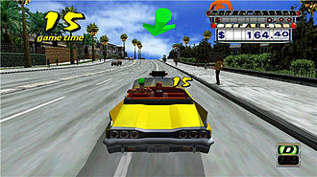
User Study 1
OnLive console
Connects to laptop configured as router
Dummynet on router
Control latency: 0-150 ms
Router connects to Internet then OnLive servers
Users play Crazy Taxi
3rd person view
Deliver customers for points
About 12 minutes total
Users volunteers from campus
https://youtu.be/7QZmvD_yQKk?t=385

Slide 14
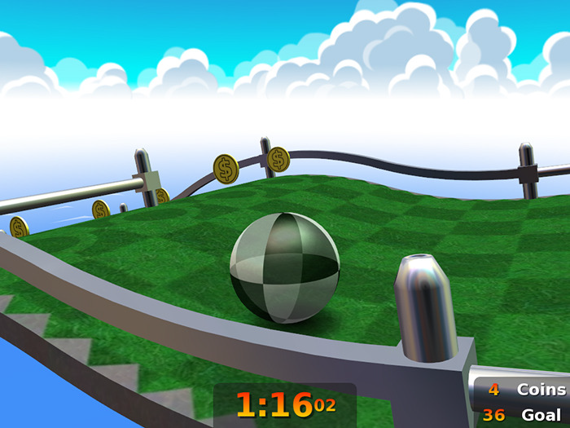
User Study 2
GamingAnywhere LAN
Client connects to PC configured as router
Dummynet on router
Control latency: 0-200 ms
Router connects to server on LAN
Users play Neverball
3rd person view
“Roll” marble to goal as fast as possible
About 10 minutes total
Users volunteers from campus
https://youtu.be/nhB7Klc2e0o?t=88

Slide 15
User Study Summary

Slide 16
Outline
Introduction (done)
User Studies (done)
Results (next)
Demographics
Subjective
Objective
Traditional network games
Conclusion

Slide 17
Demographics
OnLive Crazy Taxi: 49 users
95% 18-22 years old
70% male
75% “average+” game playing experience
GamingAnywhere Neverball: 34 users
100% 18-22 years old
90% male
100% “average+” game playing experience

Slide 18
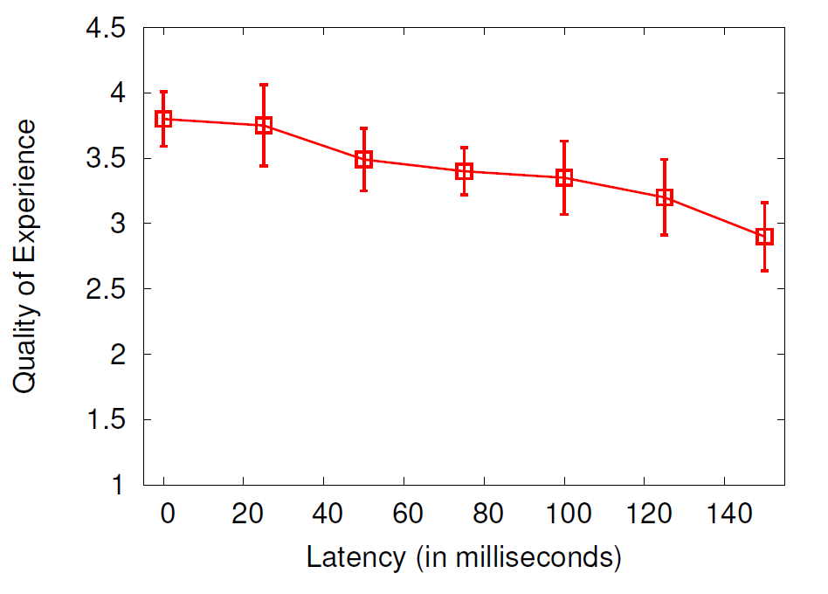
QoE for OnLive Crazy Taxi
Subjective opinions combined [Clincy and Wilgor ‘13]
Mean with standard error
Linear regression R² 0.92
QoE drop of 30% over 150 ms

Slide 19
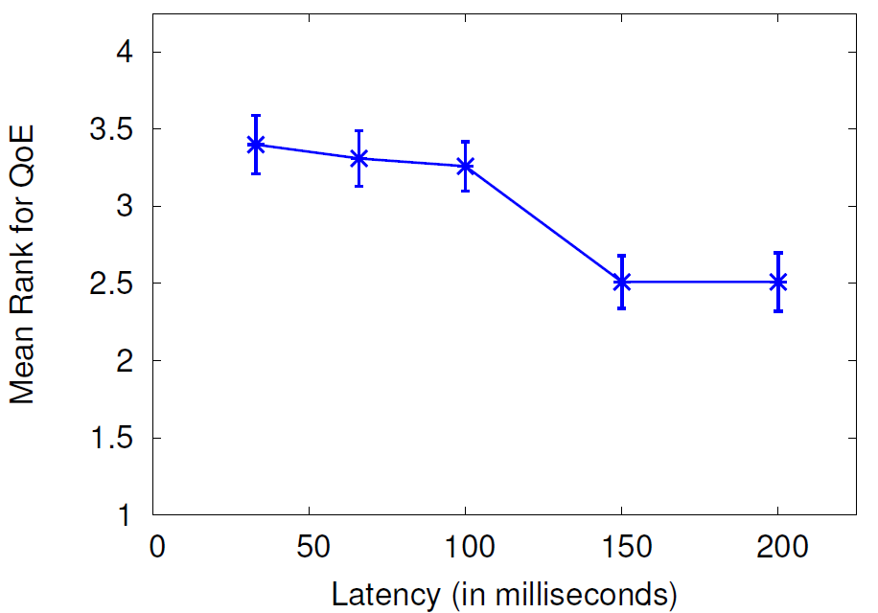
QoE for GamingAnywhere Neverball
QoE ranked for each test
Mean with standard error
Friedman test for correlation (p=0.002)
Linear regression R² 0.86
QoE drop of 40% over about 200 ms

Slide 20
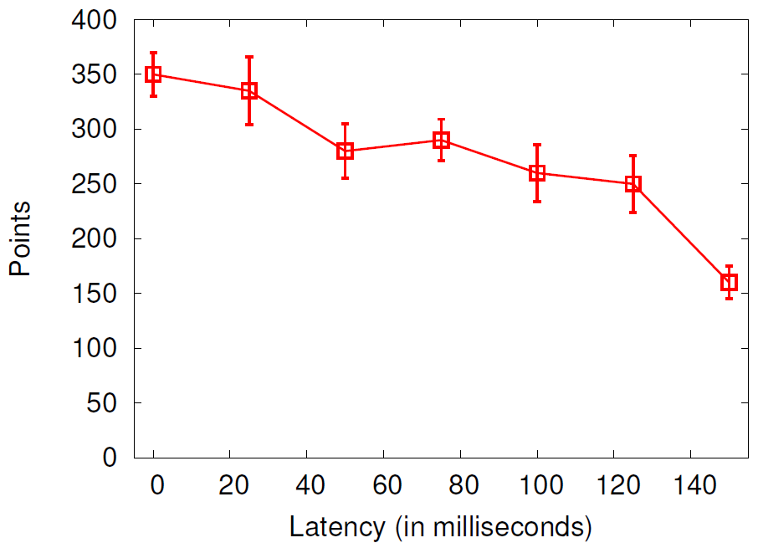
Points for OnLive Crazy Taxi
Points for delivering customers
Mean with standard error
Linear regression R² 0.87
Score drop of 35% over 150 ms

Slide 21
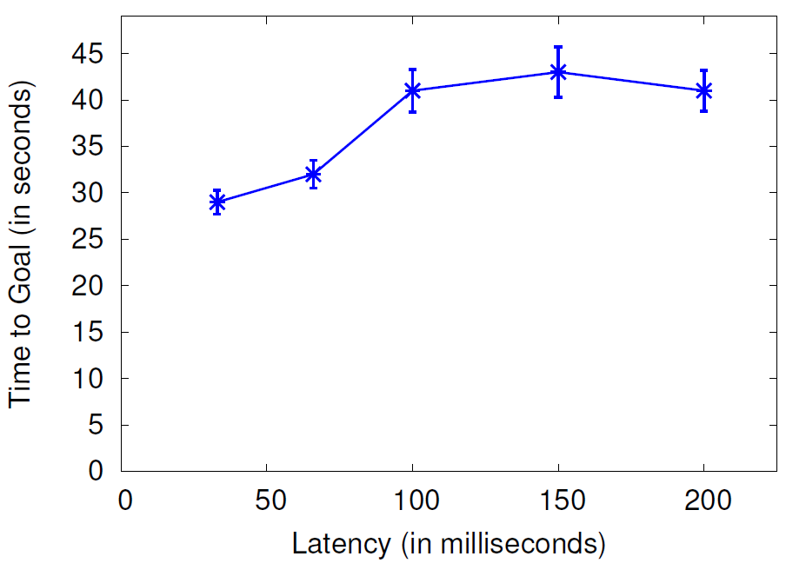
Times for GamingAnywhere Neverball
Time to get marble to goal
Mean with standard error
Linear regression R² 0.70
Time increase of 35% over about 200 ms

Slide 22
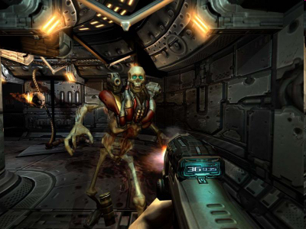
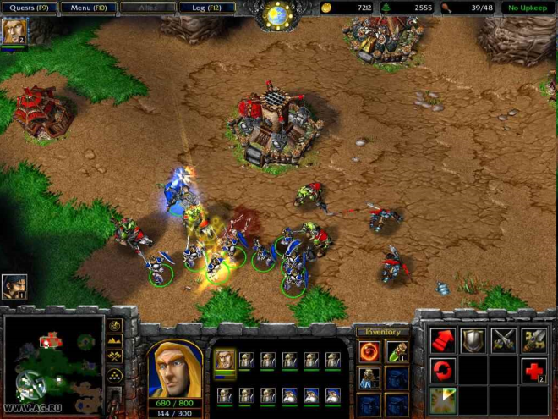
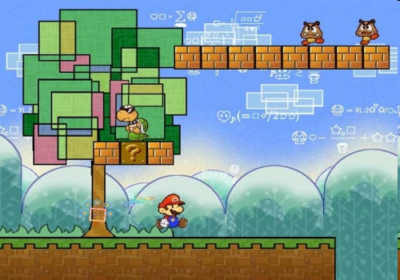
Game Perspectives
First Person Linear
Third Person Linear
Omnipresent
Third Person Isometric

Slide 23
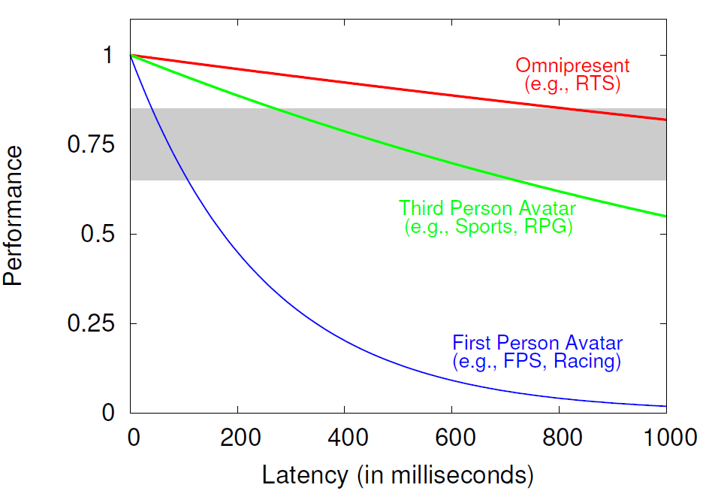
User Performance in Game Genres
Traditional games → Impact of latency depends upon perspective [5]
First Person most sensitive
Third Person less sensitive
Omnipresent least sensitive

Slide 24
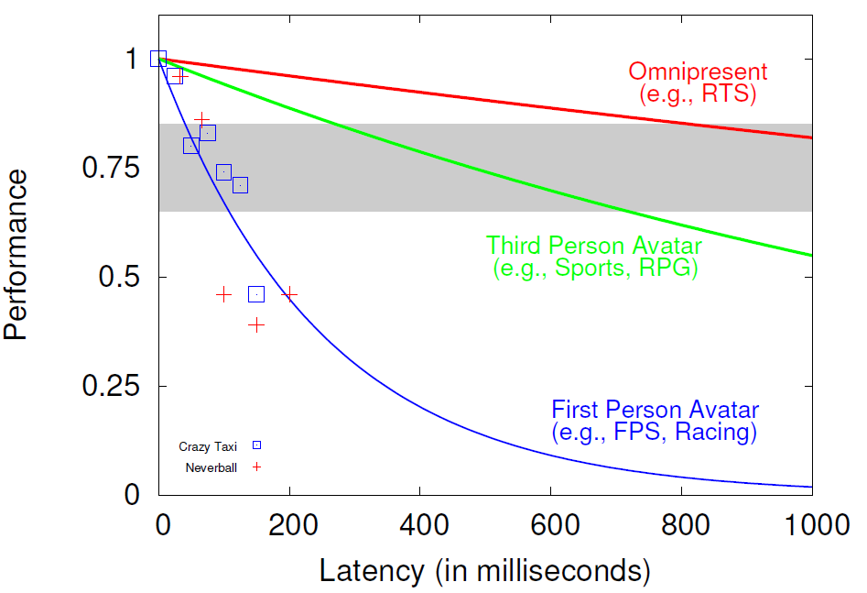
User Performance in Game Genres
Cloud-based games most closely follow first person avatar
… Despite being third person!
Convert objective measurements to performance degradation

Slide 25
Conclusion
Cloud-based games increasingly relevant
Effects of latency? Versus traditional network games?
Two user studies on cloud-based games and latency
Measure objective (score) and subjective (QoE)
Comparison with traditional games
Cloud-based games sensitive to modest latencies
25% degradation for each 100 ms
Most similar to first person games
Even if genre more tolerant to latency in traditional games
Future work
Additional user studies, other genres
Latency compensation for cloud-based games
Effects of variation in latency (i.e., delay jitter)

Slide 26
Acknowledgements
GamingAnywhere Neverball
OnLive Crazy Taxi
James Anouna
Zachary Estep
Michael French
Robert Dabrowski
Chrisitan Manuel
Robert Smieja

Slide 27
The Effects of Latency on Player Performance in Cloud-based Games
Mark Claypool and David Finkel
In Proceedings of the 13th ACM Network and System Support for Games (NetGames),
Nagoya, Japan, December 4-5, 2014.
Worcester Polytechnic Institute
Notes:
Mark Claypool and David Finkel. The Effects of Latency on Player Performance in Cloud-based Games,
In Proceedings of the 13th ACM Network and System Support for Games (NetGames),
Nagoya, Japan, December 4-5, 2014.
Online at:http://www.cs.wpi.edu/~claypool/papers/cloud-games/

