Slide 1
Lower is Better? The Effects of Local Latencies on Competitive First-Person Shooter Game Players
Atsuo Kuwahara
Jamie Sherman
James Scovell
Shengmei Liu
Mark Claypool
Worcester Polytechnic Institute
Intel Corporation
Notes:
Hi my name is Shengmei. My advisor is Prof Mark Claypool, and my research area focus on latency and gaming.
Today I’ll present the results regarding the effects of local latencies on competitive first person shooter game players.

Slide 2
Motivation
Upgrade
Local latency
Performance
🤨
😃
Quality of Experience
Mouse
Display
Local latency
Notes:
It’s a common knowledge that decrease in latency helps game players, and local latency is an important type of latency. It’s the time between mouse clicking and rendering on the screen.
Now if we upgrade the system to a high end gaming system, there would be shorter local latency. The question is how much does the upgrade help competitive fps players?
Talking about affecting gamers, the 1st aspect would be performance. This would affect your ranking in the game.
We have two matrix for performance, and they are weapon accuracy and in-game score.
We also want to know how would lower local latency helps players feeling, and player feeling is represented by the quality of experience.

Slide 3
User Study
Game customization
Local latency
Shuffled added local latency (0, 25, 50, 75, 100 ms)
Laptop
Fully automate the process
Questionnaires (Demographic, In-game surveys)
43 Users (> 100 hrs in CSGO)
25
0
100
200
300
(ms)
Gaming system
Normal PCs
Consoles, TV, etc.
Notes:
A total number of 43 users were recruited for the local latency study, and All the users are experienced gamers with over 100 hours in the game.
Different types of system would cause different local latencies. The latency for gaming system are mainly in a range of 0 -100 ms. Normal PCs are like 100-200 ms. Consoles and TVs would have latencies even higher.
The base local latency of the gaming system used in both of the studies was measured at 25 ms. For the local latency study,
There are 5 shuffled total latency for the rounds, and they are 25 50 75 100 and 125 ms.
For the network latency study, A total number of 25 users were recruited, and All the users are also experienced gamers with over 100 hours in the game
Normally speaking, network latency from 0 to 100 indicates a good internet connection, moderate internet connection may have latency between 100 and 200 ms. And bad internet connections would cause even higher network latency.
The base round trip time for the LAN in the study was less than 1 ms.
There are 4 shuffled total latency values for the rounds, and they are 25, 50, 100, 150 ms.

Slide 4
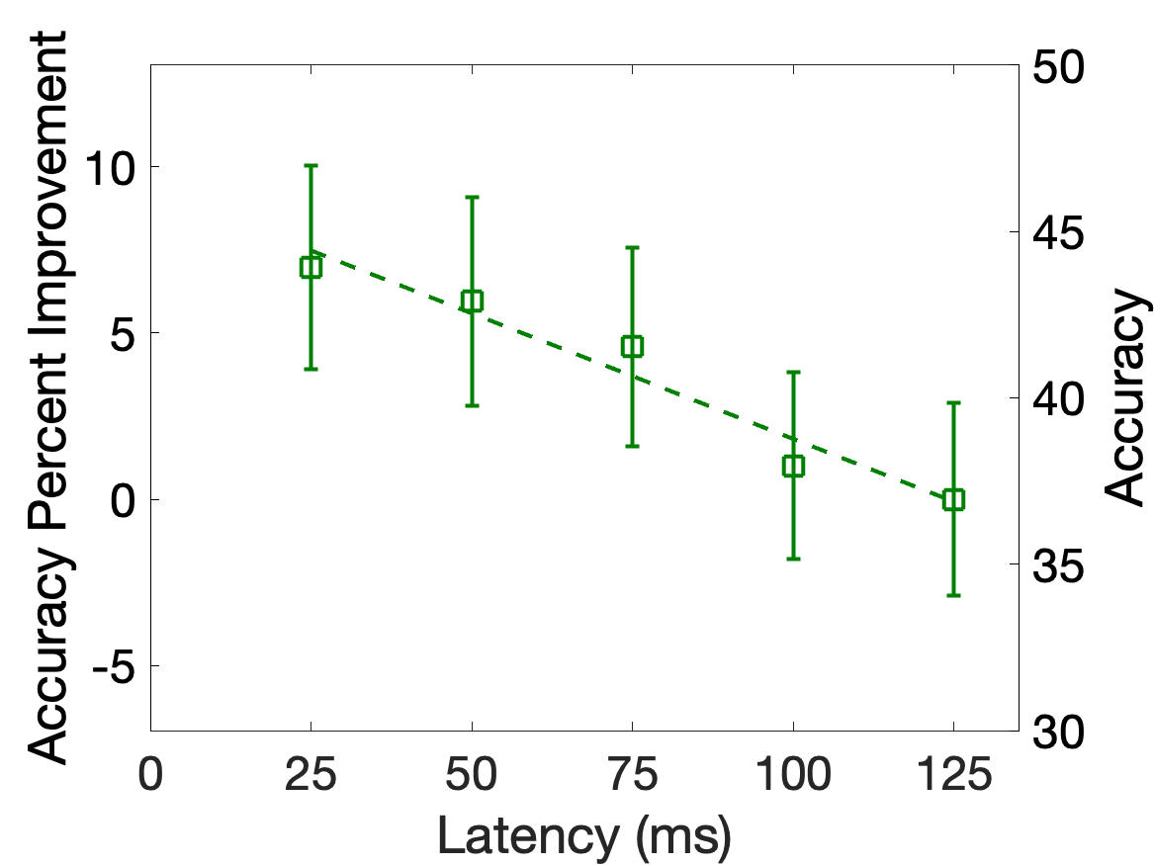
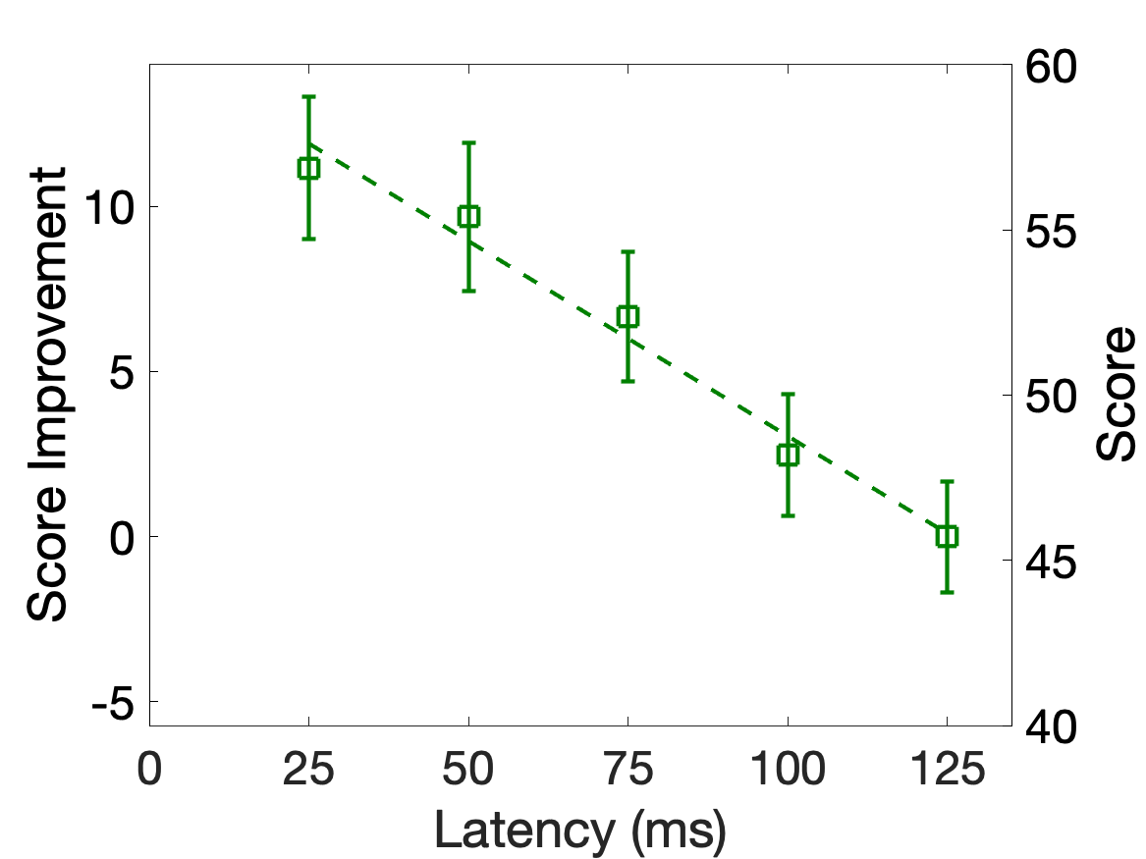
Results (Player Performance)
Decrease in latency by 100 ms improves overall accuracy percent by 8.
Decrease in latency by 100 ms improves score by 12 points per 4 minutes of gameplay.
Notes:
Here are some of our results.
The graph on the left denotes accuracy versus latency. The x-axis is latency in milliseconds, and the y-axis on the right is accuracy and the y-axis on the left is the accuracy improvement compared to 125 ms condition. The rectangles are the mean values bounded by 95% confidence interval. The dashed line denotes the linear regression for the mean values. The regression fits the data well wit the R^2 high at 0.95 and a significant p value. We can learn that Accuracy degrades linearly with local latency within low range,
and A decrease in local latency by 100 ms improves accuracy percent by 8.
The graph on the right is for score. The
axes and points are as in the left graph, but the data is the score instead of accuracy. The linear regression fits the data well with R^2 high at 0.98 and a very low p value. We can learn that Score also degrades linearly with local latency within low range,
and A decrease in local latency by 100 ms improves score by 12 points. For reference, 12 points means 6 more kills in CSGO.
Based on the two graphs, we get the conclusion that player performance degrades linearly with local latency.

Slide 5
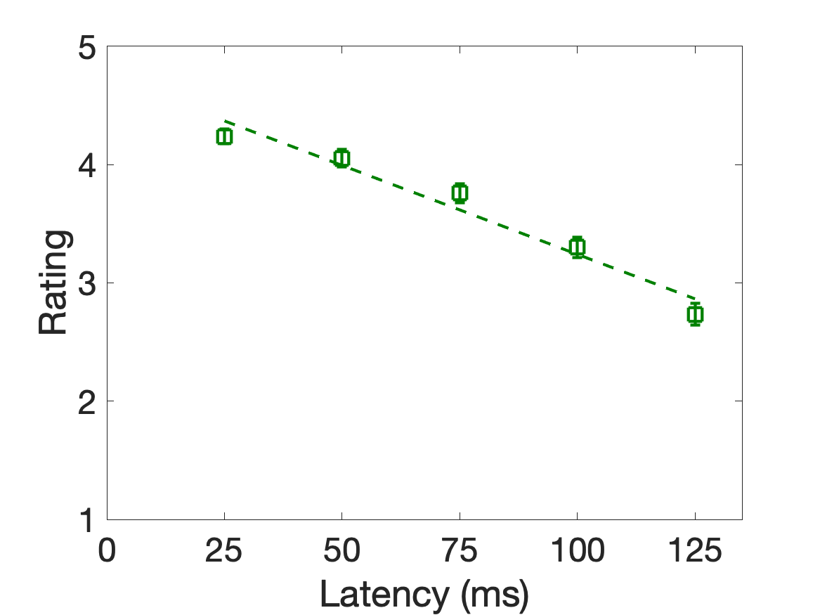
Results (Quality of Experience)
Decrease in latency by 100 ms improves QoE by 1.5 out of 5.
Notes:
For an overall measure of QoE, we compute the mean ratings by weighting all questions equally. In this graph, the x axis is local latency, and the y axis is rating. The linear regression fits the mean values well with R^2 high at 0.96 and a significant p value. Same as performance, QoE also degrades linearly with local latency.
A decrease in latency by 100 ms improves QoE by 1.5 out of 5

Slide 6
Lower is Better? The Effects of Local Latencies on Competitive First-Person Shooter Game Players
Atsuo Kuwahara
Jamie Sherman
James Scovell
Shengmei Liu
Mark Claypool
Worcester Polytechnic Institute
Intel Corporation
Notes:
Thanks for your attention on the work!

