Slide 1
The Effects of Network Latency on Counter-strike: Global Offensive Players
Xiaokun Xu
PhD student of Computer Science
xxu11@wpi.edu
Shengmei Liu
PhD student of Computer Science
sliu7@wpi.edu
Mark Claypool
Professor of Computer Science
claypool@wpi.edu

Slide 2

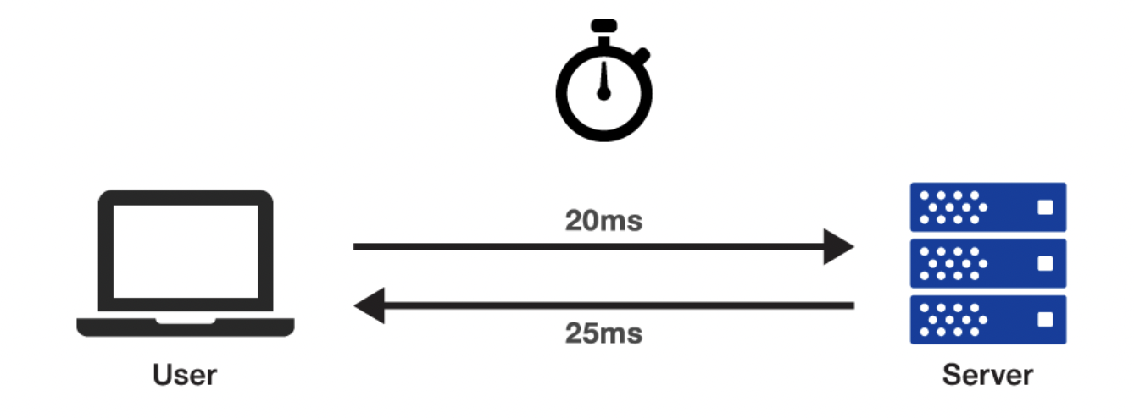



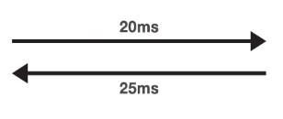
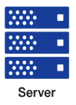




Motivation
40 ms
Network upgrade
20 ms
50 ms
25 ms
Weapons
Performance
😃
Quality of Experience

Slide 3
Outline
Methodology
  Game selection
  Game setting
  Map setting
  User study procedure
Analysis
  Demographic
  Results
Conclusion
Future work

Slide 4
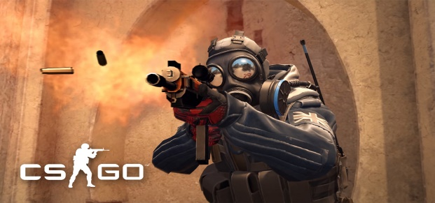

Counter-strike: Global Offensive
Popular first-person shooter game
Top-10 current most popular PC game
24 million monthly active user
Over $100 million in total prize pools

Slide 5





Game Settings
Game customization
  Deathmatch FFA
  Single player with 20 bots (difficulty “Hard”)
  3.5 mins per round
Network latency
Shuffled total network latencies
PC
tc (Traffic Control)
Add network delay
Client
Server
0
12.5
25
50
100
(ms)
Very Good
Good
Moderate
Internet Connection
Notes:
space of the values

Slide 6
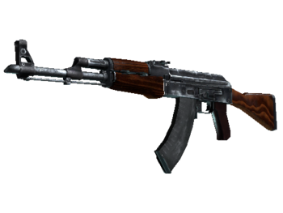
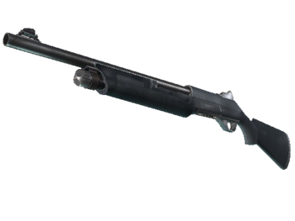
Map Settings
Map: Mirage
  Most popular
  3rd smallest (focuses combat)
Weapons:
AK 47
Damage: 35
Fire Rate: 600 RPM
Magazine capacity: 30/90
Accurate Range:21.74m
Reload Time: 2.43 seconds
NOVA
Damage: 26 (1 pellet), 234 (1 shot)
Fire Rate: 68 RPM
Magazine capacity: 8/32
Accurate Range:3.2m.
Reload Time: 1.8 seconds
Notes:
details of weapons

Slide 7

User Procedure
Screener
Select qualified participants
Yes
Consent
No
Setup
Set machines, in campus lab
Unqualified
Pre-Play
Demographics
Reaction Time test
3.5 minutes
Play
Scripts for auto-run
Latency control
game log
Repeat Play with different latency and for 60 minutes for each participant
QOE
QOE Survey
Closing
Collect data and pay participants gift card or credits

Slide 8
Demographic
Number of People | 42
Gender | 5 Females, 37 males
Age (years) | 17-25, Average: 20
CS:GO hours (hours) | 50-7000, Average: 2109
CS:GO self rating | Average: 3.3 (1-5, 1 is low, 5 is high)
Reaction Time (ms) | Min:191, Max:244, Average: 209

Slide 9
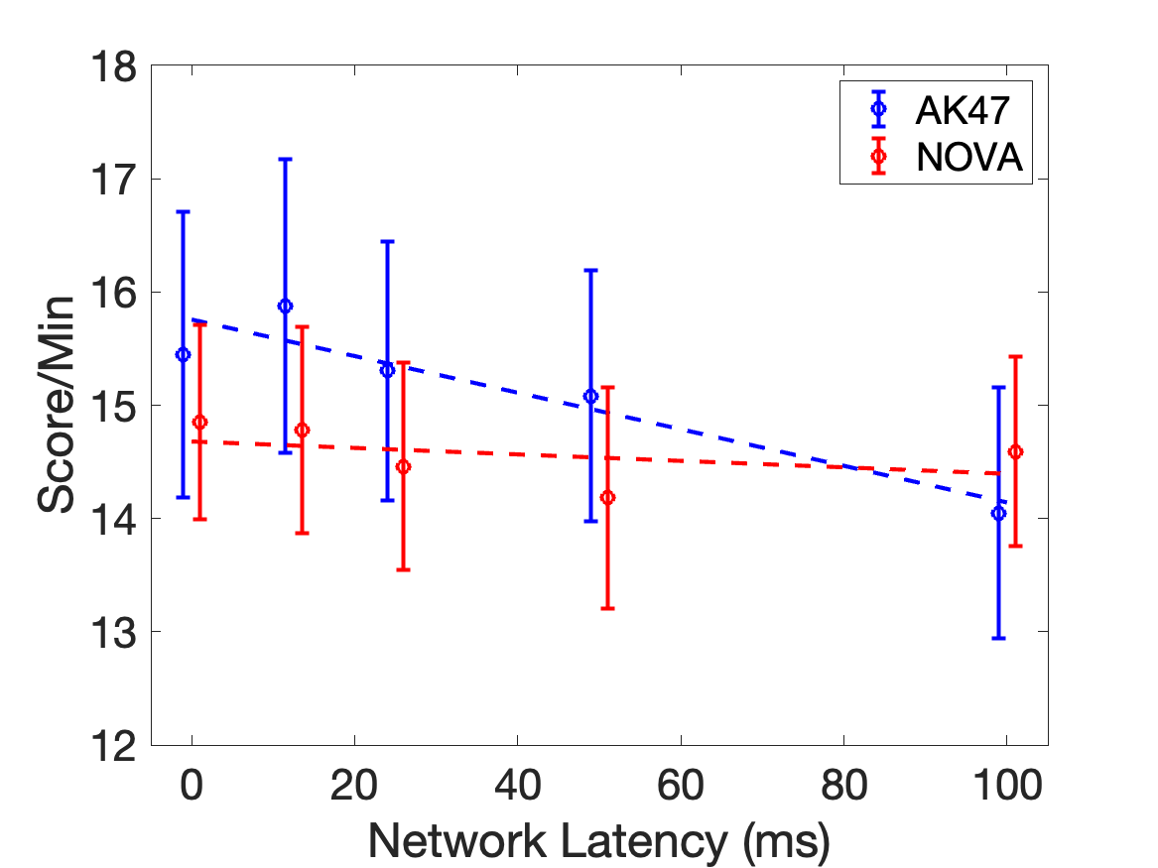
Results - Score
Network latency has a 12% higher impact on Score for AK47 weapon.

Slide 10
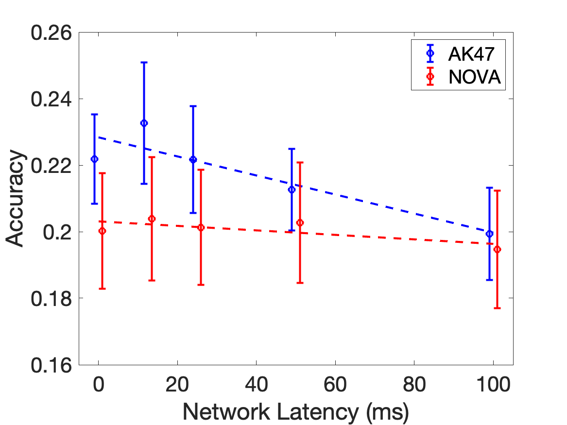
Results – Accuracy
Network latency has a 15% higher impact on accuracy for AK47 weapon.

Slide 11
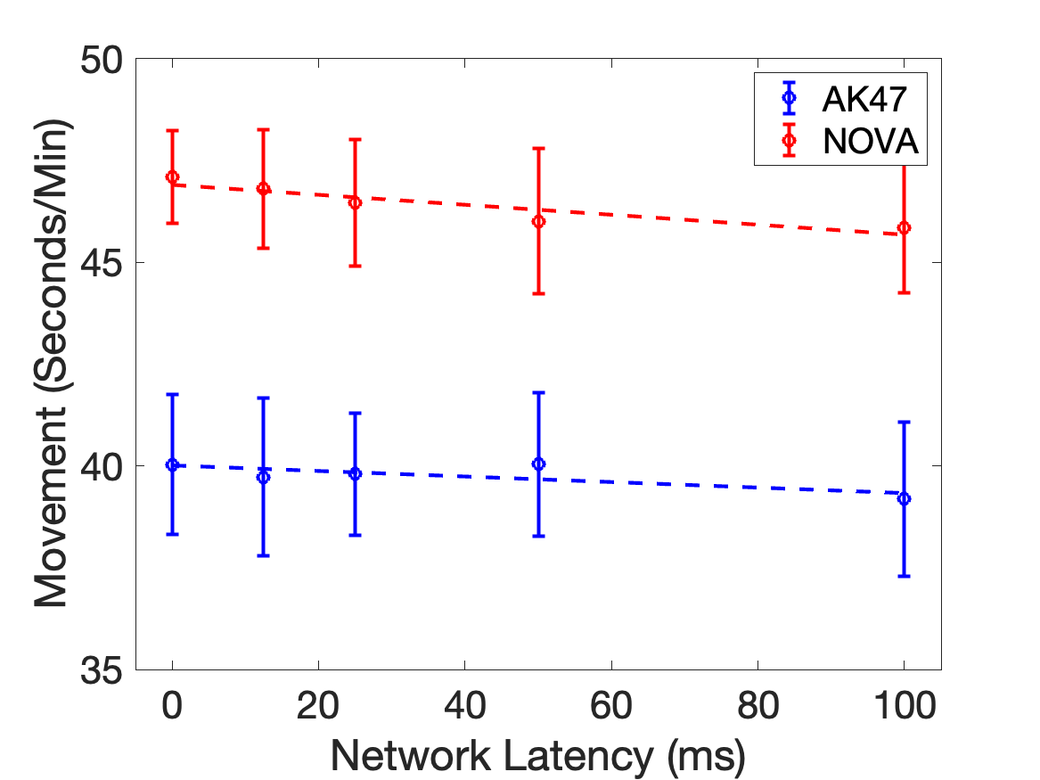
Results - Player Movement
Network latency has a 20% higher impact on movement for AK47 weapon.

Slide 12
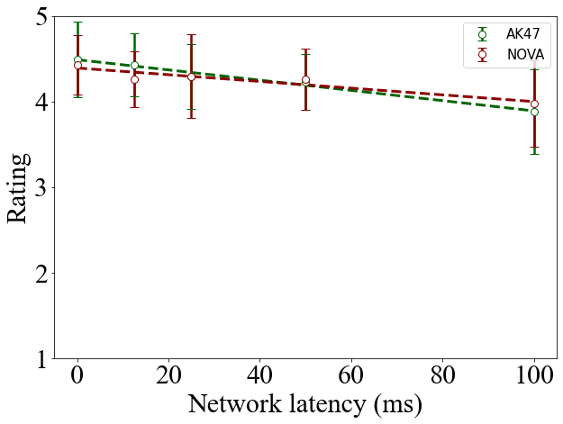
Results - QoE
AK47：R^2=0.98
NOVA: R^2=0.88

Slide 13
Conclusion
Network latency degrades player performance
  score decreases by as much as 15% for each 10 ms
  degradation independent of player skill
Weapon characteristics determine impact of network latency
  higher position weapons AK47 more effect by network latency than lower position weapons (NOVA)
Quality of experience degrades with network latency, independent of weapons
  QoE decreases by as much as 13% for each 10 ms

Slide 14

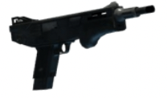





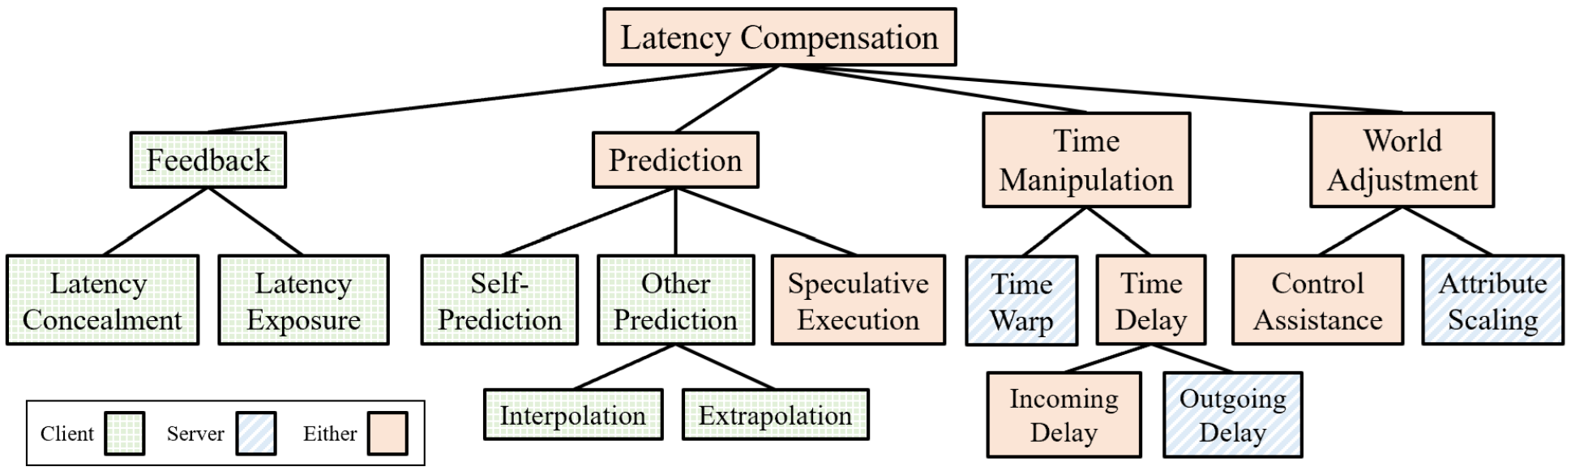
Future Work
Additional weapons, e.g., sniper
Other games, e.g., Valorant
Latency compensation

Slide 15
Appendix

Slide 16
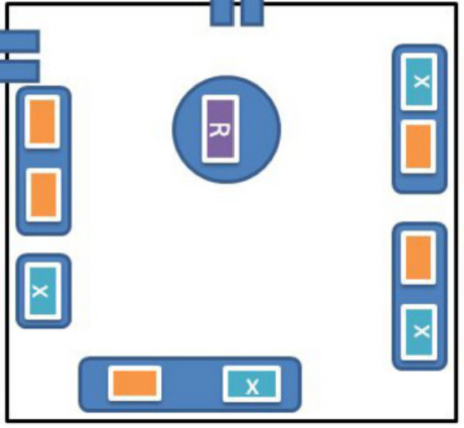


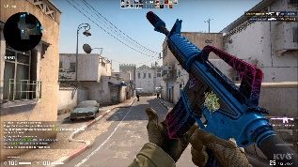

Setup Testbed
Machine Specifications
Processor: Intel i7-4790K CPU @4.00GHz x 8 cores
RAM: 16 GB
Graphics card: Intel HD Graphics 4600, NVIDIA GeForce GTX 960
Mouse: Logitech G502 12k DPI, 1000 Hz
Monitor: Lenovo Legion 25", 16:9, AMD FreeSync, 240 Hz, 1 ms Response Time
OS: Ubuntu 20.04 LTS, with Linux kernel version 5.4
PC
tc (Traffic Control)
Add network delay
Client
Server

Slide 17
Data Gathered
Raw data
  Shots fired (from evlag log)
  Shots hit
  Kills
  Assists
  Network delay
Objective data – player performance
  Accuracy: shots hit divided by shots fired
  Score: 2×kills + assists
Subjective data – QoE
  Survey given after each round
    E.g., “Rate the quality of the previous game round”

Slide 18
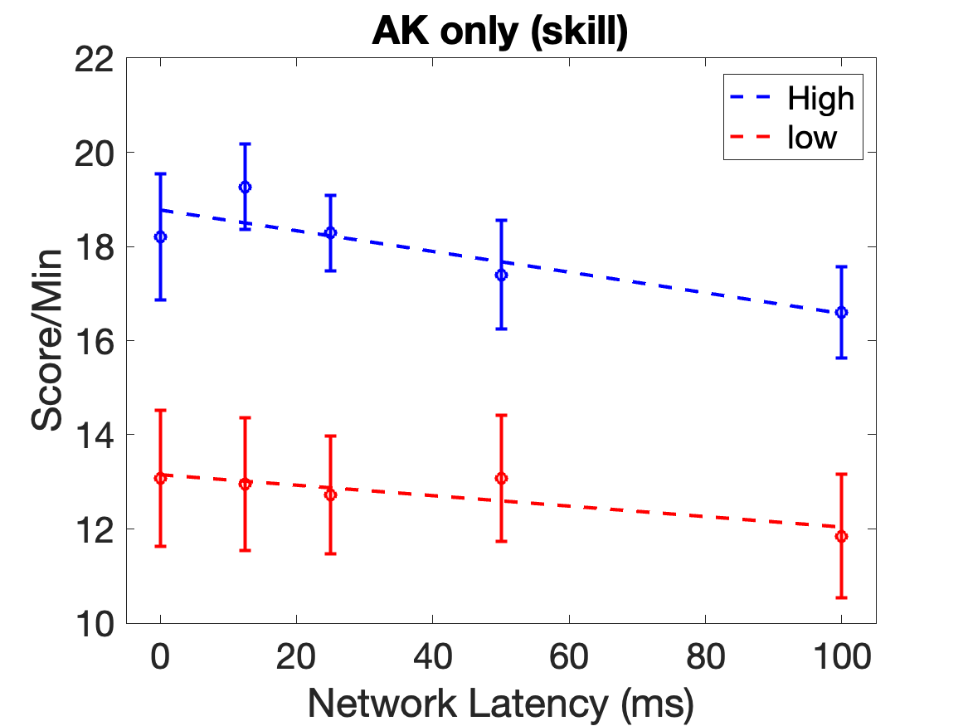
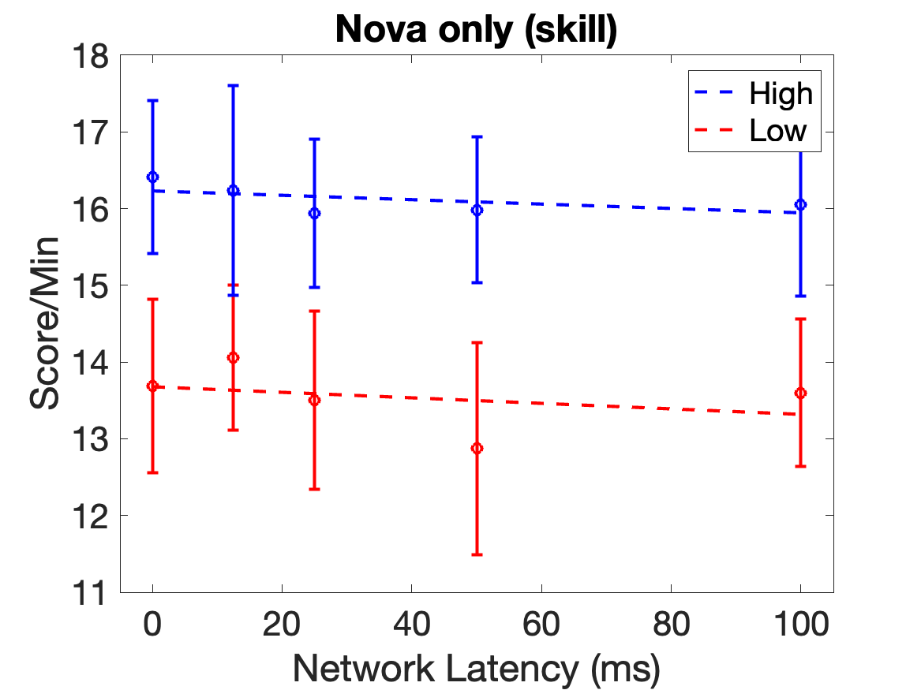
Results - Skill
Network latency has about ?X impact on higher skill players than on lower skill players for AK47.
Network latency has about ?X impact on higher skill players than on lower skill players for Nova.

