Slide 1
Comparing the Effects of Network Latency versus Local Latency on Competitive First Person Shooter Game Players
Atsuo Kuwahara
Jamie Sherman
James Scovell
Shengmei Liu
Mark Claypool
Worcester Polytechnic Institute
Intel Corporation
Notes:
Hi my name is Shengmei. My advisor is Prof Mark Claypool, and my research area focus on latency and gaming.
Today I’ll present the results regarding the effects of local latencies on competitive first person shooter game players.

Slide 2
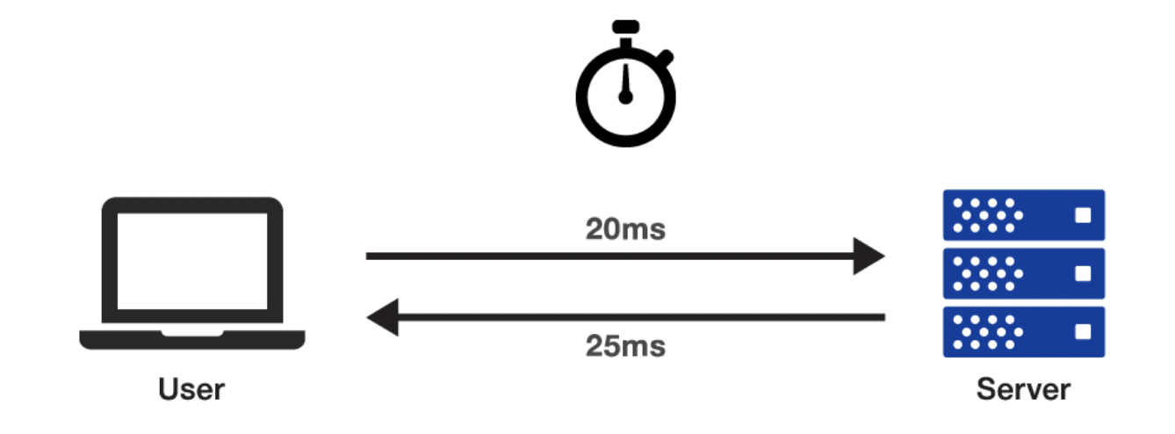
Motivation
+
VS
=
Network latency
Local latency
Performance
🤨
😃
Quality of Experience
Notes:
We already know that the network latency is the RTT between the client and server. Local latency denotes the system latency on the client side, which mainly from the input devices, like the mouse and keyboard, and also the software and display.
We compare the results of this study with a previously conducted local latency study on competitive gamers. The game and flow are the same as this study, but vary local latencies instead of network latency. There was no network latency in that study, and the base local latency is also at 25 ms.

Slide 3
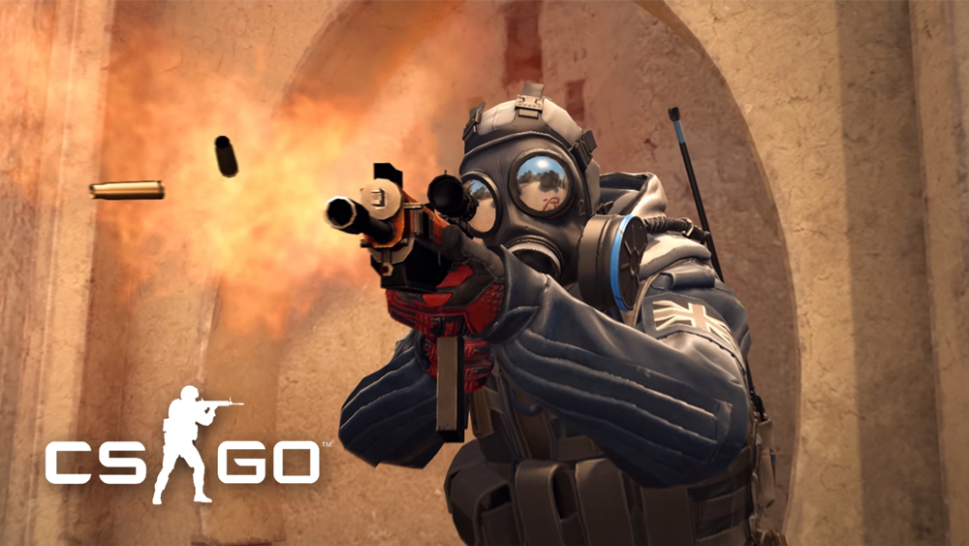
User Study
Game customization
Self-contained game process
Questionnaires (Demographic, In-game surveys)
Notes:
To understand the impact of local latency on gamers, we designed a user study.
The game for the study was CSGO. We customized the game, so the game mode is Deathmatch FFA, and the goal for players
is to kill as many as they can. We have log files to record all the game data.
The game flow was self-contained. All the users need to do was to double click on the only button on the desktop, and the flow will be loaded automatically.
After each round of game, players answers 4 questions about their experience and feelings. After completing all the games, players fill out a demographic questionnaire.
A total number of 43 users were recruited and they are all experienced CSGO players with over 100 hrs in the game.

Slide 4
User Study
Local latency study (43 users)
Network latency study (25 users)
25
50
75
100
125
25
0
100
200
300
(ms)
Gaming system
Normal PCs
Console, TV, etc.
<1
25
50
100
150
0
100
200
300
(ms)
Good
Internet Connection
Moderate
Internet connection
Other
Notes:
Different types of system cause different local latencies. The latency for gaming system are mainly in a range of 0 -100 ms. Normal PCs are like 100-200 ms. Consoles and TVs would have latencies even higher.
The local latency of the gaming system used in the study was measured at 25 ms. There are 5 shuffled latency value added to the rounds, and they are 0 25 50 75 and 100 ms.
The game flow was self-contained. All the users need to do was to double click on the only button on the desktop, and the flow will be loaded automatically.
After each round of game, players answers 4 questions about their experience and feelings. After completing all the games, players fill out a demographic questionnaire.
A total number of 43 users were recruited and they are all experienced CSGO players with over 100 hrs in the game.

Slide 5
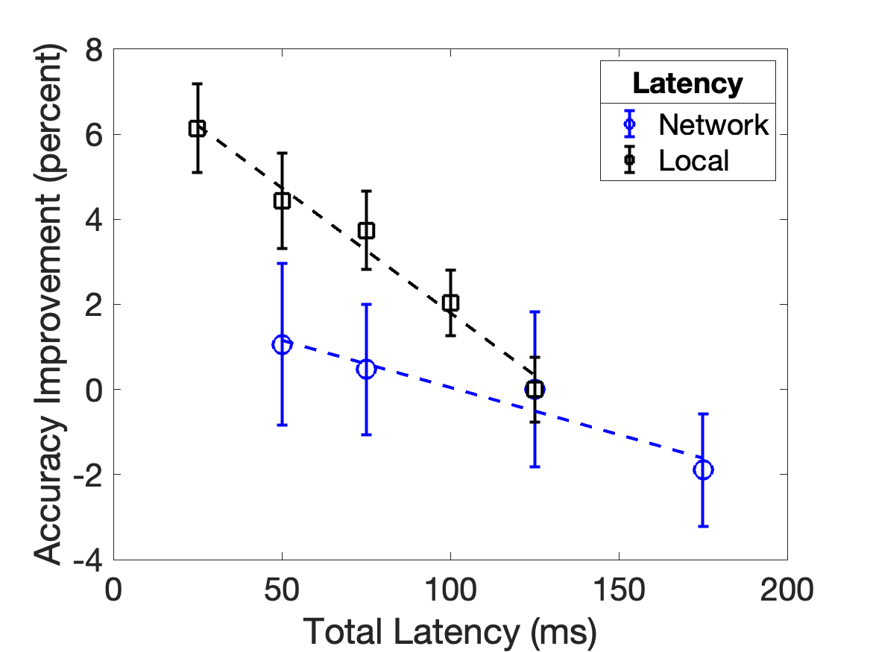
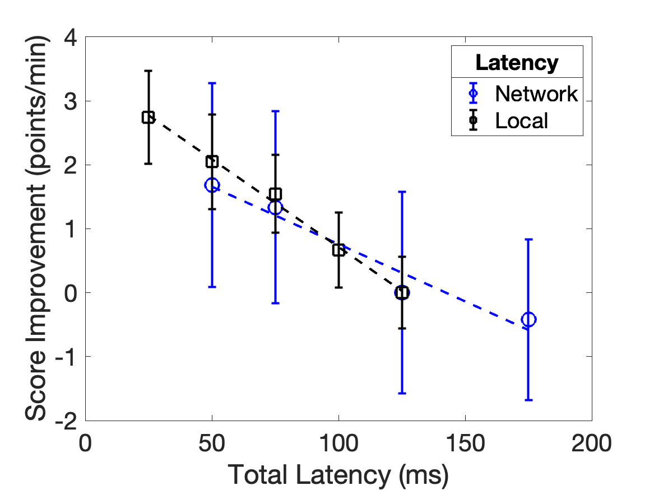
Results - Performance
Slope: -0.06
Slope: -0.03
Slope: -0.02
Slope: -0.02
Accuracy impacted 200% more by local latency than by network latency
Score impacted 50% more by local latency than by network latency
Local latency affects players performance more
Notes:
The graph on the left is for accuracy. The x axis is the total latency, it equals to local latency plus network latency. The y axis is the weapon accuracy (percent) increase from the 125ms total latency condition. The blue line is for network latency data and the black line is for the local latency data. The slope of the black line is much steeper than the blue line. Accuracy is impacted 200% more by local latency than by network latency
The graph on the right is for score per minute. The black line is still steeper than the blue line. From the slope we can learn that Score impacted 50% more by local latency than by network latency.
Based on these 2 graphs we can conclude that local latency i affects players performance more.

Slide 6
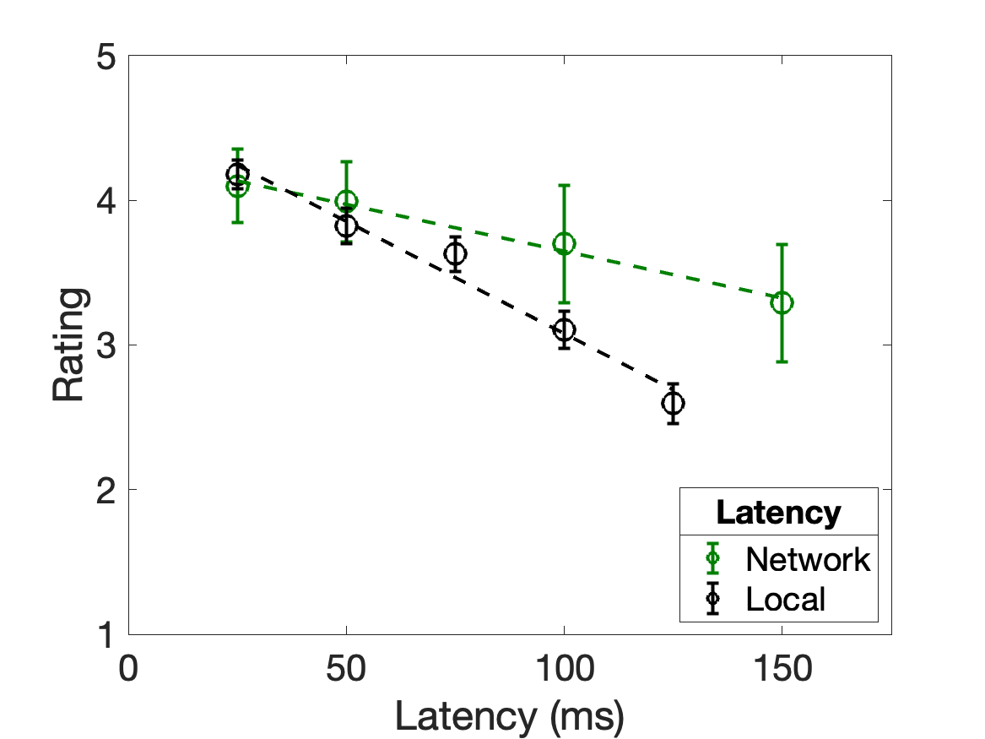
Results - QoE
Slope: -0.007
Slope: -0.015
QoE impacted 114% more by local latency than by network latency
Notes:
We already know that local latency affects performance more, will it also affect QoE more? This graph is the same as last graph, but we also put in the local latency data. The green line is for network latency and black line is for local latency. The slopes depict that QoE impacted 114% more by local latency than by network latency. Thus local latency has higher impact on both performance and QoE than network latency.

Slide 7
Future work…
More games
…..
More weapons
…..
More skills
…..
0
100
200
300
Higher latencies
(ms)
…..
Good
Moderate
Other

Slide 8
Comparing the Effects of Network Latency versus Local Latency on Competitive First Person Shooter Game Players
Atsuo Kuwahara
Jamie Sherman
James Scovell
Shengmei Liu
Mark Claypool
Worcester Polytechnic Institute
Intel Corporation
Notes:
Hi my name is Shengmei. My advisor is Prof Mark Claypool, and my research area focus on latency and gaming.
Today I’ll present the results regarding the effects of local latencies on competitive first person shooter game players.

