Slide 1

On Models for Game Input with Delay – Moving Target Selection with a Mouse
Mark Claypool
In Proceedings of the IEEE International Symposium on Multimedia (ISM), Invited Paper, San Jose, California, USA, December 11-13, 2016
Notes:
Mark Claypool. On Models for Game Input with Delay - Moving Target Selection with a Mouse, In Proceedings of the IEEE International Symposium on Multimedia (ISM), (Invited Paper), San Jose, California, USA, December 11-13, 2016. Online at: http://www.cs.wpi.edu/~claypool/papers/delay-action-ism/

Slide 2
Introduction
Real-time games sensitive to delay
  Even milliseconds of delay impacts player performance and quality of experience (QoE)
Mitigate with delay compensation (e.g., time warp, player prediction, dead reckoning …)
  But when to apply (what player actions)?
  And how effective?
Need research to better understand effects of delay on games
[Claypool, 2006]
[Bernier, 2001]

Slide 3
Research in Games and Delay
Effect of delay on games?

Slide 4
Research in Games and Delay
Game Genres
[Armitage, 2003]
[Beigbeder, 2004]
UT
Warcraft
EverQuest
[Chen, 2006]
Research
[Claypool, 2005]
Quake
Effect of delay on games?
[Amin, 2013]

Slide 5
Research in Games and Delay
Game Genres
UT
Warcraft
EverQuest
Research
Quake
Effect of delay on games?
[Hajri, 2011]
[MacKenzie, 1992]
[Raeen, 2011]
Research
Target Selection
[Fitts’ Law]
Target Selection w/Delay
Moving Target Selection
[Hoffman, 2012]
[Brady, 2015]
Input Types

Slide 6
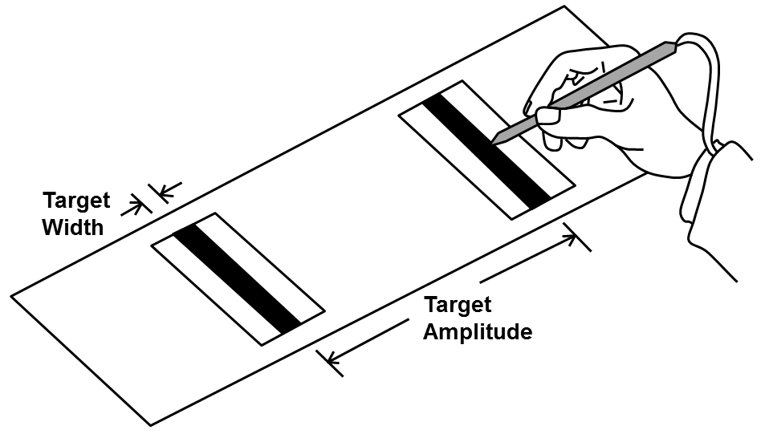
Fitts’ Law
[Fitts, 1954]
Time to select target
http://www.yorku.ca/mack/hci1992-f1.jpg

Slide 7
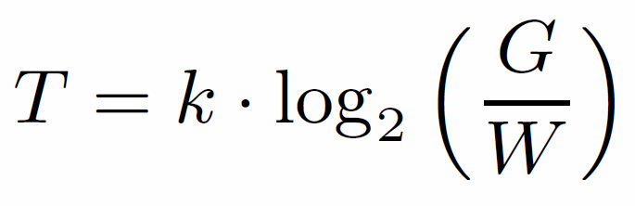
Fitts’ Law
[Fitts, 1954]
Time to select target

Slide 8
Fitts’ Law
[Fitts, 1954]
Gap distance
Width
Time to select target
Constant (determined empirically)
Index of difficulty
Robust under many conditions: limbs (hands, feet, lips, head-mounted sight, eye gaze), input devices (mouse, stylus), environments (e.g., underwater), and users (young, old, special needs, impaired).

Slide 9
Limitations of Fitts’ Law
One dimension → 2 dimensions
  Change “effective width”
  Target shape mostly irrelevant
Stationary target → moving target
  Add speed to index of difficulty
  Time linear or exponential with speed
No added delay → transmission delay
  Time linear with delay
Missing? → 2d, moving target, with delay
Problem statement: Measure and model the effects of delay on moving target selection with a mouse
[MacKenzie, 1992]
[Jacacinski, 1980]
[Hoffman, 1991]
[Hoffman, 2012]
[Brady, 2015]

Slide 10
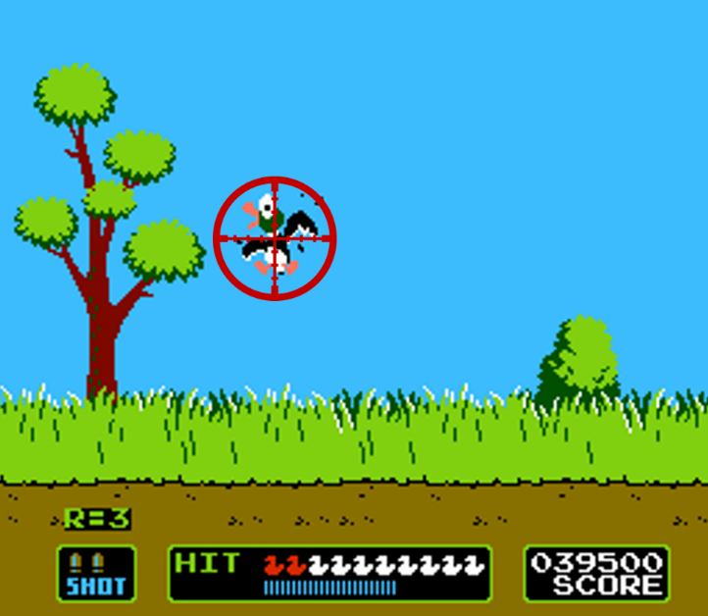
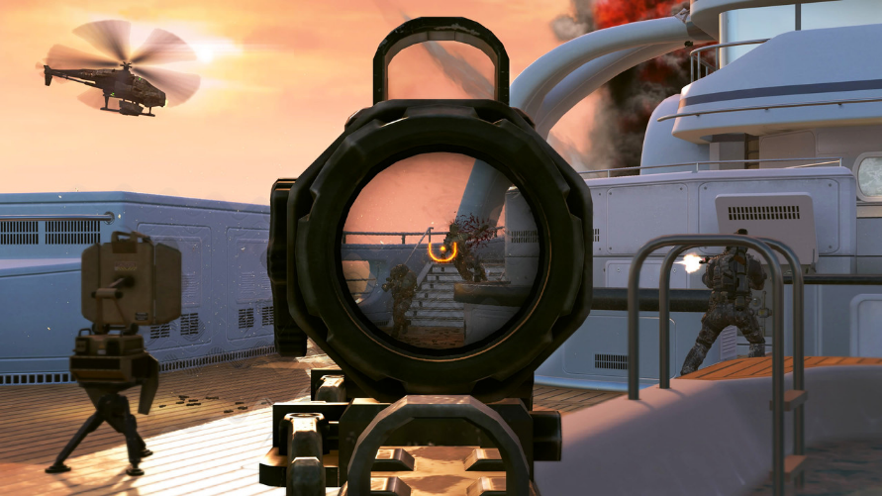
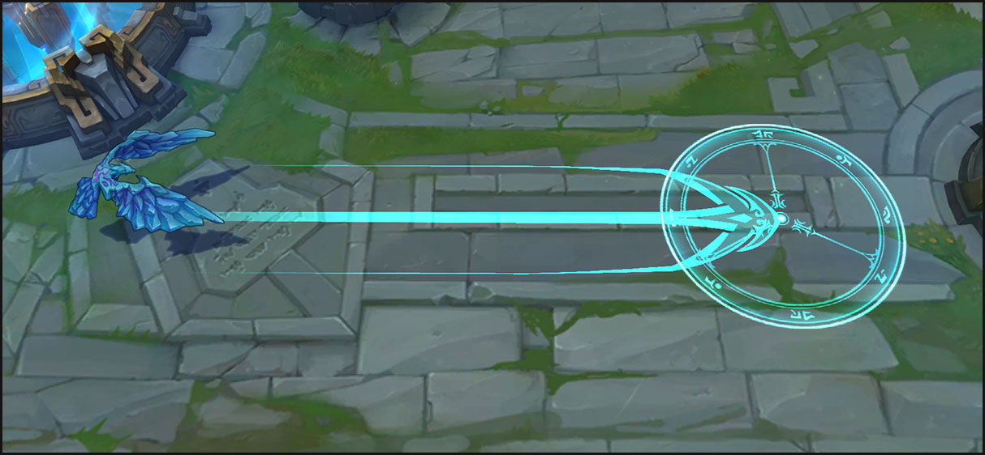
Why Moving Target Selection with Mouse?
[Call of Duty, Activision, 2003]
[Duck Hunt, Nintendo, 1984]
[League of Legends, Riot Games, 2009]

Slide 11
Outline
Introduction (done)
Methodology (next)
Results
Conclusion

Slide 12
Methodology
Develop game
  Focus player action on target selection
  Enables controlled delay
Conduct user study
Analyze results
  Graphs
  Model

Slide 13
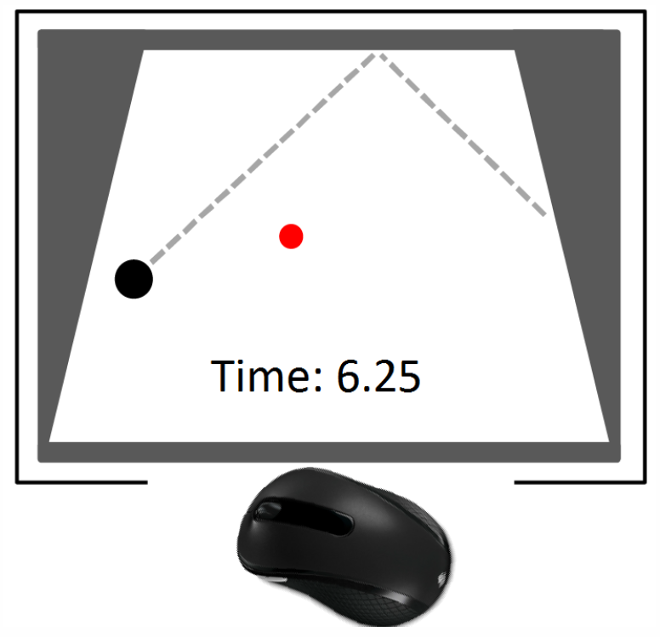
Puck Hunt
The Game of Moving Target Selection
Time to select puck with mouse

Slide 14
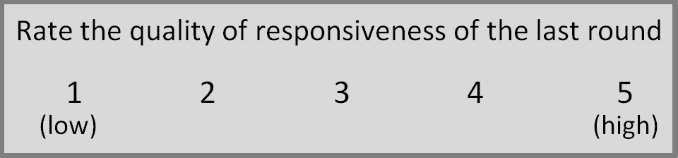
Puck Hunt
The Game of Moving Target Selection
Time to select puck with mouse
5 iterations
1 QoE for each combo

Slide 15
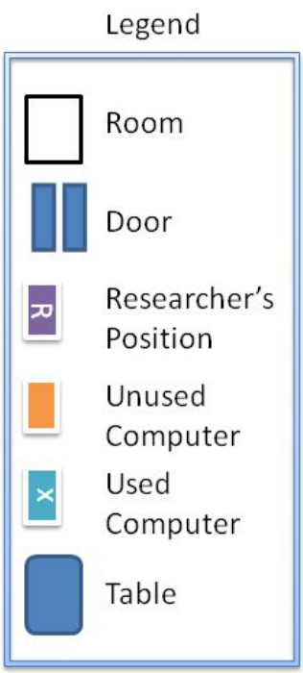
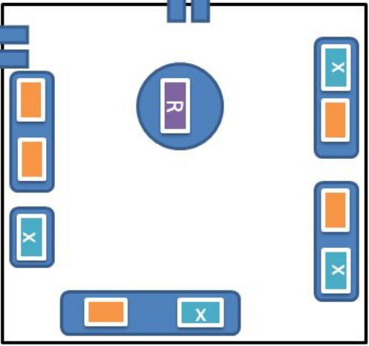
Testing Lab
Window-less computer lab, fluorescent lilghting
Computers: PCs, i7 GHz, 4 GB graphics, 16 GB RAM
Monitors: 24” LCD, 1920x1200
Users via email, participant pool and $25 raffle for gift card

Slide 16
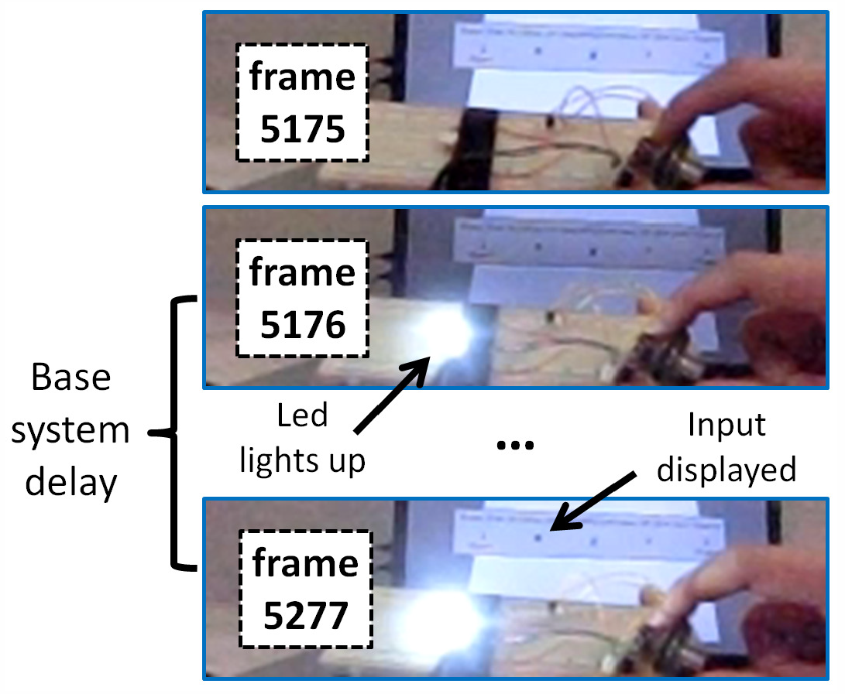
Measuring Base (Local) Delay
Base system delay shown to be significant
[Raaen, 2015]

Slide 17
Measuring Base (Local) Delay
Base system delay shown to be significant
Our system: 100 milliseconds base delay
  Added to all analysis
[Raaen, 2015]

Slide 18
Outline
Introduction (done)
Methodology (done)
Results (next)
  Selection time measurement
  Selection time model
  Additional analysis
  Comparison with other games
Conclusion

Slide 19
Results
32 users
Ages 18-26 (mean 21 years)
23 Male, 8 female, 1 unspecified
Mean self-rating (1-5) as gamer is 3.6
Play 6+ hours of games per week

Slide 20
Selection Time versus Delay – Measurement
Exponential with delay
Low delays, speed doesn’t matter
High delays, speed makes it even harder

Slide 21
Selection Time versus Speed – Measurement
Mostly linear with speed
Somewhat non-linear at high delay

Slide 22
Selection Time versus Delay – Model
Time to select target
Exponential with delay
Exponential with speed
speed-delay interaction term

Slide 23
Selection Time versus Delay – Model
R² 0.97
F-stat 328
p < 2.2 × 10⁻¹⁶

Slide 24
Selection Time versus Delay – By Skill
Delay effects all skill levels
Low skill most impacted, high skill least impacted

Slide 25
Mouse Clicks versus Delay
Users “miss” more at high speeds
May want combined model for gamer performance

Slide 26
Comparison with Commercial Games
[Beigbeder, 2004]
Trends for Puck Hunt similar
Suggests results hold for other games

Slide 27
Comparison with Commercial Games
[Claypool, 2006]
Most closely follows first-person avatar perspective model
Similar to cloud games
[Claypool, 2015]

Slide 28
Quality of Experience
Linear/logarithmic decrease
Independent of speed

Slide 29
Discussion
Hoffman [5] suggests target selection time linear with delay
  Our curvature suggests exponential
  His covers broader range, “stop and wait”
Jagacinski [18] suggests target selection time linearly with speed, Hoffman [19] suggests exponential
  Both right. Low delay linear, high delay exponential
Brady [13] QoE decreases with delay
  Our results confirm
Our model constants hold for target size (100 px), screen resolution (1920x1080)
  Other settings have other constants
Cloud games delay mouse and click (as in Puck Hunt), but traditional games delay only click

Slide 30
Conclusion
Need to better understand delay on game actions/input
  Latency compensation and game design that is resilient to delay
We measure and model target selection with a delayed mouse
Game and user study (30+) with delays from 100-500 ms and 3 target speeds

Slide 31
Conclusion
Need to better understand delay on game actions/input
  Latency compensation and game design that is resilient to delay
We measure and model target selection with a delayed mouse
Game and user study (30+) with delays from 100-500 ms and 3 target speeds
Increase in selection time even for low delays (under 200 ms)
Sharp increase in selection time for higher delays (300+ ms)
Even sharper increase in selection time for fast targets (450 px/s)
QoE sensitive to even slight delays (100 ms)
Model with exponential terms for speed, delay and combined term fits well

Slide 32
Future Work
Other model components (e.g., player skill)
Other perspectives (e.g., first person)
Other game actions (e.g., avatar movement )
Other input (e.g., thumbstick, buttons)

Slide 33



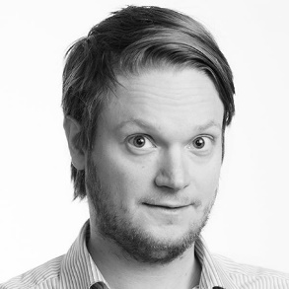
Acknowledgements
Marco Duran and Matthew Thompson
  Measuring base delay
  Conducting user study
Ragnhild Eg and Kjetil Raaen
  Initial Puck Hunt version
  Experimental design

Slide 34
On Models for Game Input with Delay – Moving Target Selection with a Mouse
Mark Claypool
In Proceedings of the IEEE International Symposium on Multimedia (ISM), Invited Paper, San Jose, California, USA, December 11-13, 2016
Notes:
Mark Claypool. On Models for Game Input with Delay - Moving Target Selection with a Mouse, In Proceedings of the IEEE International Symposium on Multimedia (ISM), (Invited Paper), San Jose, California, USA, December 11-13, 2016. Online at: http://www.cs.wpi.edu/~claypool/papers/delay-action-ism/

