Slide 1



Game Input with Delay – Moving Target Selection Parameters
Mark Claypool
Worcester Polytechnic Institute
Andy Cockburn
University of Canterbury
Carl Gutwin
University of Saskatchewan
Notes:
Mark Claypool, Andy Cockburn and Carl Gutwin. Game Input with Delay - Moving Target Selection Parameters, In Proceedings of the 10th ACM Multimedia Systems Conference, Amherst, MA, USA, June 18-21, 2019. Online at: http://www.cs.wpi.edu/~claypool/papers/delay-motion/

Slide 2
Introduction
Real-time games sensitive to delay
  Even 10s of milliseconds of delay impacts player performance and quality of experience (QoE)
Mitigate with delay compensation (e.g., time warp, player prediction, dead reckoning …)
  But when to apply (what player actions)?
  And how effective?
Need research to better understand effects of delay on games
[Claypool, 2006]
[Bernier, 2001]

Slide 3
Introduction
Real-time games sensitive to delay
  Even 10s of milliseconds of delay impacts player performance and quality of experience (QoE)
Mitigate with delay compensation (e.g., time warp, player prediction, geometric scaling, dead reckoning …)
  But how effective?
  And when needed (what player actions)?
Need research to better understand effects of delay on games
[Claypool, 2006]
[Bernier, 2001]

Slide 4
Introduction
Real-time games sensitive to delay
  Even 10s of milliseconds of delay impacts player performance and quality of experience (QoE)
Mitigate with delay compensation (e.g., time warp, player prediction, geometric scaling, dead reckoning …)
  But how effective?
  And when needed (what games/player actions)?
Need research to better understand effects of delay on games
[Claypool, 2006]
[Bernier, 2001]

Slide 5
Research in Games and Delay
Effect of delay on games?

Slide 6
Research in Games and Delay
[Pantel, 2002]
Game Genres
[Armitage, 2003]
[Beigbeder, 2004]
UT
Warcraft
EverQuest
[Nichols, 2004]
Research
[Quax, 2004]
Quake
[Claypool, 2005]
Effect of delay on games?
[Amin, 2013]
[Chen, 2014]
[Fritsch, 2005]
[Ivkovic, 2017]

Slide 7
Research in Games and Delay
Game Genres
UT
Warcraft
EverQuest
[Fitts, 1954]
Research
[MacKenzie, 1992]
Quake
[Hajri, 2011]
Effect of delay on games?
[Raeen, 2011]
[Hoffman, 2012]
[Pavlovych, 2012]
[Raaen, 2015]
Target Selection
[Fitts’ Law]
2D
Target
Selection
Moving Target Selection
Research
[Claypool, 2017]
[Long, 2018]
Game Input

Slide 8
Research in Games and Delay
Game Genres
UT
Warcraft
EverQuest
[Fitts, 1954]
Research
[MacKenzie, 1992]
Quake
[Hajri, 2011]
Effect of delay on games?
[Raeen, 2011]
[Hoffman, 2012]
[Pavlovych, 2012]
[Raeen, 2015]
Target Selection
[Fitts’ Law]
2D
Target
Selection
Moving Target Selection
Research
[Claypool, 2017]
[Long, 2018]
Game Input

Slide 9
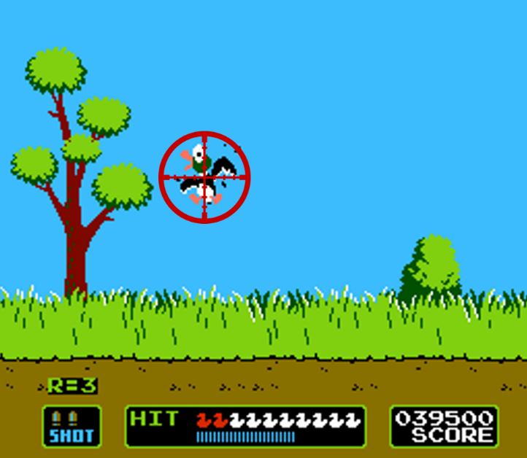
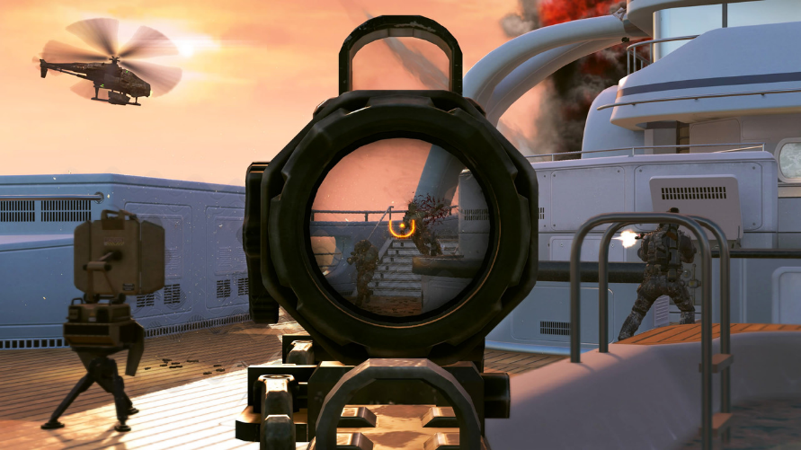
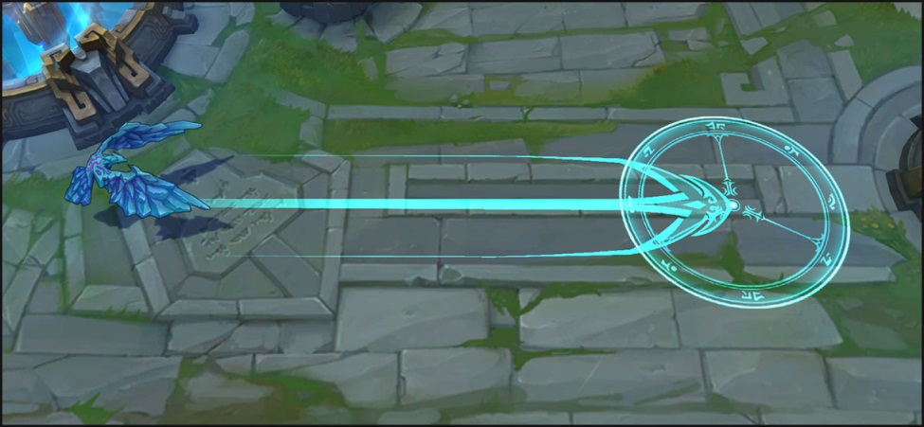
Why Moving Target Selection?
[Call of Duty, Activision, 2003]
[Duck Hunt, Nintendo, 1984]
[League of Legends, Riot Games, 2009]

Slide 10
Moving Target Selection with Delay
Target Motion
Lissajous curve
mouse
[GI’12]
constant velocity mouse
[MMM’17]
constant velocity
thumbstick
[TOMM’18]
constant velocity
Kinect
[TR’19]
stationary
stylus
[Fitts’ ‘54]
stationary
mouse
[MacKenzie ‘93]
Input Type

Slide 11
Moving Target Selection with Delay
Next? → complex motion
Problem statement: Measure effects of delay on moving target selection, where targets move with complex motion
complex motion
mouse
[MMSys’19]
Target Motion
Lissajous curve
mouse
[GI’12]
constant velocity mouse
[MMM’17]
constant velocity
thumbstick
[TOMM’18]
constant velocity
Kinect
[TR’19]
stationary
stylus
[Fitts’ ‘54]
stationary
mouse
[MacKenzie ‘93]
Input Type

Slide 12
Moving Target Selection with Delay
force-based movement
- mass, directional force
- turns (change direction)
time between turns
angle between turns
v
a
complex motion
mouse
[MMSys’19]
realistic motion
mouse
[MMSys’19]
Target Motion
Lissajous curve
mouse
[GI’12]
constant velocity mouse
[MMM’17]
constant velocity
thumbstick
[TOMM’18]
constant velocity
Kinect
[TR’19]
stationary
stylus
[Fitts’ ‘54]
stationary
mouse
[MacKenzie ‘93]
Input Type

Slide 13
Moving Target Selection with Delay
force-based movement
- mass, directional force
- turns (change direction)
time between turns
angle between turns
v
v
a
a
complex motion
mouse
[MMSys’19]
time
Lissajous curve
mouse
[GI’12]
a₁
Target Motion
a₂
angle
constant velocity mouse
[MMM’17]
constant velocity
thumbstick
[TOMM’18]
constant velocity
Kinect
[TR’19]
stationary
stylus
[Fitts’ ‘54]
stationary
mouse
[MacKenzie ‘93]
Input Type

Slide 14
Outline
Introduction (done)
Methodology (next)
Results
Conclusion

Slide 15

Methodology
Develop game
  Focus player action on selecting moving target
  Parameterize: turn frequency, turn angle
  Control added delay
Conduct user study
Analyze results
  Graphs, statistics
  (Model is future work)
Disseminate (MMSys 😉)

Slide 16
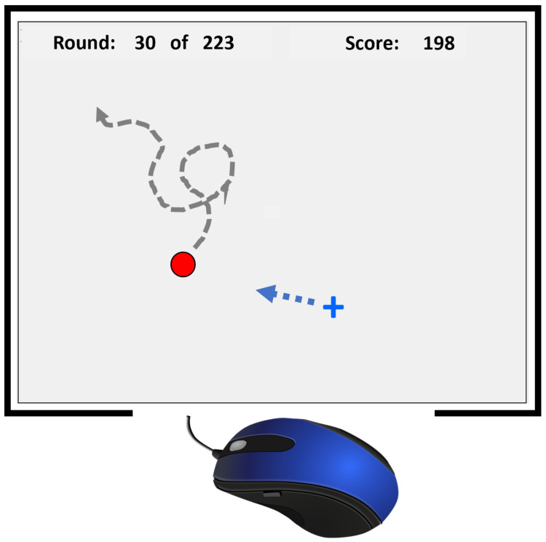
Juke!
The Game of Selecting a Dodging Target
Mouse starts in center
Target starts random, but near center
Target moves until:
  Mouse clicked
  Target off screen
Click the target as quickly and accurately as possible. Then repeat!

Slide 17
Juke!
The Game of Selecting a Dodging Target
Listing 1:
Force-based
Target Motion
vel += acceleration
if vel.speed > max then
scale(vel)
location += vel
if elapsed > interval then
direction += rand(angle)
acceleration.dir = direc
1
2
3
4

Slide 18
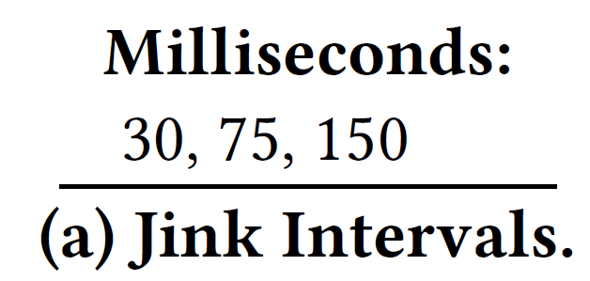
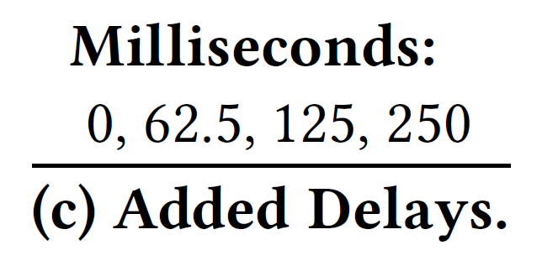
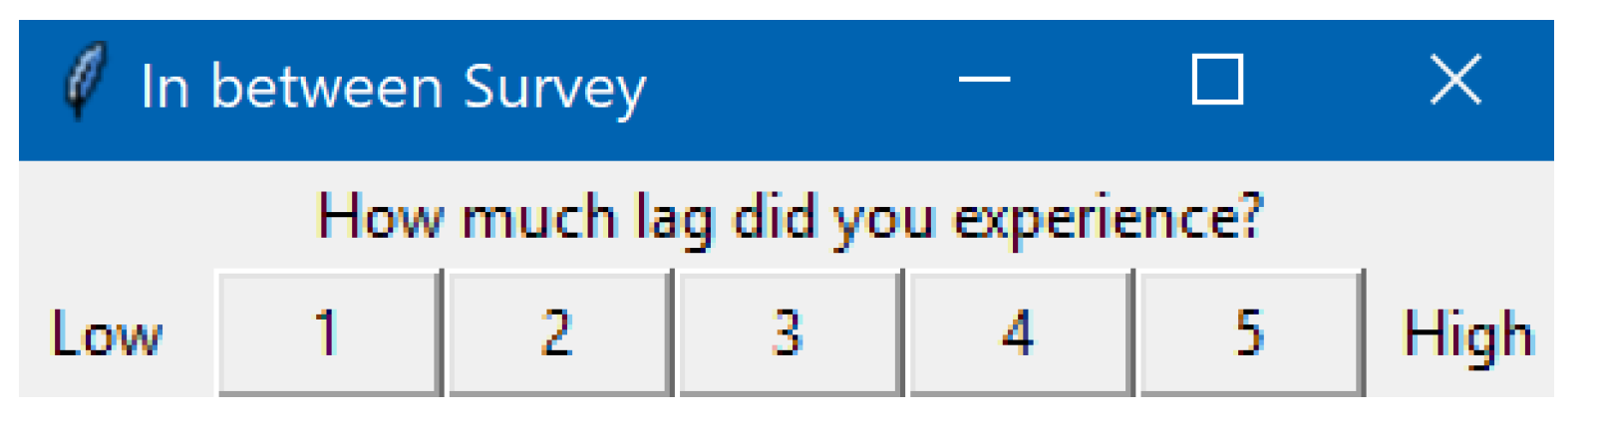
Juke!
The Game of Selecting a Dodging Target
Time to select target
Distance from target
5 iterations each
1 QoE for each combo
(+50 milliseconds base delay)

Slide 19
User Study
56 users
Ages 17-26 (mean and median 20 years)
40 male, 16 female
52 Right-handed, 3 Left-handed, 1 Ambi
Mean self-rating (1-5) as gamer is 3.5
Half play 6+ hours of games per week
Robotics, CS and Game Dev majors

Slide 20
Outline
Introduction (done)
Methodology (done)
Results (next)
  Player performance
    Angle
    Interval
    Skill
  Comparison with other studies
  QoE (in paper)
Conclusion

Slide 21
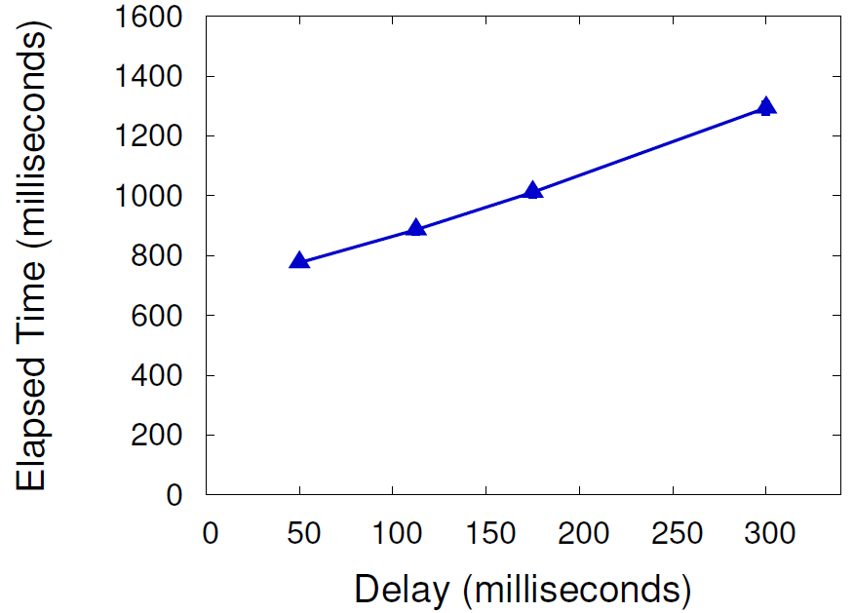
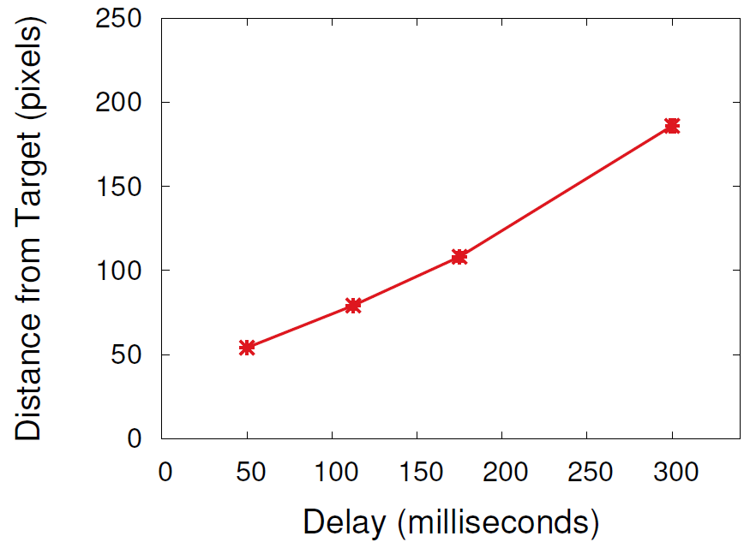
Player Performance – Mean
(Distributions in paper)
Both Time and Distance increase with Delay
Time 2x, Distance 4x
Relationship linear

Slide 22
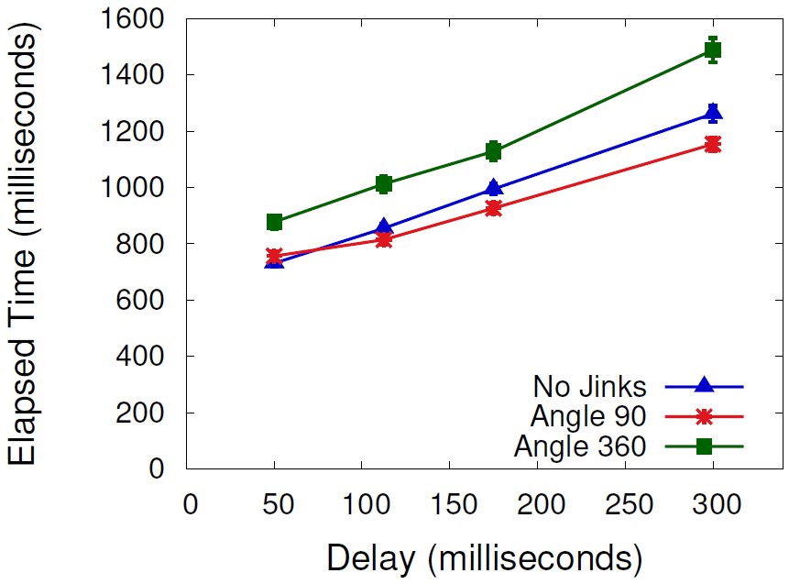
Player Performance – Angle
Large angle → More Time, but further Distance
Small angle → Less Time, but shorter Distance

Slide 23
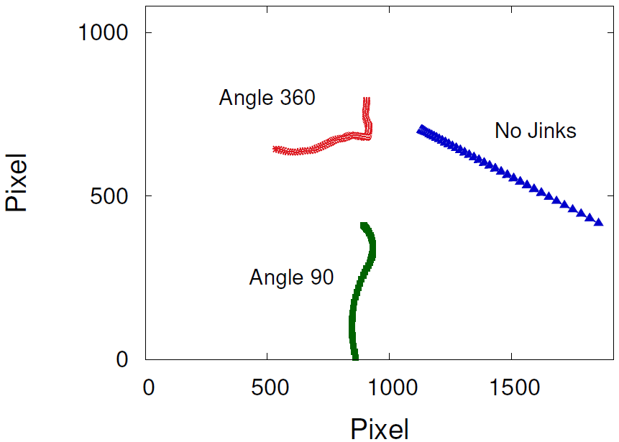
Target Movement – Angle

Slide 24
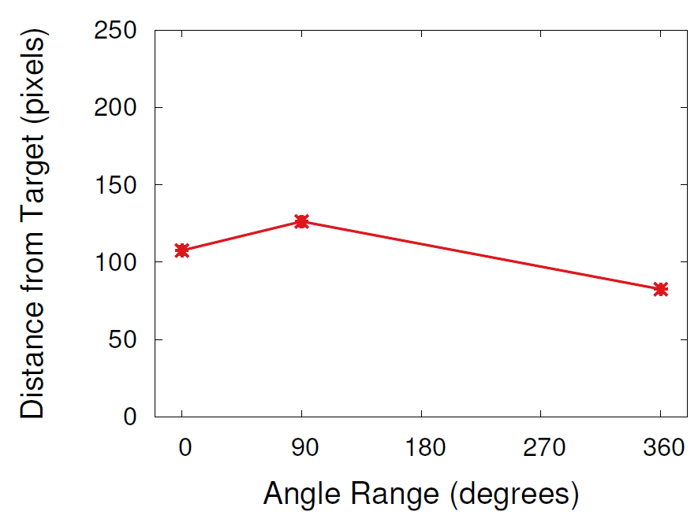
Player Performance – Angle
Large angle → More Time, but further Distance
Small angle → Less Time, but shorter Distance

Slide 25
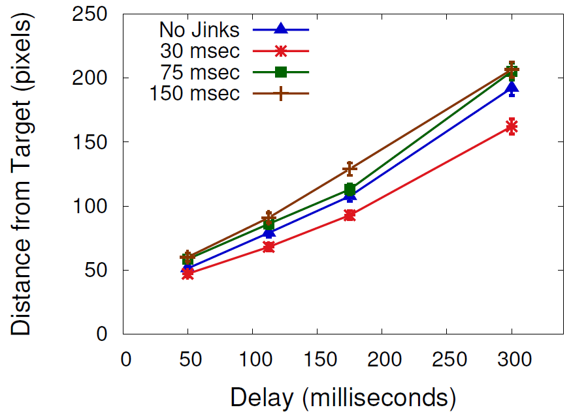
Player Performance – Interval
More turns → More Time, but closer Distance
Fewer turns → Less Time, but further Distance

Slide 26
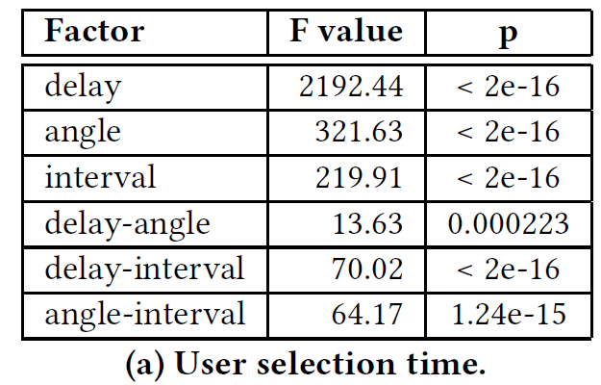
3-Factor ANOVA – delay, angle, interval
Both Time and Distance (accuracy):
significant main effects on delay, jink angle and jink interval
significant interaction effects for delay-angle, and delay-interval
interaction effect of delay-angle-interval not significant
Time only:
significant interaction effect for angle-interval

Slide 27
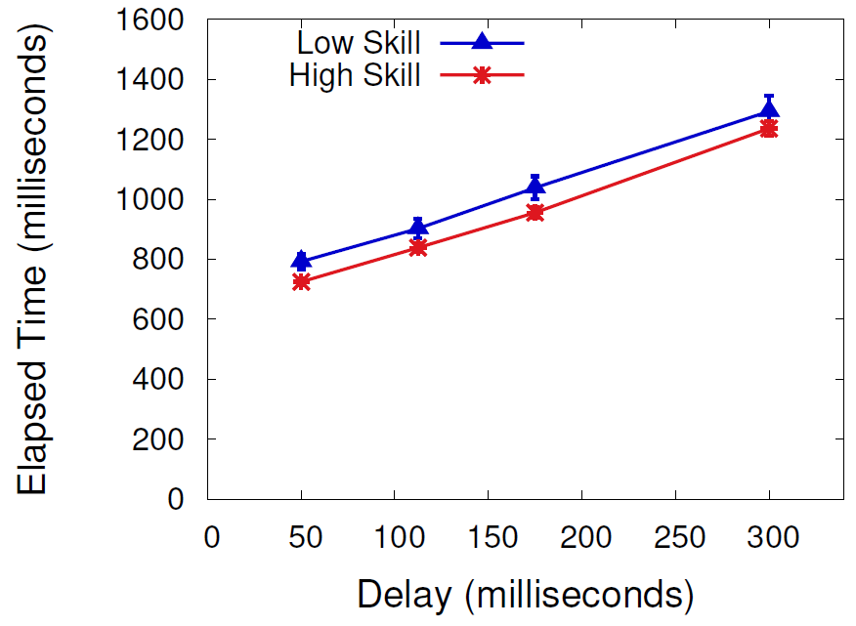
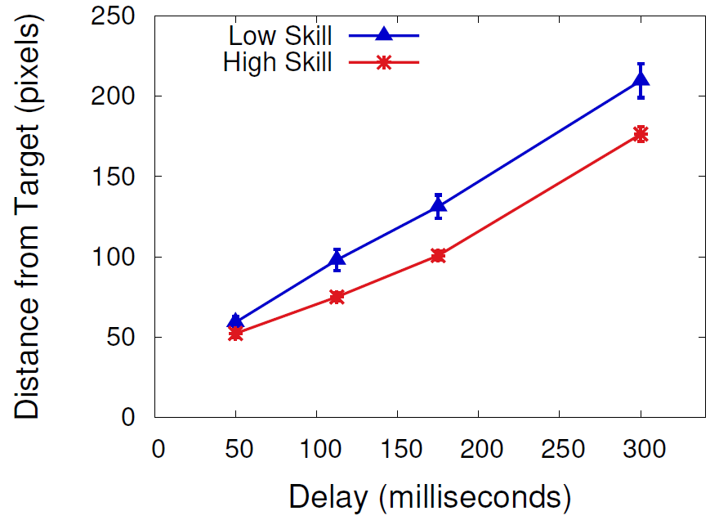
Player Performance – Skill
Delay affects all skill levels
Time for both skills impact similarly
Distance impacted more for low skill than high skill

Slide 28
Force-based versus Constant Velocity
[11]
[22]
All three games similar trends
Pong and PuckHunt show flat region on left, steep on right
Juke! has linear decrease in performance

Slide 29
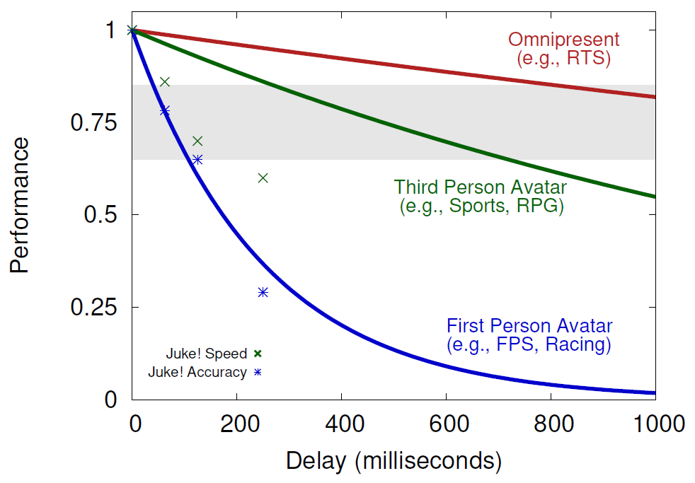
Juke! vs. traditional Network Games
Juke! Time (speed) and Distance (accuracy) most closely follow first person avatar perspective model

Slide 30
Conclusion
Need to better understand delay on game actions/input
  Delay compensation and game design that is resilient to delay
We measure target selection with delay, where targets move: jink interval, jink angle
Game and user study (50+ users) with delays from 50-300 ms, 3 angles and 4 intervals
Increase in selection time even for low delays (under 200 ms)
Sharp increase in selection time for higher delays (300+ ms)
Even sharper increase in selection time for fast targets (450 px/s)
QoE sensitive to even slight delays (100 ms)
Model with exponential terms for speed, delay and combined term fits well

Slide 31
Conclusion
Need to better understand delay on game actions/input
  Delay compensation and game design that is resilient to delay
We measure target selection with delay, where targets move: jink interval, jink angle
Game and user study (50+ users) with delays from 50-300 ms, 3 angles and 4 intervals
Increase in selection time even for low delays (under 200 ms)
Sharp increase in selection time for higher delays (300+ ms)
Even sharper increase in selection time for fast targets (450 px/s)
QoE sensitive to even slight delays (100 ms)
Model with exponential terms for speed, delay and combined term fits well
Time and Distance impacted by Delays tested (50-300 milliseconds)
  2x-4x impact
Angle and Interval have less effect on Distance than on Time
Skilled 25% less affected by Delay than unskilled
Similar trends to constant-velocity games, but even small delays have impact
Juke! similar to first-person avatar games

Slide 32
Future Work
Broader range for angle and interval
Broader range of forces (movement)
Model (e.g., like Fitts’)
Other game actions (e.g., avatar movement, steering)

Slide 33

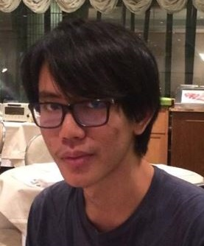

Acknowledgements
Chaiwat Ekkaewnumchai and Bhon Bunnag
  Developing Juke!
  Conducting user study
Users
  Participating

Slide 34
Game Input with Delay – Moving Target Selection Parameters
Mark Claypool
Worcester Polytechnic Institute
Andy Cockburn
University of Canterbury
Carl Gutwin
University of Saskatchewan
Notes:
Mark Claypool, Andy Cockburn and Carl Gutwin. Game Input with Delay - Moving Target Selection Parameters, In Proceedings of the 10th ACM Multimedia Systems Conference, Amherst, MA, USA, June 18-21, 2019. Online at: http://www.cs.wpi.edu/~claypool/papers/delay-motion/

Slide 35
Extra Slides

Slide 36
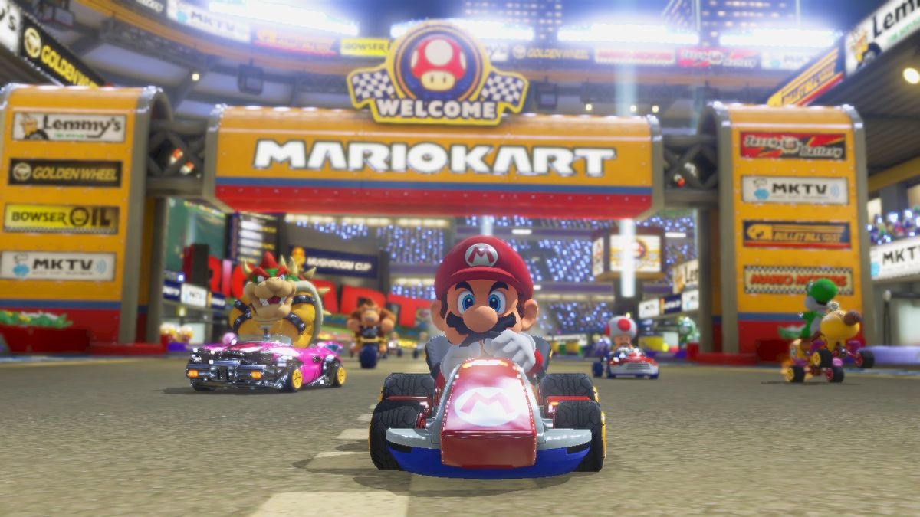

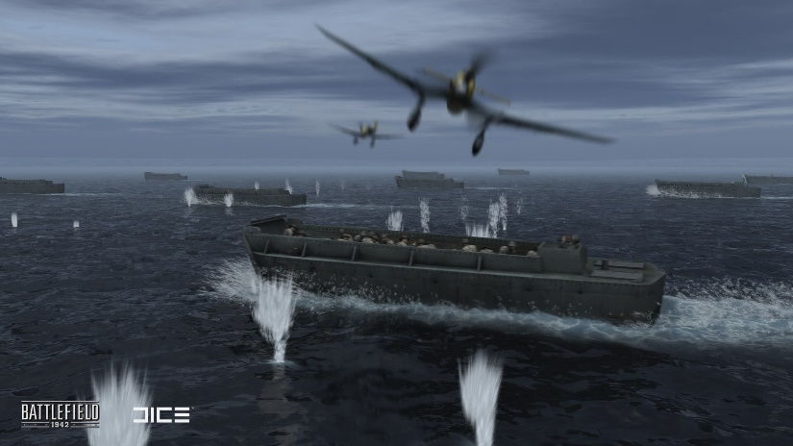
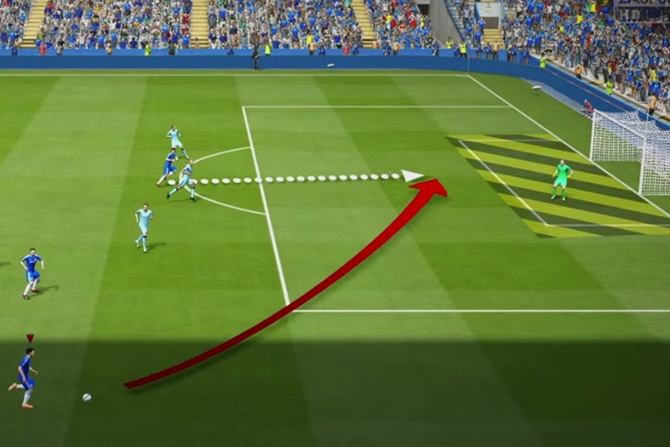
Complex Motion?
[Mario Kart 8, Nintendo, 2014]
[Madden NFL, EA, 2016]
[Battlefield 1942, EA, 2002]
[FIFA, EA, 2016]

Slide 37
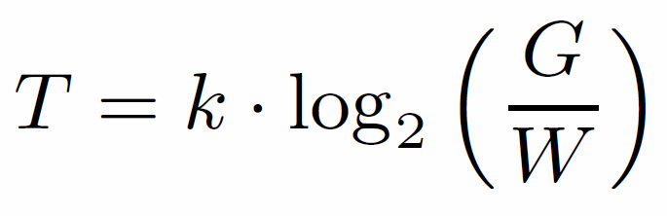
Target Selection – Fitts’ Law
[Fitts, 1954]
Gap distance
Width
Time to select target
Constant (determined empirically)
Index of difficulty
Robust under many conditions: limbs (hands, feet, lips, head-mounted sight, eye gaze), input devices (mouse, stylus), environments (e.g., underwater), and users (young, old, special needs, impaired)

Slide 38
Extensions to Fitts’ Law
One dimension → 2 dimensions
  Time proportional to area (“effective width”)
  Target shape mostly irrelevant
No added delay → transmission delay
  Time linear with delay
Stationary target → moving target
  Add speed to index of difficulty
  Time linear or exponential with speed
Missing? → delay and moving target selection
→ Fitts-type law for game actions!
[MacKenzie, 1992]
[Hoffman, 1992]
[MacKenzie, 1993]
[Jacacinski, 1980]
[Hoffman, 1991]
[Hajri, 2011]

Slide 39
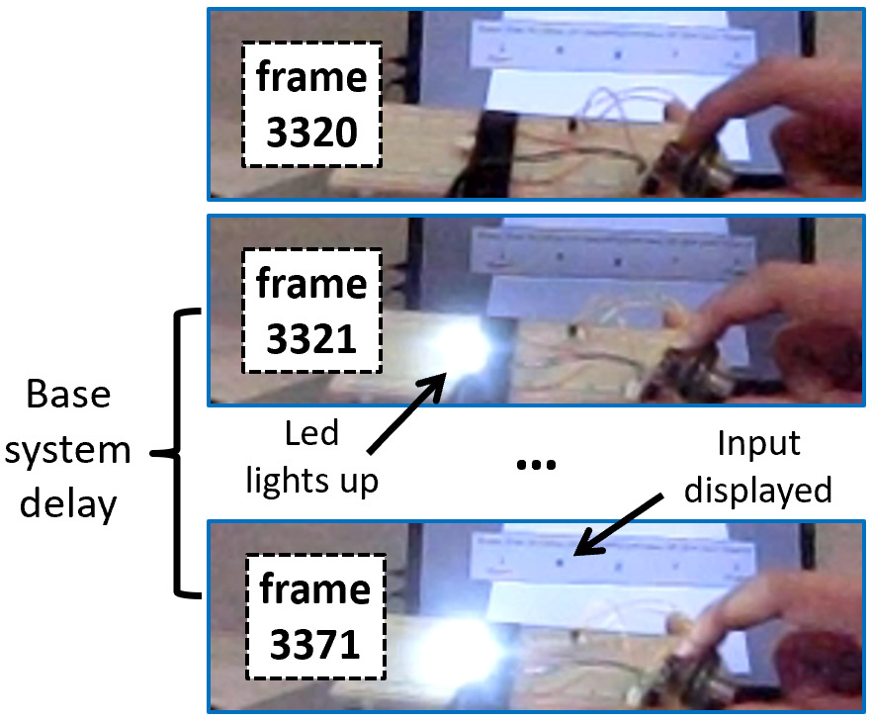
Measuring Base Delay
[Raaen, 2015]
"Blur Busters"
Measurements: 50, 49, 52, 53 and 48 milliseconds
→ 50 milliseconds of base delay

Slide 40
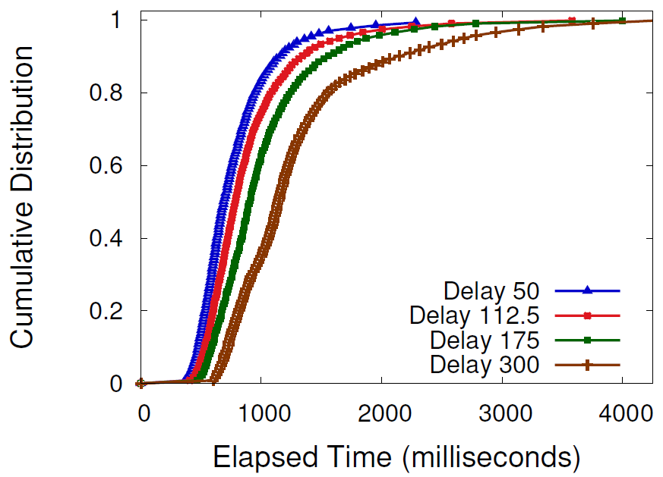
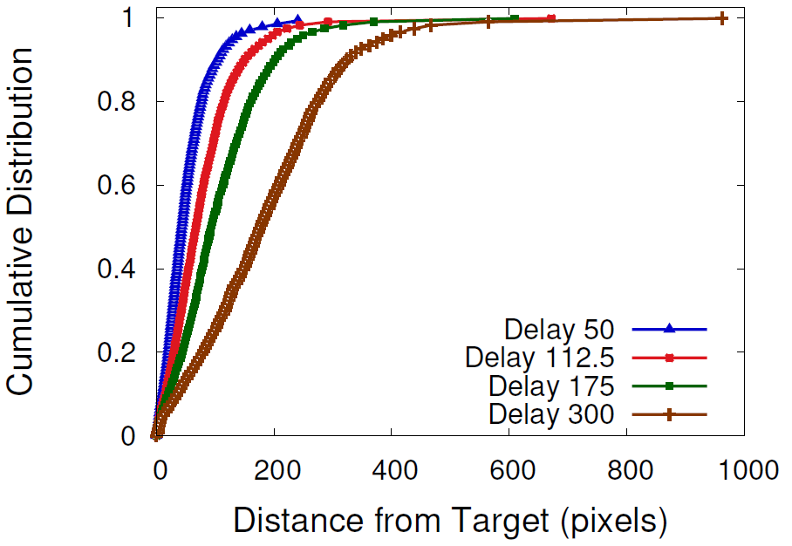
Player Performance – Distribution
Elapsed Time and Distance distributions increase with delay

Slide 41
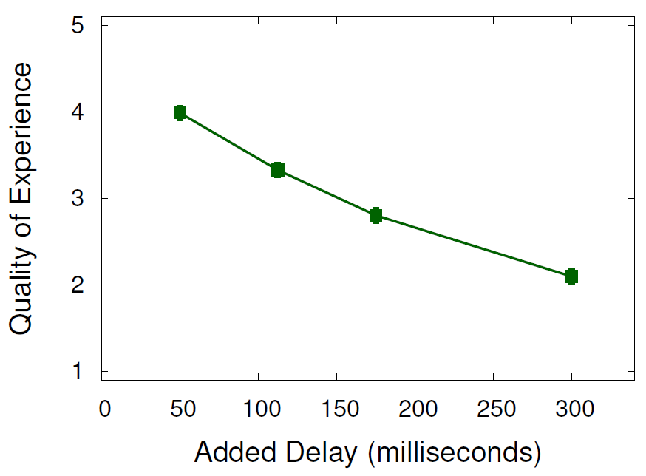
Quality of Experience
Linear/logarithmic decrease with delay

