Slide 1
TCP CUBIC versus BBR on the Highway
Feng Li, Jae Chung, Xiaoxiao Jiang and Mark Claypool
3/27/2018
Notes:
Default cover design.

Slide 2
Background

Slide 3
LTE Network Performance Challenges
TCP is the major traffic source in the market.
Most TCP flows use AIMD-on-loss Congestion Control Algorithms (CCA).
AIMD-on-loss CCA is not LTE friendly.
Packet loss is not a good congestion indicator in LTE (bit errors and hand-off)
AIMD not quickly adapt to available bandwidth change in LTE environment.
Often induce large queuing delays at eNodeB
Radio Access Network (RAN) performance challenges include:
Suboptimal radio link utilization efficiency due to smaller Tx block scheduling
User-perceived RAN performance degradation.

Slide 4
Performance Enhanced Proxy (PEP)
Transparent TCP Proxy as an attractive RAN performance enhancement option
Transparently terminates an end-to-end TCP connection to two halves.
Downlink performance enhancement by buffering L4 packets/data from servers and control transmission rate on the mobile side.
RAN-friendly CCA on the mobile side to achieve:
Fast small object download time
Maximize goodput for large object transfers
Maintain low self-inflicted RTT

Slide 5
Understanding TCP CCA Performance on LTE
No winner TCP Congestion Control Algorithm (CCA) for LTE
Not very impressive LTE performance by existing CCAs
E.g., CUBIC, Westwood+ and etc. suffer from low link utilization
Experimental TCP for wireless links implemented as UDP tunnels
E.g., TCP Sprout, TCP Verus, PCC does not yet support TCP.
LTE performance NOT evaluated for new CCAs designed for data centers
E.g., BBR, NV and DCTCP.
Less Knowledge on CCAs’ Performance on High Mobility
No real measurement studies on High-Speed driving on LTE.
No measurement studies to compare different CCAs performance.
Difficult to model or simulate RF condition on highway.

Slide 6
Evaluation

Slide 7
Outline
Methodology
Radio Network Characteristics
Compare CCAs’ Performance
Discussions
Conclusion

Slide 8
Congestion Control Algorithms Compared
BBR (Bottleneck Bandwidth and Round trip propagation time).
Developed by Google, originally for server to server communication.
BBR was released with 4.8-rc6 kernel
CUBICs
The current default CCA in Linux
Two servers running 4.8-rc6 and 3.19 kernels.
CUBIC in 4.8 introduces a patch to keep cwnd growth to cubic curve after “application limited” long idle time (bictcp_cwnd_event()).

Slide 9
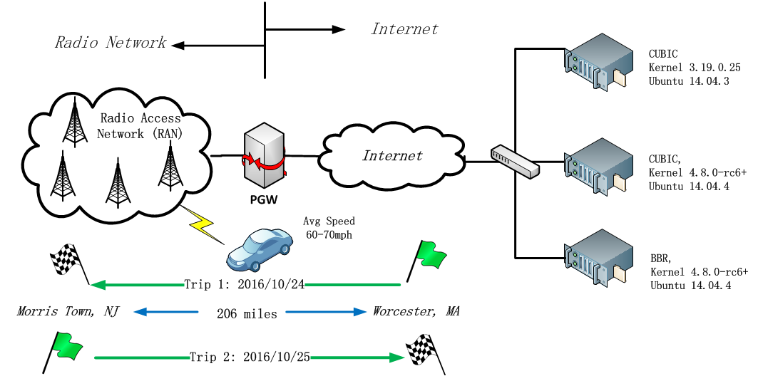
Experimental Setup

Slide 10
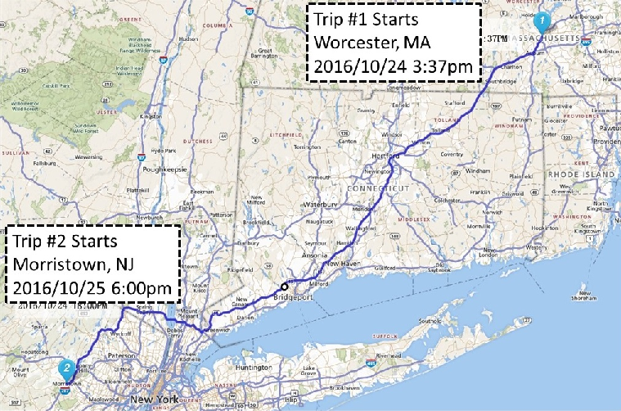
Driving Route
Date:
2016/10/24 and 2016/10/25
End Points
Worcester, MA
Morris Town, NJ
Distance
410 miles+ round trip,
Data Volume
15.0+ GB traffic as 720 20MB file downloading in 6 hours.
some “large scale” research only collect 90GB traffic in 8 months.

Slide 11
Measurement Tools Used
Commercial Tool (Qualipoc) on smart phone (LG G2 VS980)
Ping tool to measure propagation round trip time between server and phone.
Throughput measurement tool.
Physical and Link Layer statistics collected from device drivers.
Four HP Proliant 460c Gen9 blade Servers
All run with Ubuntu 14.04: two with 4.8.0-rc6 kernel, and two with 3.19.0.25 kernel.
Same kernel settings and Ethernet (NIC) settings, except default congestion control algorithm.
Apache 2.4.7 Web server with PHP 5.0, dynamically generating file to avoid caching.
Tcpdump running as a service in background,
Dedicated performance study servers, light load (< 1% CPU usage).

Slide 12
700MHz Radio Spectrum
700MHz (Band XIII)
Verizon provide 700MHz and 1700/1900MHz (AWS) radio spectrum.
AWS only provide extra capacity in urban area.
None of US carrier provides national wide AWS coverage.
Lock phone on 700MHz spectrum.
Lost GPS location and velocity in test, could only estimate average speed through checkpoints.
Efforts to Reduce Random Variables
Same route, Same Driver, Same Car
Identical Servers, except default congestion control algorithm.
Band XIII Radio Spectrum
Metric | Value
Band Number | Band XIII (13)
UP Link Freq. | 777-787 MHz
Down Link Freq. | 746-750 MHz
Channel Width | 10MHz
Modulation | QPSK, 16QAM, 64QAM
Theoretic TCP Throughput | 45 – 50 Mbps (maximum)

Slide 13
Outline
Methodology
Radio Network Characteristics
Compare CCAs’ Performance
Discussions
Conclusion

Slide 14
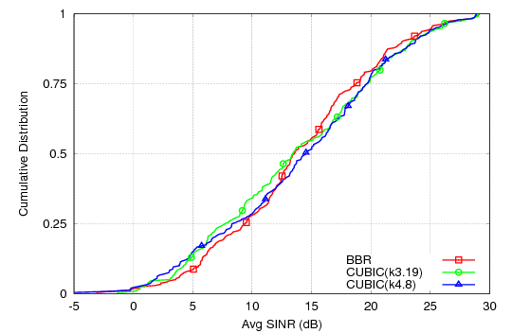
Radio Condition (SINR) on Highway
All 3 CCAs experience similar RF condition.
SINRs are distributed almost evenly.

Slide 15
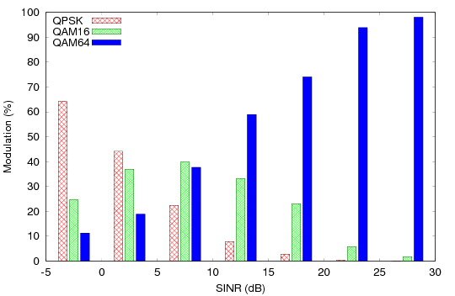
Modulation / Rate Adaption
Fig. Modulation on Highway
Theoretical Max PHY Throughput | 10MHz
QPSK | 17 Mbps
16QAM | 25 Mbps
64QAM | 50 Mbps
Modulation/Rate Adaption changes would impact bandwidth estimation algorithm, for example BBR.
Rate drop suddenly increase the RLP queuing layer delay that cause eNodeB AQM drops.

Slide 16
Outline
Methodology
Radio Network Characteristics
Compare CCAs’ Performance
Discussions
Conclusion

Slide 17
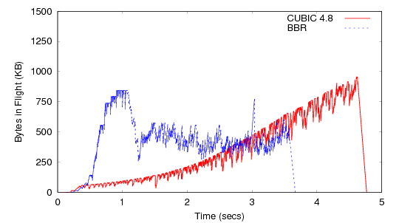
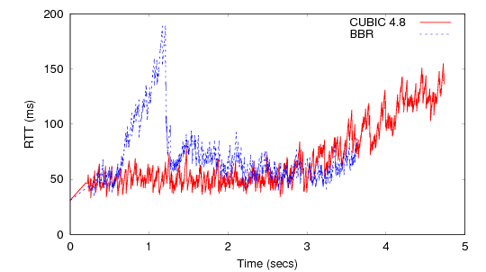
Case Study: Single BBR and CUBIC (k4.8) Flow Comparison
Bytes in Flight
RTT
BBR transmits aggressively during its initial probing phase
After probing phase, BBR maintains an RTT under 80ms.
CUBIC exits from slow start early with a small congestion window.
CUBIC unlikely fully utilize the radio link resources for the duration.

Slide 18
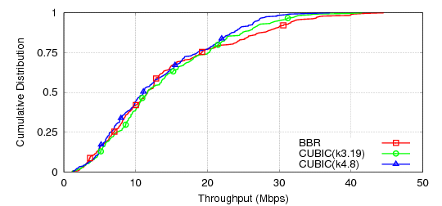
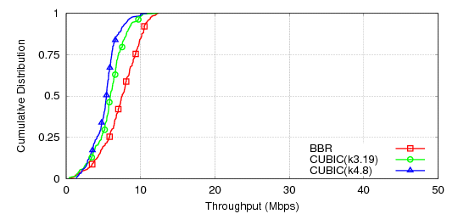
Compare Throughputs of CCAs on Highway
20 MB file Download
1 MB file Download
Table Overall Throughputs
All three CCAs achieve similar throughput distribution.
BBR achieves the highest throughput as 44 Mbps, close to theoretical maximum download throughput on a 10Mhz channel.
In first 1MB downloading, BBR’s probing phase results in higher throughput.
CCAs | Mean | Median
BBR | 14.1 ± 9.5 | 11.6
CUBIC(k3.19) | 14.0 ± 8.4 | 11.6
CUBIC(k4.8) | 13.0 ± 7.8 | 11.1

Slide 19
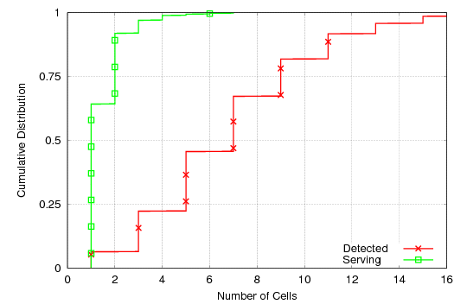
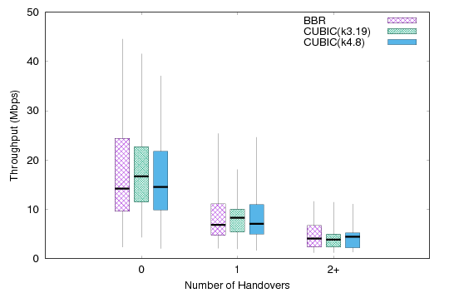
Hand-over Between eNodeBs
Cell Sector Distributions
TCP Throughput vs. Handovers
Hand-over are not as frequent as we throughput, 65%+ does not have handovers.
700MHz eNB serves a large area (up to 4000 meters in radius), and car speed is only 30 m/s.
Flows on LTE are “mice” and “dragonflies”
On average, multiple hand-over would lower the throughput.
Long Live video flows would be victim of Hand-over

Slide 20
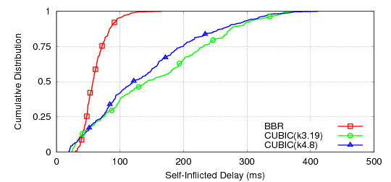
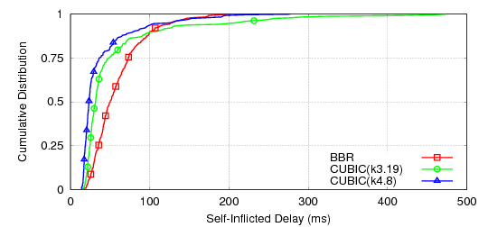
Self-Inflicted Delay
20 MB file Download
1 MB file Download
In full 20 MB file downloading, BBR has lower self-inflicted delays than CUBICs.
During the first 1MB downloading, BBR has a slightly higher median delay.

Slide 21
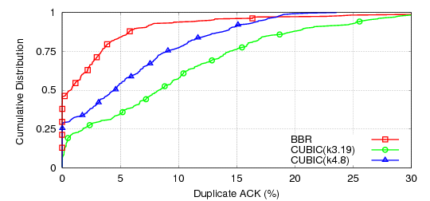
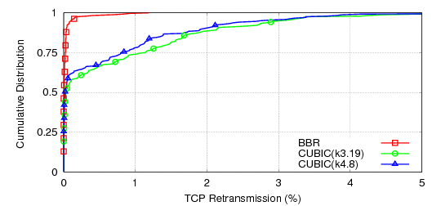
Retransmissions
Duplicate ACK Distributions
TCP Retransmission Distributions
BBR attempts to have a low RTT with smaller CWND, and its benefits are:
Fewer duplicate ACKs than either version of CUBIC
Low retransmission rate

Slide 22
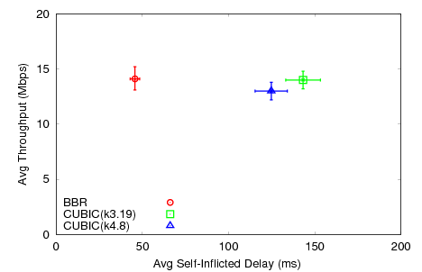
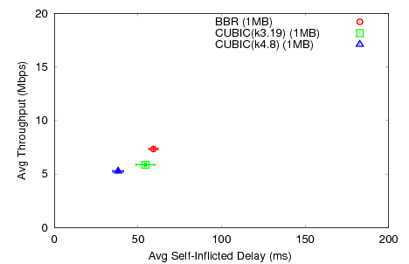
Summary
20 MB file Download
1 MB file Download
BBR balances the RTT and Throughput, (winner on Highway.)
Different design principle of BBR and CUBIC

Slide 23
Congestion Control Algorithm over Mobile Network
eNodeB’s are bottle-neck devices over mobile network, and “buffer bloat” is the main reason for TCP performance degradation.
Reducing maximum RWND on UEs to avoid “buffer bloat” is not practical.
Large buffer inside eNodeB is a double-edged sword to performance, and large buffer may increase RTT.
Fairness may not be an important metric for CCA over LTE, because eNodeB supports per-device queue.

Slide 24
Conclusions
Cross Layer and Comprehensive Measurement Study on Highway.
Results as input to model and simulation in future.
CUBIC with hystart may not preform well on LTE.
Long ramp up time to its maximum CWND causing a low link utilization
BBR balances RTT and Throughput.
BBR can achieve a high throughput with low self-inflicted RTT.
BBR seems to be a good CCA candidate for LTE PEP in the first look.
Future Works
Multiple BBR flows per device
Evaluation of RTT based CCAs.

Slide 25
Questions?

Slide 26
Backup Slides

Slide 27
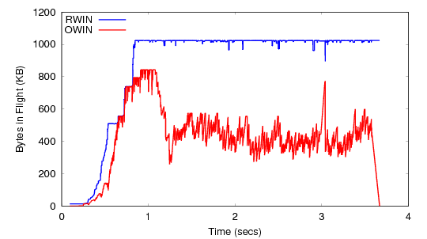
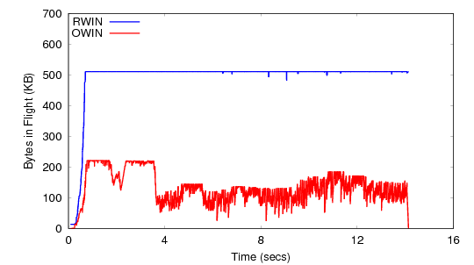
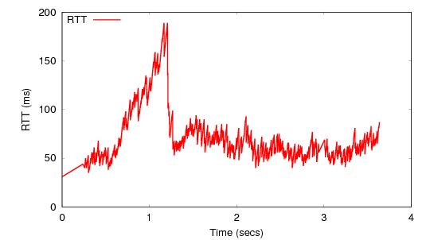
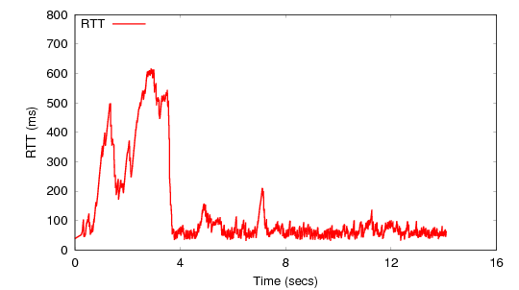
BBR Case Study
SINR is greater than 20dB
SINR is between 10 to 20dB
BBR chooses smaller CWND to control RTT as low.
OWIN
OWIN
BBR attempts to keep a low RTT.
RTT
RTT

Slide 28
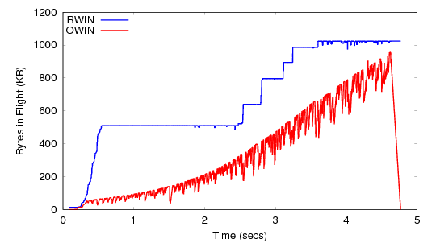
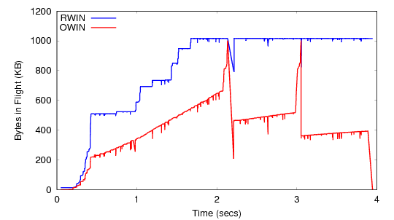
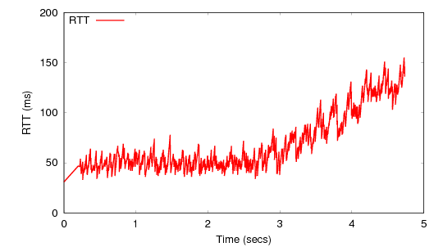
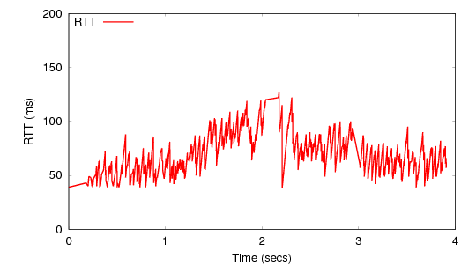
CUBIC(4.8) Case Study
OWIN
2 instances of CUBIC on Highway
4 seconds to ramp up to its max owin. (left)
Occasional loss triggers owin deduction. (right)
Both have low link utilization b/c RTT is so small.
No TCP loss (left) on high way.
OWIN
RTT
RTT

