Slide 1

Exerwalls – an Exercise Alternative to Paywalls in Mobile Games
Anthony Gallo
Philipp Baumann
Emmanuel Agu
Mark Claypool
In Proceedings of the International Academic Conference on Meaningful Play, East Lansing, Michigan, USA, October 20-22, 2016.

Slide 2
Introduction
Physical inactivity increases risk of diseases
  Diabetes, cardiovascular, cancers, obesity [CDC, 2015]
  Leasing cause of death in US [Mokdad, et al. 2000]
Physical guidelines 150 minutes exercise/day
  But most kids get far less, preferring “online” entertainment [Rideout, Foehr, and Roberts, 2010]
Approach → integrate exercise into online apps
  Inspiration: Bitwalking [Imbesi and Bahar, 2016] and Pokémon Go [The Pokémon Company, 2016]

Slide 3
Paywalls (1 of 2)
Paywall – in-game mechanism to restrict content until paid (time, money or effort)
(Dungeon Keeper, Mythic Entertainment, 2013)
Many examples: card games Hearthstone and Heroes of Warcraft (Blizzard, 2014), puzzle games such as Candy Crush (King, 2012), strategy games such as Game of War – Fire Age (Machine Zone, 2013), and classic games Monopoly (Hasbro, 2015).
Notes:
Example pictured - Player can either pay or wait predetermined amount of time to continue play.

Slide 4
Paywalls (2 of 2)
Paywall types [Doe, 2015]
  Classic paywall – purchase game content
  Pressure-wall – integrate with friends, so social pressure urges payment for content
  Patience-wall – wait for time for content
  Ad-wall – watch advertisement for content
Our idea: new kind of paywall → Exerwall

Slide 5
Exerwalls
Provide additional choice for player
exercise to unlock content
Control for player since exercise rate a choice
  Reduce player frustration
  Promote self-accomplishment, keep players engaged
Does not replace paying, instead replacing waiting
This paper → evaluate exerwall potential

Slide 6
Methodology
Survey user opinions on exerwalls and patience-walls
Develop mobile game with exerwalls for user study
Conduct user study to evaluate efficacy of exerwalls
Analyze results of user study
Notes:
Methodology servers as an outline for the rest of the talk

Slide 7
Methodology
Survey user opinions on exerwalls and patience-walls
Develop mobile game with exerwalls for user study
Conduct user study to evaluate efficacy of exerwalls
Analyze results of user study

Slide 8
Survey
Goal: Assess opinions of paywalls and explore exerwall options
Web survey, email students at WPI
56 students
31% exercising less than 4 hours per week
Many only exercise is walking to/from classes
25% paid attention to exercise
Respondents

Slide 9
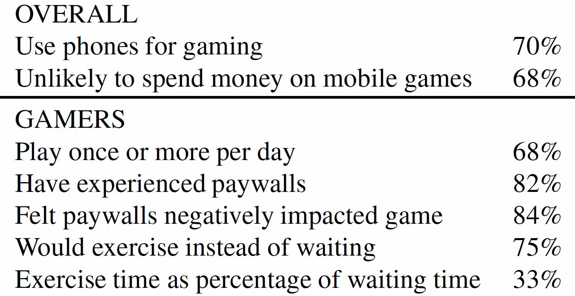
Survey Summary Results

Slide 10
Methodology
Survey user opinions on exerwalls and patience-walls
Develop mobile game with exerwalls for user study
Conduct user study to evaluate efficacy of exerwalls
Analyze results of user study

Slide 11
Game for Study
Need game with exerwalls – control duration, compare to waiting
Develop in Android, using Libgdx
Use procedural content generation for art
Conduct focus group for development focus
  (Details in paper)
→ Concentrate on making game fun given developer resources (2 students, 6 months)

Slide 12
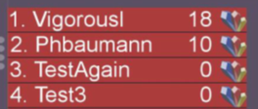
Laser Planets
Player builds team of planets – shoot laser beams to battle other planets – win battles for galactic domination!
Leader Board

Slide 13
Exerwalls in Laser Planets
(Also in “Explore” screen for fuel)
Random paywall options: Force Walk, Force Wait or Choice

Slide 14
Methodology
Survey user opinions on exerwalls and patience-walls
Develop mobile game with exerwalls for user study
Conduct user study to evaluate efficacy of exerwalls
Analyze results of user study

Slide 15
User Study Procedure
Solicit users via WPI email
  Incentives: gift card raffle
Users download game via APK
Users play brief tutorial
Asked to play at least once per day
Results
8 days (April 2016)
21 users
16 male, 5 female
Ages 18 to 31, median 21
All in CS and Engineering
Play:
  Mean 13/day for 3 minutes
Details in report
[Baumann and Gallo, 2016]

Slide 16
Methodology
Survey user opinions on exerwalls and patience-walls
Develop mobile game with exerwalls for user study
Conduct user study to evaluate efficacy of exerwalls
Analyze results of user study

Slide 17
When Choice, Walk or Wait? (1 of 2)
Walking viable choice for users versus waiting
Notes:
Percentage of time (the y-axis) users made the choice (the x-axis). From the graph, the percentages for each choice are similar. This suggests that the new exercise option (in our case, walking) may sometimes be utilized by users in favor of waiting.

Slide 18
Average Steps per Day
Slight increase in steps per day over week
Notes:
Trend in the mean number of steps taken over the course of the user study. The x-axis is the day of the user study (the study lasted a little over a week) and the y-axis is the mean number of steps. Each point is the mean number of steps across all users for that day with the bars showing the standard error of the mean. The dashed line is a trend line, the least squares line fit of the mean values. From the graph, there is considerable variation in the mean values, but a noticeable upward trend – the slope is +102 steps/day – suggesting slightly more steps per day at the end of the study than at the beginning.

Slide 19
When Walk, More Steps?
Increase in number of steps when given exerwall
Notes:
Combined analysis of the paywall presented and/or chosen (walk or wait) with the average number of steps taken. This analysis examines the average number of steps taken by each user for 20 minutes after presented with a paywall. The time window of 20 minutes is used since that is the longest patience-wall waiting time. The horizontal axis shows four cases, the two on the left when there is a choice (walk or wait) and the two on the right when there is no choice. The y-axis is the average number of steps taken. The horizontal dashed line shows the overall average number of steps over 20 minutes for reference. From the figure,
when the exerwall has the user walk, whether through choice or not, the user takes more steps than a patience-wall option of wait. Although not definitive, this suggests the exerwall may have encouraged users to exercise more.

Slide 20
Conclusion
Current paywalls limited (pay or wait) and frustrating (decreasing user base)
Exerwalls provide player-controlled option – exercise to unlock content
  Potential to increase exercise
  Potential to increase user base and revenue
Survey (54 people) shows ¾ gamers would use instead of waiting
User study (21 people) suggests exerwalls in Laser Planets encourage walking

Slide 21
Future Work
Exerwall impact
  Additional studies with more users, broader demographics, longer period of time (years – behavior change)
Exerwall placement
  Frequency and duration
Exerwall revenue
  Impact on in-app purchases

Slide 22
Exerwalls – an Exercise Alternative to Paywalls in Mobile Games
Anthony Gallo
Philipp Baumann
Emmanuel Agu
Mark Claypool
In Proceedings of the International Academic Conference on Meaningful Play, East Lansing, Michigan, USA, October 20-22, 2016.

