Slide 1
Relating Cognitive Models of Computer Games to User Evaluations of Entertainment
Paolo Piselli, Mark Claypool
James Doyle
Interactive Media and Game Development
Social Science and Policy Studies
Worcester Polytechnic Institute
Worcester, MA, USA
http://www.cs.wpi.edu/~claypool/papers/game-fun/

Slide 2
Introduction
Apply HCI techniques for studying software to studying games
Cognitive model
Relationship between cognitive model of interaction with game and enjoyment
Keep it simple so could construct model apriori
Consider number of choices and pace at which user makes those choices
Motivation – better understanding, better (more fun) games

Slide 3
Outline
Introduction (done)
Approach (next)
Results
Conclusions

Slide 4
Approach
Design game
Define models
Develop game
Build variants
Conduct user study
Analyze results

Slide 5
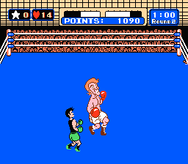
Game Design – The Idea
Choose game with model in mind
Simple so no cognitive task analysis
Choice of player limited and clear
Punch Out!
“Rules” like
IF opponent punches high THEN block high and counter-punch low
IF opponent punches low THEN block low and counter-punch high

Slide 6
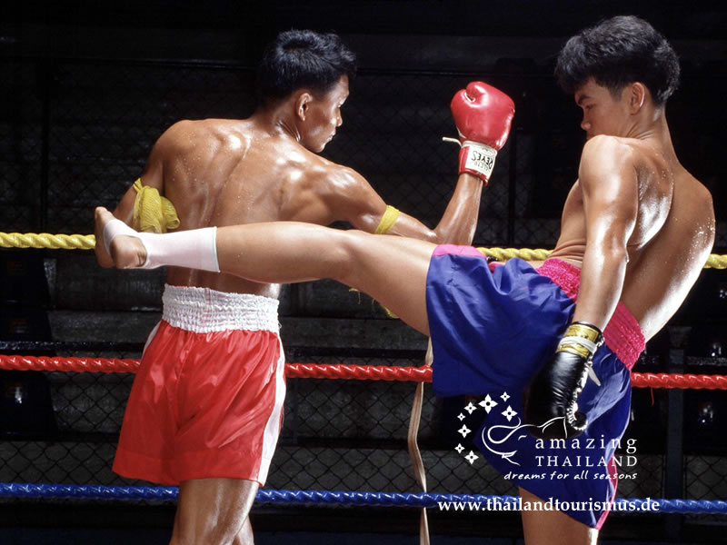
Game Design – The Concept
Pace (rules per second)
Complexity (number of active rules)
Pilot studies
Pace: 1/2 seconds or 1/4 seconds
Complexity: 4 active or 8 active conditions
Kick Boxing!
8 possible conditions? Need all 4 limbs involved!

Slide 7
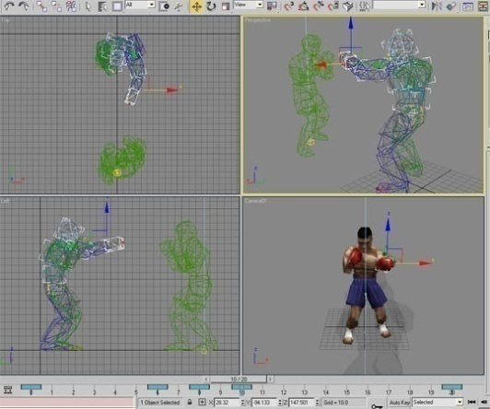
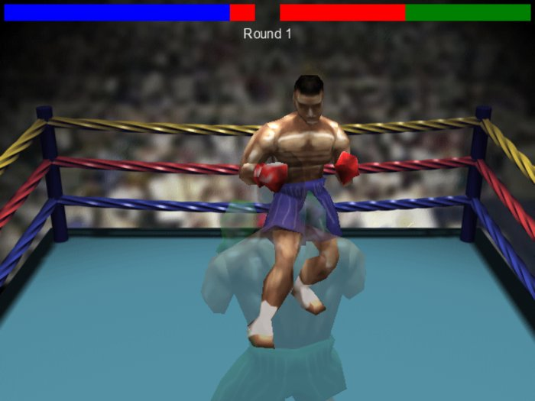
Game Development
Game Maker
2D sprites
Modeled, mapped, boned and animated in 3DS MAX
Textured in Photoshop
Variants:

Slide 8
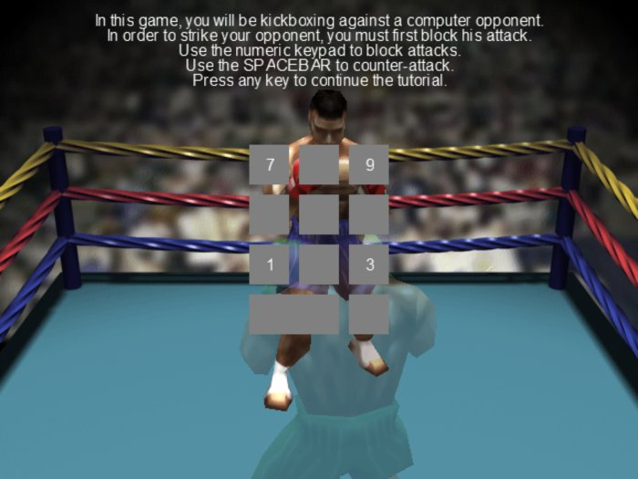
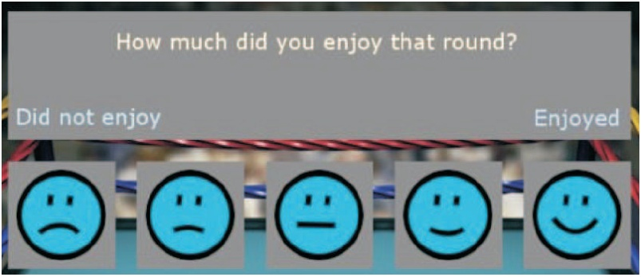
User Study
Solicit users (extra credit for class)
Scheduling in ½ hour slots
No interference from other participants
In-game tutorial
Game on → 10 rounds
One variant only
Post-round assessment
Questionnaire at end

Slide 9
Results
103 participants
Mostly undergraduates
82 male, 21 female
72% < 10 hours games/week, 50% < 5 hours
Two-way ANOVA for pace and complexity
Pace
Game was engaging
Complexity
Game was difficult to learn
Game was difficult to play
Game held attention
Game had a goal

Slide 10
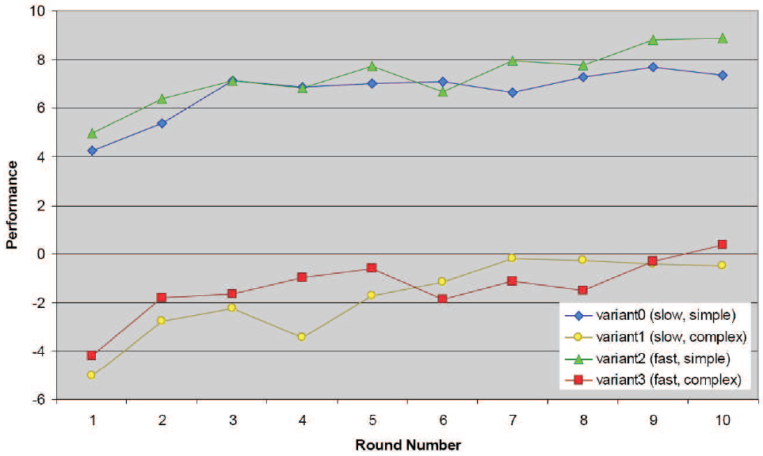
User Performance versus Time
Performance increase Slow/fast similar
Simple/complex different

Slide 11
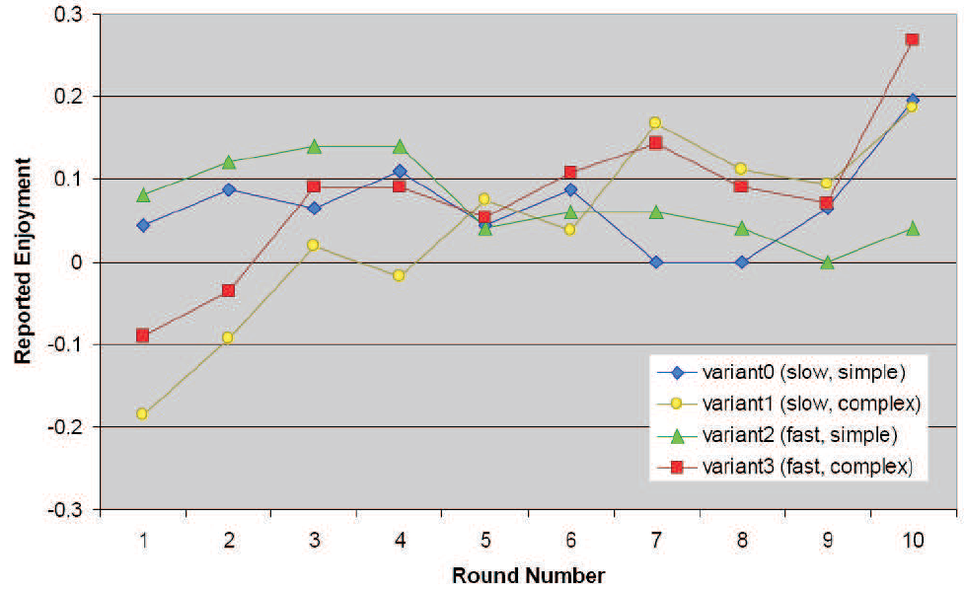
User Enjoyment versus Time
No simple increase, so not strictly tied to performance

Slide 12
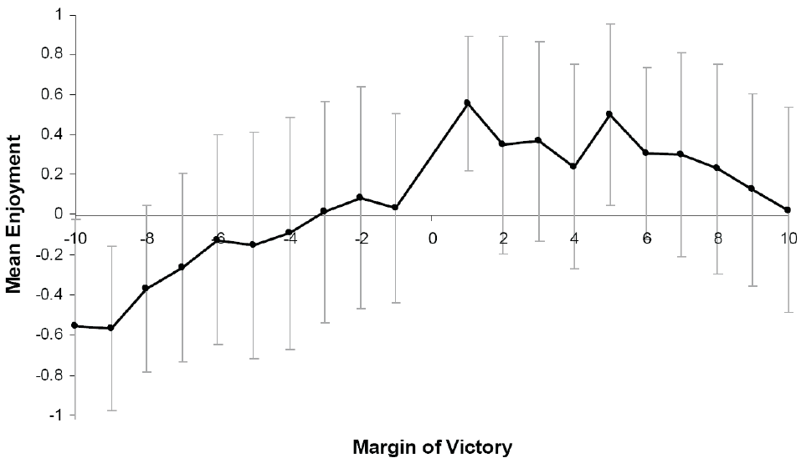
Enjoyment versus Performance
utter defeat
utter victory
“Inverted-U” [YD1908], but for performance versus enjoyment
“Golidlocks” function [BU2006]

Slide 13
Conclusions
Cognitive models did not relate directly to enjoyment, but did relate to difficulty
Inverted-U phenomenon matches theoretical models of enjoyment
Increasing performance not as important to enjoyment as being close to margin-of-victory “sweet spot”

Slide 14
Future Work
“Victory” is just a goal condition: how do goals play into enjoyment?
One victory condition vs. multiple sub goals
Frequency of goal satisfaction
Cognitive models can speak of difficulty
Investigate other variables: i.e. speed, working set
Investigate more complex games and games involving continuous control
Given identical cognitive demands, how much do aesthetics and context affect enjoyment?

Slide 15
Relating Cognitive Models of Computer Games to User Evaluations of Entertainment
Paolo Piselli, Mark Claypool
James Doyle
Interactive Media and Game Development
Social Science and Policy Studies
Worcester Polytechnic Institute
Worcester, MA, USA
http://www.cs.wpi.edu/~claypool/papers/game-fun/

