Slide 1

Nerfs, Buffs and Bugs –
Analysis of the Impact of Patching on League of Legends
Artian Kica, Andrew La Manna, Lindsay O’Donnell, Tom Paolillo Mark Claypool
In Proceedings of the 2nd International Workshop on Collaboration and Gaming (CoGames), Orlando, Florida, USA, October 31 - November 4, 2016
Notes:
Artian Kica, Andrew La Manna, Lindsay O'Donnell, Tom Paolillo and Mark Claypool. Nerfs, Buffs and Bugs - Analysis of the Impact of Patching on League of Legends, In Proceedings of the 2nd International Workshop on Collaboration and Gaming (CoGames), Orlando, Florida, USA, October 31 - November 4, 2016. Online at:http://www.cs.wpi.edu/~claypool/papers/lol-crawler/

Slide 2
PEDS feedback
Check # changes total on graphs ...
Make sure mapping of players to champions clear
Check if patch notes only for champions (I think so ...)
For "Gather Game Data (slide 2 of 2)" prune/merge with previous slide (too many details). Remove "curl".
Perhaps put the two Web slides early? They motivate the solution.
  Then, details...

Slide 3
Introduction
Patching long-standing use in software after release
  → Fix bugs or improve performance
Research in patching
  Analysis of patches adoption for software security [8], but do not enhance software features/content
  Analysis of patching behavior for open vs. closed source [9], but security focus, not features
But modern games use patching for more
  Add content, expanding gameplay
  Adjust game balance, changing existing gameplay

Slide 4


League of Legends
Most popular game in world [1], played by more than 27 million people each day [3]
Professional leagues (e-Sports), 32 million viewers 2014 at World Championships
  8.5 million simultaneous (compare to 16 million for soccer World Cup)
Team versus team game (5 vs. 5)
Teams based on player ranking (skill matters)
Players choose champions (10 unique per game)
Players ban champions (6 unique per game)
Success at top levels requires cooperation

Slide 5
Patching in League of Legends
Since 2009 release, patched over 160 times
  Average 1.5 patches/month
Traditional software patches (fix bugs)
Modern game patches (release content, adjust balance)
  Keeps game fresh for players
  Game balance affects enjoyment [6]
Despite importance, little analysis of kinds of patches and impact on gameplay

Slide 6
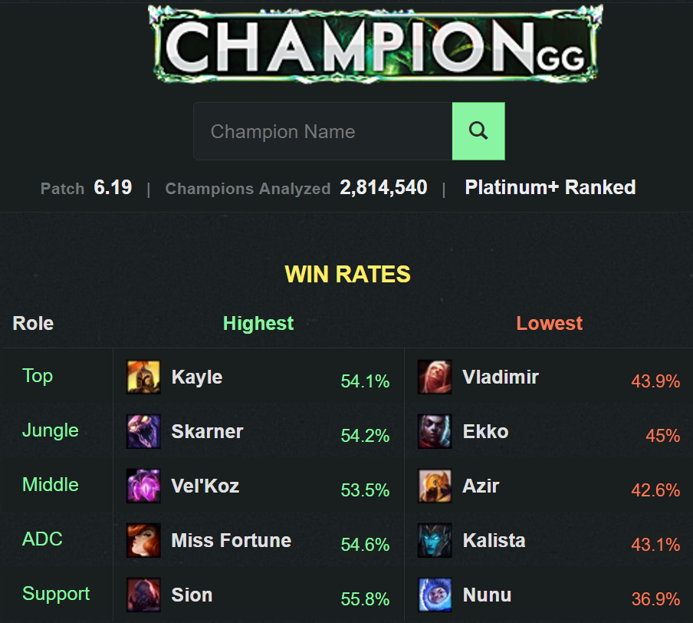
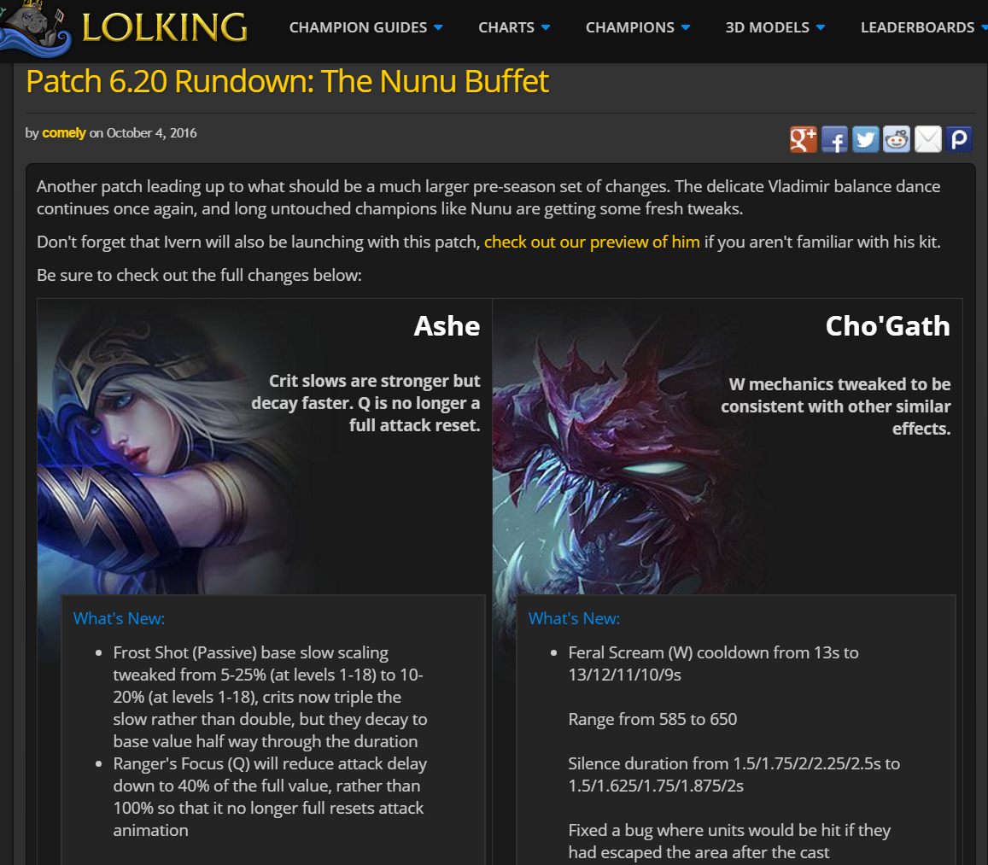
Analysis of League of Legends
3rd Party Sites w/Champion Info
3rd Party Sites w/Patch Info
But no correlation of patch data with champion data
→ must be done manually
And only latest patch information
→ no historic data from prior patches

Slide 7
This Paper
Goal: analyze patching in League of Legends (LoL)
  Classification and categorization
  Impact on gameplay
Sample games from Riot LoL database
Harvest and classify patch notes
Develop Web site for interactive exploration
Investigate patching and game data
Disseminate results (this talk)

Slide 8
Outline
Introduction (done)
Methodology (next)
  Gather data on LoL games
  Harvest data on LoL patches
Web site
Analysis
Conclusion

Slide 9

Gather Game Data (1 of 2)
Riot provides access to game data
Returns JSON formatted data
  Champions picked, Champions banned, Win/Loss …
Data from Season 4 (2014) onward
Default key limits query rate
→ obtained Riot-approved production key
curl --request GET 'https://na.api.pvp.net/-api/lol/na/v2.2/match/MATCH_ID?&api_key=DEV_KEY'

Slide 10
Gather Game Data (2 of 2)
No built-in way to get random sample of games
→ Seed “crawl” from 25 players, one for each rank, selected randomly from LolKing
Gather id’s of other players (team mates & opponents) in games
  Since matches balanced, should be similar rank
Repeat until ~11,000 unique players → player sample
Gather game histories (all ranked games) for all players, remove duplicates
From pool, choose random sample of 450,000 games → game sample
http://www.lolking.net/

Slide 11

Harvest Patch Data
LoL Wiki has Riot’s patch notes
  Human-readable, unstructured text
After manual inspection:
Develop automation to take advantage of common formatting and language
  Extract each change as single patch note
Devise taxonomy of patch notes for categorization and analysis
  (next slide)
http://leagueoflegends.wikia.com/wiki/Patch

Slide 12
Patch Taxonomy
Patch

Slide 13
Patch Taxonomy
Patch
Bug Fix
Visual
Gameplay
Bug Fix – correct inadvertent mistakes in game software
  e.g., bug fixed where interrupting player action would render champion unable to cast spells
Visual – modify look of game - map and/or champion
  e.g., new visual particles added to spell
Gameplay – affect champions and their interactions

Slide 14
Patch Taxonomy
Patch
Bug Fix
Visual
Gameplay
Numeric
Utility
Quality of Life
Numeric – quantified modifications to game statistics for champions
  e.g., amount of damage dealt per attack
Utility – affect champion’s ability interacts with other game aspects
  e.g., added effect to slow opponent hit by spell
Quality of Life – affect ease of use of champion
  e.g., visual indicator to better determine where spell hits

Slide 15
Patch Taxonomy
Patch
Bug Fix
Visual
Gameplay
Numeric
Utility
Quality of Life
Buff
Nerf
Neutral
Buff
Nerf
Neutral
Buff
Nerf
Neutral
Buff – increases strength of champion
  e.g., base armor increased from 19 to 23
Nerf – decreases strength of champion
  e.g., spell radius reduced from 350 to 300
Neutral – neither clearly nerf nor buff
  e.g., base damage changed from 100 at level 1 and 500 at level 3 to 150 at level 1 and 450 at level 3

Slide 16
Outline
Introduction (done)
Methodology (done)
Web site (next)
Analysis
Conclusion

Slide 17
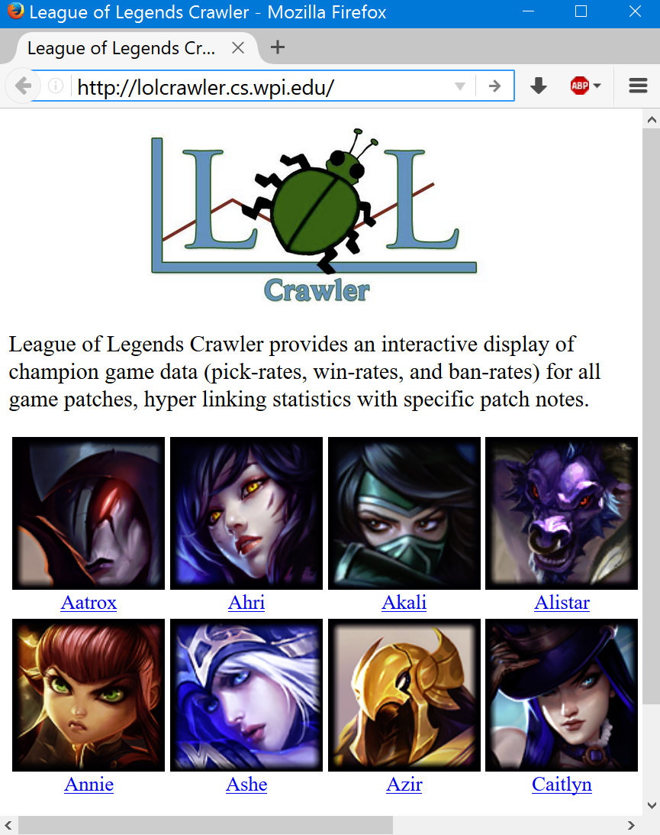
Website – LoL Crawler
http://lolcrawler.cs.wpi.edu/
Built in PHP, nodeJS and C#
Select champion to analyze
Screen similar to champion selection in-game

Slide 18
Website – LoL Crawler
http://lolcrawler.cs.wpi.edu/
Display main rates for champion
  Win, pick, ban
  Toggle on/off
Link to patch categorization and notes at bottom

Slide 19
Outline
Introduction (done)
Methodology (done)
Web site (done)
Analysis (next)
  Win, Pick, Ban rates
  Patch data
  Combination
Conclusion

Slide 20
Game Data - Win, Pick & Ban Rates
Pick rate skewed, Ban rate really skewed – perceived champion strength varies
Win rate centered around 50 – champions mostly win same amount – normal?

Slide 21
Game Data - Win Rate Normality Test
Follows line well (0.99 correlation) – appears normal
But tails deviate – thinner than would be expected – maybe intentional

Slide 22
Patch Data - Bug, Visual & Gameplay
Bug fixes are not most common – unlike traditional patches
Gameplay changes dominate – modify how game is played

Slide 23
Patch Data - Quality, Utility & Numeric
Numeric changes dominate – maybe easiest
Quality changes fewest – maybe most significant

Slide 24
Patch Data - Neutral, Buff & Nerf
Buffs and Nerfs equally common – tweak up/down in strength
Neutral distinctly less so – most adjustments clearly one way

Slide 25
Combined - Changes vs. Win Rate
Champions further from 50% patched more

Slide 26
Combined – Change Direction vs. Change in Win Rate
High win rates tend to get nerfs
Low win rates tend to get buffs

Slide 27
Combined – Change Direction vs. Change in Win Rate
Web allows for exploration of outliers

Slide 28
Combined – Change Direction vs. Change in Win Rate
Urgot (p 134)
8 buffs, but decrease in win rate!
Why? Pick rate doubled after patch
Probably non-Urgot players tried him out, but still tough to play

Slide 29
Combined – Change Direction vs. Change in Win Rate
Gangplank (p 154)
Nerfs, but increase in win rate?
Large re-work of abilities (neutral)
Many small nerfs
Overall, stronger champion

Slide 30
Combined – Change Direction vs. Change in Win Rate
Kalista (p 157)
Nerfs, but increase in win rate?
3 nerfs, all clearly negative
But other champs that counter Kalista changed/nerfed, making her stronger

Slide 31
Conclusion
Traditional software patches fix bugs, while modern game patches change content
Analysis of League of Legends, most popular game in world
Sample game data (465k games)
Harvest patches (160 patches, 7700 changes)
Build Website http://lolcrawler.cs.wpi.edu/
Analyze data

Slide 32
Conclusion
Traditional software patches fix bugs, while modern game patches change content
Analysis of League of Legends, most popular game in world
Sample game data (465k games)
Harvest patches (160 patches, 7700 changes)
Build Website http://lolcrawler.cs.wpi.edu/
Analyze data
Rates
  Ban/pick rates skewed
  Win rates normal, except for tails
Patches
  Gameplay (2x day) dominate bug fixes
  Nerfs and buffs equal
Combined
  Champs win rates further from 50% patched most often

Slide 33
Future Work
Other LoL game modes
  e.g., Normal 5v5 (non-ranked), 3v3
Other game data
  e.g., gold, kills/deaths/assists
Compare to similar games
  e.g., Defense of the Ancients 2 (Valve, 2013), Heroes of the Storm (Blizzard, 2015)
Compare to other games
  e.g., first person shooters

Slide 34
Nerfs, Buffs and Bugs –
Analysis of the Impact of Patching on League of Legends
Artian Kica, Andrew La Manna, Lindsay O’Donnell, Tom Paolillo Mark Claypool
In Proceedings of the 2nd International Workshop on Collaboration and Gaming (CoGames), Orlando, Florida, USA, October 31 - November 4, 2016
Notes:
Artian Kica, Andrew La Manna, Lindsay O'Donnell, Tom Paolillo and Mark Claypool. Nerfs, Buffs and Bugs - Analysis of the Impact of Patching on League of Legends, In Proceedings of the 2nd International Workshop on Collaboration and Gaming (CoGames), Orlando, Florida, USA, October 31 - November 4, 2016. Online at:http://www.cs.wpi.edu/~claypool/papers/lol-crawler/

