Slide 1
Surrender at 20? Matchmaking in League of Legends
Mark Claypool, Jonathan Decelle,
Gabriel Hall, and Lindsay O'Donnell
claypool@cs.wpi.edu
Computer Science and
Interactive Media & Game Development
Worcester Polytechnic Institute
Notes:
Mark Claypool, Jonathan Decelle, Gabriel Hall, and Lindsay O'Donnell. Surrender at 20? Matchmaking in League of Legends, In Proceedings of the IEEE Games, Entertainment, Media Conference (GEM), Toronto, Canada, October 2015. Online at: http://www.cs.wpi.edu/~claypool/papers/lol-matchmaking/

Slide 2
Introduction
Online games typically
coop or player-versus-player
Critical to have games
balanced for fun
Matchmaking – process of
grouping players of similar skill
Improve? Some published work [1,2] but lacking…
Matchmaking in practice
Matchmaking correlated with player opinion
Fun
Sweet spot
Too hard!
Just right!
Too easy!
Game Balance

Slide 3
Matchmaking in League of Legends
This paper → matchmaking in League of Legends (LoL)
League of Legends (Riot Games 2009)
Played by more than 27 million people each day [3]
Professional leagues
Players ranked, teams of 5 players, team vs. team
If really imbalanced game? Can surrender 20 minutes in
User study
Play LoL in controlled environment
Record objective data (e.g., player rank and game stats)
Provide survey for subjective data (e.g., match balance and enjoyment)

Slide 4
Teasers
Objective
Subjective
Teams are balanced
50% players within 1 rank of each other
Games are balanced
80% teams within 1 average rank of each other
Games are not balanced
When players win, perceive slight imbalance
When players lose, perceive large imbalance
Players enjoy winning more than losing (no surprise)
(Surprise!) Players most enjoy matches imbalanced in their favor!

Slide 5
Outline
Introduction (done)
Methodology
Results
Conclusion

Slide 6
Methodology
Computer lab with 9 computers
Windows 7
LoL version 4.21
Intel i7-3770 3.4 GHz, 12 GB DDR3 RAM, AMD Radeon graphics, 24” Dell monitors, Headsets
Players provide demographic information
Play game (solo queue)
(We gather objective data from OP GG https://na.op.gg/ )
Players provide subjective opinions

Slide 7
Outline
Introduction (done)
Methodology (done)
Results (next)
Demographics
Objective balance
Subjective balance
Enjoyment
Conclusion

Slide 8
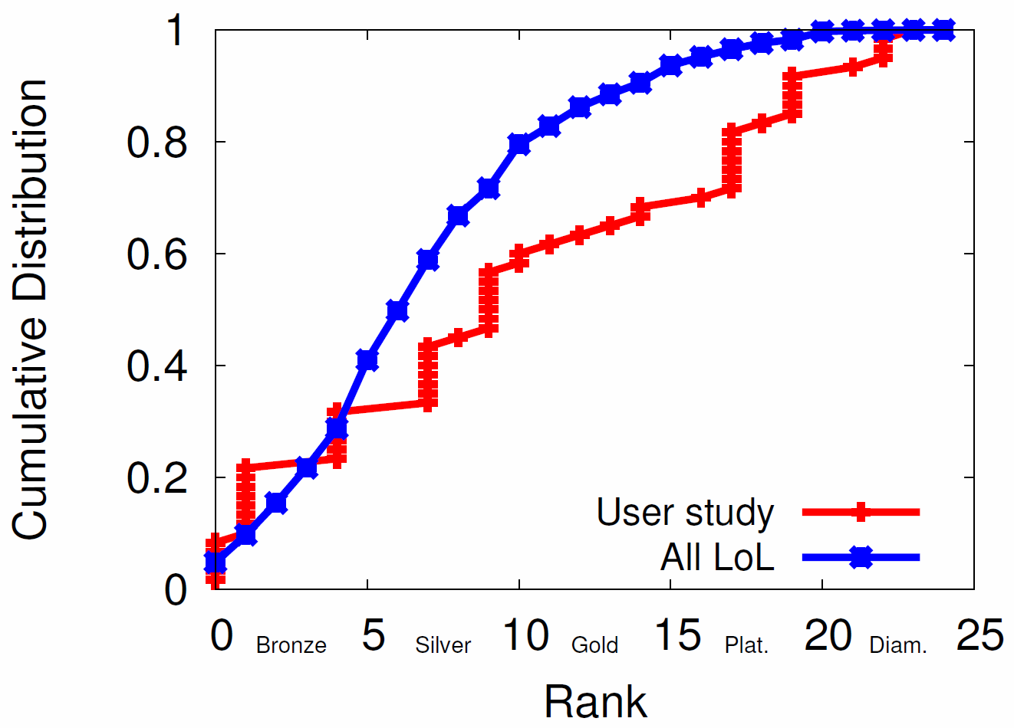
Demographics
52 complete responses
23 unique users
70% white, mostly 18-22 years, mostly males
Most played LoL
80% once a week
50% once a day
60% played solo
Our study slightly more uniform distribution of rank than LoL population

Slide 9
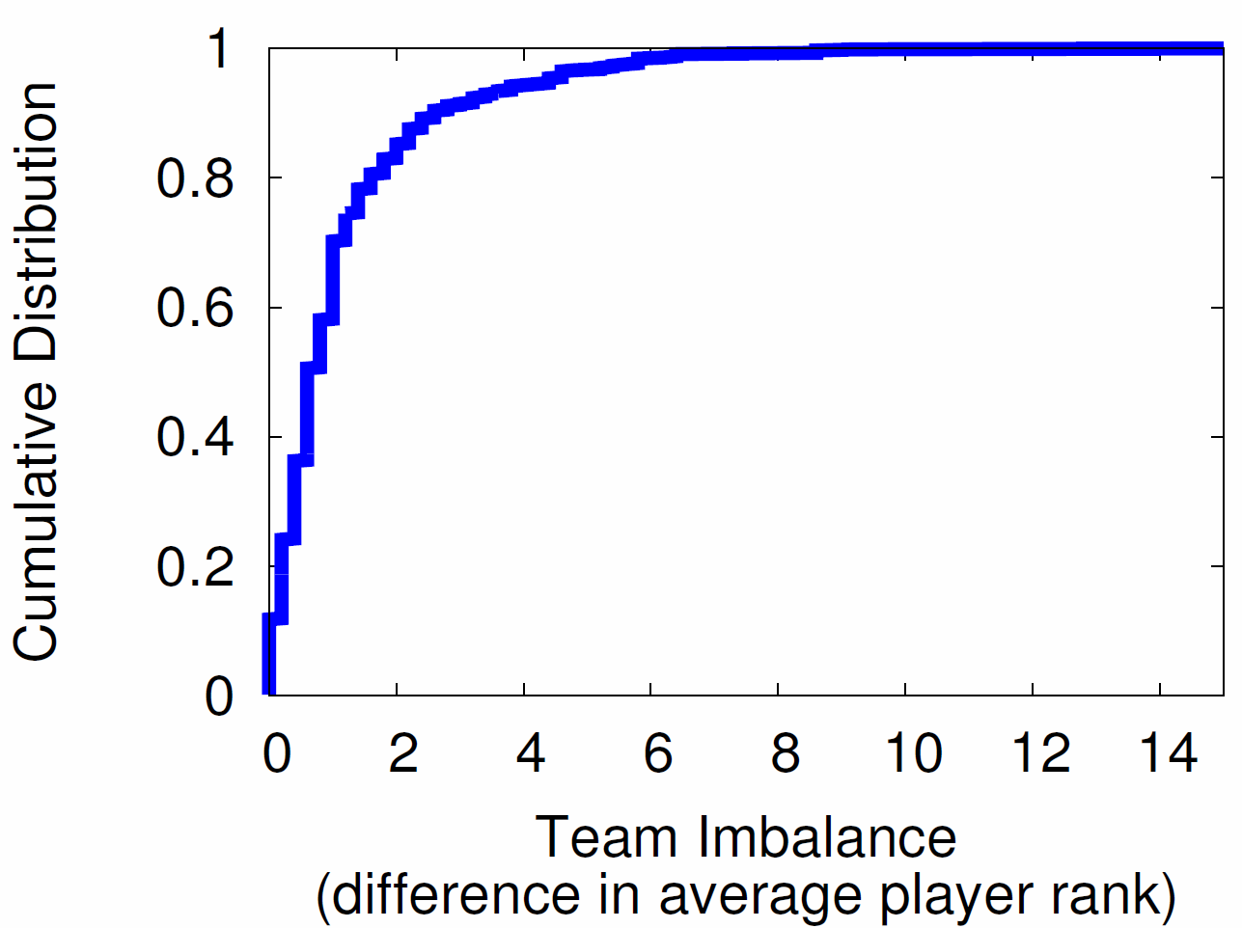
Objective Team Imbalance
Goal: Players of similar skill on each team
Result: Most teams are balanced
But about 10% more than 3 from mean

Slide 10
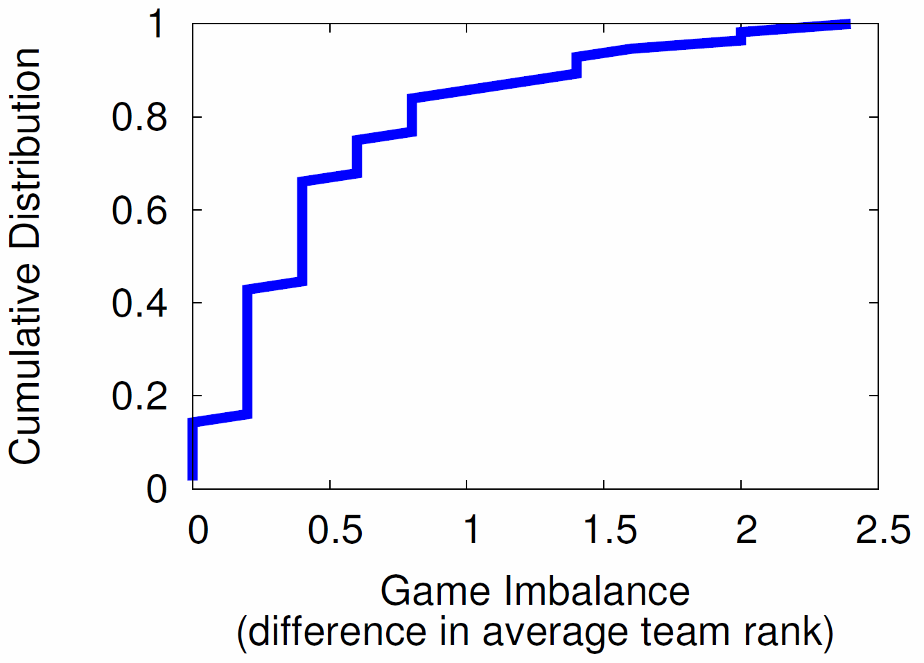
Objective Game Imbalance
Goal: Teams of similar rank versus each other
Result: Most games evenly matched
But about 5% difference of 2 from mean

Slide 11
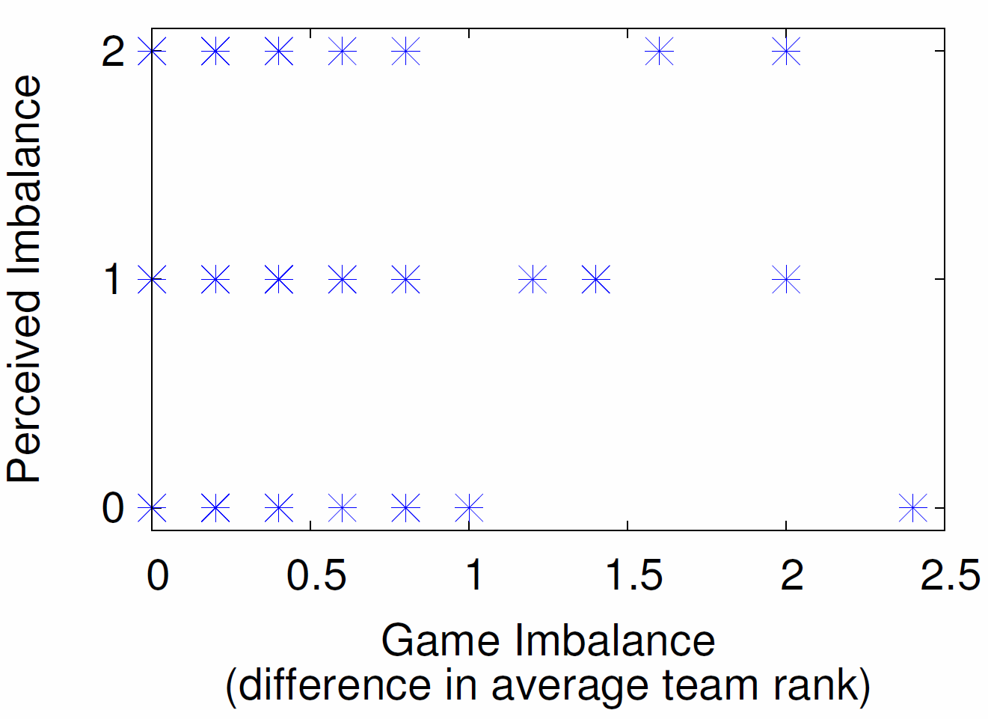
Subjective Game Imbalance (1 of 3)
“How even did you feel the game was?”
Little correlation in subjective imbalance and objective imbalance
→ Equalizing team ranks alone not sufficient

Slide 12
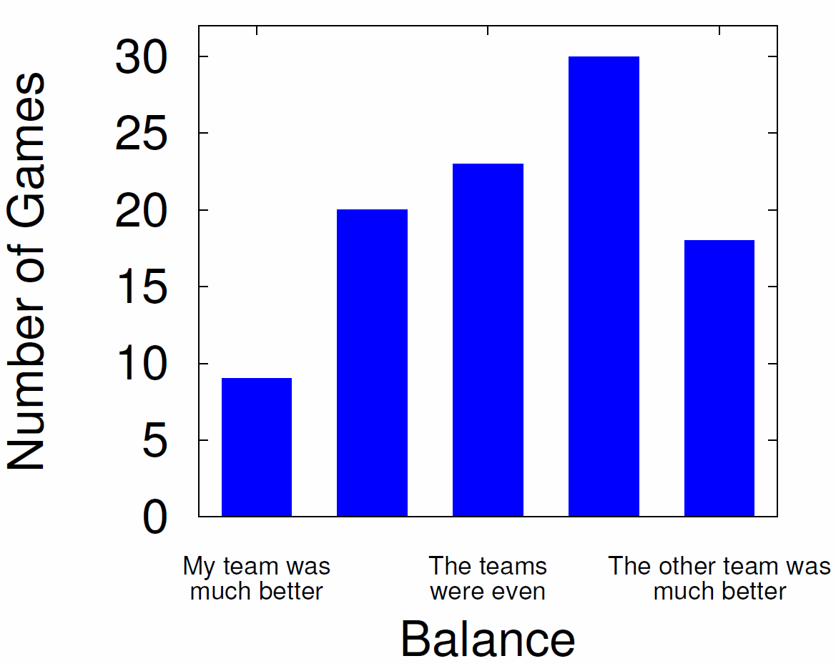
Subjective Game Imbalance (2 of 3)
Players generally felt imbalance in other teams favor

Slide 13
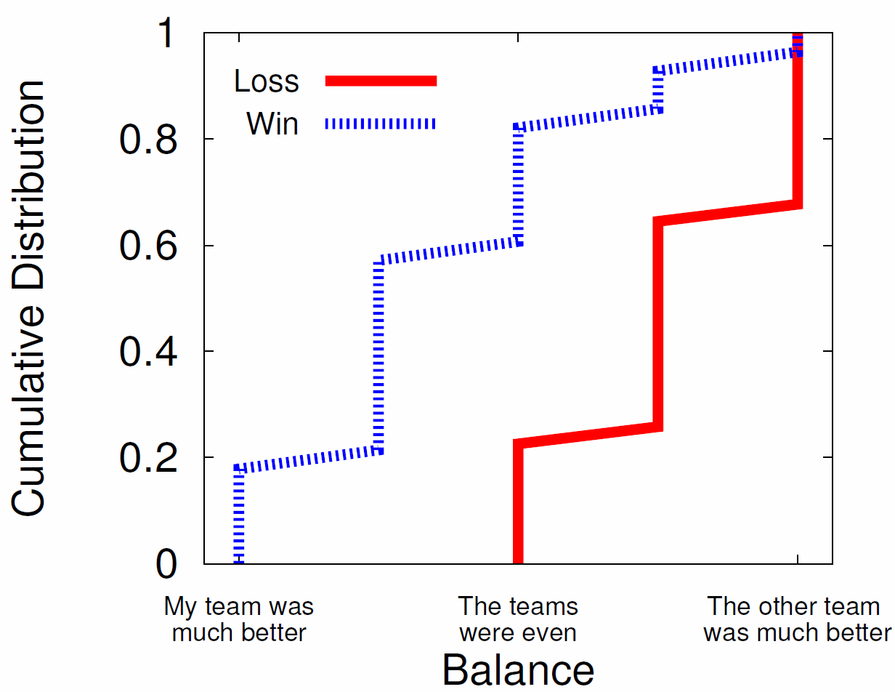
Subjective Game Imbalance (3 of 3)
Win? Game is balanced
Lose? Game is imbalanced

Slide 14
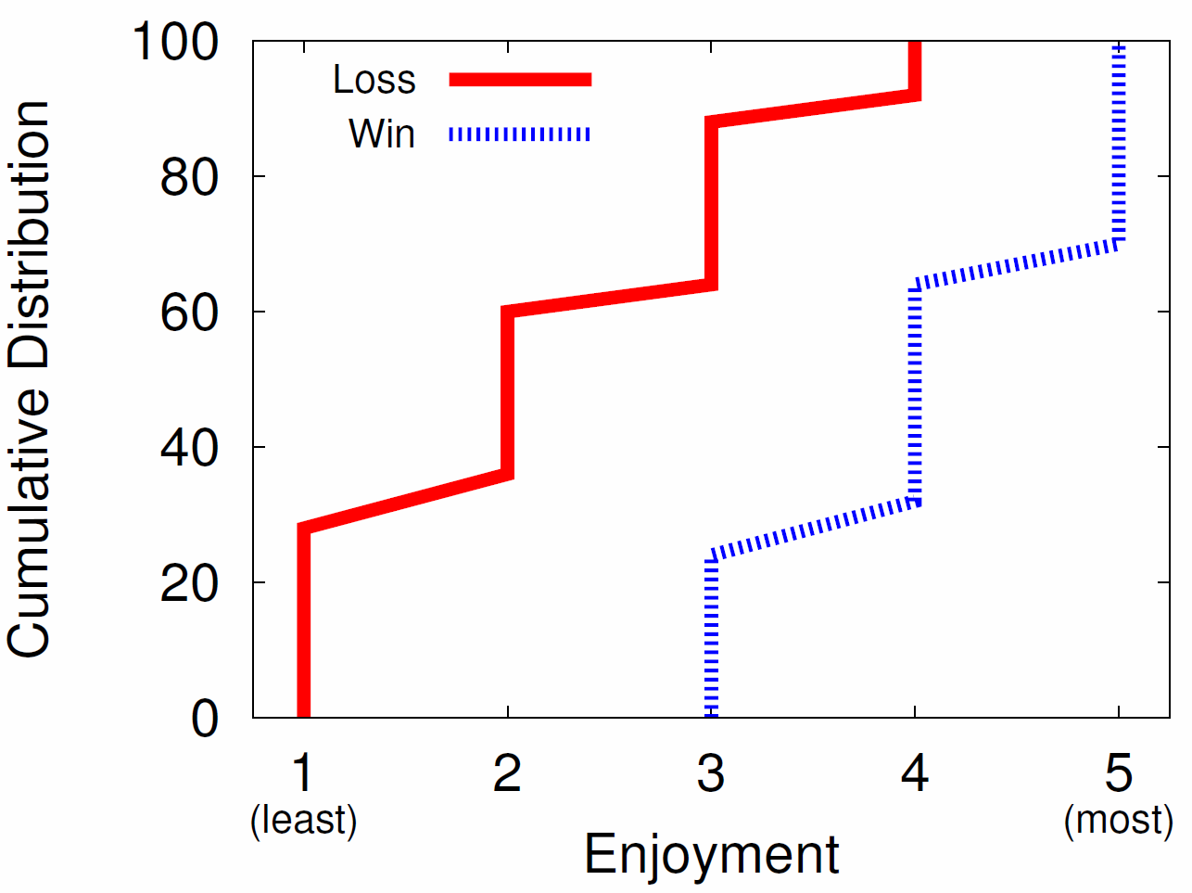
Subjective Game Enjoyment
“How enjoyable was the game you played?
Win? Game is fun (70%), never not fun
Lose? Game is almost never fun (90%)

Slide 15
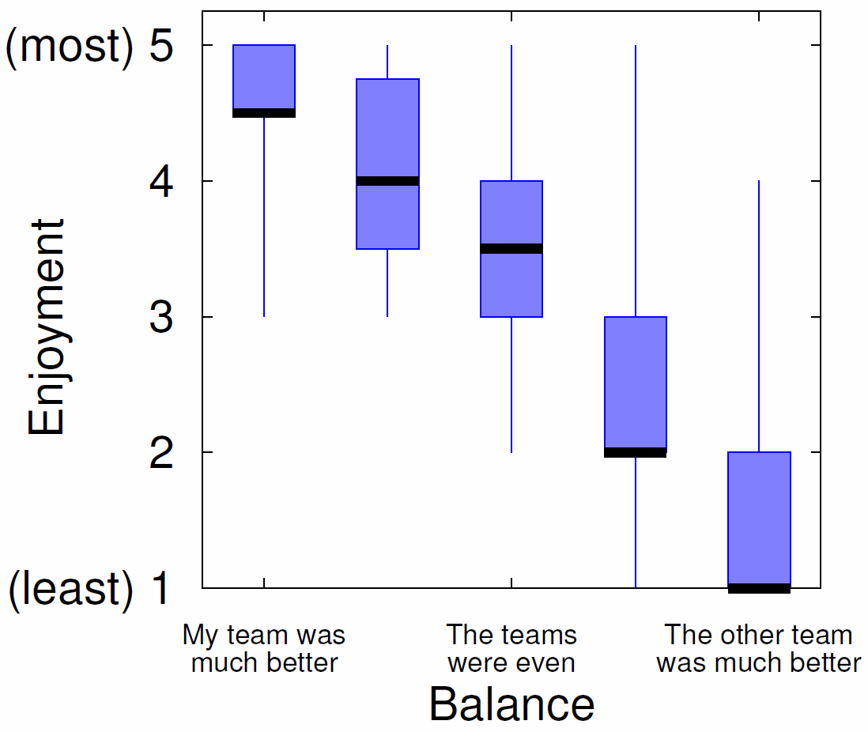
Enjoyment versus Balance
Fun
Sweet spot
Game Balance
Sweet spot?
Fun
Game Balance
Imbalance in player’s favor the most fun!

Slide 16
Conclusion
Matchmaking critical for making teams, making matches
But little published work on matchmaking systems and player opinions on them
This paper → study of matchmaking for League of Legends
Objective (rank) and Subjective (balance and fun)
Results:
Objectively teams and games are balanced
Subjectively games only balanced for winning players
Imbalanced games in players favor are the most fun!
Matchmaking systems may want to consider
e.g., balance not so important, as long as player not always on imbalanced side

Slide 17
Future Work
Other LoL game modes
Normal (unranked), Dominion, 3v3
Analysis of other objective data (e.g., in-game stats)
Other LoL-type games
Defense of the Ancients 2 (Valve 2013), Heroes of the Storm (Blizzard 2015)
Use subjective and objective data in matchmaking

Slide 18
Surrender at 20? Matchmaking in League of Legends
Mark Claypool, Jonathan Decelle,
Gabriel Hall, and Lindsay O'Donnell
claypool@cs.wpi.edu
Computer Science and
Interactive Media & Game Development
Worcester Polytechnic Institute
Notes:
Mark Claypool, Jonathan Decelle, Gabriel Hall, and Lindsay O'Donnell. Surrender at 20? Matchmaking in League of Legends, In Proceedings of the IEEE Games, Entertainment, Media Conference (GEM), Toronto, Canada, October 2015. Online at: http://www.cs.wpi.edu/~claypool/papers/lol-matchmaking/

