Slide 1
Surrender at 20? Matchmaking in League of Legends
Mark Claypool, Jonathan Decelle,
Gabriel Hall, and Lindsay O'Donnell
claypool@cs.wpi.edu
Computer Science and
Interactive Media & Game Development
Worcester Polytechnic Institute
Notes:
Mark Claypool, Jonathan Decelle, Gabriel Hall, and Lindsay O'Donnell. Surrender at 20? Matchmaking in League of Legends, In Proceedings of the IEEE Games, Entertainment, Media Conference (GEM), Toronto, Canada, October 2015. Online at: http://www.cs.wpi.edu/~claypool/papers/lol-matchmaking/

Slide 2
Introduction
Online games typically
coop or player-versus-player
Critical to have games
balanced for fun
Matchmaking – process of matching
players of similar skill
Typically, players join virtual lobby and wait until matched
Tradeoff between waiting time and match balance
Unfortunately, little published research on matchmaking done in practice
Fun
Sweet spot
Too hard!
Just right!
Too easy!
Game Balance

Slide 3
Previous Work
Vron et al. gathered objective data about matchmaking [1]
But objective data may not correspond to subjective opinions on fairness, balance
Delalleau et al. improved matchmaking and recognized need to gather player opinions [2]
But did not explicitly gather subjective opinions on matchmaking
Correlating objective matchmaking data with subjective matchmaking opinions
Can help assess current matchmaking algorithms
Can suggest ways to improve current matchmaking
Our work → compare perceived balance from player’s perspective to objective balance from game perspective
In League of Legends (next)

Slide 4
Matchmaking in League of Legends
League of Legends (LoL) (Riot Games 2009)
Played by more than 27 million people each day [3]
Professional leagues, 32 million viewers 2014 World’s
8.5 million simultaneous (16 million for soccer world cup)
Player ranking, teams of 5 players, team versus team games
If really imbalanced game? Can surrender 20 minutes in
User study
Play LoL in controlled environment
Record objective data (e.g., player rank and queue times)
Provide survey for subjective data (e.g., match balance and enjoyment)

Slide 5
Teasers
Objective
Subjective
Queue times generally short
Under 1 minute
Teams are balanced
50% players within 1 rank of each other
Games are balanced
80% teams within 1 average rank of each other
Games are not balanced
When players win, perceive slight imbalance
When players lose, perceive large imbalance
Players enjoy winning more than losing (no surprise)
(Surprise!) Players most enjoy matches imbalanced in their favor!

Slide 6
Outline
Introduction (done)
League of Legends (next)
Methodology
Results
Conclusion

Slide 7
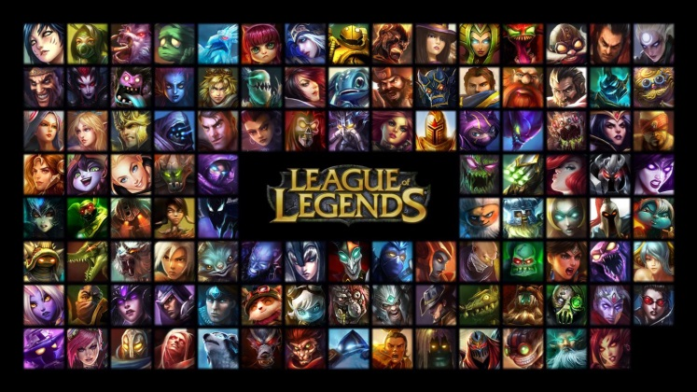
League of Legends (1 of 2)
Teams of 5 players
Players ranked into 5 divisions, 5 categories each
Players choose 1 out of
100+ characters
Team versus Team
Objective: Destroy enemy base
Mini objectives: control lane, destroy towers, kill opponents (respawn)

Slide 8
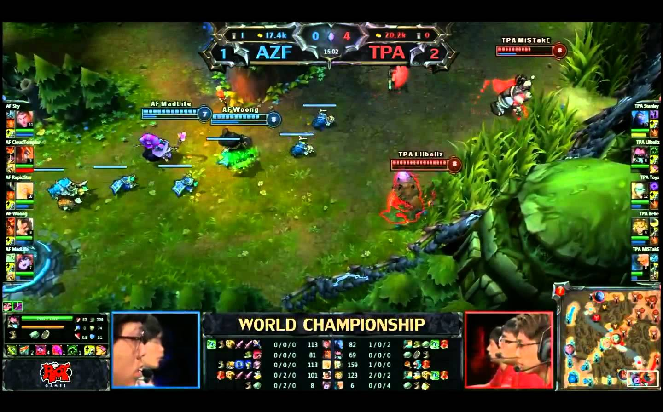
League of Legends (2 of 2)
AZF – Azuba Frost
TPA – Taipei Assassins
http://i1.ytimg.com/vi/d2d-7_SsjnE/maxresdefault.jpg
8

Slide 9
Outline
Introduction (done)
League of Legends (done)
Methodology (next)
Results
Conclusion

Slide 10
Methodology
Computer lab with 9 computers (Zoo lab)
Windows 7
LoL version 4.21
Intel i7-3770 3.4 GHz, 12 GB DDR3 RAM, AMD Radeon graphics, 24” Dell monitors, Headsets
Players provide demographic information
Play game
(We gather objective data from OP GG https://na.op.gg/)
Players provide subjective opinions

Slide 11
Outline
Introduction (done)
League of Legends (done)
Methodology (done)
Results (next)
Demographics
Objective balance
Subjective balance
Enjoyment
Conclusion

Slide 12
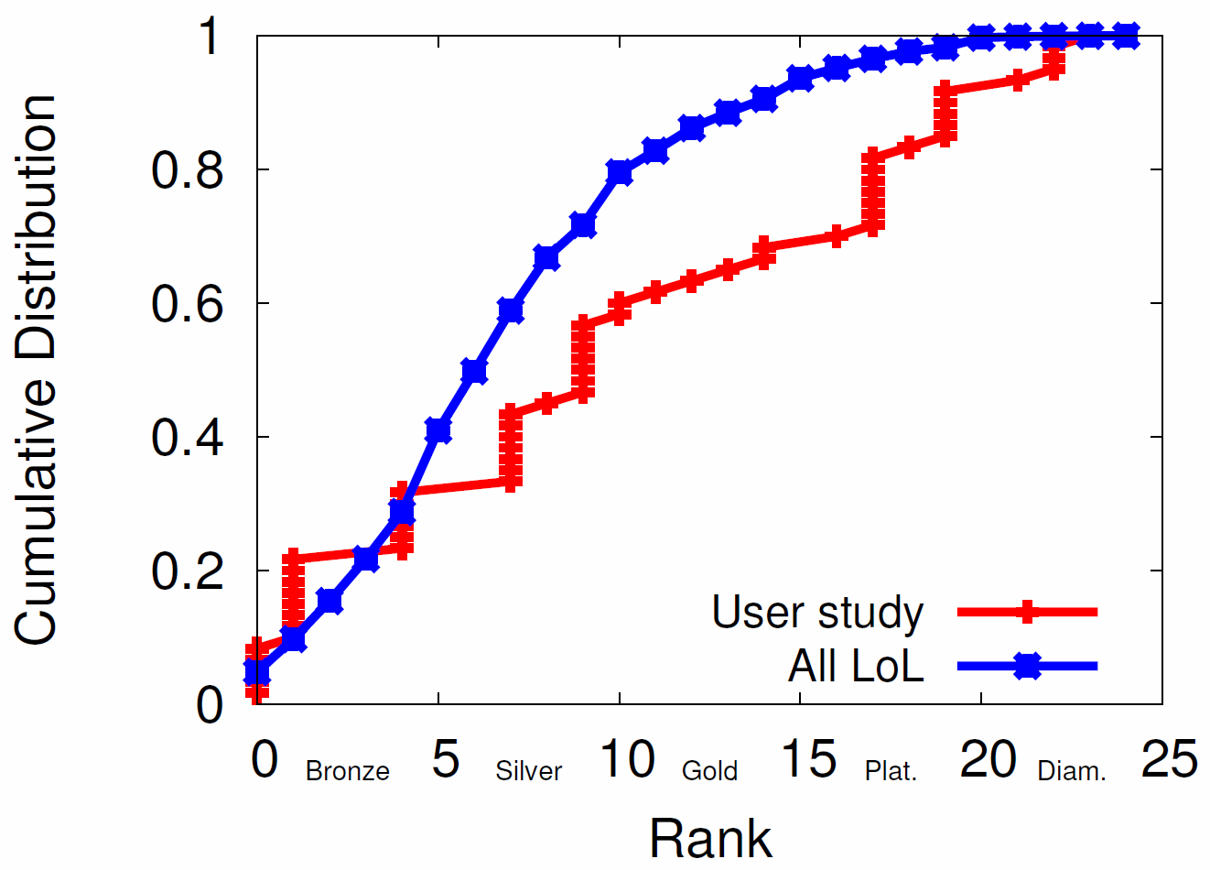
Demographics
52 complete responses
23 unique users
70% white, mostly 18-22 years, mostly males
Most played normal 5v5 matches
80% once a week
50% once a day
60% played solo
Our study slightly more uniform distribution of rank than LoL NA population

Slide 13
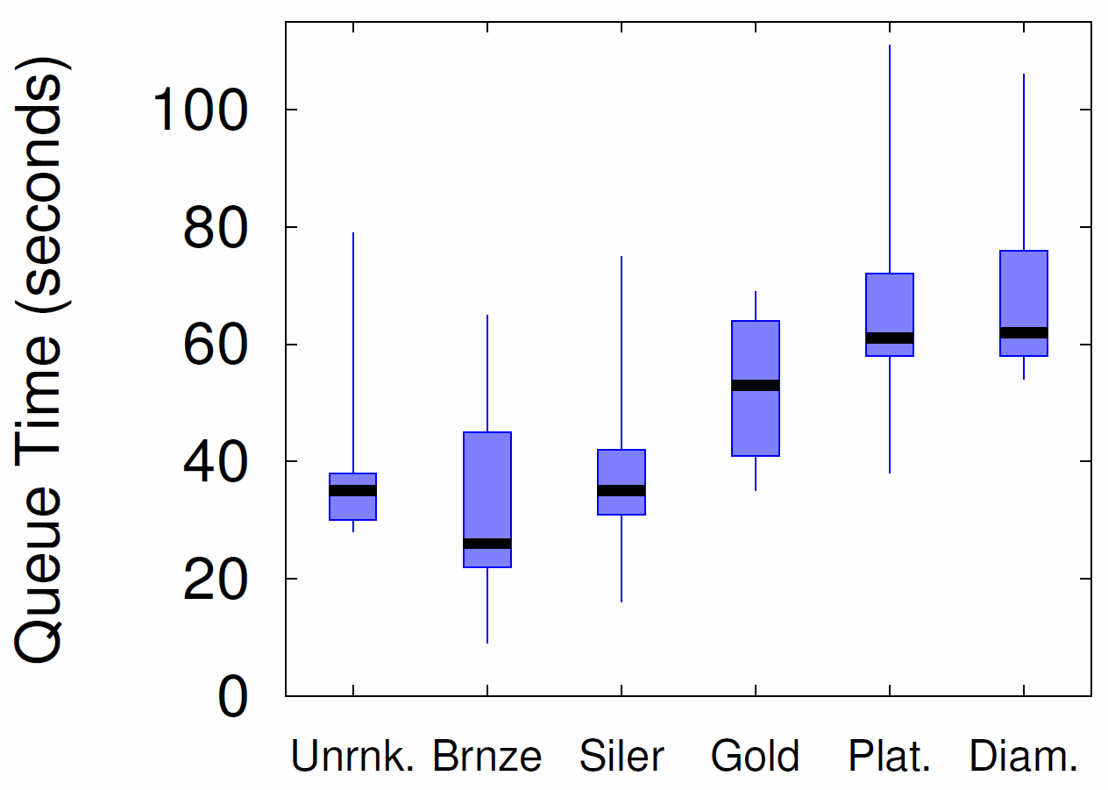
Queue Times
Option: Matchmaking can wait instead of pairing with current lobby
Result: Times generally short relative to game length
Slightly longer at higher rank (fewer players)

Slide 14
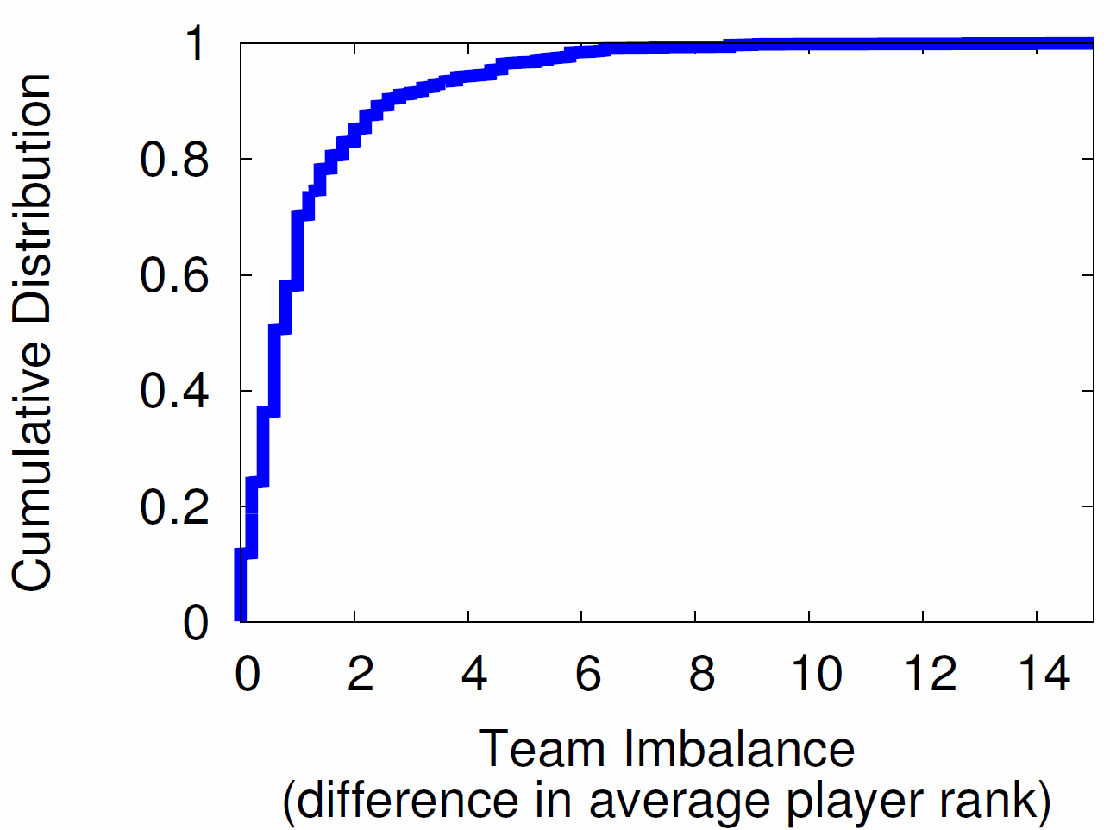
Objective Team Imbalance
Goal: Players of similar skill on each team
Result: Most teams are balanced
But about 10% more than 3 from mean

Slide 15
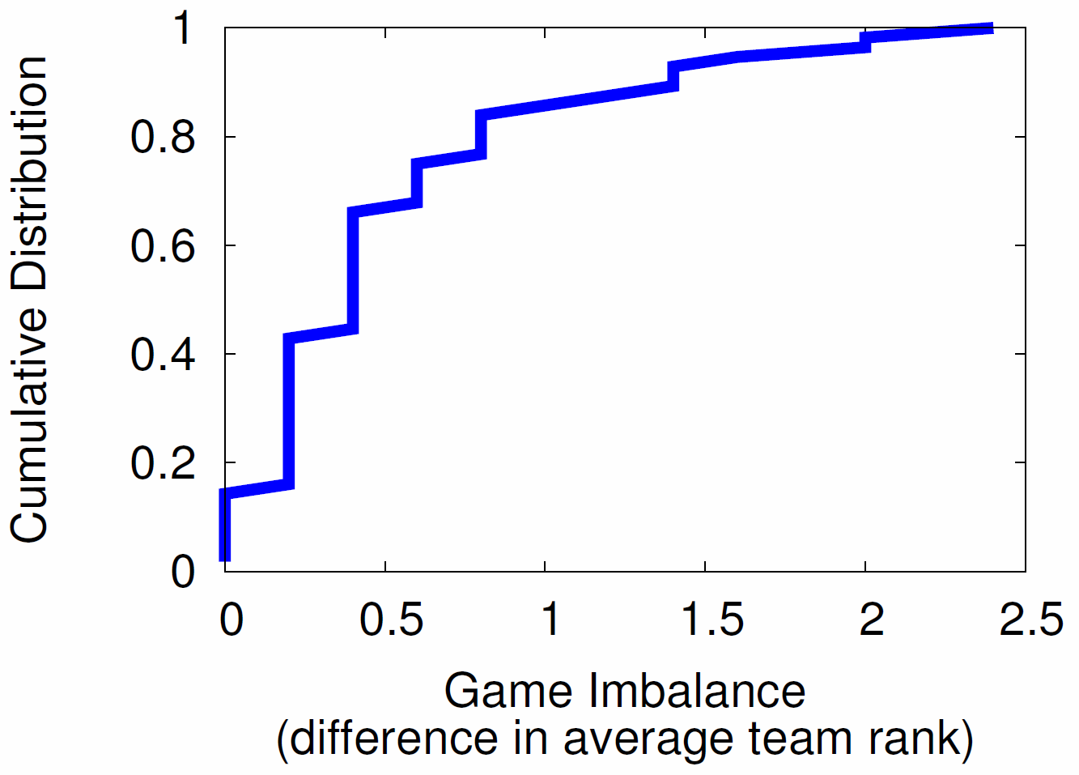
Objective Game Imbalance
Goal: Teams of similar rank versus each other
Result: Most games evenly matched
But about 5% difference of 2 from mean

Slide 16
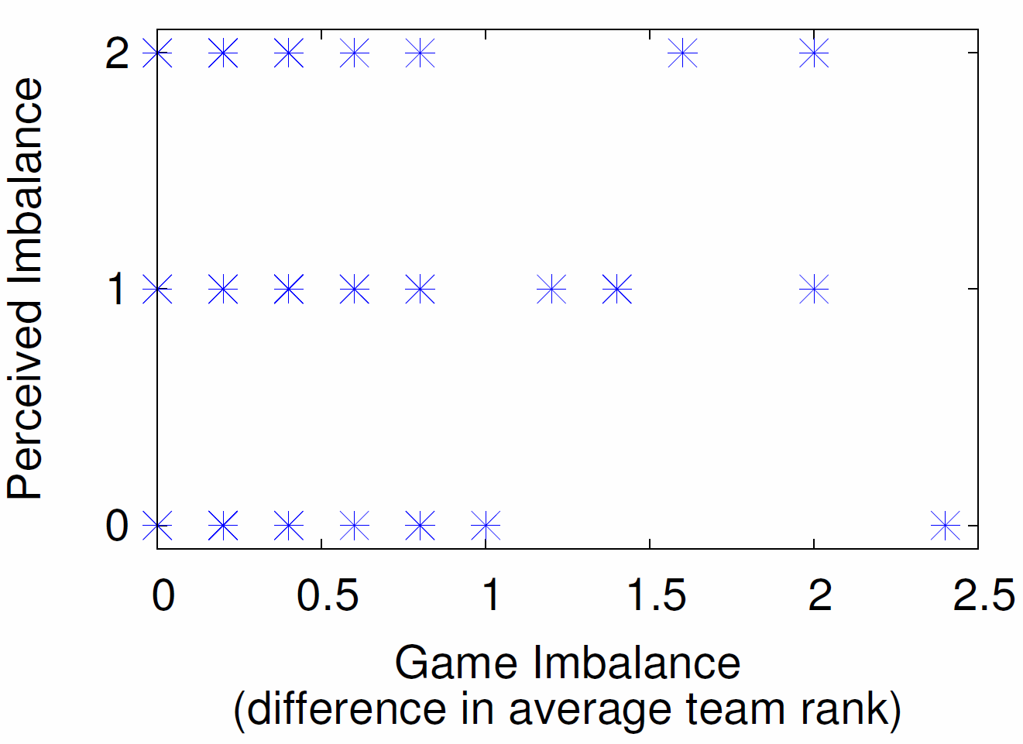
Subjective Game Imbalance (1 of 3)
“How even did you feel the game was?”
Result: Little correlation in subjective imbalance and objective imbalance
→ Equalizing team ranks alone not sufficient

Slide 17
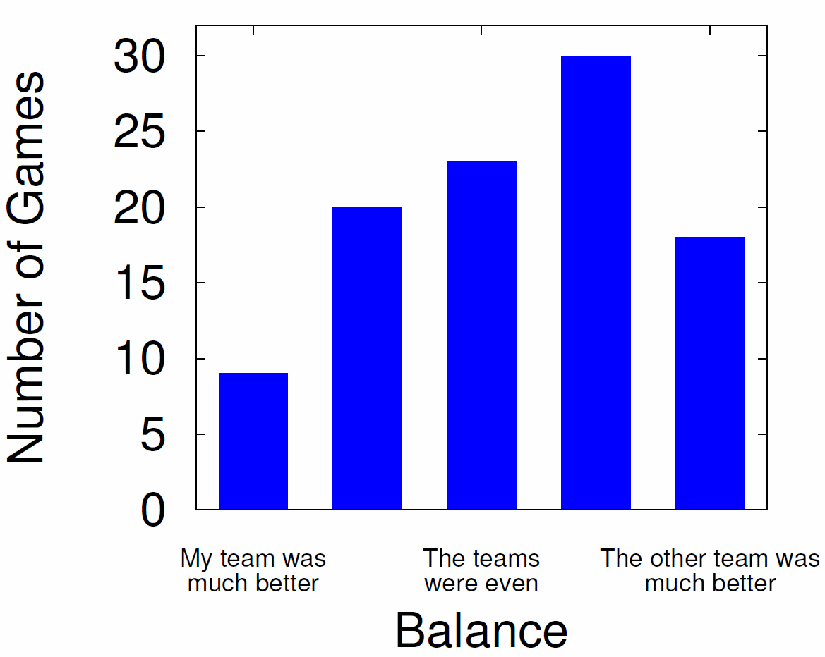
Subjective Game Imbalance (2 of 3)
Result: Players generally felt imbalance in other teams favor

Slide 18
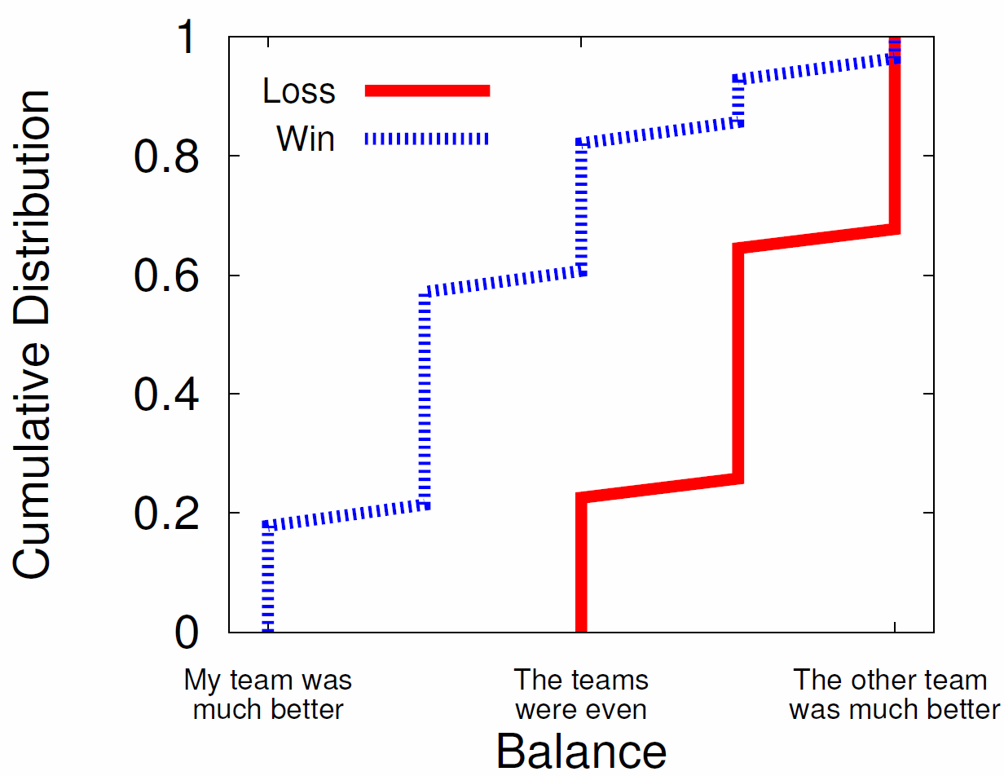
Subjective Game Imbalance (3 of 3)
Win? Game is balanced
Lose? Game is imbalanced

Slide 19
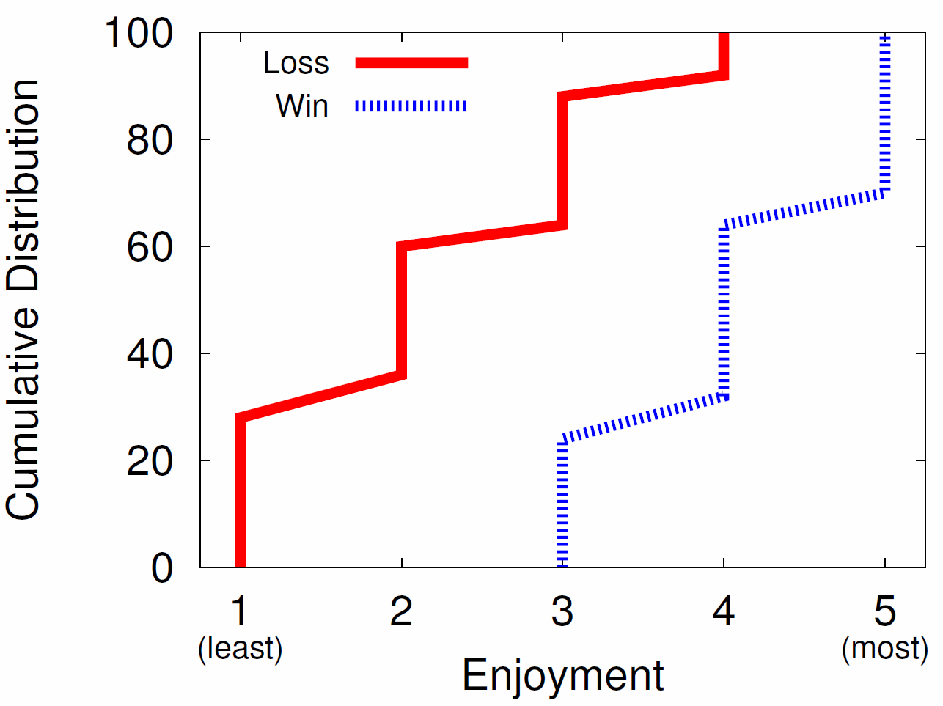
Subjective Game Enjoyment
“How enjoyable was the game you played?
Win? Game is fun (70%), never not fun
Lose? Game is almost never fun (90%)

Slide 20
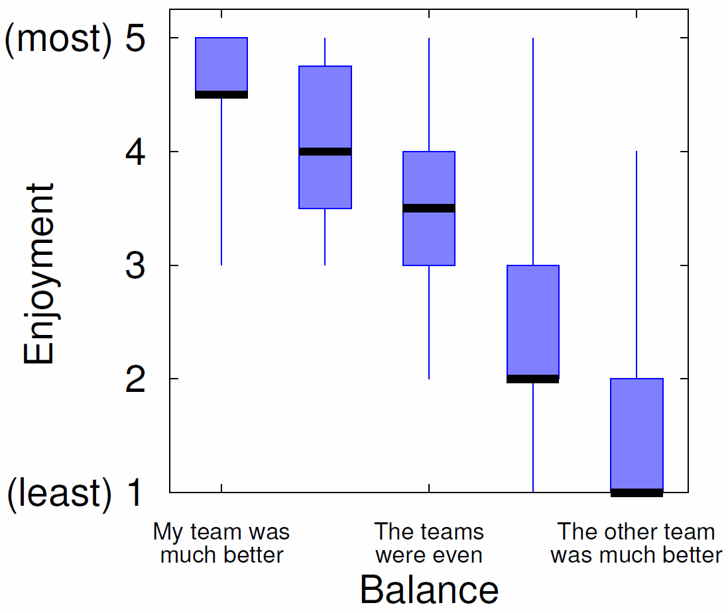
Enjoyment versus Balance
Fun
Sweet spot
Game Balance
Sweet spot?
Fun
Game Balance
Imbalance in player’s favor the most fun!

Slide 21
Conclusion
Matchmaking critical for making teams, making matches
But little published work on matchmaking systems and player opinions on them
This paper → study of matchmaking for League of Legends
Objective (rank) and Subjective (balance and fun)
Results:
Objectively teams and games are balanced
Subjectively games only balanced for winning players
Imbalanced games in players favor are the most fun!
Matchmaking systems may want to consider
e.g., balance not so important, as long as player not always on imbalanced side

Slide 22
Future Work
Other LoL game modes
Normal (unranked), Dominion, 3v3
Draft pick mode
Analysis of other objective data (e.g., in-game stats)
Other LoL-type games
Defense of the Ancients 2 (Valve 2013), Heroes of the Storm (Blizzard 2015)
Use subjective and objective data in matchmaking

Slide 23
Surrender at 20? Matchmaking in League of Legends
Mark Claypool, Jonathan Decelle,
Gabriel Hall, and Lindsay O'Donnell
claypool@cs.wpi.edu
Computer Science and
Interactive Media & Game Development
Worcester Polytechnic Institute
Notes:
Mark Claypool, Jonathan Decelle, Gabriel Hall, and Lindsay O'Donnell. Surrender at 20? Matchmaking in League of Legends, In Proceedings of the IEEE Games, Entertainment, Media Conference (GEM), Toronto, Canada, October 2015. Online at: http://www.cs.wpi.edu/~claypool/papers/lol-matchmaking/

