Slide 1
Who is the King of the Hill?
Traffic Analysis over a 4G Network
Feng Li, Xiaoxiao Jiang, Jae Chung, and Mark Claypool
Verizon Labs and Worcester Polytechnic Institute (WPI)

Slide 2
Introduction
-- Low latency and high link capacity of LTE
-- Significant growth in number and variety of mobile applications
-- Performance-enhancing proxies (PEPs) are introduced by many carriers
-- TLS/SSL make it hard to identify content type and choose traffic shaping strategies
-- To provide enhanced QoS services, carriers need better understanding of breakdown of application traffic

Slide 3
Outline
-- Introduction
-- Methodology
-- Network Protocol Breakdown
-- Flow Statistics Analysis
-- Mobile Applications
-- Conclusions

Slide 4
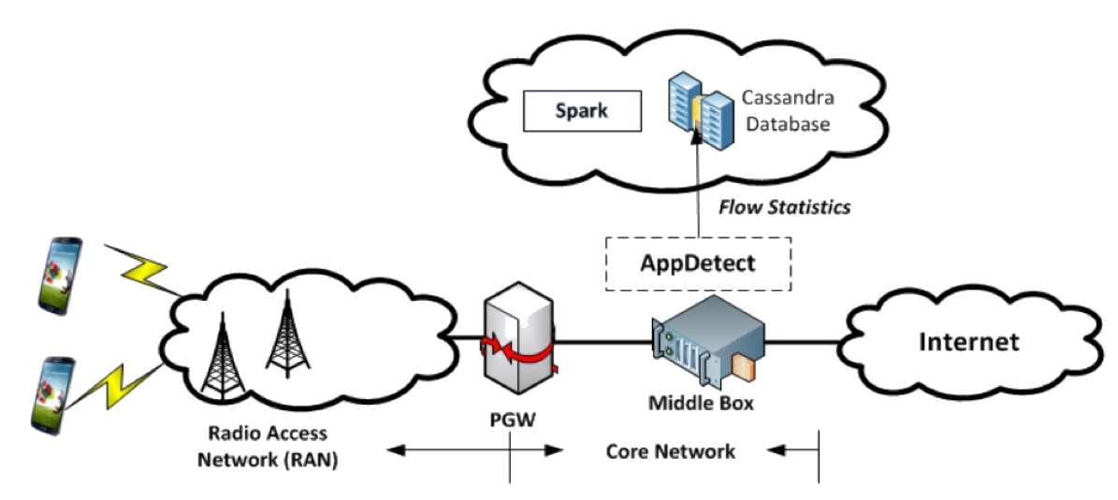
Methodology
-- Tier-1 wireless carrier in south-central U.S.
-- Mirror traffic from UE pool with over 5000 users
-- 2 consecutive days, November 7-8, 2016
-- 7 hours, 9am-4pm
-- Total 85 GB data, 2.5 million flows
Note: no subscribers’ IDs, geographic locations, device types nor mobile numbers

Slide 5
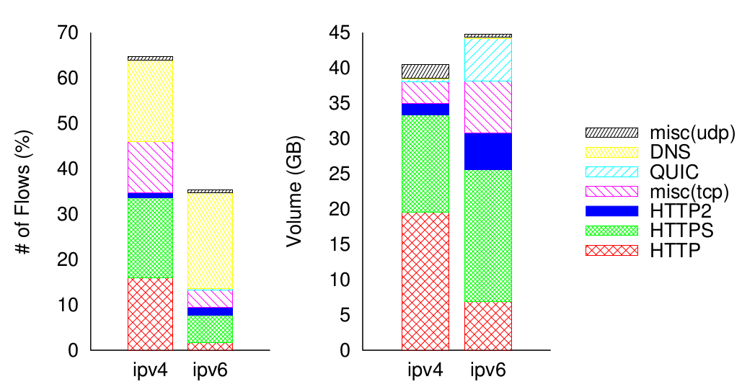
Network Protocol Breakdown
-- 64% flows IPv4 compared to 36% IPv6
-- IPv6 volume slightly larger than IPv4
-- Mean IPv6 TCP flows is 81 KB, while Mean TCP IPv4 is 11 KB
-- HTTP-family still dominates mobile: 70% of traffic volume
-- Only 30% traffic unencrypted HTTP

Slide 6
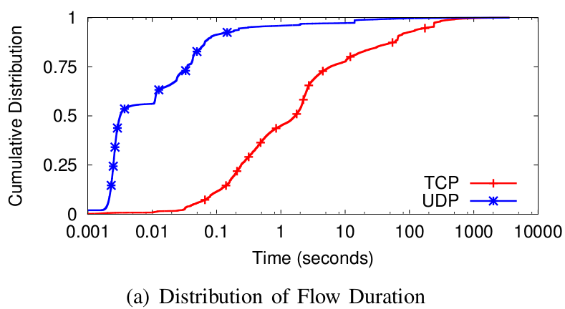
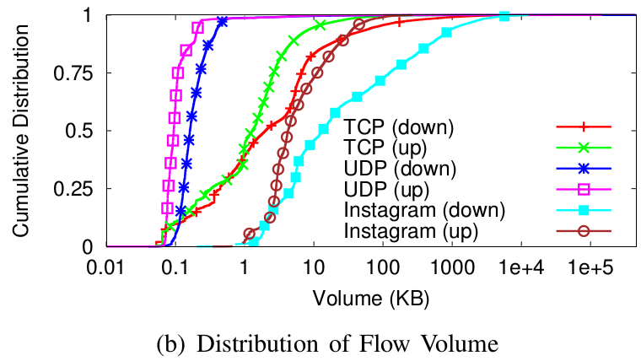
Flow Statistics
-- Characteristics important for LTE network: duration, volume, rate (throughput), RTT
-- Most flows less than 2s
-- 11% TCP flows and 0.5% UDP flows longer than 1 minute
-- Most flows small
-- High volume UDP flows contributed by QUIC

Slide 7
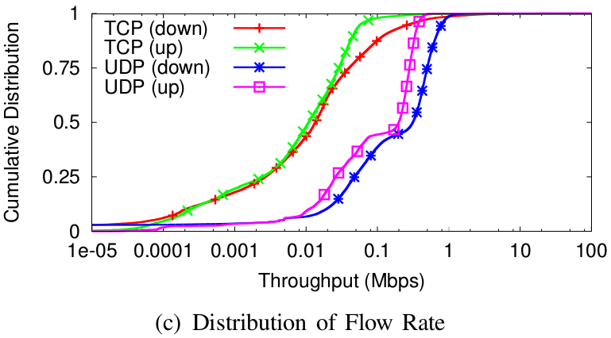
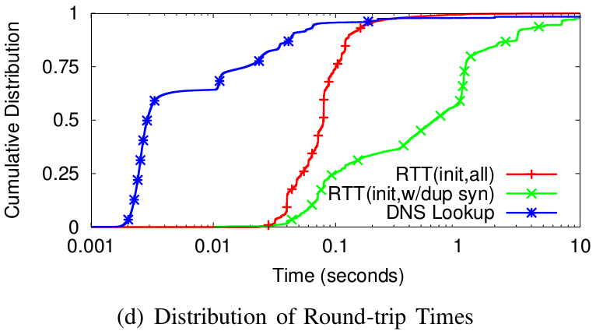
Flow Statistics
-- Applications with req/resp may never send enough data to fill pipe
-- Focus on elephant flow instead of numerous small flows
-- Median TCP initial RTT is 79ms
-- Large TCP initial RTTs may be from retransmission of SYN/SYN-ACK or backward compatible 2G/3G devices
-- Time efficiency of DNS caching is confirmed
Notes:
-- 90% of TCP flows have rates less than 285 Kbps down and 60 Kbps up, while 90% of UDP flows have rates less than 815 Kbps down and 379 Kbps up
TCP, 3-way handshank
UDP from DNS request-response pairs

Slide 8
Mobile Applications
-- Analyze applications through SNI, Hostname, reverse DNS
-- Able to classify 88% of the traffic (by volume)
-- Focus on well-know content providers
-- Goal: recognize video flows

Slide 9
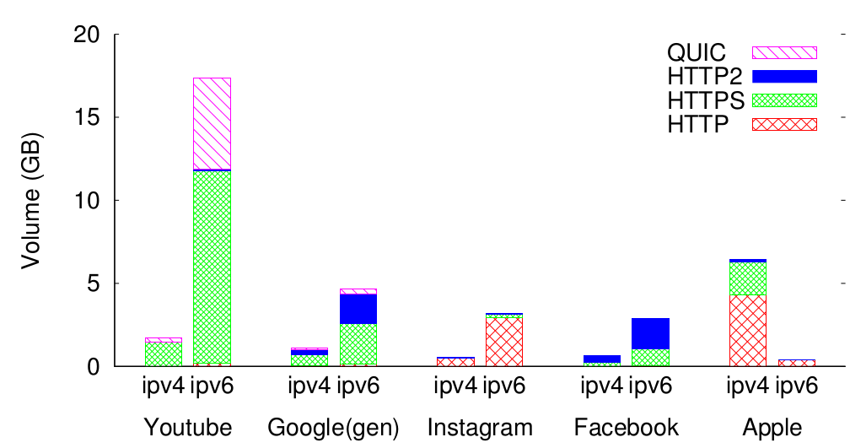
Top Content Providers
-- Top 5 Content Providers
-- Google include YouTube is largest content provider
-- QUIC constitute 25% of YouTube’s overall traffic
-- Instagram constitutes about half of all FaceBook traffic
-- Apple traffic consist of variety of different services
Notes:
Most of goolge’s traffic is protected by TSL/SSL, and mainly over IPv6
Instagram is mainly over HTTP, similar to Google, FB has migrate much of its traffic to IPv6
Most of Apple traffic is over IPv4

Slide 10
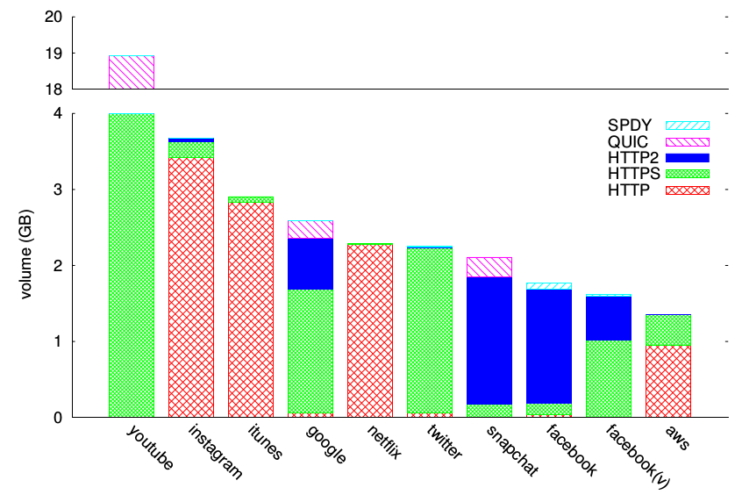
Top Mobile Applications
-- Top 10 mobile apps/servers
-- These top 10 applications account for 46% of total traffic
-- Video and Social apps most popular
-- Snapchat only application using QUIC besides Google

Slide 11
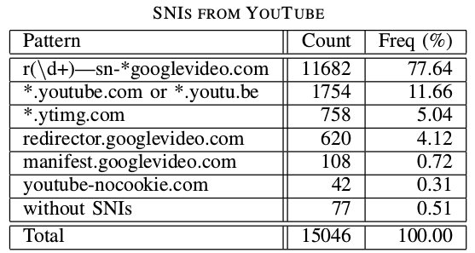
YouTube Traffic
-- 22% of total observed traffic
-- HTTPS and QUIC, hard to infer application types even with DPI
-- Classify HTTPS based YouTube flow through SNI
-- Classify QUIC based YouTube flow through reverse DNS
-- QUIC YouTube and QUIC misc

Slide 12
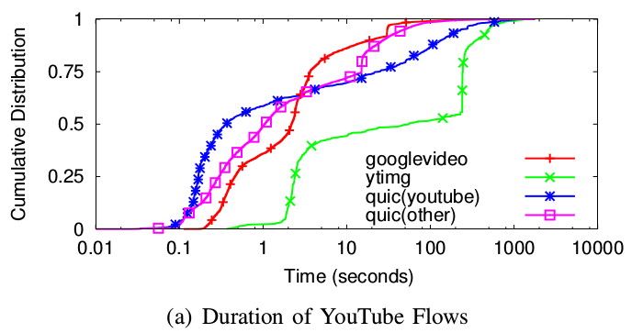
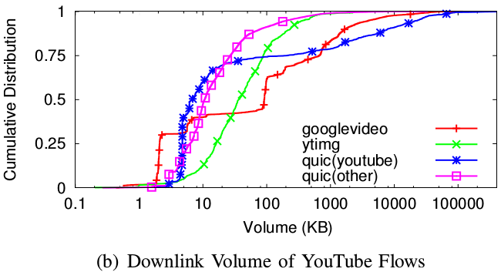
YouTube Flows Analysis
-- Flow duration not good differentiator for video flows
-- Ytimg flow even longer duration
-- Googlevideo.com and QUIC (YouTube) larger than others
-- Duration and volume come too late for detecting video

Slide 13
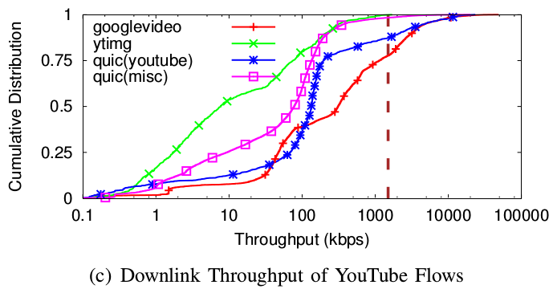
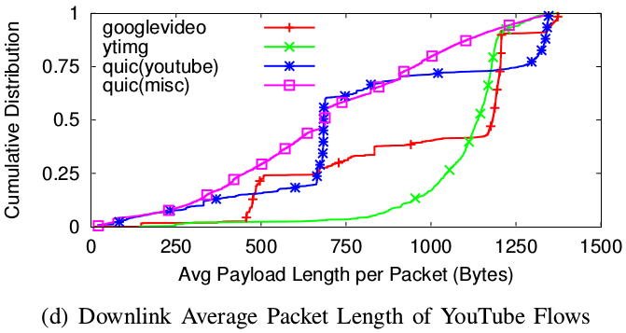
YouTube Flows Analysis
-- Throughput of googlevideo.com and QUIC (YouTube) highest
-- Throughput may be good for identifying video
-- 60% googlevideo.com and 25% QUIC (youtube) have payload of 1000+ bytes
-- Packet length may good for identifying video

Slide 14
Conclusions
Approach:
-- Detailed snapshot of current commercial mobile network
-- Cross-layer traffic analysis from tier-1 wireless network
Findings:
-- High volumes of IPv6 and HTTPs suggest renewed focus on traffic classification
-- QUIC comprises 60% of UDP traffic and warrants special attention
-- Google, Facebook and Apple top 3 content providers
-- YouTube alone accounts for over 20% of total traffic

Slide 15
Thanks! Questions?

