Slide 1
Analysis of an IEEE 802.11 Network Activity during a Small Workshop
Zhe Zhou, Mark Claypool, and Robert Kinicki
Computer Science, Worcester Polytechnic Institute
Notes:
Worcester Polytechnic Institute is in Worcester, Massachusetts, USA (not the U.K. ;-))
Zhe (“Jeff”) Zhou is a Ph.D. student at WPI
Mark Claypool and Robert Kinicki are Professors of Computer Science at WPI

Slide 2
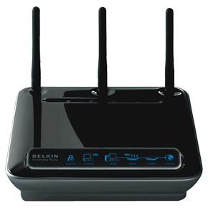
Introduction
Notes:
Main points:
802.11 wireless technologies have become ubiquitous in corporations, academies, public venues and homes
Understanding 802.11 performance and usage is valuable for effective management and planned deployment
Usage and performance are “moving targets” as devices and applications evolve and wireless base-stations grow

Slide 3
Related Work
Tang and Baker [7] trace collected at Stanford on campus
Analyzed user behavior of the network, overall network traffic and load characteristics
Henderson et al. [2] trace collected at Dartmouth on campus
Characterized user behavior in terms of application use and found residential traffic
Showed that some wireless cards roamed excessively, being unable to settle down with one AP
Saroiu and Gummadi [6] trace collected at University of Washington on campus
Observed that outbound p2p traffic dominated.
Observed the diminishing dominance of Web traffic.
Jardosh et al. [3], trace collected at the 62nd IETF meeting in hotel
Found rate adaptation implementations rarely used the 2 Mbps and 5.5 Mbps data rates, and that lower rates are detrimental to network performance during congestion.
Rodrig et al.[5] trace collected at SIGCOMM’04 in hotel
Concluded that 802.11 overhead is high and retransmissions are common.
Found that clients switched data rates more often than not, and most transmission times spent sending at 1 Mbps.
Notes:
This page can be gone over briefly, and skipped if there is not enough time.

Slide 4
Goals
Previous wireless measurement studies
Focused on large gatherings
Looked at traces now more than several years old
Provided a detailed study only off IEEE 802.11b
Traces analyzed in this paper
Collected from a recent small workshop
NetGames’08 with 35 participants and 20+ wireless users
Contains IEEE 802.11 a/b/g traffic
Seek to understand
Classification, frequency and duration of wireless usage
Application usage and comparative trends
Factors that impact network usage

Slide 5
Outline
Introduction
Methodology
Analysis
Conclusions
Notes:
Outline of talk as shown.
Talk spends the bulk of the time on analysis since this is a measurement paper (and workshop ;))

Slide 6
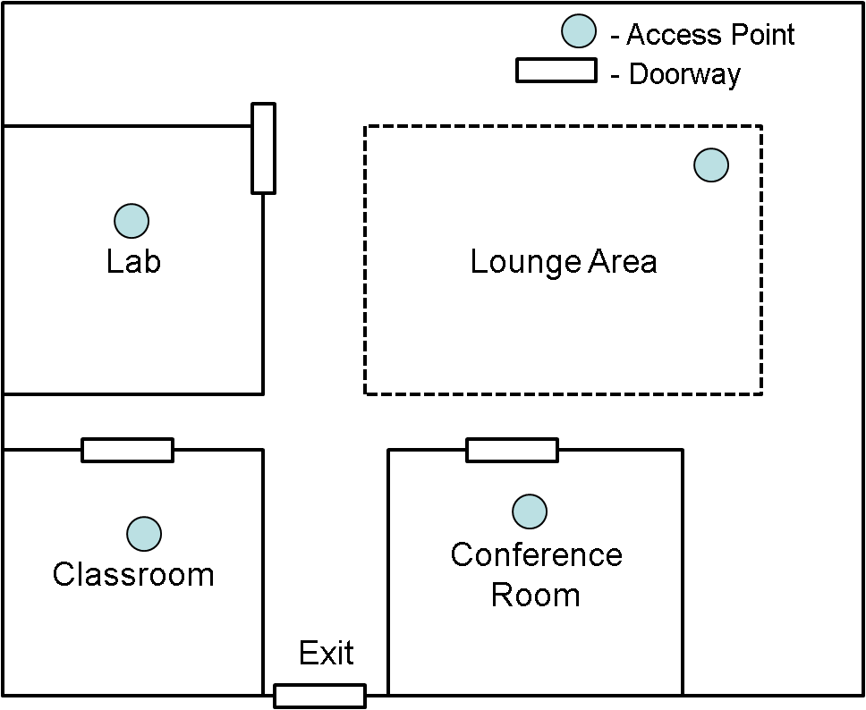
Methodology
Figure 1 NetGames 2008 Floor Plan
Notes:
NetGames’08 was held in Salisbury Labs, a multi-story, brick and steel building at Worcester Polytechnic Institute in which an IEEE 802.11a/b/g network is deployed for campus use. NetGames’08 is a two-day workshop.
Figure illustrates the floor plan showing the locations of wireless access points (APs) and the conference room where the workshop was held.
The trace was gathered during a term break when most students are off campus.
Studies focus on second day’s traffic because the first day had atypical network behavior in that wireless was not immediately available (owing to some difficulties with from the WPI network providers) and because users were not familiar with the environment (e.g., the location of power outlets).

Slide 7
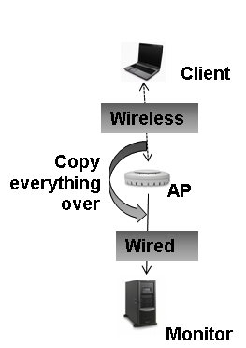
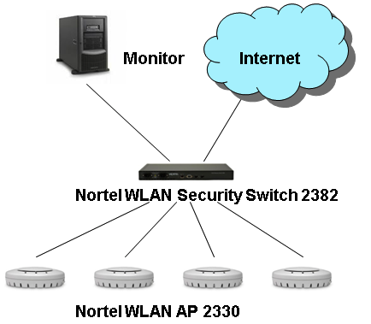
Methodology
Figure 2 Network Topology and Trace Collecting Scheme
Notes:
Each individual AP simultaneously supports 802.11a and 802.11b/g.
Clients negotiate with the AP to determine which mode (a, b or g) to use based on client support, signal strength, and the AP load.
The subnet of APs connects via a switch to the campus gigabit backbone and finally to the Internet.
Each frame collected by the AP contains link, network, transport, and application layer data encapsulated within the TaZman Sniffer Protocol (TZP) and is sent to the monitor in a UDP packet. This made sure every frame AP sees is recorded for later analysis.
Additionally, a laptop with a 802.11a/b/g compatible wireless adapter placed inside the conference room measured the received signal strength (RSSI) using a Windows Management Instrumentation script that queried the windows registry once every second.

Slide 8
Trace Summary Statistics
Attribute | Values
Number of Channels | 24
Total bytes transmitted | 2.7 GBytes
Total hours of trace | 7
Average Throughput | 857 kbps
Peak number of users | 18
Peak throughput | 8.4 Mbps
Table I Trace Statistics (Second Day)
Notes:
Total bytes transmitted includes all type of frames (data and control frames such as beacon, association, probing, etc.)
Average throughput of 857 kbps and peak of 8.5 Mbps shows the network is somewhat busy during the workshop

Slide 9
Outline
Introduction
Methodology
Analysis
Conclusion

Slide 10
Comparative Analysis
Attrib | Stanford | SIGCOMM | Dartmouth | NetGames
Users | 74 | 195 | 7134 | 20
APs | 12 | 4 | 566 | 1
Length | 12 weeks | 52 hours | 17 weeks | 7 hours
Bytes | 46 GBytes | 4.6 GBytes | 4.6 TBytes | 2.7 GBytes
Avg. bytes | 308 KBytes | 440 KBytes | 226 KBytes | 19.3 MBytes
Top 5 Apps | Web session FTP netbios X-term | Web (46%) session icp p2p email (6%) | Web (29%) file backup netbios p2p FTP | Web (73%) p2p session email (1%) netbios
Year | 1999 | 2001 | 2003/4 | 2008
Table VI Application Comparison Across Traces
Notes:
20 users are observed using wireless in NetGames’08, a small scale workshop
“Average bytes” means average bytes per user per hour. Comparing to other traces, this shows heavy usage of the network
Web traffic dominance continues and increases, different than trends reported ealier. We believe the proliferation of Web-based applications expands Web traffic to include such user activities as email, games, chat, video and live radio. For example, in our trace the increasing proportion of Web traffic is coupled with diminishing existence of email traffic.
P2p and session (ssh + vpn) usage emerge as a top-5 applications

Slide 11
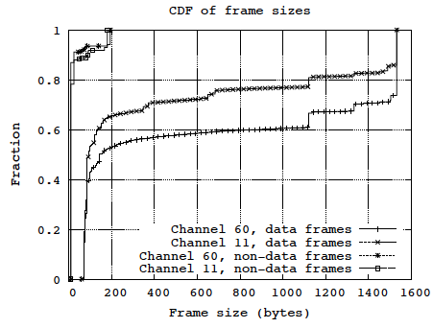
Analysis – Physical Layer Frames
Channel | Number of Frames | Volume (bytes) | Average Size (bytes)
60 | 6073329 | 1803797183 | 525
11 | 4712465 | 887727516 | 393
Figure 4 CDF of Frame Sizes
Notes:
This page shows the volume distribution on channel 60 (802.11a) and 11 (802.11bg) channels and their frame size distribution.
Channel 60 and 11 have 99% of all traffic collected (24 different channels observed).
Data frames are normally larger than control frames.
Data frames bi-modal, seen by “steps” in CDF (~100 bytes on left, 1500 bytes on right)

Slide 12
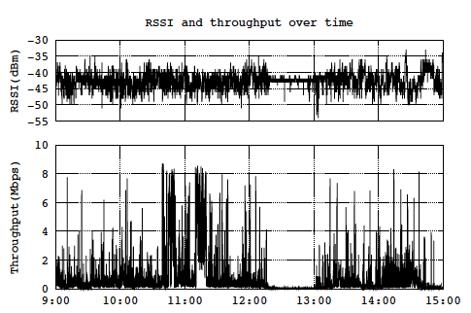
Analysis – Physical Layer RSSI
Figure 3 RSSI Variations over Time
Notes:
RSSI varies considerably with little visual correlation to background traffic spikes.
When room is occupied, the RSSI fluctuates in a range of -50 dBm to -35 dBm, even though the AP is in the ceiling directly overhead
When room empties shortly after noon for lunch break, notable decrease in RSSI variance.

Slide 13
Analysis – Data Link Layer
Type | Count | Frac. | Volume | Frac. | Size
Data | 1809004 | 0.38 | 810593393 | 0.91 | 448
Ack | 1831248 | 0.39 | 18312480 | 0.02 | 10
Beacon | 204668 | 0.04 | 36840692 | 0.04 | 180
RTS | 249 | <0.01 | 3984 | <0.01 | 16
CTS | 690403 | <0.01 | 6904030 | 0.15 | 10
Probe rqst | 112062 | 0.02 | 8887496 | 0.01 | 79
Probe rspns | 32227 | <0.01 | 5381909 | <0.01 | 167
Null data | 31841 | <0.01 | 764184 | <0.01 | 24
Assoc rqst | 143 | <0.01 | 14433 | <0.01 | 100
Assoc rspns | 141 | <0.01 | 6486 | <0.01 | 46
Disassoc | 13 | <0.01 | 338 | <0.01 | 26
Authentcte | 311 | <0.01 | 9330 | <0.01 | 30
Deauthentcte | 43 | <0.01 | 1118 | <0.01 | 26
Action | 107 | <0.01 | 7276 | <0.01 | 68
Table III Frame Distribution (Channel 11)
Notes:
Data frames dominate in volume
The numbers of data and ack frames do not match exactly because of possible frame drop by AP during peak times.
RTS/CTS is rarely used (only 249 RTS was sent, while the extra CTS frames are CTS-to-self)

Slide 14
Analysis – Transport Layer
Type | Count | Volume | Fraction
TCP | 3215156 | 2002254869 | 0.79
UDP | 1192505 | 510813319 | 0.2
GRE | 28849 | 14670242 | 0.01
IGMP | 3888 | 258310 | <0.01
ICMP | 3366 | 306671 | <0.01
IPv6 | 125 | 28221 | <0.01
Table IV Transport Layer Data Distribution
Notes:
TCP continues to dominate
However, the fraction of 20 percent of UDP is high compared to other traces (see related work)
Note, in this case, the UDP is from p2p file sharing

Slide 15
Analysis – Applications Observed
Appl. | Port | Count | Volume | Frac. | Avg.
http | 80 | 2494223 | 1745068155 | 0.69 | 700
p2p | 14900 | 721916 | 300657230 | 0.12 | 416
https | 443 | 312781 | 109974470 | 0.04 | 352
nat-t | 4500 | 235282 | 124695364 | 0.05 | 529
ssh | 22 | 146601 | 28036250 | 0.01 | 191
imap4 | 993 | 102204 | 37451476 | 0.01 | 366
openvpn | 1194 | 99302 | 63994068 | 0.03 | 644
netbios | 137 | 60383 | 7628494 | <0.01 | 126
rdp | 3389 | 53970 | 20612017 | 0.01 | 382
pop3 | 995 | 43347 | 33558788 | 0.01 | 774
Other | n/a | 105973 | 57408001 | 0.02 | 542
Table V Application Classification
Notes:
All applications are defined by port
HTTP traffic dominates, following by p2p, https, and nat-t (NAT Traversal mostly used by VPN applications)
P2p port acquired by manually analysis

Slide 16
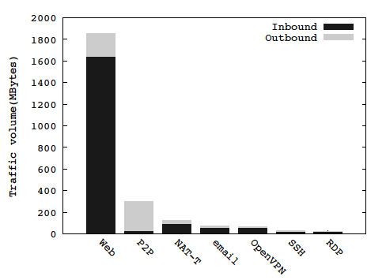
Analysis – Application Data Rates
Figure 5 Inbound and Outbound Traffic
Notes:
Again, note how Web dominates by total traffic volume
Most applications consume more downlink capacity than uplink
This despite the fact that many conference settings symmetric in terms of ingress/egress capacities
Except p2p which takes much more uplink capacity, confirming the findings in Saroiu and Gummadi [6].

Slide 17
Analysis – Application Data Rates vs Time
9:00 - 10:30 Morning session (3 speakers)
10:30 - 11:00 Break
11:00 - 12:00 Panel session
12:00 - 13:30 Lunch break
13:30 - 15:00 Afternoon session (3 speakers)
Figure 7 Application Throughput
9:00
10:30
11:00
12:00
13:30
Notes:
Web, email and p2p are selected to illustrate application usage correlating to workshop organization (see paper for others)
Overall, network activity very closely tied to conference schedule
Morning session has the most variation overall.
9:20am jump of network activities for Web, email and p2p, showing a coordinated pattern.
Morning break started (indicated by the left-most vertical line), the overall throughput of Web and p2p dropped, indicating people left the room.
After about 10 minutes, people started returning to the room and there was an increase in Web and p2p throughput.
When the panel started at 11:00am, Web traffic diminished and then went up (but with fewer users, as shown in Figure 7.
Most prominently, the lunch break at 12:00 provided a quiet period, with some traffic at the beginning and end. The small amount of periodic Web traffic seen during the lunch break was due to the authentication of clients to the WPI Web server, needed to retain guest access to the wireless network.
In the afternoon session, Web traffic low except for a burst in the late afternoon. Email also had a burst in the late afternoon, possibly indicating some end-of-day checking and sending of emails before the workshop ended and the participants dispersed.
P2p’s throughput covers large areas of the graph, except for during the breaks, but has a small Coefficient of Variation (CoV).

Slide 18
Analysis – Application Rate Variability
App. | Min | Max | Median | Mean | stddev | CoV
http | 0.001 | 8.621 | 0.194 | 0.875 | 1.655 | 1.892
email | 0.001 | 5.368 | 0.017 | 0.075 | 0.223 | 2.952
vpn | 0.001 | 5.549 | 0.007 | 0.09 | 0.448 | 4.994
nat-t | 0.001 | 4.35 | 0.045 | 0.114 | 0.218 | 1.917
ssh | 0.001 | 4.116 | 0.003 | 0.021 | 0.118 | 5.608
rdp | 0.001 | 0.098 | 0.058 | 0.056 | 0.14 | 2.491
p2p | 0.001 | 0.01 | 0.262 | 0.172 | 0.118 | 0.686
Figure 6 Applications Statistics in Mbps
Notes:
Web (http) has most variability (or bursty), prerhaps reflecting varied Web page sizes an intermittent usage
P2p although covers large area of the graph but has a small Coefficient of Variation (CoV).

Slide 19
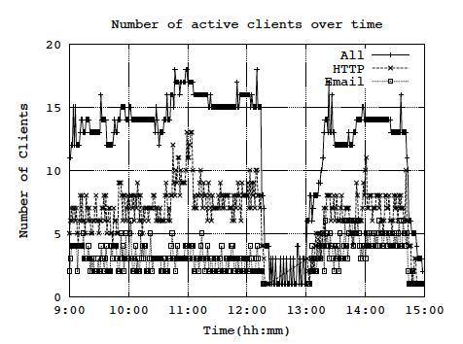
Analysis – Clients vs Time
13 users
7 users
4 users
Figure 8 Clients over Time
Notes:
Client activeness provides another view into how participants used the wireless network
‘All’ in the graph means a client that at least sends a data frame (to exclude clients only kept open and exchange control frames with the access pooint) during the past minute.
On average, at any time there are 13 users active, 7 browsing websites and 4 using email services.
At any time there are more than 10 people using their laptops, and several of them using http and email services.
Number of people using the network can be clearly seen influenced by the workshop organization.
Periodic traffic in lunch break (12:00 – 13:00) is likely an automatic refresh of web pages or email.

Slide 20
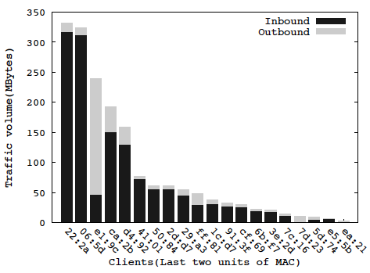
Analysis – Clients and Data Volume
Figure 9 Clients Inbound and Outbound Traffic Volume
Notes:
Figure 8 plots the inbound and outbound traffic volume for each client (identified by their MAC addresses), sorted from highest volume to lowest.
Most clients used more downlink capacity, with the exception of client e1:9c and 7d:23 that used more uplink capacity when running p2p file sharing application.

Slide 21
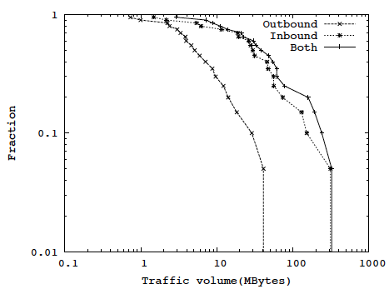
Analysis – Clients and Data Volume
Figure 10 CCDF of Traffic In and Out
Notes:
Figure 9 shows the complementary CDF (CCDF) of the inbound and outbound traffic of all clients. The trendlines are not heavy-tailed.

Slide 22
Outline
Introduction
Methodology
Analysis
Conclusion

Slide 23
Conclusion
IEEE 802.11a and IEEE 802.11g are heavily used
About two-thirds of the participants werr active
Peak throughput of 8.73Mbps (large, but not at capacity)
Web remains dominant, may be increasing after a brief decline
Emerging use of p2p and vpn as top applications
Wireless use directly influenced by workshop organization
People using wireless in vicinity of access point affect signal strength
Notes:
Researchers can use this analysis and these traces to build synthetic workloads for experiments or plan for improved deployment of wireless networks at future forums.

Slide 24
Future Work
Analyze Web traffic in depth to understand the applications it carries
E.g. Email, IM, videos …
Analyze application performance (e.g. video streaming supported by http) in wireless networks

Slide 25
Questions?

Slide 26
References
[1] A. Balachandran, G. Voelker, P. Bahl, and V. Rangan. Characterizing User Behavior and Network Performance in a Public Wireless LAN. In Proceedings of ACM SIGMETRICS, Marina del Rey, CA, USA, 2002.
[2] T. Henderson, D. Kotz, and I. Abyzov. The Changing Usage of a Mature Campus-wide Wireless Network. In Proceedings of MobiCom, Philadelphia, PA, USA, 2004.
[3] Amit P. Jardosh, Krishna N. Ramachandran, Kevin C. Almeroth, and Elizabeth M. Belding-Royer. Understanding Congestion in IEEE 802.11b Wireless Networks. In Proceedings of SIGCOMM IMC, Berkeley, CA, USA, October 2005.
[4] R. Mahajan, M. Rodrig, D. Wetherall, and J. Zahorjan. Analyzing the MAC-Level Behavior of Wireless Networks in the Wild. In Proceedings of ACM SIGCOMM, Pisa, Italy, September 2004.
[5] M. Rodrig, C. Reis, R. Mahajan, D. Wetherall, and J. Zahorjan. Meas- based Characterization of 802.11 in a Hotspot Setting. In Proceedings of ACM SIGCOMM E-WIND, Phil., PA, USA, August 2005.
[6] S. Saroiu, P. Gummadi, and S. Gribble. Measuring and Analyzing the Characteristics of Napster and Gnutella Hosts. Multimedia Systems Journal, 9(2):170 – 184, August 2003.
[7] D. Tang and M. Baker. Analysis of a Local-Area Wireless Network. In Proceedings of MobiCom, Boston, MA, USA, August 2000.

