Slide 1
Towards Usable Attribute Scaling for Latency Compensation in Cloud-based Games
Edward Carlson, Tian Fan, Zijian Guan, Xiaokun Xu and
Mark Claypool
Notes:
Edward Carlson, Tian Fan, Zijian Guan, Xiaokun Xu and Mark Claypool. Towards Usable Attribute Scaling for Latency Compensation in Cloud-based Games, In Proceedings of the Game Systems Workshop (GameSys), Istanbul, Turkey, September 28 - October 1, 2021. Online at: http://www.cs.wpi.edu/~claypool/papers/scale-gamesys-21/

Slide 2
Introduction
Google Stadia
Additional challenge:
Latency
Attribute
Scaling
2

Slide 3
Attribute Scaling Inspiration
Lagged game
(too hard)
Game with
no lag
Fun
Lagged game with
compensation
Too hard!
Just right!
Too easy!
Game Difficulty
With latency → game more difficult!
Adjust game to keep player performance “in the zone”
3

Slide 4
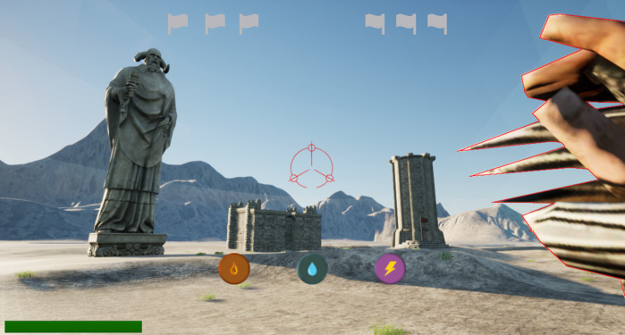
Develop Games – Catalyst
4

Slide 5
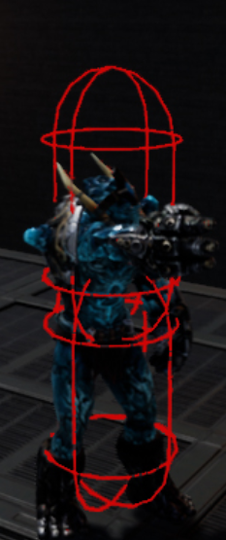
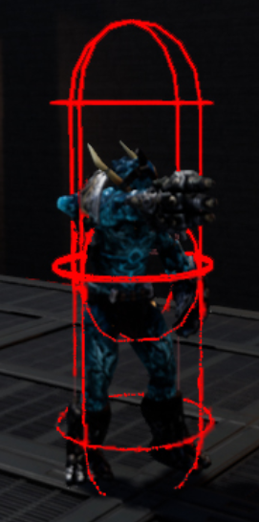
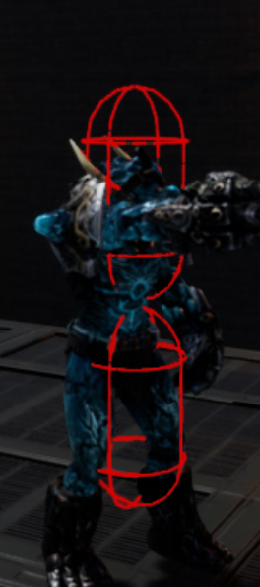
Catalyst Scaling
Scale 1.0
Scale 1.5
Scale 2.0
5

Slide 6
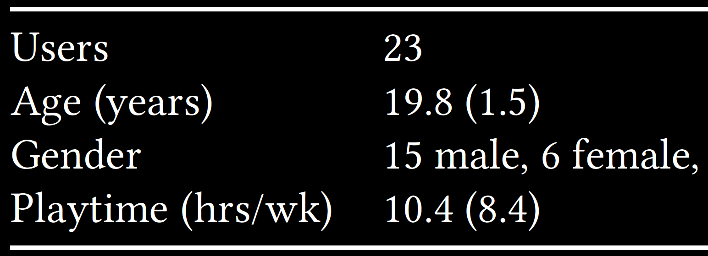
Demographics
6

Slide 7
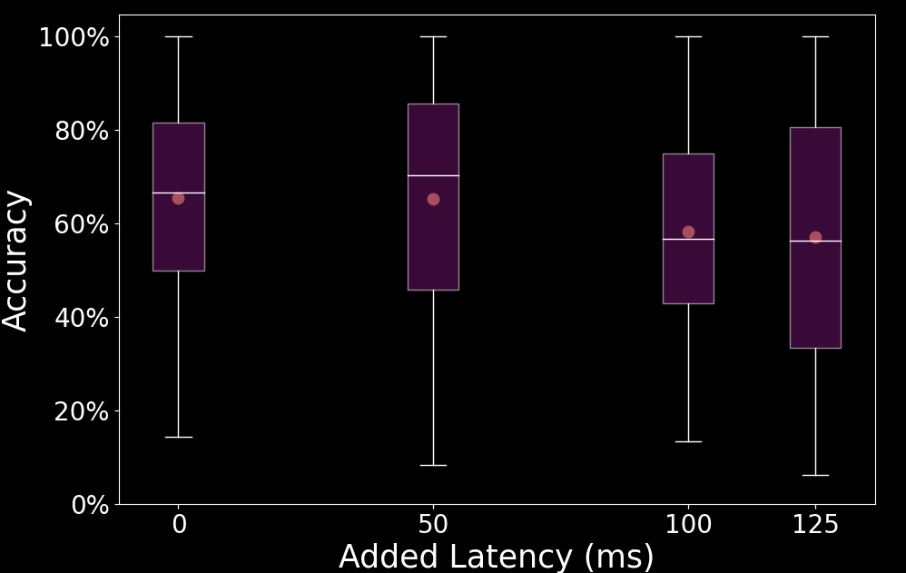
User Study
23 users, 4 latencies, 3 scaling, 2 difficulty
7

Slide 8
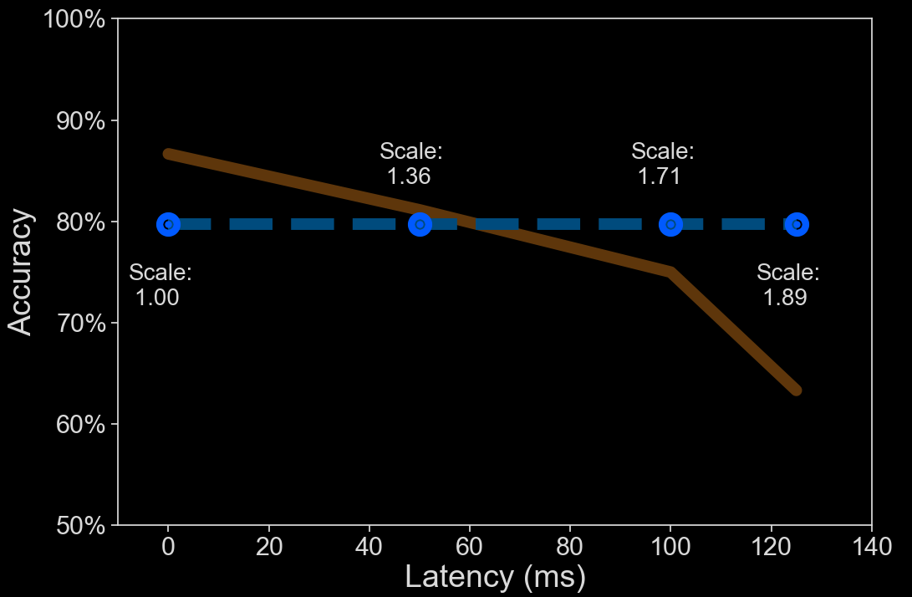
Using the Model
8

Slide 9
Towards Usable Attribute Scaling for Latency Compensation in Cloud-based Games
Thank-you for your attention!
Edward Carlson, Tian Fan, Zijian Guan, Xiaokun Xu and
Mark Claypool
Notes:
Edward Carlson, Tian Fan, Zijian Guan, Xiaokun Xu and Mark Claypool. Towards Usable Attribute Scaling for Latency Compensation in Cloud-based Games, In Proceedings of the Game Systems Workshop (GameSys), Istanbul, Turkey, September 28 - October 1, 2021. Online at: http://www.cs.wpi.edu/~claypool/papers/scale-gamesys-21/

