Slide 1
CounterMeasures: A Game for Teaching Computer Security
Craig Jordan, Matt Knapp, Dan Mitchell, Mark Claypool and
Kathi Fisler
CS and IMGD
Worcester Polytechnic Institute
Notes:
Abstract: Since games typically demand considerable computer resources, game players will often purchase new technologies to improve their game performance. One such technology is the solid state drive (SSD) with the potential to provide significantly better performance than the traditional hard disk drive (HDD). However, while the benefits of SSDs to drive access speeds can be demonstrated, the benefits to computer game performance is largely unknown. This paper presents a detailed study comparing the performance of SSDs to HDDs for several popular computer games. Initial experiments provide read access speeds on both a desktop PC and a laptop to provide a baseline for SSD and HDD comparison. Then, detailed experiments are run for three computer games, Civilization IV, Portal 2, and Torchlight, covering a range of disk activity types. Analysis of the results shows SSDs compared with HDDs provide a 25% improvement to game boot times and game start times, but no significant improvement to game save times.

Slide 2
Security Alert!
Number of network users has grown
About 150% since 2000
Smaller fraction are technically skilled
Need ways to protect users and applications from harm
In U.S., only about 1000 security specialists
10,000 – 30,000 are needed
[1, Internet World Stats.com]
[2, USA Defense Industry Jobs.com]

Slide 3
Learning about Security
Security theory is dry, abstract, boring
e.g. textbook
Security contests can be fun and concrete, but difficult to get started
i.e. easy to be a “noob”
Games FTW?
Are great at teaching you how to play them
Can be concrete and applied
But … security-based games are unrealistic

Slide 4
This Work
Develop security game that
1) Teaches about computer security
2) Is fun
Method?
Use real security tools (e.g. fping)
Provide guided learning
Make game-type objectives for win/loss conditions and rewards
→ CounterMeasures

Slide 5
Outline
Introduction (done)
Related Work (next)
CounterMeasures
Evaluation
Results
Conclusions

Slide 6
Related Work
Books on security
Security-themed games
Web sites to try exploits
Organized, “real” hacking games

Slide 7
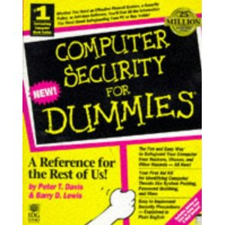
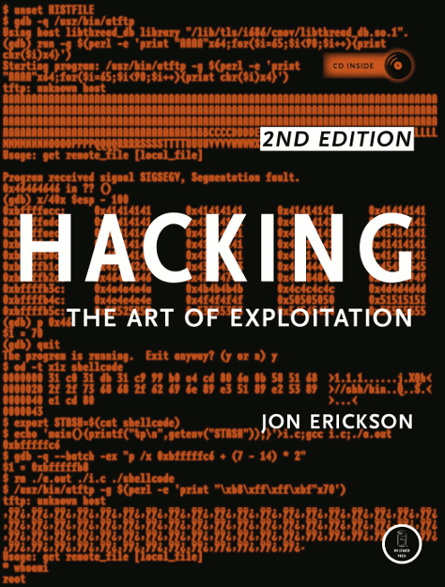
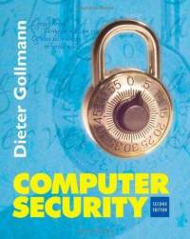
Books
Setting passwords
Stack overflows
Code and system exploits
Difficult to self-teach
Can be hard to apply

Slide 8
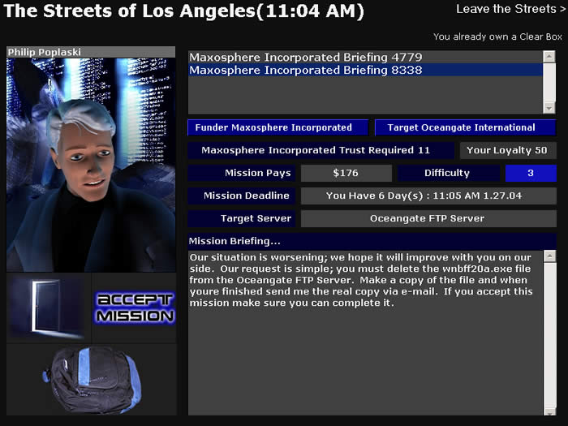
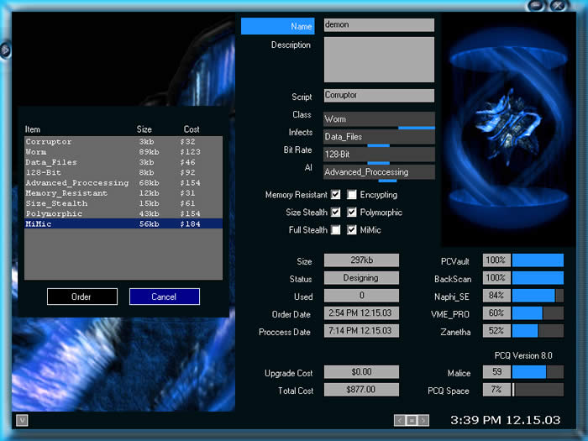
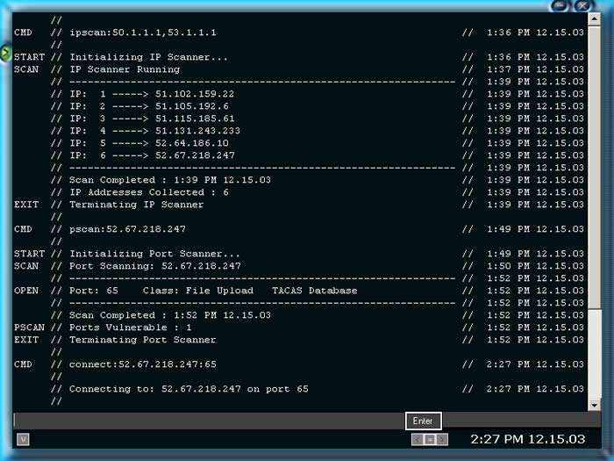
Street Hacker

Slide 9
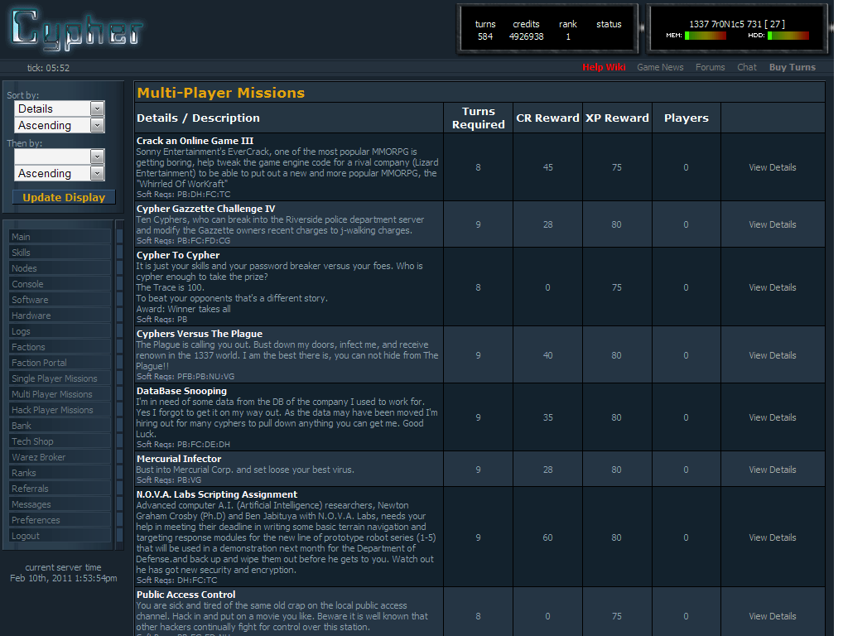
HackerSkills and Cypher
Self learning
But mostly puzzles
Team gameplay, story
But not realistic

Slide 10
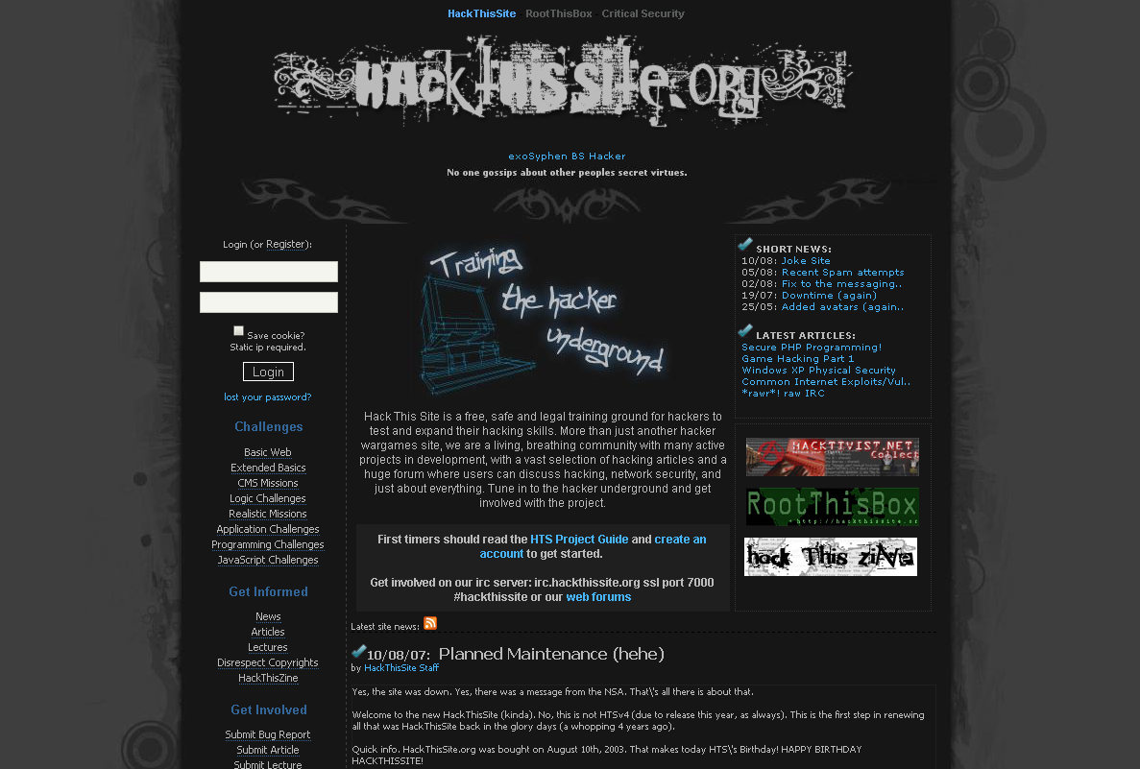
HackThisSite
Ultimate challenge → Break into the site itself!

Slide 11
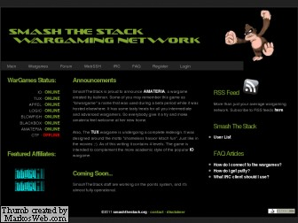
SmashTheStack

Slide 12
OverTheWire
Real exploits, Web-based environment so easy access
But little guided learning

Slide 13
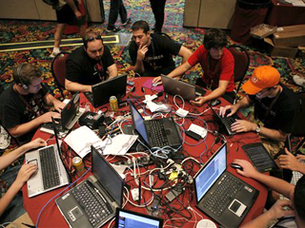
DEFCON, SANS NetWars
Team-based contests, test knowledge from courses
Teams capture machines, harden defenses. Real exploits
But noobs not welcome!

Slide 14
CrackMe
We … had to close this site. Hopefully we are back soon!
Log File:
May 1st 2011: An abuse mail hit the provider. 2 virus infected files have been found (e.g. Lafarge Crackme 1 which is from 2005 !)
May 2nd 2011: The provider forced to take the website down until problems are fixed.
During May: Many thoughts on how to proceed
June 1st 2011: A phone call with the CEO of Clean MX, who is responsible for the abuse mail, resulted in that a company called ParetoLogic is responsible for the scan. They have reported during the last years (?) that crackmes.de is a full scaled virus website (muah!)
Now waiting for direct contact with ParetoLogic.
How to bring the site back:
Do some advanced virus scanning on all files
Preventing any website copying via wget etc.
Virus scanning when submitting any crackmes
No direct download, only after registering with additional Captcha
Password protection for every file with a randomly generated password for every download
Or we can do this:
Moving everything to a more secure system

Slide 15
Outline
Introduction (done)
Related Work (done)
CounterMeasures (next)
Design, Implementation, Interface, Content
Evaluation
Results
Conclusions

Slide 16
Game Design
Single player
Guide player through several missions, each teaching new aspect of security
1 skill, until final mission
Missions build upon each other
Use real shell
Blacklist (block) some commands
Score based on commands, time
Decrement when get hint

Slide 17
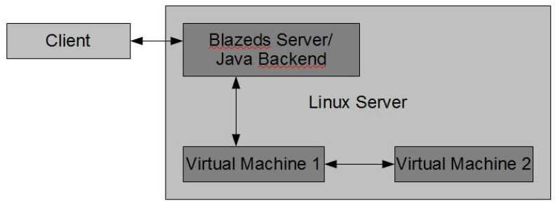
Implementation
Client on player’s machine
Adobe Flex with Java, Adobe AIR so on desktop
Server runs Linux with Tomcat Web server
BlazeDS to integrate with Adobe
Virtual machines – Shell commands and Target host
jsch
JDBC to Oracle for login

Slide 18
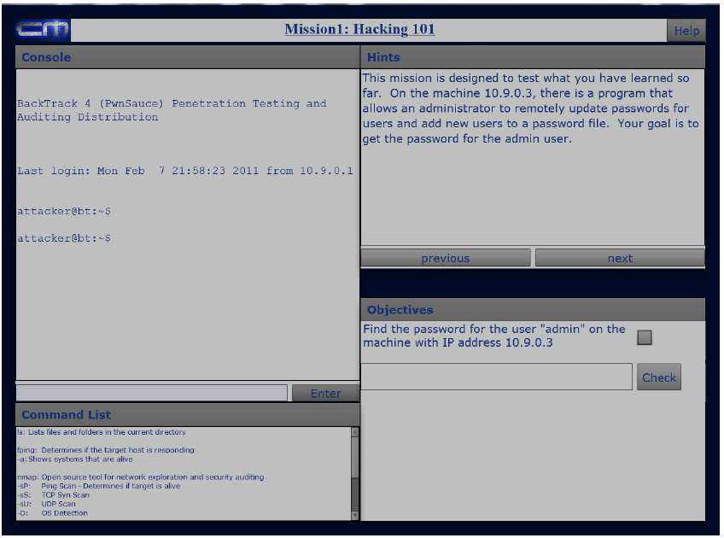
Game Interface

Slide 19
Mission Content
Training Mission 1 - Finding Your Target
Port scanning, OS detection, ports open
fping and nmap
Training Mission 2 - Bypassing Authentication
Buffer overflow
Training Mission 3 - Discovering Passwords
Format string vulnerabilities
Live Mission 1 - Hacking 101
Combine skills
Crack the password for the user “admin” on the system with IP address 10.9.0.3

Slide 20
Outline
Introduction (done)
Related Work (done)
CounterMeasures (done)
Evaluation (next)
Results
Conclusions

Slide 21
Hypotheses
1) Training simulation that emulates real-world system better for learning security than reading about it
2) Learning computer security from game more engaging and less time consuming than same material through books

Slide 22
User Study (1 of 2)
Preliminary questionnaire assessing user background
Two groups
Control group – read material
Experiment group – play CounterMeasures
Both groups do Mission 101
Experiment group uses shell
Post questionnaire assessing knowledge, opinions

Slide 23
User Study (2 of 2)
Reserved laboratory, computer separated by space
2 PCs w/shell for control group
2 laptops w/CounterMeasures for exp. group
Target demographic: general technical knowledge, but no computer security skills
College students studying CS or related
Solicitation via:
Email (CS & IMGD), pitch to OS class (reward with bonus point), food (pizza)

Slide 24
Outline
Introduction (done)
Related Work (done)
CounterMeasures (done)
Evaluation (done)
Results (next)
Participation, Objective, Subjective
Conclusions

Slide 25
Results - Participation
20 users
10 in control group, 10 in experiment group
All undergraduate students
Most from OS course
All had CS background
19 of 20 indicated little or no computer security background

Slide 26
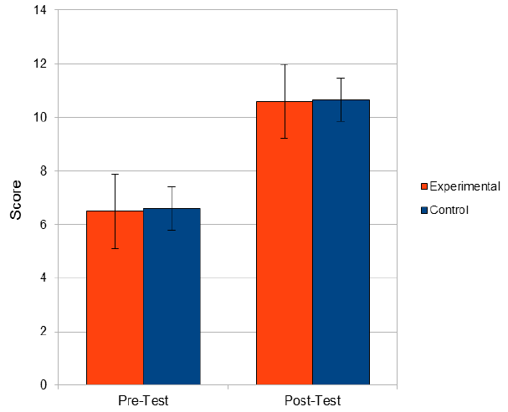
Results – Objective: Knowledge
Background similar (pre)
Both groups learned (post)

Slide 27
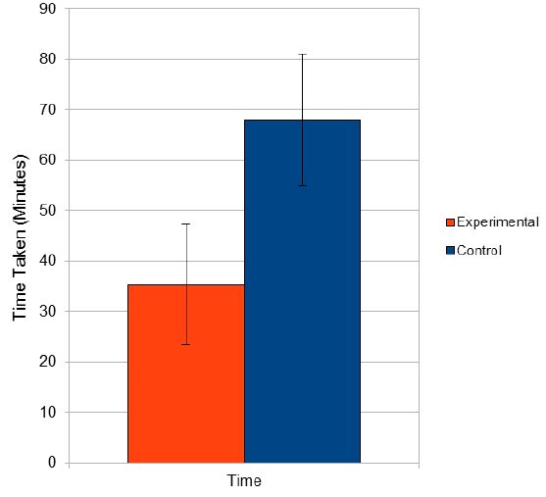
Results – Objective: Time
Experimental group about 50% faster

Slide 28
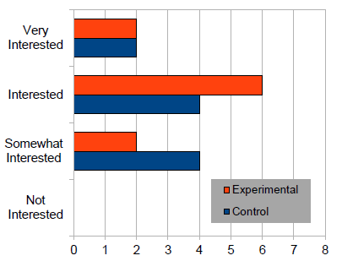
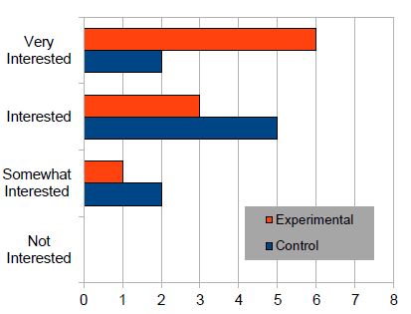
Results – Subjective: Interest
Pre
Post
Reading piques interest little
Playing game piques interest more

Slide 29
Results – Subjective: Learning
Game players felt they learned more

Slide 30
Conclusion
Computer security increasingly important
Tough to learn security through books, current games
CounterMeasures designed to
Teach practical security
Be more engaging than books
User study shows CounterMeasures
Teaches same as reading, but in ½ the time
Piques interest in security

Slide 31
Future Work
Additional missions
XML documents
Other gameplay elements
Scoring, story/plot
Multi-player
Competition
Attack and defend

