Slide 1

Datasets – Moving Target Selection with Delay
Shengmei Liu
Mark Claypool
Andy Cockburn
University of Canterbury
New Zealand
Worcester Polytechnic Institute
USA
Ragnhild Eg
Kjetil Raaen
Carl Gutwin
Kristiania University College
Norway
University of Saskatchewan
Canada
Notes:
Hi my name is Shengmei. I’m a Ph.D. student in computer science at WPI, an engineering school
near Boston, Massachusetts. My research area focus on latency and gaming.
I did this work with my advisor, professor Mark Claypool.
I am funded by Intel corporation and worked with
Atsuo Kuwahara, James Scovelle and Jamie Sherman on this work.
Today I’ll present our paper: The Effects of Network Latency on Competitive First-Person Shooter Game Players. We are honored to have this paper included in QoMex 2021.

Slide 2

Delay and Interactivity
Delay as low as 1-2 ms can be perceived by humans
Delay around 50 ms is known to affect performance in mouse-based pointing tasks
Notes:
Latency can cause interactivity.
Latency can be an important factor that impact player experience.
Although this is a joke, it still reflect the fact that latency degrades player performance a lot.

Slide 3
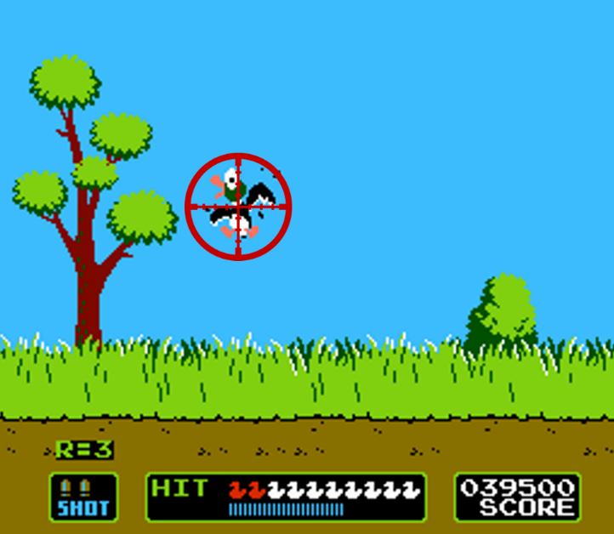
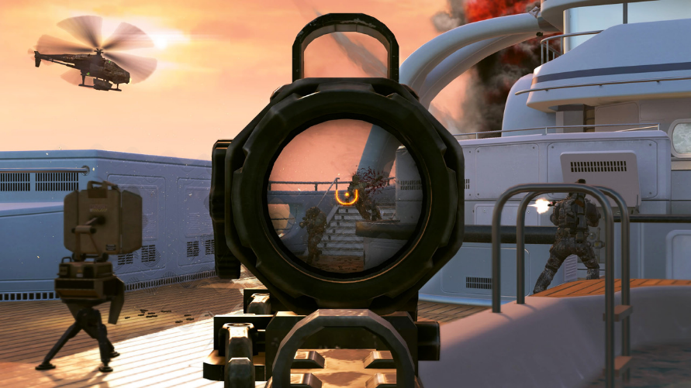
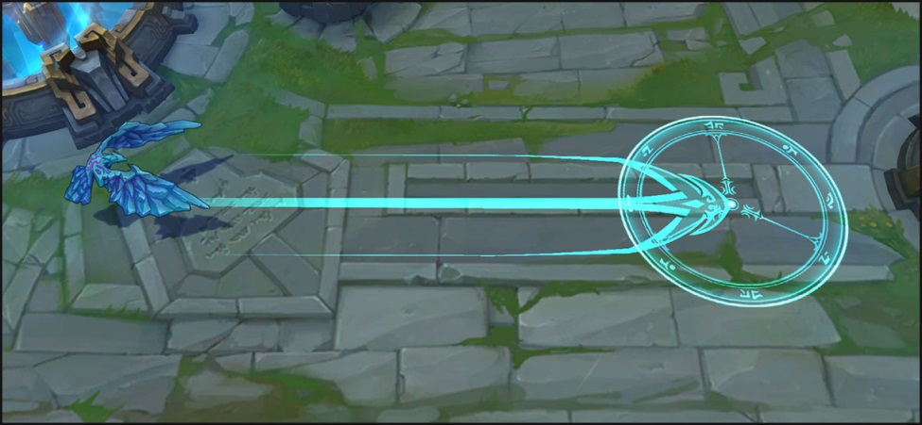
Why Moving Target Selection?
[Call of Duty, Activision, 2003]
[Duck Hunt, Nintendo, 1984]
[League of Legends, Riot Games, 2009]

Slide 4
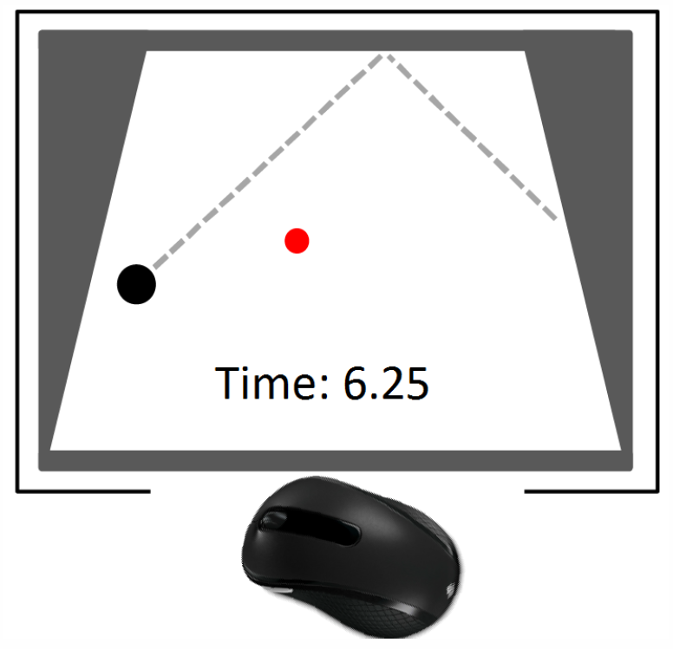
Puck Hunt
The Game of Selecting a Moving Target
Time to select puck with mouse
Number of clicks
5 iterations
1 QoE for each combo
83 users
167 trials
Self-rated score
Notes:
Each combo of speed and delay is a difficulty.
In the demographic questionnaire, all users are asked about the gender, age, and self-rated score as a gamer.
What we want to do here with the data is to model the distribution of target selection times based on speed and delay.

Slide 5
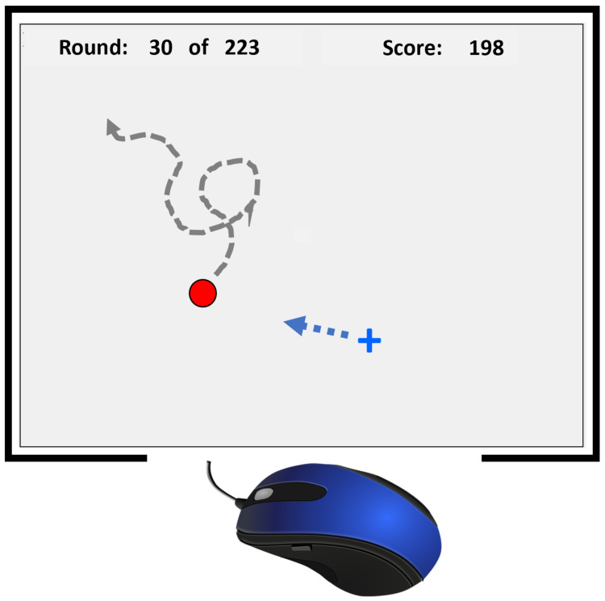
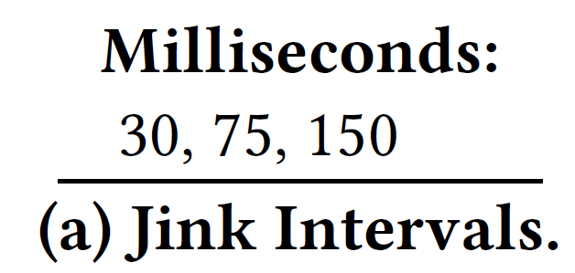
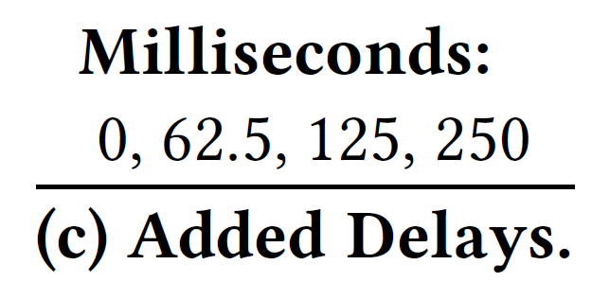
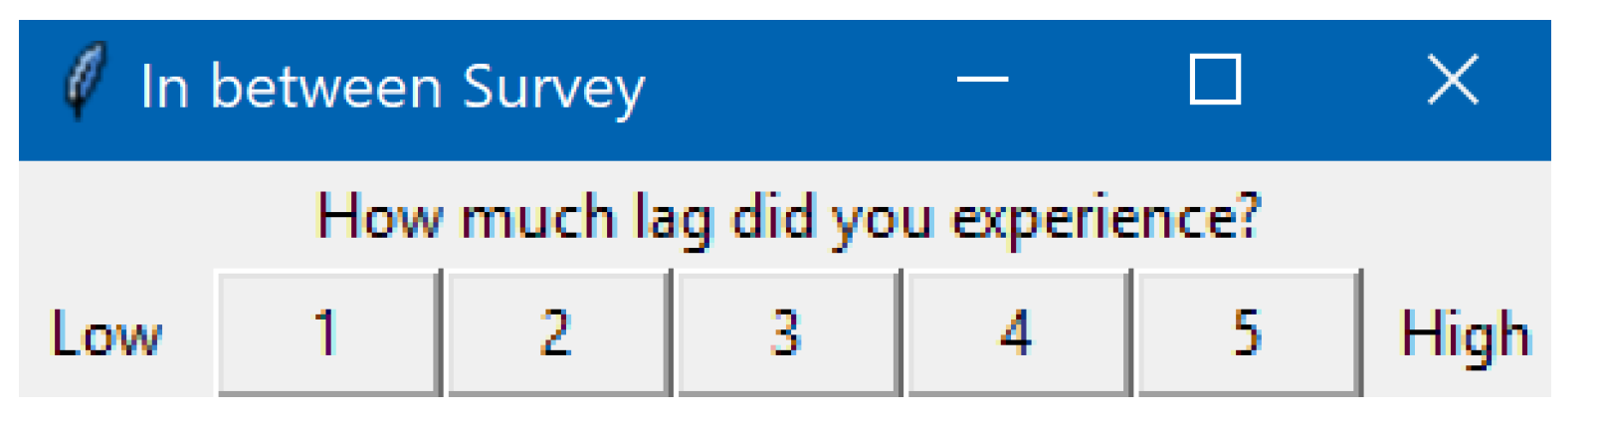
Juke!
The Game of Selecting a Dodging Target
Time to select target
Distance from target
5 iterations each
1 QoE for each combo
53 users
223 trials
(+50 milliseconds base delay)

Slide 6
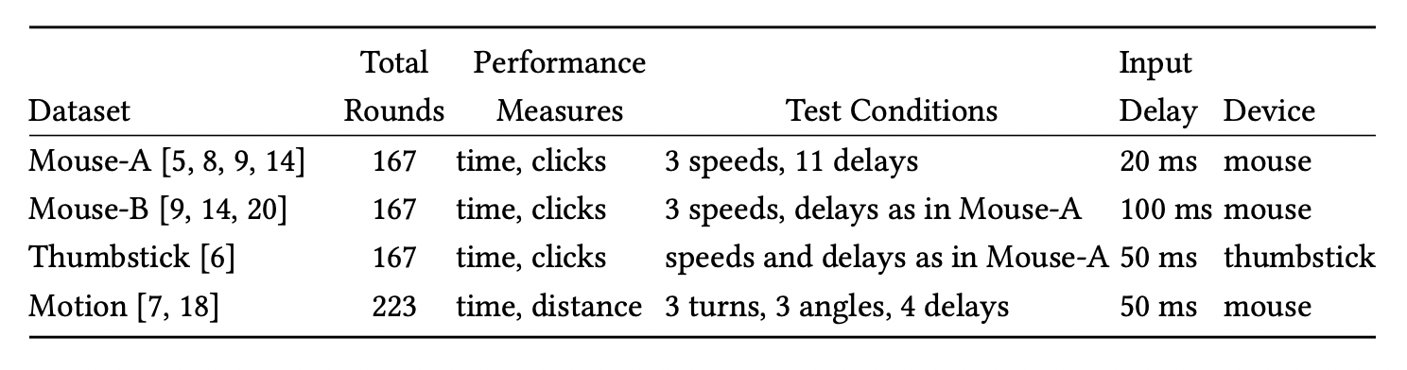
Datasets
Notes:
For datasets, we have two datasets from two prior user studies. In total we have 83 users where 66 are males, 16 are females and 1 prefer not to say. In the demographic questionnaire, all users are asked about the gender, age, and self-rated score as a gamer. Players with self-rated score from 1-3 are classified as low skill player, and a score 4 or 5 is considered high skill player. The mean self-rating was about 3.9, showing a slight skew of “high ability”. According to our pervious work at the bottom, self-rated score is a good indicator for actual player skill. We have 24 low skill players, and 59 high skill players.

Slide 7
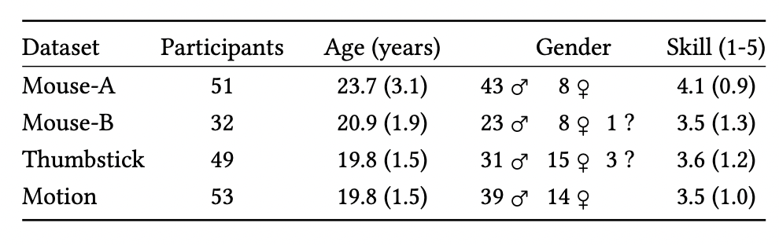
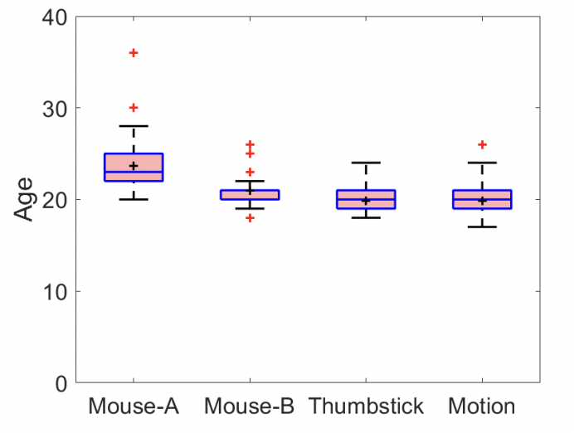
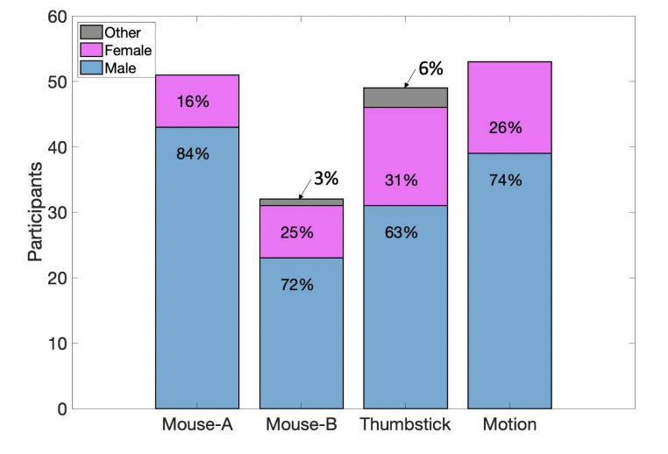
Demographics

Slide 8
Example (Devices)
Selection time increases exponentially with latency
Thumbstick takes 2x mouse for the same delays
Notes:
The Mouse-A and Thumbstick datasets have identical user studyparameters except for the selection device – mouse or game con-troller thumbstick, respectively. This allows for a comparison of theeffects the two different pointing devices have on selection times.Figure 3(a) and Figure 3(b) depict graphs of selection time versusdelay, with data grouped by target speed. The x-axes are the totalinput delays (added delay + base delay) and the y-axes are the timesto select the moving target. The trendlines are for each pointingdevice tested. Each point is the mean time for all users for thatdevice, delay & speed combination, shown with a 95% confidenceinterval.Overall, there is an increase in mean selection time as delay in-creases. This increase appears exponential over the range of delaystested. Comparing the thumbstick data to the mouse data showsthe thumbstick as a selection device takes about twice as long asthe mouse for the same delays. Comparing Figure 3(a) to Figure 3(b)shows this 2x elapsed time holds irrespective of target speed.

Slide 9
Example (Demographics)
Self-rated score can be indicator for player performance
Notes:
Responses to the datasets’ demographics questions can be used toanswer queries related to user background experience and attributesin relation to game-specific data.Since each dataset included the question “Rate your ability as acomputer gamer (1 - low to 5 - high)”, correlations between answersto this question and in-game performance may indicate if self-ratedgame skills are reasonable indicators of actual game performance.We grouped participants’ normalized target selection times (loweris better) by their self-ratings of ability. Figure 4 shows boxplots (asin Figure 2(a)) of normalized elapsed time on the y-axis for usersclustered by self-rating on the x-axis. The “n=” labels on the x-axisindicate the number of participants in each self-rating group.From the figure, the mean and median normalized elapsed timesdecrease (improve) approximately linearly with self-rated skill.However, the spread indicated by the boxes shows that some indi-viduals with lower self-ratings performed better than others withhigher self-ratings. A one-way between subjects ANOVA test showsthere was a significant effect of self-rated skill on elapsed time atthe 0.05 significance level for the five conditions, F(4, 176) = 17.86,𝑝<.001.

Slide 10
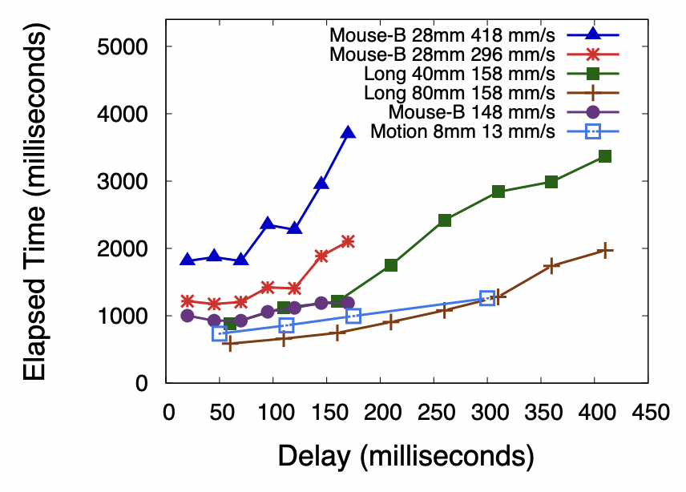
Example (Comparisons)
High-velocity targets are sensitive to delay
Notes:
Analytic models of player performance lay the groundwork for abroad exploration of the impact of delay in games. The describeddatasets can be used to model the distribution of the times to selectmoving targets, providing for models to be used in simulations.

Slide 11
Example (Modeling)
Selection times can be modeled as lognormal
Notes:
Analytic models of player performance lay the groundwork for abroad exploration of the impact of delay in games. The describeddatasets can be used to model the distribution of the times to selectmoving targets, providing for models to be used in simulations.

Slide 12
Future work
FPS Gaming Actions
Navigation
Selection
Data
Models
Simulations
Analysis of Performance in FPS game
Notes:
Our approach is to look at the building blocks for FPS games. The building blocks are the atomic gaming actions. There are mainly 3 of them, reaction, which is players’ ability to react to stimulus, navigation, which is players ability in avatar movement, and selection, which is players ability in selecting the moving targets. We want to study the 3 gaming actions, collect data and then build models for them. With the models, we can simulate conditions in fps games. With the simulations, we can evaluate and analyze player performance in FPS games.
With this work, we are focusing on selection action.
We built models for the distribution of time to select with player skill, latency, and target speed from existing user study data.
The model is then used for some simulations where player response times are selected from a range of possible values based on the model.

Slide 13

Acknowledgements
Marco Duran and Matthew Thompson
  Conducting the Mouse-B study
Robyn Domanico and Linh Hoang
  Conducting the Thumbstick study
Chaiwat Ekkaewnumchai and Bhon Bunnag
  Developing Juke!
  Conducting the Motion study
Users
  Participating

Slide 14
Datasets – Moving Target Selection with Delay
git@bitbucket.org:claypool/target-selection-datasets.git
Shengmei Liu
Mark Claypool
Andy Cockburn
University of Canterbury
New Zealand
Worcester Polytechnic Institute
USA
Ragnhild Eg
Kjetil Raaen
Carl Gutwin
Kristiania University College
Norway
University of Saskatchewan
Canada
Notes:
Hi my name is Shengmei. I’m a Ph.D. student in computer science at WPI, an engineering school
near Boston, Massachusetts. My research area focus on latency and gaming.
I did this work with my advisor, professor Mark Claypool.
I am funded by Intel corporation and worked with
Atsuo Kuwahara, James Scovelle and Jamie Sherman on this work.
Today I’ll present our paper: The Effects of Network Latency on Competitive First-Person Shooter Game Players. We are honored to have this paper included in QoMex 2021.

