Slide 1
‘Git Gud!’ – Evaluation of Self-Rated Player Skill Compared to Actual Player Performance
Shengmei Liu, Mark Claypool
Atsuo Kuwahara, Jamie Sherman,
Bhuvana Devigere
Notes:
Hello, my name is Shengmei. Today I’m gonna introduce our paper - ‘Git Gud!’ – Evaluation of Self-Rated Player Skill Compared to Actual Player Performance

Slide 2
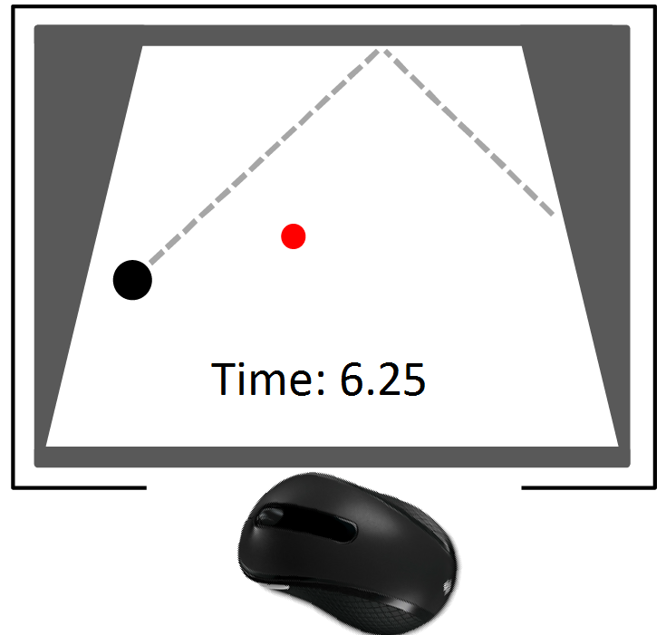
Motivation & Datasets
Can self-rated score effectively categorize players of different skill levels?
Are females under-recognized compared to males for the same skill?
Notes:
With this paper, we want to answer two questions: No1. Can self-rated score effectively categorize players of different skill levels, No2. Are females under-recognized compared to males for the same skill.
We have four datasets from previous user studies included in the table on the right. All the players were playing a moving target selection game called puck hunt as shown in the picture on the left. The players’ time to select were recorded.

Slide 3
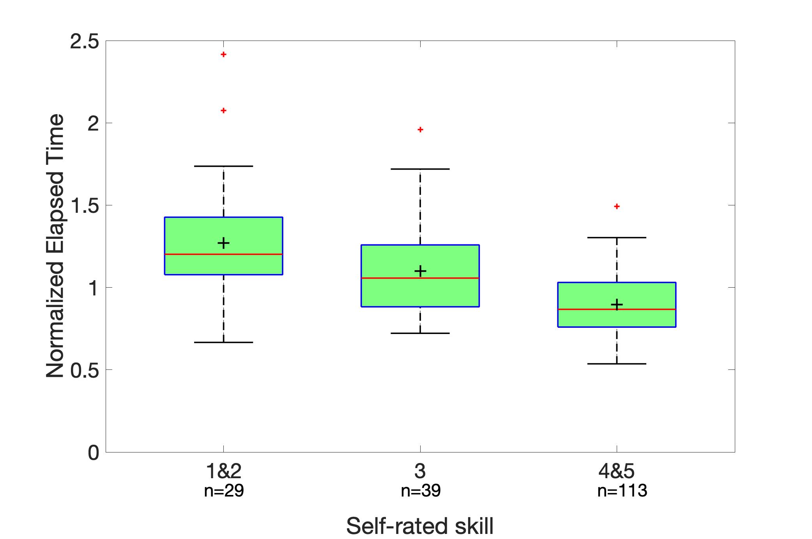
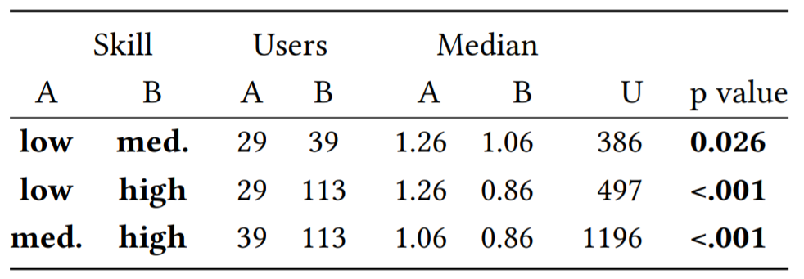
Results – Self-rated skill
Notes:
Here are our results about self-rated skill. In the graph on the left, the x-axis is combined self-rated skill. N=a number denotes number of players in the group. The y axis is normalized elapsed time. The graph shows a clear decreasing trend of the elapsed time vs self-rated skill.
The Mann-whitney U test results in the table indicate significant diff between all the 3 groups.
self-rated score effectively categorize players of different skill levels

Slide 4
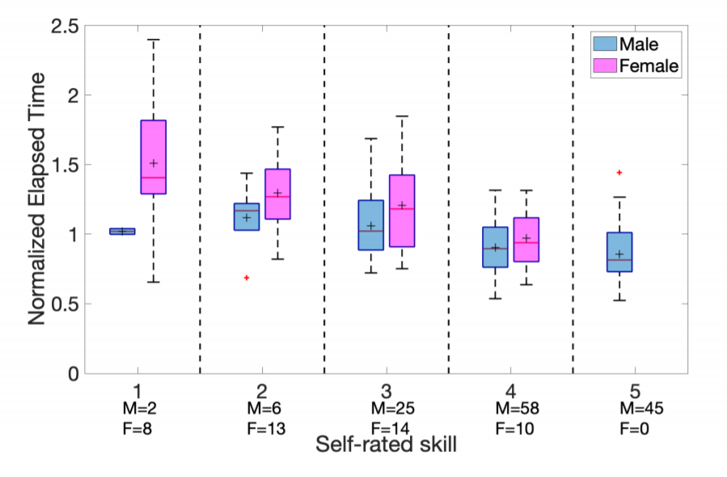
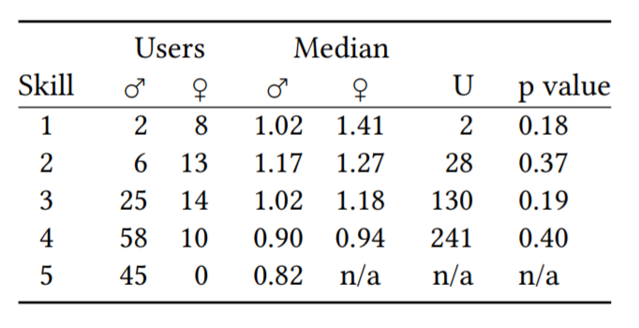
Results - Gender
Notes:
Here are our results about gender. The x axis is self-rated score, the M= a number denotes the number of males, and F= denotes the number of females. The y axis is the normalized elapsed time. The blue bars are for males, and the pink bars are for females. There is no females rate themselves at 5. The Mann-Whitney U test results in the table depicts that there is no significant diff between males and females within every self-rated skill, and between females in group 4, and males in group 5. It indicates that females in high skill groups are under-recognized.

Slide 5
‘Git Gud!’ – Evaluation of Self-Rated Player Skill Compared to Actual Player Performance
Shengmei Liu, Mark Claypool
Atsuo Kuwahara, Jamie Sherman,
Bhuvana Devigere
https://web.cs.wpi.edu/~claypool/papers/skill/
Notes:
Thanks for your attention!

