Slide 1
Comparison of TCP Congestion Control over a Satellite Network
Saahil Claypool, Mark Claypool
Jae Chung
Notes:
Saahil Claypool, Jae Chung, and Mark Claypool. Measurements Comparing TCP Cubic and TCP BBR over a Satellite Network, In Proceedings of the IEEE Consumer Communications & Networking Conference (CCNC), Virtual Conference, January 9-12, 2021.
Online at: http://www.cs.wpi.edu/~claypool/papers/bbr-cubic-sat/

Slide 2
Introduction (1 of 2)
Satellites provide global networking
“Always on” connectivity for remote locations, during disasters
Bitrates increasing (20x recently)
Challenge is latency → about 300 ms min. one-way for geosynchronous
300 ms

Slide 3
Introduction (2 of 2)
Latency impacts TCP bitrates
One window of packets each RTT
Window size depends upon congestion control algorithm
TCP Cubic – loss-based
TCP BBR – BDP-based
TCP PCC – utility function-based
TCP Hybla – satellite optimized
Few published studies of TCP over satellite network
Mostly simulation or emulation
This paper → TCP over satellite netwrk

Slide 4
Outline
Introduction (done)
Methodology (next)
Results
Conclusions

Slide 5
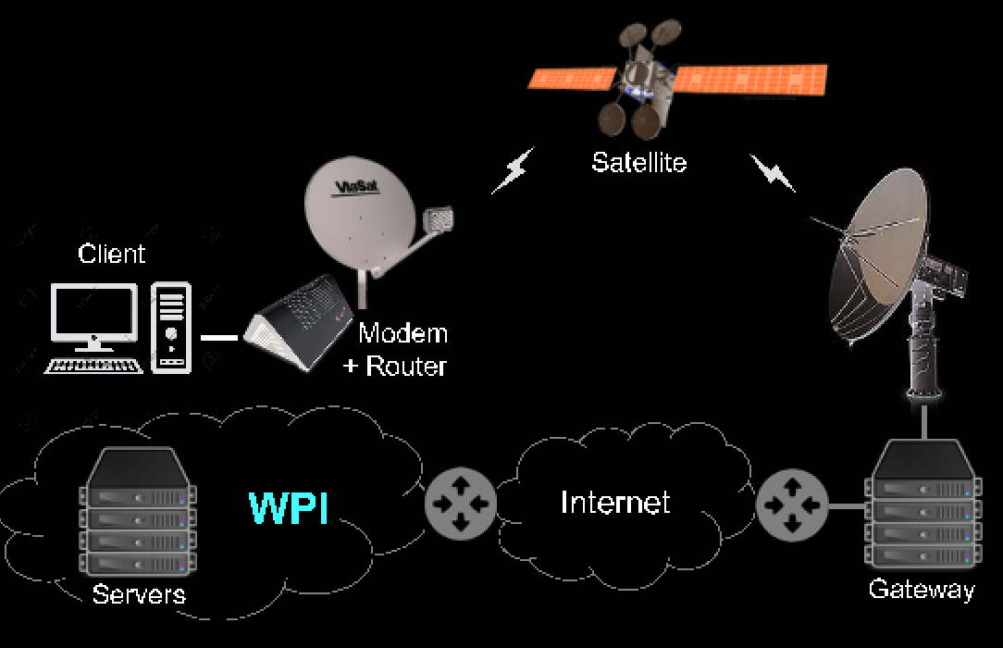
Methodology
Client
144 Mb/s
Servers
Baseline
UDP Ping
Bulk-download
iperf
[RFC 5166]
Throughput
Round-trip time
Retransmissions (loss)
Notes:
Client Intel i7-1065G7 CPU @ 1.30GHz and 32 GB RAM
Servers Intel Ken E312xx CPUs @ 2.5 GHz and 32 GB RAM
Servers and client run Ubuntu 18.04.4 LTS, Linux kernel v4.15.0
Servers connect to WPI LAN via Gb/s Ethernet.
WPI campus connected to Internet via several 10 Gb/s, throttled to 1 Gb/s.
Viasat terminal to Ka-band outdoor antenna (RF amplifier, up/down converter, reflector and feed) through Viasat 2 satellite to Ka-band gateways links
Service plan peak data rate of 144 Mb/s
Gateway does per-client queue management for traffic
Queue up to 36 MBytes (about 2 seconds)
Active Queue Management (AQM) randomly drops 25% when queue over 18 MBytes

Slide 6
Outline
Introduction (done)
Methodology (done)
Results (next)
Baseline
Steady State
Start-up
Conclusions

Slide 7
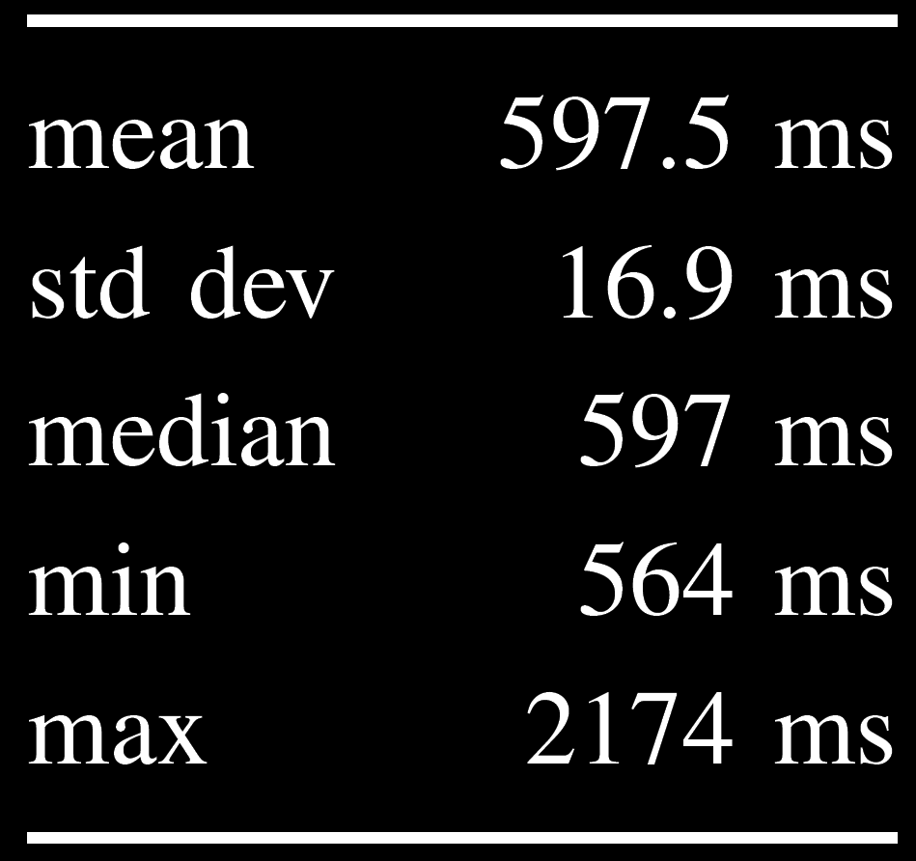
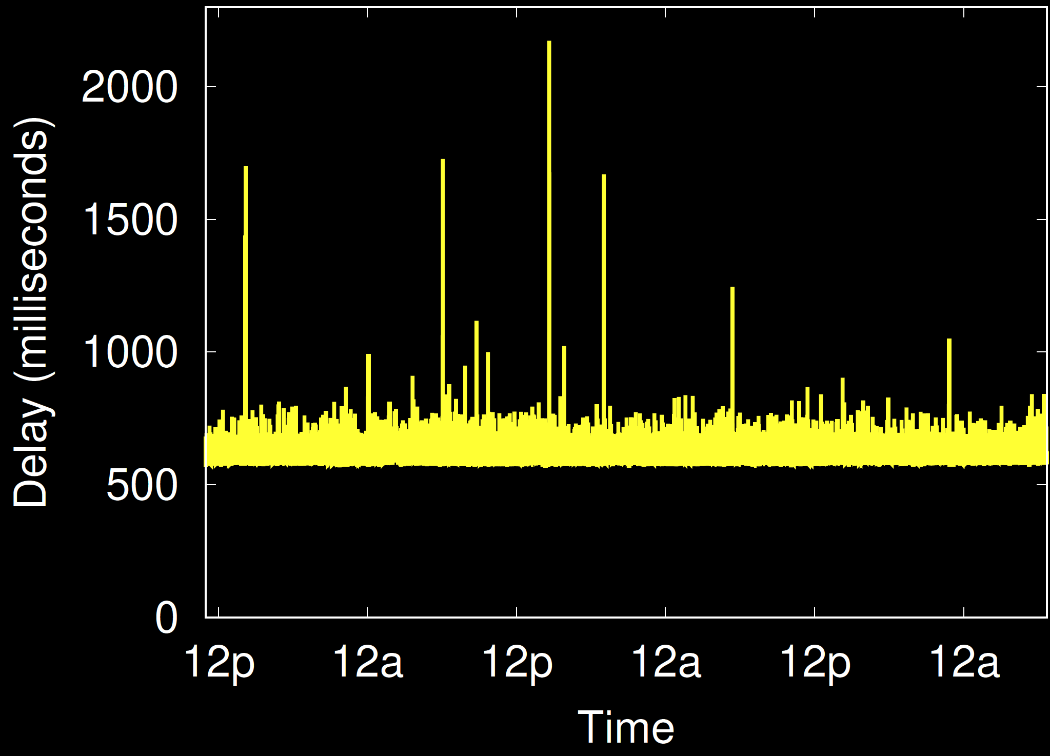
Baseline
Loss: 0.05%
77% are single packet
Largest 11 packets (2.2 seconds)

Slide 8
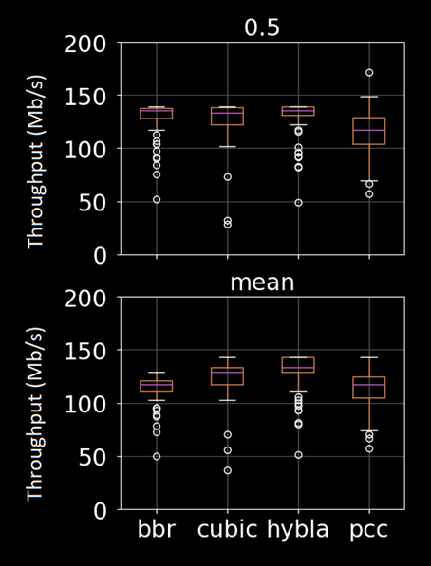
Steady State – Throughput
median
BBR
Cubic
Hybla
PCC

Slide 9
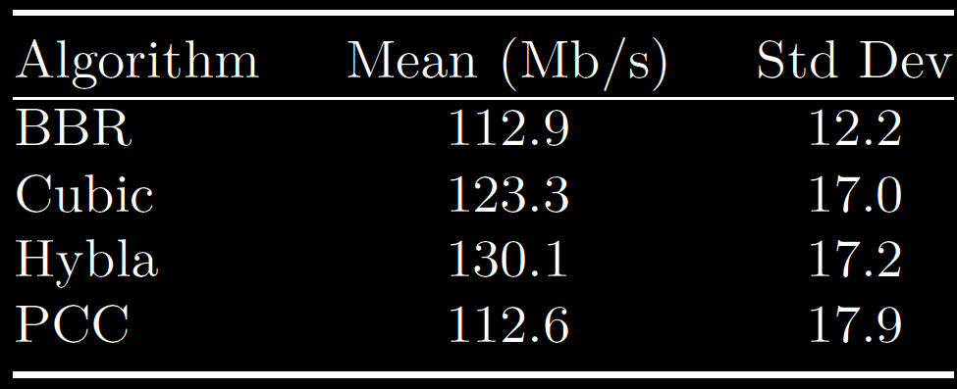
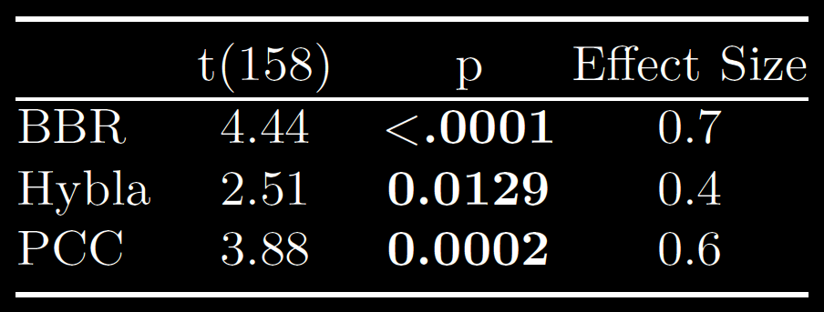
Steady State – Throughput
Tput (Mb/s)
RTT (ms)
BBR
Cubic
Hybla
PCC
780
821
958
685
BBR
Hybla
PCC
Large

Slide 10
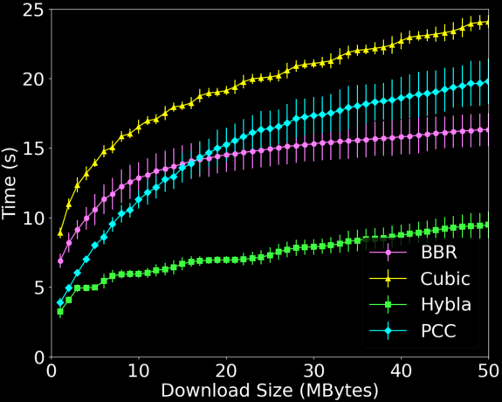
Start-up

Slide 11
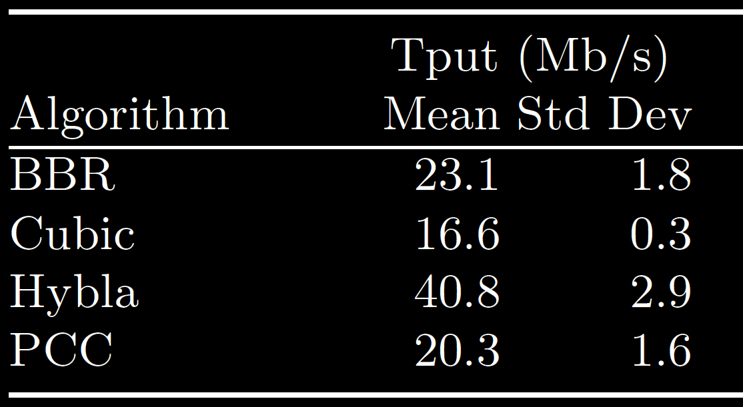
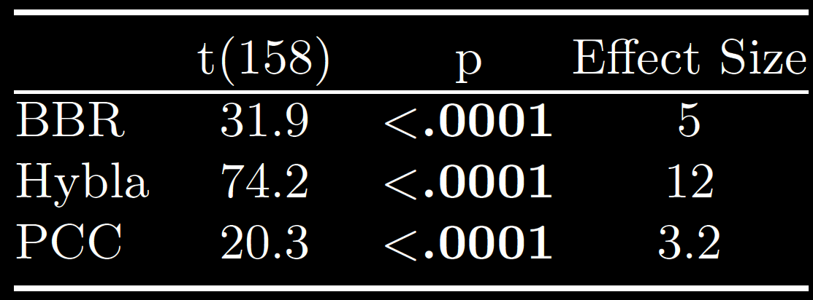
Start-up
Tput
(ms)
RTT
(ms)
BBR
Cubic
Hybla
PCC
917
757
799
806
BBR
Hybla
PCC
Very Large

Slide 12
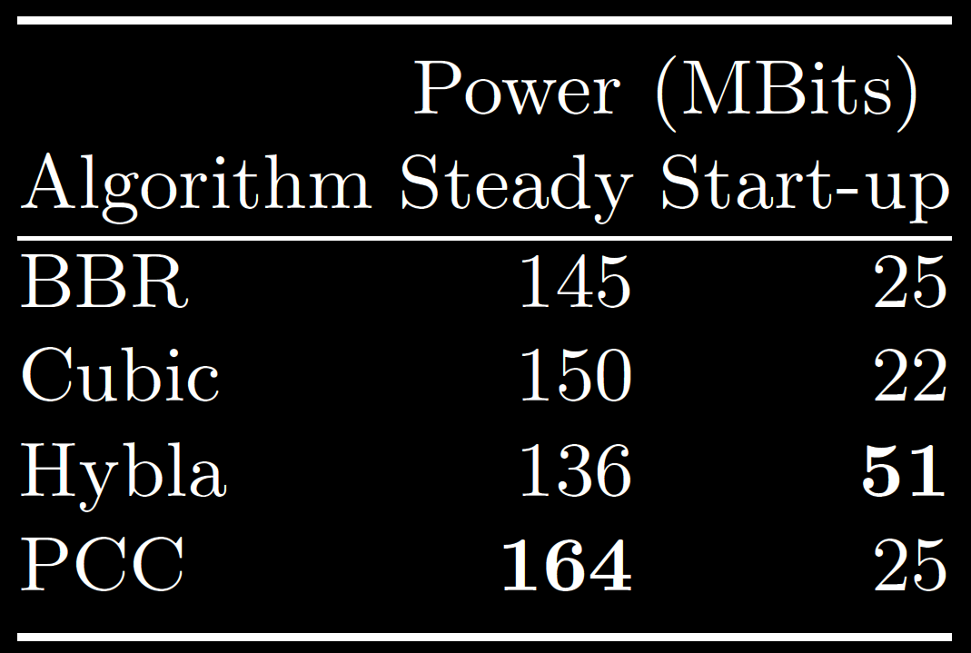
Power
$$P=\frac{Tput}{RTT}$$
BBR
Cubic
Hybla
PCC

Slide 13
Conclusion
Baseline consistent RTT 600ms, low loss
Steady state:
Medians similar
Mean – BBR, PCC lowest
Start-up:
Hybla fastest
BBR, PCC next
Cubic slowest
Power:
PCC – steady state
Hybla – start-up

Slide 14
Future Work
Multiple Flows
e.g., BBR and Cubic together
TCP settings and Protocols
e.g., RTT₀, QUIC
Performance Enhancing Proxy (PEP)
Other applications
e.g., Web browsing, streaming video

Slide 15
Comparison of TCP Congestion Control over a Satellite Network
Saahil Claypool, Mark Claypool
Jae Chung
Notes:
Saahil Claypool, Jae Chung, and Mark Claypool. Measurements Comparing TCP Cubic and TCP BBR over a Satellite Network, In Proceedings of the IEEE Consumer Communications & Networking Conference (CCNC), Virtual Conference, January 9-12, 2021.
Online at: http://www.cs.wpi.edu/~claypool/papers/bbr-cubic-sat/

