Slide 1
Measurement-based Analysis of the Video Characteristics of Twitch.tv
Mark Claypool, Daniel Farrington, and Nicholas Muesch
claypool@cs.wpi.edu
Computer Science and
Interactive Media & Game Development
Worcester Polytechnic Institute
Notes:
Mark Claypool, Daniel Farrington, and Nicholas Muesch. Measurement-based Analysis of the Video Characteristics of Twitch.tv, In Proceedings of the IEEE Games, Entertainment, Media Conference (GEM), Toronto, Canada, October 2015. Online at:http://www.cs.wpi.edu/~claypool/papers/twitch-tv/

Slide 2
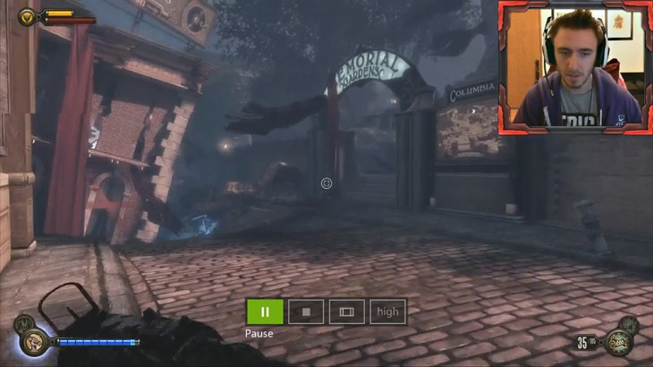
Introduction
Established services provide pre-recorded video content for streaming (e.g., YouTube)
More recently, services provide live video content for streaming (e.g., Twitch.tv)
Twitch.tv most popular live-streaming service [8], streams games
Every month:
1.5 million players,
11 million live streams,
100 million viewers
Must design infrastructures to support and management networks for live streaming
Requires understanding of video characteristics

Slide 3
Previous Work
Many studies of pre-recorded video sites
Cha et al. study popularity [2]
Gill et al. study network characteristics [3]
Fewer studies of live-streaming sites
Kaytoue et al. analyze Twitch.tv [4], but no individual stream characteristics
Pires and Simon [5, 6], compare Twitch.tv and YouTube but consider only bitrate
Zhang and Liu analyze Twitch.tv [7], but do not consider time of day, length, bitrate or resolution

Slide 4
Our Work
Crawler to harvest data, analysis of video characteristics
Provides recent (2015) data
Provides data on video characteristics
Goal: Complement previous study
Compare results, where possible
Re-inforce results and/or analyze change over time
Goal: Fill gaps in knowledge
Live streaming evolving rapidly
New live streaming characteristics (frame rate, frame resolution)

Slide 5
Teasers
Number of Twitch.tv streams correlates with time of day and day of week in U.S.
Confirms results from previous studies
Length of Twitch.tv videos is heavy-tailed
Shown for other file types, but novel for live-streaming
Dominant resolutions are HD, and almost half stream at 60 f/s
Novel and frame rates differ greatly from pre-recorded streaming

Slide 6
Outline
Introduction (done)
Methodology (next)
Results
Conclusion

Slide 7
Methodology
Web crawler
Based on Scrapy (open source crawler in Python)
Modified to use Twitch.tv API for resource data
Gathers details on active streams and length of pre-recorded videos
Ran every hour, Jan 1st to Jan 23rd, 2015
Stream analyzer
3rd party tool that provides resolution, frame rate and bitrate for source stream
Also have data on: audio, encoding, delay, creation times, viewers and views [10]

Slide 8
Outline
Introduction (done)
Methodology (done)
Results (next)
Time of Day
Length
Resolution
Frame Rate
Bitrate
Conclusion

Slide 9
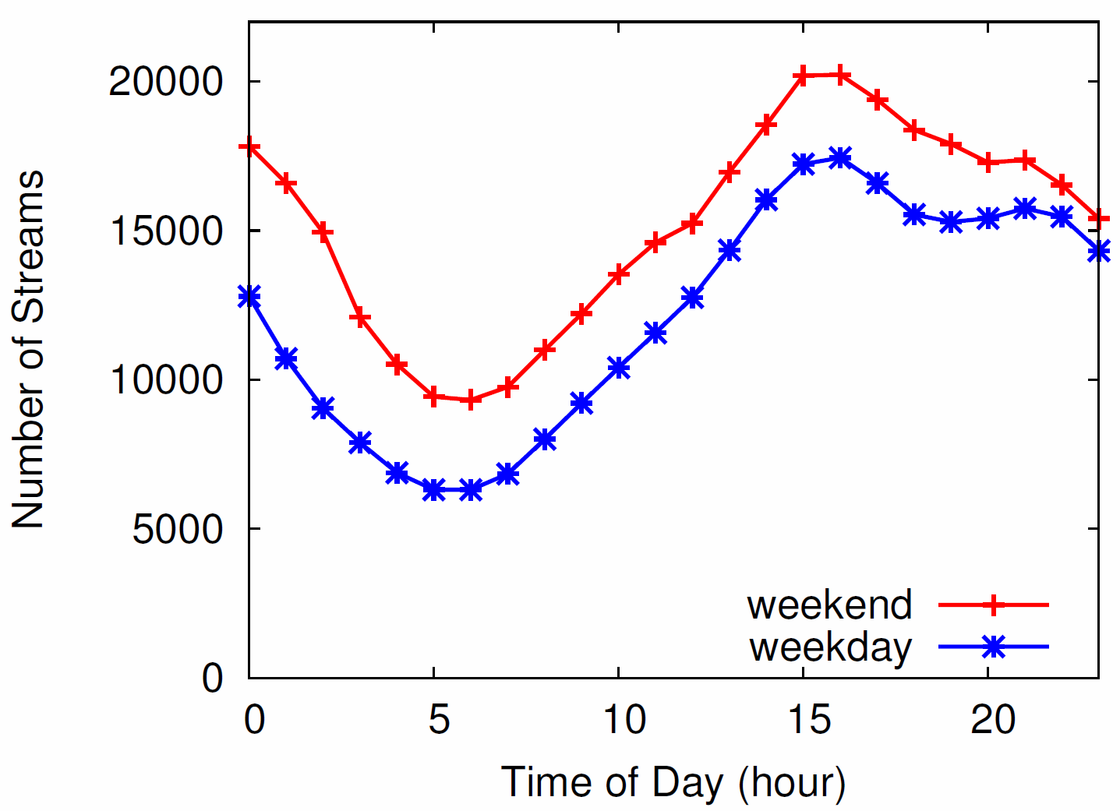
Time of Day
Change in number of streams over 1 day (2x to 3x at peak)
Modest change in number of streams over week (about 25% more)
Compare [5, 6]: similar time of day, day of week
Double number of streams (1 year later)

Slide 10
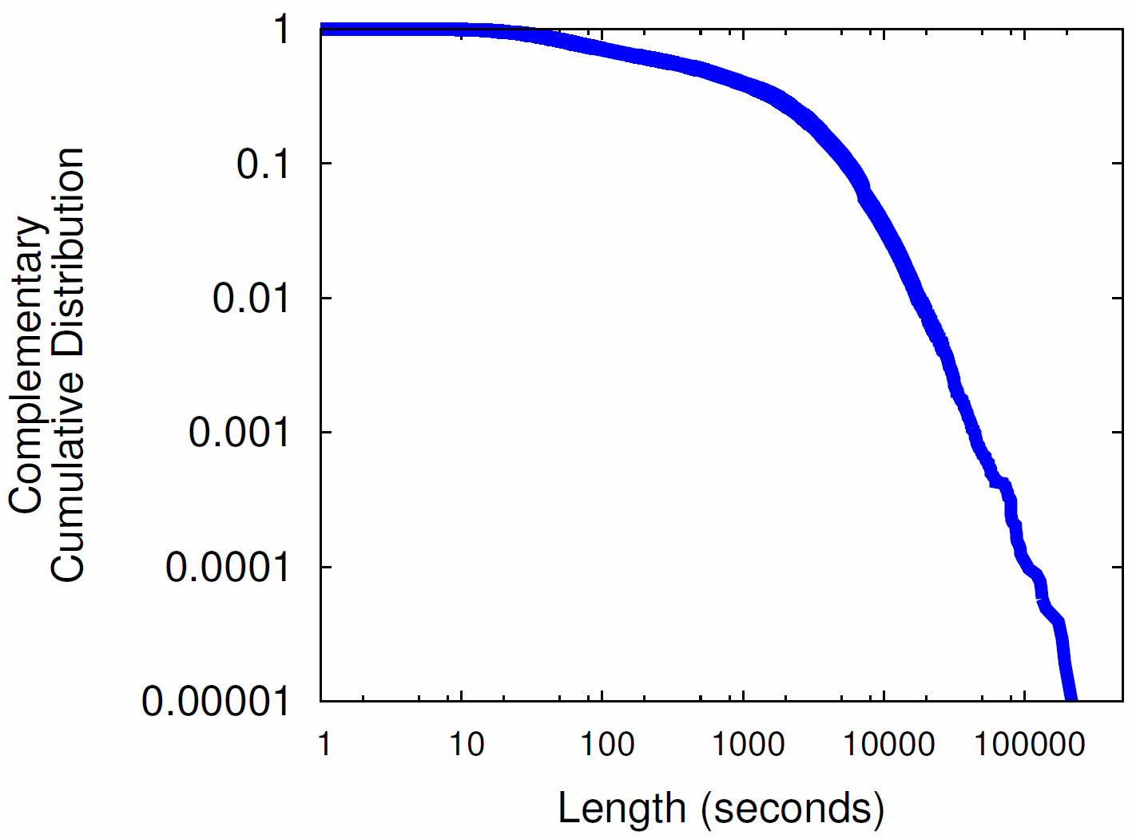
Pre-recorded Video Lengths
Long
tailed
Median is 8 minutes (live streams usually slightly longer [4, 7])
Compare [3]: slightly higher than YouTube, but similar
Long-tailed may contribute to self-similarity on Internet

Slide 11
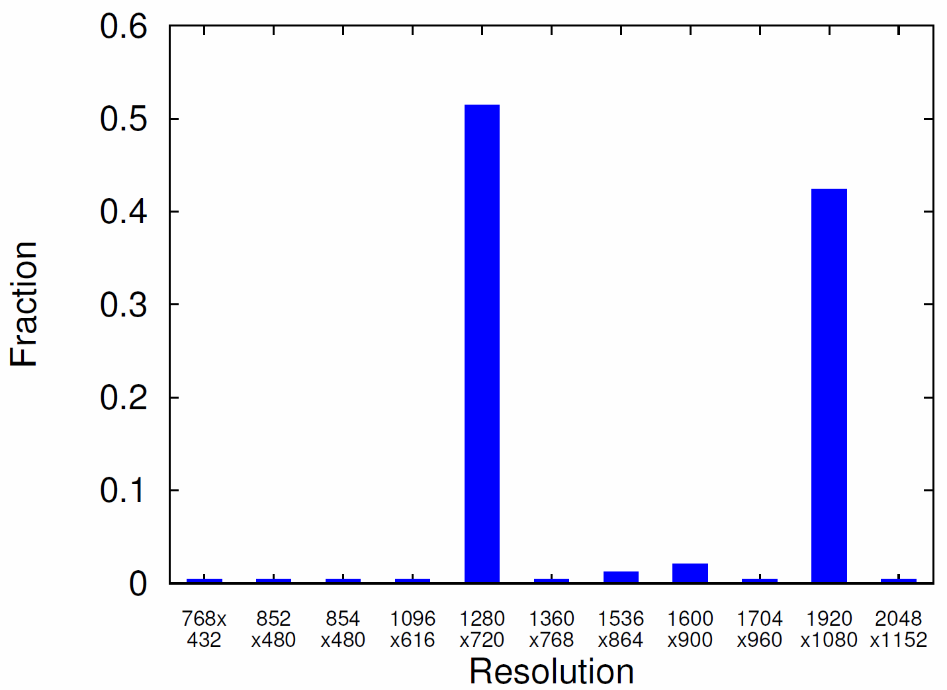
Frame Resolutions
HD resolutions dominate
720p streams at 1 Mb/s
1080p streams at 3 Mb/s
Compare: new! (no previous results)

Slide 12
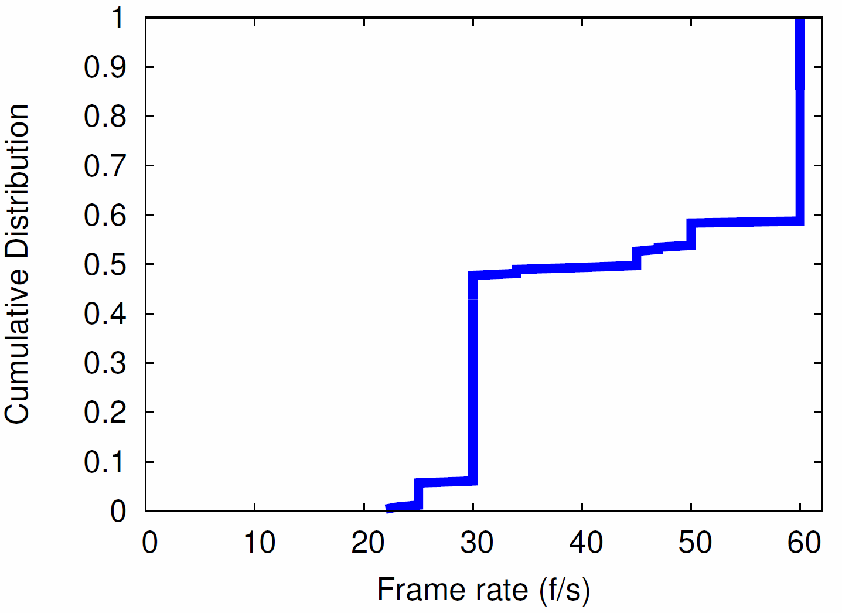
Frame Rates
50% at “full-motion” rates (30 f/s)
40% at “game-motion” rates (60 f/s)
Compare: new! (no previous results)

Slide 13
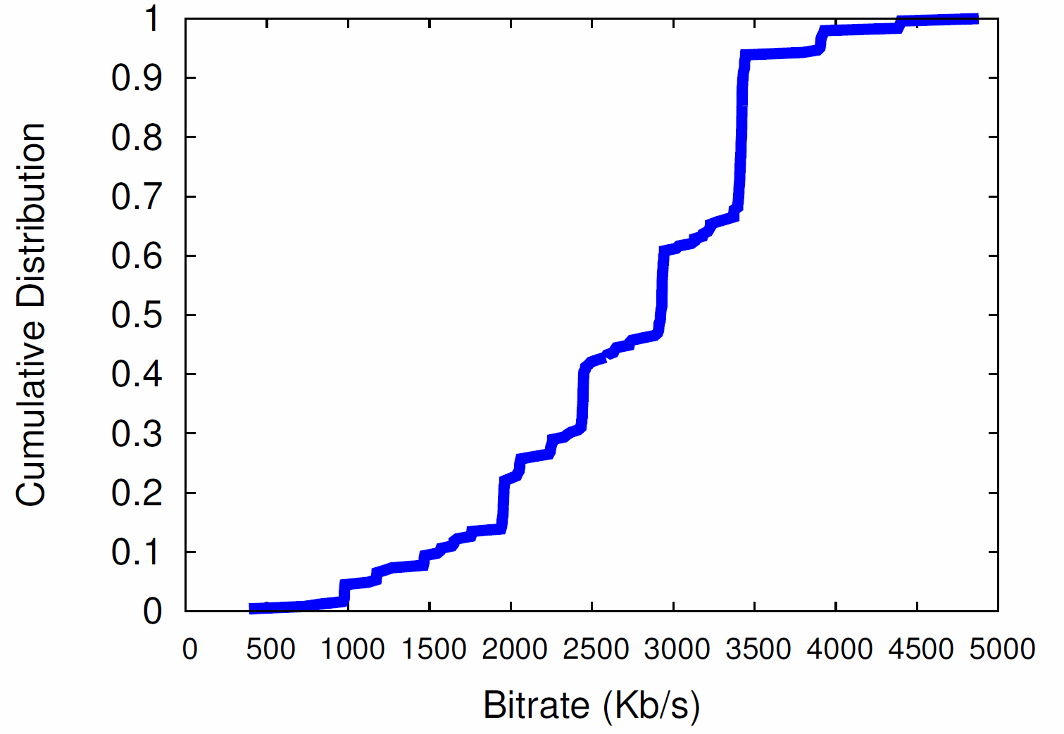
Bitrates
Median 3 Mb/s, even distribution
Compare [5, 6]: Median was 2 Mb/s

Slide 14
Conclusion
Better understanding of live-streaming can help
capacity planning
network management
design of new systems
Complement previous work with new data on Twitch.tv, the most popular live streaming (of games)
Crawl and analyze streams, January 2015
Number of streams correlates with time of day, day of week
Lengths are heavy-tailed
May contribute to self-similarity
Most streams HD, with almost half streamed at 60 f/s
Much higher than 30 f/s of pre-recorded video

Slide 15
Future Work
Additional analysis as Twitch.tv evolves
Stream behavior in response to congestion
Study other live streaming systems
YouTube [1]

Slide 16
Measurement-based Analysis of the Video Characteristics of Twitch.tv
Mark Claypool, Daniel Farrington, and Nicholas Muesch
claypool@cs.wpi.edu
Computer Science and
Interactive Media & Game Development
Worcester Polytechnic Institute
Notes:
Mark Claypool, Daniel Farrington, and Nicholas Muesch. Measurement-based Analysis of the Video Characteristics of Twitch.tv, In Proceedings of the IEEE Games, Entertainment, Media Conference (GEM), Toronto, Canada, October 2015. Online at:http://www.cs.wpi.edu/~claypool/papers/twitch-tv/

