Slide 1
Uniquitous: Implementation and Evaluation of a Cloud-based Game System in Unity
Meng Luo and Mark Claypool
claypool@cs.wpi.edu
Computer Science and
Interactive Media & Game Development
Notes:
Meng Luo and Mark Claypool. Uniquitous: Implementation and Evaluation of a Cloud-based Game System in Unity, In Proceedings of the IEEE Games, Entertainment, Media Conference (GEM), Toronto, Canada, October 2015. Online at: http://www.cs.wpi.edu/~claypool/papers/uniquitous/

Slide 2
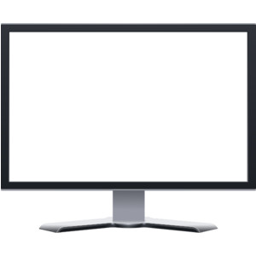
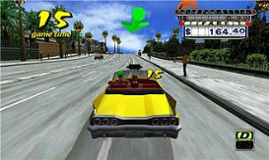
Introduction (1 of 2)
What is cloud gaming?
New service based on cloud computing technology
Why cloud games?
Convenience for players
Efficiency for developers
Reduce piracy for publishers
Game frames
Server
Server
Player input
Server
Thin Client
Cloud Servers

Slide 3
Introduction (2 of 2)
Existing Cloud Gaming Systems
OnLive, Gaikai, StreamMyGame, GamingAnywhere etc.
Cloud Games Are Growing Fast
Estimated to grow from $1 billion in 2010 to $9 billion in 2017 [1]
In 2012, Sony bought Gaikai service for $380 million and integrated the service into PlayStation in Jan. 2014 [2]

Slide 4
Challenges
Network latencies
High bitrate requirements
e.g., 2 Mb/s min for OnLive [3]
System processing
Ideally, Researchers and developers tune game and cloud system
e.g., Game scene complexities
e.g., Camera perspective
Need: testbed for cloud gaming R&D
Commercial cloud gaming systems (e.g., OnLive)
Proprietary
Open cloud gaming systems (e.g., GamingAnywhere [3])
Not integrated with game code

Slide 5
Uniquitous
Open source cloud gaming system in Unity
Allows modifications of game code and system code
Unity popular
1 million users in 2012
Grown to 2.5 million in 2014 [4]
This paper
Design and implementation of Uniquitous
Evaluation of components (Micro experiments)
Evaluation of system (Macro experiments)

Slide 6
Outline
Introduction (done)
Related Work (next)
Implementation
Micro Experiments
Macro Experiments
Conclusion

Slide 7
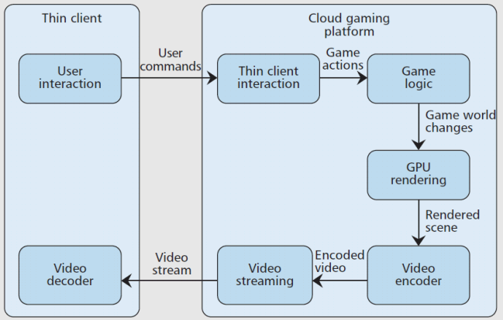
Related Work
Cloud gaming measurement
Huang et al. delay [3]
Chang et al. frame rate, frame quality [10]
Frame rate, frame resolution [11]
Huang et al. cloud gaming framework [3]
None are open systems that support tuning cloud service and game

Slide 8
Outline
Introduction (done)
Related Work (done)
Implementation (next)
Micro Experiments
Macro Experiments
Conclusion

Slide 9
Implementation (1 of 4)

Slide 10
Implementation (2 of 4)
Image Data Flow: carry data for game frames
Image Encoding: JPEG encoder [12] (open C# impl.)
Image Transmission: remote procedural call (RPC) (ulink, networking for games in C#)

Slide 11
Implementation (3 of 4)
Audio data flow: carry data for game audio
Audio Source: Audio listener
Audio Capture: OnAudioFilterRead(), localhost TCP socket
Audio Encoding & Transmission: mp3 via FFMPEG
Audio Reception & Decoding: UDP to FFPLAY and SDL (library to assist playing)

Slide 12
Implementation (4 of 4)
Input data flow: carry data for user input
Player input captured: mouse, keyboard
Input Transmission: remote procedural call (RPC)
Unity Game: “replay” input to GUI elements, if needed

Slide 13
Outline
Introduction (done)
Related Work (done)
Implementation (done)
Micro Experiments (next)
Macro Experiments
Conclusion

Slide 14
Micro Experiments Setup
Goal
Measure processing times of Uniquitous components
Identify performance bottlenecks in cloud game system
Main results here, but full results in [13]
Experiment setup
Hardware
12 GB RAM, Intel 3.4GHz i7-3770, AMD Radeon HD 7700
Operating System
64-bit Windows 7 Enterprise edition
Unity version 4.3

Slide 15
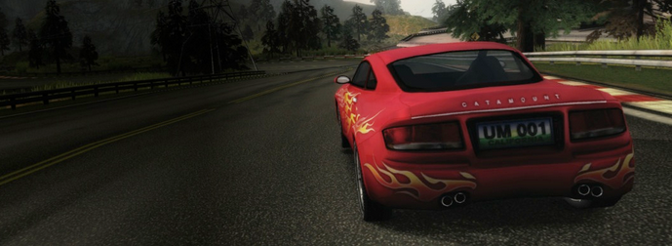
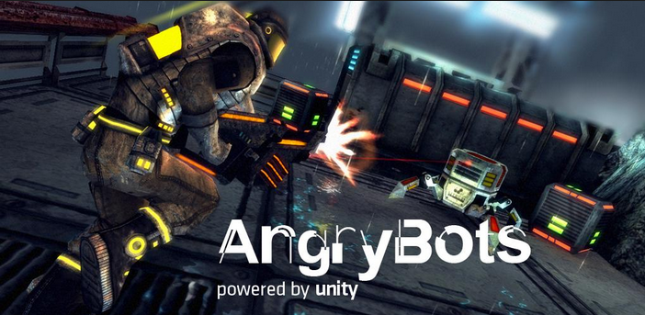
System Parameters
Two games
Eight game image qualities
(worst) 1 to 100 (best)
Nine game resolutions
210x158 up to 1920x1080
Car Tutorial (v1.3)
(https://www.assetstore.unity3d.com/en/#!/content/10)
AngryBots (v4.0)
(https://www.assetstore.unity3d.com/en/#!/content/12175)

Slide 16
Measuring Processing Time
Instrument code
Screen Capture
Image Encoding
Image Transmission
Unity Pro profiler
Unity Project
Game Window
Command line time
Audio Encoding & Transmission
10 runs for each, averaged

Slide 17
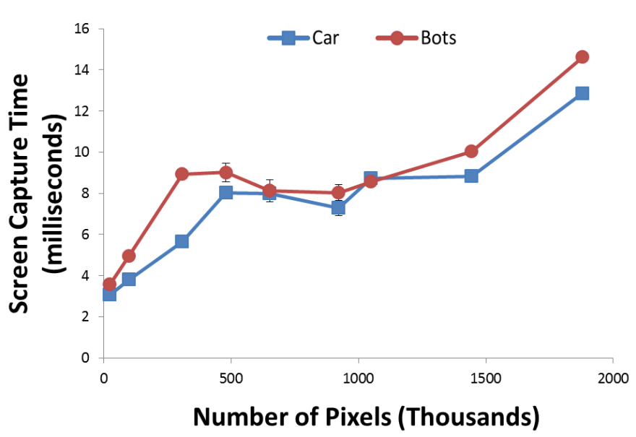
Screen Capture
640x480 to 1680x860 similar times
Not much difference between games
Subsequent analysis Car Tutorial

Slide 18
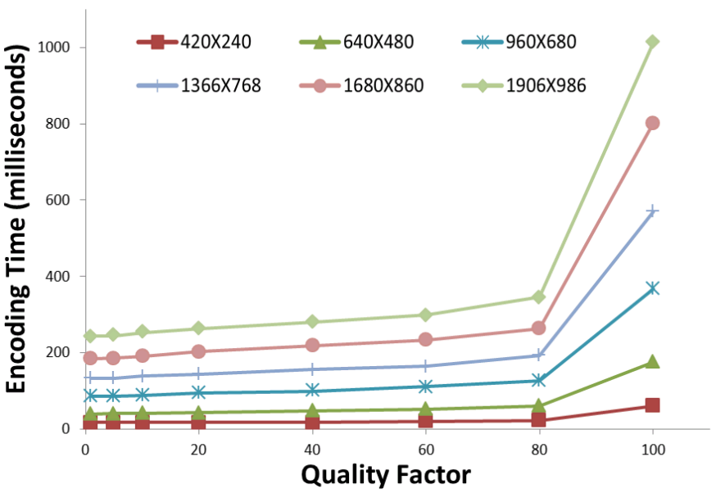
Image Encoding
Much higher than capture times!
Increase game image quality modestly increases time
Increase game resolution increases time

Slide 19
Outline
Introduction (done)
Related Work (done)
Implementation (done)
Micro Experiments (done)
Macro Experiments (next)
Conclusion

Slide 20
Macro Experiments - Goals
Evaluate performance of Uniquitous
Game image quality
Frame rate
Predict performance of Uniquitous under alternate configurations

Slide 21
Game Image Quality (1 of 2)
Compressed image samples
Original Image: game image from Car Tutorial
200 images with 20 compression ratios and 10 resolution levels
Objective visual quality measurement
Peak Signal Noise Ratio (PSNR)
Structural Similarity Index (SSIM)
Experiment setup
Same as the micro experiments

Slide 22
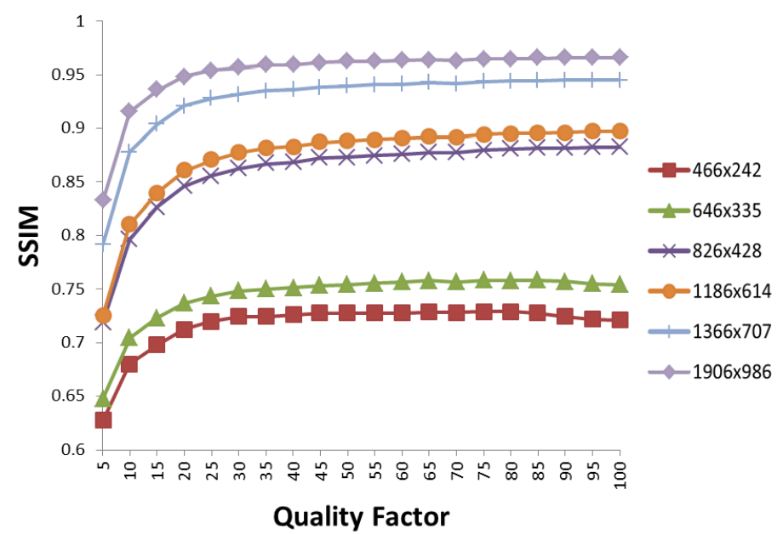
Game Image Quality (2 of 2)
Marked increase from 1 to 15
Modest increase from 15 to 35
Recommended quality factor: 15 to 35

Slide 23
Frame Rate (1 of 2)
Independent variables
JPEG encoding quality and resolution
→ 44 data samples for the Car Tutorial
→ 37 data samples for the AngryBots
Frame rate computation
Measure frame intervals
Inverse of average interval
Experiment setup
Same as for micro experiments

Slide 24
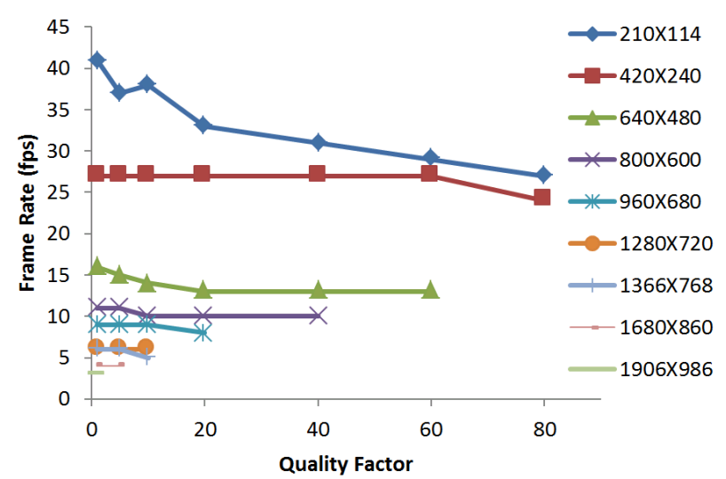
Frame Rate (2 of 2)
Car Tutorial
Only low resolution achieves high frame rate
Recommended min frame rate: 15 fps [8]
Recommended resolution: 640x480

Slide 25
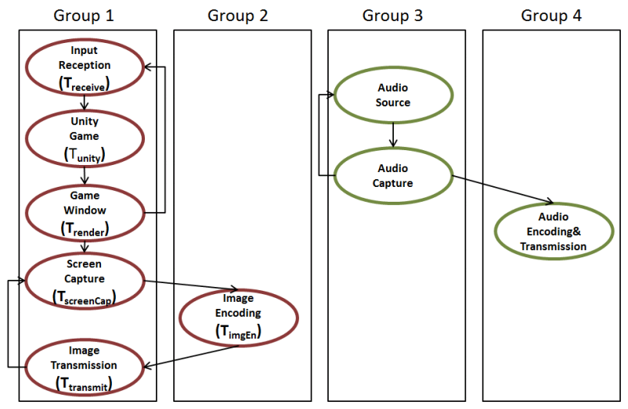
Predicting Frame Rate (1 of 3)
Coroutine

Slide 26
Predicting Frame Rate (2 of 3)
F = 1/T
T = Max (T₁,T₂) +
T_{screenCap} + T_{transmit}
T₁ = T_{unity} + T_{render} + T_{recv}
T₂ = T_{imgEn}
Model
Based on game resolution (R), JPEG encoding quality (Q)
Weka linear regression classifier (10-fold cross validation)
Car Tutorial: F = 1 / (0.1348×R + 0.118×Q + 21.0)
AngryBots: F = 1 / (0.1361×R + 0.1224×Q + 22.5)
T_{1’}: Group 1
T₂: Group 2
T: frame interval
F: predicted frame rate

Slide 27
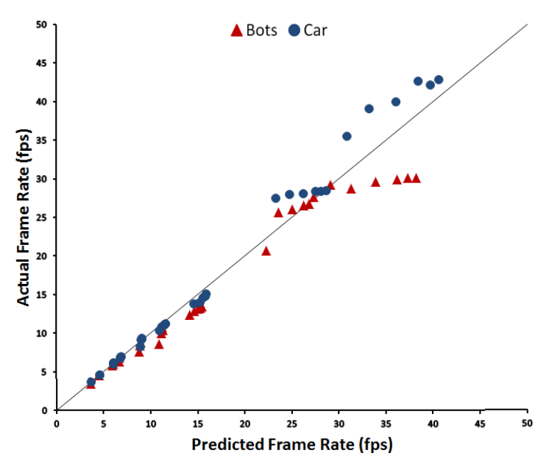
Predicting Frame Rate (3 of 3)
Correlation
→ Car: 0.995
→ Bots: 0.981
Models predict well

Slide 28
Conclusions
Uniquitous open source, cloud gaming system for Unity
Blend Unity game development with cloud system
Online: http://uniquitous.wpi.edu/
This paper
Uniquitous design and implementation
Evaluation of components (micro)
Evaluation of system (macro) and model
Image encoding is bottleneck for high resolutions and qualities
Keep both low
Recommended settings for good quality (SSIM 75+, 15 fps)
JPEG image quality 15-35
Resolution 640x480 pixels

Slide 29
Future Work
Increase frame rates, frame qualities, resolutions
H.264 encoding
Test with more games and other genres
Mobile devices

Slide 30
Uniquitous: Implementation and Evaluation of a Cloud-based Game System in Unity
Meng Luo and Mark Claypool
claypool@cs.wpi.edu
Computer Science and
Interactive Media & Game Development
Notes:
Meng Luo and Mark Claypool. Uniquitous: Implementation and Evaluation of a Cloud-based Game System in Unity, In Proceedings of the IEEE Games, Entertainment, Media Conference (GEM), Toronto, Canada, October 2015. Online at: http://www.cs.wpi.edu/~claypool/papers/uniquitous/

Slide 31
References (1 of 2)
“Distribution and Monetization Strategies to Increase Revenues from Cloud Gaming,” http://goo.gl/YnlE9V, 2012, accessed 01-May-2014
S. Sakr, “Sony Buys Gaikai Cloud Gaming Service for $380 Million,” http://goo.gl/S9P3KJ, July 2012, accessed 01-May-2014
C. Huang, Y. C. C. Hsu, and K. Chen, “GamingAnywhere: An Open Cloud Gaming System,” in Proceedings of ACM MMSys, Oslo, Norway, Feb. 2013
“Unity Company Facts,” http://unity3d.com/public-relations, accessed 09-Jun-2015
I. Foster, Y. Zhao, I. Raicu, and S. Lu, “Cloud Computing and Grid Computing 360-Degree Compared,” in Proceedings of Grid Computing Environments Workshop (GCE), Austin, TX, USA, Nov. 2008, pp. 1–10
D. Winter, P. Simoens, L. Deboosere, F. Turck, J. Moreau, B. Dhoedt, and P. Demeester, “A Hybrid Thin-client Protocol for Multimedia Streaming and Interactive Gaming Applications,” in NOSSDAV, Newport, RI, USA, May 2006
R. Shea, J. Liu, E. Ngai, and Y. Cui, “Cloud Gaming: Architecture and Performance,” IEEE Network, vol. 27, pp. 16–21, Aug. 2013
M. Jarschel, D. Schlosser, S. Scheuring, and T. Hoβfeld, “An Evaluation of QoE in Cloud Gaming Based on Subjective Tests,” in IEEE Innovative Mobile and Internet Services in Ubiquitous Computing, Seoul, Korea, 2011, pp. 330–335

Slide 32
References (2 of 2)
Y.-T. Lee, K.-T. Chen, H.-I. Su, and C.-L. Lei, “Are All Games Equally Cloud-gaming-friendly? An Electromyographic Approach,” in Proceedings of IEEE/ACM NetGames, Venice, Italy, Oct. 2012
Y.-C. Chang, P.-H. Tseng, K.-T. Chen, and C.-L. Lei, “Understanding the Performance of Thin-Client Gaming,” in Proceedings of Communications Quality and Reliability (CQR), Naples, FL, USA, May 2011
M. Claypool and K. Claypool, “Perspectives, Frame Rates and Resolutions: Its all in the Game,” in Proceedings of Foundations of Digital Games (FDG), FL, USA, Apr. 2009
A. Broager, “JPEG Encoder Source for Unity in C#,” http://goo.gl/FwOfOW, accessed 06-May-2014
M. Luo, “Uniquitous: Implementation and Evaluation of a Cloud-Based Game System in Unity 3D,” Master’s thesis, Worcester Polytechnic Institute, 2014, adv: M. Claypool
Z. Wang, A. C. Bovik, H. R. Sheikh, and E. P. Simoncelli, “Image Quality Assessment: From Error Visibility to Structural Similarity,” IEEE Transactions on Image Processing, vol. 13, no. 4, Apr. 2004
M. Hall, E. Frank, G. Holmes, B. Pfahringer, P. Reutemann, and I. H. Witten, “The WEKA Data Mining Software: An Update,” SIGKDD Explorations, vol. 11, no. 1, 2009.

