Slide 1
Three-year Trends in YouTube Video Content and Encoding
Feng Li, Verizon Labs;
Jae Won Chung, Viasat Inc;
Mark Claypool, Worcester Polytechnic Institute.
SIGMAP 2021

Slide 2
Video Traffic Growing Fast
79% internet traffic in 2020 (Cisco Inc, 2016);
YouTube alone 2B monthly users, 500 hr unloaded per min;
However
Because of development of End to End Encryption (e.g. QUIC/HTTP3m HTTPS), it hard for ISP to detect video traffic from middle boxes

Slide 3
Important to Understand Video Characteristics
Many Machine Learning (ML) has been proposed in last five years.
Requiring flow level statistics, e.g duration, data rate, etc, for training.
Without knowing video Characteristics, it is difficult to
Accurately detect video
Correctly treat videos

Slide 4
Related Work
Our Video Crawler in early years (Li et al., 2005)
Analysis characteristics of video/audio clips stored on Web
YouTube Data Analysis (Cheng et al., 2008)
Crawled 3 million YouTube videos before HTML5 and DASH used.
Social Behaviors (Bartl et al., 2018, Broadersen et al., 2012, etc)
Focus on number of views and video popularity.
It is time to re-crawl on popular streaming video sites (e.g. YouTube).

Slide 5
OutLine
Introduction
Methodology
Results
Conclusions

Slide 6
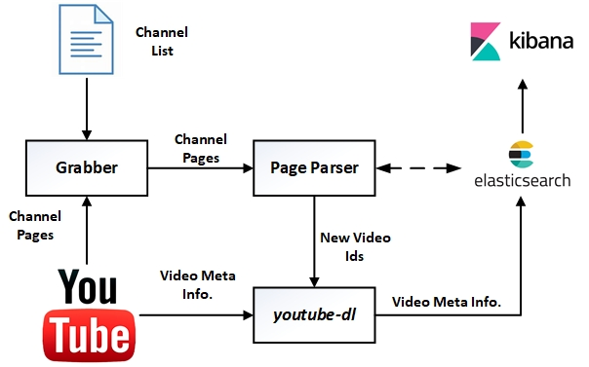
YouTube Crawler
Key Component Built upon youtube-dl
Running from AWS EC2 (useast-2).
Crawling content neutral by deleting cookies/cache before each crawling.
Elasticsearch and Kibana quickly visualize results;
data set available at
youtube-crawler
1
7
3
2
4
5
6

Slide 7
Wild Crawling or Sampling
It is almost impossible to crawl all YouTube videos (e.g. 37 M channels).
Most videos are less frequently viewed, popular videos are more interesting for traffic shaping purpose.
Monitor popular YouTube channels might be a “cost efficient” solution.

Slide 8
Recrawling Popular Videos
Our primary goal is to ascertain encoding and content information and only crawling each video once upon “discovery”.
Gathering video trends in popularity might be beneficial for other researchers:
From 2020/01/06, start daily re-crawlering top 100 videos based on view count.
Time span between video upload time and first discovery time is relatively short (7 days on average)
From 2020/08/01, re-crawler videos discovered both 1 month and 1 year early.
Respect to User Privacy,
do not collect video marked as “private” or “paid”, and
videos are removed by uploader or moderators
All information collected is solely based on videos’ public metadata

Slide 9
OutLine
Introduction
Methodology
Results
Conclusions

Slide 10
Results
Start daily crawling on 2017/12/11, and continue crawling
Several YouTube outages (2018/10/17),
a handful of times our IP address was blacklisted.
By 10/31/2020,
160,156 unique videos, including 5472 live videos.
Some video statistics are fixed after uploading,
Duration, display id, date uploaded
Some video statistics are dynamic
Number of views, supported video format etc.
Consider dynamic information to be static since last crawl, except number of views.

Slide 11
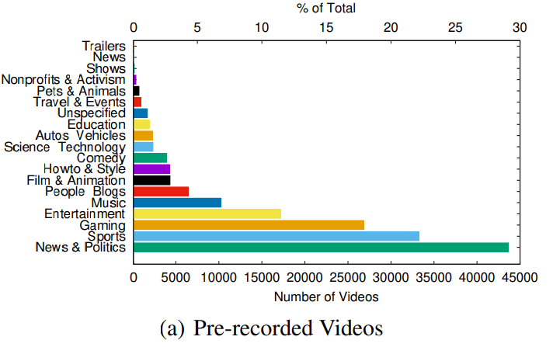
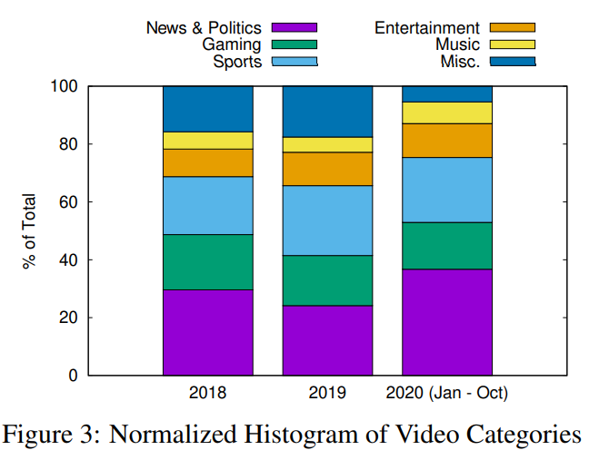
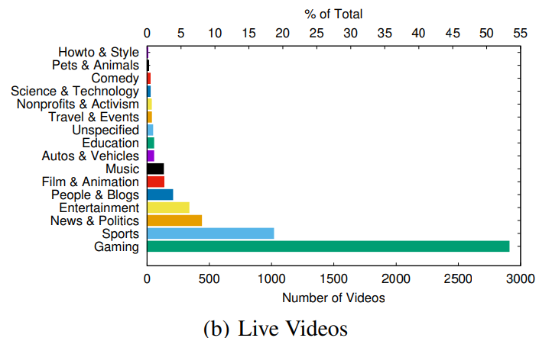
Video Categories
Results (1/6 ) Video Categories
Gaming video becomes popular in pre-recorded and live videos.

Slide 12
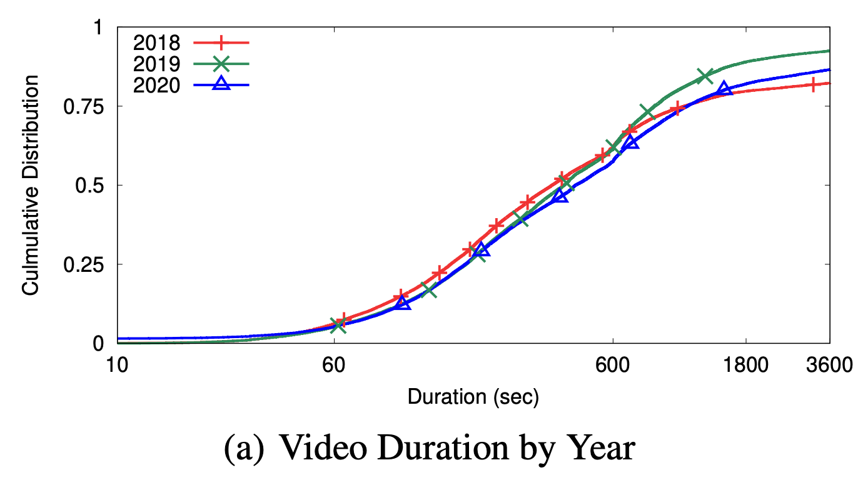
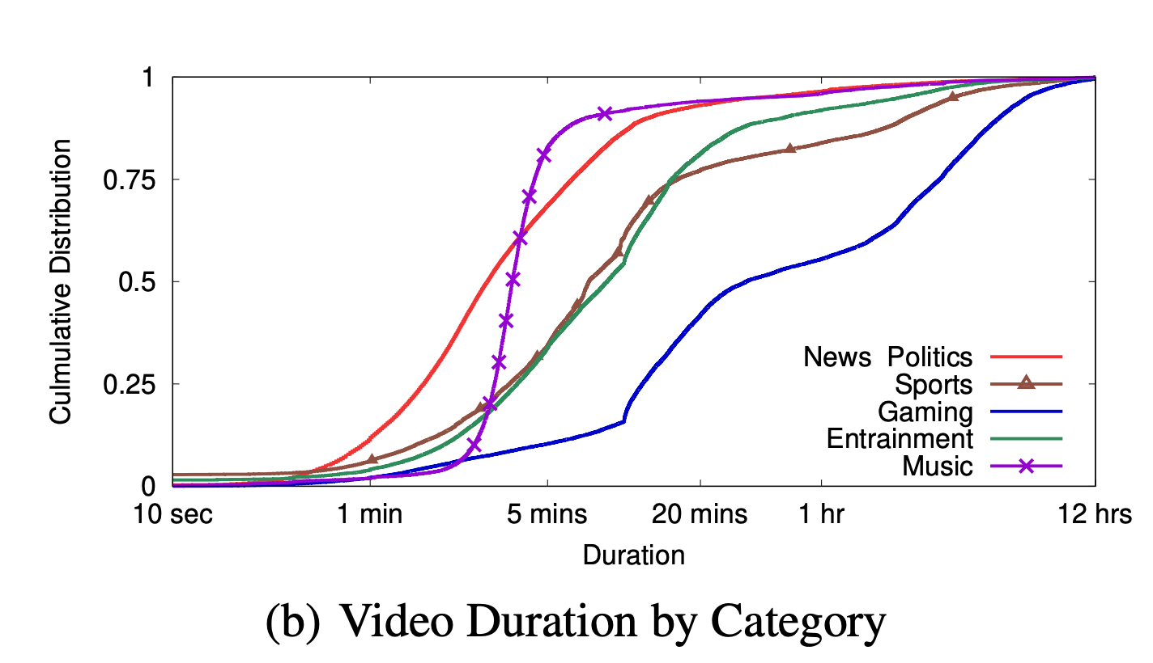
Results (2/6 ) Video Length
Video Length is an important feature for offline video classification training.
As expected, videos have gotten longer:
2008, 97.9% YouTube videos under 700 seconds,
2020, 25% % YouTube videos longer than 931 seconds.
Medians of uploaded videos also grow
296 seconds in 2018
440 seconds in 2020

Slide 13
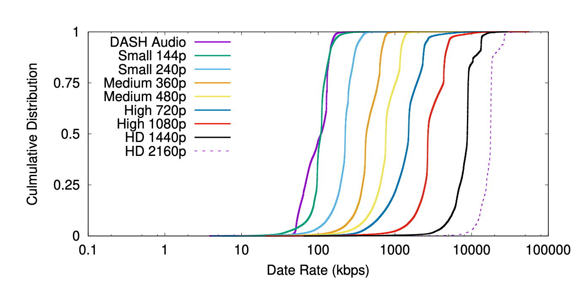
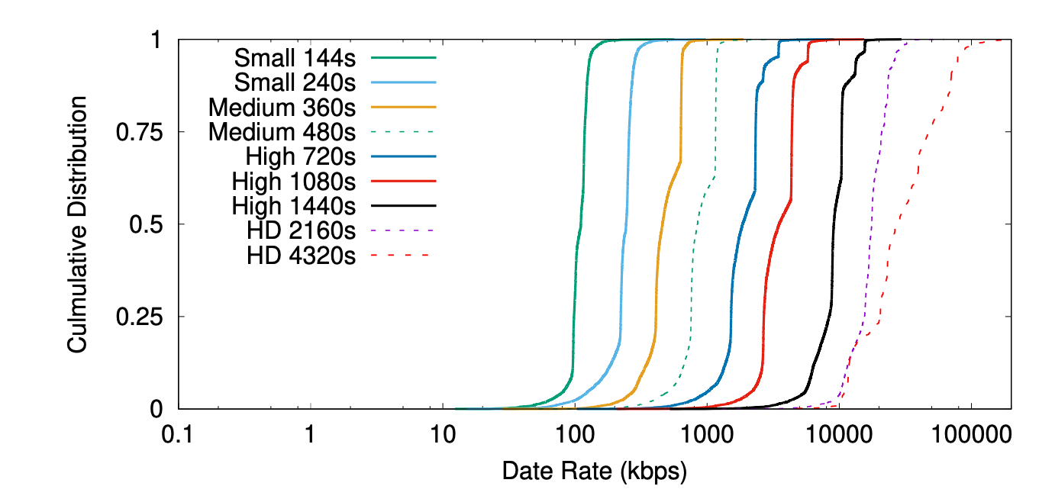
Results (3/6 ) Encoding Rate
Video Flow Rate is an import feature to infer video quality for passive video detection algorithms used in middle-boxes.
As expected, videos with higher resolution have higher data rate for both 2D and 3D videos.
2D videos
3D videos

Slide 14
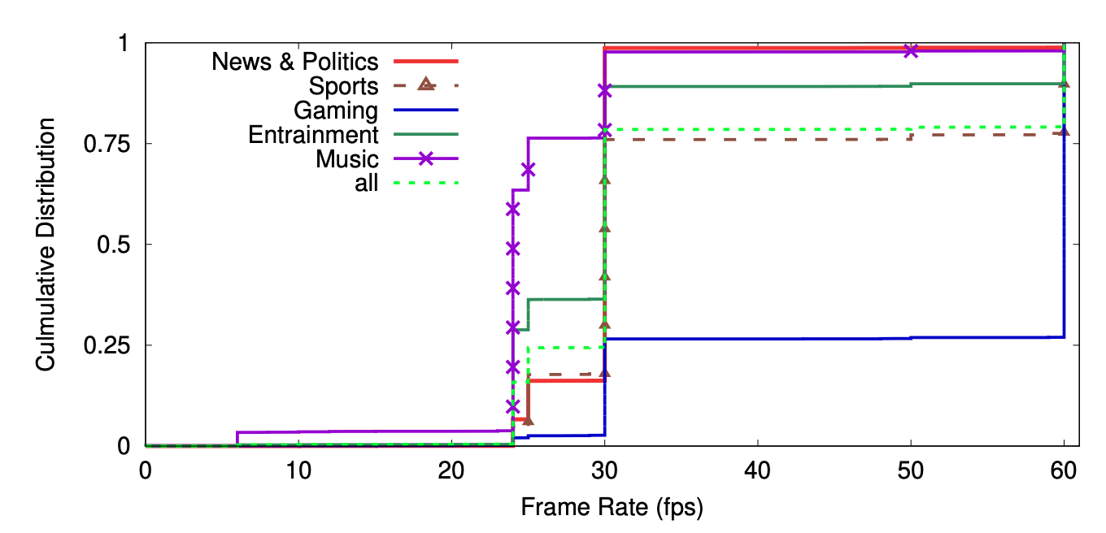
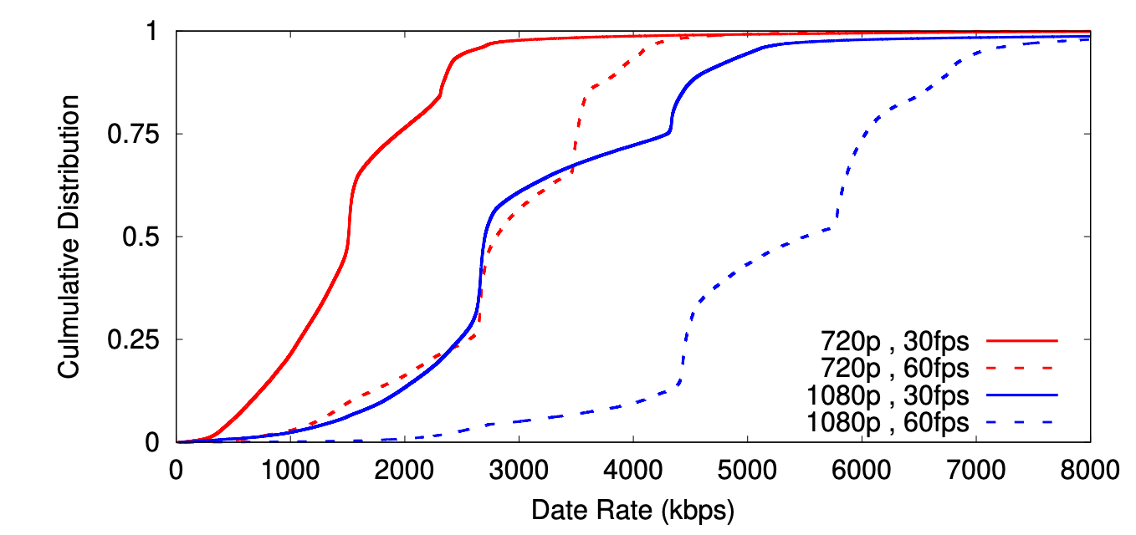
Results (4/6 ) Frame Rate and Encoding Rate
Max Frame Rate
Encoding Rate for video Video with Different Frame Rate

Slide 15
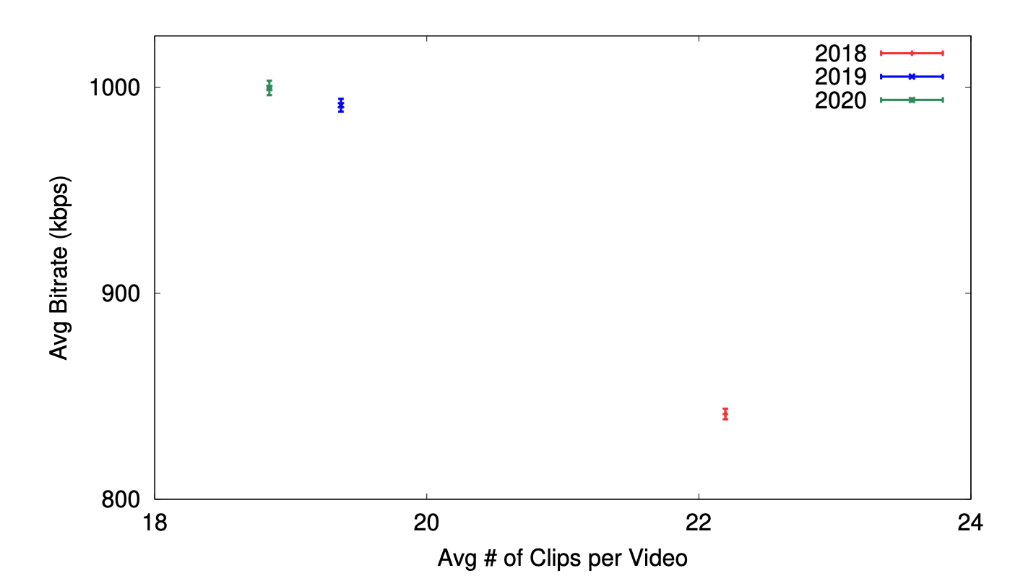
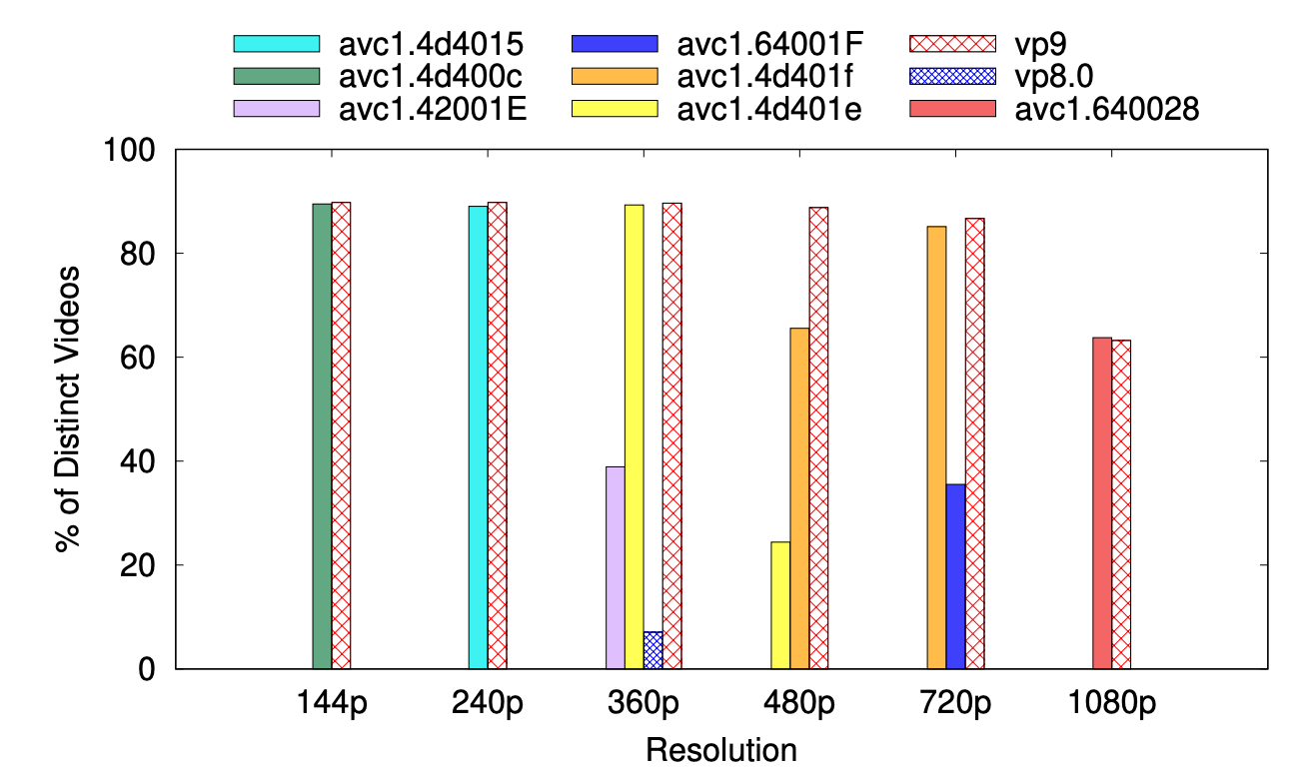
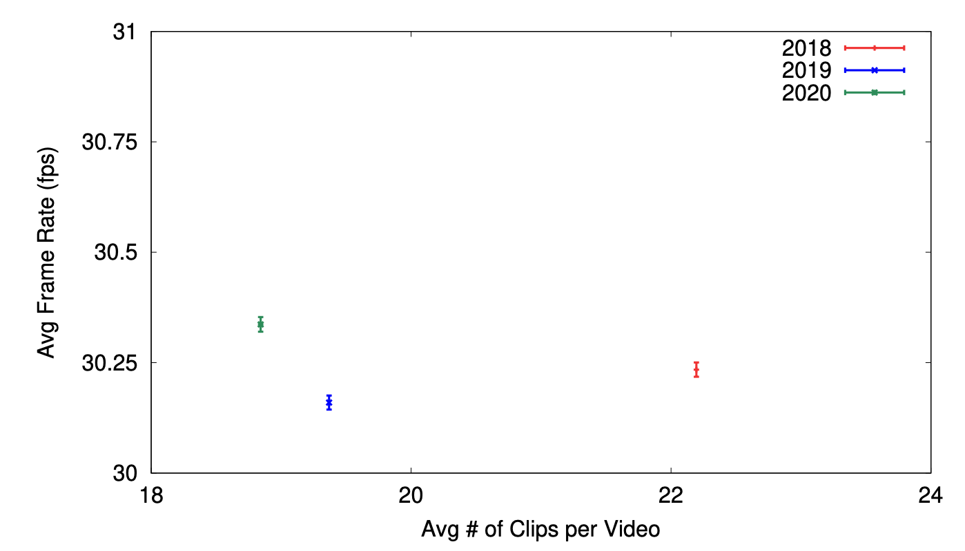
Results (5/6 ) Frame and Encoding Rate, Codec
Encoding Rate
Frame Rate
Video Codec used in 2D Videos

Slide 16
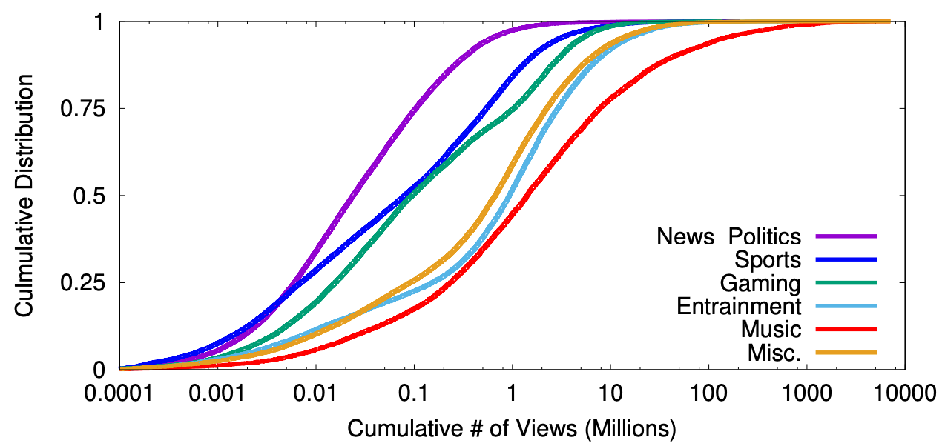
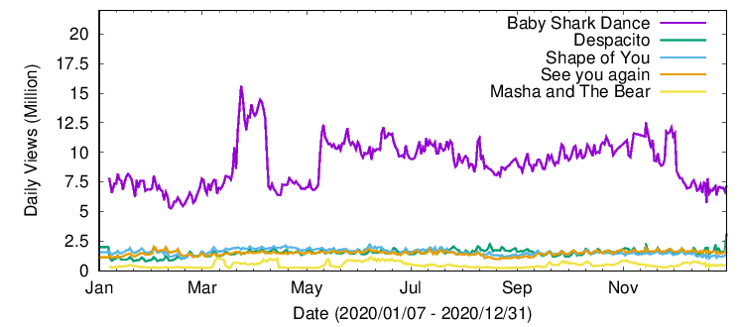
Results (6/6 ) Social Statistics
Distribution of Cumulative Number of Views
Daily Views Top 5 Popular Videos

Slide 17
Conclusions
We analyze 160, 000+ videos (more than 3M clips) collected over past three years, and plan to continue this effort.
Videos are much longer than they were a decade ago (Cheng et al. 2008)
On average each video has 20+ different media clips (different codec, and resolution), requiring considerable storage space.
Data set is public available (link) and could be used for CDN server design and develop new traffic classification methods.

Slide 18
Thank you.

