Slide 1
Treatment-Based Classification in Residential
Wireless Access Points
A PhD Dissertation
Feng Li (lif@cs, EMC)
Committee:
Prof. Mark Claypool – CS, Worcester Polytechnic Institute
Prof. Robert Kinicki – CS, Worcester Polytechnic Institute
Prof. Craig Wills – CS, Worcester Polytechnic Institute
Dr. Timothy Strayer – BBN Technologies
PhD Dissertation
Computer Science Dept.
Worcester Polytechnic Institute
April 28, 2014

Slide 2
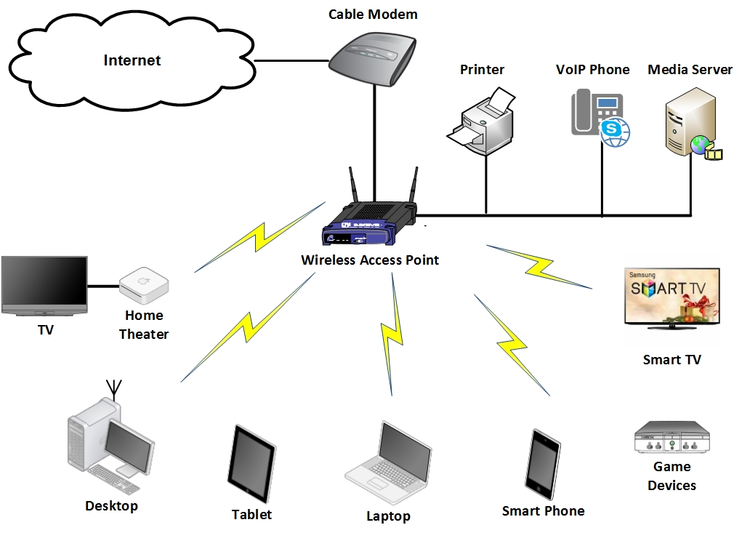
Access Point as Central Point in Home
Notes:
AP is the central communication point in Home.
It connects wired devices and wireless devices. In addition to internet traffic, AP also handles the intra-home traffic, for example, when you watch video on iPad from the media server inside your home.
In the past 10 years, people are arguing which device is the bottlenect in home.

Slide 3
IEEE 802.11 Wireless Network Review
Why not reach claimed speed?
3 non-overlapping 20 MHz channels.
  802.11n using 40 MHz channel.
  MIMO needs separate channels.
Crowded air space.
  Neighbor APs as hidden terminal.
  Interference from non-wifi devices.
Mixed wireless environment.
  802.11 b/g devices in use (cheaper!).
  Lower datarate larger range.
  802.11n performs bad in mixed environments.
5GHz has more trouble penetrating solid objects.
Throughput Comparison between 802.11 Standards [Singha, 2012]
Notes:
Here is a short review of IEEE 802.11 families. By this year, IEEE 802.11 wireless standard includes a,b,g, and n.
The figure on the left shows the measured throughput of each kind of AP. We can see even in lab environment, IEEE 801.11 protocol hardly reach their claimed speed.
IEEE 802.11g AP only yield 19 Mbps throughput which is less than half of its claimed datarate 54 Mbps.
Why this happens ?
First, on

Slide 4
Broadband Connectivity
Country/Region | Q3/13 peak Mbps | QoQ Change | YoY Change
Hong Kong | 65.4 | 0.5 % | 21 %
2 South Korea | 63.6 | 19 % | 30 %
Japan | 52.0 | 6.4 % | 23 %
Singapore | 50.1 | 9.9 % | 63 %
Israel | 47.7 | 19 % | 55 %
6 Romania | 45.5 | -4.4 % | 22 %
Latvia | 43.1 | -3.3 % | 15 %
Taiwan | 42.7 | 8.2 % | 50 %
Netherlands | 39.6 | 1.9 % | 29 %
10 Belgium | 38.5 | -3.6 % | 18 %
………….. | ……. | ….. | ……
16 United States* | 36.3 | 1.2 % | 25 %
State | Q3/13 peak Mbps | QoQ Change | YoY Change
Mass. | 51.9 | 0.5 % | 21 %
Maryland | 49.4 | 19 % | 30 %
New Jersey | 49.2 | 6.4 % | 23 %
Top Speed Town
Ephrata, WA. | 71.09 | - | -
Top 3 States with Peak Connection Speed [Akamai, 2014]
“5GHz is technically faster, this may not show up in real-world performance.… the Cisco Linksys WAG320N to give the speed at between 27 Mbps and 52 Mbps at 10m distance….
Another reason is that you have switched to a very fast internet service and your 2.4GHz Wi-Fi connection is a bottleneck …..”
-- Jack Schofield.
Top 10 Countries with Peak Connection Speed [Akamai, 2014]
Notes:
How about your cable modem or your ISP ? Your ISP decides the last mile speed.. In the past 10 years, more and more home had broadband connection. The table on the left lists the top 10 conturies, we can notice the top 4 countries have more than 50 Mbps peak connections to home. Unite States is No 16, its average peak connection speed is more than 36 Mbps, about 10 Mbps faster than the IEEE 802.11g actual throughput.
The right side is top 3 states in US, we can see MA, NJ and Mary land provide 50 Mbps peak conenction to residences and which is close to IEEE 802.11g fastest datarate. If we look at the Year to year change, the last mile connection speed is keep increasing… As a british technical writer noticed,

Slide 5
Quality of Service (QoS) Spectrum of Applications
Game, VoIP
(time sensitive)
Video, VoIP
(UDP-based, loss-tolerant)
Interactive
Non-response-based
Interactivity
Video
Streaming
Non-greedy
Bandwidth Eagerness
File
Transfer
Responsiveness
Greedy
Response-based
Non-interactive
File Transfer,
SSH
(TCP based, loss-sensitive)
File Transfer,
P2P File Sharing.
(time insensitive)
Notes:
In addition, hardware changes in home, let look at the software and applications.
Blue, response-based, TCP
Red, interactive, time-sensitive
Green. Greedy…

Slide 6
Problems in Current Home Wireless Network (1/2)
Residential APs do not guarantee low transmission delays required by time sensitive applications.
Residential APs do not automatically provide traffic classifications.
Current QoS methods may not fit home wireless APs.

Slide 7
Problems in Current Home Wireless Network (2/2)
5th Generation Apple AirPort Extreme (A1521).
  “If you are looking for supreme control over your home network such as QoS or controlling Frame Burst—you are going to need a router with more functionality. The AirPort does not offer really fine control over settings; it lacks the Web interface through which most routers offer that level of control.” – PCMAG, June 2013.
  “No, Apple routers missed out on QoS.. although they might respond to QoS packet settings on the Mac.. not sure.. but unlikely.. Apple just don't include anything difficult to configure.. QoS is difficult.. ” –Apple discussion board. – Sept. 2013.
Cisco Wireless LAN Controller Configuration Guide.
  Cisco 5500 Series Controller, enterprise class product on market 2012.
  User manual is 1072 pages long, 31.69 MB in total.
  Difficult to configure QoS, e.g. bandwidth limitation per user, 14 steps!

Slide 8
Problem Statement
Improve QoS support for applications on home wireless networks.
  Reducing queuing delay for interactive applications.
  Taming response-based applications other than dropping.
  Protecting non-greedy applications without significantly punishing greedy applications.
Feasibility of implementing a smart AP.
  Automatically classify flows for treatment purposes,
  Choose and apply correct treatments on flows.
  Without user’s manual configuration.
  Without modification on end hosts or network standards.
  Feasible to implement on “low-end” devices.

Slide 9
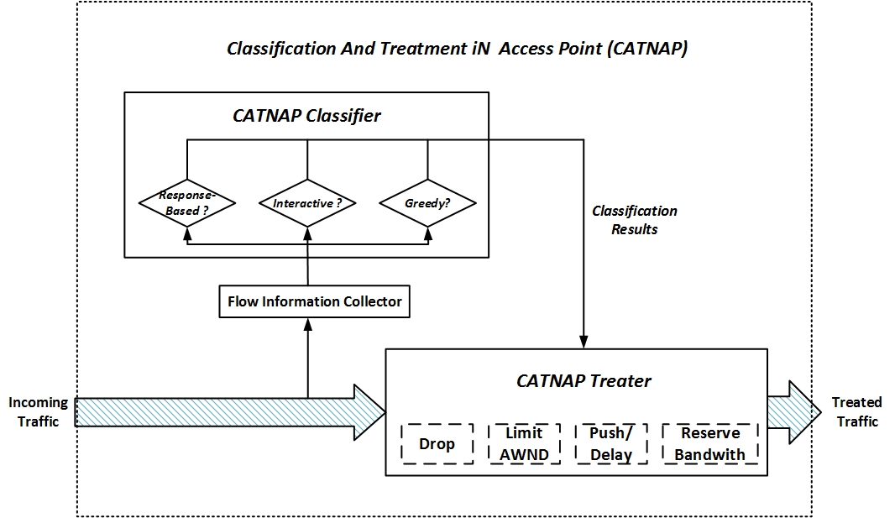
Classification And Treatment iN Access Point (CATNAP)

Slide 10
Outline
Introduction
Related Work
Classification And Treatment iN AP (CATNAP)
Experiment
  Validation
  Evaluation
Future work
Conclusions

Slide 11
Traffic Classification Methods
Port-based approach [IANA, 2014], [Corsaro, 2013].
  Based on transport port.
  Pros: widely used, simple.
  Cons: low accuracy.
Payload-based approach [Moore, 2005], [Khalife, 2013].
  Based on payload content.
  Pros: nearly 100% accuracy.
  Cons: offline, need human invention, encryption.
Statistics-based approach [Nguyen, 2012], [Zhang, 2013].
  Based on flow level statistics information.
  Pros: reasonable accuracy.
  Cons: training dataset matters, unable to detect new apps.
Behavior-based approach [Karagiannis, 2005], [Xie, 2013].
  Based on users’ behavior.
  Pros: accurate.
  Cons: user behavior matters.

Slide 12
Improve Quality of Service (QoS)
IEEE 802.11e & Wi-Fi Multimedia (WMM) [Lee 2013][Li 2011].
  Prioritizes traffic according to four Access Categories (AC): Voice, Video, Best-effort, and background.
  Pros: Enhance Media Access Control (MAC) layer, wireless oriented.
  Cons: MAC layer changes, performance bad in mixed environment.
Linux Traffic Control [Siemon, 2013].
  Traffic Control (TC) supports FIFO, Token Bucket Filter (TBF), Credit based (CBQ) and Stochastic Fair Queue (SFQ), etc.
  Pros: more predictable usage of network when properly used.
  Cons: complexity, inappropriate used leading more divisive contention, and TOS bits needed.
Active Queue Management (AQM) [Chung, 2005], [Sharma, 2013].
  Drop or mark packets (ECN) before the queue is full.
  Pros: inform sender to slow down, maintain a short queue length.
  Cons: dropping may not be correct, ECN could not carry information such as available bandwidth.

Slide 13
Outline
Introduction
Related Work
Classification And Treatment iN AP (CATNAP)
Experiment
  Validation
  Evaluation
Future work
Conclusions

Slide 14
CATNAP
Limit Rate
Drop Packets
Bandwidth Eagerness
Non-Greedy
Streaming Video
Greedy
Delay
Packets
FTP
P2P, Email
NFS w/UDP
P2P w/UDP
Non-interactive
Web
Push
Packets
Interactivity
VoIP
Game
Interactive
Reserve Bandwidth
Telnet/SSH
DNS, IM
Response-based
Non-response-based
Responsiveness

Slide 15
Treatment Based Classification
Responsiveness.
  Response-based: loss sensitive applications.
    Dropping packets triggers retransmission.
    Modify advertised window size to slow down the sender.
  Non-response-based: loss tolerant applications.
    Dropping a small fraction of packets would NOT degrade their quality.
Interactivity.
  Interactive: delay sensitive applications.
    Push, cut-in-line.
  Non-Interactive: delay tolerant applications.
    Delay, lower its priority.
Bandwidth eagerness.
  Greedy: best-effort applications.
    Dropping or limited advertised window size.
  Non-greedy: bandwidth requirement limited by itself.
    Reserve bandwidth for them.

Slide 16
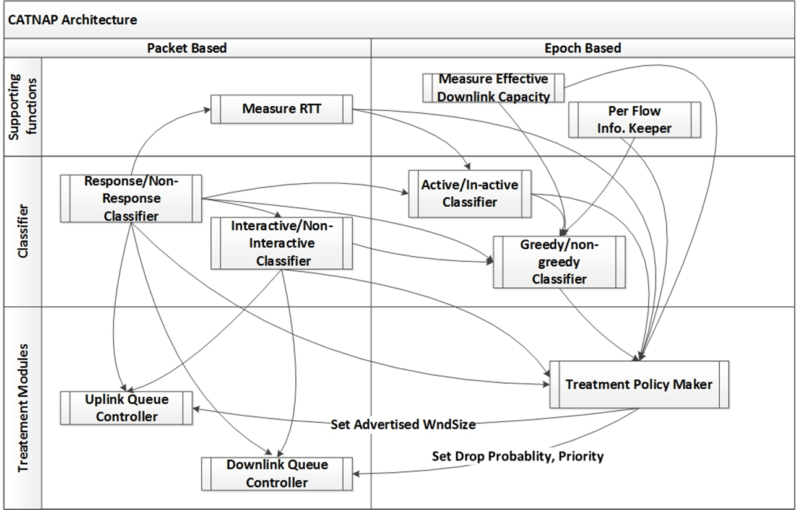
CATNAP Architecture

Slide 17
TCP Based VoIP Flow
Response-Based
Interactive
Non-Greedy
1
2
2
Response-Based
3
1
4
3
Non-Greedy
Interactive
5
No Rate limitation
No Drop, Push

Slide 18
UDP Based P2P File Downloading
Non-Response-Based
Non-Interactive
Greedy
1
Use Default RTT
2
Non-Response-Based
3
1
4
2
Greedy
Non-Interactive
5
No Treat
Droppable
Set Drop Probability, Delay

Slide 19
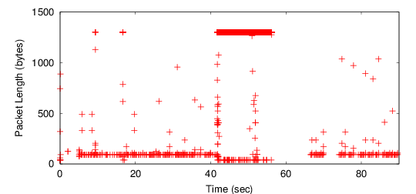
Example: A Remote Login Flow
Between 0 – 41th seconds, the user executed directory commands.
Between 41- 57th seconds, the user opened a 100 MB+ file.
Between 57th-65th seconds, no activity.
After 65th seconds, the user resumed directory operations.

Slide 20
Example: Interactive Classifier w/ a Remote Login Flow
Notes:
Here is a sample of a SSH flow with flow state changes. Before the time 40th seconds, the user executes several shell cmds on a remote host, at time 41th seconds, we can see the

Slide 21
CATNAP
Classification
CATNAP
Treatment

Slide 22
Outline
Introduction
Related Work
Classification And Treatment iN AP (CATNAP)
Experiment
  Validation
  Evaluation
Future work
Conclusions

Slide 23
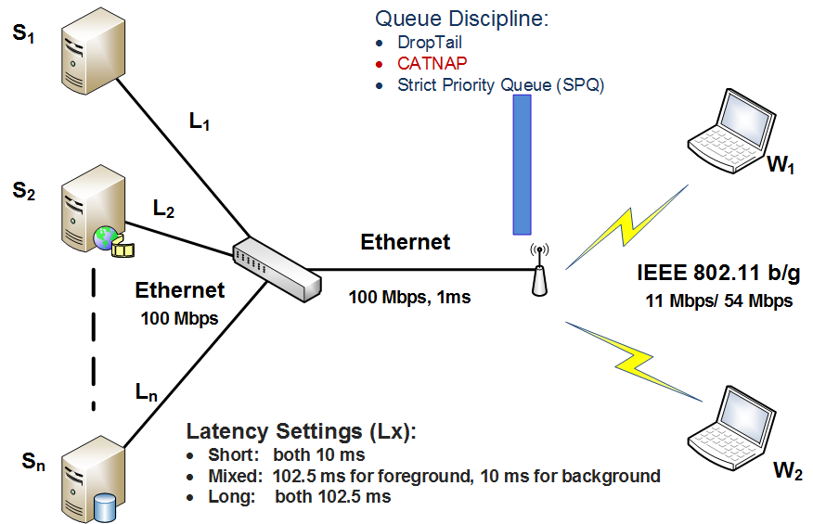
Simulation Setup
Notes:
1 show AP, AP queue controller, what is SPQ

Slide 24
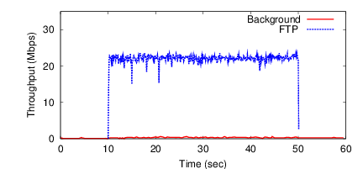
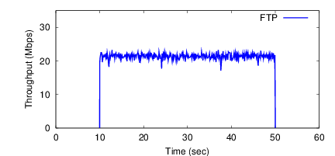
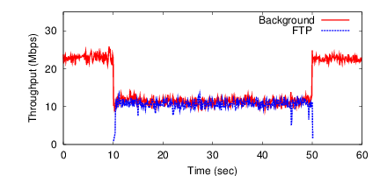
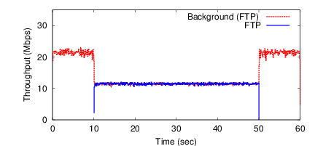
Simulation Setup Validation
a) FTP downloading w/ insignificant background traffic
b) Simulated FTP downloading w/o background traffic
c) FTP downloading w/ background traffic
d) Simulated FTP downloading w/ background traffic
Note: left column figures are from home wireless measurement study (Worcester #4)

Slide 25
Core Simulation Settings
Settings | Variables
Queue Controller | DropTail, Strict Priority Queue (SPQ), CATNAP.
Queue Capacity | CATNAP:1000 Packets. DropTail/SPQ: based on bandwidth delay products.
IEEE 802.11 standard | IEEE 802.11b, IEEE 802.11g
Latency Setting | Short (both 10 ms) Mixed (foreground: 102.5 ms, background: 10 ms) Long (both 102.5 ms)
QoS Metrics | Throughput, and queue size. Mean Opinion Score (MOS) for game, VoIP flows. Video frame rate for video streaming. ( > 15 fps as good). Response time for Web flows. Jain’s fairness index for the fairness of FTP flows.

Slide 26
Applications in Simulation
Background
Stress wireless link and build up the queue.
  FTP
  NFS w/ UDP
Foreground
Evaluate their QoS improvements.
  FTP
  NFS w/UDP
  Game w/UDP
  Game w/TCP
  VoIP w/UDP
  VoIP w/TCP
  Video w/TCP
  Video w/UDP
  Web
Verified all possible combinations in the cube.

Slide 27
Application Performance Improvements (802.11g)
Application | Quality Metric | Latency Settings
 |  | short | mixed | long
FTP | Throughput | 1.3 % | 104.4 % | 18.4%
 | Jain’s Fairness Index | 1.0 % | 23.8 % | 6.4 %
Game w/UDP | Throughput | 0.0 % | 0.0 % | 0.0 %
 | MOS (10% tail) | 58.1 % | 52.4 % | 15.7 %
Game w/TCP | Throughput | 0.0 % | 0.0 % | 0.0 %
 | MOS (10% tail) | 54.5 % | 55.6 % | 53.7 %
VoIP w/UDP | Throughput | 0.0 % | 0.0 % | 0.0 %
 | MOS (10% tail) | 1.1 % | 1.8 % | 1.6 %
VoIP w/TCP | Throughput | 0.0 % | 0.0 % | 0.0 %
 | MOS (10% tail) | 0.2 % | 0.6 % | 0.8 %
Video w/UDP | Throughput | 0.0 % | 0.0 % | 0.0 %
 | Fr Rate (10 % tail) | 0.0 % | 0.0% | 0.0 %
 | Video Fr Delay (10% tail) | 89.5 % | 97.6 % | 75.0%
Video w/TCP | Throughput | 0.0 % | 0.0 % | 0.0 %
 | Fr Rate (10% tail) | 3.4 % | 3.4 % | 0.0%
 | Video Fr Delay (10% tail) | 80.9 % | 95.6 % | 77.8%
Web | Throughput | 23.5 % | 41.3 % | 75.7%
 | Response Time | 13.6 % | 48.1 % | 56.4%

Slide 28
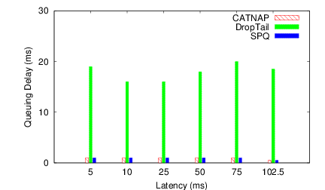
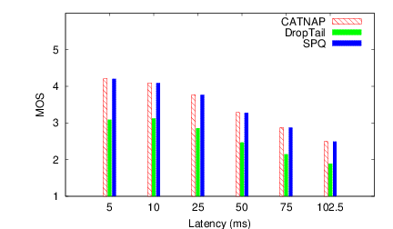
Result #1:
Game
Games are time sensitive.
CATNAP provides better QoS support by reducing queuing delay.
CATNAP achieves same performance as SPQ.

Slide 29
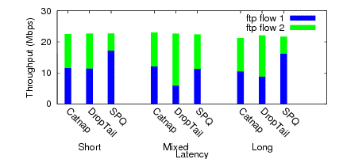
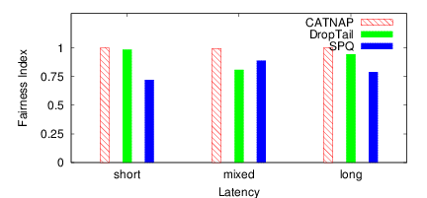
Result #2: Cumulative Throughput (FTP)
DropTail acts not fair when two FTPs have different RTTs.
SPQ shows the risk when manual configuration is wrong.

Slide 30
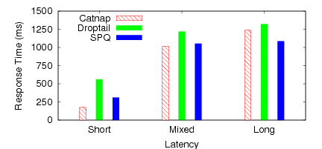
Result #3: Web Response Time

Slide 31
Result #4: Multiple Flows
QoS Comparison Between DropTail and CATNAP
 | DropTail | CATNAP | Improvements
Background FTP (Mbps) | 17.20 | 18.48 | 7.4%
VoIP w/UDP (MOS) | 4.36 | 4.37 | 0%
Game w/UDP (MOS) | 2.52 | 3.28 | 30.2%
Video w/TCP (fps) | 16.00 | 30.00 | 87.5%

Slide 32
Outline
Introduction
Related Work
Classification And Treatment iN AP (CATNAP)
Experiment
  Validation
  Evaluation
Future work
Conclusions

Slide 33
Future Work
Improve RTT Estimator.
  Measure RTT during the life cycle of TCP flows.
  Estimated RTT for UDP flows based on paired TCP flows
Self-tuning Epoch.
  Dynamically epoch selection can save more CPU resources.
Identify and treat paced traffic.
  Video and audio flows are “paced”.
  Better scheduling to improve bandwidth utilization.

Slide 34
Conclusions (1/2)
Home AP is important.
  Supporting many applications.
  Can be a bottleneck to application qualities.
CATNAP provides
  Plug-&-play solution.
  Classify and treat home applications.

Slide 35
Conclusions (2 of 2)
CATNAP lowers the queuing delay for time sensitive applications by effectively controlling queue length.
  Improve QoS for interactive applications, VoIP and game.
  Reducing the response time for Web traffic.
CATNAP provides a better QoS.
  Automatically classify flows for treatment purposes.
  Taming greedy high-bandwidth traffic, especially misbehaved UDP flows.
CATNAP can be implemented in a real AP router.
  Without modification on end-host, applications or network standards.
  Possible design guideline for future APs.

Slide 36
Treatment-Based Classification in Residential
Wireless Access Points
Question ?
Feng Li (lif@cs, EMC)
Committee:
Prof. Mark Claypool – CS, Worcester Polytechnic Institute
Prof. Robert Kinicki – CS, Worcester Polytechnic Institute
Prof. CraigWills – CS, Worcester Polytechnic Institute
Dr. Timothy Strayer – BBN Technologies
PhD Dissertation (practice)
Computer Science Dept.
Worcester Polytechnic Institute
April 28, 2014

Slide 37
References (1/3)
[Singha, 2012] A. Singh and B. Mishra, “Comparative Study on Wireless Local Area Network Standards”, International Journal of Applied Engineering and Technology 2012.
[Akamai, 2014] Akamai Inc, “ The State of the Internet: Q3, 2013 Report”, 2014.
[NetIndex, 2014] Ookla, http://www.netindex.com/, 2014.
[IANA, 2014] Internet Assigned Numbers Authority (IANA), http://www.iana.org/assignments/port-numbers, last updated on 2014-02-21.
[CORSARO, 2013] Corsaro. Online at http://www.caida.org/tools/measurement/corsaro/, Last Access on October 30th, 2013.
[Khalife, 2013] Jawad Khalife, et al. “Performance of OpenDPI in Identifying Sampled Network Trace”. Journal of Networks, 8(1), January 2013.
[Xie, 2013] Guowu Xie, et al., “ReSurf: Reconstructing web-surng activity from network tracffic”. In Proceedings of IFIP Networking Conference, 2013, May 2013.
[Nguyen, 2012] Thuy Nguyen, et al., “Timely and Continuous Machine-learning-based Classication for Interactive IP Traffic”. Journal of IEEE/ACM Transactions on Networking (TON), 20(6), December 2012.

Slide 38
References (2/3)
[Roughan, 2004] M. Roughan, et al., “Class-of-service Mapping for QoS: a Statistical Signature-based Approach to IP Traffic Classification”, the ACM SIGCOMM Internet Measurement Conference (IMC), 2004.
[Karagiannis, 2005] K. Papagiannaki and M. Faloutsos, “BLINC: Multilevel Traffic Classication in the Dark”, SIGCOMM, 2005.
[Zhang, 2013] Jun Zhang, et al., “Internet Traffic Classification by Aggregating Correlated Naive Bayes Predictions”. Journal of IEEE Transactions on Information Forensics and Security, 8(1), January 2013.
[Rawat, 2007] M. Rawat, “Interoperability of 802.11 with 802.11e”, MS Thesis, IIT India, 2007.
[Li, 2011] Maodong Li, et al., “Cross-layer optimization for SVC video delivery over the IEEE 802.11e wireless networks”. Journal of Visual Communication and Image Representation, Vol(22):3, 2011.
[Lee, 2013] Kang Yong Lee, et al., Traffic Aware QoS Scheduling for IEEE 802.11 e HCCA WLAN. IEICE Transactions on Communications, 96(2), 2013.
[Siemon, 2013] Dan Siemon. “Queueing in the Linux Network Stack”. Linux Journal., 2013, July 2013.
[Chung, 2005], J Chung, “Congestion Control for Streaming Media”, Ph.D. thesis, 2005.

Slide 39
References (3/3)
[Wu, 2005] H. Wu, “ARMOR - Adjusting Repair and Media Scaling with Operations Research for Streaming Video”, Ph.D. thesis, WPI, 2006.
[Pau, 2007] G. Pau, et al., “Wireless Home Entertainment Center: Reducing Last Hop Delays for Real-Time Applications”, ACM SIGCHI International Conference on Advances in Computer Enter-tainment Technology (ACE), 2006.
[Sharma, 2013] Vishal Sharma, et al., “Quality of Service (QoS) evaluation of IEEE 802.11 WLAN using different PHY-Layer Standards”. Optik-International Journal for Light and Electron Optics, 124(4):2013.
[Claypool, 2007] M. Claypool, et al., “Treatment-Based Trac Signatures”, IETF Internet Measurement Research Group Workshop on Application Classification and Identification, 2007.
[Patro, 2013] A. Patro, et al., “Observing Home Wireless Experience through WiFi APs”, MobiCom, 2013.
[Maier, 2009] G. Maier, et al., “On Dominant Characteristics of Residential Broadband Internet Traffic”, IMC,2009.

Slide 40
Thank You !

Slide 41
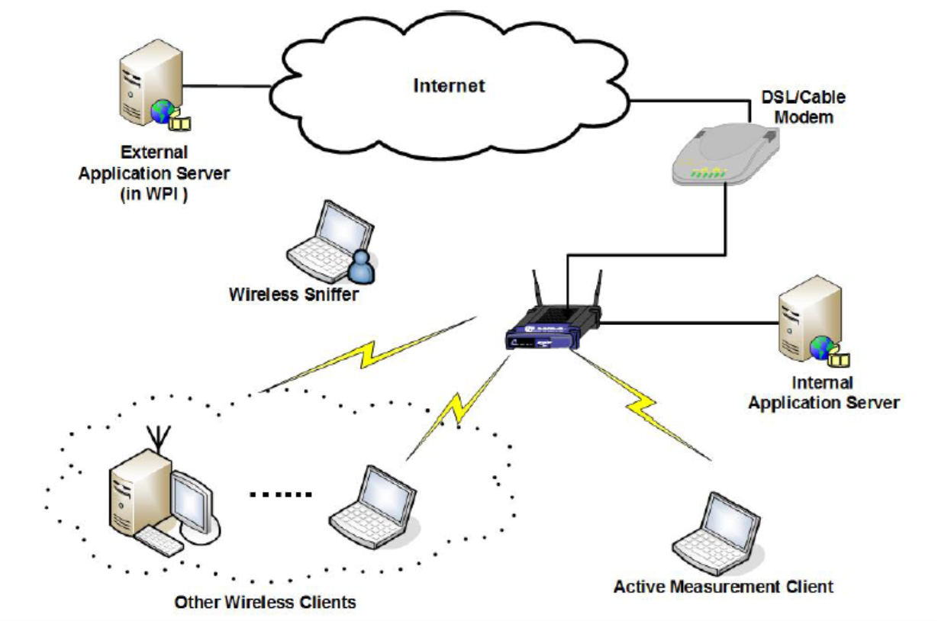
Home Wireless Measurement Study
Help to design realistic simulation.
Run wireless sniffer and multiple applications in six volunteers’ home around New England, in Spring 2009.
Experience several technical and non-technical problems.
Only occasional congestions in wireless APs.
Applications Involved.
Measurement Setup

Slide 42
Issues with Implementation
OpenSource AP is not really open.
  OpenWRT hardware compatibility issues (2009-now).
  Firmware updates on OpenSource APs.
  IEEE 802.11n APs on market 2009.
Linux Host as AP (Host AP).
  Linux kernel wireless support issues (2009).
  Wireless driver stability issues in 2009-2010.
    mad-wifi, ACX and Realtek.
Difficulties of evaluation.
  Well-controlled wireless environment.
  Limitation on various traffic and network settings.
Implemented and evaluated with network simulator.
  NS-2.33.

Slide 43
DropTail
CATNAP
Notes:
Green cycle shows CATNAP provides better QoS because the file transfer finishised 3 seconds earlier.

Slide 44
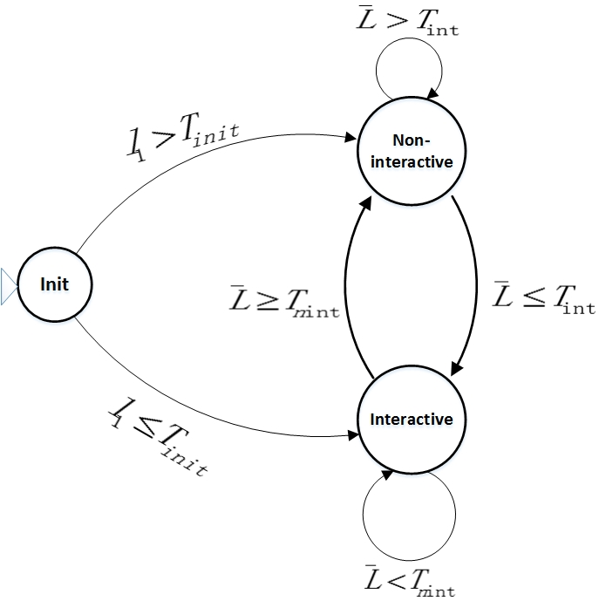
Example: Interactive/Non-Interactive Classifier
Classification based on packet length.
  Interactive flows usually consist of small packets.
  Non-interactive flows usually consist of large packets.
Avoid oscillating classification result.
  Using Exponential Weighted Moving Average (EWMA) packet length.
  Two Threshold, high water marker and low water marker.
Quickly detect flow state changes
  Two exponential weights.

Slide 45
Treatments on Wireless APs
Drop packets.
  Dropping 3% packets from UDP based streaming flow does not degrade video quality [Wu, 2006].
Limited TCP transmission rate [Pau, 2007].
  TCP sending rate is the smallest of senders’ window size, congestion window size and advertised windows size.
Push and Delay [Claypool, 2007].
  Packets from time-sensitive application can “cut in line”.
  Packets from best-effort applications can be delayed slightly without users’ notice.
Reserve Bandwidth.
Notes:
This slide summaries the possible treatments could be used o

Slide 46
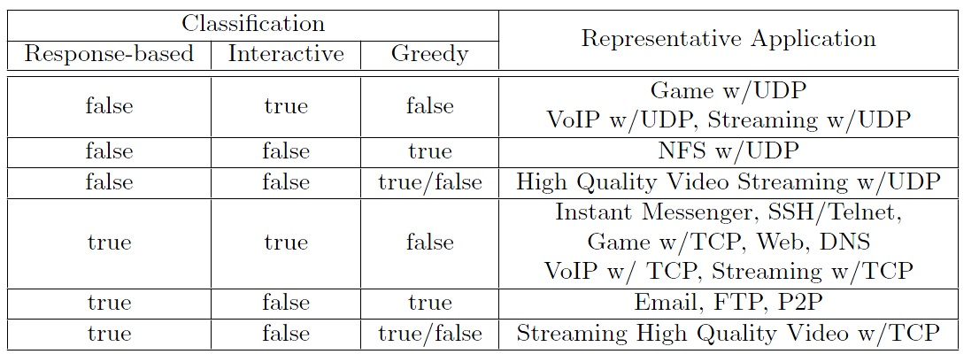
Treatment-Based Classification for Typical Applications

Slide 47
Problems in Current Home Wireless Network (1/2)
Residential APs do not guarantee low transmission delays required by time sensitive applications.
  Applications with various Quality of Service (QoS) requirements.
  Large queuing delays at AP when congestion.
Residential APs do not automatically provide traffic classifications.
  Traffic classification usually for security purposes.
  Manual configuration (by LAN port, MAC/IP address).
Current QoS methods may not fit home wireless APs.
  Type of Service (TOS) bits never saw widespread use.
  Dropping on packets from TCP flows might not relieve congestion.

Slide 48
Foreground Applications in Simulation
Application | CATNAP Classification
FTP | response-based | non-interactive | greedy
NFS w/ UDP | non-response-based | non-interactive | greedy
Game w/UDP | non-response-based | non-interactive | greedy
Game w/TCP | response-based | interactive | non-greedy
VoIP w/UDP | non-response-based | interactive | non-greedy
VoIP w/TCP | response-based | interactive | non-greedy
Video w/UDP | non-response-based | non-interactive | non-greedy
Video w/TCP | response-based | non-interactive | non-greedy
Web | response-based | interactive/non-interactive | greedy/non-greedy
Notes:
Mention we have back ground application/flow to stress wireless link

