Slide 1
Analysis of Algorithms
These slides are a modified version of
the slides used by Prof. Eltabakh
in his offering of CS2223 in D term 2013

Slide 2
Analysis of Algorithms
Correctness Analysis:
An algorithm is correct if under all valid inputs it produces the correct output
Efficiency (Complexity) Analysis:
We want the algorithm to make best use of
Space (storage)
Time (how long it take to run, number of instructions executed, …)

Slide 3
Time and Space Complexity
Time
Executing instructions take time
How fast does the algorithm run?
What affects its runtime?
Space
Data structures take space
What kind of data structures can be used?
How does the choice of data structure affect the runtime?

Slide 4
Time vs. Space
Very often, we can trade space for time:
For example: maintain a collection of students with SSN
Use an array of a billion elements and have immediate access (better time)
Use an array of 110 elements and have to search (better space)
 |  |  | Joe Smith
000-00-0000 | 000-00-0001 | … | 555-55-5555 | … | 999-99-9999
 |  | Name: Joe Smith SSN: 555-55-5555
1 | … | 97 | … | 110

Slide 5
The Right Balance
The best solution uses a reasonable mix of space and time.
Select effective data structures to represent your data model.
Utilize efficient methods on these data structures.

Slide 6
Measuring the Growth of Work
While it is possible to measure the work done by an algorithm for a given set of input, we need a way to:
Measure the rate of growth of an algorithm based upon the size of the input
Compare algorithms to determine which is better for the situation
For example, compare performance of sorting algorithms on different input array conditions at:
http://www.sorting-algorithms.com/

Slide 7
Worst-Case Analysis
Worst case running time
Obtain bound on largest possible running time of algorithm on input of a given size N
Generally captures efficiency in practice
We will focus on the Worst-Case when analyzing algorithms

Slide 8
Example I: Linear Search Worst Case
Search(A,target)
for i = 1 … N:
if A[i] == target:
return “Found”
return(“Not found”)
Scan the array
Worst Case: N comparisons
Worst Case: target matches last array item (or target
doesn’t match any element in the array)
7
12
5
22
13
32
target = 32

Slide 9
Example II: Binary Search Worst Case
def BinarySearch(A, first, last, target):
middle <- (first + last) / 2
if first > last:
return false
if A[middle] = target:
return true
if target< A[middle]:
return BinarySearch(A, first, middle–1, target)
else:
return BinarySearch(A, middle+1, last, target)
How many comparisons??
Worst Case: divide until reach one item, or no match,

Slide 10
Example II: Binary Search Worst Case
With each comparison we throw away ½ of the list
N
…………
1 comparison
N/2
…………
1 comparison
Total number of comparisons in the worst case: Log₂ N
N/4
…………
1 comparison
N/8
…………
1 comparison
Worst Case: Number of
Steps is: Log₂N
.
.
.
1
…………
1 comparison

Slide 11
In General
Assume the initial problem size is N
If you reduce the problem size in each step by factor k
Then, the max steps to reach size 1 ➔ Log_{k}N
If in each step the amount of work done is α
Then, the total amount of work is (α Log_{k}N)
In Binary Search
Factor k = 2, then we have Log₂N
In each step, we do one comparison (1)
Total : Log₂N

Slide 12
Example III: Insertion Sort Worst Case
Worst Case: Input array is sorted in reverse order
In each iteration i , we do i comparisons.
Total : N(N-1) comparisons
Sum of the # of comparisons over all iterations
Notes:
We’ll resolve the discrepancy between N(N-1) and N(N-1)/2 in a following slide

Slide 13
Order Of Growth
Less efficient (infeasible for large N)
More efficient
Log N
N
N²
N³
2^{N}
N!
Logarithmic
Polynomial
Exponential

Slide 14
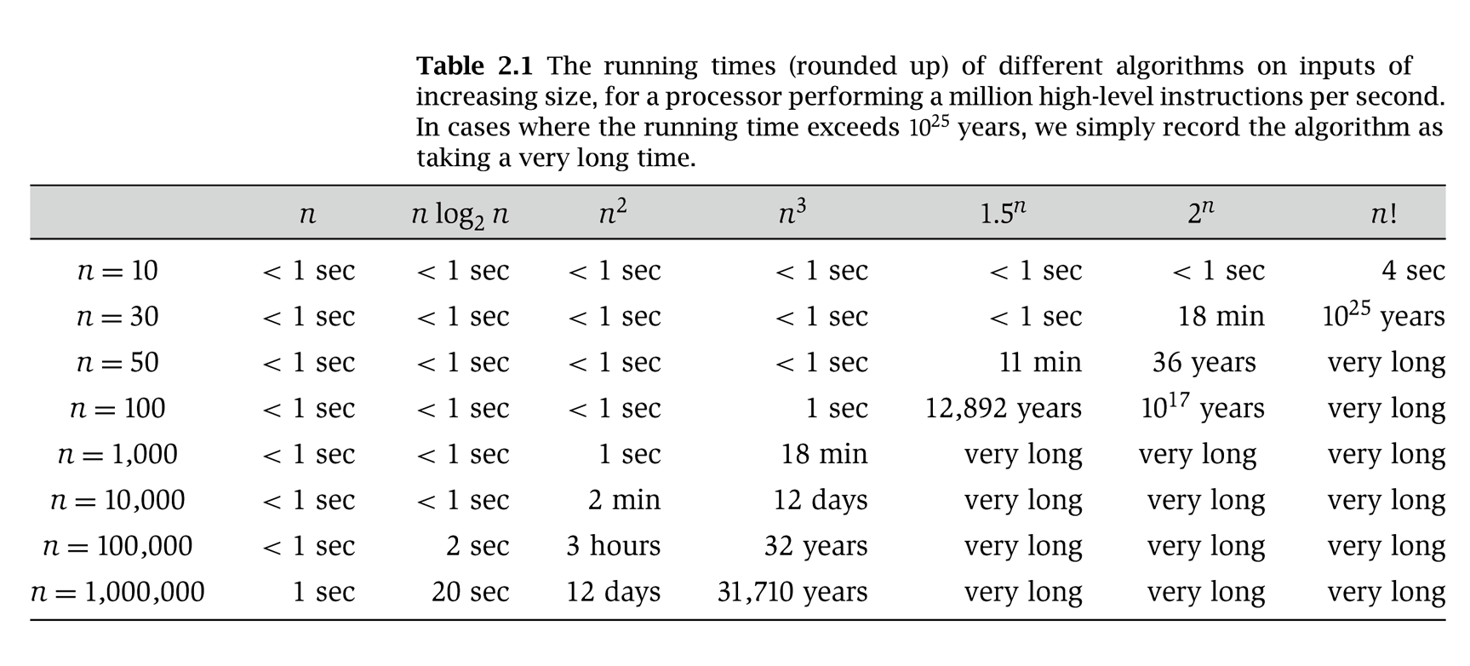
Why It Matters
For small input size (N) ➔ It does not matter
For large input size (N) ➔ it makes all the difference
Notes:
table taken from More Programming Pearls, p. 82, 400MhZ Pentium II scaled up
one step takes one nanosecond
msec = millisecond

Slide 15
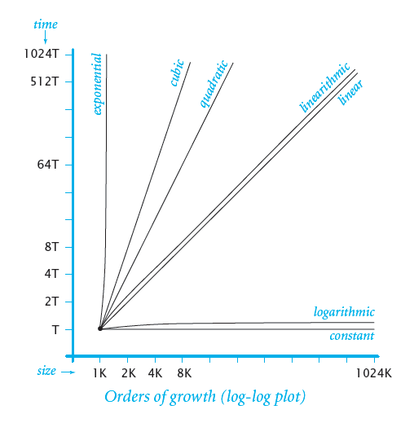
Order of Growth
Notes:
An algorithm is said to run in linearithmic time if T(n) = O(n log n).

Slide 16
Worst-Case Polynomial-Time
By convention, we say that an algorithm is efficient if its running time is polynomial.
Justification: It really works in practice!
Although 6.02 × 10²³ × N²⁰ is technically polynomial time, such a runtime would be prohibitive. But in practice, the poly-time algorithms that people develop almost always have low constants and low exponents.
Even N² with very large N is infeasible

Slide 17
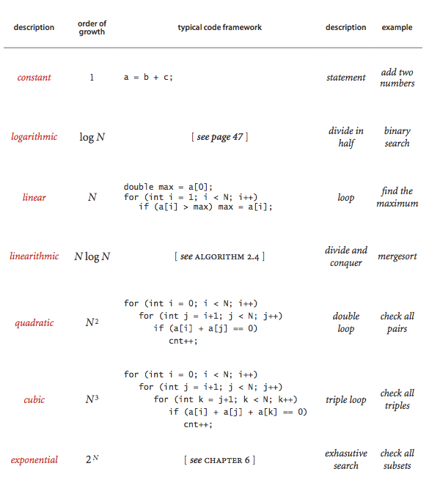
Input size N objects

Slide 18
Introducing Big O
LB
Allows us to evaluate algorithms by providing us with an upper bound of the complexity (e.g., runtime, space) of the algorithm
Has a precise mathematical definition
Helps us group algorithms into families

Slide 19
Size of Input
In analyzing rate of growth based upon size of input, we’ll use a variable for each factor in the input size that affects the performance of the algorithm
N is most commonly used …
Examples:
A linked list of N elements
A 2D array of N x M elements
2 Lists of size N and M elements
A Binary Search Tree of N elements

Slide 20
Formal Definition
For a given function g(n),
O(g(n)) is defined to be the following set of functions:
O(g(n)) = {f(n): there exist positive constants c and n₀
such that
0 ≤ f(n) ≤ cg(n) for all n ≥ n₀}
note that f(n) belongs to O(g(n)) if there is a constant multiple of g(n) that is an asymptotic upper bound of f(n)

Slide 21
Visual O() Meaning
cg(n)
Asymptotic
Upper Bound
f(n)
f(n) = O(g(n))
Work done
Runtime of
Our Algorithm
n₀
Size of input

Slide 22
Simplifying O() Answers
Notation “abuse”: it should be 3n² + 2 belongs to O(n²)
We say 3n² + 2 = O(n²) ← drop constants!
because we can show that there is a n₀ and a c such that:
0 ≤ 3n² + 2 ≤ cn² for n ≥ n₀
i.e. take c = 4 and n₀ = 2 yields:
0 ≤ 3n² + 2 ≤ 4n² for all n ≥ 2

Slide 23
Correct but Meaningless
You could say
3n² + 2 = O(n⁶) or 3n² + 2 = O(n⁷)
But this is like answering:
What is the world’s record for running one mile?
Less than 3 days.
How long does it take to drive from here to Chicago?
Less than 11 years.
O (n²)
is a tighter asymptotic
upper bound

Slide 24
Analyzing Algorithm Complexity
Now that we know the formal definition of the O() notation (and what it means intuitively)…
We can determine the complexity of an algorithm:
Construct a function T(n)
T(n): time (e.g., number of operations) taken by the algorithm on an input of size n
2. Find g(n), an asymptotic upper bound g(n)
of T(N). That is, T(n) = O(g(n))
we aim for as tight upper bound g(n) as we can find
This works also for space complexity analysis:
S(n) = space taken by the algorithm on input size n

Slide 25
Comparing Algorithms
Now that we know the formal definition of the O() notation (and what it means intuitively)…
We can compare different algorithms that solve the same problem:
Determine the O(.) for the time complexity of each algorithm
Compare them and see which has “better” performance

Slide 26
Comparing Asymptotic Growth
N²
N
Work done
log N
1
Size of input

Slide 27
Do not get confused: O-Notation
O(1) or “Order One”
Does not mean that it takes only one operation
Does mean that the work doesn’t change as N changes
Is notation for “constant work”
O(N) or “Order N”
Does not mean that it takes N operations
Does mean that the work changes in a way that is proportional to N
Is a notation for “work grows at a linear rate”

Slide 28
Modular Analysis
Algorithms typically consist of a sequence of logical steps/sections/modules
We need a way to analyze these more complex algorithms…
It’s easy – analyze the sections and then combine them

Slide 29
Example: Insert in a Sorted Linked List
Insert an element into an ordered list of length N
Find the right location
Create a new node and add it to the list
head
17
38
142
//
Step 1: find the location = O(N)
Inserting 75

Slide 30
Example: Insert in a Sorted Linked List
Insert an element into an ordered list of length N
Find the right location
Create a new node and add it to the list
head
17
38
142
//
75
Step 2: Do the node insertion = O(1)

Slide 31
Combine the Analysis
Find the right location: O(N)
Insert Node: O(1)
Steps 1 and 2 are performed sequentially, so add:
O(N) + O(1) = O(N + 1) =
O(N)
Only keep dominant factor

Slide 32
Example: Search a 2D Array
Search an unsorted 2D array of size NxM (row, then column)
Traverse all rows
For each row, examine all the cells (changing columns)
Row
1
2
3
4
5
O(N)
1 2 3 4 5 6 7 8 9 10
Column

Slide 33
Example: Search a 2D Array
Search an unsorted 2D array of size NxM (row, then column)
Traverse all rows
For each row, examine all the cells (changing columns)
Row
1
2
3
4
5
1 2 3 4 5 6 7 8 9 10
Column
O(M)

Slide 34
Combine the Analysis
Traverse rows = O(N)
Examine all cells in row = O(M)
Embedded (i.e., nested loops) so multiply:
O(N) x O(M) = O(N*M)

Slide 35
Sequential Steps
If steps appear sequentially (one after another), then add their respective O().
loop
. . .
endloop
loop
. . .
endloop
N
O(N + M)
M

Slide 36
Embedded Steps
If steps appear embedded (one inside another), then multiply their respective O().
loop
loop
. . .
endloop
endloop
M
N
O(N*M)

Slide 37
Correctly Determining O()
Can have multiple factors (variables that measure input size)
O(N*M)
O(logP + N²)
But keep only the dominant factors:
O(N + NlogN) →
O(N*M + P)→
O(V² + VlogV) →
Drop constants:
O(2N + 3N²) →
O(NlogN)
remains the same
O(V²)
O(N + N²)
→ O(N²)

Slide 38
Summary
We use O() notation to analyze the rate at which the work done (or space used by) an algorithm grows with respect to the size of the input.
O() provides asymptotic upper bounds
(nicely focusing on asymptotic rate of growth, only keeping dominant terms and dropping non-dominant terms and constants)

