Slide 1
Graphs-Part II Depth First Search (DFS)

Slide 2
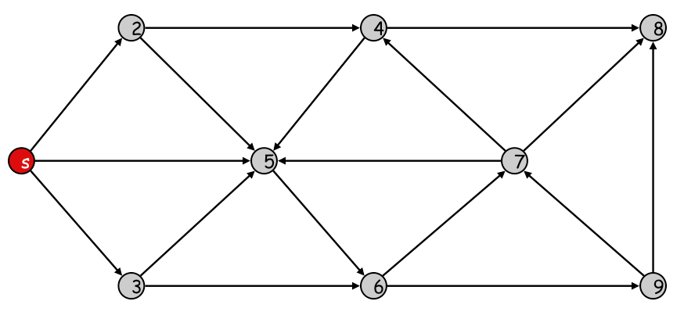
We Already Covered Breadth First Search(BFS)
Traverses the graph one level at a time
Visit all outgoing edges from a node before you go deeper
Needs a queue
BFS creates a tree called BFS-Tree
Time Complexity O(V+E)

Slide 3
BFS & Shortest Path
BFS can be used to compute the shortest path (minimum number of edges) from source s and any reachable nodes v
Maintain a counter for each node
When a node x is first visited from parent y ➔ x.counter = y.counter + 1

Slide 4
Connected Undirected Graph
G = (V, E) is called connected iff
From any node u, we can read all other nodes
Connected graph
Un-Connected graph
What is the time complexity to decide if G is a connected graph?
Take any node from G and apply BFS
If you reached all nodes ➔ G is connected
Otherwise ➔ G is not connected
Time Complexity O(V+E)

Slide 5
Depth First Search (DFS)
Traverse the graph by going deeper whenever possible
DFS uses a stack, hence can be implemented using recursion
While traversing keep some useful information
u.color:
White ➔ u has not been visited yet
Gray ➔ u is visited but its descendent are not completed yet
Black ➔ u and its all descendent are visited
u.startTime (u.d)= the first time u is visited
u.endTime (u.f) = the last time u will be seen (after all descendent of u are processed)

Slide 6
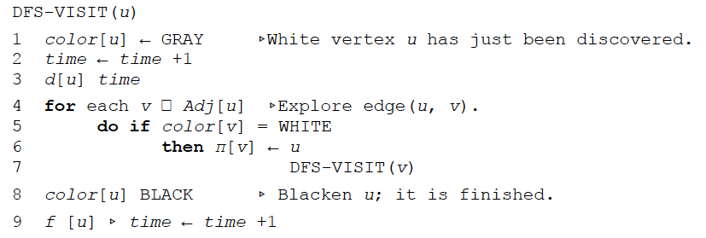
DFS: Pseudocode
U is just discovered…make it gray
Time is a global veriable
=
U start time
in
If v is not seen before, recursively visit v
=
Notice: We maintain 4 arrays during the traversal
d[u] ➔First time u is seen
f[u] ➔Last time u is seen
color[u] ➔ {white, Gray, Black}
π[u] ➔ parent of node u

Slide 7
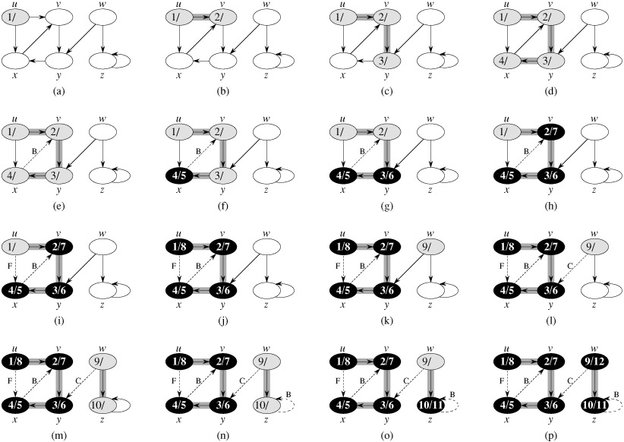
Depth First Search (DFS): Example

Slide 8
Depth First Search (DFS): Example

Slide 9
Depth First Search (DFS): Example

Slide 10
Depth First Search (DFS): Example

Slide 11
Depth First Search (DFS): Example

Slide 12
Depth First Search (DFS): Example

Slide 13
Depth First Search (DFS): Example

Slide 14
Depth First Search (DFS): Example

Slide 15
Depth First Search (DFS): Example

Slide 16
Depth First Search (DFS): Example

Slide 17
Depth First Search (DFS): Example

Slide 18
Depth First Search (DFS): Example

Slide 19
Depth First Search (DFS): Example

Slide 20
Depth First Search (DFS): Example

Slide 21
Depth First Search (DFS): Example

Slide 22
Depth First Search (DFS): Example

Slide 23
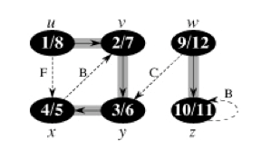
DFS: Forest
The DFS may create multiple disconnected trees called forest

Slide 24
DFS: Time Complexity
=
in
=
Each node is recursively called once ➔ O(|V|)
The For Loop (Step 4) visits the outgoing edges of each node ➔ Total O(|E|)
Total Complexity O( |V| + |E|)

Slide 25
Analyzing The Collected Info.
The algorithm computes for each node u
u.startTime (u.d)
u.endTime (u.f)
These intervals form a nested structure
Parenthesis Theorem
If u has (u.d, u.f) , and v has (v.d, v.f), then either:
Case 1: u descendant of v in DFS
Case 2: v descendant of u in DFS
Case 3: u and v are disjoint (different trees in the forest)
v.d < u.d < u.f < v.f
u.d < v.d < v.f < u.f
(u.d, u.f) and (v.d, v.f) are not overlapping

Slide 26
Example
Based on the numbers you can draw the DFS trees
v, y, x are all descendants of u
In other words: u is an ancestor to v, y, x
w and u are disjoint

Slide 27
Classification of Graph Edges
While doing DFS, we can label the edges
Tree edges: Included in the DFS trees
Forward edges: From ancestor to already-visited descendant
Backward edges: From descendant to already-visited ancestor
Cross edges: Any other edges

Slide 28
Depth First Search (DFS): Example
Tree edge
Backward edge
Forward edge
Cross edge
Backward edge

Slide 29
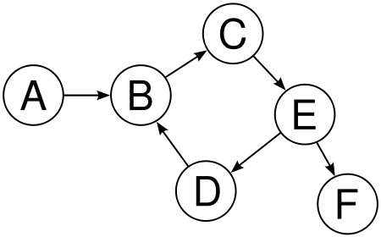
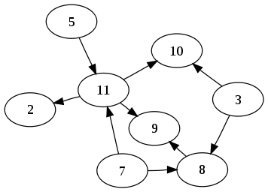
Cycles in Graphs
Cyclic graph (Graph containing cycles)
Acyclic graph (Graph without cycles)
Called: Directed Acyclic Graph DAG
How to know if a graph has a cycle or not? What is the time complexity?

Slide 30
Cycles in Graphs (Cont’d)
Answer
Perform DFS on the graph
If there are backward edges ➔ there is a cycle
Otherwise ➔ there are no cycles

