Slide 1
Data Link Layer CS 3516 – Computer Networks

Slide 2
Chapter 5: The Data Link Layer
Goals:
Understand principles behind data link layer services:
Error detection, correction
Sharing a broadcast channel: multiple access
Link layer addressing
Reliable data transfer, flow control (done! in Ch3)
Instantiation and implementation of various link layer technologies

Slide 3
Link Layer
5.1 Introduction and services
5.2 Error detection and correction
5.3Multiple access protocols
5.4 Link-layer Addressing
5.5 Ethernet
5.6 Link-layer switches
5.7 PPP
5.8 Link virtualization: MPLS
5.9 A day in the life of a web request

Slide 4
Link Layer: Introduction
Some terminology:
Hosts and routers are nodes
Communication channels that connect adjacent nodes along communication path are links
Wired links
Wireless links
LANs
Layer-2 packet is a frame, encapsulates datagram
data-link layer has responsibility of
transferring datagram from one node
to adjacent node over link

Slide 5
Link Layer: Context
Datagram transferred by different link protocols over different links:
e.g., Ethernet on first link, frame relay on intermediate links, 802.11 on last link
Each link protocol provides different services
e.g., may or may not provide rdt over link
Transportation analogy
Trip from Princeton to Lausanne
limo: Princeton to JFK
plane: JFK to Geneva
train: Geneva to Lausanne
Tourist = datagram
Transport hop = communication link
Transportation mode = link layer protocol
Travel agent = routing algorithm

Slide 6
Link Layer Services
Framing, link access
Encapsulate datagram into frame, adding header, trailer
Channel access if shared medium
Medium Access Control (MAC) addresses used in frame headers to identify source and dest
Different from IP address!
Reliable delivery between adjacent nodes
We learned how to do this already! (in ch3)
Seldom used on low bit-error link (fiber, some twisted pair)
Used for wireless links with high error rates

Slide 7
Link Layer Services (more)
Flow control
Pacing between adjacent sending and receiving nodes
Error detection
Errors caused by signal attenuation, noise.
Receiver detects presence of errors
Signals sender for retransmission or drops frame
Error correction
Receiver identifies and corrects bit error(s) without resorting to retransmission
Half-duplex and full-duplex
With half duplex, nodes at both ends of link can transmit, but not at same time

Slide 8
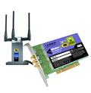
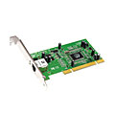
Where is Link Layer Implemented?
In each and every host
Link layer implemented in “adaptor” (aka network interface card NIC)
Ethernet card, PCMCI card, 802.11 card
Implements link, physical layer
Attaches into host’s system buses
Combination of hardware, software, and firmware
host schematic
application
transport
network
link
cpu
memory
link
physical
host
bus
(e.g., PCI)
controller
physical
transmission
network adapter
card

Slide 9
Adaptors Communicating
datagram
datagram
controller
controller
sending host
receiving host
datagram
frame
Sending side:
Encapsulates datagram in frame
Adds error checking bits, rdt, flow control, etc.
Receiving side
Looks for errors, rdt, flow control, etc.
Extracts datagram, passes to upper layer

Slide 10
Data Link Layer
5.1 Introduction and services
5.2 Error detection and correction
5.3 Multiple access protocols
5.4 Link-layer Addressing
5.5 Ethernet
5.6 Link-layer switches
5.7 PPP
5.8 Link virtualization: MPLS
5.9 A day in the life of a web request

Slide 11
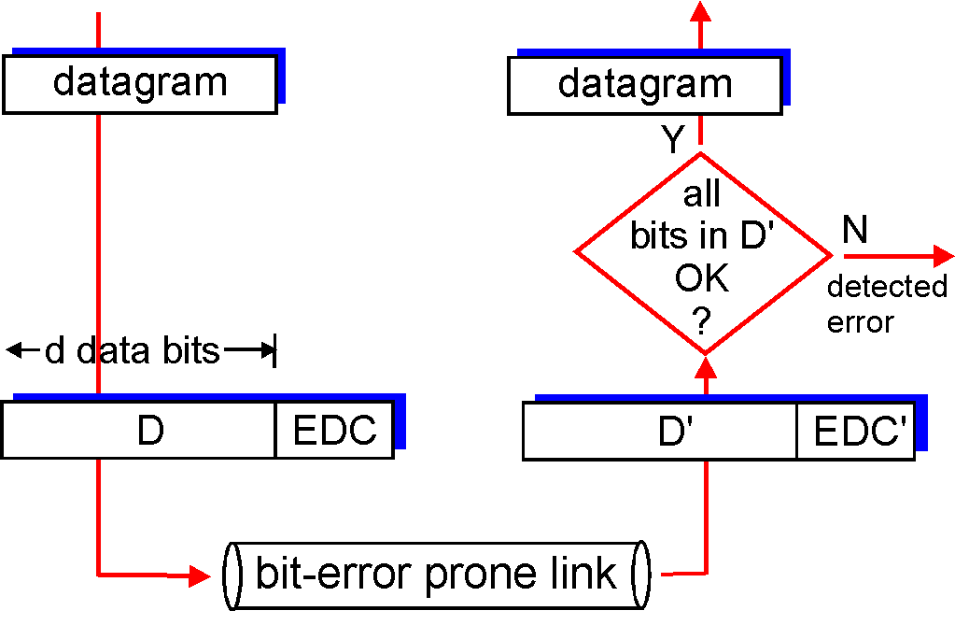
Error Detection
EDC= Error Detection and Correction bits (redundancy)
D = Data protected by error checking, may include header fields
Error detection not 100% reliable!
Protocol may miss some errors, but rarely
Larger EDC field yields better detection and correction
otherwise

Slide 12
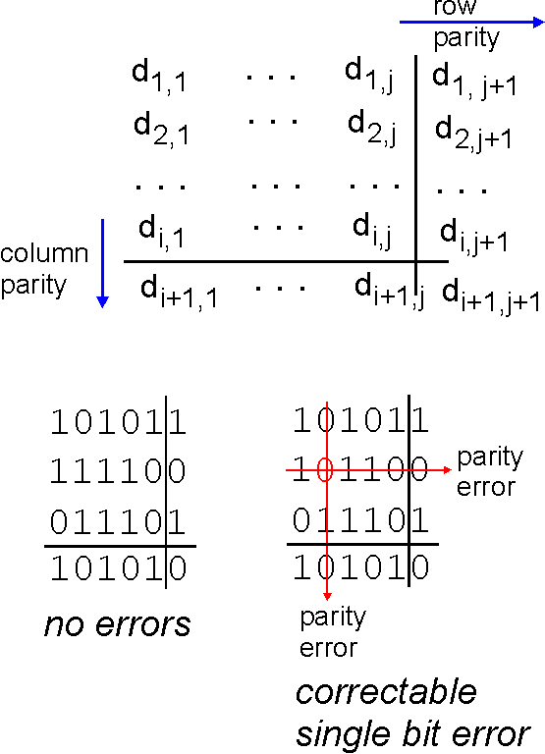
Simple - Parity Checking
Single Bit Parity:
Detect single bit errors
Two Dimensional Bit Parity:
Detect and correct single bit errors
0
0

Slide 13
Internet Checksum (review)
Goal: detect “errors” (e.g. flipped bits) in transmitted packet
Sender:
Treat segment contents as sequence of 16-bit integers
Checksum: addition (1’s complement sum) of segment contents
Sender puts checksum value into UDP checksum field
Receiver:
Compute checksum of received segment
Check if computed checksum equals checksum field value:
NO - error detected
YES - no error detected. But maybe errors nonetheless?

Slide 14
Checksumming: Cyclic Redundancy Check (CRC)
View data bits, D, as a binary number
Choose r+1 bit pattern (generator), G
Goal: choose r CRC bits, R, such that
<D,R> exactly divisible by G (modulo 2)
Receiver knows G, divides <D,R> by G.
If non-zero remainder → error detected!
Can detect all burst errors less than r+1 bits
Widely used in practice (Ethernet, 802.11 WiFi)

Slide 15
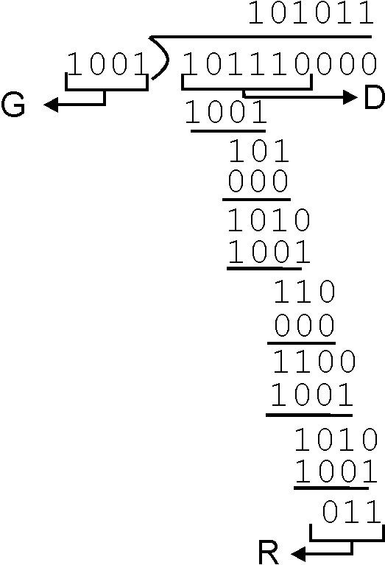
CRC Example – Choosing R
Want:
D.2^{r} XOR R = nG
Equivalently:
D.2^{r} = nG XOR R
Equivalently:
If we divide D.2^{r} by G, want remainder R
D.2^{r}
G
R = remainder[ ]

Slide 16
CRC Standards
Defined for 8, 12, 16 and 32 bit genrators (G)
CRC-32 adopted by many IEEE link-layer protocols uses generator:
G_{crc-32} = 100000100110000010001110110110111
Detects all errors burst less than 33 bits
Detects all odd number bit errors
Burst errors greater than 33 bits with probability 1-0.5^{r}

Slide 17
Data Link Layer
5.1 Introduction and services
5.2 Error detection and correction
5.3 Multiple access protocols
5.4 Link-layer Addressing
5.5 Ethernet
5.6 Link-layer switches
5.7 PPP
5.8 Link virtualization: MPLS
5.9 A day in the life of a web request

Slide 18
Multiple Access Links and Protocols
Two types of “links”:
point-to-point (not shared)
PPP for dial-up access
point-to-point link between Ethernet switch and host
broadcast (shared wire or medium)
old-fashioned Ethernet
upstream HFC
802.11 wireless LAN
humans at a
cocktail party
(shared air, acoustical)
shared wire (e.g.,
cabled Ethernet)
shared RF
(e.g., 802.11 WiFi)
shared RF
(satellite)

Slide 19
Multiple Access Protocols
Single shared broadcast channel
Two or more simultaneous transmissions by nodes →interference
collision if node receives two or more signals at the same time
Multiple access protocol
Distributed algorithm determines how nodes share channel (i.e. determine when/who node can transmit)
Communication about channel sharing must use channel itself!
no “out-of-band” channel for coordination

Slide 20
Ideal Multiple Access Protocol
Broadcast channel of rate R bps
1. When one node wants to transmit, it can send at rate R
2. When M nodes want to transmit, each can send at average rate R/M (no overhead)
3. Fully decentralized
No special node to coordinate transmissions
No synchronization of clocks, slots
4. Simple

Slide 21
MAC Protocols: a Taxonomy
Three broad classes:
Channel Partitioning
Divide channel into smaller “pieces” (time slots, frequency)
Allocate piece to node for exclusive use
Random Access
Channel not divided, allow collisions
“Recover” from collisions
Taking turns
Nodes take turns, but nodes with more to send can perhaps take longer turns

Slide 22
Channel Partitioning MAC protocols: TDMA
TDMA: time division multiple access
Access to channel in "rounds"
Each station gets fixed length slot (length = pkt trans time) in each round
Unused slots go idle
Example: 6-station LAN, 1,3,4 have pkt, slots 2,5,6 idle
6-slot
frame
1
3
4
1
3
4

Slide 23
Channel Partitioning MAC protocols: FDMA
FDMA: frequency division multiple access
Channel spectrum divided into frequency bands
Each station assigned fixed frequency band
Unused transmission time in frequency bands go idle
Example: 6-station LAN, 1,3,4 have pkt, frequency bands 2,5,6 idle
time
frequency bands
FDM cable

Slide 24
Random Access Protocols
When node has packet to send
Transmit at full channel data rate R
No a priori coordination among nodes
Two or more transmitting nodes ➜ “collision”
Random access MAC protocol specifies:
How to detect collisions
How to recover from collisions (e.g. via delayed retransmissions)
Examples of random access MAC protocols
slotted ALOHA
ALOHA
CSMA, CSMA/CD, CSMA/CA

Slide 25
Slotted ALOHA
Assumptions:
All frames same size
Time divided into equal size slots (time to transmit 1 frame)
Nodes start to transmit only slot beginning
Nodes are synchronized
If 2 or more nodes transmit in slot, all nodes detect collision
Operation:
When node obtains fresh frame, transmits in next slot
If no collision: node can send new frame in next slot
If collision: node retransmits frame in each subsequent slot with prob p until success

Slide 26
Slotted ALOHA
Pros
Single active node can continuously transmit at full rate of channel
Highly decentralized: only slots in nodes need to be in sync
Simple
Cons
Collisions, wasting slots
Idle slots
Nodes may be able to detect collision in less than time to transmit packet
Clock synchronization

Slide 27
Slotted Aloha Efficiency
Efficiency : long-run fraction of successful slots (many nodes, all with many frames to send)
Max efficiency: find p’ that maximizes Np(1-p)^{N-1}
For many nodes, take limit of Np’(1-p’)^{N-1} as N goes to infinity, gives:
Max efficiency = 1/e ~ .37
Suppose: N nodes with many frames to send, each transmits in slot with probability p
Prob that given node has success in a slot = p(1-p)^{N-1}
Prob that any node has a success = Np(1-p)^{N-1}
At best: channel
used for useful
transmissions 37%
of time!
!

Slide 28
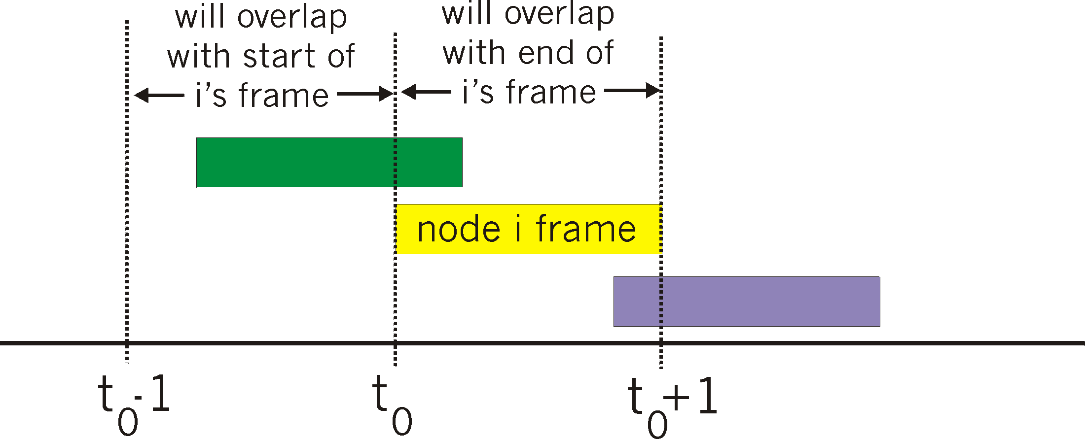
Pure (Unslotted) ALOHA
Unslotted Aloha: simpler, no synchronization
When frame first arrives
Transmit immediately
Collision probability increases:
Frame sent at t₀ collides with other frames sent in [t₀-1,t₀+1]

Slide 29
Pure Aloha Efficiency
P(success by given node) = P(node transmits) .
P(no other node transmits in [p₀-1,p₀] .
P(no other node transmits in [p₀-1,p₀]
= p . (1-p)^{N-1 .} (1-p)^{N-1}
= p . (1-p)^{2(N-1)}
… choosing optimum p and then letting n -> infty ...
^{= 1/(2e) = .18}
Even worse than slotted Aloha!

Slide 30
CSMA (Carrier Sense Multiple Access)
CSMA: listen before transmit
If channel sensed idle → transmit entire frame
If channel sensed busy → defer transmission
Human analogy: someone else talking? → Don’t interrupt!

Slide 31
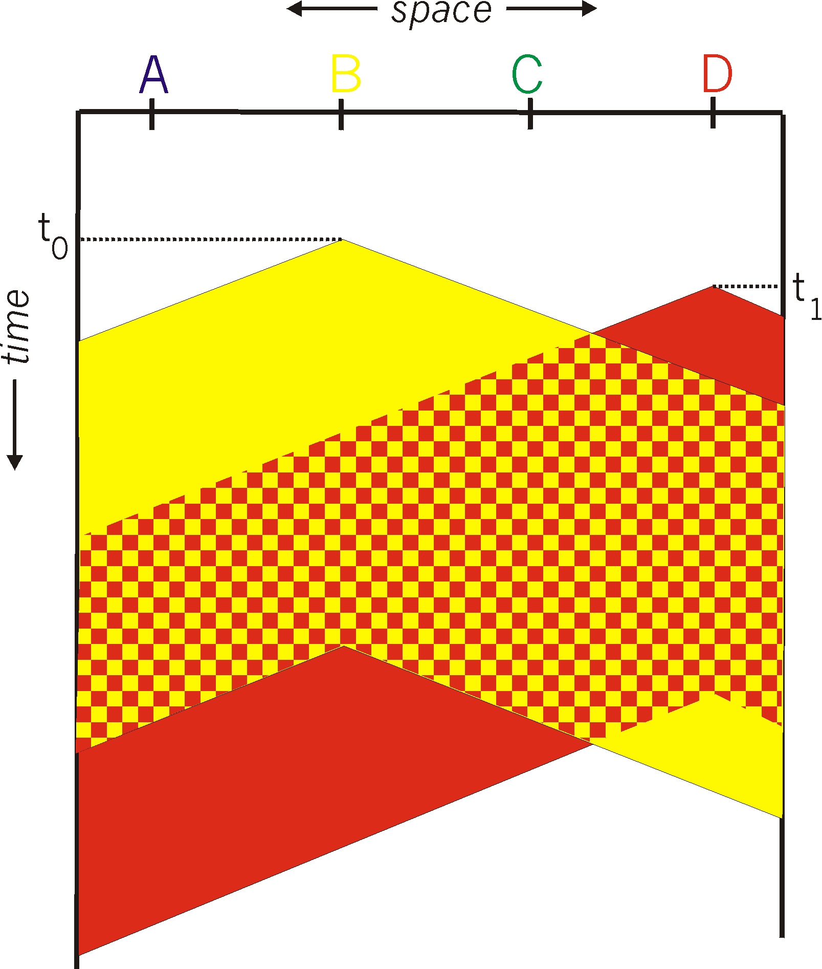
CSMA Collisions
spatial layout of nodes
Collisions can still occur:
Propagation delay means
two nodes may not hear
each other’s transmission
Collision:
Entire packet transmission
time wasted
Note:
Role of distance & propagation delay in determining collision probability

Slide 32
CSMA/CD (Collision Detection)
CSMA/CD: carrier sensing, deferral as in CSMA
Collisions detected within short time
Colliding transmissions aborted, reducing channel wastage
Collision detection:
Easy in wired LANs
Measure signal strengths, compare transmitted, received signals
Difficult in wireless LANs
Received signal strength overwhelmed by local transmission strength
Human analogy: the polite conversationalist

Slide 33
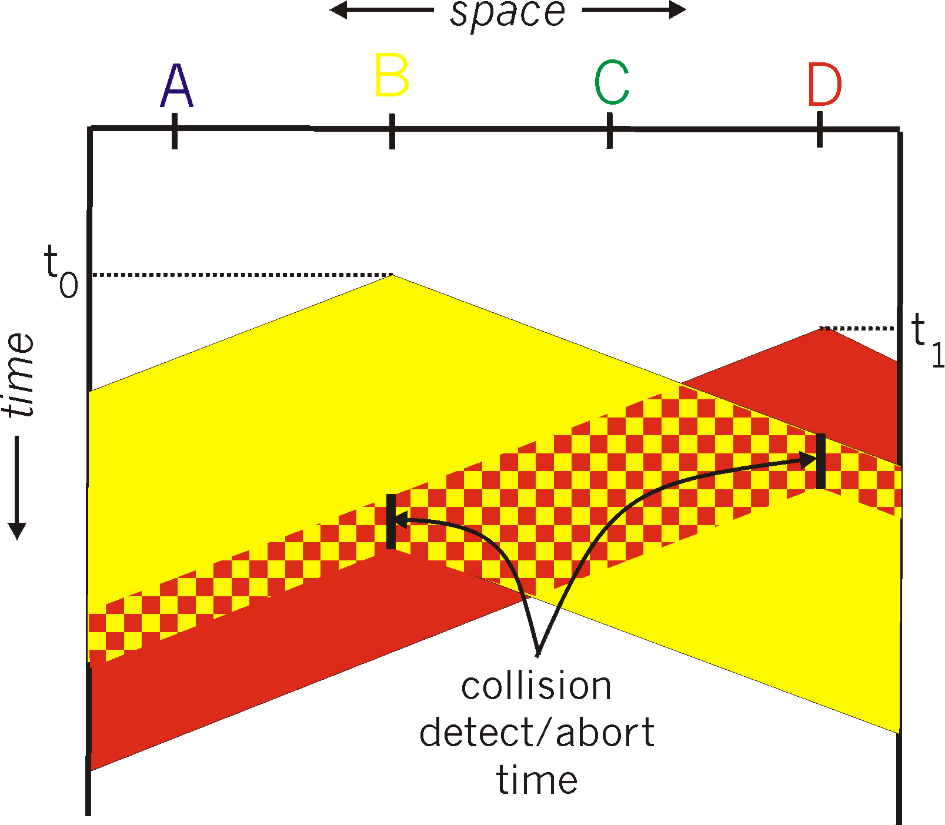
CSMA/CD (Collision Detection)

Slide 34
“Taking Turns” MAC protocols
Channel partitioning MAC protocols
Share channel efficiently and fairly at high load
Inefficient at low load: delay in channel access, 1/N bandwidth allocated even if only 1 active node!
Random access MAC protocols
Efficient at low load: single node can fully utilize channel
High load: collision overhead
“Taking turns” protocols
Look for best of both worlds!

Slide 35
“Taking Turns” MAC protocols
Polling:
Master node “invites” slave nodes to transmit in turn
Typically used with “dumb” slave devices
Concerns:
Polling overhead
Latency
Single point of failure (master)
data
poll
master
data
slaves

Slide 36
“Taking Turns” MAC protocols
Token passing:
Control token passed from one node to next sequentially.
Token message
Concerns:
token overhead
latency
single point of failure (token)
T
(nothing
to send)
T
data

Slide 37
Summary of MAC protocols
Channel partitioning
Time Division, Frequency Division
Random access (dynamic),
ALOHA, S-ALOHA, CSMA, CSMA/CD
carrier sensing: easy in some technologies (wire), hard in others (wireless)
CSMA/CD used in Ethernet
CSMA/CA used in 802.11
Taking turns
polling from central site, token passing
Bluetooth, FDDI, IBM Token Ring

Slide 38
Data Link Layer
5.1 Introduction and services
5.2 Error detection and correction
5.3 Multiple access protocols
5.4 Link-Layer Addressing
5.5 Ethernet
5.6 Link-layer switches
5.7 PPP
5.8 Link virtualization: MPLS
5.9 A day in the life of a web request

Slide 39
MAC Addresses
32-bit IP address:
Network-layer address
Used to get datagram to destination IP subnet
MAC (or LAN or physical or Ethernet) address:
Function: get frame from one interface to another physically-connected interface (same network)
48 bit MAC address (for most LANs)
burned in NIC ROM, also sometimes software settable

Slide 40
LAN Addresses
Each adapter on LAN has unique LAN address
1A-2F-BB-76-09-AD
Broadcast address =
FF-FF-FF-FF-FF-FF
LAN
(wired or
wireless)
= adapter
71-65-F7-2B-08-53
58-23-D7-FA-20-B0
0C-C4-11-6F-E3-98

Slide 41
LAN Address (more)
MAC/LAN address allocation administered by IEEE
Manufacturer buys portion of MAC address space (to assure uniqueness)
Analogy:
(a) MAC address: like Social Security Number
(b) IP address: like postal address
MAC flat address ➜ portability
Can move LAN card from one LAN to another
IP hierarchical address NOT portable
Address depends on IP subnet to which node is attached

Slide 42
ARP: Address Resolution Protocol
Question: how to determine
MAC address of B
knowing B’s IP address?
Each IP node (host, router) on LAN has ARP table
ARP table: IP/MAC address mappings for some LAN nodes
IP address; MAC address; TTL
TTL (Time To Live): time after which address mapping will be forgotten (typically 20 min)
137.196.7.78
1A-2F-BB-76-09-AD
137.196.7.23
137.196.7.14
LAN
71-65-F7-2B-08-53
58-23-D7-FA-20-B0
0C-C4-11-6F-E3-98
137.196.7.88

Slide 43
ARP Protocol: Same LAN
A wants to send datagram to B, and B’s MAC address not in A’s ARP table.
A broadcasts ARP query packet, containing B's IP address
dest MAC address = FF-FF-FF-FF-FF-FF
all machines on LAN receive ARP query
B receives ARP packet, replies to A with its (B's) MAC address
frame sent to A’s MAC address (unicast)
A caches (saves) IP-to-MAC address pair in its ARP table until information becomes old (times out)
soft state: information that times out (goes away) unless refreshed
ARP is “plug-and-play”:
nodes create their ARP tables without intervention from net administrator

Slide 44
Addressing: Routing to Another LAN
Walkthrough: send datagram from A to B via R
assume A knows B’s IP address
Two ARP tables in router R, one for each IP network (LAN)
74-29-9C-E8-FF-55
88-B2-2F-54-1A-0F
A
E6-E9-00-17-BB-4B
222.222.222.221
111.111.111.111
1A-23-F9-CD-06-9B
222.222.222.220
222.222.222.222
111.111.111.110
B
111.111.111.112
R
49-BD-D2-C7-56-2A
CC-49-DE-D0-AB-7D

Slide 45
A creates IP datagram with source A, destination B
A uses ARP to get R’s MAC address for 111.111.111.110
A creates link-layer frame with R's MAC address as dest, frame contains A-to-B IP datagram
A’s NIC sends frame
R’s NIC receives frame
R removes IP datagram from Ethernet frame, sees its destined to B
R uses ARP to get B’s MAC address
R creates frame containing A-to-B IP datagram sends to B
This is a really important
example – make sure you
understand!
74-29-9C-E8-FF-55
88-B2-2F-54-1A-0F
A
E6-E9-00-17-BB-4B
222.222.222.221
111.111.111.111
1A-23-F9-CD-06-9B
222.222.222.220
222.222.222.222
111.111.111.110
B
111.111.111.112
R
49-BD-D2-C7-56-2A
CC-49-DE-D0-AB-7D

Slide 46
Data Link Layer
5.1 Introduction and services
5.2 Error detection and correction
5.3 Multiple access protocols
5.4 Link-Layer Addressing
5.5 Ethernet
5.6 Link-layer switches
5.7 PPP
5.8 Link virtualization: MPLS
5.9 A day in the life of a web request

Slide 47
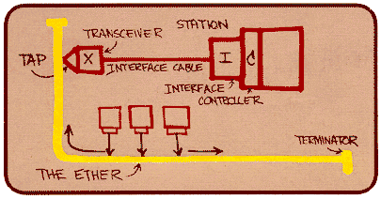
Ethernet
Dominant wired LAN technology:
Cheap ($20) for NIC
First widely used LAN technology
Simpler, cheaper than token LANs and ATM
Kept up with speed race: 10 Mbps – 10 Gbps
Metcalfe’s Ethernet
sketch

Slide 48
Topology (Bus and Star)
Bus topology popular through mid 90s
All nodes in same collision domain (can collide with each other)
Today: star topology prevails
Active switch in center (contrast with hub)
Each “spoke” runs a (separate) Ethernet protocol (nodes do not collide with each other)
switch
bus: coaxial cable
star

Slide 49
Ethernet Frame Structure
Sending adapter encapsulates IP datagram (or other network layer protocol packet) in Ethernet frame
Preamble:
7 bytes with pattern 10101010 followed by one byte with pattern 10101011
Used to synchronize receiver, sender clock rates

Slide 50
Ethernet Frame Structure (more)
Addresses: 6 bytes
If adapter receives frame with matching destination address or with broadcast address (e.g. ARP packet), it passes data in frame to network layer protocol
otherwise, adapter discards frame
Type: indicates higher layer protocol (mostly IP but others possible, e.g., Novell IPX, AppleTalk)
CRC: checked at receiver, if error is detected, frame is dropped

Slide 51
Ethernet: Unreliable, Connectionless
Connectionless: No handshaking between sending and receiving NICs
Unreliable: receiving NIC doesn’t send acks or nacks to sending NIC
Stream of datagrams passed to network layer can have gaps (missing datagrams)
Gaps will be filled if app is using TCP
Otherwise, app will see gaps
Ethernet’s MAC protocol: unslotted CSMA/CD

Slide 52
Ethernet CSMA/CD algorithm
1. NIC receives datagram from network layer, creates frame
2. If NIC senses channel idle, starts frame transmission If NIC senses channel busy, waits until channel idle, then transmits
3. If NIC transmits entire frame without detecting another transmission, NIC is done with frame!
4. If NIC detects another transmission while transmitting, aborts and sends jam signal
5. After aborting, NIC enters exponential backoff: after mth collision, NIC chooses K at random from {0,1,2,…,2^{m}-1}. NIC waits K·512 bit times, returns to Step 2

Slide 53
Ethernet’s CSMA/CD (more)
Jam Signal: make sure all other transmitters are aware of collision; 48 bits
Bit time: .1 microsec for 10 Mbps Ethernet ; for K=1023, wait time is about 50 msec
Exponential Backoff:
Goal: adapt retransmission attempts to estimated current load
heavy load: random wait will be longer
First collision: choose K from {0,1}; delay is K· 512 bit transmission times
After second collision: choose K from {0,1,2,3}…
After ten collisions, choose K from {0,1,2,3,4,…,1023}
See/interact with Java
applet on AWL Web site:
highly recommended!

Slide 54
CSMA/CD Efficiency
T_{prop} = max prop delay between 2 nodes in LAN
t_{trans} = time to transmit max-size frame
Efficiency goes to 1
as t_{prop} goes to 0
as t_{trans} goes to infinity
Better performance than ALOHA: and simple, cheap, decentralized!

Slide 55
802.3 Ethernet Standards: Link & Physical Layers
Many different Ethernet standards
Common MAC protocol and frame format
Different speeds: 2 Mbps, 10 Mbps, 100 Mbps, 1Gbps, 10G bps
Different physical layer media: fiber, cable
application
transport
network
link
physical
MAC protocol
and frame format
100BASE-TX
100BASE-T2
100BASE-FX
100BASE-T4
100BASE-SX
100BASE-BX
copper (twisted
pair) physical layer
fiber physical layer

Slide 56
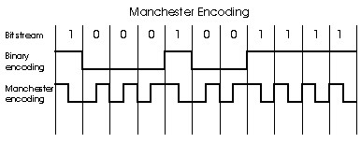
Manchester Encoding
Used in 10BaseT
Each bit has a transition
Allows clocks in sending and receiving nodes to synchronize to each other
No need for a centralized, global clock among nodes!
Hey, this is physical-layer stuff!

Slide 57
Data Link Layer
5.1 Introduction and services
5.2 Error detection and correction
5.3 Multiple access protocols
5.4 Link-layer Addressing
5.5 Ethernet
5.6 Link-layer switches, LANs, VLANs
5.7 PPP
5.8 Link virtualization: MPLS
5.9 A day in the life of a web request

Slide 58
Hubs
… physical-layer (“dumb”) repeaters:
bits coming in one link go out all other links at same rate
all nodes connected to hub can collide with one another
no frame buffering
no CSMA/CD at hub: host NICs detect collisions
twisted pair
hub

Slide 59
Switch
Link-layer device: smarter than hubs, take active role
store, forward Ethernet frames
examine incoming frame’s MAC address, selectively forward frame to one-or-more outgoing links when frame is to be forwarded on segment, uses CSMA/CD to access segment
Transparent
hosts are unaware of presence of switches
Plug-and-play, self-learning
switches do not need to be configured

Slide 60
Switch: Allows Multiple Simultaneous Transmissions
A
Hosts have dedicated, direct connection to switch
Switches buffer packets
Ethernet protocol used on each incoming link, but no collisions; full duplex
Each link is its own collision domain
Switching: A-to-A’ and B-to-B’ simultaneously, without collisions
Not possible with dumb hub
C’
B
1
2
6
3
5
4
C
B’
A’
switch with six interfaces
(1,2,3,4,5,6)

Slide 61
Switch Table
A
Q: how does switch know that A’ reachable via interface 4, B’ reachable via interface 5?
A: each switch has a switch table, each entry:
(MAC address of host, interface to reach host, time stamp)
looks like a routing table!
Q: how are entries created, maintained in switch table?
something like a routing protocol?
C’
B
1
2
6
3
5
4
C
B’
A’
switch with six interfaces
(1,2,3,4,5,6)

Slide 62
Switch: Self-learning
Source: A
Dest: A’
A
A A’
Switch learns which hosts can be reached through which interfaces
When frame received, switch “learns” location of sender: incoming LAN segment
Records sender/location pair in switch table
C’
B
1
2
6
3
5
4
C
B’
A’
MAC addr interface TTL
A
1
60
Switch table
(initially empty)

Slide 63
Switch: Frame Filtering / Forwarding
When frame received:
1. Record link associated with sending host
2. Index switch table using MAC dest address
3. if entry found for destination then {
if dest on segment from which frame arrived then drop the frame
else forward the frame on interface indicated
}
else flood
forward on all but the interface
on which the frame arrived

Slide 64
Self-learning, Forwarding: example
Source: A
Dest: A’
A
A A’
C’
B
frame destination unknown:
1
2
flood
6
3
A A’
A A’
A A’
A A’
A A’
5
4
Destination A location known:
C
selective send
A’ A
B’
A’
MAC addr interface TTL
A
1
60
Switch table
(initially empty)
A’
4
60

Slide 65
Interconnecting Switches
Switches can be connected together
S₄
S₁
S₃
A
S₂
F
I
B
C
D
E
G
H
Q: sending from A to G - how does S₁ know to forward frame destined to F via S₄ and S₃?
A: self learning! (works exactly the same as in single-switch case!)

Slide 66
Self-learning multi-switch example
Suppose C sends frame to I, I responds to C
1
S₄
S₁
2
S₃
A
S₂
F
I
B
C
D
E
G
H
Q: show switch tables and packet forwarding in S₁, S₂, S₃, S₄

Slide 67
Institutional Network
mail server
to external
network
router
web server
IP subnet

Slide 68
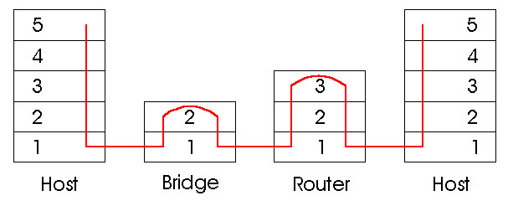
Switches vs. Routers
both store-and-forward devices
routers: network layer devices (examine network layer headers)
switches are link layer devices
routers maintain routing tables, implement routing algorithms
switches maintain switch tables, implement filtering, learning algorithms

Slide 69
Data Link Layer
5.1 Introduction and services
5.2 Error detection and correction
5.3 Multiple access protocols
5.4 Link-Layer Addressing
5.5 Ethernet
5.6 Link-layer switches
5.7 PPP
5.8 Link virtualization: MPLS
5.9 A day in the life of a web request

Slide 70
But First! Elements of Wireless (WiFi)
Note some key characteristics of Wireless that differ from wired
802.11 (WiFi) as contrast to 802.3 (Ethernet)
(Bits of Ch 6.1 – 6.3)

Slide 71
Characteristics of Selected Wireless Link Standards
200
802.11n
54
802.11a,g
data
5-11
802.11b
802.16 (WiMAX)
4
UMTS/WCDMA-HSPDA, CDMA2000-1xEVDO
3G cellular
enhanced
Data rate (Mbps)
1
802.15
.384
UMTS/WCDMA, CDMA2000
3G
.056
IS-95, CDMA, GSM
2G
Indoor
10-30m
Outdoor
50-200m
Mid-range
outdoor
200m – 4 Km
Long-range
outdoor
5Km – 20 Km

Slide 72
Wireless Link Characteristics (1)
Differences from wired link ….
decreased signal strength: radio signal attenuates as it propagates through matter (path loss)
interference from other sources: standardized wireless network frequencies (e.g., 2.4 GHz) shared by other devices (e.g., phone); devices (motors) interfere as well
multipath propagation: radio signal reflects off objects ground, arriving ad destination at slightly different times
…. make communication across (even a point to point) wireless link much more “difficult”

Slide 73
Wireless Link Characteristics (2)
SNR: signal-to-noise ratio
larger SNR – easier to extract signal from noise (a “good thing”)
SNR versus BER tradeoffs
Given physical layer: increase power → increase SNR → decrease BER
Given SNR: choose physical layer that meets BER requirement, giving highest thruput
SNR may change with mobility: dynamically adapt physical layer (modulation technique, rate)
10⁻¹
10⁻²
10⁻³
BER
10⁻⁴
10⁻⁵
10⁻⁶
10⁻⁷
10
20
30
40
SNR(dB)
QAM256 (8 Mbps)
QAM16 (4 Mbps)
BPSK (1 Mbps)

Slide 74
Wireless Network Characteristics
Multiple wireless senders and receivers create additional problems (beyond multiple access):
A
B
C
C
A’s signal
strength
C’s signal
strength
B
A
Hidden terminal problem
B, A hear each other
B, C hear each other
A, C can not hear each other
means A, C unaware of their interference at B
space
Signal attenuation:
B, A hear each other
B, C hear each other
A, C can not hear each other interfering at B

Slide 75
IEEE 802.11 Wireless LAN
802.11b
2.4-5 GHz unlicensed spectrum
up to 11 Mbps
direct sequence spread spectrum (DSSS) in physical layer
all hosts use same chipping code
802.11a
5-6 GHz range
up to 54 Mbps
802.11g
2.4-5 GHz range
up to 54 Mbps
802.11n: multiple antennae
2.4-5 GHz range
up to 200 Mbps
All use CSMA/CA for multiple access
All have base-station and ad-hoc network versions

Slide 76
IEEE 802.11: multiple access
Avoid collisions: 2⁺ nodes transmitting at same time
802.11: CSMA - sense before transmitting
don’t collide with ongoing transmission by other node
802.11: no collision detection!
difficult to receive (sense collisions) when transmitting due to weak received signals (fading)
can’t sense all collisions in any case: hidden terminal, fading
goal: avoid collisions: CSMA/C(ollision)A(voidance)
A
B
C
C
A’s signal
strength
C’s signal
strength
B
A
space

Slide 77
IEEE 802.11 MAC Protocol: CSMA/CA
802.11 sender
1 if sense channel idle for DIFS then
transmit entire frame (no CD)
2 if sense channel busy then
start random backoff time
timer counts down while channel idle
transmit when timer expires
if no ACK, increase random backoff interval, repeat 2
802.11 receiver
- if frame received OK
return ACK after SIFS (ACK needed due to hidden terminal problem)
sender
receiver
DIFS
data
SIFS
ACK

Slide 78
802.11: Advanced Capabilities
Rate Adaptation
Base station, mobile dynamically change transmission rate (physical layer modulation technique) as mobile moves, SNR varies
10⁻¹
10⁻²
10⁻³
BER
10⁻⁴
10⁻⁵
10⁻⁶
10⁻⁷
10
20
30
40
SNR(dB)
1. SNR decreases, BER increase as node moves away from base station
QAM256 (8 Mbps)
QAM16 (4 Mbps)
2. When BER becomes too high, switch to lower transmission rate but with lower BER
BPSK (1 Mbps)
operating point

Slide 79
More Wireless!
Power management
Other protocols: Zigbee, 3G, WiMax …
Mobility
Security

Slide 80
Link Layer
5.6 Link-layer switches
5.7 PPP
5.8 Link virtualization: MPLS
5.9 A day in the life of a web request
5.1 Introduction and services
5.2 Error detection and correction
5.3Multiple access protocols
5.4 Link-Layer Addressing
5.5 Ethernet

Slide 81
Synthesis: a day in the life of a Web request
Journey down protocol stack complete!
Application, Transport, Network, Data Link
Putting-it-all-together: synthesis!
goal: identify, review, understand protocols (at all layers) involved in seemingly simple scenario: requesting www page
scenario: student attaches laptop to campus network, requests/receives www.google.com

Slide 82
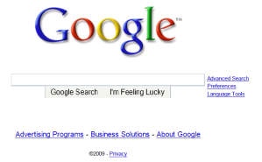
A day in the life: Scenario
browser
DNS server
Comcast network
68.80.0.0/13
school network
68.80.2.0/24
web page
web server
Google’s network
64.233.160.0/19
64.233.169.105

Slide 83
A day in the life… connecting to the Internet
DHCP
DHCP
UDP
IP
Eth
Phy
connecting laptop needs to get its own IP address, addr of first-hop router, addr of DNS server: use DHCP
DHCP
DHCP
DHCP
DHCP
DHCP request encapsulated in UDP, encapsulated in IP, encapsulated in 802.1 Ethernet
DHCP
DHCP
UDP
IP
Eth
Phy
DHCP
DHCP
DHCP
DHCP
router
(runs DHCP)
Ethernet frame broadcast (dest: FFFFFFFFFFFF) on LAN, received at router running DHCP server
Ethernet demux’ed to IP demux’ed, UDP demux’ed to DHCP

Slide 84
A day in the life… connecting to the Internet
DHCP
DHCP
UDP
IP
Eth
Phy
DHCP server formulates DHCP ACK containing client’s IP address, IP address of first-hop router for client, name & IP address of DNS server
DHCP
DHCP
DHCP
Encapsulation at DHCP server, frame forwarded (switch learning) through LAN, demultiplexing at client
DHCP
DHCP
UDP
IP
Eth
Phy
DHCP
DHCP
DHCP
router
(runs DHCP)
DHCP client receives DHCP ACK reply
DHCP
Client now has IP address, knows name & addr of DNS
server, IP address of its first-hop router

Slide 85
A day in the life… ARP (before DNS, before HTTP)
DNS
UDP
IP
Eth
Phy
Before sending HTTP request, need IP address of www.google.com: DNS
DNS
DNS
DNS
ARP
ARP query
DNS query created, encapsulated in UDP, encapsulated in IP, encasulated in Eth. In order to send frame to router, need MAC address of router interface: ARP
ARP
ARP reply
Eth
Phy
ARP query broadcast, received by router, which replies with ARP reply giving MAC address of router interface
Client now knows MAC address of first hop router, so can now send frame containing DNS query

Slide 86
A day in the life… using DNS
DNS
UDP
IP
Eth
Phy
DNS
DNS server
DNS
UDP
IP
Eth
Phy
DNS
DNS
DNS
DNS
DNS
DNS
DNS
DNS
Comcast network
68.80.0.0/13
IP datagram forwarded from campus network into comcast network, routed (tables created by RIP, OSPF, IS-IS and/or BGP routing protocols) to DNS server
IP datagram containing DNS query forwarded via LAN switch from client to 1st hop router
demux’ed to DNS server
DNS server replies to client with IP address of www.google.com

Slide 87
A day in the life… TCP connection carrying HTTP
HTTP
HTTP
TCP
IP
Eth
Phy
SYNACK
SYN
SYNACK
SYN
SYNACK
SYN
SYN
To send HTTP request, client first opens TCP socket to web server
TCP SYN segment (step 1 in 3-way handshake) inter-domain routed to web server
TCP
IP
Eth
Phy
SYNACK
SYN
SYNACK
SYN
SYNACK
SYNACK
SYN
Web server responds with TCP SYNACK (step 2 in 3-way handshake)
web server
64.233.169.105
TCP connection established!

Slide 88
A day in the life… HTTP request/reply
Web page finally (!!!) displayed
HTTP
HTTP
TCP
IP
Eth
Phy
HTTP
HTTP
HTTP
HTTP
HTTP
HTTP
HTTP
HTTP
HTTP request sent into TCP socket
IP datagram containing HTTP request routed to www.google.com
HTTP
HTTP
TCP
IP
Eth
Phy
HTTP
HTTP
HTTP
Web server responds with HTTP reply (containing web page)
HTTP
web server
64.233.169.105
IP datgram containing HTTP reply routed back to client

Slide 89
Chapter 5: Summary
Principles behind data link layer services:
error detection, correction
sharing a broadcast channel: multiple access
link layer addressing
Instantiation and implementation of various link layer technologies
Addressing
Ethernet
Switched LANS
Synthesis: a day in the life of a web request

Slide 90
Chapter 5: Let’s take a breath
Journey down protocol stack complete (except PHY)
Solid understanding of networking principles, practice
….. could stop here …. but lots of interesting topics!
Wireless
Multimedia
Security
Network management

