Slide 1
Wireshark – Introduction
Wire 1
Due date: Friday, October 30th

Slide 2
Outline
Overview
Introduction
Packet Sniffer
Lab and Grading

Slide 3
Overview
First of series of “sniffer” labs
This one designed to get you familiar with the Wireshark packet capture tool
Work through a “cook-book” like set of instructions
Install Wireshark
Gather a trace
Basic investigation about performance
Turn in
Trace
Answers to some questions

Slide 4
Motivation
“Tell me and I forget. Show me and I remember. Involve me and I understand.”
Chinese proverb
Better understanding by “seeing” network protocols in action
Seeing sequence of messages exchanged
Delving into details
Can be done by simulation or observing real Internet data → we’ll choose the latter
Basic tool to do so is the packet sniffer

Slide 5
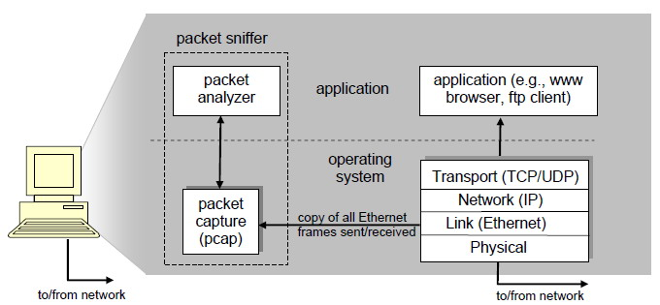
Packet Sniffer
Captures (“sniffs”) messages send/received by your computer
Also stores
A passive application (does not send data itself)
Contrast that to active measurements
Gets a copy of all data send/received

Slide 6
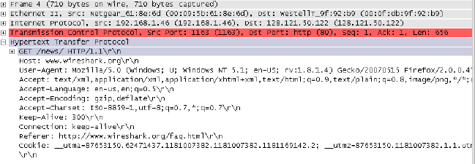
Packet Sniffer w/Analyzer
“Understand” format of the data
Layers of the network (e.g. HTTP, TCP, Ethernet …)
Within the layer (e.g. GET and POST in HTTP)

Slide 7
Wireshark
One of the best open-source packet sniffers available today
Mutiple platforms (Windows, Linux, Mac)
Get it and install
Note! You need your own computer
Capturing traffic requires root/administrator access
Or, borrow a friends for capture and can analyze on a public machine

Slide 8
The Lab
Download and install Wireshark
http://www.wireshark.org
Work through book lab
Wireshark Lab: Getting Started
Answer questions in lab
Only a few on this one, more later

Slide 9
Submission
Answers in text file
Wireshark trace
Zip up, submit
wire1 is lab name
Web-based turnin
http://web.cs.wpi.edu/~kfisler/turnin.html
Should get password!
Email: cs3516-staff@cs.wpi.edu if not!

Slide 10
Grading Guidelines
Wireshark 50% Answers 50%
90-100: The Wireshark capture file is present, answers to the questions are thorough and accurate.
80-89: The Wireshark capture file is present, all questions are answered and mostly accurate, but there are some minor errors.
70-79: The Wireshark capture file is present, but an answer is missing or several answers are incomplete or inaccurate.
60-69: The Wireshark capture file is present, but one or more answers are missing and/or most of the answers are incomplete or inaccurate.
0-50: The Wireshark capture file is not present and the answers to the questions are incorrect or severely lacking.

