Slide 1
Distributed Computing Systems
Project 1 – Dumpster Diving
Due: Sunday, January 24th

Slide 2
Three Utilities
rm
“Remove” files to dumpster
dv
“Dive” to restore files that were “removed”
dump
Permanently remove files from dumpster

Slide 3
RM
Transparently replace /bin/rm
Actually, just earlier in users PATH
Moves files to “dumpster" directory
Specified by user in DUMPSTER environment variable
Use rename(), link(), unlink(), as appropriate
Note, need to pay attention to partitions for file and dumpster
Same name? Add extension .1, .2, .3 ... .9
If already .9? Then report dumpster full
File permissions, including access times, should be preserved
Use the stat(), chmod(), utime(), as appropriate
Command line options:
f : force complete remove, do not move to dumpster directory
r : recurse directories (requires directory commands and traversal)

Slide 4
DV
Restore “deleted” files from dumpster to current directory (not origin)
Use getcwd() to get current working directory
File permissions, including access times, should be preserved
Feel free to support any command line options that you think are useful
e.g., -a option restores all files with same name, and .1, .2, ... extension

Slide 5
DUMP
Permanently remove files from dumpster directory
Use unlink() and rmdir(), as appropriate
Recursive, until whole dumpster is empty

Slide 6
Linux
Must be coded in C or C++
Must work in Linux
Specifically, CCC machines
Development can be elsewhere, but must ensure works on CCC machines

Slide 7
Hints (1 of 6)
See get-opt.c for help in parsing command line parameters
See stat.c for sample code on how to get status (e.g., permissions) information
See env.c for sample code on how to (more easily) access environment variables
See ls.c for sample code on how to do a directory listing
See touch.c for sample code on how to set modification times
Other system calls that may be useful:
chmod() - change (user, group, other) permissions
chown() - change ownerships
link() - add a hard link to a file
unlink() - delete a file
rmdir() - remove a directory
remove() - delete a file or directory
rename() - change the name or location of a file
getcwd() - get current working directory for a process
perror() - print appropriate text-based strings for system call errors
access() - can be used to check for existance of a file
basename() and dirname() - split full path to dir and filename (warning! can modify incoming string so copy first)

Slide 8
Hints (2 of 6)
In general …
Proceed incrementally, write SMALL pieces of code first and then test
When appropriate, place code in separate function to aid readability and testing
e.g., int getExtension(const char *name)
Do not worry about efficiency nor elegance initially
e.g., static arrays vs. malloc() fine to start
Refactor code as appropriate as proceed
More than one way to do something
e.g., checking partition can be done using the stat() call, looking at st_dev or by doing the rename() call, looking for EXDEV

Slide 9
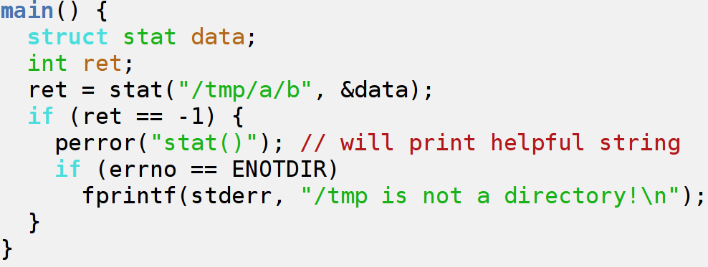
Hints (3 of 6)
Error check all system calls!
Can fail for a variety of reasons
Can use perror() to print appropriate text-based strings for system call errors
Or strerror()
Or errno
Man pages indicate return values at end

Slide 10
Hints (4 of 6)
Suggested development steps:
Setup program, take in 1+ arg (argv[1]) and DUMPSTER with getenv()
Move file in current working directory to DUMPSTER on same partition using rename()
Add check for same name using access(), adding extension .num
Add support for single file in another directory (e.g., /tmp), using dirname() and basename()
Check if file to be moved is on another partition using stat() with st_dev or EXDEV error set by rename() call
For files on another partition, write copy function to move across partitions, using link() and unlink()
Modify copy to preserve permissions using stat() and utime()
Check if file to be moved is a directory using stat() and S_ISDIR()
For directories on another partition, write function to iterate through directory using opendir() and readdir(), providing each file name for moving
Parse additional command line arguments (e.g., "-r") using getopt()
Modify code to recurse through sub-directories, as appropriate, moving all to DUMPSTER
Enable iterations through all filenames passed in
Error check many test cases thoroughly

Slide 11
Hints (5 of 6)
Final flow of rm may look like:
Parse command line arguments
Check environment setup (for dumpster)
For each file to be removed
If file does not exist
Report error
If file is directory
Create directory in dumpster
For each file to be removed ... (recursive)
If file is on another partition
Copy file to dumpster
If file is on same partition
Link file to dumpster
Unlink old file
End for

Slide 12
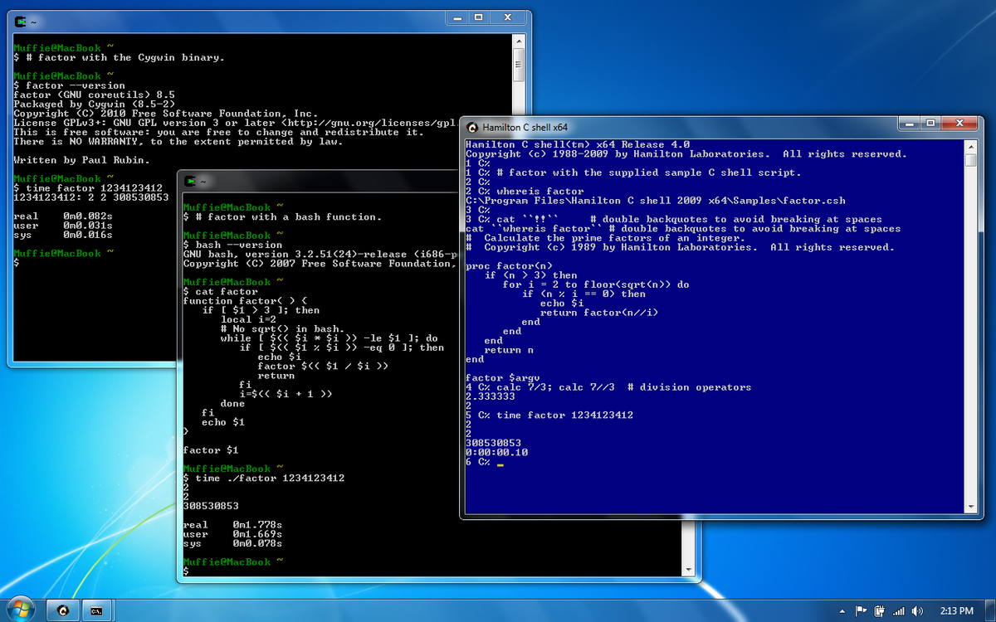
Hints (6 of 6)
Already installed on the Zoo lab
Or, can install in user space anywhere
http://www.cygwin.com/

Slide 13
Experiments
Measure time to link()+unlink() or rename()
Small operation so repeat and divide
Measure throughput (bytes/sec) for copy
Large file
Use sync() to be sure flushed and not in RAM
Put together have per-file cost and per-byte cost. Use to predict time to rm for large dir with many files
Measure time for many files (large and small) and compare to predicted

Slide 14
Writeup
Design - describe your experiments
Programs/scripts (pseudo-code)
Number of runs
Data recording method
System conditions
Other …
Results - depict your results clearly
Tables or graphs
At least mean and standard deviation
Analysis - interpret the results
Describe what results mean
How does your prediction match measured? If there is a difference, why do you think there is?

Slide 15
Hand In
Source code package
rm.c, dv.c, dump.c
Support files (*.h)
Makefile
Experimental writeup
tar and gzip
See Web page for turn in instructions

Slide 16
Grading
Support for all command line args (10 points)
Proper checking of DUMPSTER env (2 points)
Support for rename() of single ﬁles (5 points)
Support for copy and unlink() when needed (15 points)
Preserving permissions during copy and unlink() (5 points)
Support for directories (10 points)
Support for recursive directories (5 points)
Support for name collision with .num extension (8 points)
Proper working dump (15 points)
Proper working dv (15 points)
Experiments:
Design (4 points)
Results (3 points)
Analysis (3 points)
See rubric on Web page, too

