Slide 1
Distributed Computing Systems
Project 2 – Distributed Shell
Due: Tuesday, February 2nd

Slide 2
Motivation
Shell is core operating systems concept
Executing commands on remote machine is core distributed systems concept
Computing in the “cloud” (except in this case, server address is known, not a service) with results returned to user
→ Distributed Shell

Slide 3
Distributed Shell
Client-Server
Server on “known” port for client
Non-interactive
Command line args
get-opt.c
Authentication built-in
Uses TCP sockets
listen.c and talk.c
Security
Authentication (next slide)
Can handle multiple requests
fork()
Concurrent server
1. connect
Server
Client
2. authenticate
3. ls
4. fork()
and exec()
5. data
Server

Slide 4
Simple Authentication
Client connects to server, sending in user-name (not password)
Note, typically name used to lookup unique data (salt) stored with each name that further randomizes hash salt – here, just a check that valid
Server responds by sending back unique random number
Use rand()
Changes each invocation (provide different random seed each run, using srand())
Client encrypts using password and number as key
Here, password can be “hard coded” into client
Use crypt()
Client sends hashed value to server
Server encrypts with user's password and same number as key
Server “knows” password (e.g., externally exchanged)
Here, password can be “hard coded” into server
Server compares two hashed/encrypted values, if same then ok
Otherwise, return error message and exit
Note, can do authentication either before or after fork()
Question: pluses and minuses for each?

Slide 5
Sample
Server
Client
cccwork3% ./server
./server activating.
port: 4513
dir: /home/claypool/dsh Socket created!
Accepting connections.
Connection request received. forked child
received: john
password ok
command: ls
executing command...
cccwork2% ./dsh -c "ls" -s cccwork3
Makefile
client.c
dsh
dsh.c
index.html
server
server.c
server.h
sock.c
sock.h

Slide 6
Hints
Build shell independent of server
Get basic connection working without shell
Socket help: listen-tcp.c and talk-tcp.c
Socket slides (next deck)
Shell help
fork.c
execl.c
fork(), execve(), getopt(), strtok(), dup2()
Use a Makefile
Web page’s is simple
Use man pages for functionality, return codes
Beware of zombies!

Slide 7
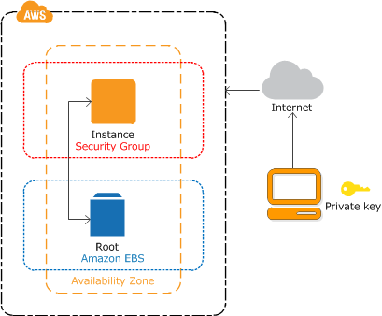
Cloud Computing – Amazon
Setup Amazon Elastic Compute Cloud (EC2)
Sign up (free, 1 year)
Launch Linux VM
Copy security keys
Connect (e.g., putty)
Clean up (when done)

Slide 8
Cloud Computing – Amazon
Will have “cloud” Linux host to admin
Note IP of instance when starting
Install software
gcc (or g++)
make
sysbench (for performance)
Typically: sudo apt-get install {name}
Copy server source (e.g., server.c and Makefile) to cloud host
Build
Test
(See Web page for links to documentation)

Slide 9
Experiments – Network Performance
Latency of connection (milliseconds)
Includes authentication
Force call to server so that server does not do exec()
Maximum throughput (b/s)
Transfer large file
redirect > to file else stdout may be bottleneck
Multiple runs
- measured data
Time (s)
(slope is per-
byte time)
(y-intercept is
connection time)
Transfer Size (MB)

Slide 10
Experiments – CPU and File I/O Performance
Sysbench for CPU
sysbench --test=cpu --cpu-max-prime=20000 run
total time: 23.8724s
Sysbench for File I/O
sysbench --test=fileio --file-total-size=16G prepare
sysbench --test=fileio --file-total-size=16G --file-test-mode=rndrw --init-rng=on --max-time=30 --max-requests=0 run
Read 9.375Mb …(53.316Kb/sec)
Clean up!
sysbench --test=fileio --file-total-size=16G cleanup
Local (own host or CCC) and remote (cloud)

Slide 11
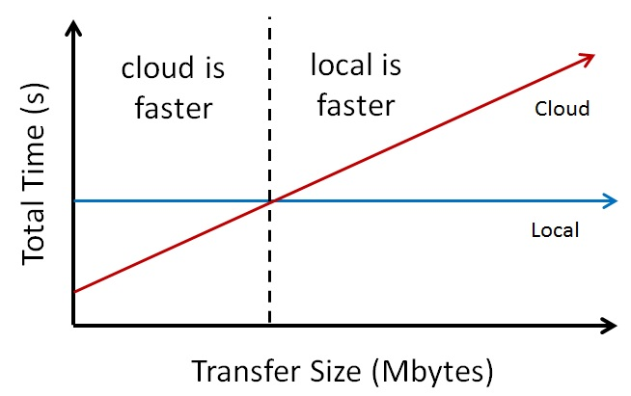
Model
Local_CPU + Local_File_I/O = n * Network + Remote_CPU + Remote_File_I/O
Simple, algebraic model
Compute when (for data transfer) cloud computing gives better performance (reduced time for task)
Solve for n

Slide 12
Writeup
Design - describe your experiments
Programs/scripts (pseudo-code)
Number of runs
Data recording method
System conditions
lscpu CPU information (also /proc/cpuinfo)
lsblk block device information (also /df/mount | column -t)
free -h available memory
uname -a OS version (also /proc/version)
Other …
Results - depict your results clearly
Graph (see previous slide)
Table (at least mean and standard deviation)
Analysis - interpret results
Describe what results mean

Slide 13
Hand In
Source code package
server.c, client.c
Support files (*.h)
Makefile
README.txt detailing building and using
Experimental writeup
Clean and zip
Turnin via Instruct Assist

Slide 14
Grading
Basic shell program (15 points)
Basic Client-Server communication program (15 points)
Proper re-direction of standard output (10 points)
Proper error checking of system/socket calls (10 points)
Proper authentication (10 points)
Proper closing of sockets in relation to fork (5 points)
Proper handling of zombies (5 points)
Amazon EC2 setup (15 points)
Experiment Design (6 points)
Experiment Results (5 points)
Experiment Analysis (4 points)
See rubric on Web page, too

